Slide 1
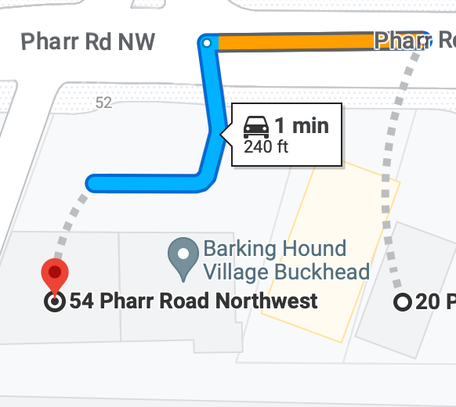

Slide 2
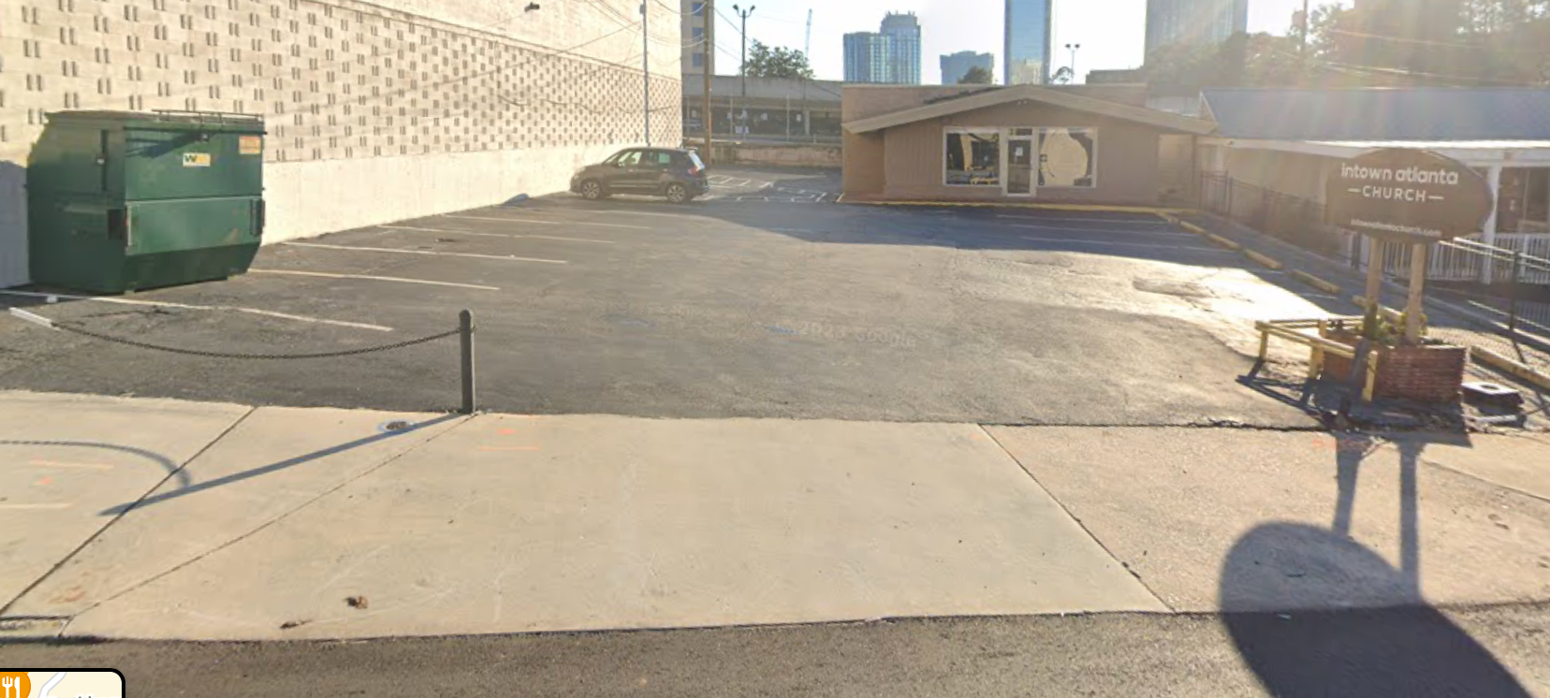

Slide 3
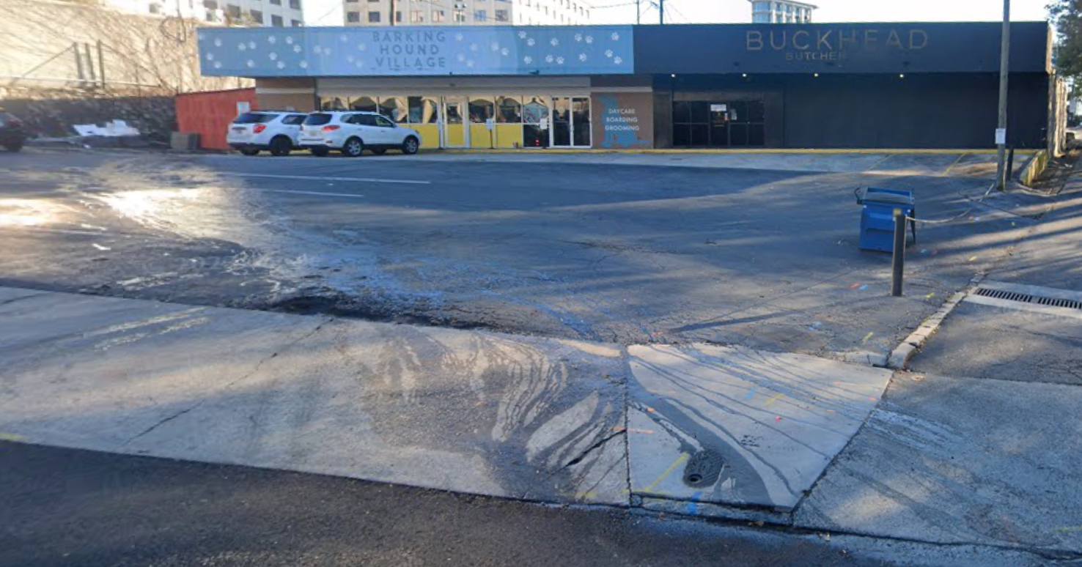

Slide 4
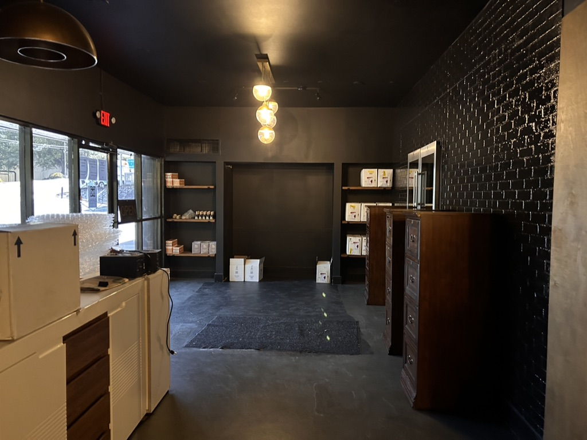
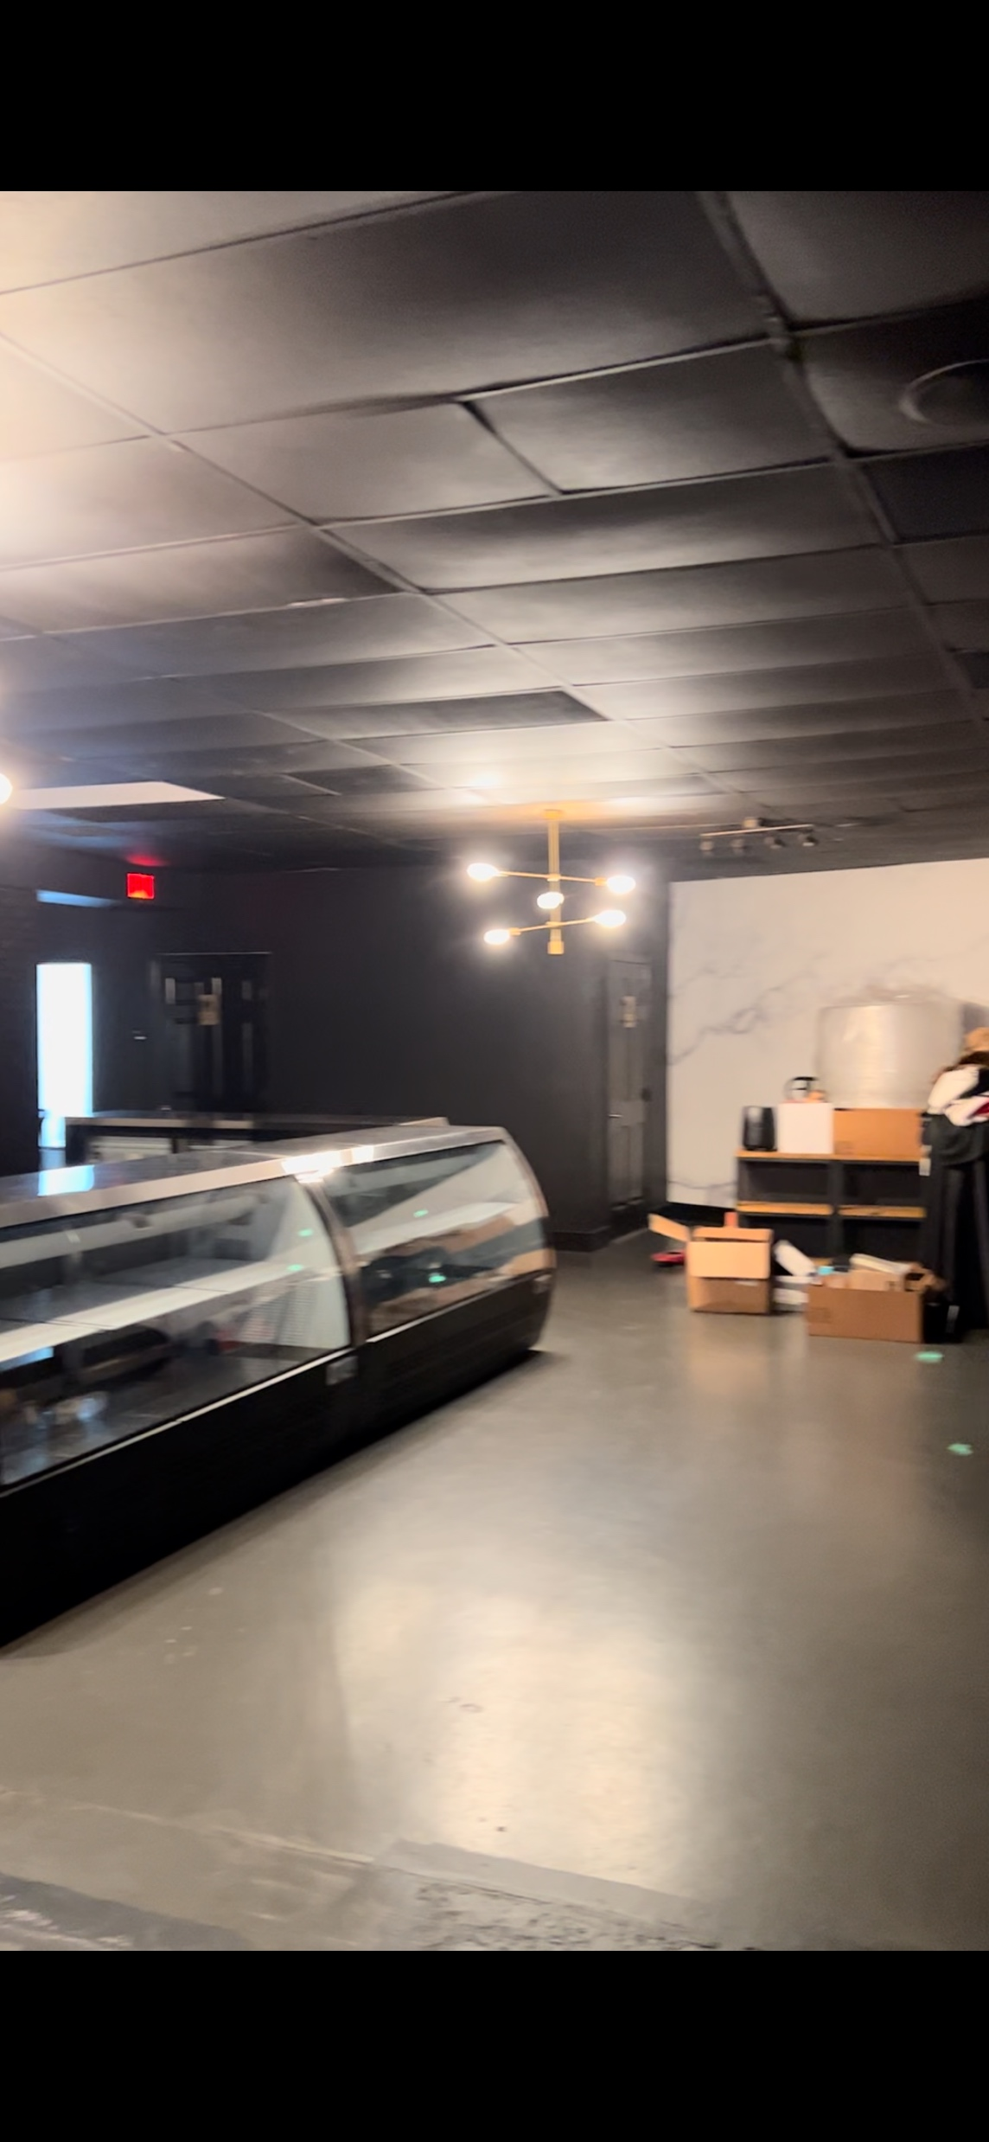
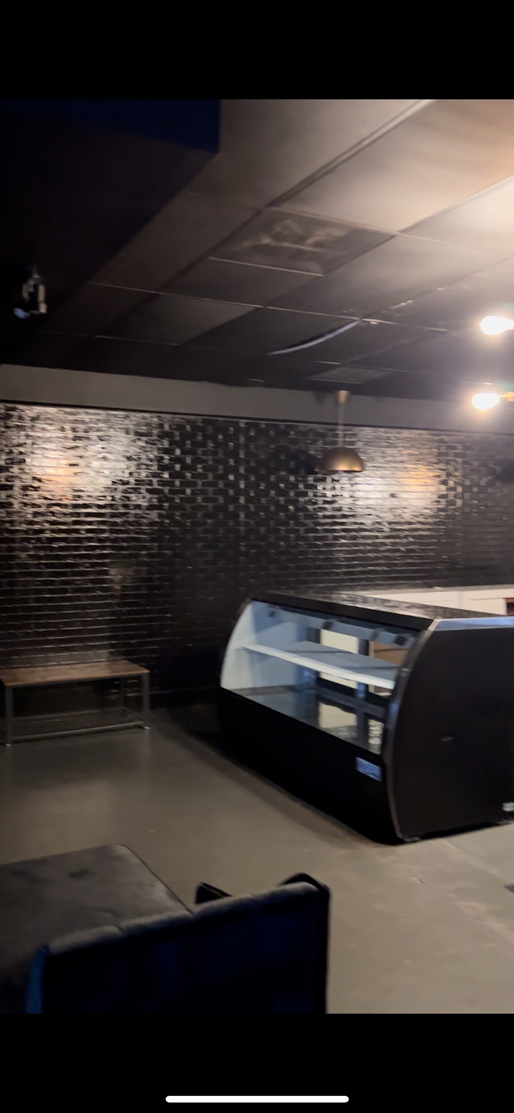

Slide 5
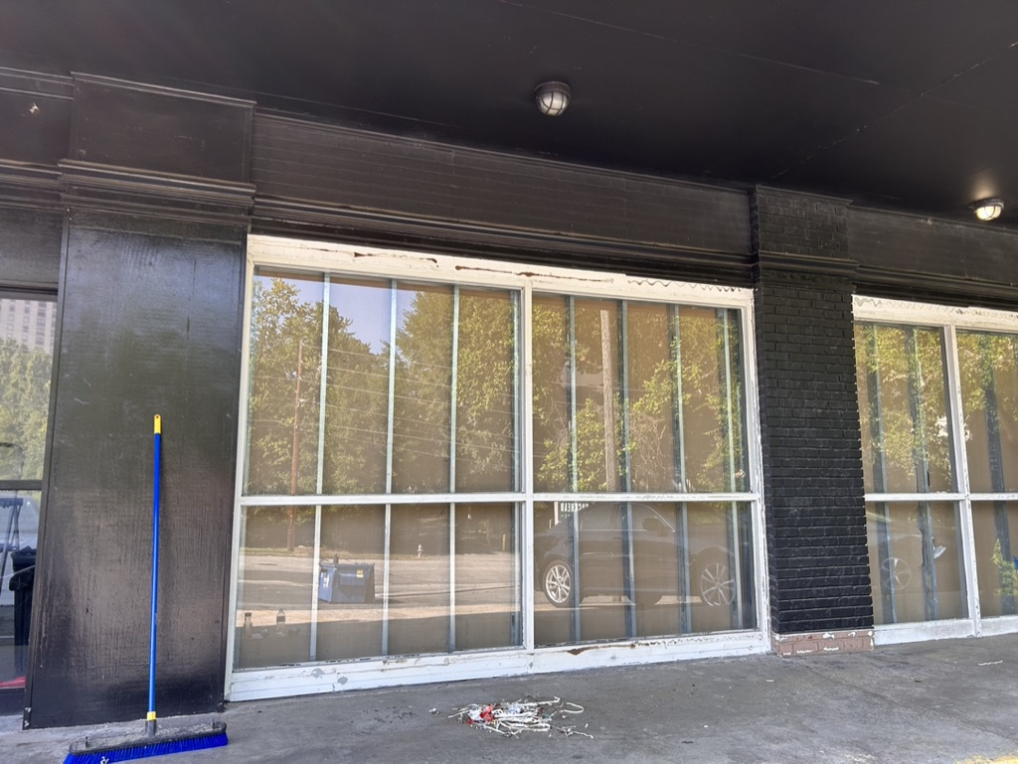
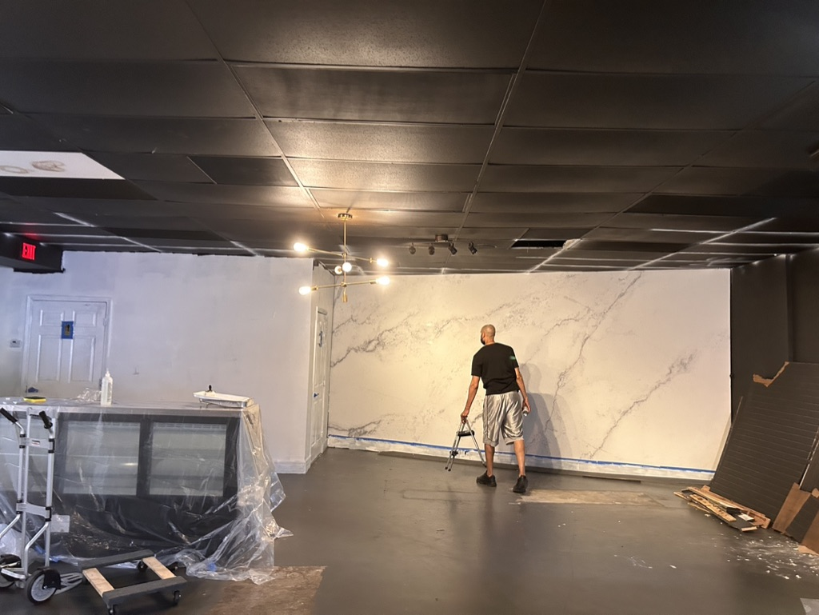
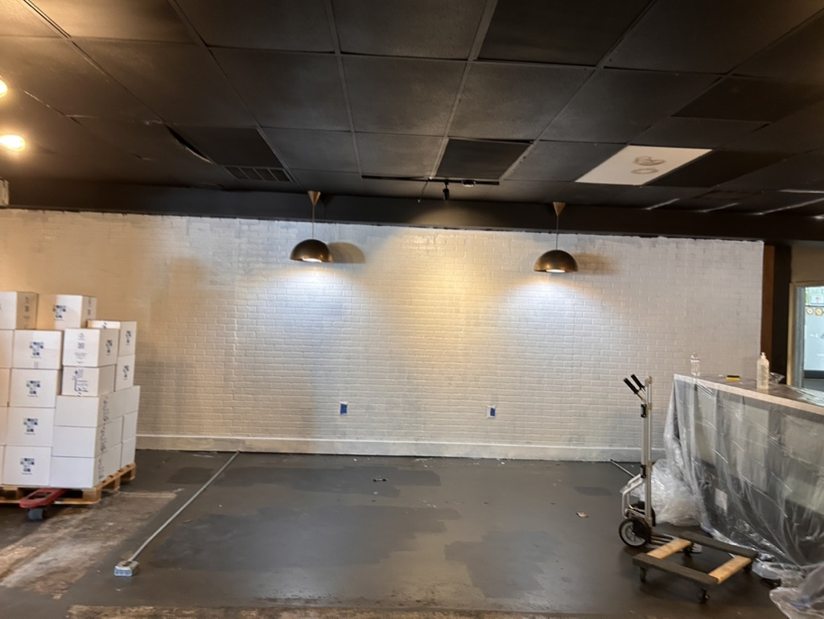

Slide 6
Continued Healing within Our Church

Slide 7
Luke 4:17 And the scroll of the prophet Isaiah was given to him. He unrolled the scroll and found the place where it was written, 18 “The Spirit of the Lord is upon me, because he has anointed me to proclaim good news to the poor. He has sent me to proclaim liberty to the captives and recovering of sight to the blind, to set at liberty those who are oppressed, 19 to proclaim the year of the Lord's favor.” 20 And he rolled up the scroll and gave it back to the attendant and sat down. And the eyes of all in the synagogue were fixed on him. 21 And he began to say to them, “Today this Scripture has been fulfilled in your hearing.” 22 And all spoke well of him and marveled at the gracious words that were coming from his mouth. And they said, “Is not this Joseph's son?” 23 And he said to them, “Doubtless you will quote to me this proverb, ‘Physician, heal yourself.’”

Slide 8
Luke 4:17 And the scroll of the prophet Isaiah was given to him. He unrolled the scroll and found the place where it was written, 18 “The Spirit of the Lord is upon me, because he has anointed me to proclaim good news to the poor. He has sent me to proclaim liberty to the captives and recovering of sight to the blind, to set at liberty those who are oppressed, 19 to proclaim the year of the Lord's favor.” 20 And he rolled up the scroll and gave it back to the attendant and sat down. And the eyes of all in the synagogue were fixed on him.

Slide 9
21 And he began to say to them, “Today this Scripture has been fulfilled in your hearing.” 22 And all spoke well of him and marveled at the gracious words that were coming from his mouth. And they said, “Is not this Joseph's son?” 23 And he said to them, “Doubtless you will quote to me this proverb, ‘Physician, heal yourself.’”

Slide 10
Luke 4:17 And the scroll of the prophet Isaiah was given to him. He unrolled the scroll and found the place where it was written, 18 “The Spirit of the Lord is upon me, because he has anointed me to proclaim good news to the poor. He has sent me to proclaim liberty to the captives and recovering of sight to the blind, to set at liberty those who are oppressed, 19 to proclaim the year of the Lord's favor.” 20 And he rolled up the scroll and gave it back to the attendant and sat down. And the eyes of all in the synagogue were fixed on him. 21 And he began to say to them, “Today this Scripture has been fulfilled in your hearing.”…23 And he said to them, “Doubtless you will quote to me this proverb, ‘Physician, heal yourself.’”

Slide 11
Luke 5:29 And Levi made him a great feast in his house, and there was a large company of tax collectors and others reclining at table with them. 30 And the Pharisees and their scribes grumbled at his disciples, saying, “Why do you eat and drink with tax collectors and sinners?” 31 And Jesus answered them, “Those who are well have no need of a physician, but those who are sick. 32 I have not come to call the righteous but sinners to repentance.”

Slide 12
Once we become Christians, do we still need healing from Jesus the Physician?

Slide 13
If we think we don’t need Jesus the Physician, who are we most like according Luke 5?

Slide 14
Is the Church a hotel for saints or hospital for sinners?

Slide 15
Is the Church a hotel for saints or hospital for sinners?
This changes how we treat and approach people outside the church

Slide 16
Is the Church a hotel for saints or hospital for sinners?
This changes how we treat and approach people outside these walls
This changes how we treat and approach people at this church

Slide 17
Continued Healing/Growth as a Church
Strive for purity and peace while not neglecting mercy
Reach maturity through knowledge of Jesus, but be patient with growth
Appoint and trust godly leaders while staying humble
Prioritize brotherly love and serving together without showing partiality

Slide 18
1 Peter 2:21 For to this you have been called, because Christ also suffered for you, leaving you an example, so that you might follow in his steps. 22 He committed no sin, neither was deceit found in his mouth. 23 When he was reviled, he did not revile in return; when he suffered, he did not threaten, but continued entrusting himself to him who judges justly. 24 He himself bore our sins in his body on the tree, that we might die to sin and live to righteousness. By his wounds you have been healed. 25 For you were straying like sheep, but have now returned to the Shepherd and Overseer of your souls.

