Slide 1
Getting Started Tonight: What have you come to appreciate more about God’s grace? What questions do you hope we will still address in our remaining classes?
Notes:
This may seem simplistic – but please trust me – IT BECOMES SO HELPFUL to really SEE how Paul organizes his thoughts to TELL US ABOUT GOD’S GRACE…

Slide 2
Lesson 10: Respecting God’s Grace

Slide 3
Notes:
These are the things we will be emphasizing in each section.
You can see that the first half is focused on the projects and the city. The second half is focused on the people who fill the city.

Slide 4
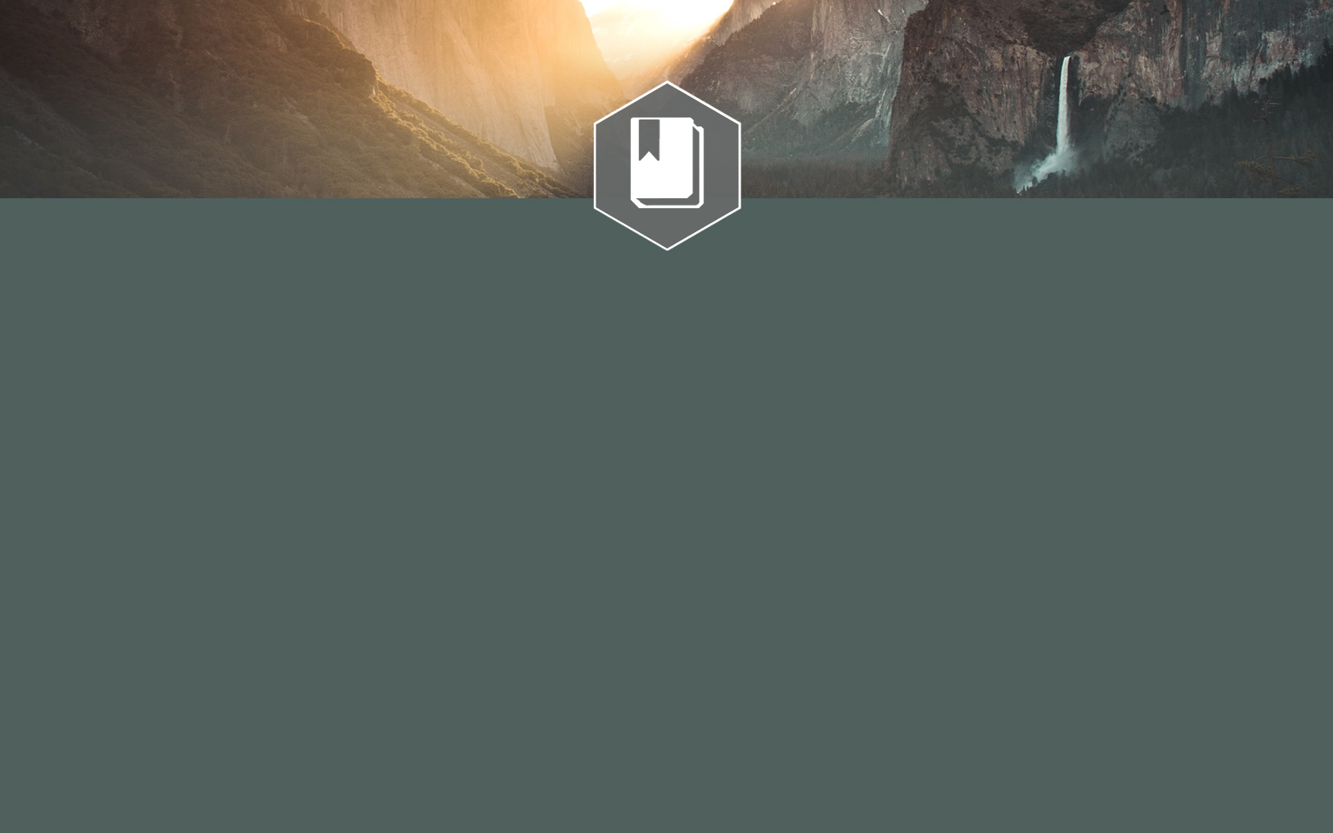
To help students gain greater clarity and comfort in God’s grace. Today’s Goal: To respond to God’s grace respectfully.
Notes:
Class Goal is = Clarity and Comfort

Slide 5
Seeing God’s Grace Clearly
Honor & Respect: Give Greater Weight Because…
God’s grace can be described as: God’s admirable character, to act with kindness we do not deserve, to accomplish what we cannot alone.
Who He is...
What He’s done...
Why He helped...
Notes:
This may seem simplistic – but please trust me – IT BECOMES SO HELPFUL to really SEE how Paul organizes his thoughts to TELL US ABOUT GOD’S GRACE…

Slide 6
Titus 2:11-14
Grace Given
¹¹ For the grace of God has appeared, bringing salvation to all men,
¹² instructing us to deny ungodliness and worldly desires and to live sensibly, righteously and godly in the present age,
¹³ looking for the blessed hope and the appearing of the glory of our great God and Savior, Christ Jesus,
¹⁴ who gave Himself for us to redeem us from every lawless deed, and to purify for Himself a people for His own possession, zealous for good deeds.
Outcome Intended
Notes:
This may seem simplistic – but please trust me – IT BECOMES SO HELPFUL to really SEE how Paul organizes his thoughts to TELL US ABOUT GOD’S GRACE…

Slide 7
CAN THIS MAN SAVE HIMSELF?
IMPOSSIBLE. THIS MAN NEEDS A SAVIOR.
Slide by Scott Smelser

Slide 8
What Did It Take To Lift Us Out of Our Sin?
“But we do see Him who was made for a little while lower than the angels, namely, Jesus, because of the suffering of death crowned with glory and honor, so that by the grace of God He might taste death for everyone.”
Hebrews 2:9
Notes:
We communicate COMMITMENT with wedding rings.
We communicate 45 Years of Service with a retirement gift.
We communicate Victories with Trophies.
“A Token of Our Appreciation”
How do we show our love, our respect, our joy? These are all specifically defined concepts, but how do we put them into into visible form?
We applaud when we celebrate a job well done.
We give a dozen roses to someone we love – our gift is an expression of how we feel.
We bow when we worship – our posture is reflective of our heart.
James argues that we can show our faith by our works…James 2
So How Can GOD put His ABUNDANT GRACE into words, actions, and gifts that help us see what is in His heart? The Answer is Jesus.

Slide 9
We Have Been Rescued!
“who gave Himself for our sins so that He might rescue us from this present evil age, according to the will of our God and Father,” (Galatians 1:4)
“For He rescued us from the domain of darkness, and transferred us to the kingdom of His beloved Son,” (Colossians 1:13)
“and to wait for His Son from heaven, whom He raised from the dead, that is Jesus, who rescues us from the wrath to come.” (1 Thessalonians 1:10)

Slide 10
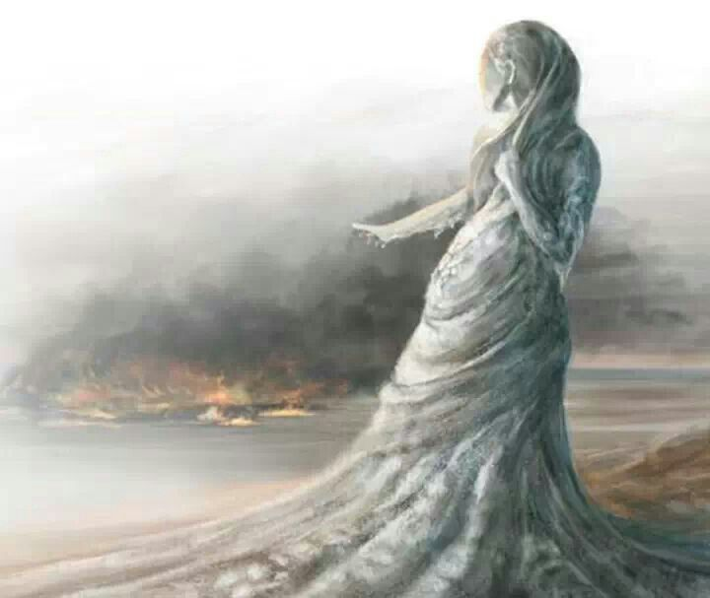
How Will We Respond To Such An Incredible Gift?
Like Lot’s wife?
Luke 17:28-33
Like the 9 Lepers?
Luke 17:17
Like Demas?
2 Timothy 4:10
Like an Animal?
2 Peter 2:18-22

Slide 11
How Will We Respond…?
¹⁸ For speaking out arrogant words of vanity they entice by fleshly desires, by sensuality, those who barely escape from the ones who live in error, ¹⁹ promising them freedom while they themselves are slaves of corruption; for by what a man is overcome, by this he is enslaved.
²⁰ For if, after they have escaped the defilements of the world by the knowledge of the Lord and Savior Jesus Christ, they are again entangled in them and are overcome, the last state has become worse for them than the first. ²¹ For it would be better for them not to have known the way of righteousness, than having known it, to turn away from the holy commandment handed on to them.
²² It has happened to them according to the true proverb, “A dog returns to its own vomit,” and, “A sow, after washing, returns to wallowing in the mire.”

Slide 12
Jude Describes This Mindset
³ Beloved, while I was making every effort to write you about our common salvation, I felt the necessity to write to you appealing that you contend earnestly for the faith which was once for all handed down to the saints.
⁴ For certain persons have crept in unnoticed, those who were long beforehand marked out for this condemnation, ungodly persons who turn the grace of our God into licentiousness and deny our only Master and Lord, Jesus Christ.

Slide 13
How did the people Jude mentions disrespect God’s grace? Israelites (vs. 5) Sodom (vs. 7) Cain, Balaam, Korah (vs. 11)
Notes:
Class Goal is = Clarity and Comfort

Slide 14
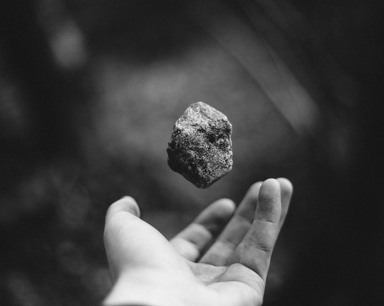
Sad Memories
Throwing stones…
We’ve all thrown the stones…
Hurtful Words
Selfish Choices
Personal Idols
Cowardly Inaction

Slide 15
Overcoming Broken Thinking
The Mindset of Low Value
The Mindset of Surplus Grace
The Mindset of Carelessness
The Mindset of Minimal Consequences.
The Mindset of Pride
The Mindset of Disconnection
The Mindset of Denial
The Mindset of Hiding
Notes:
** Why This Slide – Because we need to examine our thinking – and we need to consider CAREFULLY how to teach our children to avoid these misconceptions that abuse Grace.
Things in an abundance tend to be wasted.
Nothing I do matters, it will all be washed away anyway – wrong. Our choices do matter.
Just because something “can” be repaired is NO REASON to break it! I certainly don’t treat my body that way – I try to avoid broken arms, broken legs, burnt skin, etc… The pain is too great and the loss – loss of time, strength, etc.. too costly.
When Saved by Grace – the consequence may be displaced – but that doesn’t mean there is no consequence. Like the unfaithful spouse who continues to cheat – expecting to be forgiven – they have shifted the pain from themselves to the one they claim to love.
A view of grace that follows every impulse to do something wrong – believing there are no consequences – is broken. Instead we care. We care enough to self-regulate. We care enough not only about getting caught or avoiding the punishment – but we care about what is right.
Minimal Consequences…immediately changes if we think about the “pain” involved in the break. Just because our arm or leg “can be” treated and heal, is no reason to break them! The loss of time, strength, and comfort are too high for us to be so careless with our bodies.
Hiding – Hiding from God. Under cover of darkness. All alone… “No one will know…” (John 3:19)

Slide 16
We must not view God’s grace as an excuse to do things we know are wrong. We must care about more than the consequences…we must care about God.
Notes:
Class Goal is = Clarity and Comfort

Slide 17
We can’t turn back to sin… The cost paid was too high. The gift given was too great. The debt paid was too deep. The path ahead too wonderful.
Notes:
Class Goal is = Clarity and Comfort

Slide 18
God’s Grace Sets Us On A New Path
Not a path of merit. A path of maturity!
Ephesians 4:13-15
Not a path of self-righteousness. A gift.
Romans 3:24, 4:5, 5:17

Slide 19
God’s Grace Sets Us On A New Path
Not a path of hedonism. A path of good works.
Ephesians 2:10
Titus 2:14
Not a path of greed. A path of gratitude.
2 Corinthians 4:15

Slide 20
Jude’s Exhortation…
Sound Teaching
¹⁷ But you, beloved, ought to remember the words that were spoken beforehand by the apostles of our Lord Jesus Christ, ¹⁸ that they were saying to you, “In the last time there will be mockers, following after their own ungodly lusts.” ¹⁹ These are the ones who cause divisions, worldly-minded, devoid of the Spirit. ²⁰ But you, beloved, building yourselves up on your most holy faith, praying in the Holy Spirit, ²¹ keep yourselves in the love of God, waiting anxiously for the mercy of our Lord Jesus Christ to eternal life. ²² And have mercy on some, who are doubting; ²³ save others, snatching them out of the fire; and on some have mercy with fear, hating even the garment polluted by the flesh.
Edification
Prayer
Relationship
Mercy
Notes:
This may seem simplistic – but please trust me – IT BECOMES SO HELPFUL to really SEE how Paul organizes his thoughts to TELL US ABOUT GOD’S GRACE…

Slide 21
Lesson 10: Respecting God’s Grace

