Slide 1
Fruitfulness in Technology
Using Wisdom to Protect & Cultivate

Slide 2
Fruitfulness in Technology
Cast a vision for you & your family
Establish & protect boundaries
Cultivate goodness and virtue

Slide 3
Where there is no vision, the people cast off restraint; But he that keepeth the law, happy is he.
Proverbs 29:18

Slide 4
Fruitfulness in Technology
Cast a vision for you & your family
Establish & protect boundaries
Cultivate goodness and virtue

Slide 5
Establishing Boundaries
Set Limits of Time
Set Limits of Place

Slide 6
For the moment all discipline seems painful rather than pleasant, but later it yields the peaceful fruit of righteousness to those who have been trained by it.
Hebrews 12:11

Slide 7
Fruitfulness in Technology
Cast a vision for you & your family
Establish & protect boundaries
Cultivate goodness and virtue

Slide 8
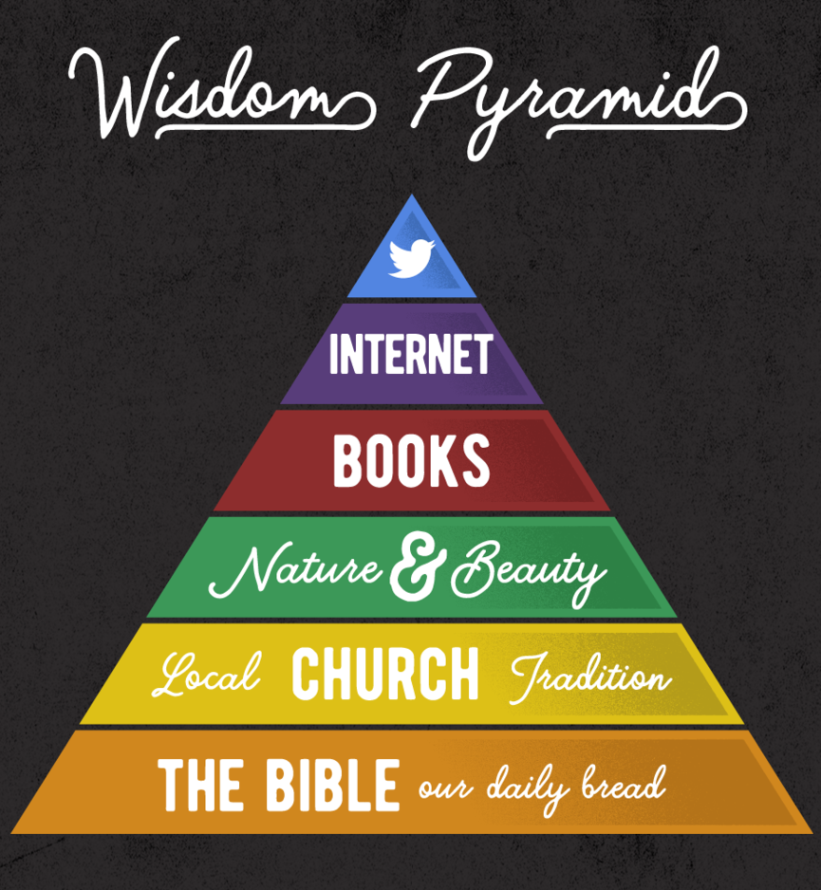
Cultivating Goodness in Our Lives
Use internet/social media selectively
Find wisdom, beauty in Nature & Books
Fullness requires church connection
The Bible is our daily bread

Slide 9
Fruitfulness in Technology
Cast a vision for you & your family
Establish & protect boundaries
Cultivate goodness and virtue

Slide 10
Where there are no oxen, the manger is clean,
but abundant crops come by the strength of the ox.
Proverbs 14:4

Slide 11
Fruitfulness in Technology
Using Wisdom to Protect & Cultivate

