Slide 1
Better Decisions

Slide 2
Essential Observations
This Is A Story of Reversal & Comfort.
This Is A Lesson to Correct Callous Decisions.
This Is A Glimpse into Eternity.
This Is A Command to Take Scripture Seriously.
Notes:
Callous – when their conscience has been seared and become
When the conscience is insensitive, it is “seared” (1 Timothy 4:2 ). The sinful conscience is “defiled” (Titus 1:15 ) or “evil” (Hebrews 10:22 ).
Glimpse Into Eternity – When Jesus teaches with an illustration – it is always based on the way things really are… The way plants really grow, the way fish are really scooped up in nets, the way leaven really influences what is around it. So, when Jesus teaches about life after death –He is telling us the way things really are. We are gaining INSIGHT into Eternity.

Slide 3
BETTER DECISIONS
Life Is Constantly Moving In The Direction of Our Decisions.
“he habitually…every day” Luke 16:19
Notes:
Jesus Wants Us To Make Better Decisions TODAY…
The decisions we make each day are bringing us closer to ETERNAL REST or closer to ETERNAL TORMENT.
Talk about the power of our habits!
1.
2.
3.

Slide 4
BETTER DECISIONS
“
People have uphill hopes and downhill habits. The only way to break downhill habits is to get intentional.
”
- John Maxwell
Notes:
Watch your thoughts, they become your words; watch your words, they become your actions; watch your actions, they become your habits; watch your habits, they become your character; watch your character, it becomes your destiny.
If I am honest with myself…what doesn’t feel right about this? What hesitations do I have?

Slide 5
BETTER DECISIONS
Jesus Wants Me To Consider The Needs Next Door.
“laid at his gate, covered with sores” Luke 16:20
Notes:
Jesus Wants Us To Make Better Decisions TODAY…
The decisions we make each day are bringing us closer to ETERNAL REST or closer to ETERNAL TORMENT.
Talk about the Importance of Caring for the People We See Every Day.

Slide 6
BETTER DECISIONS
Jesus Wants Me To Anticipate The Regrets My Decisions May Bring.
“I am in agony in this flame” Luke 16:24
Notes:
What is the story I want to tell?

Slide 7
BETTER DECISIONS
Jesus Wants Me To Live For Heaven Before It’s Too Late.
“he is being comforted here” Luke 16:25
Notes:
Jesus Wants Us To Make Better Decisions TODAY…
The decisions we make each day are bringing us closer to ETERNAL REST or closer to ETERNAL TORMENT.
Talk about the Importance of Caring for the People We See Every Day.

Slide 8
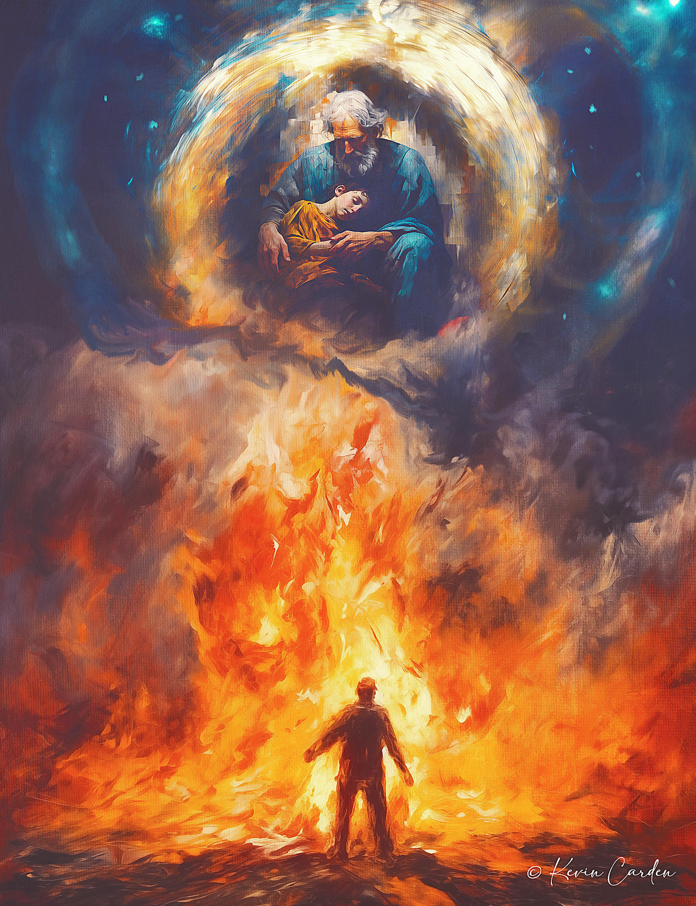
BETTER DECISIONS
Jesus Wants Me To Live For Heaven Before It’s Too Late.
Notes:
Jesus Wants Us To Make Better Decisions TODAY…
The decisions we make each day are bringing us closer to ETERNAL REST or closer to ETERNAL TORMENT.
Talk about the Importance of Caring for the People We See Every Day.

Slide 9
BETTER DECISIONS
Jesus Wants Me To Use The Power of My Example.
“I beg you father that you send him to my father’s house for I have five brothers” Luke 16:27-28
Where is my influence leading the people I love the most?
Notes:
Jesus Wants Us To Make Better Decisions TODAY…
The decisions we make each day are bringing us closer to ETERNAL REST or closer to ETERNAL TORMENT.
Talk about the Importance of Caring for the People We See Every Day.

Slide 10
BETTER DECISIONS
Jesus Wants Me To Hear The Message of The Bible.
“…let them hear them…” Luke 16:29-31
Notes:
What brings maximum glory to God?

Slide 11
Better Decisions
Notes:
I Make Better Decisions… When I think about where this leads.
I Make Better Decisions… When I notice who needs my help.
I Make Better Decisions… When I remember focus on my ultimate home.
I Make Better Decisions… When I anticipate my regrets.
You could do what you’ve always done.
Choose what you want now over what you
want most. But there’s a Greater Reward
waiting for you.
What if becoming the person you want to be
starts long before the moment you make a
decision? Before you click "buy,
" before you
take one more bite, or before you lash out at
the people you love. Can the decisions you
make today help you live the life you really
want tomorrow? Let's learn together in the
series, Pre-Decide.
If your life is moving in the direction of your
decisions, do you like the direction your
decisions are taking you?
Don't make permanent decisions based on
temporary emotions.

