Slide 1
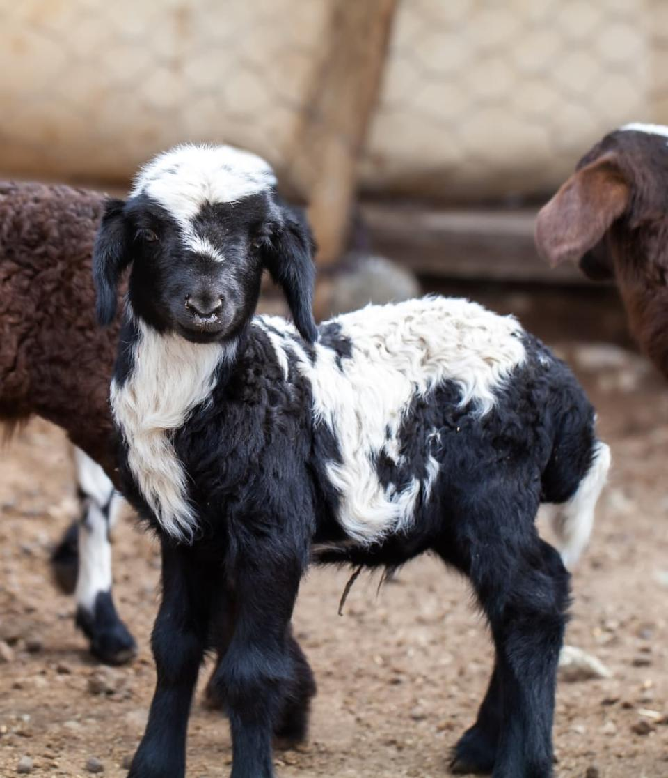

Slide 2
” I will surely assemble all of you, O Jacob; I will gather the remnant of Israel; I will set them together like sheep in a fold, like a flock in its pasture, a noisy multitude of men ” Micah 2:12
” He will tend his flock like a shepherd; he will gather the lambs in his arms; he will carry them in his bosom, and gently lead those that are with young ”
Isaiah 40:11
” Fear not, little flock, for it is your Father's good pleasure to give you the kingdom ”
Luke 12:32
”But we your people, the sheep of your pasture, will give thanks to you forever; from generation to generation we will recount your praise”
Psalm 79:13

Slide 3
Psalm 23: The Promise For Sheep
Contentment & Satisfaction
” The Lord is my shepherd, I shall not want…”
Psalm 23:1
” Therefore I tell you, do not be anxious about your life, what you will eat or what you will drink, nor about your body, what you will put on. Is not life more than food, and the body more than clothing? Look at the birds of the air: they neither sow nor reap nor gather into barns, and yet your heavenly Father feeds them. Are you not of more value than they? And which of you by being anxious can add a single hour to his span of life?
Matthew 6:25
” Do not be anxious about anything, but in everything by prayer and supplication with thanksgiving let your requests be made known to God. And the peace of God, which surpasses all understanding, will guard your hearts and your minds in Christ Jesus….19 And my God will supply every need of yours according to his riches in glory in Christ Jesus ”
Philippians 4:6-7, 19

Slide 4
Psalm 23: The Promise For Sheep
Restoration Of The Soul
” 2 He makes me lie down in green pastures; He leads me beside quiet waters. 3 He restores my soul…”
Psalm 23:2-3
” For the sake of Christ, then, I am content with weaknesses, insults, hardships, persecutions, and calamities. For when I am weak, then I am strong.”
2 Corinthians 12:10
” Seek the Lord and his strength; seek his presence continually!”
1 Chronicles 16:11
” But they who wait for the Lord shall renew their strength; they shall mount up with wings like eagles; they shall run and not be weary; they shall walk and not faint.”
Isaiah 40:31

Slide 5
Psalm 23: The Promise For Sheep
The Absence Of Fear
” 4 Even though I walk through the valley of the shadow of death, I fear no evil, for You are with me; Your rod and Your staff, they comfort me. 5 You prepare a table before me in the presence of my enemies …”
Psalm 23:4-5
” Your servant was tending his father’s sheep. When a lion or a bear came and took a sheep from the flock, 35 I went out after it and attacked it, and rescued the sheep from its mouth; and when it rose up against me, I grabbed it by its mane and struck it and killed it.”
1 Samuel 17:34-35
”For I am sure that neither death nor life, nor angels nor rulers, nor things present nor things to come, nor powers, nor height nor depth, nor anything else in all creation, will be able to separate us from the love of God in Christ Jesus our Lord.”
Romans 8:38-39
” When I am afraid, I put my trust in you. In God, whose word I praise, in God I trust; I shall not be afraid. What can flesh do to me?”
Psalm 56:3-4

Slide 6
Psalm 23: The Promise For Sheep
Contentment & Satisfaction
Restoration Of The Soul
The Absence Of Fear
” The Lord is my Shepherd…”
Psalm 23:1

Slide 7
Am I Living Like A Shepherd Or Being A Sheep?

