Slide 1
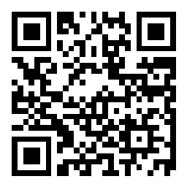
Hebrews
slido.com
#embryhills
Lesson Seven: The Eternal Priesthood

Slide 3
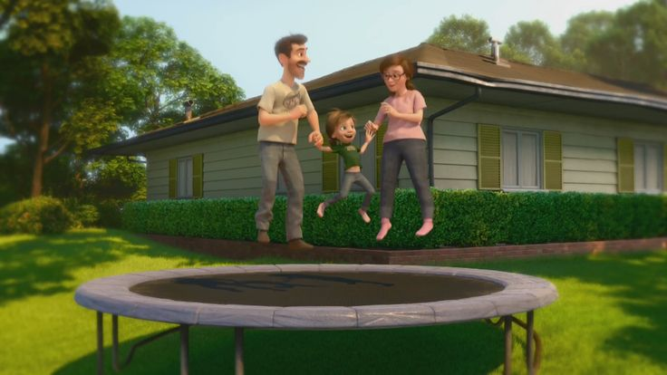
Great Family
Great House
Great Yard
Great Friends
Great Hockey Team
Happy
Life

Slide 4
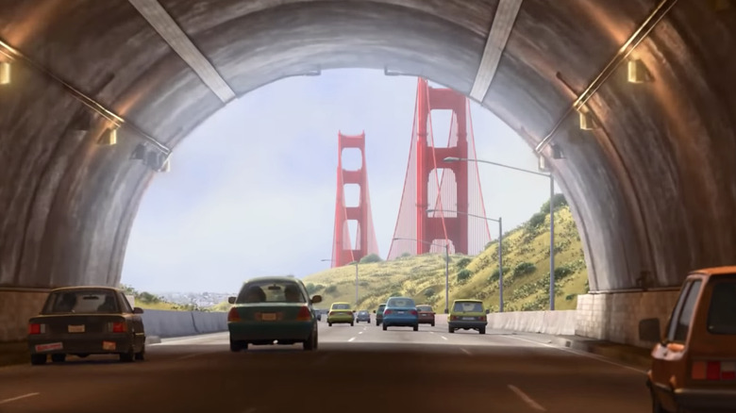
Hopeful
Change
Happy
Life

Slide 5
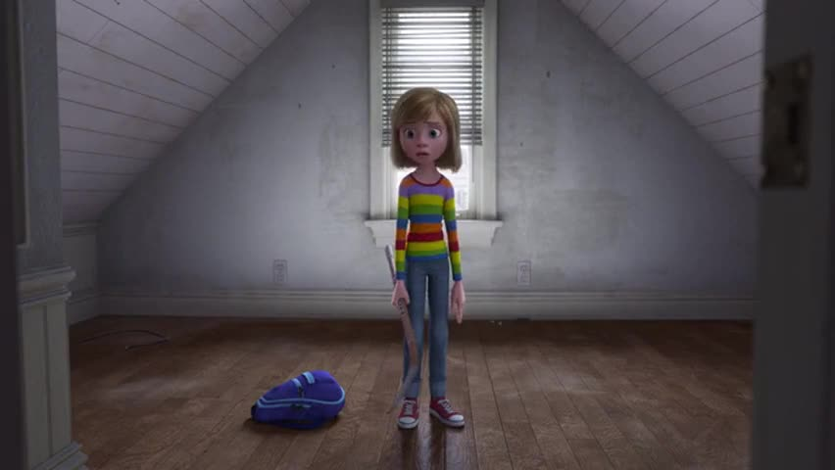
Ugly House
Nasty Room
Stressed
Parents
Broccoli Pizza!
Fails Hockey Tryouts
Hard
Struggles
Hopeful
Change
Happy
Life

Slide 6
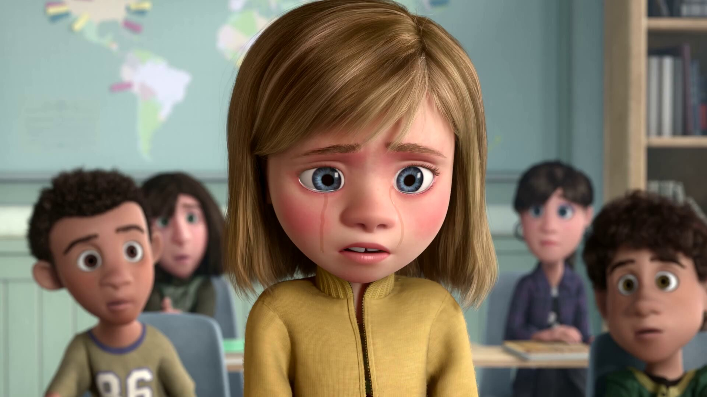
Emotional
Crisis
Hard
Struggles
Hopeful
Change
Happy
Life

Slide 7
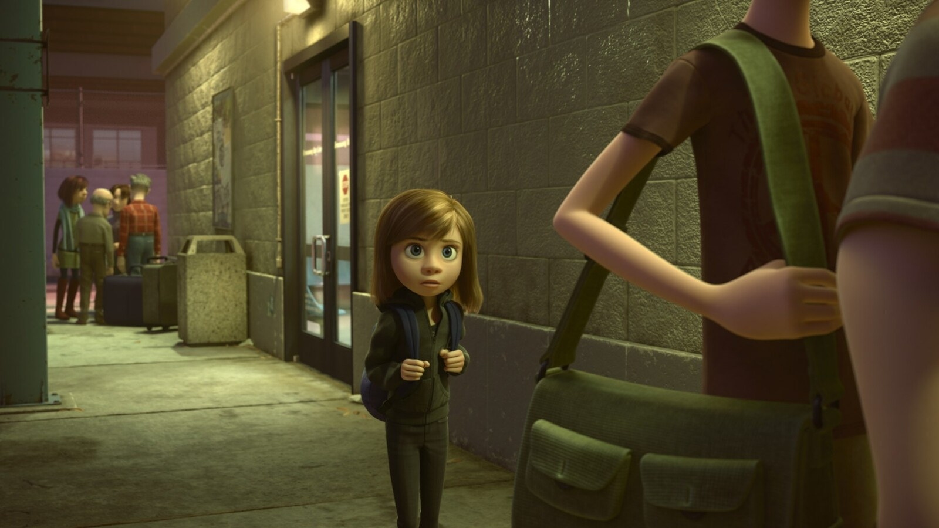
Emotional
Crisis
Hard
Struggles
Hopeful
Change
Happy
Life
Go Back!

Slide 8
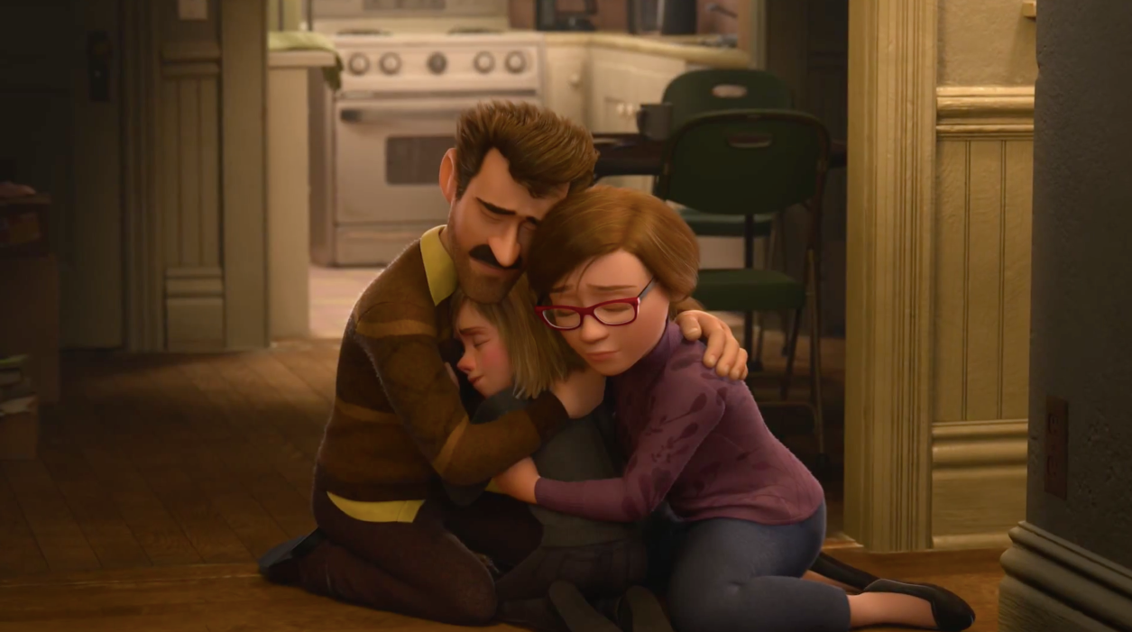
Seek
Help
Emotional
Crisis
Hard
Struggles
Hopeful
Change
Happy
Life
Go Back!

Slide 9
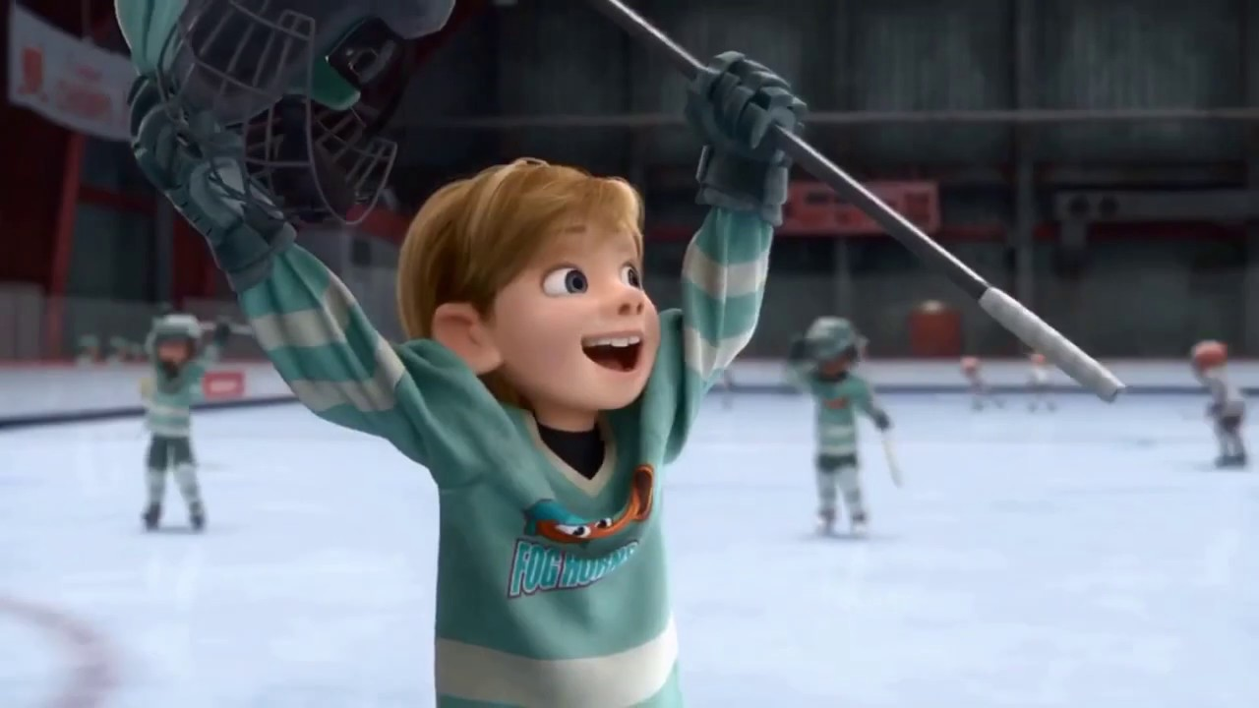
Better
Life
Seek
Help
Emotional
Crisis
Hard
Struggles
Hopeful
Change
Happy
Life
Go Back!

Slide 10
10:32-34
Hebrews
Better
Life
Seizure of Property
Moses, Law, Traditions
Public Ridicule
Became Christians
Secure Community
Sent to Prison
Seek
Help
Emotional
Crisis
Temple & Feasts
Hard
Struggles
Hopeful
Change
Happy
Life
Harden your hearts
Throw away your confidence
Shrink back
Grow weary
Lose heart
Go Back!
DO NOT

Slide 11
JESUS IS OUR
7-10:18
GREAT HIGH PRIEST
Better
Life
Seek
Help
Emotional
Crisis
Hard
Struggles
Hopeful
Change
Happy
Life
Harden your hearts
Throw away your confidence
Shrink back
Grow weary
Lose heart
Go Back!
DO NOT

Slide 12
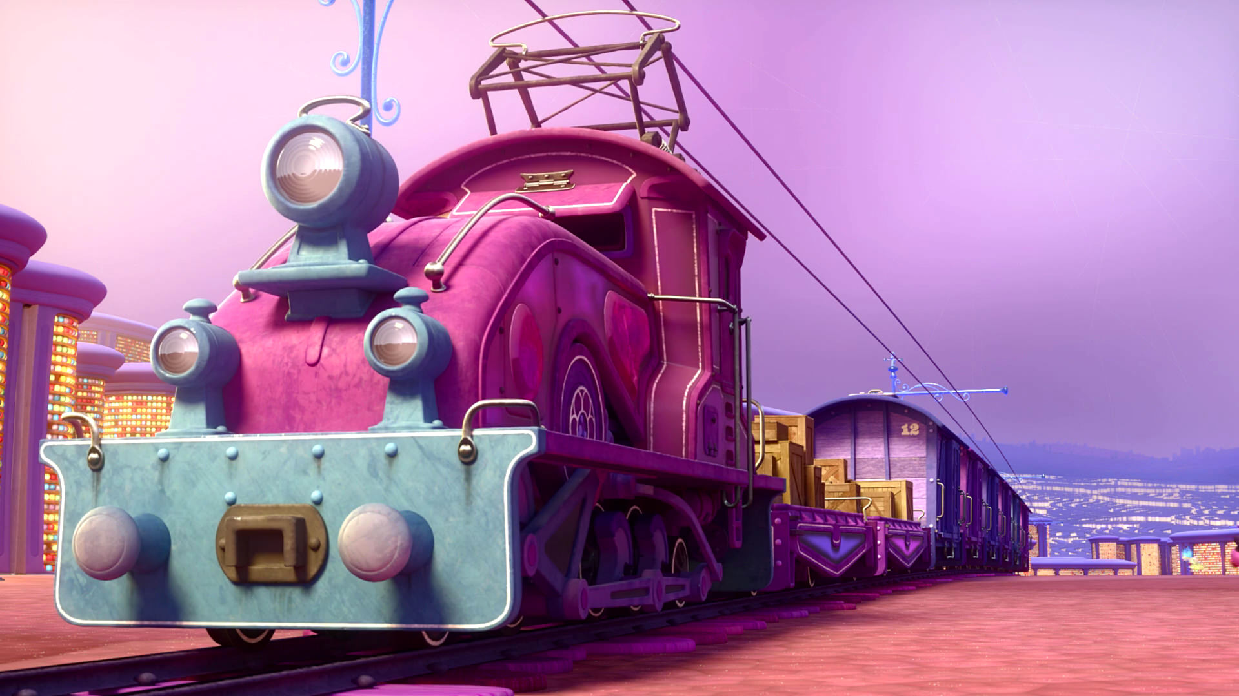
Train of Thought

Slide 13
Train of Thought

Slide 14
TABERNACLE
COVENANT
ORDER & OATH
JESUS IS OUR
7-10:18
GREAT HIGH PRIEST
SACRIFICE
promises
MINISTRY
Train of Thought

Slide 15
Sorrowful
Straighten
Lest we drift
Enduring foR
12:4-11
Discipline
Pay Attention
Joy set before Him
Angels
1:4-2:16
God has spoken
1:1-3
In his son
Strengthen
Pursue Peace
Why Lower?
Right Hand
Righteousness
Prepare
12:12-17
to Endure
Endured Cross
Right Hand
Short of Grace
Purification
Despising Shame
Bitterness
Encourage
Suffering
FIXING OUR
12:2-3
Eyes On Jesus
Esau
Hold Firm
Faithful
Run with Endurance
2:17-18
Merciful
No Evil Hearts
Able to Help
Moses
Joshua
3-4
Be Diligent
MINISTRY
Have Faith
promises
SACRIFICE
COVENANT
TABERNACLE
ORDER & OATH
JESUS IS OUR
7-10:18
GREAT HIGH PRIEST
Miss Rest
God’s Word
THE CLOUD
10:32-12:1
OF witnesses
Shaking
Hold Fast
Throw Away
Need Endurance
Time of Need
4:14-16
Gratitude & Service
Reveremce & Awe
Grace to Help
Sinai
12:18-29
AND Zion
Draw Near
Consuming Fire
Immaturity
Suffering of Christ
Falling Away
Aaron
5:1-10
Melchi
zEdek
Judgment
Draw Near
Vengeance
Hold Fast
SINCE Therefore
10:19-25
LET US
For if we go
10:26-31
on sinning
Stir Up
Faith & Patience
Anchor of Hope
Encourage
Fury of Fire
Terrifying
5:11-6:20
Closing
13
exhortations
Train of Thought

Slide 16
THE OATH
HOLY
SPIRIT
GOD
The exalted Son of God
SON
MAN
MAN
MAN
MAN
MAN

Slide 17
THE OATH
HOLY
SPIRIT
GOD
Became lower than the angels … partook of flesh and blood
MAN
MAN
SON
MAN
MAN
MAN
SON
SON

Slide 18
HOLY
SPIRIT
GOD
Tasted of death for everyone
SON
SON
MAN
MAN
SON
MAN
MAN
MAN

Slide 19
THE OATH
HOLY
SPIRIT
GOD
Perfected to be the author of our salvation
SON
SON
MAN
MAN
SON
MAN
MAN
MAN

Slide 20
THE OATH
HOLY
SPIRIT
GOD
SON
Freed us from slavery
MAN
MAN
MAN
MAN
SON
SON
SON
SON
SON
MAN
SON

Slide 21
THE OATH
HOLY
SPIRIT
GOD
And become our merciful and faithful high priest
PROMISED LAND
SON
To bring many sons to glory
SON
SON
SON
SON
MAN
MAN
MAN
MAN
MAN
MAN
MAN
MAN
PASSOVER
SON
MAN
MOSES
MAN
SON

Slide 22
THE OATH
HOLY
SPIRIT
GOD
PROMISED LAND
Moses was a type of Christ
SON
SON
SON
SON
SON
ANGELS
MAN
MAN
MAN
MAN
MAN
MAN
MAN
MAN
PASSOVER
SON
MAN
MOSES
MAN
SON

Slide 23
GOD
THE OATH
HOLY
SPIRIT
GOD
PROMISED LAND
Aaron was a type of Christ
AARON
SON
SON
SON
SON
SON
TABERNACLE
MAN
MAN
MAN
MAN
LEVI
LEVI
LEVI
MAN
MAN
MAN
MAN
PASSOVER
BULL
SON
MAN
COVENANT
MOSES
MAN
MAN
MAN
SON
MAN
MAN
MAN

Slide 24
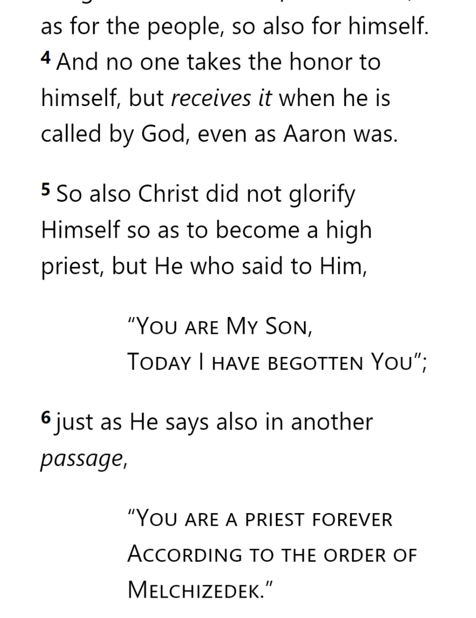
GOD
THE OATH
HOLY
SPIRIT
GOD
MELCHIZEDEK
PRIEST
AARON
SON
SON
SON
SON
SON
TABERNACLE
LEVI
LEVI
LEVI
MAN
MAN
MAN
MAN
BULL
SON
COVENANT
MAN
MAN
MAN
SON
MAN
Hebrews 5
MAN
MAN

Slide 25
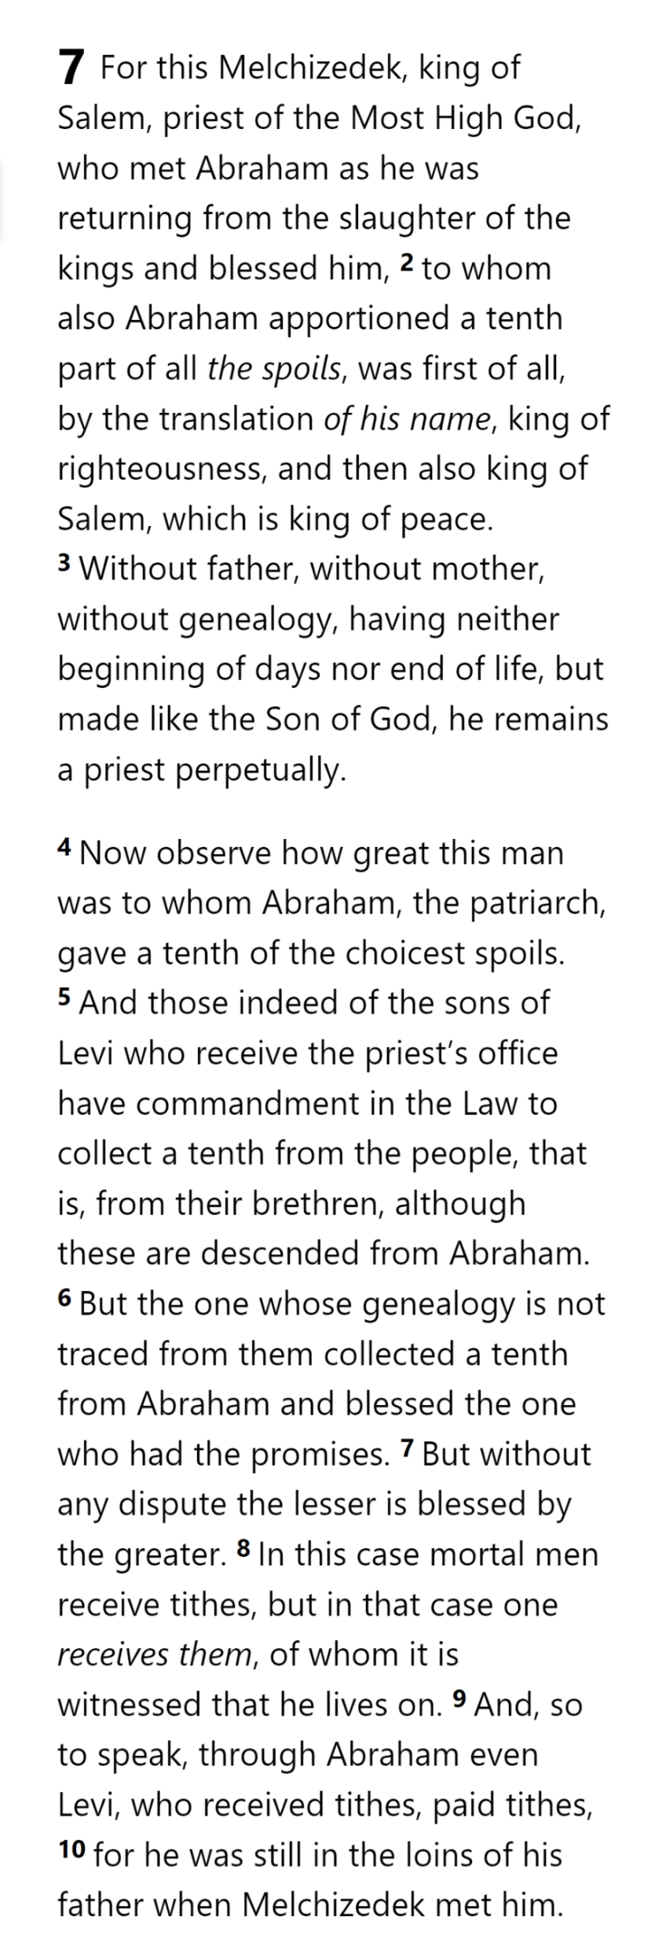
GOD
GOD
THE OATH
HOLY
SPIRIT
GOD
MELCHIZEDEK
PRIEST
AARON
SON
SON
SON
SON
SON
TITHE
BLESSING
TABERNACLE
ABRAHAM
LEVI
LEVI
LEVI
MAN
MAN
MAN
MAN
BULL
SON
COVENANT
MAN
MAN
MAN
SON
MAN
HEBREWS 7
MAN
MAN

Slide 26
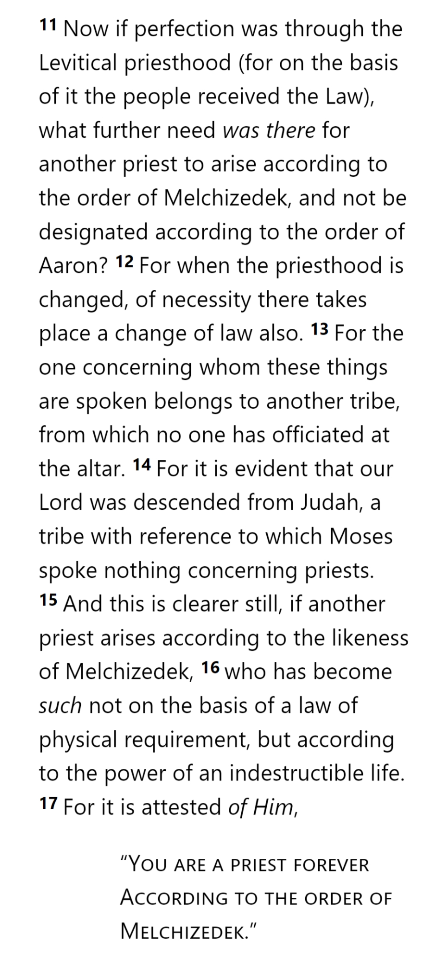
GOD
GOD
THE OATH
HOLY
SPIRIT
GOD
MELCHIZEDEK
PRIEST
AARON
SON
SON
SON
SON
SON
TITHE
BLESSING
TABERNACLE
ABRAHAM
LEVI
MAN
MAN
LEVI
LEVI
LEVI
MAN
MAN
TITHES
BULL
SON
LAND
NATION
SEED
COVENANT
MAN
MAN
MAN
SON
MAN
HEBREWS 7
MAN
MAN

Slide 27
GOD
GOD
THE OATH
HOLY
SPIRIT
GOD
MELCHIZEDEK
PRIEST
AARON
SON
SON
SON
SON
SON
TITHE
BLESSING
TABERNACLE
ABRAHAM
LEVI
LEVI
LEVI
LEVI
MAN
MAN
MAN
MAN
TITHES
ISAAC
BULL
SON
LAND
NATION
SEED
COVENANT
MAN
MAN
MAN
SON
MAN
HEBREWS 7
MAN
MAN

Slide 28
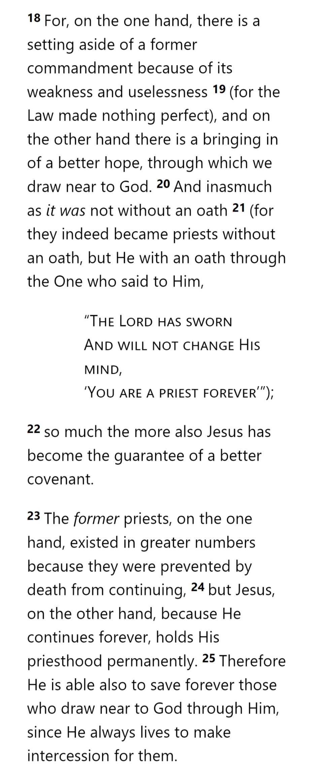
GOD
GOD
THE OATH
HOLY
SPIRIT
GOD
MELCHIZEDEK
PRIEST
AARON
SON
SON
SON
SON
SON
TITHE
BLESSING
TABERNACLE
ABRAHAM
LEVI
LEVI
LEVI
LEVI
MAN
MAN
MAN
MAN
ISAAC
BULL
SON
LAND
NATION
SEED
COVENANT
COVENANT
MAN
MAN
MAN
SON
MAN
HEBREWS 7
MAN
MAN

Slide 29
GOD
GOD
THE OATH
HOLY
SPIRIT
GOD
MELCHIZEDEK
PRIEST
AARON
SON
SON
SON
SON
SON
TITHE
BLESSING
TABERNACLE
ABRAHAM
LEVI
LEVI
LEVI
LEVI
MAN
MAN
MAN
MAN
ISAAC
BULL
SON
LAND
NATION
SEED
COVENANT
COVENANT
MAN
MAN
MAN
SON
MAN
HEBREWS 7
MAN
MAN

Slide 30
GOD
GOD
THE OATH
HOLY
SPIRIT
GOD
MELCHIZEDEK
PRIEST
AARON
SON
SON
SON
SON
SON
TITHE
BLESSING
TABERNACLE
ABRAHAM
LEVI
LEVI
LEVI
LEVI
MAN
MAN
MAN
MAN
ISAAC
BULL
SON
LAND
NATION
SEED
COVENANT
COVENANT
MAN
MAN
MAN
SON
MAN
HEBREWS 7
MAN
MAN

Slide 31
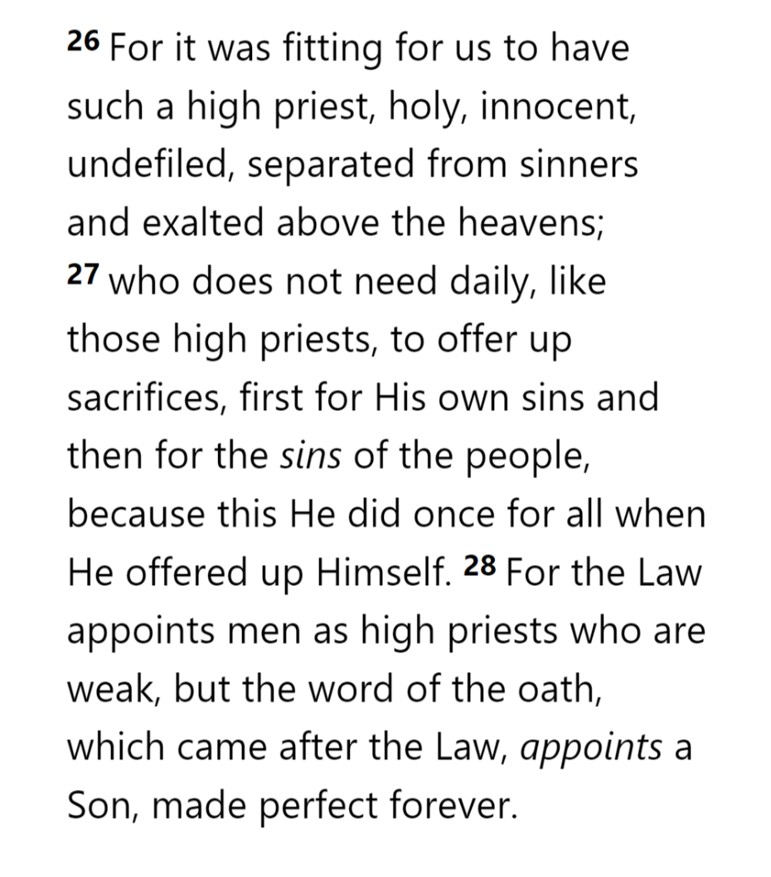
GOD
GOD
THE OATH
HOLY
SPIRIT
GOD
MELCHIZEDEK
PRIEST
AARON
SON
SON
SON
SON
SON
TITHE
BLESSING
TABERNACLE
ABRAHAM
LEVI
LEVI
LEVI
LEVI
MAN
MAN
MAN
MAN
ISAAC
BULL
SON
LAND
NATION
SEED
COVENANT
COVENANT
MAN
MAN
MAN
SON
MAN
HEBREWS 7
MAN
MAN

Slide 32
GOD
GOD
THE OATH
HOLY
SPIRIT
GOD
MELCHIZEDEK
PRIEST
AARON
SON
SON
SON
SON
SON
TITHE
BLESSING
TABERNACLE
ABRAHAM
LEVI
LEVI
LEVI
LEVI
MAN
MAN
MAN
MAN
ISAAC
BULL
SON
LAND
NATION
SEED
COVENANT
COVENANT
MAN
MAN
MAN
SON
MAN
HEBREWS 7
MAN
MAN

Slide 33
GOD
GOD
THE OATH
HOLY
SPIRIT
GOD
MELCHIZEDEK
PRIEST
AARON
SON
SON
SON
SON
SON
TITHE
BLESSING
TABERNACLE
ABRAHAM
LEVI
LEVI
LEVI
LEVI
MAN
MAN
MAN
MAN
ISAAC
BULL
SON
LAND
NATION
SEED
COVENANT
COVENANT
MAN
MAN
MAN
SON
MAN
HEBREWS 7
MAN
MAN

Slide 34
THE OATH
Now … about verse 3 …

Slide 35
THE OATH
Literally Eternal
No Succession
No predecessor
Supernatural Being?
Angel?
Preincarnate Christ?
Still alive on earth?
No successor
His priesthood ended when he died
His priesthood foreshadows that of Christ

Slide 36
THE OATH
Eternal as a Type
No Succession
Unrecorded facts suggest he is “always living”
No predecessor
No successor
“having been made like”: how and by whom?
His priesthood ended when he died
His priesthood foreshadows that of Christ
Has a type of eternal life

Slide 37
THE OATH
Eternal as a Type
No Succession
“mortal”:
dying, about to die, wither, decay
“In this case, a succession of men receive tithes, but in that case, one receives them who has no successor”
“it is witnessed”: how and by whom?
Zē = “to live, be alive”

Slide 38
THE OATH
Eternal as a Type
No Succession
16A:
No Succession!
16A:
No Succession!
16B:
Applies to Melchizedek as a type
Applies to Jesus in the full reality
16B:
Only applies to Jesus

Slide 39
THE OATH
Eternal as a Type
No Succession
Levites:
Death
Levites: Succession
Jesus:
Always Lives
Jesus: Permanent

Slide 40
Independence Day in the USA and Bastille Day in France are like each other (and different from other days) primarily because
ⓘ Start presenting to display the poll results on this slide.

Slide 41
LIFE
THE OATH
DEATH
Eternal as a Type
No Succession
Need Successors
No Succession
No Law
Law of Requirements
No Genealogy
Need Genealogy
One Priest
Many Priests

Slide 42
Hebrews

