Slide 1
Ecclesiastes
Thought Question:
What has the book of Ecclesiastes meant to you in your spiritual development?
Class #1
Introduction

Slide 2
1:1-3
“Contempt of the World”
(Jerome)
“Go, eat your bread with joy … Enjoy life…”
(9:7-9)
?
“The words of the Preacher, the son of David, king in Jerusalem.
Vanity of vanities, says the Preacher, vanity of vanities! All is vanity.
What does a man gain by all the toil at which he toils under the sun?”

Slide 3
schedule
Class # | Day | Date | Reading | Lesson
1 | Sun | 2/25/24 | (intro) | Introduction
2 | Wed | 2/28/24 | 1:1-11 | Opening Statement
3 | Sun | 3/3/24 | 1:12-2:26 | Solomon's Search
4 | Wed | 3/6/24 | 3:1-22 | "For Everything There Is A Season"
5 | Sun | 3/10/24 | 4:1-5:7 | Problems Under The Sun (Part 1)
6 | Wed | 3/13/24 | 5:8-6:12 | Problems Under The Sun (Part 2)
7 | Sun | 3/17/24 | 7:1-18 | What Is "Better"?
Meeting | Wed | 3/20/24
8 | Sun | 3/24/24 | 7:19-8:17 | Finding Wisdom
9 | Wed | 3/27/24 | 9:1-12 | Death, Time, and Chance
10 | Sun | 3/31/24 | 9:13-10:20 | There Is More Gain In Wisdom
11 | Wed | 4/3/24 | 11:1-12:8 | Carpe Diem
12 | Sun | 4/7/24 | 12:9-14 | The End of the Matter
13 | Wed | 4/10/24 | (conclusion) | Review and Miscellaneous

Slide 4
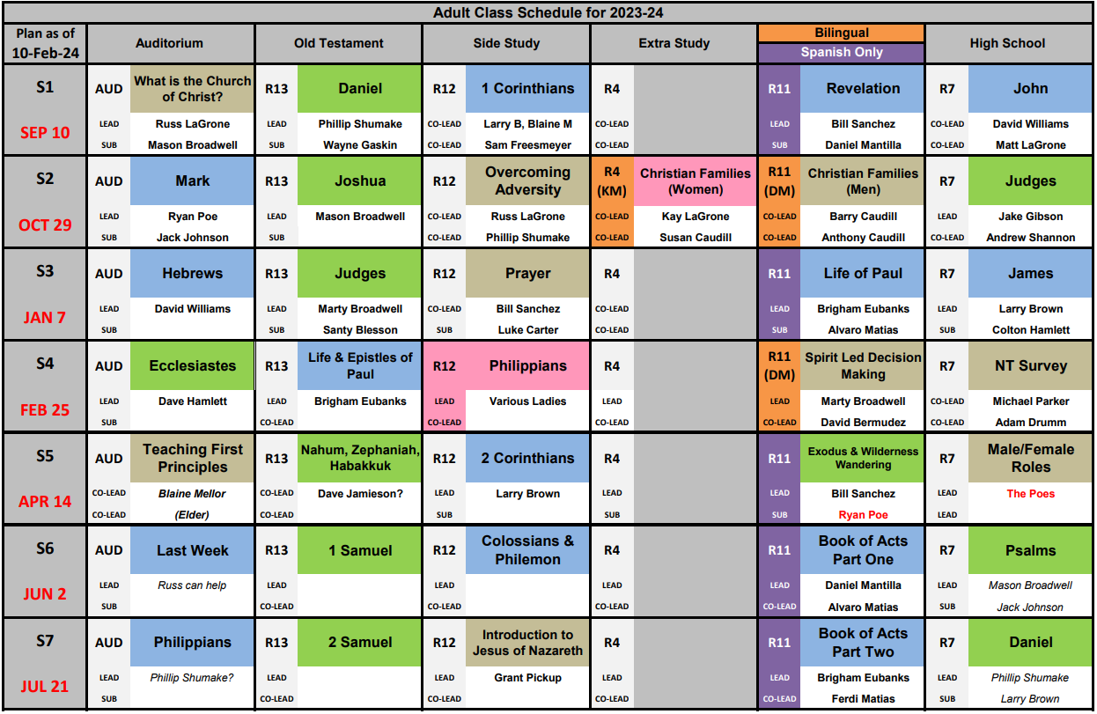

Slide 5
The Value of OT Study
“Now these things took place as examples for us, that we might not desire evil as they did … Now these things happened to them as an example, but they were written down for our instruction, on whom the end of the ages has come.” (1 Corinthians 10:6-12)
“… and how from childhood you have been acquainted with the sacred writings, which are able to make you wise for salvation through faith in Christ Jesus. All Scripture is breathed out by God and profitable…” (2 Timothy 3:14-17)

Slide 6
Old Testament Wisdom literature
Proverbs
Job
Ecclesiastes
Song of Songs
Psalms (at least a few)

Slide 7
proverbs
Writer?
Mostly Solomon (1:1, 10:1, 25:1)
Purpose?
“To know wisdom and instruction, to understand words of insight, to receive instruction in wise dealing…” (1:2-3)
Value?
“So you will walk in the way of the good and keep to the paths of the righteous.” (2:30)
Design?
Wit; well-constructed; structure (groupings); parallelism; cause/effect; formulaic?
”Whoever works his land will have plenty of bread, but he who follows worthless pursuits lacks sense.” (12:11)
“No ill befalls the righteous, but the wicked are filled with trouble.” (12:21)
“Train up a child in the way he should go; even when he is old he will not depart from it.” (22:6)

Slide 8
JOB
Writer?
Possibly Moses, Job, or Elihu, but Solomon is a considered candidate.
Purpose?
“I know that you can do all things, and that no purpose of yours can be thwarted. ‘Who is this who hides counsel without knowledge?’ Therefore I have uttered what I did not understand, things too wonderful for me, which I did not know.” (42:2-3)
Value?
When wisdom has failed, how do believers respond to God?
Design?
Poetry, dialogues
Structure (1st two chapters are narrative, 3rd is Job’s lament, then 3 cycles of speeches between Job and Eliphaz/Bildad/Zophar. Elihu speaks, God speaks, Job confesses, then concluding narrative)

Slide 9
Song of Songs
Writer?
Solomon (1:1)
Purpose?
God’s wisdom regarding love, marriage, and sexuality
Value?
Who created these things? Wouldn’t it be awesome if He gave us a book of Scripture to understand?
Design?
Poetry: terseness/brevity, parallelism, imagery (e.g., vineyards, spices, pomegranates, myrrh, frankincense, ‘like a roe or a young deer’, ‘gazelle or a young stag’)
Repetitive phrases/refrains
”Do not awaken love” (2:7, 3:5, 8:4); “I am my beloved’s” (2:16, 6:3, 7:10)
Dream sequences (3:1-5 and 5:2-7); Description of woman/man

Slide 10
ECCLESIASTES
Writer?

Slide 11
References to The Preacher
“The words of the Preacher, the son of David, king in Jerusalem.” (1:1)
“Vanity of vanities, says the Preacher, vanity of vanities! All is vanity.” (1:2)
“I the Preacher have been king over Israel in Jerusalem.” (1:12)
“Behold, this is what I found, says the Preacher, while adding one thing to another to find the scheme of things –“ (7:27)
“Vanity of vanities, says the Preacher; all is vanity.” (12:8)
“Besides being wise, the Preacher also taught the people knowledge, weighing and studying and arranging many proverbs with great care.” (12:9)
“The Preacher sought to find words of delight, and uprightly he wrote words of truth.” (12:10)

Slide 12
Solomon (1 Kings)
3:5-14 - God gives wisdom
4:29-34 – Wisdom, proverbs, songs
7:1-12 – His houses
10:14-29 – His wealth
11:1-3 – His women

Slide 13
ECCLESIASTES
Writer?
Solomon (but when? cf. 2 Chron. 11:17)
Purpose?
“What does a man gain by all the toil at which he toils under the sun?” (1:3), “The end of the matter, all has been heard. ‘Fear God and keep his commandments, for this is the whole duty of man. For God will bring every deed into judgment, with every secret thing, whether good or evil.” (12:13-14)
Value?
TBD ☺
Design?
Autobiographical sections (e.g., 1:12-2:26; 3:10-4:16; 5:13-6:12), including 1st person narration, reflection
Proverbs (e.g., 1:15, 1:18, 7:1-12); Poems (1:4-11, 3:1-8, 11:7-12:8); Rhetorical Questions
Example Stories (4:13-16, 9:13-16); Commands/Prohibitions (5:1-7, 8:2-4)
Repetitive phrases/refrains

Slide 14
outline
Class # | Day | Date | Reading | Lesson
1 | Sun | 2/25/24 | (intro) | Introduction
2 | Wed | 2/28/24 | 1:1-11 | Opening Statement
3 | Sun | 3/3/24 | 1:12-2:26 | Solomon's Search
4 | Wed | 3/6/24 | 3:1-22 | "For Everything There Is A Season"
5 | Sun | 3/10/24 | 4:1-5:7 | Problems Under The Sun (Part 1)
6 | Wed | 3/13/24 | 5:8-6:12 | Problems Under The Sun (Part 2)
7 | Sun | 3/17/24 | 7:1-18 | What Is "Better"?
Meeting | Wed | 3/20/24
8 | Sun | 3/24/24 | 7:19-8:17 | Finding Wisdom
9 | Wed | 3/27/24 | 9:1-12 | Death, Time, and Chance
10 | Sun | 3/31/24 | 9:13-10:20 | There Is More Gain In Wisdom
11 | Wed | 4/3/24 | 11:1-12:8 | Carpe Diem
12 | Sun | 4/7/24 | 12:9-14 | The End of the Matter
13 | Wed | 4/10/24 | (conclusion) | Review and Miscellaneous

Slide 15
1:2-11 Opening Statment
Next time

