Slide 1
Hebrews
Lesson Two: Introduction • Christ and the Angels

Slide 3
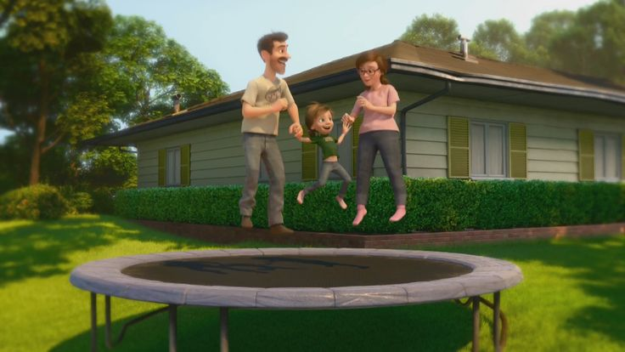
Great Family
Great House
Great Yard
Great Friends
Great Hockey Team
Happy
Life

Slide 4
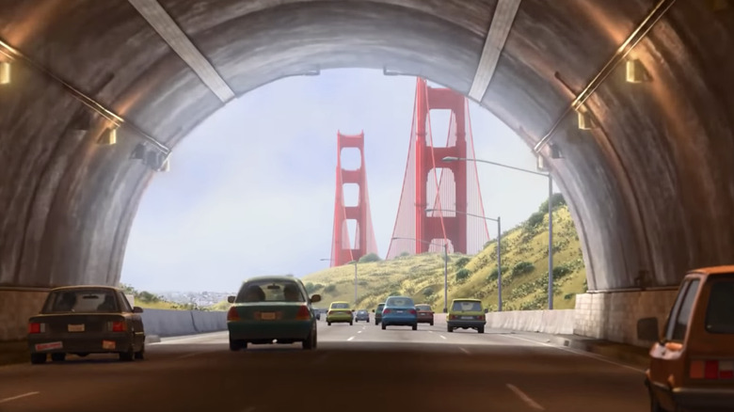
Hopeful
Change
Happy
Life

Slide 5
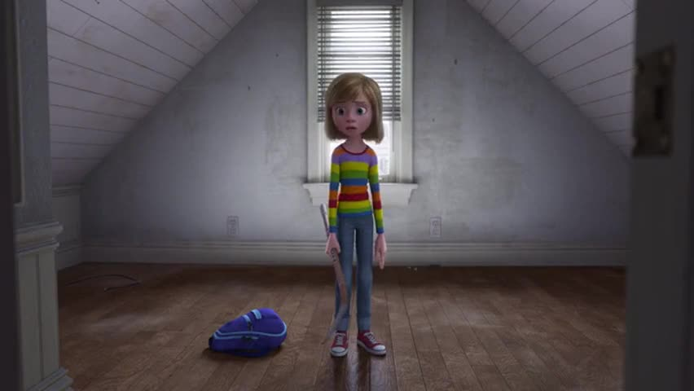
Ugly House
Nasty Room
Stressed
Parents
Broccoli Pizza!
Fails Hockey Tryouts
Hard
Struggles
Hopeful
Change
Happy
Life

Slide 6
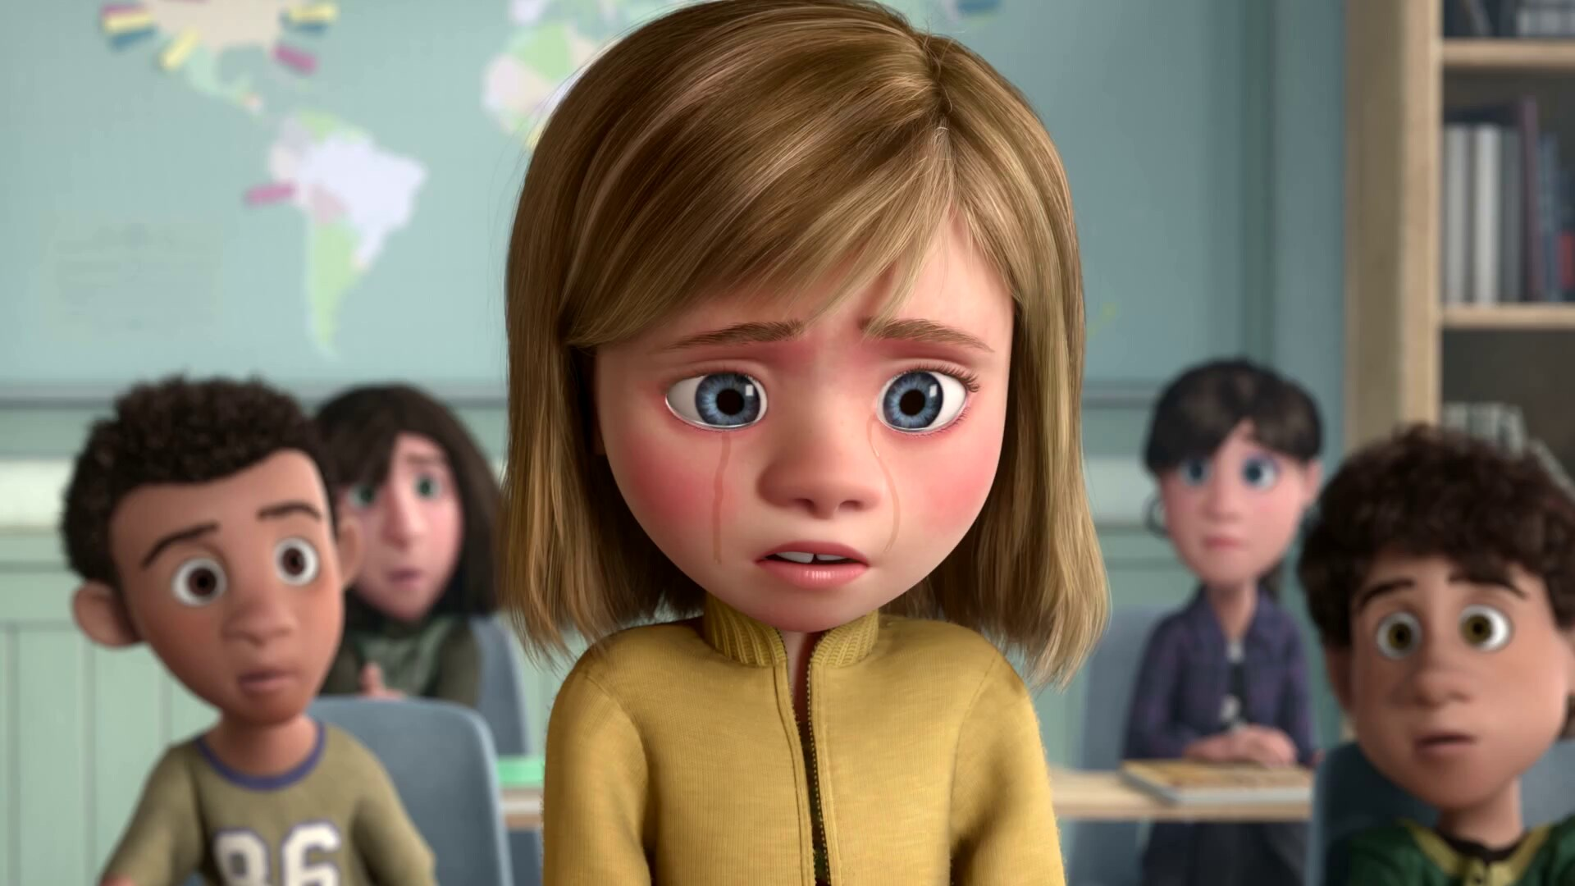
Emotional
Crisis
Hard
Struggles
Hopeful
Change
Happy
Life

Slide 7
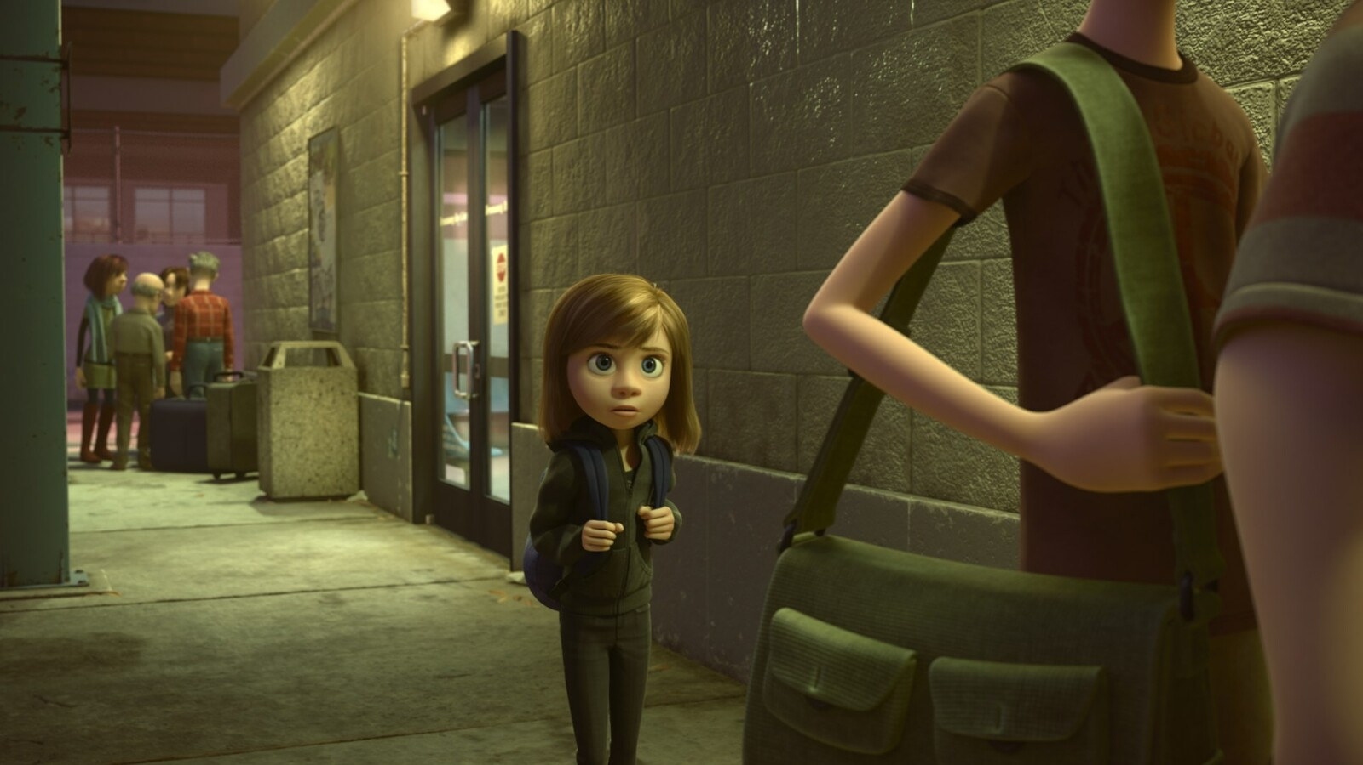
Emotional
Crisis
Hard
Struggles
Hopeful
Change
Happy
Life
Go Back!

Slide 8
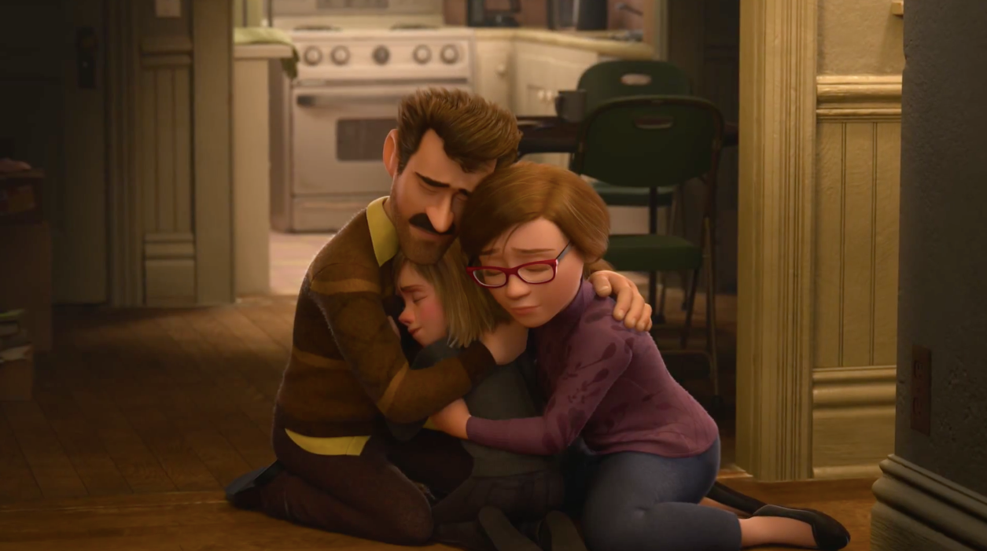
Seek
Help
Emotional
Crisis
Hard
Struggles
Hopeful
Change
Happy
Life
Go Back!

Slide 9
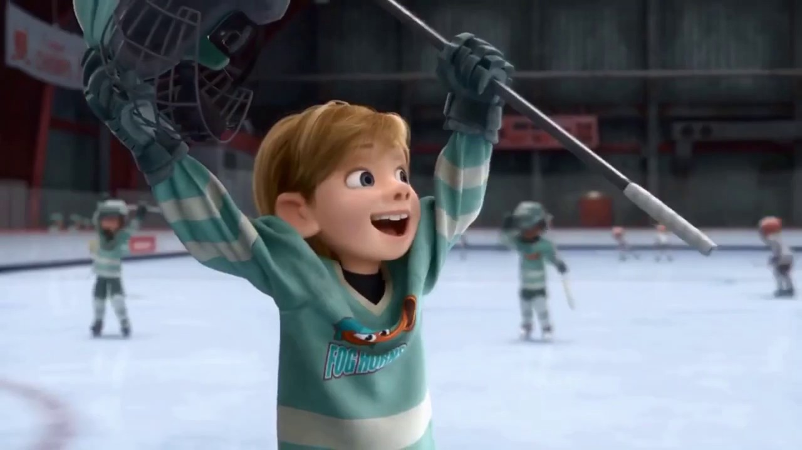
Better
Life
Seek
Help
Emotional
Crisis
Hard
Struggles
Hopeful
Change
Happy
Life
Go Back!

Slide 10
10:32-34
Hebrews
Better
Life
Seizure of Property
Moses, Law, Traditions
Public Ridicule
Became Christians
Secure Community
Sent to Prison
Seek
Help
Emotional
Crisis
Temple & Feasts
Hard
Struggles
Hopeful
Change
Happy
Life
Harden your hearts
Throw away your confidence
Shrink back
Grow weary
Lose heart
Go Back!
DO NOT

Slide 11
¹⁴ Therefore, since we have a great high priest who has passed through the heavens, Jesus the Son of God, let us hold fast our confession. ¹⁵ For we do not have a high priest who cannot sympathize with our weaknesses, but One who has been tempted in all things as we are, yet without sin. ¹⁶ Therefore let us draw near with confidence to the throne of grace, so that we may receive mercy and find grace to help in time of need.
Better
Life
Seek
Help
Emotional
Crisis
Hard
Struggles
Hopeful
Change
Happy
Life
Harden your hearts
Throw away your confidence
Shrink back
Grow weary
Lose heart
Go Back!
DO NOT

Slide 12
JESUS IS OUR
7-10:18
GREAT HIGH PRIEST
Better
Life
How can our lives today resemble the situation of the Hebrews?
Seek
Help
Emotional
Crisis
Hard
Struggles
Hopeful
Change
Happy
Life
Harden your hearts
Throw away your confidence
Shrink back
Grow weary
Lose heart
Go Back!
DO NOT

Slide 13
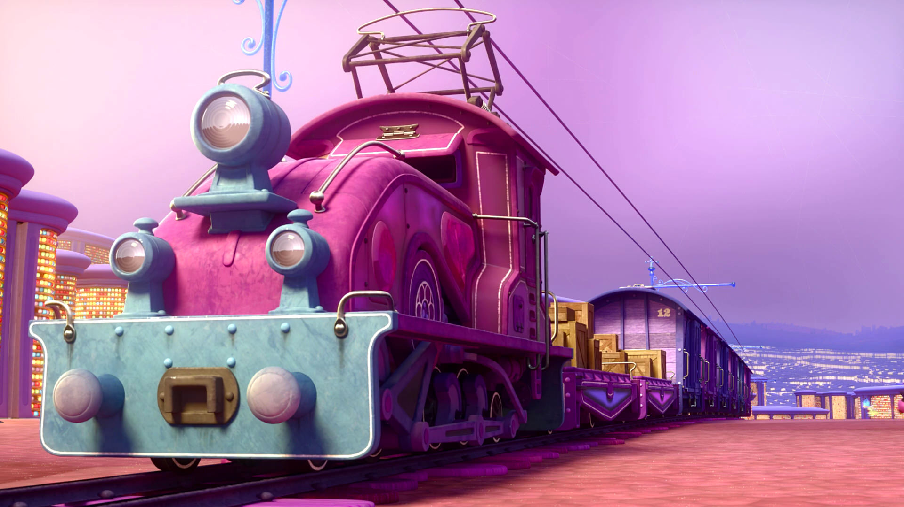
Train of Thought

Slide 14
Train of Thought

Slide 15
TABERNACLE
COVENANT
ORDER & OATH
JESUS IS OUR
7-10:18
GREAT HIGH PRIEST
SACRIFICE
promises
MINISTRY
Train of Thought

Slide 16
Sorrowful
Straighten
Lest we drift
Enduring foR
12:4-11
Discipline
Pay Attention
Joy set before Him
Angels
1:4-2:16
God has spoken
1:1-3
In his son
Strengthen
Pursue Peace
Why Lower?
Right Hand
Righteousness
Prepare
12:12-17
to Endure
Endured Cross
Right Hand
Short of Grace
Purification
Despising Shame
Bitterness
Encourage
Suffering
FIXING OUR
12:2-3
Eyes On Jesus
Esau
Hold Firm
Faithful
Run with Endurance
2:17-18
Merciful
No Evil Hearts
Able to Help
Moses
Joshua
3-4
Be Diligent
MINISTRY
Have Faith
promises
SACRIFICE
COVENANT
TABERNACLE
ORDER & OATH
JESUS IS OUR
7-10:18
GREAT HIGH PRIEST
Miss Rest
God’s Word
THE CLOUD
10:32-12:1
OF witnesses
Shaking
Hold Fast
Throw Away
Need Endurance
Time of Need
4:14-16
Gratitude & Service
Reveremce & Awe
Grace to Help
Sinai
12:18-29
AND Zion
Draw Near
Consuming Fire
Immaturity
Suffering of Christ
Falling Away
Aaron
5:1-10
Melchi
zEdek
Judgment
Draw Near
Vengeance
Hold Fast
SINCE Therefore
10:19-25
LET US
For if we go
10:26-31
on sinning
Stir Up
Faith & Patience
Anchor of Hope
Encourage
Fury of Fire
Terrifying
5:11-6:20
Closing
13
exhortations
Train of Thought

Slide 19
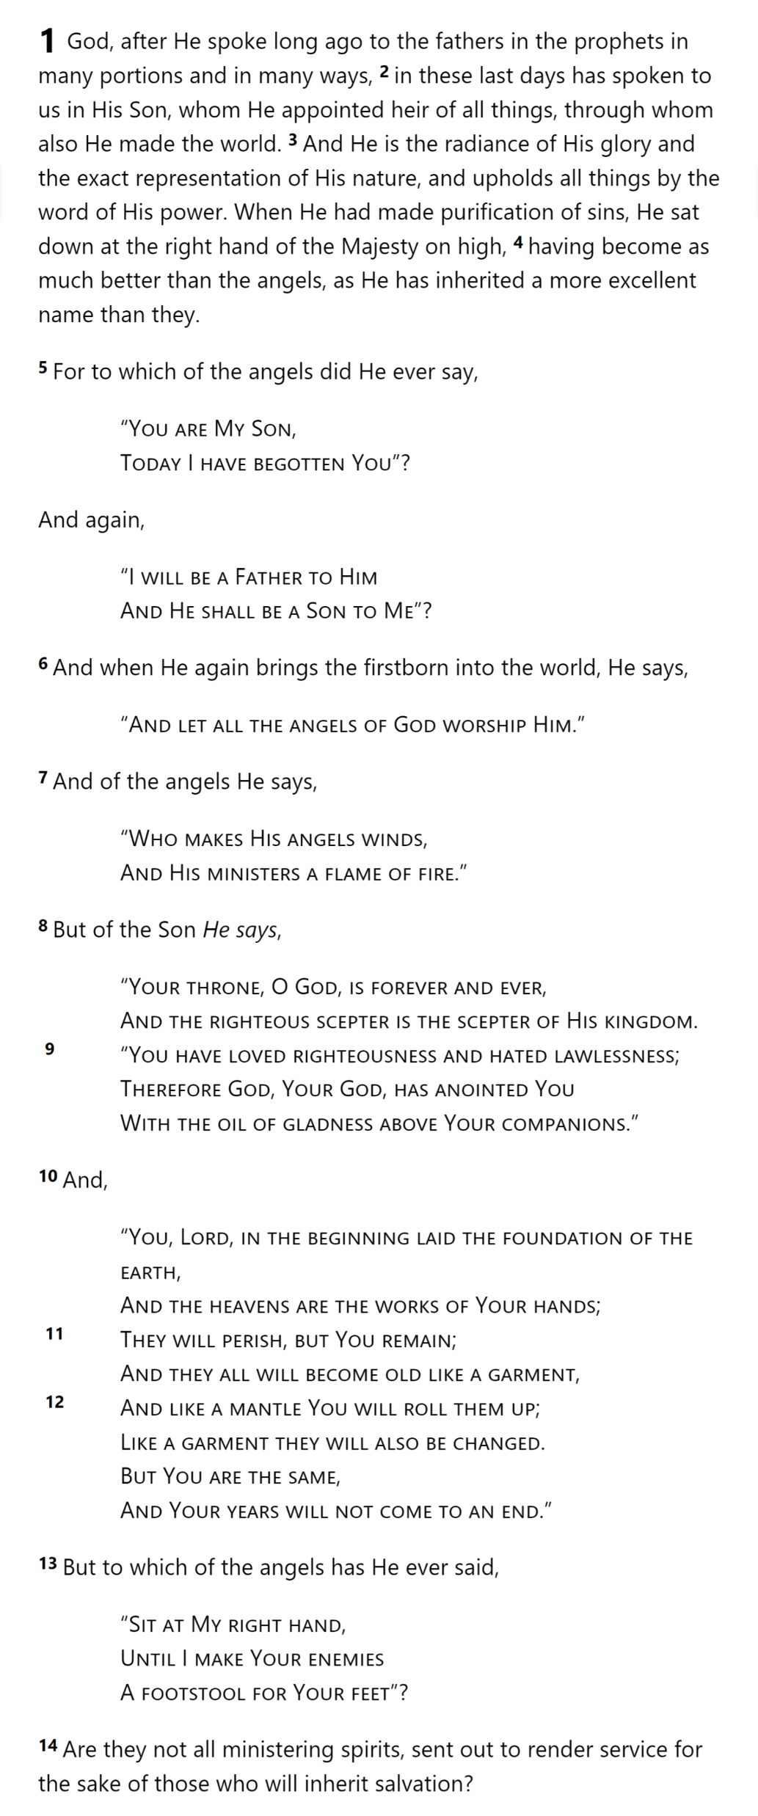
GOD
SON
MAN
Hebrews 1

Slide 20
THE OATH
GOD
SON
ANGELS
God’s
Activity
Son’s
Nature
Son’s
Activity
MAN
Hebrews 1

Slide 21
THE OATH
Why compare Jesus to Angels?
GOD
SON
As a man, Jesus appears lower
ANGELS
Angels were powerful creatures
Some worshipped of angels
The Law was “ordained” by angels
MAN
Angels provide a reference point
Notes:
As a man, Jesus appears lower
Angels were powerful creatures
Some worshipped of angels
The Law was “ordained” by angels
Angels provide a reference point

Slide 22
THE OATH
GOD
SON
ANGELS
MAN
Hebrews 1

Slide 23
THE OATH
GOD
SON
ANGELS
Psalm 2:7
2 Samuel 7:14
MAN
Hebrews 1
Notes:
Psalm 2: “Coronation” Psalm (envisions an ideal king)
2 Samuel 7: Covenant with David: promise of Solomon as heir

Slide 24
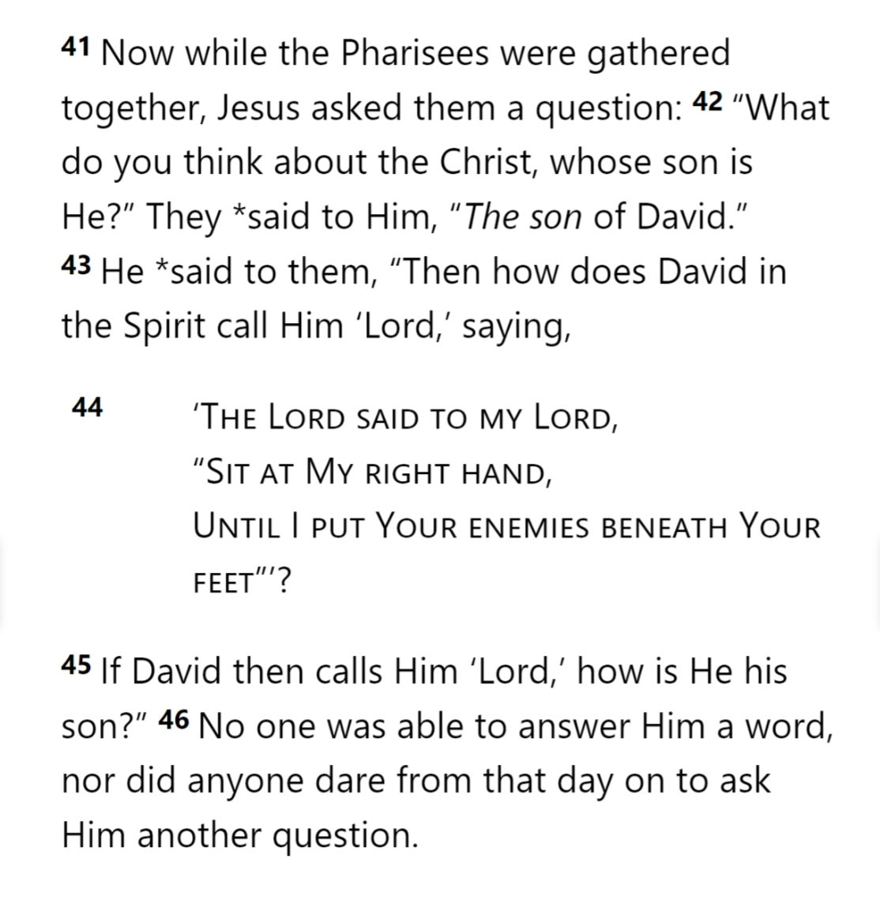
THE OATH
GOD
SON
ANGELS
MAN
Matthew 22
Notes:
Psalm 2: “Coronation” Psalm (envisions an ideal king)
2 Samuel 7: Covenant with David: promise of Solomon as heir

Slide 25
THE OATH
GOD
SON
ANGELS
Psalm 97:7
MAN
Hebrews 1
Notes:
Psalm 97: Elohim (angels or gods) Also Deut 32:43 LXX?

Slide 26
THE OATH
GOD
Psalm 104:4 [LXX]
SON
Psalm 45:6-7
ANGELS
MAN
Hebrews 1
Notes:
Psalm 104: “makes the winds His messengers” (LXX switches)
Psalm 45: Royal Wedding Psalm

Slide 27
THE OATH
GOD
SON
ANGELS
Psalm 102:25-26
MAN
Hebrews 1

Slide 28
THE OATH
GOD
SON
ANGELS
Psalm 110:1
MAN
Hebrews 1

Slide 29
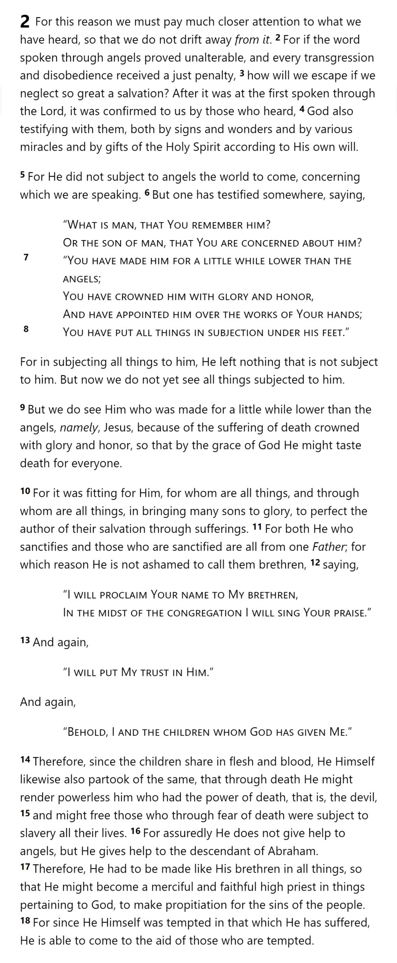
THE OATH
HOLY
SPIRIT
GOD
SON
ANGELS
Angels
Punish
ment
Lesser
DISOBEDIENCE
MAN
SON
PUNISH
MENT
Greater
DISOBEDIENCE
MAN
MAN
MAN
MAN
Hebrews 2

Slide 30
Hebrews

