Slide 1
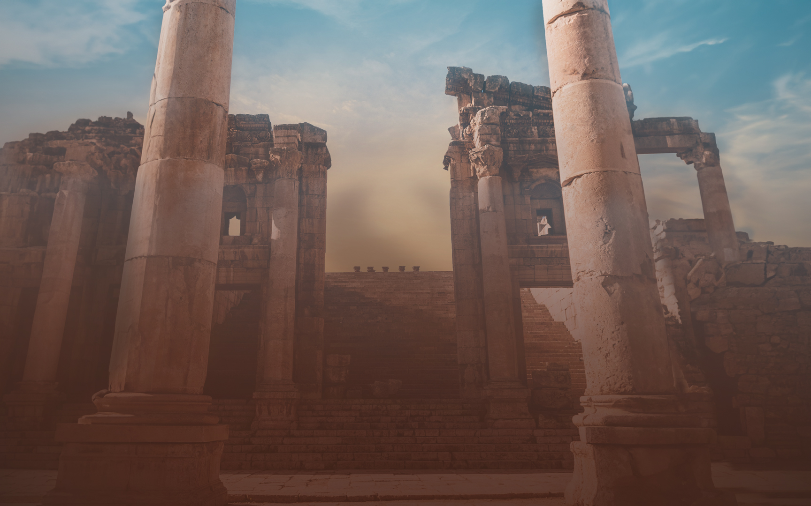
Notes:
Tonight we are continuing with our theme lessons….

Slide 2
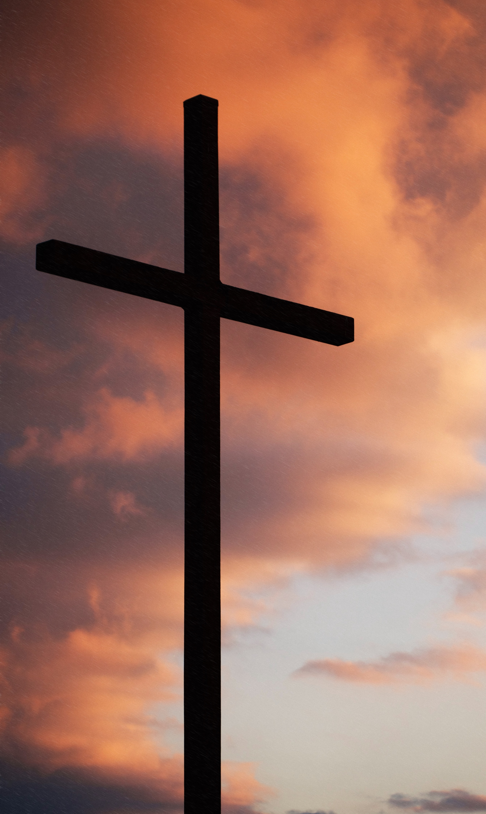
BECAUSE OF JESUS, CHRISTIANS NOW HAVE A HEAVENLY JOY
SO SIGNIFICANT,
SO REWARDING,
AND SO NEAR,
THAT EVEN PERSECUTION CANNOT STOP US FROM PURSUING IT.
Notes:
Remind us the 1st half of the theme was considering the phrases in our theme verse that DESCRIBE Jesus…. Joy set before Him…

Slide 3
LAY ASIDE EVERY WEIGHT
THE STORY OF
Leroy’s Backpack
Notes:
And our Second Half – is about RUNNING OUR RACE like Jesus.
Last month, we talked about laying aside every weight and sin…
So if we are going to run our race like Jesus…

Slide 4
Lesson Titles | Sundays at 6 PM
Intro: Fixing Our Eyes on Jesus | September 17, 2023
Focusing Our Eyes on Jesus:
The Author and Perfector of Faith | October 15, 2023
The Joy Set Before Him | November 19, 2023
Enduring the Cross, Despising the Shame | December 17, 2023
Sitting at the Right Hand of God’s Throne | January 21, 2024
The Same Yesterday, Today, and Tomorrow | February 18, 2024
Living Like Jesus:
Laying Aside Every Weight and Sin | March 17, 2024
Sharing in His Holiness | April 21, 2024.
Seeking the City to Come | May 19, 2024
Loving Sacrificially | June 16, 2024
Rejecting Strange Teaching | July 21, 2024
Conclusion: Jesus Working in Us | August 18, 2024
Notes:
Russ started this series.
Bill did lesson 2…

Slide 5
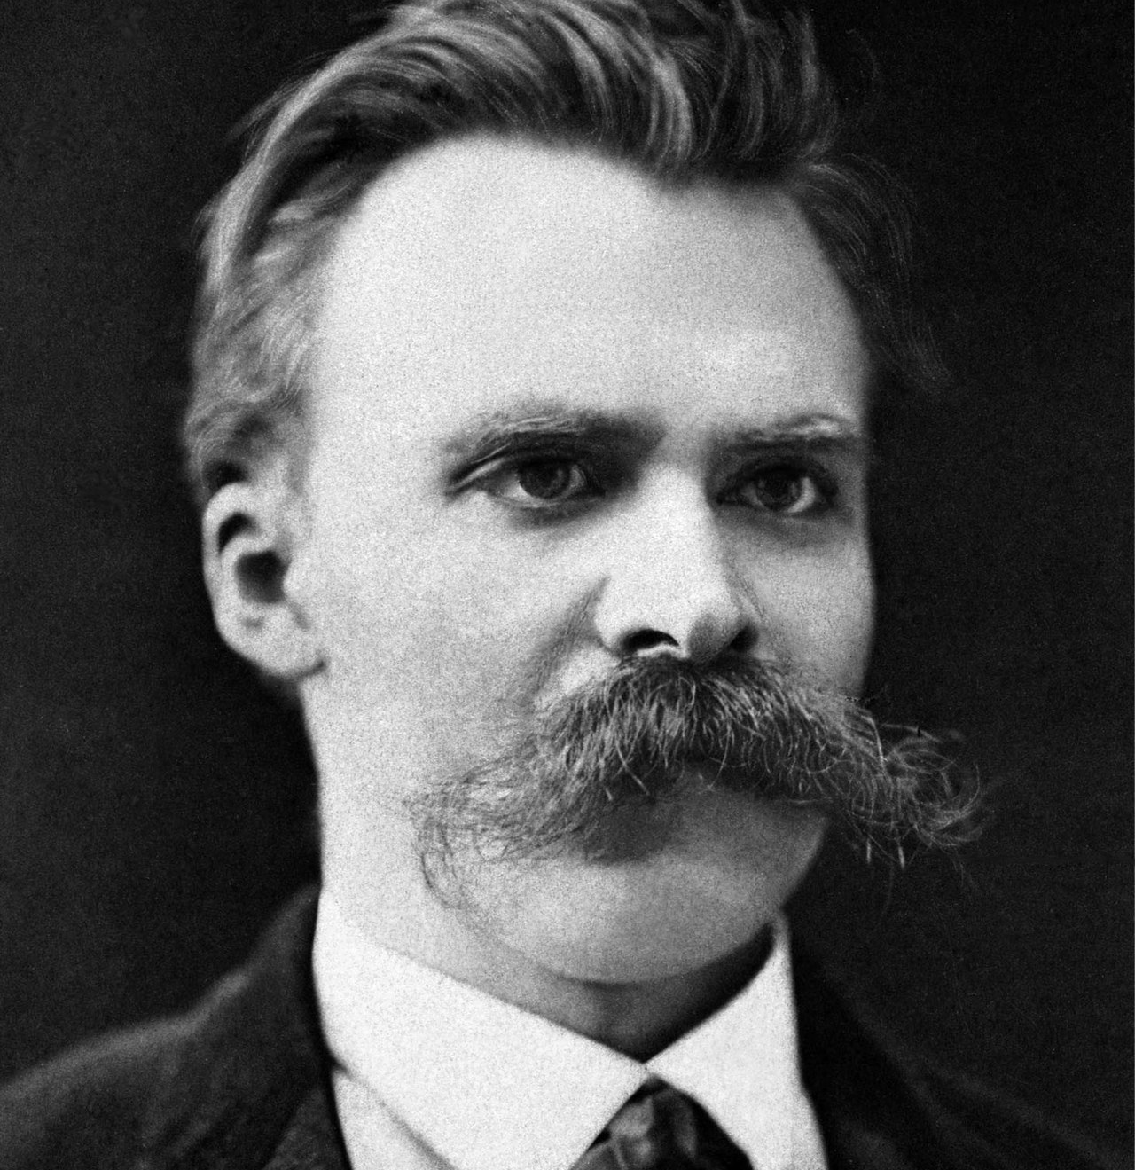
What Do German Philosopher Friedrich Nietzsche & American Idol Musician Kelly Clarkson Have In Common?
In 1888, German philosopher Friedrich Nietzsche first stated, “Out of life's school of war— what doesn't kill me, makes me stronger.”
And in 2011, Kelly Clarkson released her 5th Studio album “Stronger” singing, “What doesn’t kill you makes you stronger, stand a little taller…”
Notes:
If your first thought from these pictures is – over-styled hair – you wouldn’t be wrong…
But there’s more to the story…
123 Year Later…
Both the philosopher and the pop star are reflecting in their own way – that life is hard. Bad things happen to good people… and at some point – we are going to have to decide. HOW WILL I RESPOND to these pressures?
Both Nietzsche and Clarkson choose the perspective that when bad things happen – I can grow in that process….
This approach and perspective on Suffering is *part* of what Hebrews 12 is telling us. Hebrews 12 will obviously have a much deeper and higher message – but it does begin here…
We need to recognize that when Bad Things happen – there can be growth…

Slide 6
3 For consider Him who has endured such hostility by sinners against Himself, so that you will not grow weary and lose heart.
4 You have not yet resisted to the point of shedding blood in your striving against sin; 5 and you have forgotten the exhortation which is addressed to you as sons, “My son, do not regard lightly the discipline of the Lord, Nor faint when you are reproved by Him; 6 For those whom the Lord loves He disciplines, And He scourges every son whom He receives.”
7 It is for discipline that you endure; God deals with you as with sons; for what son is there whom his father does not discipline? 8 But if you are without discipline, of which all have become partakers, then you are illegitimate children and not sons. 9 Furthermore, we had earthly fathers to discipline us, and we respected them; shall we not much rather be subject to the Father of spirits, and live? 10 For they disciplined us for a short time as seemed best to them, but He disciplines us for our good, so that we may share His holiness. 11 All discipline for the moment seems not to be joyful, but sorrowful; yet to those who have been trained by it, afterwards it yields the peaceful fruit of righteousness.
Notes:
Take 3 minutes to survey the beginning of the chapter and then we will really dive in…
Hostility by Sinners = Subject.
Concern = Possible outcome is we lose heart. This hurt more than I want to endure. This is taking longer than I thought it would, etc….
* Big Idea: Where they are trying to discourage you – God is going to discipline you.
GOLD = ACTION / OUTCOME
GREEN = Problem
BLUE = God’s Involvement
RED = God’s Love

Slide 7
3 For consider Him who has endured such hostility by sinners against Himself, so that you will not grow weary and lose heart.
4 You have not yet resisted to the point of shedding blood in your striving against sin; 5 and you have forgotten the exhortation which is addressed to you as sons, “My son, do not regard lightly the discipline of the Lord, Nor faint when you are reproved by Him; 6 For those whom the Lord loves He disciplines, And He scourges every son whom He receives.”
7 It is for discipline that you endure; God deals with you as with sons; for what son is there whom his father does not discipline? 8 But if you are without discipline, of which all have become partakers, then you are illegitimate children and not sons. 9 Furthermore, we had earthly fathers to discipline us, and we respected them; shall we not much rather be subject to the Father of spirits, and live? 10 For they disciplined us for a short time as seemed best to them, but He disciplines us for our good, so that we may share His holiness. 11 All discipline for the moment seems not to be joyful, but sorrowful; yet to those who have been trained by it, afterwards it yields the peaceful fruit of righteousness.
Notes:
Take 3 mintues to Notice the KEY IDEAS in the text….
Hostility by Sinners = Subject.
Concern = Possible outcome is we lose heart. This hurt more than I want to endure. This is taking longer than I thought it would, etc….
GOLD = ACTION / OUTCOME
GREEN = Problem
BLUE = God’s Involvement
RED = God’s Love

Slide 8
SHARING IN HIS HOLINESS
HEBREWS 12:3-11 Changes How We Think About Difficulties.
HEBREWS 12:12-17 Changes How We Respond To Difficulties.
Notes:
Very clear in the life of Joseph – but only clear in the end. Praise God – we have this lesson.
Look at Jesus… the day he hears the heart-breaking news of

Slide 9
“
It is normal for Christians to have experiences of stress and suffering that threaten their faith and press too hard, last too long, and feel almost intolerable. Losing heart is a great spiritual danger. And these Christians were in that danger, as are many of you.
”
Notes:
Rejoicing in our Suffering was the intro to the Sermon on the Mount! (Mt. 5:12). This has always been the picture for disciples.
This kind of faith finds JOY in the city prepared by God.
This kind of faith finds JOY in understanding the “better” nature of what is to come.
This kind of faith draws us closer to God in our relationship.
Connects to Lesson 9 (in May 2024)

Slide 10
SHARING IN HIS HOLINESS
Our Heavenly Father Accomplishes His Loving Purposes
Even When Others Mean To Harm Us.
The Life of Joseph: Genesis 50:20
The Life of Jesus: Matthew 14:13-21
Notes:
** We are urged to look at difficulties as Discipline.
Ch 12 – this is a chapter that deals with the problem of suffering. We often hear that God can’t be all Good and all Powerful. The assumption is that if he was powerful – he would stop these things. But there is another possibility. He is SO powerful that he can bring good – out of actions that are intended to be evil.
Very clear in the life of Joseph – but only clear in the end. Praise God – we have this lesson.
Look at Jesus… the day he hears the heart-breaking news of

Slide 11
SHARING IN HIS HOLINESS
Our Heavenly Father Helps Us Reach New Heights of Faith During Hard Times.
The Cloud of Witnesses: Heb 11:32-40
The Life of Jesus: Heb 5:8
Notes:
Rejoicing in our Suffering was the intro to the Sermon on the Mount! (Mt. 5:12). This has always been the picture for disciples.
This kind of faith finds JOY in the city prepared by God.
This kind of faith finds JOY in understanding the “better” nature of what is to come.
This kind of faith draws us closer to God in our relationship.
Connects to Lesson 9 (in May 2024)

Slide 12
SHARING IN HIS HOLINESS
Our Heavenly Father Helps Us Reach New Heights of Holiness As His Children.
LOVING OUR ENEMIES
TOP PRIORITIES
EMPATHY FOR OTHERS
DEEPER GRATITUDE
HUMILITY VS. CONTROL
RESOLVE & DETERMINATION
Notes:
Parents pushed us to follow their rules.
Teachers push us to learn their subjects.
Coaches push us to improve our skills.
Musicians push us to play our best.
>> Our lives are FULL of people who introduce challenges and difficulty in order to help us grow – and Hebrews is a reminder that God isn’t just doing the same thing – GOD IS CARRYING OUT THIS PRINCIPLE for our GOOD – with HIS perfect wisdom and power!
Discipline Provides Breakthroughs That Can’t Be Achieved Any Other Way…
Peter’s Letter: 1 Peter 1:14-21
God is the GREAT COACH…
The slide is nearly identical – but this is a MAJOR point.
We aren’t just learning to Trust God More. We are changing on the inside – as things we used to depend on are stripped away. As we become more centered, more concerned, and more in awe of being Holy as God is Holy.
AS HIS CHILDREN – so many times we are tempted to think that when Bad things are happening – does God really love me? The answer is a RESOUNDING YES!!!
God never stopped Loving JOB – as he endured Satan’s onslaught – and God hasn’t stopped loving the Hebrews – and HE HASN’T Stopped loving us!
** More determined to LEAVE this temporary world – and spend eternity with GOD in HEAVEN….
We learn to LOVE our ENEMIES.
We learn to extend PEACE to ”ALL” Men… even the ones who make life painful.
We learn RESOLVE and DETERMINATION – a quality God has exercised throughout History….
We learn Empathy – compassion for those around us.
We learn Humility – what is outside our control.
WE learn Priorities – What matters most to us is revealed when there are various things competing for our time and energy.
We learn Gratitude – We see the value of light most clearly when it is dark. We see the precious nature of goodness and righteousness VIVIDLY – when it is absent.
Moses – perfected by his time tending sheep.
David – perfected on the run from King Saul.

Slide 13
SHARING IN HIS HOLINESS
Our Heavenly Father Wants Us To Respond With Devotion.
Renewed Strength
Straight Paths
Pursue Peace
My Sanctification
Focused On Grace
Notes:
Challenge To: Myself, My Neighbor, and My God.
Renewed Strength – Isaiah 35:3 “Encourage the Exhausted and strengthen the feeble…”
Jamieson, Fausset, Brown: The Greek active verb, not the middle or reflexive, requires the sense to be, Lift up not only your own hands and knees, but also those of your brethren (compare Hbr 12:15 Isa 35:4 ).
The author seems to have Isaiah on his mind.
Isaiah 35:8 - A highway will be there, a roadway, And it will be called the Highway of Holiness. The unclean will not travel on it, But it will be for him who walks that way, And fools will not wander on it.
literally, "wheel tracks." Let your walk be so firm and so unanimous in the right direction that a plain track and "highway" may be thereby established for those who accompany and follow you, to perceive and walk in ( Isa 35:8 ) [ALFORD].

Slide 14
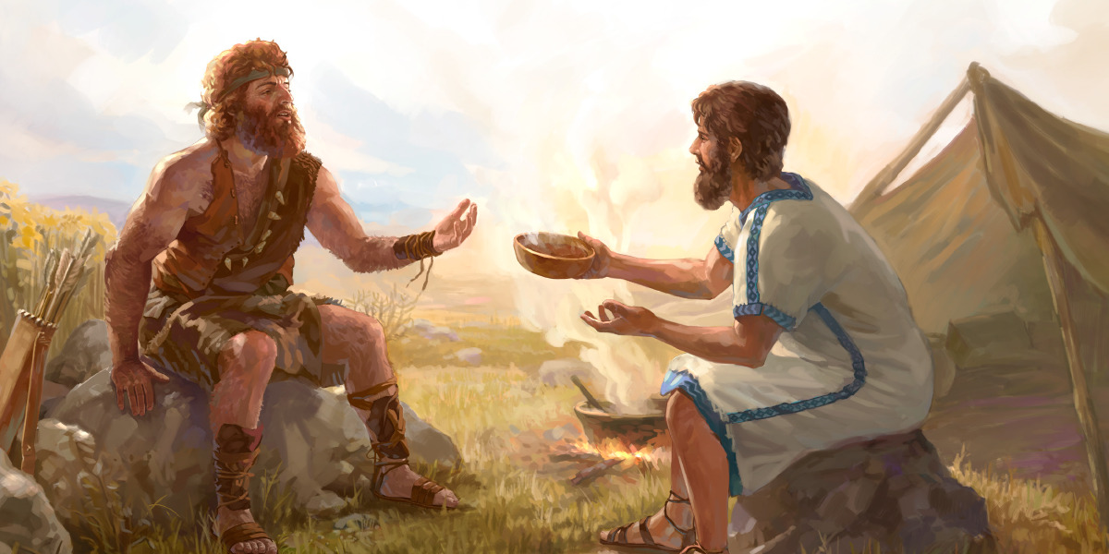
SHARING IN HIS HOLINESS
Our Heavenly Father Wants Us To Avoid The Failures of Esau.
Notes:
Choose Holiness, Not Bitterness
Choose Holiness, Not Immorality
Choose Holiness, Not Godlessness
Choose Holiness, Not Momentary Relief
Choose Holiness, NOW Is The Time…
Genesis 25…
²⁷ When the boys grew up, Esau became a skillful hunter, a man of the field, but Jacob was a ^{[s]}peaceful man, ^{[t]}living in tents. ²⁸ Now Isaac loved Esau, because ^{[u]}he had a taste for game, but Rebekah loved Jacob. ²⁹ When Jacob had cooked stew, Esau came in from the field and he was ^{[v]}famished; ³⁰ and Esau said to Jacob, “Please let me have a swallow of ^{[w]}that red stuff there, for I am ^{[x]}famished.” Therefore his name was called ^{[y]}Edom. ³¹ But Jacob said, “^{[z]}First sell me your birthright.” ³² Esau said, “Behold, I am about to die; so of what use then is the birthright to me?” ³³ And Jacob said, “^{[aa]}First swear to me”; so he swore to him, and sold his birthright to Jacob. ³⁴ Then Jacob gave Esau bread and lentil stew; and he ate and drank, and rose and went on his way. Thus Esau despised his birthright.
Genesis 27:30-41

Slide 15
Notes:
I Will Not Lose Heart Because…
Even In My Pain, God Is Creating An Opportunity.
Even In My Pain, God’s Love Is With Me.
Even In My Pain, There Is A Greater Reward.
Even In My Pain, My Savior Is Waiting For Me.

