Slide 1
Our Common Faith
A study of What Binds Us to God and to Each Other

Slide 2
Foundational Beliefs
Who God is (Nature of God)
Our personal accountability to God (Nature of Man)
How we learn of and from God (Revelation and Inspiration)
God’s plan in Christ (Jesus the Christ)
How we are saved (Salvation)
How we work together (The Church)
Promise of resurrection and eternal life (End Things)

Slide 3
Class Lesson Schedule
Date | Day | Class | Lesson | Title | Teacher
4/14/24 | Sun | 1 | 1 | Introduction – Nature of God | Russ
4/17/24 | Wed | 2 | 2 | The Nature of God | Sam
4/21/24 | Sun | 3 | 3 | The Nature of Man | Sam
4/24/24 | Wed | 4 | 4 | Revelation and Inspiration | Barry
4/28/24 | Sun | 5 | 4 | Revelation and Inspiration | Barry
5/1/24 | Wed | 6 | 5 | Jesus, the Christ – Identity and Promise | Russ
5/5/24 | Sun | 7 | 5 | Jesus, the Christ – Life and Purpose | Russ
5/8/24 | Wed | 8 | 5 | Jesus, the Christ – Resurrection and Rule | Russ
5/12/24 | Sun | 9 | 6 | Salvation | Russ
5/15/24 | Wed | 10 | 6 | Salvation | Russ
5/19/24 | Sun | 11 | 7 | The Church | Russ
5/22/24 | Wed | 12 | 7 | The Church | Russ
5/26/24 | Sun | 13 | 8 | End Things | Russ

Slide 4
God Has Spoken
What are some other ways God has “spoken”?
  Creation (Rom 1, Psalm 19)
  Dreams (Joseph, Daniel, Ezekiel,…)
  Fulfilled prophecy
  Angel of the Lord (Moses, Jacob, Abraham,…)
  Sinai’s thunder and lightening (Israel)
  Elijah and a still small voice
  Miracles (Egypt, Red Sea, manna, water, etc)
  Urim (I Samuel 28:6)

Slide 5
Prologue - Hebrews 1:1-4 (NASB)
The Preeminent Son – God’s Greatest Spokesman
God, after He spoke long ago to the fathers in the prophets in many portions and in many ways, ² in these last days has spoken to us in His Son,
Do we only need to focus on the words of Jesus (red letters)?

Slide 6
”However, when He, the Spirit of truth, has come, He will guide you into all truth; for He will not speak on His own authority, but whatever He hears He will speak; and He will tell you things to come. (John 16:13)
How Did Jesus Promise to Speak to His Apostles?
The Holy Spirit would speak “whatever He hears” from Jesus (vs 14)
He would guide them into “all truth.”
He would tell them things to come.

Slide 7
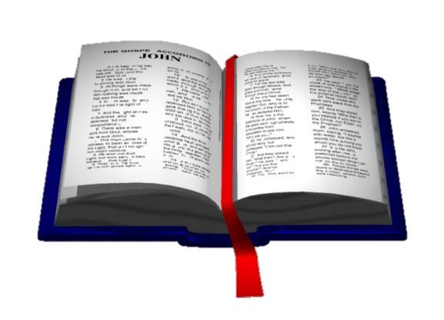
How is Jesus’ Will Transmitted?
Jesus
Truth
But the Helper, the Holy Spirit, whom the Father will send in My name, He will teach you all things, and bring to your remembrance all things that I said to you. (John 14:26)
...When He, the Spirit of truth, has come, He will guide you into all truth; for He will not speak on His own authority, but whatever He hears He will speak.
(John 16:13)
Holy Spirit
Apostles
Spoke & Wrote
Disciples

Slide 8
“Prophecy never came by the will of man, but holy men of God spoke as they were moved* by the Holy Spirit.” (2 Peter 1:21)
Prophecy Was of God’s Spirit
*Carried along (ESV)
Prophecy was not the product of man’s will.
The prophets were “carried along by the Holy Spirit.”
Note Hebrews 3:7 - Therefore, just as the Holy Spirit says, “TODAY IF YOU HEAR HIS VOICE, (quotes Psalm 95:7-11)

Slide 9
All Scripture is inspired by God and profitable for teaching, for reproof, for correction, for training in righteousness; so that the man of God may be adequate for every good work” (2 Tim 3:16-17- NAS)
The Source of Scripture
theopneustos – “God-breathed”
“complete” (ESV, NKJV)
All scripture is “breathed by God.” cf Gen. 2:7 - breathed into his nostrils the breath of life; and man became a living being., Ezekiel 37 – God’s breath Spirit) works through the prophet’s word to bring life
Includes OT and NT, much of which had been written and circulated at the time of this writing
All scripture is profitable for teaching, reproof (tests and convicts of sinfulness), correction (what to do in order make right whatever is wrong before God), and instruction in righteousness. (All Sufficient)
With scripture the man of God is “complete, thoroughly equipped for every good work.”
Peter designated Paul’s writing as scripture (See 2 Peter 3:15-16)

Slide 10
”But even if we, or an angel from heaven, preach any other gospel to you than what we have preached to you, let him be accursed. ⁹ As we have said before, so now I say again, if anyone preaches any other gospel to you than what you have received, let him be accursed.” (Galatians 1:8-9)
Any Other is Not Authorized
The teaching of the apostles was truth and anything that contradicted it was false.
If any man or angel teaches anything different, he is accursed.

Slide 11
“Beloved, while I was very diligent to write to you concerning our common salvation, I found it necessary to write to you exhorting you to contend earnestly for the faith which was once for all delivered to the saints.” (Jude 3)
“Once For All”
Notes:
"The Faith" refers to the body of revealed truth. John's epistles, and II Peter are "review," rather than first-time revelation. These words are inspired and authoritative (see II Pet 1:21; 3:15-16), but are primarily reminders/warnings to those who already knew all they needed.

Slide 12
”Heaven and earth will pass away, but My words will by no means pass away.” (Matthew 24:35)
Permanence of God’s Word
“All flesh is like grass,
And all its glory like the flower of grass.
The grass withers,
And the flower falls off,
²⁵ But the word of the Lord endures forever.”
And this is the word which was preached to you.
(1 Peter 1:24-25)
How permanent did God intend His word to be?
Do we doubt His ability to preserve it?
What does this indicate about modern questions regarding the dependability of our text?

Slide 13
Summary
God speaks to us today through His Son.
The Son sent the Holy Spirit to His apostles to reveal His will and to inspire the words in which they should deliver.
They would be guided into “all truth.”
The scriptures are the words they wrote.
The scriptures are sufficient for our needs.
Nothing was to be added to the scriptures.
God intended that His word will not pass away.
Therefore it is:
True (respecting its intention and context)
Inerrant (despite transmission imperfections)

Slide 14
Foundational Assumptions
What we believe matters, to be acceptable to God (Heb 11:6)
God has revealed all that we need to know in the Bible (II Tim 3:17)
The Bible is inspired and is the final source of truth (II Tim 3:16)
Some doctrines are essential for acceptance by God, and for unity
It is possible to determine truth on essential doctrines (John 7:17)
What we believe will be expressed in our behavior
We may disagree on many unessential things
Some things cannot be known (Is 55:8-9, Deut 29:29)

Slide 15
The living voice of the church (tradition) has equal authority with the Scriptures.

Slide 16
The living voice of the church (tradition) has equal authority with the Scriptures.
CATECHISM OF THE CATHOLIC CHURCH (CHAPTER TWO / ARTICLE 2)
THE TRANSMISSION OF DIVINE REVELATION
77 "In order that the full and living Gospel might always be preserved in the Church the apostles left bishops as their successors. They gave them their own position of teaching authority." Indeed, "the apostolic preaching, which is expressed in a special way in the inspired books, was to be preserved in a continuous line of succession until the end of time."
78 This living transmission, accomplished in the Holy Spirit, is called Tradition, since it is distinct from Sacred Scripture, though closely connected to it. "The sayings of the holy Fathers are a witness to the life-giving presence of this Tradition, showing how its riches are poured out in the practice and life of the Church, in her belief and her prayer.". .

Slide 17
The living voice of the church (tradition) has equal authority with the Scriptures.
II. THE RELATIONSHIP BETWEEN TRADITION AND SACRED SCRIPTURE
81 "Sacred Scripture is the speech of God as it is put down in writing under the breath of the Holy Spirit."
"And [Holy] Tradition transmits in its entirety the Word of God which has been entrusted to the apostles by Christ the Lord and the Holy Spirit. It transmits it to the successors of the apostles so that, enlightened by the Spirit of truth, they may faithfully preserve, expound and spread it abroad by their preaching."
82 As a result the Church, to whom the transmission and interpretation of Revelation is entrusted, "does not derive her certainty about all revealed truths from the holy Scriptures alone. Both Scripture and Tradition must be accepted and honored with equal sentiments of devotion and reverence."

Slide 18
The living voice of the church (tradition) has equal authority with the Scriptures.
“the Spirit of truth, has come, He will guide you into all truth” (John 16:13)
“But even if we, or an angel from heaven, preach any other gospel to you than what we have preached to you, let him be accursed” (Gal. 1:8)
All Scripture is given by inspiration of God…, ¹⁷ that the man of God may be complete (2 Tim 3:16-17)
“The faith” was “once for all delivered” (Jude 3)
Where did Jesus provide for continuing revelation?

Slide 19
The Holy Spirit guides Church councils today as they create or amend denominational creeds.
“the Spirit of truth, has come, He will guide you into all truth” (John 16:13)
“But even if we, or an angel from heaven, preach any other gospel to you than what we have preached to you, let him be accursed” (Gal. 1:8)
All Scripture is given by inspiration of God…, ¹⁷ that the man of God may be complete (2 Tim 3:16-17)
Which one is H.S. guided? Why do they differ?

Slide 20
The Holy Spirit leads individuals today through an inner voice we can hear as we pray.
HOW TO RECOGNIZE THE VOICE OF GOD THROUGH THE INWARD WITNESS
Intuition — the ability to understand something instantly without the need for conscious reasoning (an inner knowing).
Ex: Mothers often have intuition as it relates to their children. They don’t always know the details offhand, but they may have a feeling that “hmmm, something isn’t right here.”
Prompting — a gentle nudge to do something; a fleeting thought.
Ex. The thought may be that someone or something “crosses your mind” out of nowhere. Or you get an urge out of the blue to call and “check on so-and-so.” Or that you’re supposed to do something in particular.
Check — feeling of uneasiness or restraint; gnawing discomfort you cannot explain; feeling something is not right; this is a brake pedal or red light in your spirit; you have a loss of peace.
Ex: Everything naturally looks great. It’s exactly what you want. You’re at the car dealership & the car is the color and price you wanted, but for “some reason internally,” you feel uneasy about this particular deal.
Abiding Peace — restful feeling; sense of release; quiet assurance; deep sense of security, this is a gas pedal or green light in your spirit.
Ex: You walk in a house and feel in your spirit that this is a “go” and “yes” to buy it. You ask God about a certain upcoming decision and you feel restful and assured about it. No nagging hesitations.
Desires — God changes, intensifies, and downloads new desires in our hearts. Philippians 2:13; Psalm 37:4
Most of your desires are God’s desires.

Slide 21
The Holy Spirit leads individuals today through an inner voice we can hear as we pray.
Most everything in God comes down to hearing His voice. That is why the doctrine that says that God does not speak today is so insidious and dangerous. It attacks the very heart of our walk with God. If God does not speak then faith, specific obedience, and His direct involvement in our lives all falls apart. Faith, the Bible says, comes from hearing, and hearing comes from someone speaking, and that Someone is God.
So then faith comes by hearing, and hearing by the (spoken) word of Christ. Rom. 10:17
It is not a hearing of the mind, nor it is of the intellect. This kind of hearing does not come from reading. It does not come from someone else speaking – even if they are speaking from the written word of God. It comes directly from Christ Himself. Jesus told us that He would speak to us through the Holy Spirit, and that is exactly what it is. This word and this hearing are the basis of faith.
Hearing from God is more of an art than a science
Comment Section
Penny - The Holy Spirit is not the author of confusion. The Holy Spirit guides you into all truth. Just because someone has an experience sees a vision hears a voice or has a feeling does not mean it came from God. The Bible is very clear on Truth, take your experience to the Bible and see if it aligns with it or if it contradicts.
Jason Hawkins - It was probably the devil bro, honestly

Slide 22
Do inner promptings reveal God’s will?
“Impressions could be produced by any number of sources: God, Satan, an angel, a demon, human emotions (such as fear or ecstasy), hormonal imbalance, insomnia, medication, or an upset stomach. (Gary Friesen)
It is interesting in this connection that when Jesus told His disciples that He would send the Holy Spirit and that the Spirit would lead them into all truth, He said, `He will teach you all things, and bring to your remembrance all that I said to you’ (John 14:26). Here the leading is bringing to mind Jesus’ statements. (Arthur Johnson)
“Scripture never commands us to tune into any inner voice. We’re commanded to study and meditate on Scripture (Joshua 1:8; Ps. 1:1-2). We’re instructed to cultivate wisdom and discernment (Prov. 4:5-8). We’re told to walk wisely and make the most of our time (Eph. 5:15-16). We’re ordered to be obedient to God’s commands (Deut. 28:1-2; Jn. 15:14). But we are never encouraged to listen for inner promptings. (J MacArthur)

Slide 23
The Holy Spirit leads individuals today through an inner voice we can hear as we pray.
All the scriptures above apply, especially 2 Timothy 3:16-17.
God has never directed His servants by frequent inner voices.
We show ourselves “approved unto God” by “handling aright the word of truth” (1 Tim. 3:15).
Prayer is talking to God, not hearing God.
How do we know the inner voice is God’s?

Slide 24
The Bible contains many mistakes due to the mistakes of copiers.
The Lord promised: “My words will be no means pass away.” (Matt. 24:35)
If He revealed His will and inspired the words, is it reasonable that He would fail to protect it?
Copyists doubtless made some mistakes, but the multitude of manuscripts enable us to correct them. None affect essential doctrine.

Slide 25
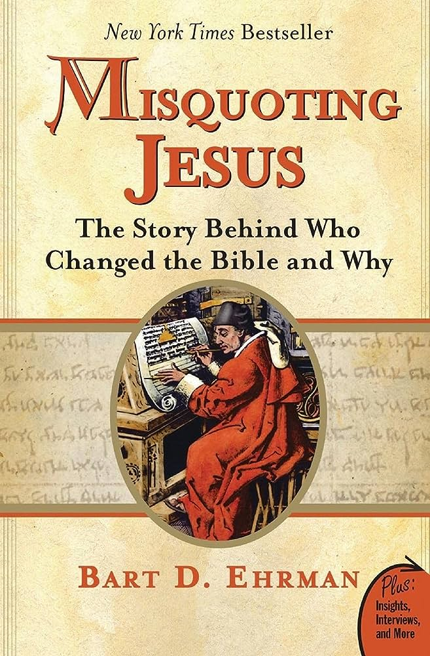
In 2006, a best-selling book challenged the reliability of the text of the Gospels.
Most slides from John Weaver’s Lessons in 2008 on The Historical Reliability of the Biblical Text and The Hidden Gospels
“This is a book about ancient manuscripts of the New Testament and the difference found in them, about scribes who copied scripture and sometimes changed it.” (pg. 1)

Slide 26
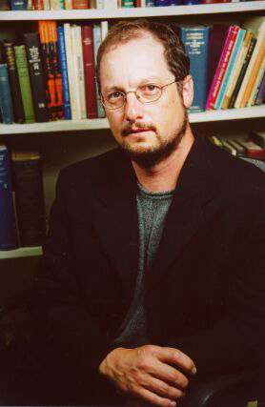
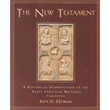
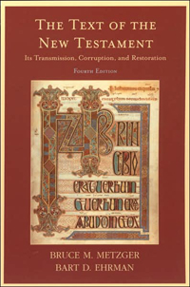
The author of Misquoting Jesus is Bart Ehrman
Distinguished Professor and Chair of Religious Studies Department at University of North Carolina, Chapel Hill
Ph.D., Princeton Theological Seminary
M.Div., Princeton Theological Seminary
B.A., Wheaton College
Diploma Moody Bible Institute

Slide 27
The book has the potential to weakening the faith of some Christians
“Please help me. I have just read Bart Ehrman’s book Misquoting Jesus. I was raised in the church and I’m now 26 years old. The book has devastated my faith. I don’t want to be kept in the dark; I want to know what really is going on in the Bible and what I should believe, even if it goes against what I’ve believed since I was a little boy. Is Ehrman correct?”
(Lee Strobel, The Case for the Real Jesus, 69)

Slide 28
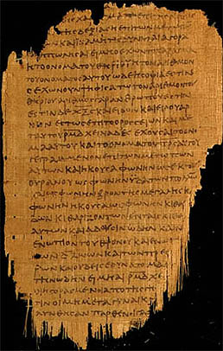
Misleading Claim #1:
The manuscripts of the New Testament are late and leave us in doubt
TO THE CONTRARY:
1. Many important manuscripts survive from 1-2 hundred years after of the completion of the New Testament

Slide 29
How many years (x) before our first extant manuscripts?
X = 75 years!
Autograph (No longer extant)
Earliest Manuscript Copy
Modern version
X
The earliest copies appear approximately 75 years after the writing of the New Testament.

Slide 30
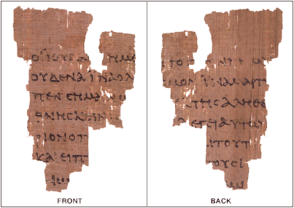
Many important manuscripts have early dates
For example:
  John Ryland fragment (117-138 A.D.) – John 18:31-33, in Greek, and the back contains lines from verses 37-38
  Bodmer Papyrus (150-200 A.D. ) - whole books
  Chester Beatty Papyri (250 A.D.) - most of the N.T.
  Codex Vaticanus (325-350 A.D.) - nearly all the Bible

Slide 31
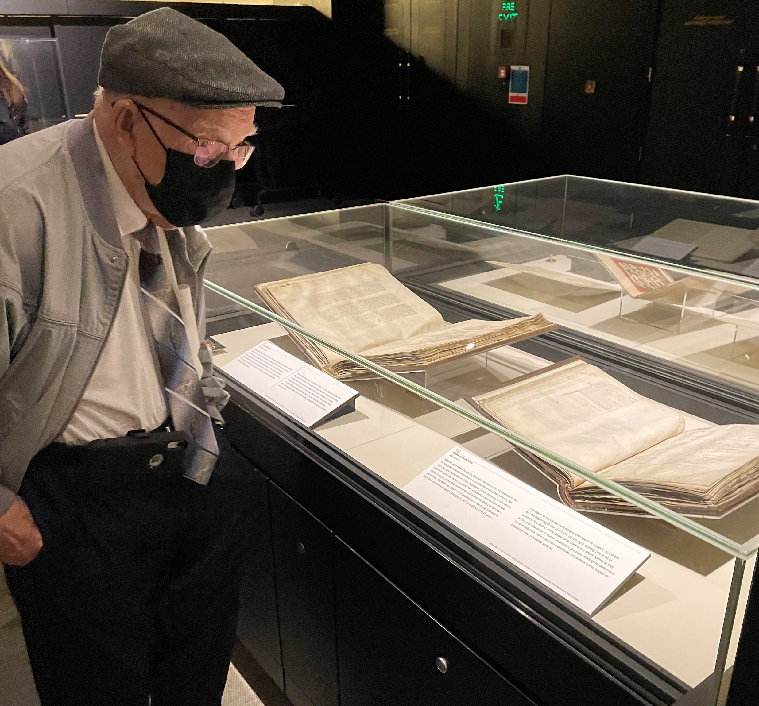
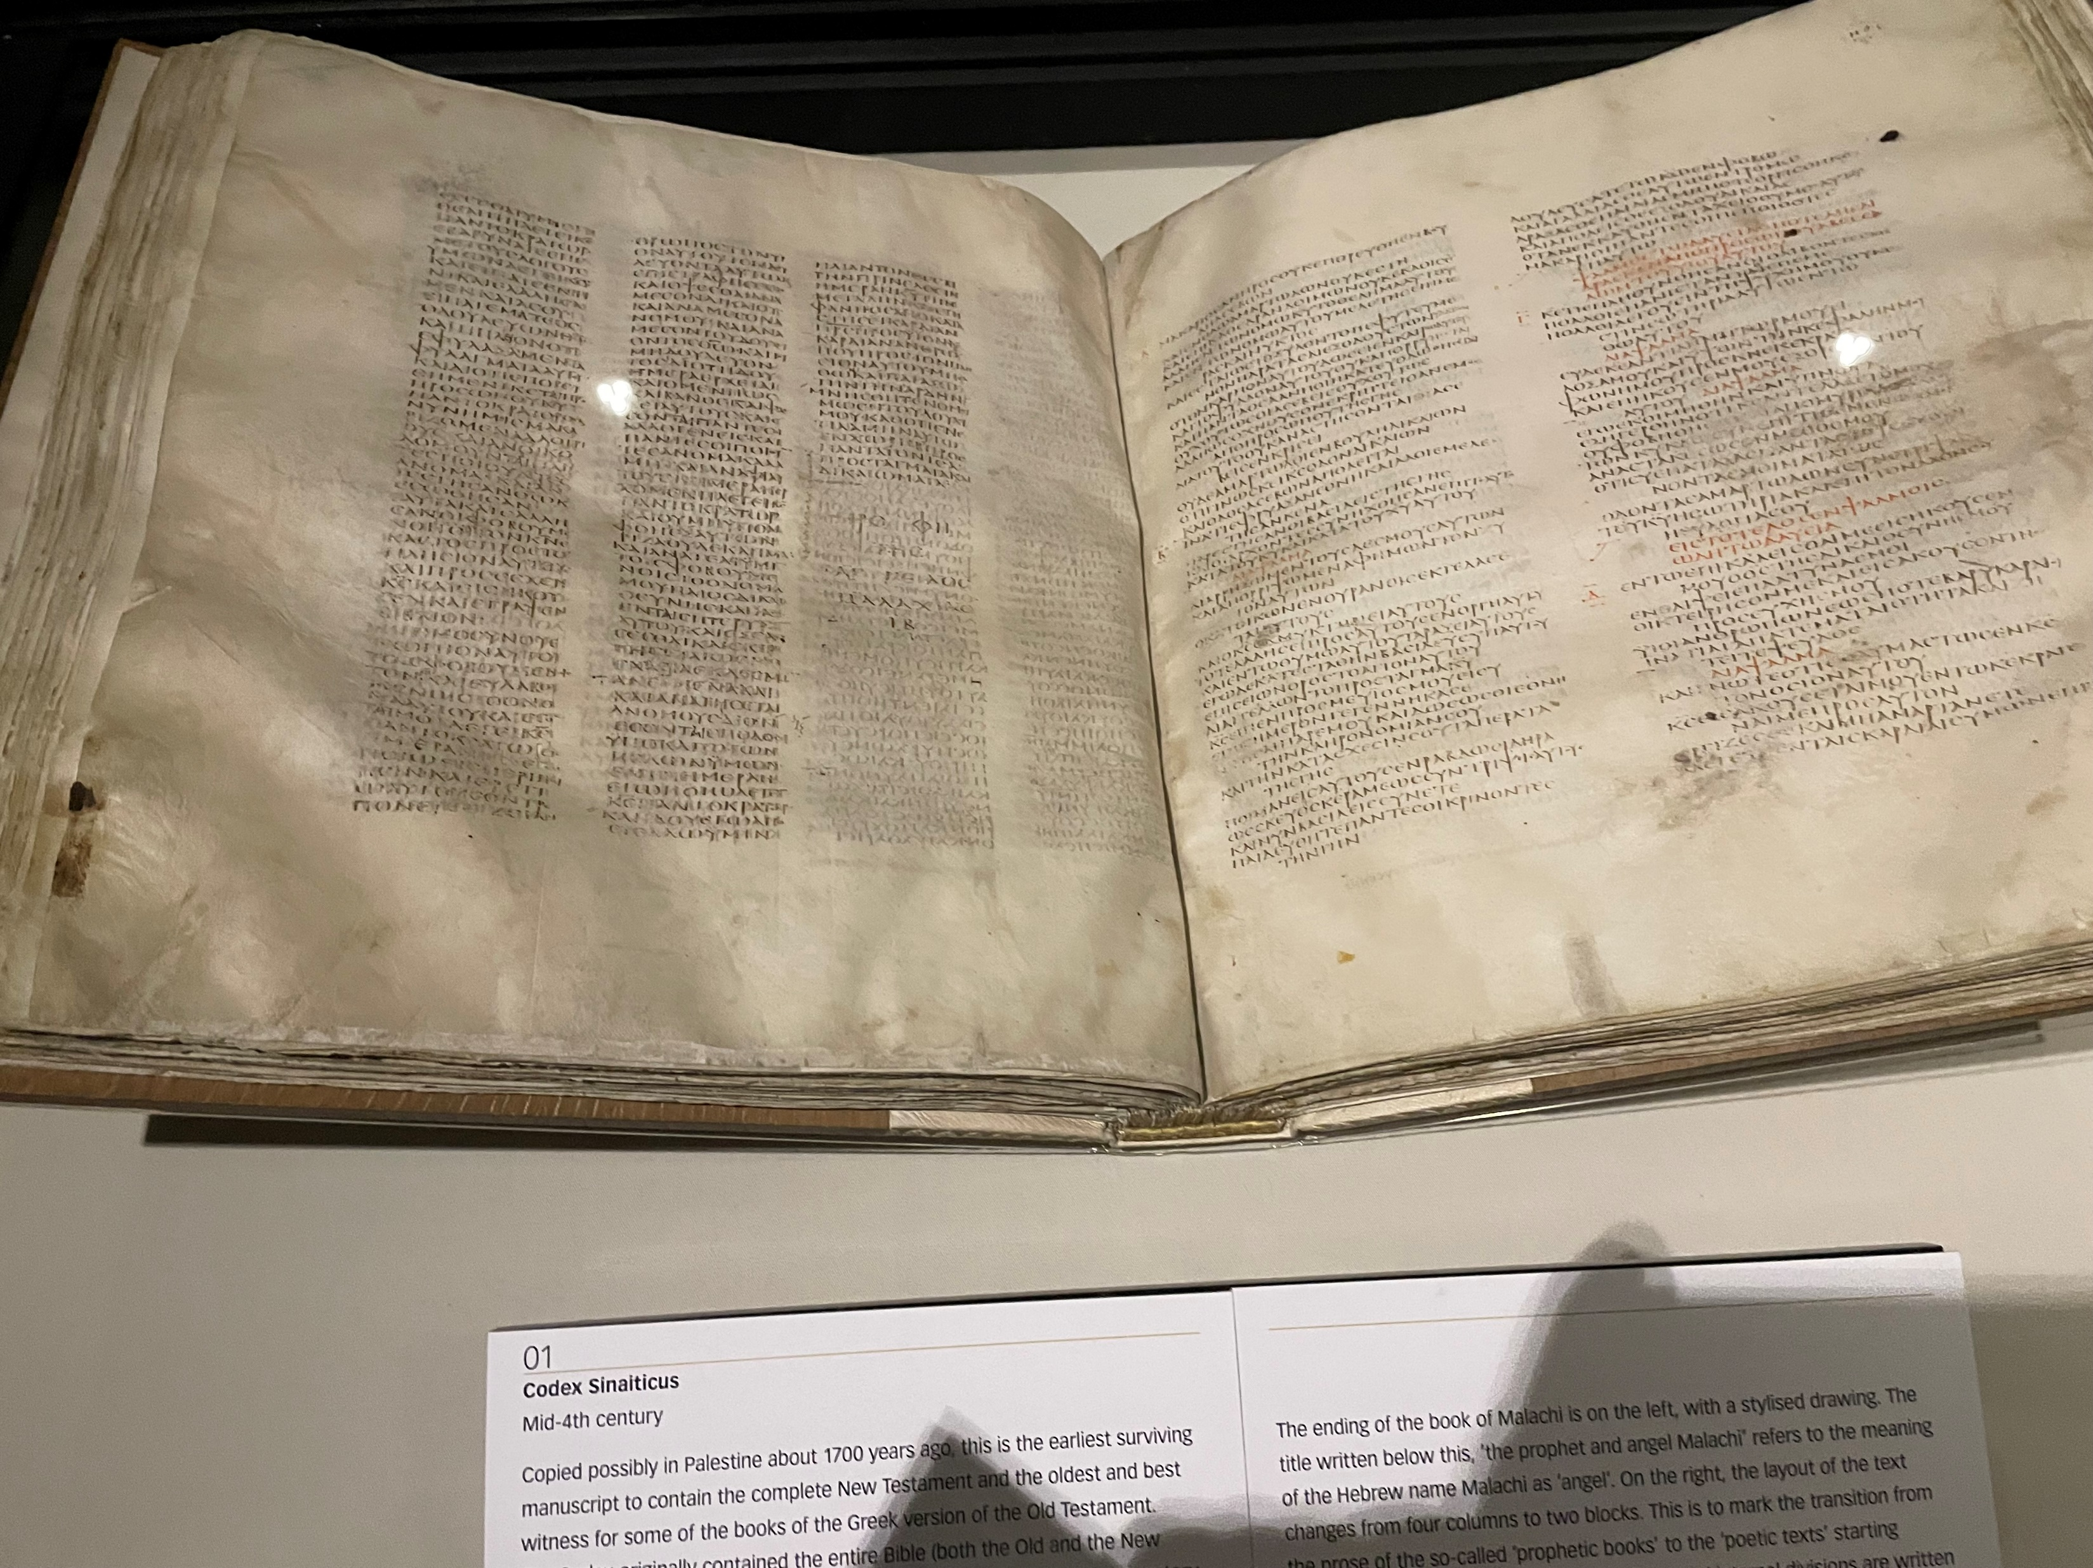
First Complete Manuscript of New Testament
Sinaiticus
Alexandrinus
British Library
Codex Sinaiticus, 330 AD
Sinaiticus - Contains half of the Old Testament books and all the N.T. except a few verses such as Mark 16:9-20 and Jn. 7:53-8:11.
Codex Alexandrinus – a 5th century manuscript containing the majority of the Septuagint (Greek Translation of OT) and the New Testament. Given to King Charles I of England in 1627
Notes:
We have four manuscripts—and only four manuscripts—from the first millennium that were originally whole Bibles: Codex Sinaiticus, Codex Vaticanus, Codex Alexandrinus, and Codex Ephraemi Rescriptus.
Codex Alexandrinus was originally from the city of Alexandria in modern-day Egypt before it was brought to Constantinople. From there, Alexandrinus was given to the King of England in 1627 by Cyril Lucaris, the patriarch of Constantinople. Cyril gave it to the king because he was Reformed, and he sympathized with the Calvinist movement in England. In fact, this happened 16 years after the King James Bible had been published.

Slide 32
The original New Testament writings may have existed as late as 330 AD
“Come now, you who would indulge a better curiosity; if you would apply it to the business of salvation, run over to the apostolic churches, in which the very thrones of the apostles are still pre-eminent in their places, in which their authentic writings are read, uttering the voice and representing the face of each of them severally.”
(Tertullian, Prescription against Heretics, 36)
Notes:
Around 330 – church leader Tertullian. There may have been the authentic writings of the apostles around at 330. These writing could have been copies of the autographs

Slide 33
Misleading Claim #1:
The manuscripts of the New Testament are late and leave us in doubt
TO THE CONTRARY:
1. Many important manuscripts survive from 1-2 hundred years after the completion of the New Testament
The New Testament manuscripts stand closer to the original and are more plentiful than any other ancient literature.

Slide 34
The manuscript evidence for the New Testament is greater than any other ancient text
Author
Book
Written
Earliest Copy
(X)
Caesar
Gallic Wars
100 – 44 BC
c. 900 AD
1000 yrs
Plato
400 BC
c. 900 AD
c. 1300 yrs
Tacitus
Annals
100 AD
c. 1100 AD
c. 1000 yrs
Pliny
Natural History
61 – 133 AD
c. 850 AD
c. 750 yrs
Thucydides
History
460 – 400 BC
c. 900 BC
c. 1300 yrs
Herodotus
History
480 – 425 BC
c. 900 AD
c. 1350 yrs
Homer
Iliad
800 BC
c. 400 BC
c. 400 yrs
New Testament
50 – 100 AD
c. 114 fragments
c. 200 books
c. 250 most of NT
c. 325 complete NT
25-50 yrs
100 yrs
150 yrs
225 yrs
Notes:
Classics of the ancient world. NT is not subpar. NT has the best evidence

Slide 35
1000 times as many manuscripts as the average classical author
Author
Book
(X)
Copies
We have copies of copies (manuscripts)
36,000* manuscripts and fragments of OT
20,000* manuscripts and fragments of NT
Most NT MSS from 1000+ yrs after first writing
1000 NT MSS (in Greek) before 1000 AD
Average work of antiquity has 15 manuscripts
Caesar
Gallic Wars
1000 yrs
10
Plato
c. 1300 yrs
7
Tacitus
Annals
c. 1000 yrs
3
Pliny
Natural History
c. 750 yrs
7
Thucydidies
History
c. 1300 yrs
20
Herodotus
History
c. 1350 yrs
75
Homer
Iliad
c. 400 yrs
643
New Testament
50 yrs
100 yrs
150 yrs
225 yrs
>5600 Greek MSS
From: Komoszewski, Reinventing Jesus, page 71
Notes:
There are approximately 5,800 Greek manuscripts of the New Testament. In addition, there are 10,000 Latin manuscripts, and 9,300 manuscripts in other languages.
The New Testament was written in first century A.D. There are some 25,000 early manuscripts in existence, almost 6,000 of which (many being only recognizable fragments) are Greek texts and the others being early translations of the Greek New Testament. The earliest textual evidence we have was copied not long after the original. In contrast:
Caesar’s Gallic Wars was written in the first century B.C. There are only 10 manuscripts in existence. The earliest textual evidence we have was copied 1,000 years after the original.
Aristotle’s Poetics was written in the fourth century B.C. There are only 5 manuscripts in existence. The earliest textual evidence we have was copied 1,400 years after the original.
There are many more writings of the Church Fathers quoting sections of Scripture; we could reconstruct the entire New Testament from their writings alone. There were millions of man-hours spent in cross-checking the manuscripts. There remains only 1 percent of all New Testament words about which questions still exist; no questionable passage contradicts any Bible teaching.
The Old Testament has been more accurately transmitted to us than any other ancient writing of comparable age. The textual evidence is greater for both the Old and New Testaments than any other historically reliable ancient document. The ancient scribes were very meticulous. There were only 1,200 variant readings in A.D. 500.
The Masorites produced an official text in A.D. 500. There are other versions that confirm the accuracy of the Masoritic Text.
Samaritan Pentateuch: 400 B.C.
Septuagint Greek: 280 B.C.
Dead Sea Scrolls: 0 A.D.
Latin Vulgate: 400 A.D.
The quotations from pre-Christian writing confirm the text. The New Testament accepts the Old Testament as authentic, confirming the traditional authors, quoting from at least 320 different passages, and confirming the supernatural events cited in the Old Testament.

Slide 36

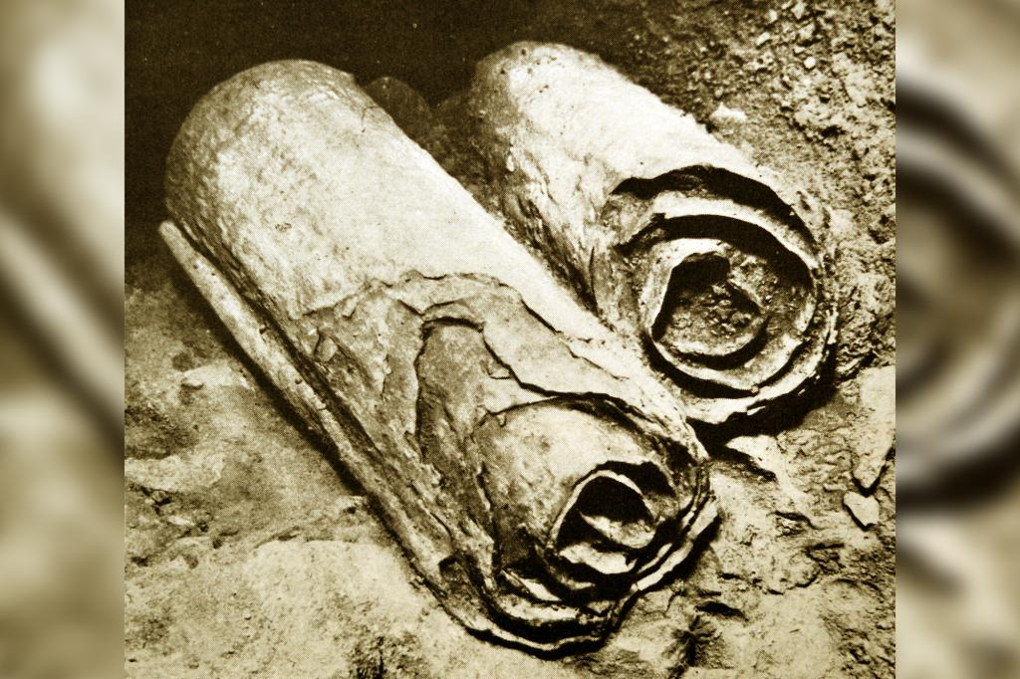
Our OT based on MSS from around 1000 AD
Dead Sea Scrolls (discovered 1946)
Contained all OT books (but Esther)
Texts from 3rd cen. BC to 1st cen. AD
Provides MSS of Messianic texts before Jesus’ life (Ps.22, Is.53, etc.)

Slide 37
Misleading Claim #2:
There is a massive number of differences in the wording of the manuscripts
Variant = any place among the manuscripts in which there is variation in wording, including word order, omission or addition of words, spelling differences
However:
There is a large number of variants (>1 million variants in NT manuscripts) because there is a large number of manuscripts
The vast majority of variants are spelling differences or otherwise insignificant
Less than one percent (1%) of variants change the meaning of the text to some degree
‘Meaningful’ variants don’t change doctrine
Examples of potential Scribal changes are mostly insignificant changes and don’t change the meaning of the text. Three potentially significant changes are well known and indicated in Bibles. John 7:53-8:12, Mark 16:9-20 and I John 5:7-8. Even if they are scribal additions, no doctrine is affected.
Notes:
Church fathers writings and manuscripts A textual variant is any place among the manuscripts in which there is variation in wording, including word order, omission or addition of words, even spelling differences.
John 7:53 - 8:12 – The Woman Taken in Adultery
Mark 16:9-20 – The Post-Resurrection appearances of Jesus
1 John 5:7-8 – The testimony of the Father, the Word, and the Holy Spirit
The text of these are not in the earliest and best manuscripts that we have. They were retained in most bibles because they were in the King James version.

Slide 38
Example of a “meaningful” variant
Romans 5:1
“We have peace” (echomen)
“Let us have peace” (echōmen)
Notes:
Having been justified by faith, we have peace
One variant – changes one letter in the Greek changes it to Let us have peace. This is one of a few examples where a variant reading would change a little bit the meaning of the text. This is one of 10 examples Erhman sites. In each instance of a variant reading being meaningful, except for three, the meaning is insignificantly changed.

Slide 39
Examples of ‘Meaningful’ Variants in the NT
Mark 9:29 (ESV)
And he said to them, “This kind cannot be driven out by anything but prayer.”^{[e]}
[e] Some manuscripts add “and fasting”
1 John 1:4 (ESV)
And we are writing these things so that our^{[a]} joy may be complete.
[a] Some manuscripts “your”
The evidence—in quantity and quality—is resounding that the original text of the OT and NT has been faithfully transmitted.

Slide 40

There are additional books that should be in our Bible.
OT Apocrypha (Hidden) / Deuterocanonical (second canon) books.
46 OT books in Catholic Bible
Historical Books
  Tobit
  Judith
  1-2 Maccabees
Poetic Books
  Wisdom of Solomon
  Sirach (Ecclesiasticus)
Prophetic Books
  Baruch
Additions to Esther & Daniel

Slide 41
There are additional books that should be in our Bible.
Some NT Apocrypha Gospels
Judas
Thomas
Peter
Philip
Mary
the Ebionites
the Nazorean
the Hebrews
the Egyptians
Notes:
Since the Jews had the Hebrew canon intact without question and Jesus affirmed that canon while on the earth, why does the Catholic Bible have more than the 39 books of the Old Testament regarded as inspired? There are a few reasons why the Roman Catholics include other books.
The writings called Tobit, Judith, 1 & 2 Maccabees, Wisdom, Sirach, and Baruch, as well as other additions to the canonical book of Esther and the canonical book of Daniel (The Prayer of Azariah, Susanna, Bel and the Dragon) have been called “deuterocanonical” books. “Deutero” means “second” and therefore these books are the second canon.
These writings were found in the Septuagint, which is the Greek translation of the Old Testament. The Septuagint was commonly used and quoted by the Jews in the first century and is quoted from in our New Testament. The Roman Catholic church argued that since these books were in the Septuagint, they are inspired and ought to be in our Bibles
However, this is fallacious thinking. Is everything in your Bible inspired? No, we have maps, study guides, charts, commentaries, and even our own writings in the margins. Literature would be found in one codex for transporting ease. Additional writings do not demand that everyone accepted these writings as inspired. Further, our copies of the Septuagint only date to the 5 th century, so we do not know if these books were in their Greek translation or not.
The most condemning evidence in my mind, however, is that these books were not regarded as canonical until the Roman Catholic deemed them inspired at the Council of Trent in 1546. We see no acceptance of these books by the Christian church in at least the first four centuries. Many Roman Catholic scholars through the reformation rejected these books
A simple reading of these additional books helps us to clearly see that these books are not inspired. Consider the ending to 2 Maccabees: “Author’s Apology. Since Nicanor’s doings ended in this way, with the city remaining in possession of the Hebrews from that time on, I will bring my own story to an end here too. If it is well written and to the point, that is what I wanted; if it is poorly done and mediocre, that is the best I could do. Just as it is harmful to drink wine alone or water alone, whereas mixing wine with water makes a more pleasant drink that increases delight, so a skillfully composed story delights the ears of those who read the work. Let this, then, be the end” (15:37-39). One can see that the book does not even claim inspiration but has an ending similar to the Book of Mormon’s beginning title page.
One inherent problem is that the Catholic church teaches that they are able to set the canon of the scriptures. This teaching has given rise to the DaVinci Code book which makes claims that the Catholic church has suppressed the truth concerning Jesus and suppressed many undesirable writings. Of course, this assumes that the Roman Catholic church had control of the New Testament canon and was in existence from the very start, both of which are not true and not provable. So let us consider the New Testament canon.

Slide 42
There are additional books that should be in our Bible.
The Lord promised: “My words will be no means pass away.” (Matt. 24:35)
God would not allow His word to be lost.
All books that people claim should have a place in the New Testament were written after the apostles died. The Apostles were guided into “all truth.”
No other books compare with the N.T.

Slide 43
Why The OT Apocrypha is Rejected
They were never included in the Hebrew canon by the Jews
They were rejected by Jewish and Christian writers in the early centuries of Christianity
They do not bear intrinsic qualities of inspiration: historical, chronological and geographical accuracy
They have been shrouded with continual uncertainty
They cannot be made canonical by a ruling of the Council of Trent (1546)
Written between the Testaments
Notes:
Apocrypha books first appeared in a Greek translation of the Old Testament called the Septuagint (LXX). The Septuagint was produced in Alexandria, Egypt, around 200 BC, but the individual books that constitute the Apocrypha were written roughly between 400 BC and AD 1.
The Septuagint was used and quoted by the Jews in the first century and is quoted from in our New Testament. The Roman Catholic church argued that since these books were in the Septuagint, they are inspired and ought to be in our Bibles
These books were not regarded as canonical until the Roman Catholic church deemed them inspired at the Council of Trent in 1546. We see no acceptance of these books by the Christian church in at least the first four centuries.
Many Roman Catholic scholars through the reformation rejected these

Slide 44
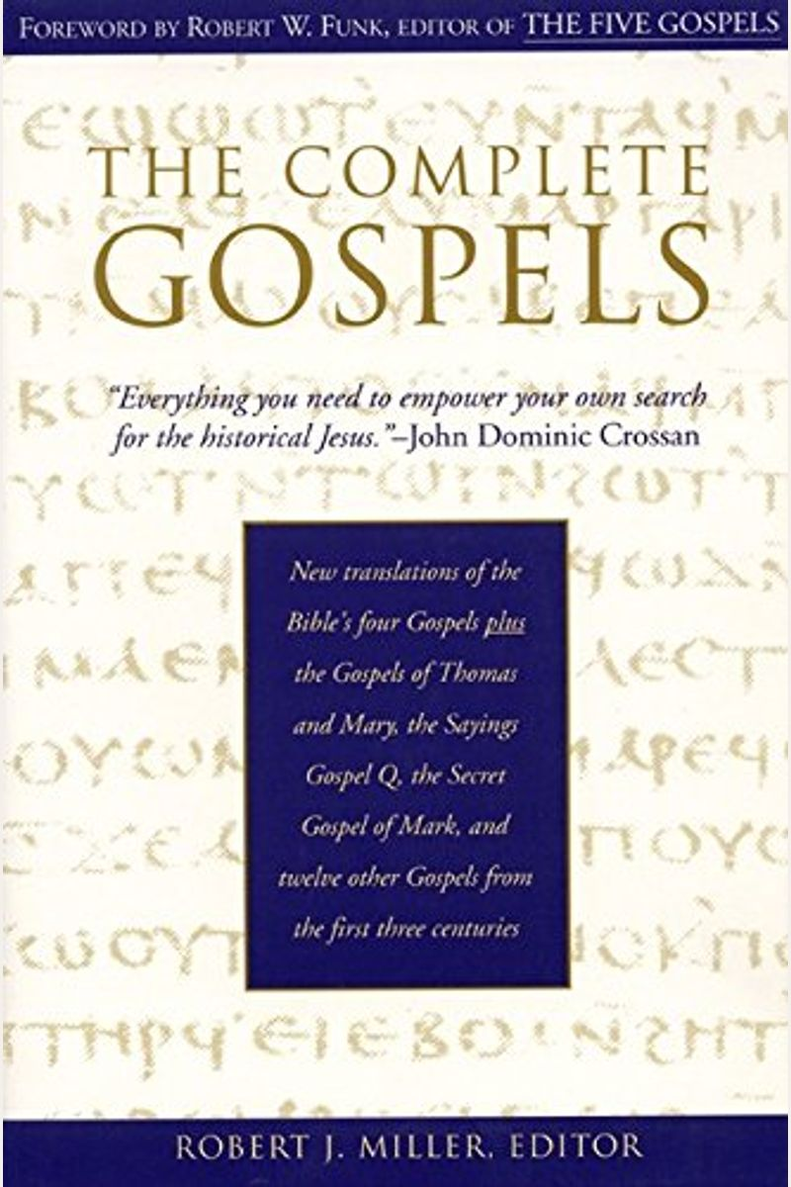
The “Hidden” Gospels:
Are There Other Gospels That Should Be in the Bible?
New translations of the Bible’s four Gospels plus the Gospels Of Thomas and Mary, the Sayings, Gospel Q, the Secret Gospel Of Mark, and twelve other Gospels from the first three centuries
Notes:
In 1945, in Nag Hammadi, Egypt, a group of writings were discovered that have come to be known as the “Gnostic gospels.” They have been dated as early as the 2nd century

Slide 45
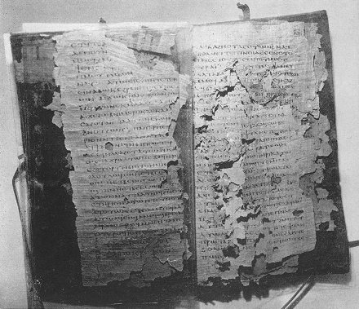
Scholars claim that the four NT Gospels are a “small selection”
“For nearly 2,000 years, most people assumed that the only sources of tradition about Jesus and his disciples were the four Gospels in the New Testament. But the unexpected discovery at Nag Hammadi in 1945 of more than 50 ancient Christian texts proved what church fathers said long ago: that Matthew, Mark, Luke, and John are only a small selection of gospels from among the dozens that circulated among early Christian groups . . .
- Dr. Elaine Pagels, “The Gospel Truth,” The New York Times, April 8, 2006.

Slide 46
The Gospel of Judas shows that early Christianity was diverse
“What is clear is that the Gospel of Judas has joined the other spectacular discoveries that are exploding the myth of a monolithic Christianity and showing how diverse and fascinating the early Christian movement really was.”
- Dr. Elaine Pagels, “The Gospel Truth,” The New York Times, April 8, 2006.

Slide 47
What is different about these Gospels?
Many of these Gospels are “Gnostic”
Gnosticism is a set of beliefs and practices in which some people have inside knowledge about the faith.
  The main insight is that the spirit lives and returns to heaven as light.
Gnostics know that the spirit is good; physical world is evil.
  there is no resurrection of the body and little emphasis on morality and community.
Jesus is a revealer of esoteric knowledge and divine mysteries, but is not divine.
The NT attests to late 1st century false teachers known as Gnostics, whom Paul, John, and Peter condemned. These same apostles even speak of their spurious writings which they tried to claim came from the apostles (Galatians, 2 Corinthians, 2 Thessalonians, 1, 2, 3 John).
Notes:
the NT itself attests to late 1st century false teachers known as Gnostics, whom Paul, John, and Peter condemned. These same apostles even speak of their spurious writings which they tried to claim came from the apostles (Galatians, 2 Corinthians, 2 Thessalonians, 1, 2, 3 John).
47

Slide 48
What is different about these Gospels?
According to the Gospel of Thomas, Jesus:
    Performs no miracles
    Speaks no prophecies
    Does not die for anyone’s sins
    Does not accept faith in himself
    Salvation based on knowledge of secret teaching
First Lines in Gospel of Thomas:
“These are the secret sayings that the living Jesus spoke and Didymos Judas Thomas recorded.”
“And [Jesus] said, "Whoever discovers the interpretation of these sayings will not taste death."

Slide 49
What is different about these Gospels?
According to the Gospel of Judas:
  The Creator of the World is not the one true God
  The World was created as an evil place to be escaped
  Jesus Christ is not the son of the creator
  Salvation does not come through death and resurrection of Jesus
  Salvation comes through the revelation of secret knowledge Jesus provides
  Judas Iscariot is the hero of the Gospel, exalted and transported to heaven.

Slide 50
Judas has special insight
‘… Judas [said] to [Jesus], “I know who you are and where you have come from. You are from the immortal realm of Barbelo. And I am not worthy to utter the name of the one who has sent you.”’
“Knowing that Judas was reflecting on something that was exalted, Jesus said to him, “Step away from the others and I shall tell you the mysteries of the kingdom.”
Notes:
50

Slide 51
Three key facts about these “Hidden, Early Christian Gospels”
They were not “hidden” (not unknown)

Slide 52
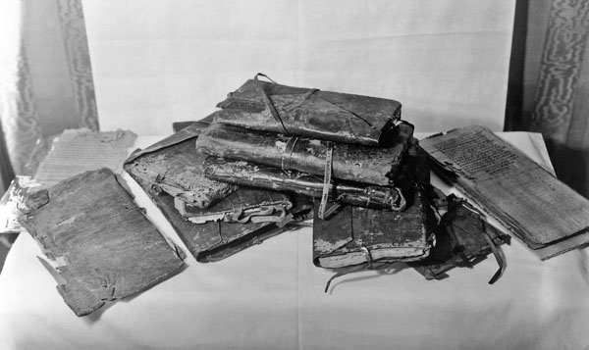
There were, in fact, “New Discoveries”
The Gospel of Thomas is a 4th Century Coptic text discovered 1945 near Nag Hammadi .

Slide 53
There were, in fact, “New Discoveries”
The Gospel of Thomas is a 4th Century Coptic text discovered 1945 near Nag Hammadi .
The Gospel of Judas is a late 3rd Century, Coptic text found 1970's.
  Languished on antiquities market for decades.
  Published by National Geographic Society in 2006, with huge marketing blitz!
Notes:
53

Slide 54
However, The Gospel of Judas and Thomas were known & rejected by early Church leaders in the 200’s
  “They declare that Judas the traitor was thoroughly acquainted with these things, and that he alone, knowing the truth as no others did, accomplished the mystery of the betrayal; by him all things, both earthly and heavenly, were thus thrown into confusion. They produce a fictitious history of this kind, which they style the Gospel of Judas.”
  (Irenaeus, Against Heresies, I.30, circa 180 AD)
Notes:
54

Slide 55
Three key facts about these “Hidden, Early Christian Gospels”
They were not “hidden” (not unknown)
They were not “early Christian”

Slide 56
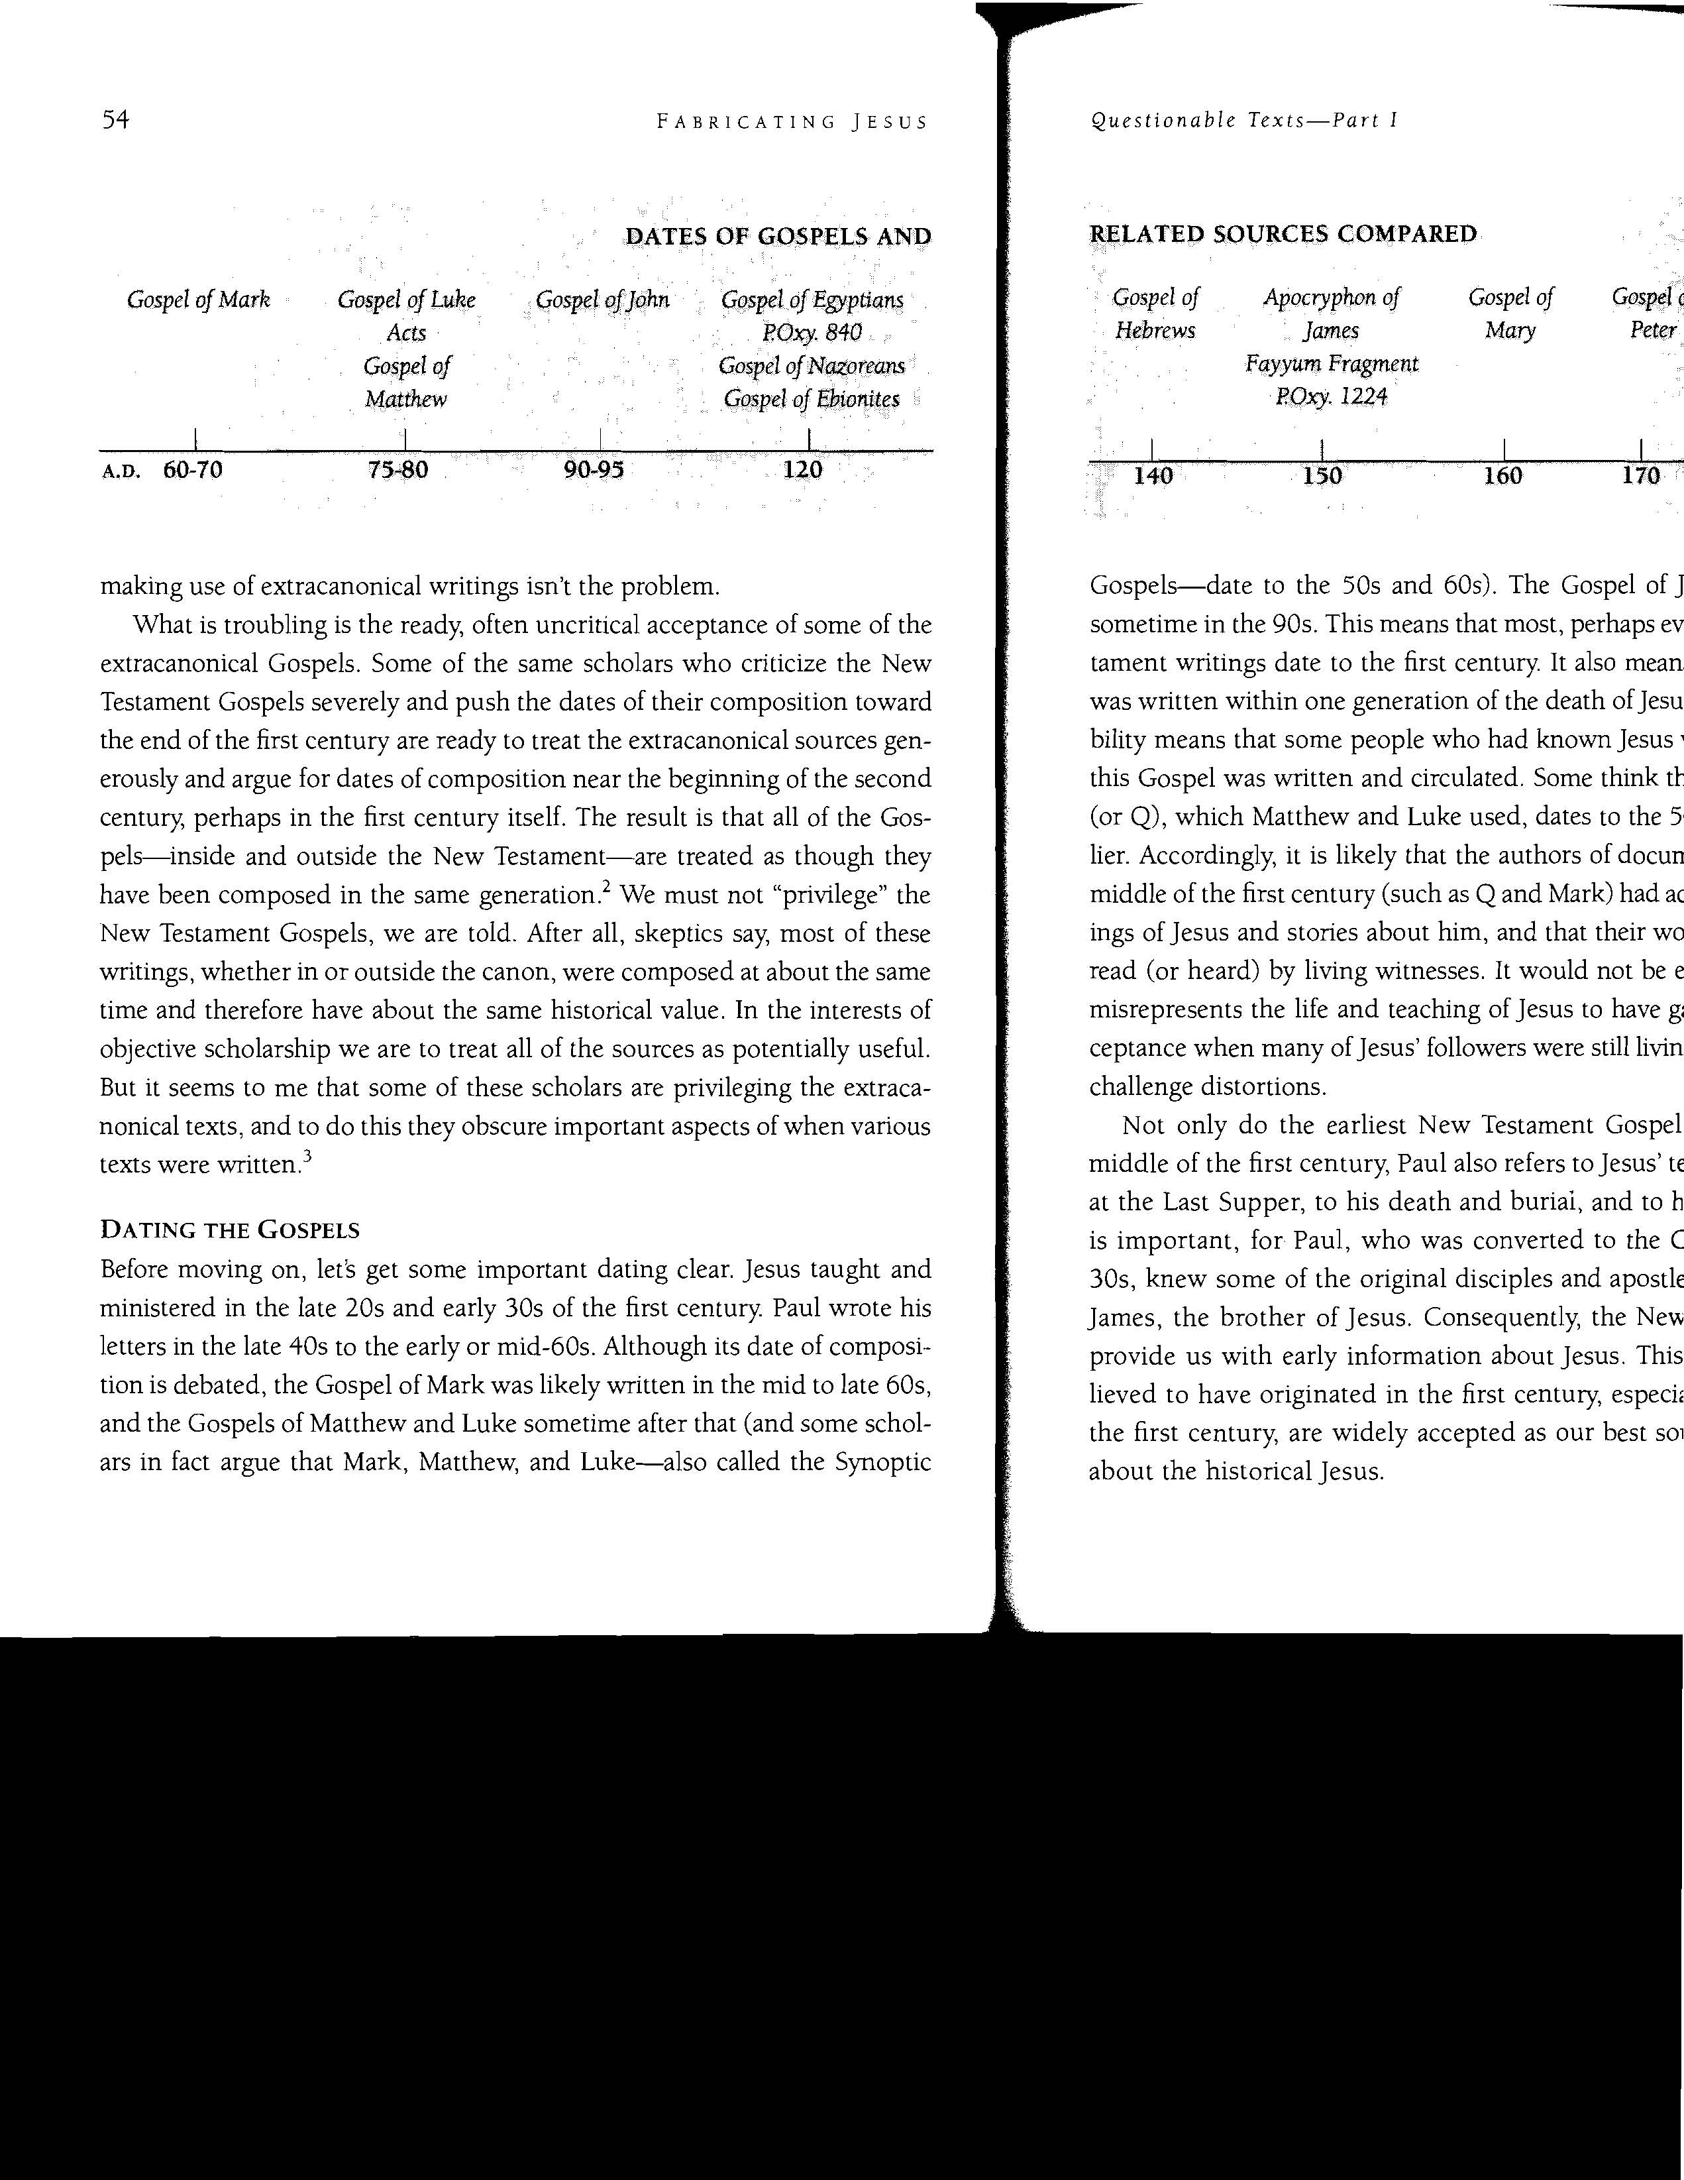
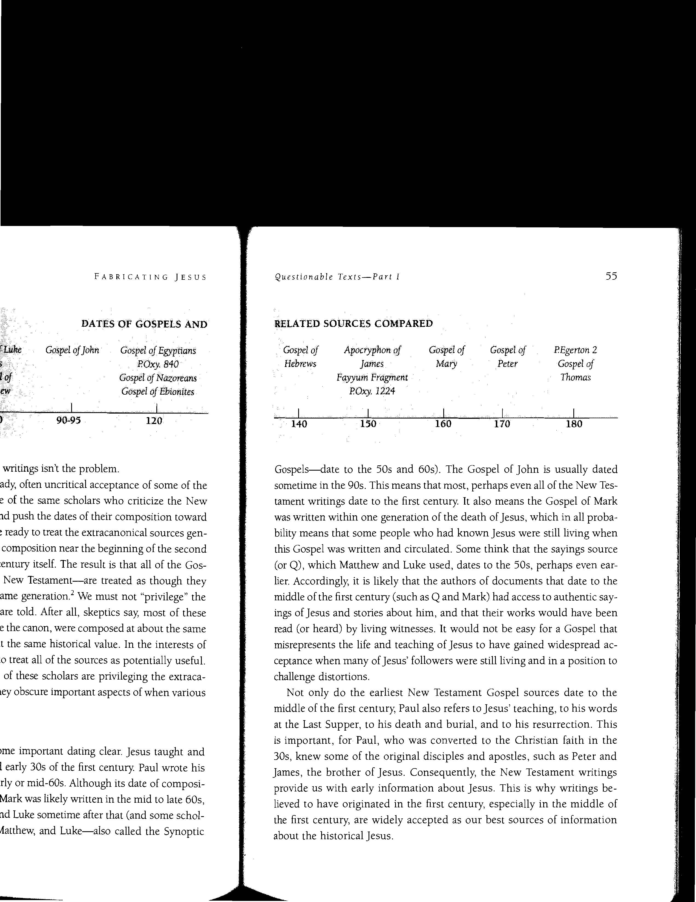
Second Century A.D.
First Century A.D.

Slide 57
Three key facts about these “Hidden, Early Christian Gospels”
They were not “hidden” (not unknown)
They were not “early Christian”
They are not comparable to the New Testament Gospels
(i.e., not realistic biographies of Jesus’ life, death, and
resurrection)

Slide 58
Bizarre Sayings
‘Jesus said, "Lucky is the lion that the human will eat, so that the lion becomes human. And foul is the human that the lion will eat, and the lion still will become human.”’ (Gospel of Thomas, 7)
‘Simon Peter said to them, "Make Mary leave us, for females don't deserve life."
Jesus said, "Look, I will guide her to make her male, so that she too may become a living spirit resembling you males.
For every female who makes herself male will enter the kingdom of Heaven.”’ (Gospel of Judas, 114)

Slide 59
Bizarre Sayings
On another occasion, Jesus was passing through the village and a child ran by and jostled him on his shoulder. Jesus was upset and said to him, “You won’t finish your journey.” At once the child fell down and died.
- Infancy Gospel of Thomas, 4:1-2
  Acts of John—John commanded bedbugs to behave themselves
  Acts of Paul—Paul baptized a lion that eventually spared him from death

Slide 60
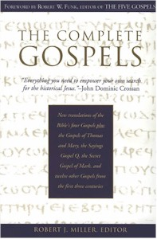
Conclusion: These “Lost Gospels” do not belong in the Bible
Arabic Infancy Gospel Gospel of Matthias Gospel of the Lord Gospel of the Nazareans Gospel of Gamaliel Gospel of James Gospel of the Egyptians | Gospel of the Birth of Mary Gospel of Nicodemus Gospels of the 12 Apostles Gospel of the Ebionites Gospel of Basilides Infancy Gospel of Thomas Coptic Gospel of Thomas | Gospel of Pseudo-Matthew Gospel of Bartholomew Gospel of Mary (Magdalene) Gospel of the Hebrews Gospel of Mani Gospel of Peter Gospel of Truth, etc.

Slide 61
Why are the Apocryphal Gospels being emphasized and legitimated?
Much contemporary “spirituality” is “Gnostic:”
Gnostics have inside knowledge about the faith.
  Many today prefer to think about conspiracy theories and secret knowledge, rather than obedient faith to the revealed word of God.
Gnostics know that the inner spirit is divine, outer body and conduct is bad and irrelevant.
  Many today prefer to focus on individual experience and not the apostolic tradition (New Testament) with its standards for faithful conduct in the body and in community.
Gnostics think Jesus is a revealer, but is not divine.
  Many put Jesus on a level with humankind (Jesus the Sage)

Slide 62
By contrast, Jesus in the Four Authentic Gospels:
Reveals knowledge in order to elicit belief and obedience.
  John 3:36 "He who believes in the Son has eternal life; but he who does not obey the Son shall not see life, but the wrath of God abides on him.“
Reveals to all His apostles and the church everything pertaining to “life and godliness”
  2 Peter 1:3 seeing that His divine power has granted to us everything pertaining to life and godliness, through the true knowledge of Him who called us by His own glory and excellence (virtue).
Reveals himself as the divine Son of God in life and resurrection – “The Father and I are one" (John 10:30)

Slide 63
Conclusions
The reliability of the New Testament Text will be challenged.
2. The evidence supports the reliability of the text of the Gospels and entire New Testament
3. The Scriptures are a firm foundation for following Christ and serving God.

