Slide 1
¹⁴ But even if you should suffer for righteousness' sake, you will be blessed. Have no fear of them, nor be troubled, ¹⁵ but in your hearts honor Christ the Lord as holy, always being prepared to make a defense to anyone who asks you for a reason for the hope that is in you; yet do it with gentleness and respect
1 Peter 3:14-15

Slide 2
Sharing Our Hope (1 Peter 3:14-15) 14-15 Congregational Theme
September – Introduction
October – Honoring the Lord as Holy
November – There Is a God
December – The Bible Is God’s Revelation
January – Jesus is the Resurrected Son of God
February – Teaching with Gentleness
March – Can We Be Lost? How Are We Saved?
April – Nature of Our Hope
May – Nature of the Church
June – The Sanctity of Marriage
July – Roles of Men & Women
August – Value of Our Hope

Slide 3
Thus you are to be holy to Me, for I the Lord am holy; and I have set you apart from the peoples to be Mine.
Leviticus 20:26
For you are a holy people to the Lord your God; the Lord your God has chosen you to be a people for His own possession out of all the peoples who are on the face of the earth.
Deuteronomy 7:6
In that day there will be inscribed on the bells of the horses, “HOLY TO THE LORD.”
Zechariah 14:20

Slide 4
Holy to the lord 4 Keys to Honoring Christ as holy
Different People Make a Difference
(Studies in 1st Peter)

Slide 5
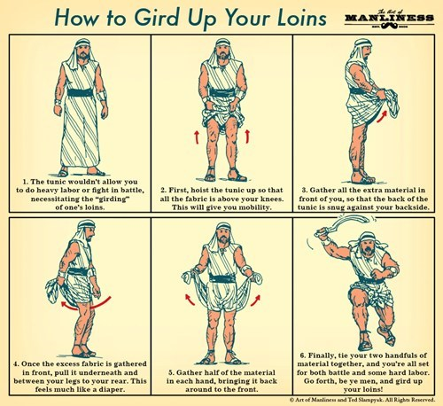
Mindset of holiness
Holiness requires intentionality.
Preparing Our Minds for Action

Slide 6
Mindset of holiness
Holiness requires intentionality.
Preparing Our Minds for Action
Full Sobriety
Hope in Grace
Obedience

Slide 7
Standard for holiness
Our goal is to be holy even as God is holy!
God Models, Measures & Motivates our holiness as…
Heavenly Father
Impartial Judge
Spotless Lamb

Slide 8
Growth toward holiness
God’s Word, the Imperishable Seed
Holiness Born from the Word
Purification through Obedience
Sincere, Mutual, Fervent Love
Tasting, Yearning, and Cleansing in God

Slide 9
Purpose in holiness
Coming to the Living Stone
Living Stones
Built into a Spiritual House
For a Holy Priesthood
Holy Identity → Holy Purpose
Living as the Holy & Royal Priesthood
“offer spiritual sacrifices acceptable to God”
“proclaim the excellencies of him who has called you”

Slide 10
Is Christ the lord of my heart?
Or is my mind drunk and distracted by things of the world?
Or do I measure the value of my life by other standards?
Or am I satisfied or seeking growth by other means?
Or have my identity & purpose been built on lesser things?

