Slide 1
There is a God – Sharing Our Hope

Slide 2
Sharing Our Hope (1 Peter 3:14-15) Congregational Theme Sermons
September – Sharing Our Hope
October – Honoring the Lord as Holy
November – There Is a God
December – The Bible Is God’s Revelation
January – Jesus is the Resurrected Son of God
February – Teaching with Gentleness
March – Can We Be Lost? How Are We Saved?
April – Nature of Our Hope
May – Nature of the Church
June – The Sanctity of Marriage
July – Roles of Men and Women
August – Value of Our Hope

Slide 3
I Peter 3:13-15
¹³ Now who is there to harm you if you are zealous for what is good? ¹⁴ But even if you should suffer for righteousness' sake, you will be blessed. Have no fear of them, nor be troubled, ¹⁵ but in your hearts honor Christ the Lord as holy, always being prepared to make a defense to anyone who asks you for a reason for the hope that is in you; yet do it with gentleness and respect

Slide 4
Sharing Our Hope (1 Peter 3:14-15) Congregational Theme Sermons
November – There Is a God
December – The Bible Is God’s Revelation
January – Jesus is the Resurrected Son of God

Slide 5
Evidence and Conclusions
Peter – Myths or Reality (II Peter 1:16-17)
John – Questions regarding Jesus (I John 1:1-2; John 1:14, 21:24 and 20:30-31)
Paul – Was Jesus raised from the dead? Will we be resurrected? (I Corinthians 15)
Is there a God?
Romans 1:19-20
Psalms 19:1
¹⁹ For what can be known about God is plain to them,
because God has shown it to them. ²⁰ For his invisible
attributes, namely, his eternal power and divine nature,
have been clearly perceived, ever since the creation of
the world, in the things that have been made.
So they are without excuse
The heavens declare the
glory of God, and the sky
above proclaims his handiwork

Slide 6
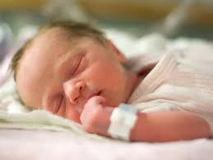
There is a God
Soft Evidence:
Birth of a new child
Grand Canyon

Slide 7
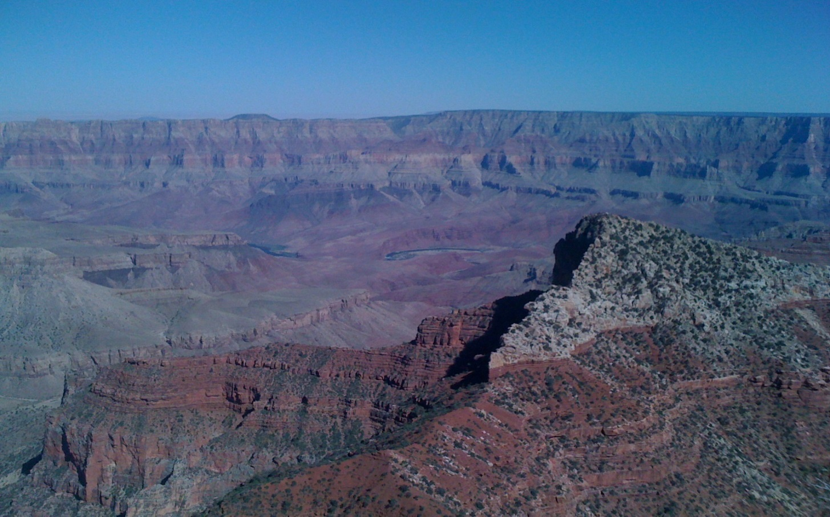
There is a God
Soft Evidence:

Slide 8
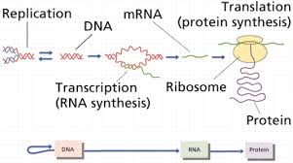
There is a God
Hard Evidence:
Life – DNA, RNA, Proteins

Slide 9
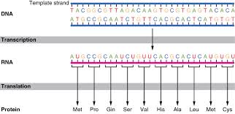
There is a God
Hard Evidence – DNA is a code

Slide 10
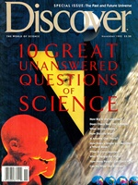
There is a God
Hard Evidence – Requirements for life
How Did Life Start?

Slide 11
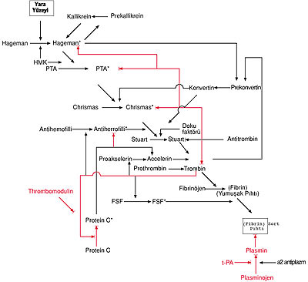
There is a God
Hard Evidence:
Life – DNA, RNA, Proteins
Complexity

Slide 12
There is a God
Evidence from Our Own Nature:
I praise you, for I am fearfully and wonderfully made. Wonderful are your works; my soul knows it very well. – Psalms 139:14
So God created man in his own image,
in the image of God he created him;
male and female he created them. – Genesis 1:27

Slide 13
There is a God
Evidence from Our Own Nature:
Level of intelligence
Ability to communicate
Range of emotions – laughter, sorrow, regret, joy
Imagination
Anticipation of the future
The universal sense of a divine
Conscience

