Slide 1
Establishing a Lasting Legacy

Slide 2
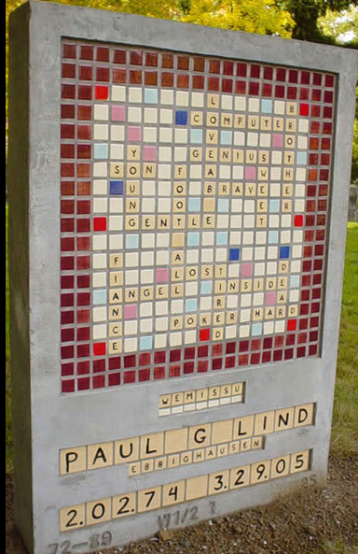
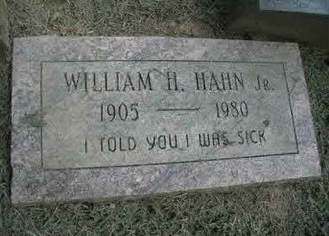
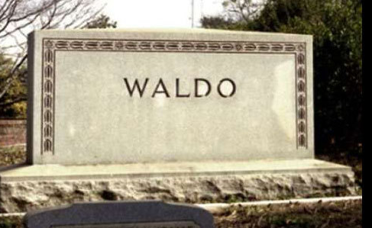

Slide 3
Establishing a Lasting Legacy
Legacy:
(1) Money or property left to someone by a will, (2) Something handed down from an ancestor or predecessor or from the past.
Riches, Fame, Name, etc…
WHAT DOES GOOD LOOK LIKE?
Father, Mother, Husband, Wife?
Proverbs 22:1 – a good name (character) is rather to be chosen than great riches, and love favor rather than silver and gold
Philippians 2:19-30: Timothy and Epaphroditus

Slide 4
What Does Good Look Like?
A Good Dad Makes Godly Decisions (PS 78:5-7)
The Lord made an agreement with Jacob and gave the teachings to Israel, which he commanded our ancestors to teach to their children. Then their children would know them, even their children not yet born. And they would tell their children. So they would all trust God and would not forget what he had done but would obey his commands. (Psalm 78:5-7)
A Good Dad Treasures His Children (Eph 6:4)
Fathers, do not make your children angry; but raise them with the training and teaching of the Lord. (Ephesians 6:4)
A Good Dad is “There” for His Children
When I come home from work and see those little noses pressed against the windowpane, then I know I’m a success.—Paul Faulkner

Slide 6
A Lasting Legacy
Philippians 2:19-30 –
¹⁹I hope in the Lord Jesus to send Timothy to you soon, so that I too may be cheered by news of you. ²⁰For I have no one like him, who will be genuinely concerned for your welfare. ²¹They all seek their own interests, not those of Jesus Christ. ²²But you know Timothy’s£ proven worth, how as a son£ with a father he has served with me in the gospel. ²³I hope therefore to send him just as soon as I see how it will go with me, ²⁴and I trust in the Lord that shortly I myself will come also. ²⁵I have thought it necessary to send to you Epaphroditus my brother and fellow worker and fellow soldier, and your messenger and minister to my need, ²⁶for he has been longing for you all and has been distressed because you heard that he was ill. ²⁷Indeed he was ill, near to death. But God had mercy on him, and not only on him but on me also, lest I should have sorrow upon sorrow. ²⁸I am the more eager to send him, therefore, that you may rejoice at seeing him again, and that I may be less anxious. ²⁹So receive him in the Lord with all joy, and honor such men, ³⁰for he nearly died for the work of Christ, risking his life to complete what was lacking in your service to me.

Slide 7
Goal Setting
WHAT:
What do I desire to accomplish?
What is the contribution I want to make?
What is the end I have in mind?
WHY? –
Why do I want to do it (Really)?
HOW?
How am I going to do it?
What strategies can I use to?
What key principles will empower me?

Slide 8
GOAL – To Have A Better Prayer Life
WHAT?
I Want to have a better
Prayer Life.
I want Prayer to Become
“Natural” / “Habitual” with
out becoming Routine.
I feel weaker spiritually.
I can’t accomplish any
of my other goals until I
accomplish this goal !!!
To draw closer to God.
To teach my children
to depend on God and not
self. (ME TO!)
WHY?
Get a new job, travel less.
Ask Lynn to help me!
Inform others of my goal.
Have a check list.
Keep Prayer list with me.
Have Family “Prayer Time.”
Keep Reminders Around.
I get too busy.
I get too tired.
I get pulled in too many
different directions.
Satan doesn’t want me
to pray.
5. Sometimes I doubt.
HOW?
THREATS?

Slide 9
GOAL
WHAT?
I want to be a better father
I want to be a better husband
I want to be a better role model at work
I want to make a difference in kids lives
I want to pray more
I feel weaker spiritually.
I can’t accomplish any
of my other goals until I
accomplish this goal !!!
To draw closer to God.
To teach my children
to depend on God and not
self. (ME TO!)
WHY?
Get a new job, travel less.
Ask Lynn to help me!
Inform others of my goal.
Have a check list.
Keep Prayer list with me.
Have Family “Prayer Time
Keep Reminders Around.
I get too busy.
I get too tired.
I get pulled in too many
different directions.
Satan doesn’t want me
to pray.
5. Sometimes I doubt.
HOW?
THREATS?

Slide 10
A Lasting Legacy
Godly Character / Conduct / Consistency
Philippians 2:22 – you know Timothy’s proven worth
Reputation vs Character

Slide 11
REPUTATION |  | CHARACTER
Reputation is what you are supposed to be |  | Character is what you are.
Reputation is what you have when you come to a new community |  | Character is what you have when you go away.
Reputation is made in a moment |  | Character is built in a lifetime.
Your reputation is learned in an hour |  | Your character does not come to light for a year
A single newspaper report gives your reputation |  | A life of toil gives you your character.
Reputation makes you rich or makes you poor |  | Character makes you happy or makes you miserable.
Reputation is what men say about you on your tombstone |  | Character is what angels say about you before the throne of God.
Your reputation is what men think you are |  | Our character is what God knows you to be.

Slide 12
A Lasting Legacy
Godly Character / Conduct / Consistency
Philippians 2:22 – you know Timothy’s proven worth
Reputation vs Character
Godly Convictions / Commitment
Philippians 2:29-30 – He nearly died for the gospel
Preference vs Conviction

Slide 13
A Lasting Legacy
Godly Character / Conduct / Consistency
Philippians 2:22 – you know Timothy’s proven worth
Reputation vs Character
Godly Convictions / Commitment
Philippians 2:29-30 – He nearly died for the gospel
Preference vs Conviction
Godly Compassion
Philippians 2:20-21 – genuinely concerned for you
Patient, Kind, Giving, Accepting, Protecting, etc…

Slide 14
A Lasting Legacy
Godly Character / Conduct / Consistency
Philippians 2:22 – you know Timothy’s proven worth
Reputation vs Character
Godly Convictions / Commitment
Philippians 2:29-30 – He nearly died for the gospel
Preference vs Conviction
Godly Compassion
Philippians 2:20-21 – genuinely concerned for you
Patient, Kind, Giving, Accepting, Protecting, etc…
Godly Cooperation
Philippians 2:25-26 – My brother, fellow-worker, soldier, messenger, minister,

Slide 15
A Lasting Legacy
Godly Character / Conduct / Consistency
Philippians 2:22 – you know Timothy’s proven worth
Reputation vs Character
Godly Convictions / Commitment
Philippians 2:29-30 – He nearly died for the gospel
Preference vs Conviction
Godly Compassion
Philippians 2:20-21 – genuinely concerned for you
Patient, Kind, Giving, Accepting, Protecting, etc…
Godly Cooperation
Philippians 2:25-26 – My brother, fellow-worker, soldier, messenger, minister,
Godly Courage
Philippians 2:30 – Risked his life for the gospel

