Slide 2
June 5th, 1968

Slide 3
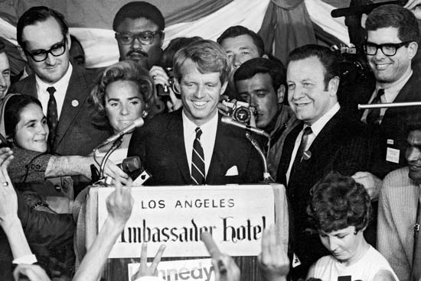
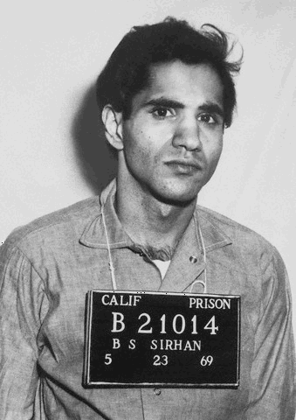
5:58am
Portland Oregon
June 5th, 1968
12:10 a.m.
Los Angles California

Slide 4
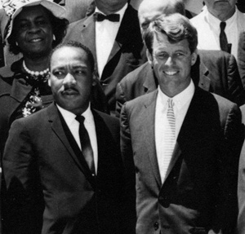
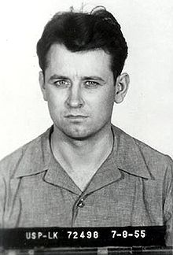
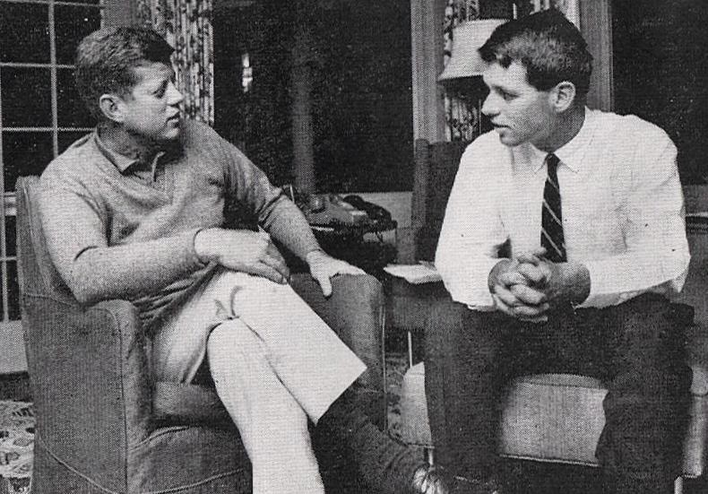
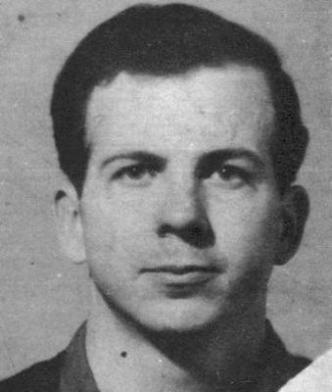
April 4, 1968, Memphis, Tennessee
November 22, 1963, Dallas, Texas

Slide 5
Why so much hate and violence?
What is behind all this?

Slide 6

November 10, 2014 Douglasville, Georgia
Florene Duke 75 years old,
who suffered from dementia,
known for helping those in need,
robbed and murdered

Slide 7
Why so much hate and violence?
Sin
What is behind all this?
Satan’s rebellion against God

Slide 8

So what? Everyone knows those things are wrong…
Satan’s ‘Recruiting Tools’
For us to join in rebellion against God:
A. Satan is a lair
John 8:44 You are of your father the devil, and the desires of your father you want to do. He was a murderer from the beginning, and does not stand in the truth, because there is no truth in him. When he speaks a lie, he speaks from his own resources, for he is a liar and the father of it.

Slide 9
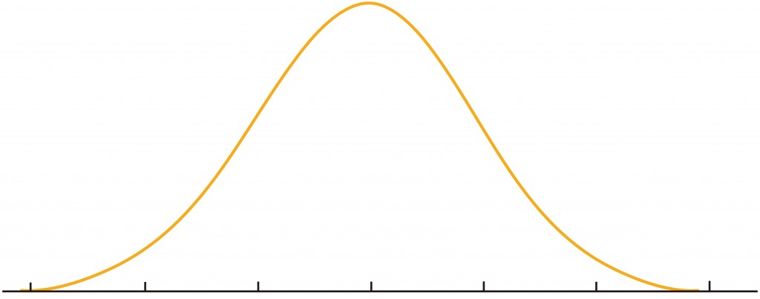


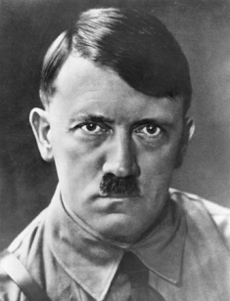

Lie #1 – Sin is ‘not that bad’
Number of People
Evil Righteous

Slide 10
Teachings:
1 Corinthians 6: 9 Do you not know that the unrighteous will not inherit the kingdom of God? Do not be deceived. Neither fornicators, nor idolaters, nor adulterers, nor homosexuals, nor sodomites, 10 nor thieves, nor covetous, nor drunkards, nor revilers, nor extortioners will inherit the kingdom of God. 11 And such were some of you. But you were washed, but you were sanctified, but you were justified in the name of the Lord Jesus and by the Spirit of our God.
1 Peter 4: 15 But let none of you suffer as a murderer, or as a thief, or as an evildoer, or as a busybody in other men's matters… 17 For the time is come that judgment must begin at the house of God: and if it first begin at us, what shall the end be of them that obey not the gospel of God? 18 And if the righteous scarcely be saved, where shall the ungodly and the sinner appear?

Slide 11
Lie #1 – Sin is ‘not that bad’
1 Corinthians 6: 9 Do you not know that the unrighteous will not inherit the kingdom of God? Do not be deceived. Neither fornicators, nor idolaters, nor adulterers, nor homosexuals, nor sodomites, 10 nor thieves, nor covetous, nor drunkards, nor revilers, nor extortioners will inherit the kingdom of God.
Number of People
1 Peter 4: 18 And if the righteous scarcely be saved, where shall the ungodly and the sinner appear?
Evil Righteous

Slide 12
Teachings:
Matthew 5: 19 Whoever therefore breaks one of the least of these commandments, and teaches men so, shall be called least in the kingdom of heaven; but whoever does and teaches them, he shall be called great in the kingdom of heaven. 20 For I say to you, that unless your righteousness exceeds the righteousness of the scribes and Pharisees, you will by no means enter the kingdom of heaven.

Slide 13
Lie #1 – Sin is not that bad
“No one can serve two masters; for either he will hate the one and love the other, or else he will be loyal to the one and despise the other. You cannot serve God and mammon." Matthew 6:24
Jesus
Number of People
‘Playing on Satan’s team’
“In this the children of God and the children of the devil are manifest: Whoever does not practice righteousness is not of God, nor is he who does not love his brother.” 1 John 3:10
Evil Righteous

Slide 14
Lie #2 – Evil is Good – Good is Evil
Isaiah 5:20 Woe unto them that call evil good, and good evil; that put darkness for light, and light for darkness; that put bitter for sweet, and sweet for bitter!
Genesis 3 :1 Now the serpent was more cunning than any beast of the field which the Lord God had made. And he said to the woman, “Has God indeed said, ‘You shall not eat of every tree of the garden’?”
2 And the woman said to the serpent, “We may eat the fruit of the trees of the garden; 3 but of the fruit of the tree which is in the midst of the garden, God has said, ‘You shall not eat it, nor shall you touch it, lest you die.’”
4 Then the serpent said to the woman, “You will not surely die. 5 For God knows that in the day you eat of it your eyes will be opened, and you will be like God, knowing good and evil.”
Evil Righteous

Slide 15
Lie #2 – Evil is Good – Good is Evil
James 1: 13 Let no one say when he is tempted, “I am tempted by God”; for God cannot be tempted by evil, nor does He Himself tempt anyone. 14 But each one is tempted when he is drawn away by his own desires and enticed. ..16 Do not be deceived, my beloved brethren. 17 Every good gift and every perfect gift is from above, and comes down from the Father of lights, with whom there is no variation or shadow of turning.
1 John 3:7 Little children, let no one deceive you. He who practices righteousness is righteous, just as He is righteous. 8 He who sins is of the devil, for the devil has sinned from the beginning. For this purpose the Son of God was manifested, that He might destroy the works of the devil. 9 Whoever has been born of God does not sin, for His seed remains in him; and he cannot sin, because he has been born of God.
Evil Righteous

Slide 16
Lie #3 – There is no Evil
16 These six things the Lord hates,
Yes, seven are an abomination to Him:
17 A proud look,
A lying tongue,
Hands that shed innocent blood,
18 A heart that devises wicked plans,
Feet that are swift in running to evil,
19 A false witness who speaks lies,
And one who sows discord among brethren.
Proverbs 6:16-19
Current World View:
Self Promotion & ‘confidence’ admired
‘Little Lies’ OK , Lies OK for the right reasons
Abortion, Assisted Suicides, Jihad
Entertaining, viewed as ‘creative’
Turn on the news…
Truth is subjective & can be viewed differently
Lack of Love & bitterness everywhere
Righteous
Evil

Slide 17
Satan’s ‘Recruiting Tools’
For us to join in rebellion against God:
Satan is a lair
1. Sin is not that bad
2. Evil is Good – Good is Evil
3. There is no Evil
B. Satan will use others as recruiters

Slide 18
Satan will use others as recruiters
1. Sin is not that bad
I Cor 15:33-34 – Do not be deceived: “Evil company corrupts good habits.” ³⁴Awake to righteousness, and do not sin; for some do not have the knowledge of God. I speak this to your shame. [NKJ]
Col 4:5 – Behave yourselves wisely in your relations with those of the outside world, making the very most of the time and seizing the opportunity. [Ampl. Bible]
James 4 :4You adulterous people! Do you not know that friendship with the world is enmity with God? Therefore whoever wishes to be a friend of the world makes himself an enemy of God.

Slide 19
Satan will use others as recruiters
1. Sin is not that bad
2. Evil is Good – Good is Evil
I John 5:19 – We know that we are of God, and the whole world lies under the sway of the wicked one.
2 Peter 2: 1 But there were also false prophets among the people, even as there will be false teachers among you, who will secretly bring in destructive heresies, even denying the Lord who bought them, and bring on themselves swift destruction. 2 And many will follow their destructive ways, because of whom the way of truth will be blasphemed.

Slide 20
Satan will use others as recruiters
1. Sin is not that bad
2. Evil is Good – Good is Evil
3. There is no Evil
2 Thessalonians 2:9 The coming of the lawless one is according to the working of Satan, with all power, signs, and lying wonders, 10 and with all unrighteous deception among those who perish, because they did not receive the love of the truth, that they might be saved. 11 And for this reason God will send them strong delusion, that they should believe the lie, 12 that they all may be condemned who did not believe the truth but had pleasure in unrighteousness.

Slide 21

Satan will use others as recruiters
1. Sin is not that bad
2. Evil is Good – Good is Evil
3. There is no Evil

Slide 22
Our Defense:
Romans 12:2, 9 "Do not be conformed to this world.... Abhor what is evil. Cling to what is good."
1 John 5:18 We know that whoever is born of God does not sin; but he who has been born of God keeps himself, and the wicked one does not touch him.
James 4 :7 Submit yourselves therefore to God. Resist the devil, and he will flee from you. 8 Draw near to God, and he will draw near to you.
Matthew 4:10 Then Jesus said to him, “Away with you, Satan! For it is written, ‘You shall worship the Lord your God, and Him only you shall serve.’” 11 Then the devil left Him, and behold, angels came and ministered to Him.

Slide 23
Our Defense:
1 Corinthians 10:12 Therefore let anyone who thinks that he stands take heed lest he fall. 13 No temptation has overtaken you that is not common to man. God is faithful, and he will not let you be tempted beyond your ability, but with the temptation he will also provide the way of escape, that you may be able to endure it.

