Slide 2
Paul’s Final Charge (I Timothy 4:1-2)
Embry Hills – December 2014

Slide 3
2014/15 Theme: Sharing the Hope
¹⁴ But even if you should suffer for righteousness' sake, you will be blessed. Have no fear of them, nor be troubled, ¹⁵ but in your hearts honor Christ the Lord as holy, always being prepared to make a defense to anyone who asks you for a reason for the hope that is in you; yet do it with gentleness and respect… (I Peter 3:14-15, ESV)

Slide 4
Key Characters
Timothy (Paul’s “Son”)
Young
Timid (Ashamed?)
Unhealthy
You therefore, my son, be strong in the grace that is in Christ Jesus. (II Tim 2:1)

Slide 5
The ‘Charge’
…¹¹ According to the glorious gospel of the blessed God which was committed to my trust…. ¹⁸ This charge I commit to you, son Timothy, according to the prophecies previously made concerning you, that by them you may wage the good warfare, ¹⁹ having faith and a good conscience… (I Tim 1:11, 18-19)
O Timothy! Guard what was committed to your trust… [‘deposit entrusted’ ESV] (I Tim 6:20)
Hold fast the pattern of sound words which you have heard from me, in faith and love which are in Christ Jesus. ¹⁴ That good thing which was committed to you, keep by the Holy Spirit who dwells in us. (II Tim 1:13-14)

Slide 6
The ‘Charge’
And the things that you have heard from me among many witnesses, commit these to faithful men who will be able to teach others also. (II Tim 2:2)
Faithful Men
Christ
Paul
Timothy
Others
(See II Tim 1:10-11)
(See I Tim 4:16)

Slide 7
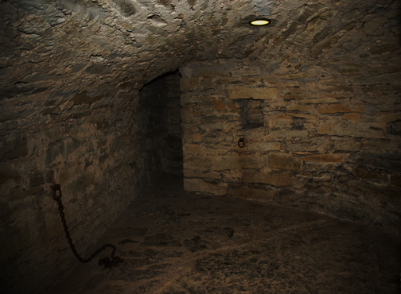
Key Characters
Paul
In Prison (1:8); a fetter (1:16); chains (2:9)
Lonely? (4:9 & 21; 11)
Cold? (4:13)
Bored? (4:13)
Forsaken, Betrayed? (4:10, 14, 16)

Slide 8
II Timothy 2 & 3
Chapter 2 – Images of Service
Six pictures
Theme is hardship
Chapter 3 – Perilous Times
Men with misdirected affections
Deceptive and dangerous tactics
Results in persecution of godly people

Slide 9
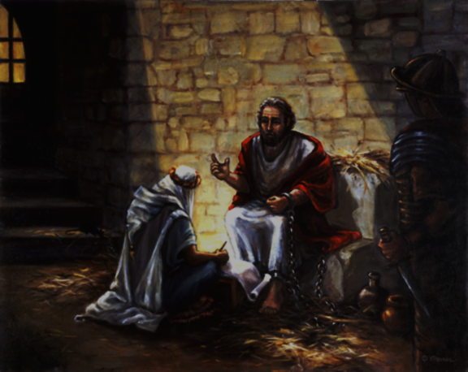

Slide 10
Paul’s Final Charge
3:12-13
4:3-4
Evil men will grow worse.
Men will not listen.
4:1-2
3:14-15
Preach the Word
4:5
Scripture will save you.
It is your mission.
3:16-17
4:6-8
Scripture is all you need.
I am finished (victorious).

Slide 11
A Closer Look (4:1)
Before God and the Lord Jesus Christ
The charge is really from God.
Who will judge the living and the dead
All men will be held accountable.
A ‘righteous’ judge will judge in righteousness (v 8).
At His Appearing
It will be the resolution of all things
Those who have loved this (8) will receive a crown.
And His Kingdom
His rule will be demonstrated in awarded crowns (8).
He will deliver (4:17,18) for His Heavenly Kingdom.

