Slide 1

Book of Joshua
Lesson 6
Central Conquest - Ai & Achan

Slide 2
Class Objectives
Learn about God's fulfillment of the land promise.
Learn about Serving the Lord in the days of Joshua
Learn about the character of Joshua
Study the Geography & Archaeology of the Conquest of Canaan
Be ready to give a defense of the Conquest of Canaan

Slide 3
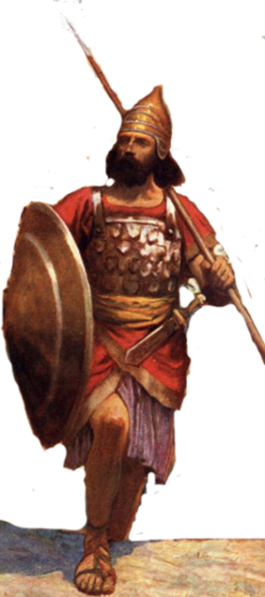
Resting in the land
Living the land
Distributing
the land
Joshua
24:29-33
Conquering the land
Joshua
13-21
Joshua
22-24
Claiming the land
Joshua
6-12
Joshua
1-5
Notes:
I. Claiming the Land (1:1–5:15)
II. Conquering the Land (6:1–12:24)
III. Distributing the Land (13:1–21:45)
IV. Living in the Land (22:1–24:28)
V. Resting in the Land (24:29–33)

Slide 4
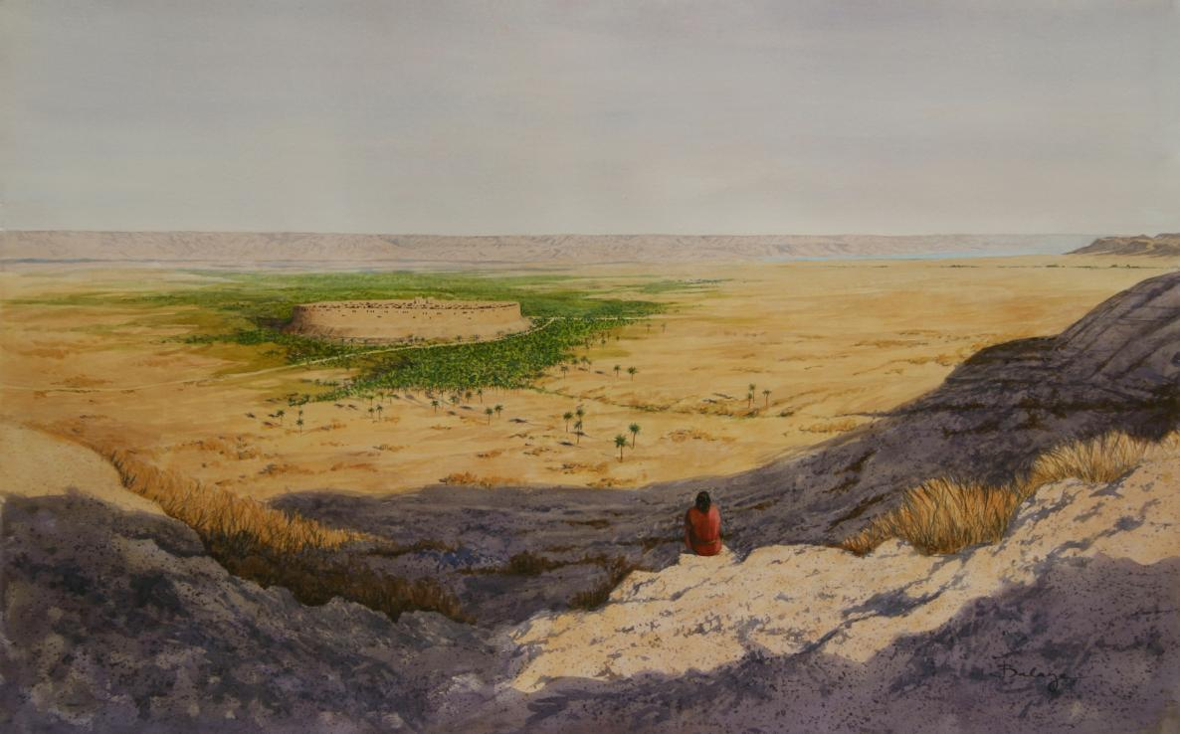

Joshua’s Challenges –
People who had failed last time – 40 yrs
New Leader
New Generation
A swollen river
A walled city
Unknown city/people
Be Strong & Courageous
Just as I was with Moses, so I will be with you.
I will not leave you or forsake you
People – tell Be Strong & Courageous
Prepared people (3 days provisions)
Checked that Tribes across Jordan with him
Sent spies into Jericho
Lord took care of the river
& walled city
Jo 1:2 Now therefore arise, go over this Jordan

Slide 5
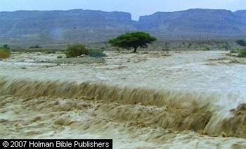
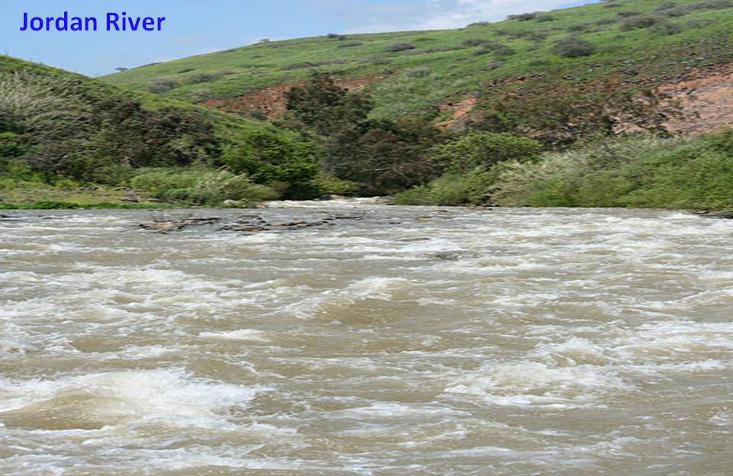
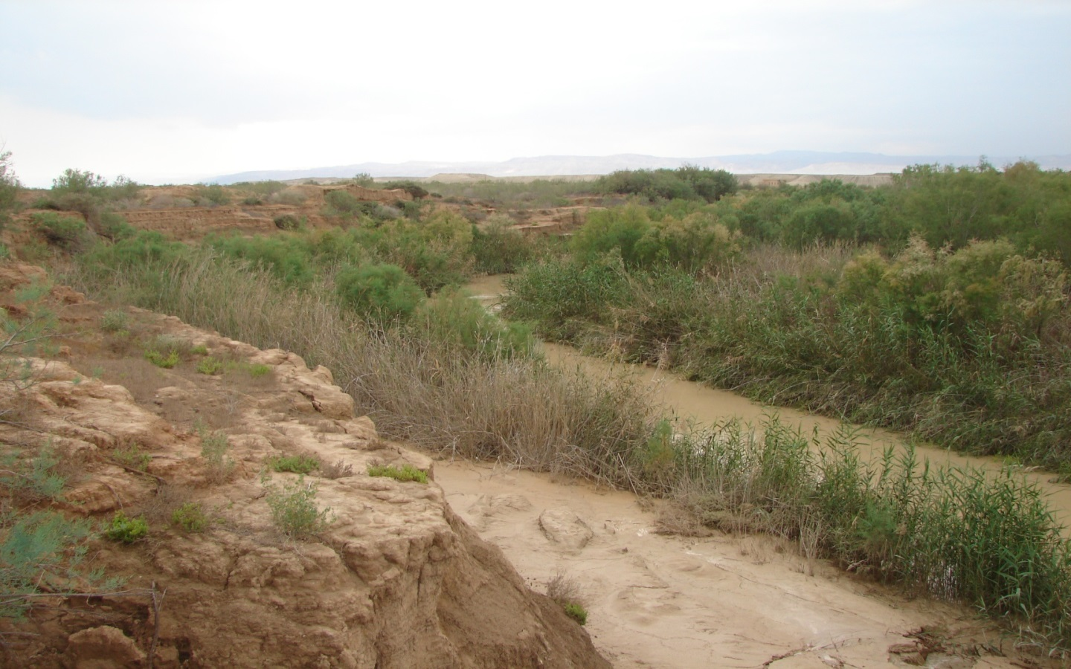
Normal vs Flooded Jordan River
Joshua 3:15(ESV)
¹⁵ …(now the Jordan overflows all its banks throughout the time of harvest),
Joshua 4 ¹⁴On that day the Lord exalted Joshua in the sight of all Israel, and they stood in awe of him just as they had stood in awe of Moses, all the days of his life.

Slide 6
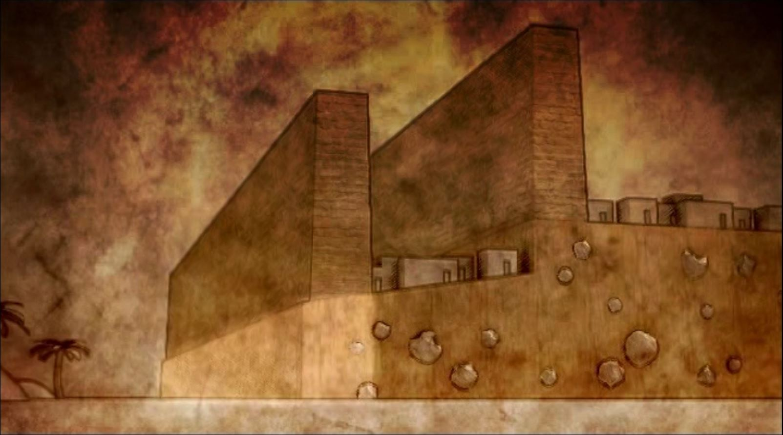
A Double
Walled City
Inner Wall
Outer Wall
Retaining Wall

Slide 7
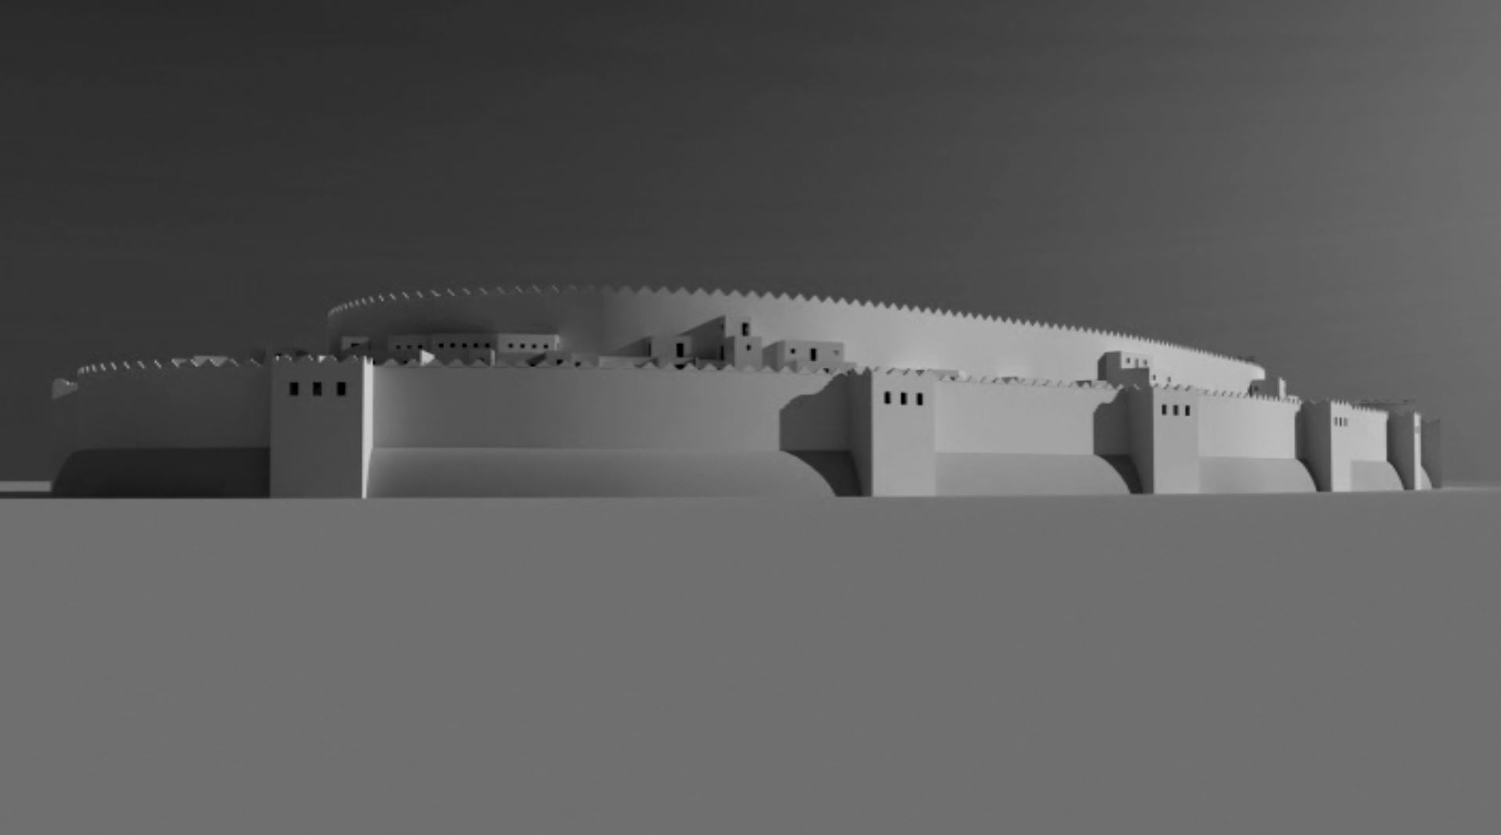
Hebrews 11:30-31(ESV)
³⁰By faith the walls of Jericho fell down after they had been encircled for seven days.
³¹By faith Rahab the prostitute did not perish with those who were disobedient, because she had given a friendly welcome to the spies.

Slide 8
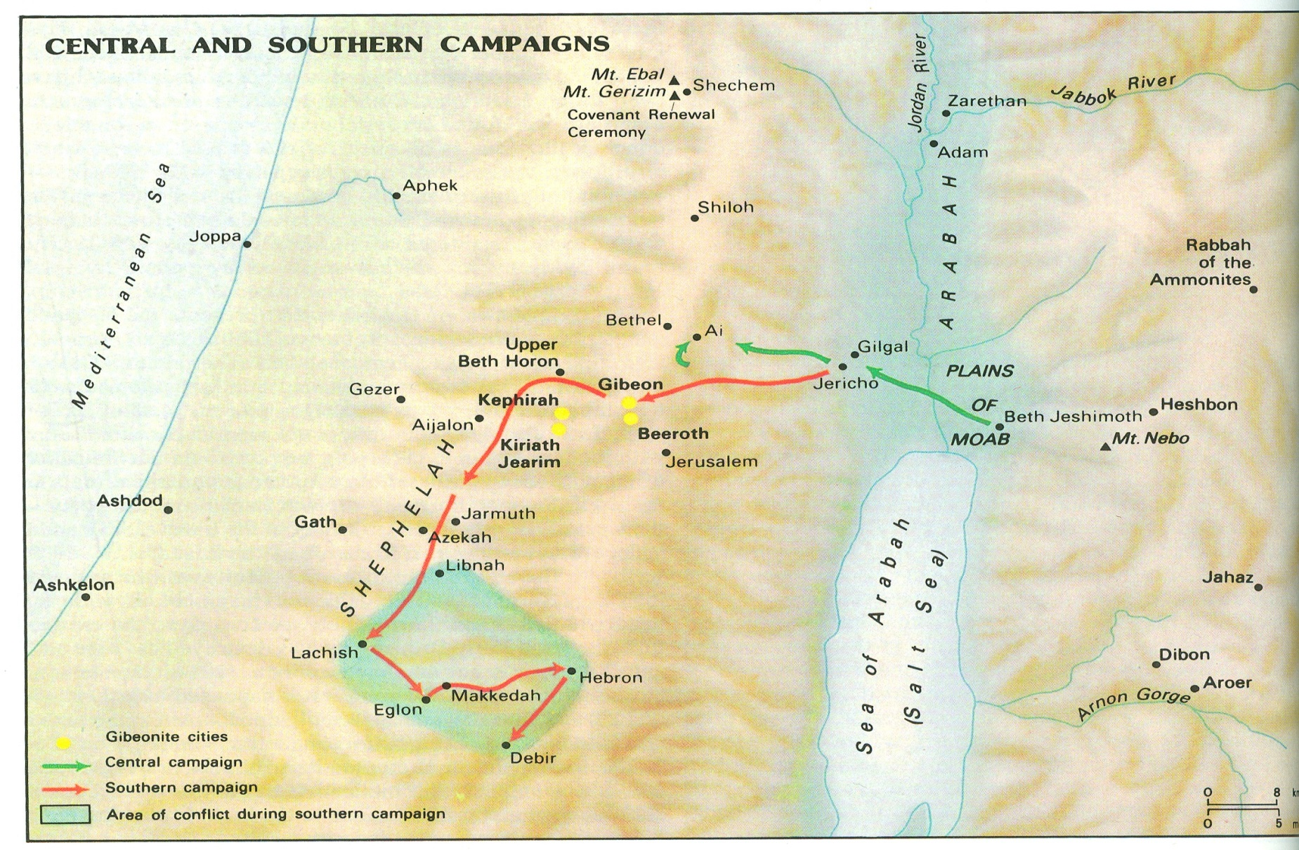
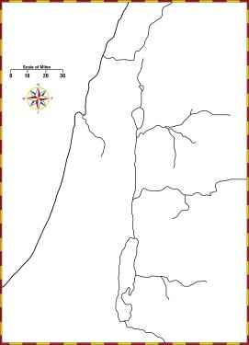

Slide 9
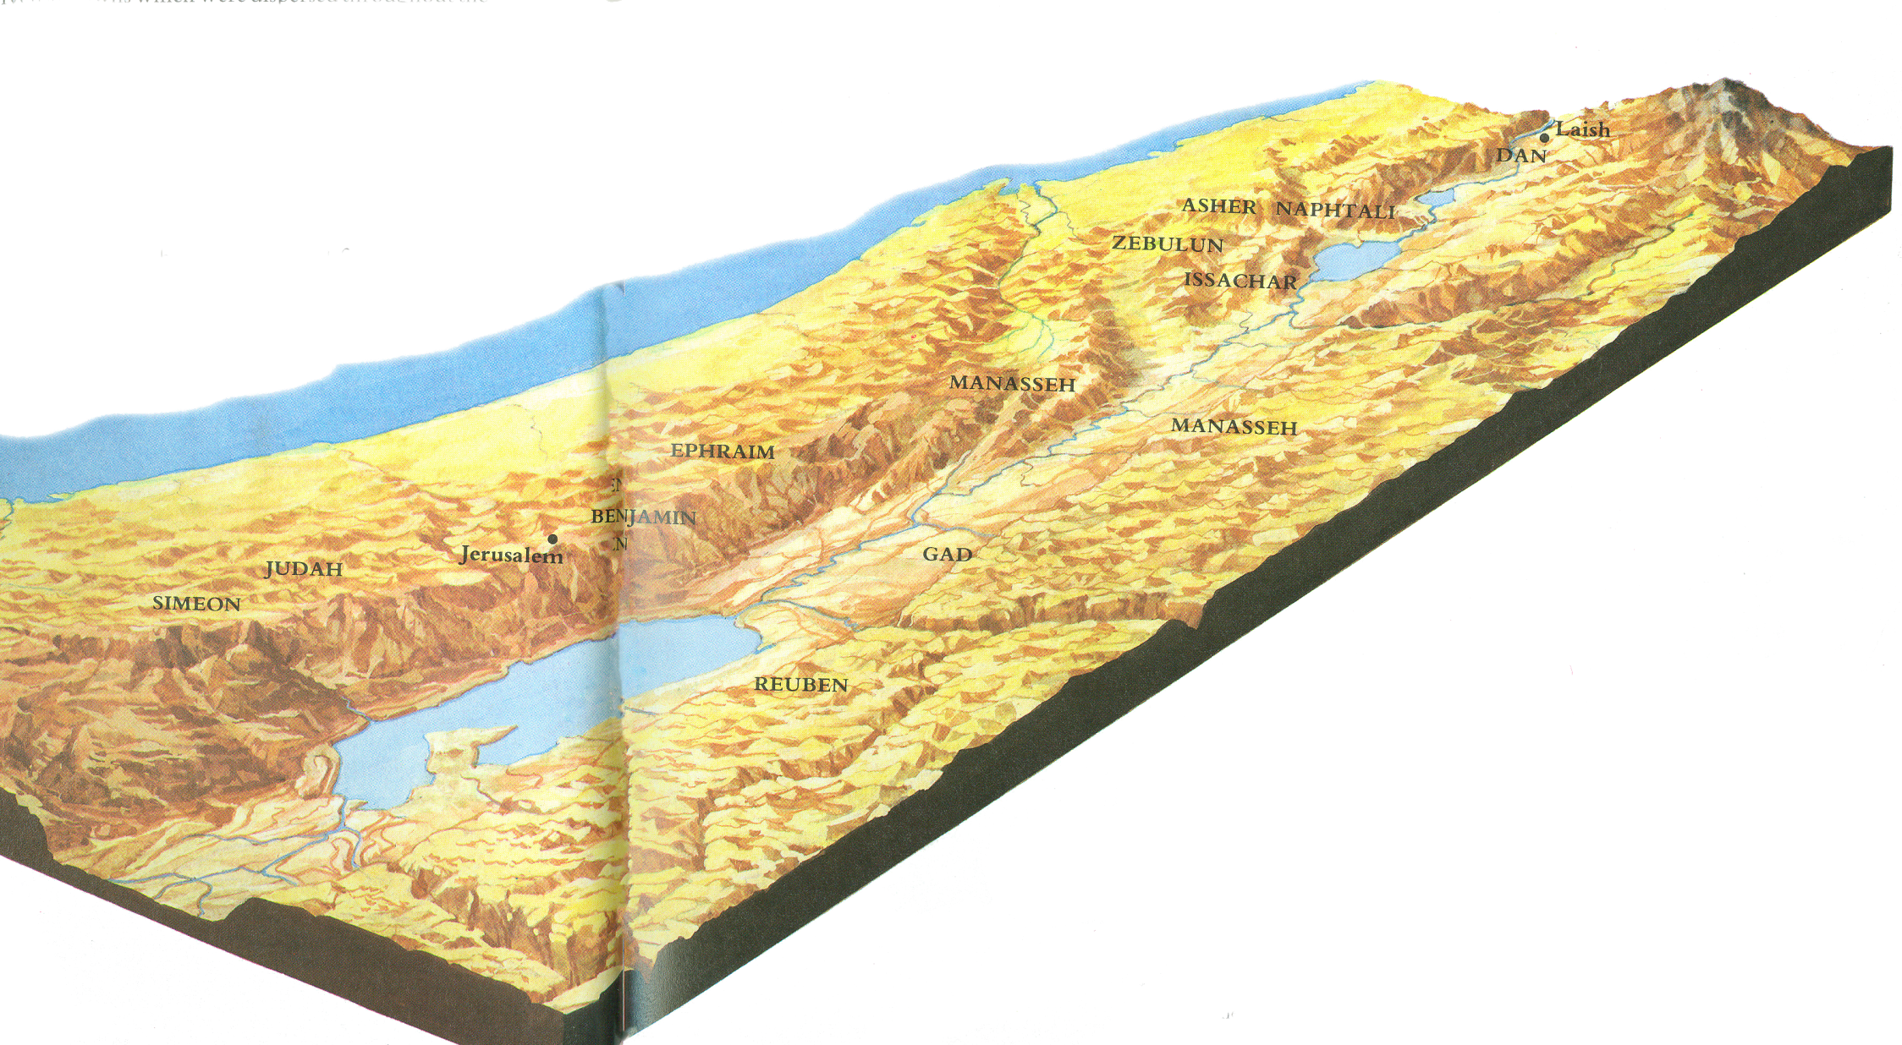
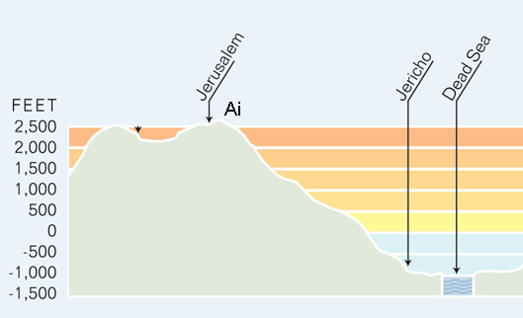

Slide 10
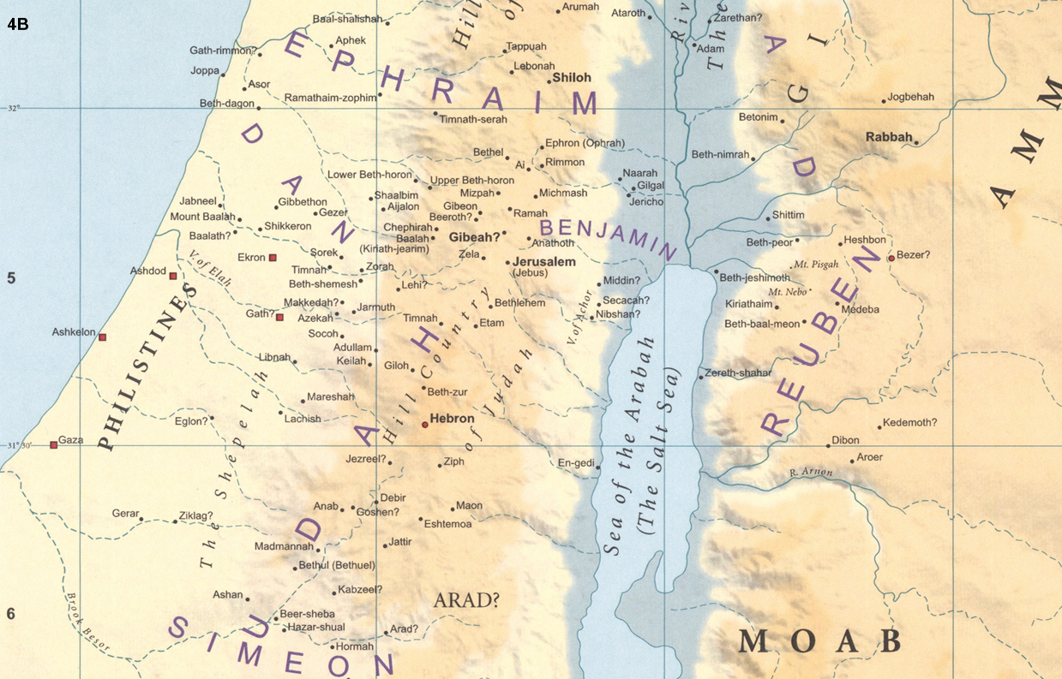
W
X
Y

Slide 11
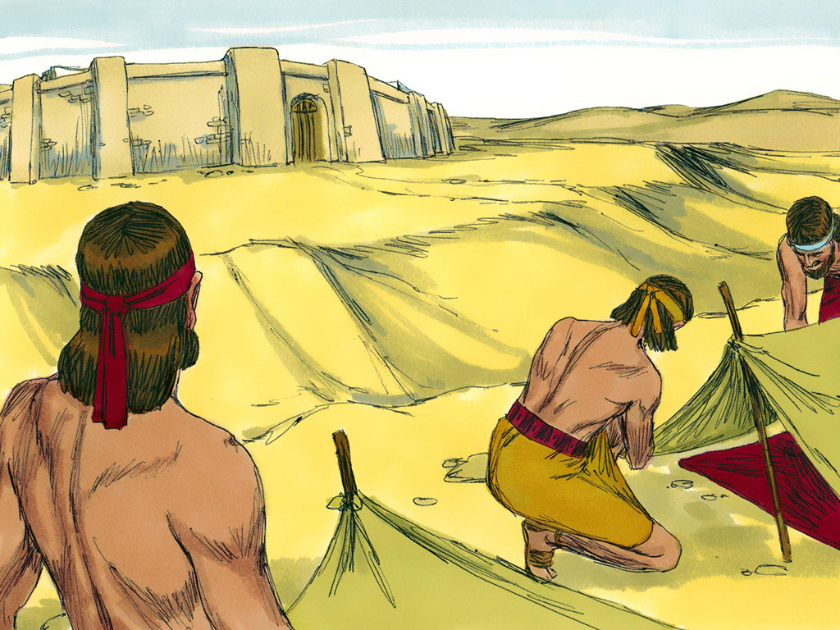
Joshua 7:2-4
Joshua sent men from Jericho to Ai, which is near Beth-aven, east of Bethel, and said to them, “Go up and spy out the land.”
Do not have all the people go up, but let about two or three thousand men go up and attack Ai.
Do not make the whole people toil up there, for they are few.”
So about 3,000 men went up there from the people

Slide 12
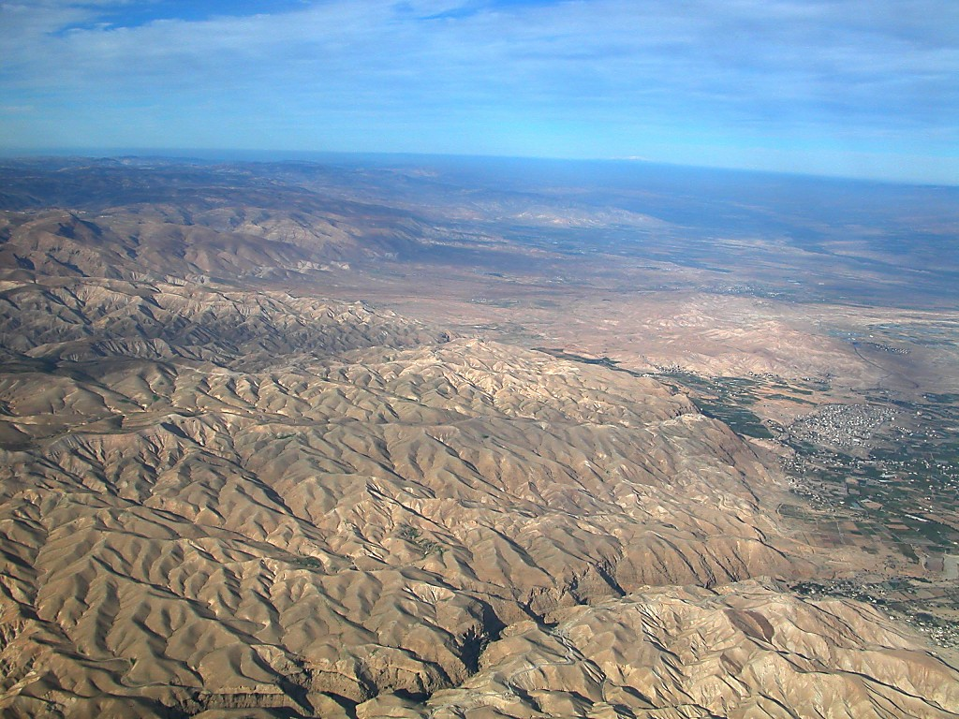
Do not have all the people go up,
Mt. Hermon
Ophrah-Ephraim-Taiybe ridge
Ai
Jericho
Valley of Zeboiim
Tell es-Sultan
Herod’s Palaces
Wadi Qilt
Jerusalem
Cypros
Jericho, Jordan Rift with Mount Hermon aerial from south
Notes:
tb010703124

Slide 13
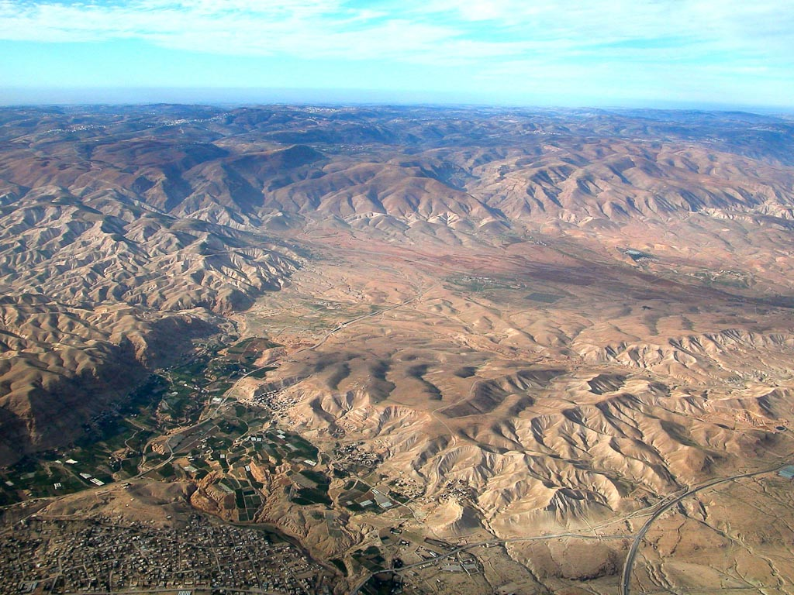
Do not have all the people go up,
Taiybe-Ophrah-Ephraim ridge
Ai
Jericho
Tell es-Sultan
Jericho and wilderness aerial from south
Notes:
tb010703116

Slide 14
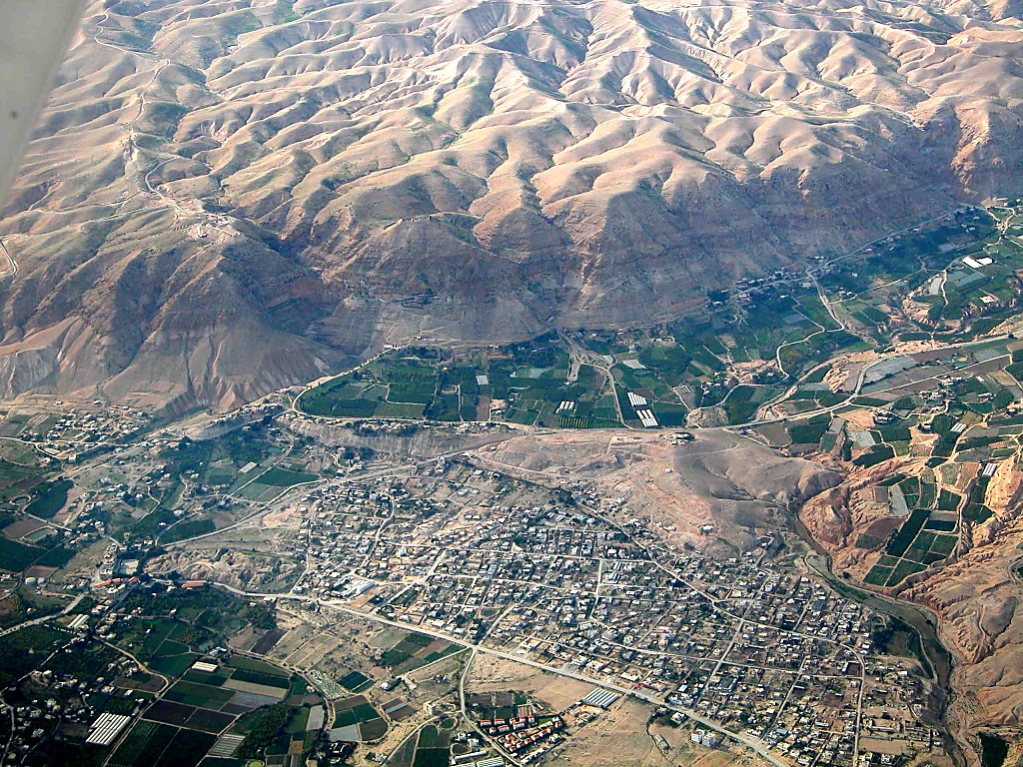
Jerusalem
Do not have all the people go up,
Docus
Monastery of Temptation
Jericho
Tell es-Sultan
Jericho, Tell es-Sultan and cliffs aerial from east
Notes:
tb010703123

Slide 15
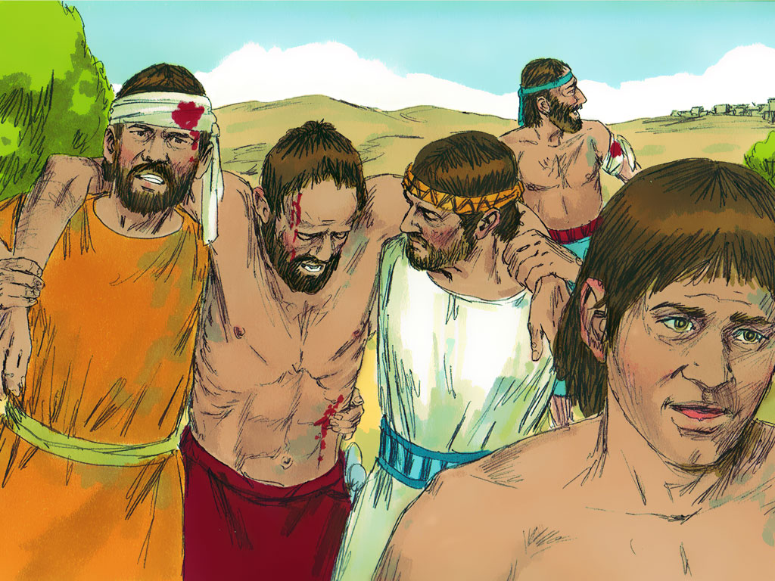
Joshua 7
⁴…And they fled before the men of Ai,
⁵and the men of Ai killed about thirty-six of their men
and chased them before the gate as far as Shebarim
and struck them at the descent.
And the hearts of the people melted and became as water.

Slide 16
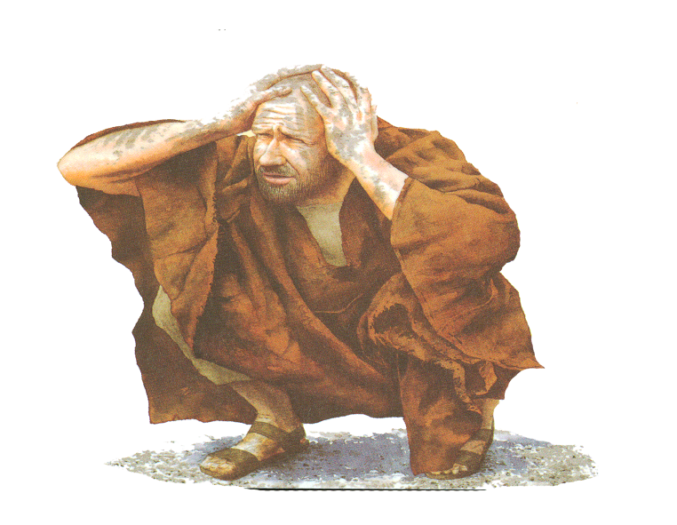
Reaction of Joshua 7:6-9
Then Joshua tore his clothes
Fell to the earth on his face before the ark of the Lord until the evening,
he and the elders of Israel.
And they put dust on their heads.
And Joshua said, “Alas, O Lord God, why have you brought this people over the Jordan at all, to give us into the hands of the Amorites, to destroy us? Would that we had been content to dwell beyond the Jordan!
O Lord, what can I say,
  when Israel has turned their backs before their enemies!
  For the Canaanites and all the inhabitants of the land
    will hear of it and will surround us and cut off our name from the earth.
    And what will you do for your great name?”

Slide 17
Israelites vs Joshua
Under Stress
Pharaoh Traps them at Red Sea
Exodus 14 (ESV)
¹¹They said to Moses, “Is it because there are no graves in Egypt that you have taken us away to die in the wilderness? What have you done to us in bringing us out of Egypt?
¹²Is not this what we said to you in Egypt, ‘Leave us alone that we may serve the Egyptians’? For it would have been better for us to serve the Egyptians than to die in the wilderness.”
Defeated at Ai
Joshua 7 (ESV)
⁷And Joshua said, “Alas, O Lord God, why have you brought this people over the Jordan at all, to give us into the hands of the Amorites, to destroy us?
Would that we had been content to dwell beyond the Jordan!
⁸O Lord, what can I say, when Israel has turned their backs before their enemies!

Slide 18
God’s Response 7:10-13
The Lord said to Joshua,
“Get up! Why have you fallen on your face?
Reason for defeat –
  Israel has sinned;
  they have transgressed my covenant that I commanded them;
  they have taken some of the devoted things;
  they have stolen and lied and put them among their own belongings.
Therefore the people of Israel cannot stand before their enemies.
I will be with you no more, unless you destroy the devoted things from among you.
Get up! Consecrate the people and say, ‘Consecrate yourselves for tomorrow;
There are devoted things in your midst, O Israel. You cannot stand before your enemies until you take away the devoted things from among you.”

Slide 19
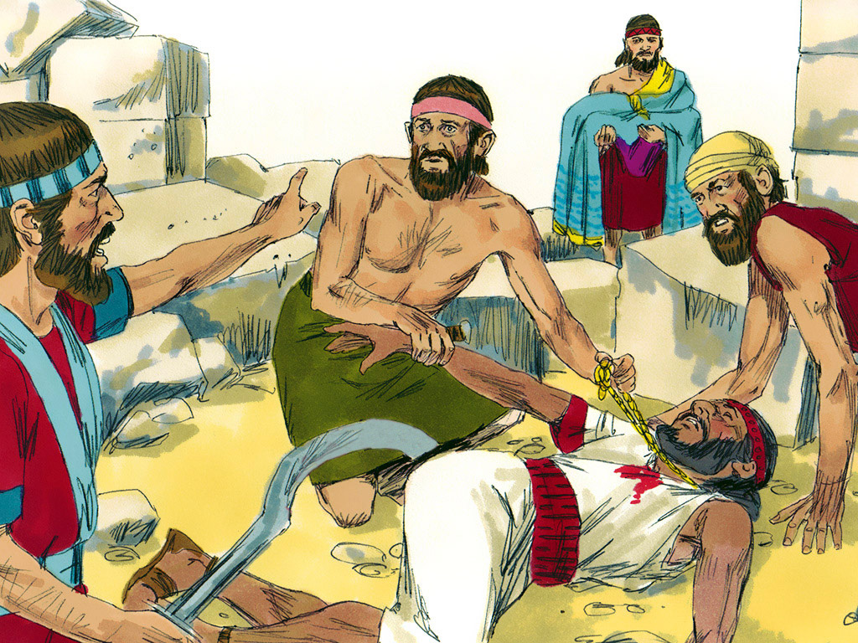
Joshua 6:16 (ESV)
¹⁷And the city and all that is within it shall be devoted to the Lord for destruction.
7:1 But the people of Israel broke faith in regard to the devoted things, for Achan the son of Carmi, son of Zabdi, son of Zerah, of the tribe of Judah, took some of the devoted things. And the anger of the Lord burned against the people of Israel.

Slide 20
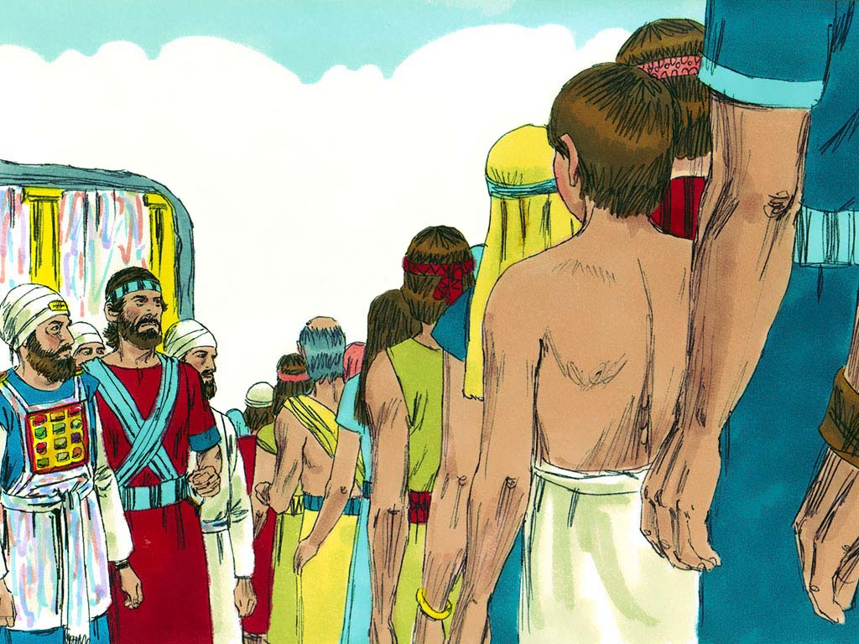
Joshua 7
” ¹⁶So Joshua rose early in the morning and brought Israel near tribe by tribe, and the tribe of Judah was taken.
¹⁷And he brought near the clans of Judah,
and the clan of the Zerahites was taken.
And he brought near the clan of the Zerahites man by man, and Zabdi was taken.
¹⁸And he brought near his household man by man, and Achan the son of Carmi, son of Zabdi, son of Zerah, of the tribe of Judah, was taken.

Slide 21
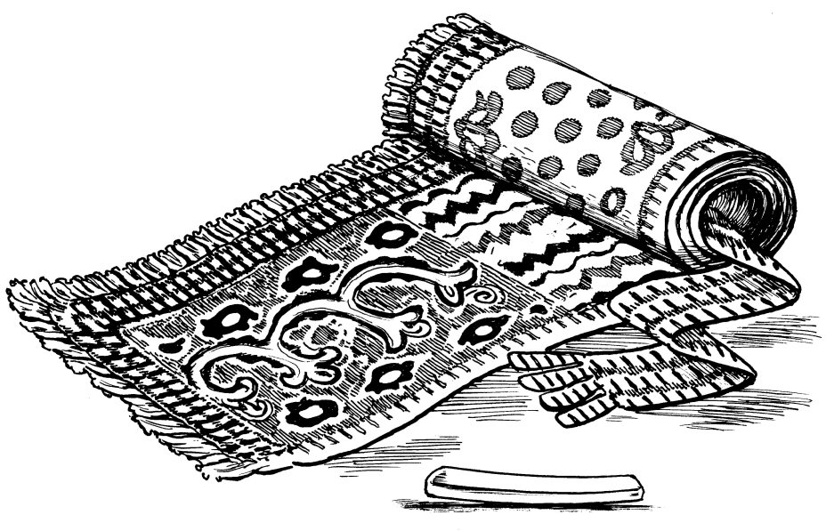
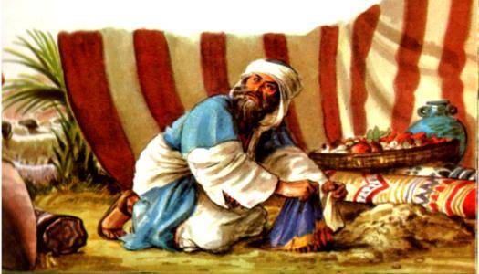
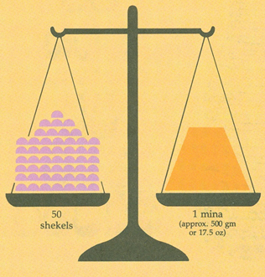
Sin of Ai
7:20-21 And Achan answered Joshua, “Truly I have sinned against the Lord God of Israel, and this is what I did:
when I saw among the spoil a beautiful cloak from Shinar, and 200 shekels of silver, and a bar of gold weighing 50 shekels, then I coveted them and took them. And see, they are hidden in the earth inside my tent, with the silver underneath.”
70oz of silver
17.5 oz of gold

Slide 22
Sin of Ai
Joshua 7:20-21
James 1:12-15
Ai’s Action in Joshua
when I saw among the spoil a beautiful cloak, gold & silver
then I coveted them
took them
Tempted in James
Drawn away by his own desires (lust-covet)
Desire gives birth to sin
Sin full grown brings death

Slide 23
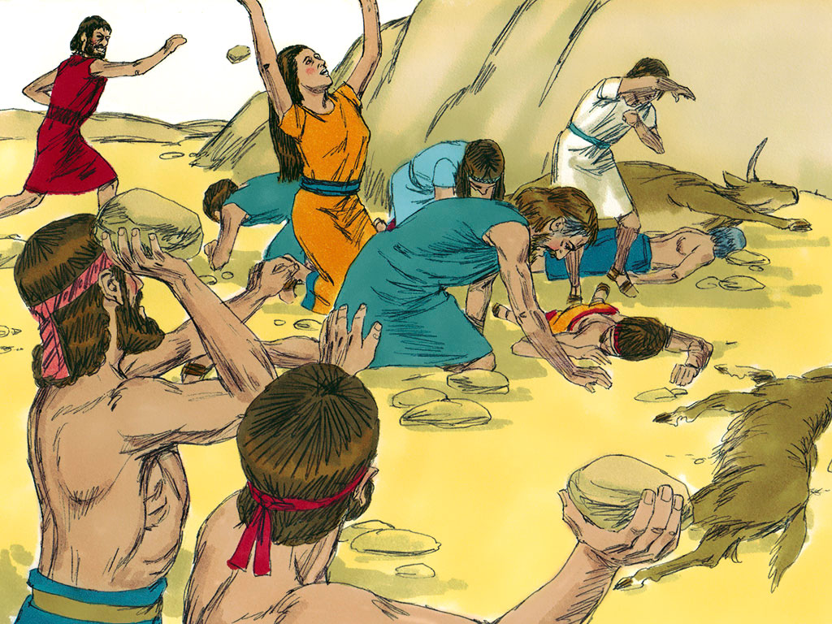
Joshua 7
²⁴And Joshua and all Israel with him took
Achan the son of Zerah,
and the silver
and the cloak
and the bar of gold,
and his sons
and daughters
and his oxen
and donkeys
and sheep
and his tent
and all that he had.
And they brought them up to the Valley of Achor.
²⁵And Joshua said, “Why did you bring trouble on us? The Lord brings trouble on you today.” And all Israel stoned him with stones. They burned them with fire and stoned them with stones.

Slide 24
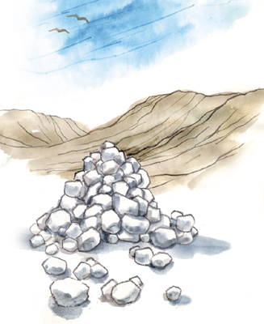
Death of Ai
25 … And all Israel stoned him with stones. They burned them with fire and stoned them with stones.
26 And they raised over him a great heap of stones that remains to this day. Then the Lord turned from his burning anger. Therefore, to this day the name of that place is called the Valley of Achor.

Slide 25
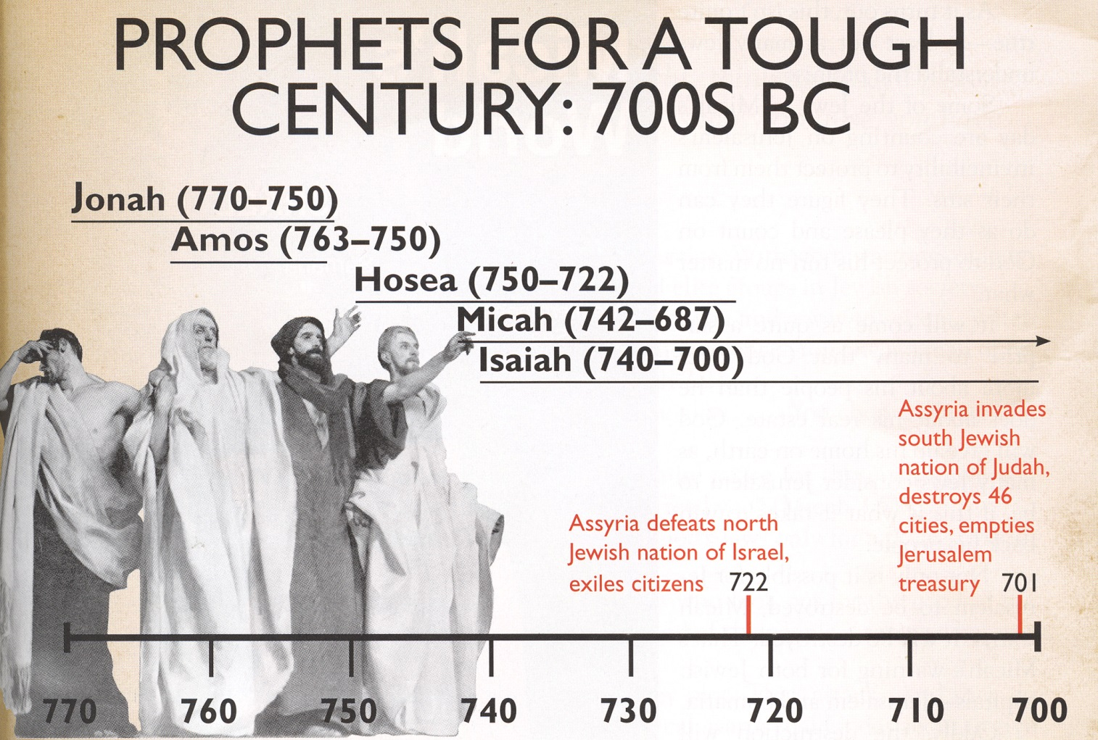

1400

Slide 26
Outline of Hosea
Marriage of Hosea to Gomer (1:1-3:5) (Adulterous wife & Faithful Husband)
  Hosea’s marriage (1:1-2:1)
  Application of Gomer to Israel’s sins (2:2-2:13)
  Lord’s Mercy (2:14-23)
  Restoration of Gomer (3:1-3:5)
Lord &Israel (3:6-14:9) (Adulterous Israel & Faithful Lord)
  Spiritual Adultery of Israel (4:1-6:3)
  Refusal of Israel to repent (6:4-8:14)
  Judgment of Israel by God (9:1-10:15)
  Restoration of Israel to God (11:1-14:9)

Slide 27
Promise of Restoration
Hosea 2:14-16(ESV)
¹⁴ “Therefore, behold, I will allure her,
and bring her into the wilderness,
and speak tenderly to her.
¹⁵ And there I will give her her vineyards
and make the Valley of Achor a door of hope.
And there she shall answer as in the days of her youth,
as at the time when she came out of the land of Egypt.
¹⁶“And in that day, declares the Lord, you will call me ‘My Husband,’ and no longer will you call me ‘My Baal.’

Slide 28
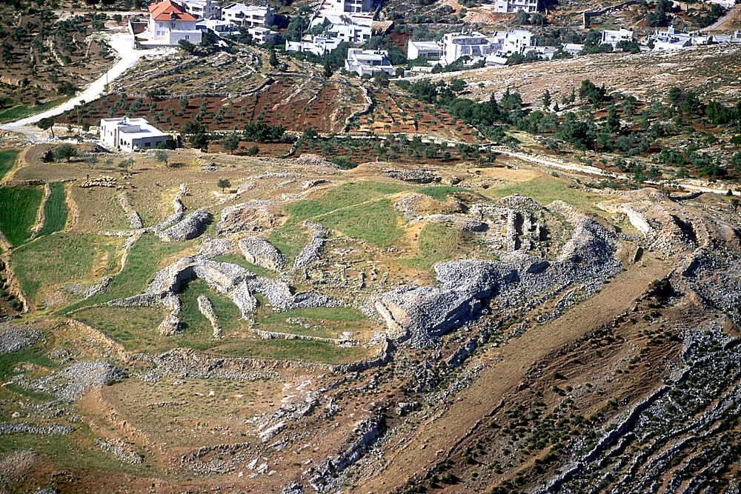
“Et”-is Arabic for “the ruin.” Ai is Hebrew for “the ruin.”
Et-Tell aerial from north
Notes:
Et-Tell: Introduction
Et-Tell is Arabic for “the ruin.” Ai is Hebrew for “the ruin.”
Most scholars accept et-Tell as Ai, but there are no remains from the Middle or Late Bronze Ages at the sate. Et-Tell was a large urban center in the Early Bronze Age, but it was destroyed at the end of Early Bronze III and later re-inhabited about 1150 BC.
Some argue that the topography of et-Tell works perfectly with the geographical description of Ai in Bible. However,
Robinson didn’t like et-Tell.
Condor didn’t like et-Tell.
Kitchener suggested Khirbet Haiy was the location of Ai, on the grounds that the story of Joshua could not have happened at et-Tell.
The battle narrative of the conquering Israelites under Joshua is very helpful in determining topographical features of the cities of both Bethel and Ai. In it, Ai is said to be near Beth Aven to the east of Bethel (Josh 7:2). There is evidently a valley to the north of Ai and Joshua and his men camped on the hill to the north of this valley, and another group was able to hide between Bethel and Ai, apparently without detection from either city (Josh 8:11-12). Another topographical feature is mentioned when the king of Ai leads his force to a “certain place overlooking the Arabah” in preparation for battle (Josh 8:14). This is evidently close to Ai.
Abram pitched his tent between the two cities, with Bethel to his west and Ai to his east (Gen 12:8).
tbs104299905

Slide 29
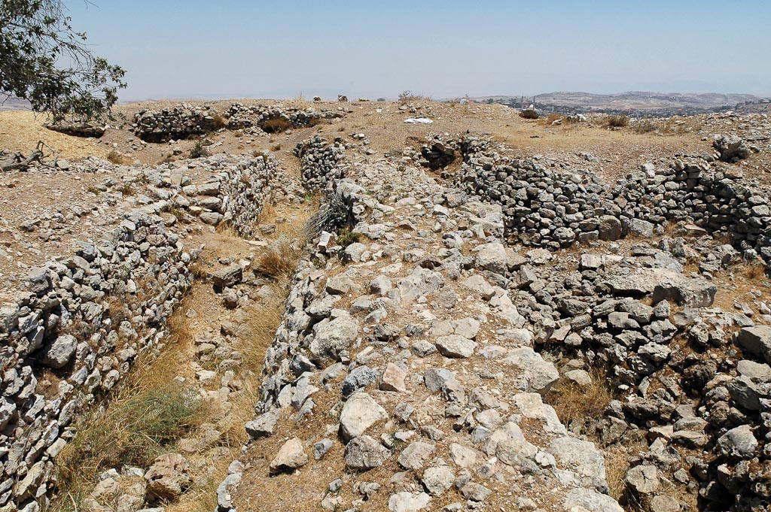
Et-Tell was completely abandoned between 2400 and 1220 BC
Et-Tell Early Bronze southern fortifications
Notes:
The Late Bronze Absence Problem at Et-Tell
Et-Tell was completely abandoned between 2400 and 1220 BC (Callaway 1993: 44).
The biblical data indicates that the city of Ai was destroyed by Joshua about 1400 BC (Joshua 7-8; 1 Kgs 6:1; Judg 11:26).
Such a discrepancy between the archaeological evidence and the biblical account must be explained. The difficulty is not resolved by the adoption of an early or late date conquest. Either suggestion faces a lack of occupation at et-Tell during their respective periods.
Possible solutions:
The biblical account is fictional. The story was made up to explain the existence of this prominent ruin.
The archaeological conclusion concerning the inhabitation history of et-Tell is incorrect.
Ai was another site nearby, but the name shifted.
The most common approach to the lack of remains at Ai in the Late Bronze Age is to assume that the biblical account is fictitious, in whole or in part. Martin Noth and Judith Marquet-Krause regarded the recorded battle against Ai as “a purely aetiological story lacking historical foundation... a typical folk tale” (Aharoni 1979: 210).
Another interpretation:
The evangelical International Standard Bible Encyclopedia interprets the story differently in order to account for the negative archaeological evidence (Ewing and Harrison 1979: 466). Following Vincent (1937), they adopt the 13th century BC as the time of Joshua’s conquest and argue that the battle was against the neighboring town of Bethel, but as the encounter was won at Ai, the event was described in terms of the latter place. Such an interpretation creates more difficulties than it resolves. Repeatedly in the biblical record, Ai is mentioned as distinct from Bethel. Clearly Ai was a city in its own right: “not a man remained in Ai or Bethel” (Josh 8:17); “[Joshua] hung the king of Ai on a tree and left him there until evening” (Josh 8:29); “Joshua burned Ai and made it a permanent heap of ruins” (Josh 8:28); “[the] king of Jerusalem heard that Joshua had taken Ai and totally destroyed it” (Josh 10:1), etc. In several places in the narrative, the city is clearly described as having a “city gate” (Josh 7:5, 8:29). Thus it is difficult to argue from the biblical text that Ai was not a distinct city with its own ruler and fortifications.
The excavator of Bethel, James L. Kelso, argues along a similar vein, suggesting “that the two names, Bethel-Ai, are blended into a common episode” or “that the Bethel army moved to Ai and tried to make a preliminary defense there” (1962: 391).
Et-Tell was inhabited from 1150-1050 BC, which does not fit the biblical description that the city was “in ruins to this day” (Josh 8:28).
Perhaps et-Tell is not Ai.
Besides his otherwise critical suggestions, Kelso proposes another alternative, which “is to locate a nearby ruin which can answer to Ai, but this has not yet been done” (1962: 391).
Any proposed site would have to fit within defined boundaries: be east of Bethel, and have the right topography.
There are limited possibilities because of defined parameters.
The site must fit all biblical descriptions.
The site must have appropriate archaeology.
What about the name? Has Ai moved?
The first modern explorer, Edward Robinson, was certain that Beitin was the ancient city of Bethel on the basis of name preservation. He was unsure of the location of Ai but suggested et-Tell and preferred Khirbet Khaiyan, 2.4 miles (1.5 km) southeast of et-Tell. However, excavations at Khirbet Khaiyan in 1964 and 1969 dated the earliest settlement to the 1st century AD.
In the 1870s, Claude Condor also preferred Khirbet Khaiyan.
Condor’s partner, Horatio Kitchener, was even more convinced that et-Tell was not Ai, on the grounds that the biblical narrative of Joshua could not have taken place at et-Tell, suggesting instead the site of Khirbet Hai, southeast of Mukhmas (Callaway 1968: 314).
Guerin suggested that Ai was at Khirbet Khudriya, east of et-Tell. However, the earliest remains there are Byzantine.
Khirbet Raddana (Iron Age) has also been proposed as the site of Ai.
In 1924, before excavations, Albright proposed et-Tell as the site based upon the results of his survey, which determined that et-Tell was the only site with the right period of occupation for the conquest of Joshua. Though this was disproved, the site was not dropped from consideration, but has only been defended more adamantly.
tb071304386

Slide 30
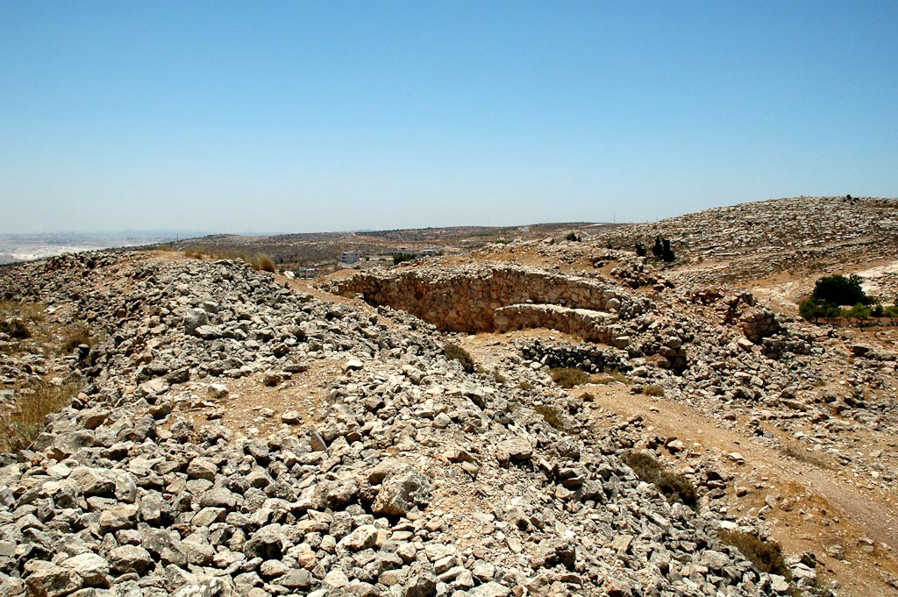
The difficulty is not resolved by the adoption of an early or late date conquest. Either suggestion faces a lack of occupation at et-Tell during their respective periods.
If a site other than et-Tell is actually Ai?
Et-Tell Early Bronze western fortifications
Notes:
Conclusion on the Problem of Ai
Callaway has chastised members of his own denomination (Southern Baptist) for their “wrong interpretation” of the conquest narrative and comments on the “damage to the social and religious fabric of our society” because of such radical fundamentalist beliefs that hold Scripture to be literally true.
“What we see then, in the conquest accounts in general, and in the Ai account in particular, is a rather free use of ancient sources expanded and interpreted to speak to the needs of later generations. At the same time, there was enough respect for the traditions that no effort was made to synthesize them into a harmonious narrative without repetitions, numerical inaccuracies and contradictions. This faithfulness in preserving traditions that did not always agree in details is, to me, evidence of their authenticity, and it says something about the people who preserved these traditions. I do not believe that they would spin a tale out of whole cloth about some landmark such as the mound of Ai. Instead, they worked with ancient oral and written traditions handed down from generation to generation. During this process, the history of places such as Ai and Gibeon yielded to theological constructs that built up layers of interpretation like strata in a tell, forever concealing the real events themselves” (Callaway 1985: 69).
The problem with Callaway’s conclusion is that it assumes Ai to be et-Tell and, on the basis of that assumption, denies biblical historicity. If a site other than et-Tell is actually Ai, then Callaway has proved nothing. In fact, Callaway uncovered no evidence to support his assumption that et-Tell was Ai. His best argument is its general location (east of the apparent location of Bethel) and the fact that it is a site in ruins.
It is a remarkable thing that the most detailed geographical passage in the Bible (the battle of Ai) is assumed to be wholly fabricated.
tb071304409

Slide 31
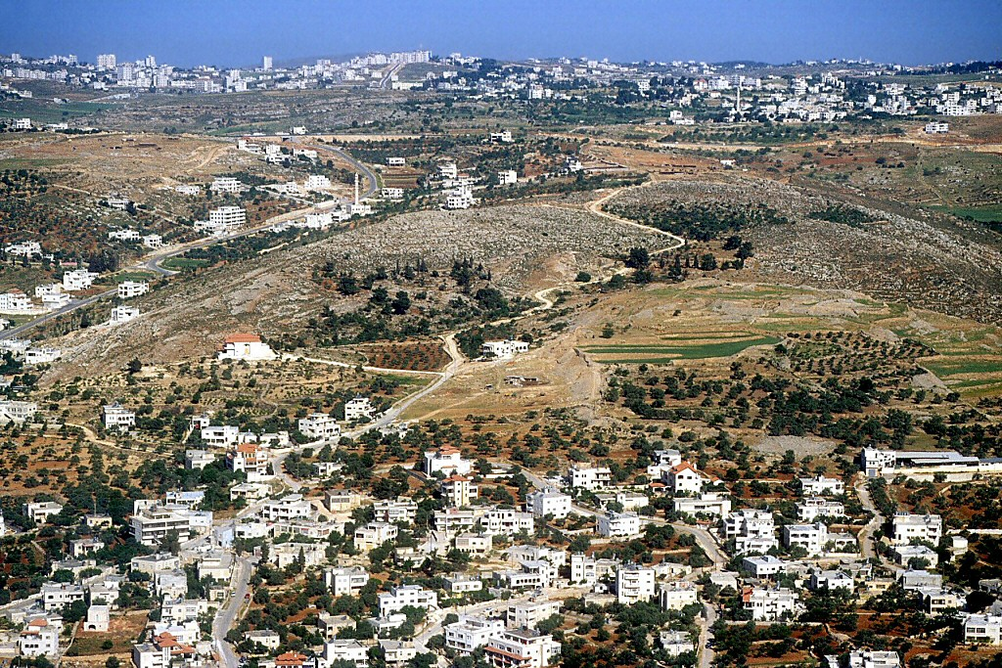
Khirbet el-Maqatir
Beitin
Et-Tell
1.6 miles west
Et-Tell, Khirbet el-Maqatir, Beitin aerial from east
Notes:
Tbs104309905
Alternate Site for Ai: Khirbet el-Maqatir
Following Callaway’s conclusion that et-Tell was the location biblical Ai, and that the biblical story of Ai was fictional, other scholars began looking for other candidates for Ai.
Excavations at Khirbet el-Maqatir began in 1995 under the direction of Bryant G. Wood and the Associates for Biblical Research.
The site is 10 miles (16 km) north of Jerusalem and 1.6 miles (1 km) west of et-Tell.

Slide 32
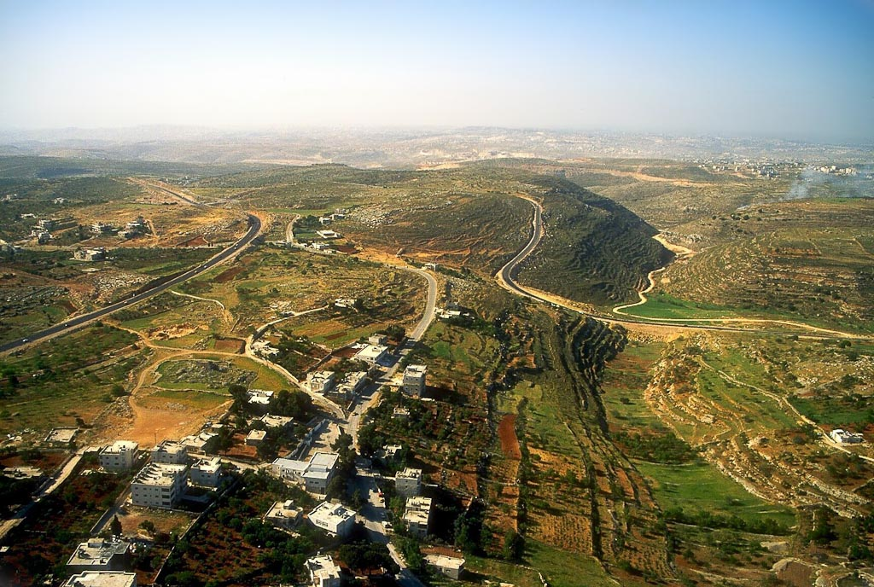
Et-Tell
Khirbet el-Maqatir
(Ai?)
Jerusalem
Wadi Sheban
(Ambush Force)
Bethel
Khirbet el-Maqatir and Wadi Sheban aerial
Notes:
Tbs104369905
Topographical Features of Khirbet el-Maqatir
The topography of Khirbet el-Maqatir fits the biblical requirements, and is also hidden from el-Bireh (Bethel?) by ridges.
Khirbet el-Maqatir is east of the candidates for Bethel (Josh 7:2).
There is a hill and valley to the north (Josh 8:11) of Khirbet el-Maqatir, where Joshua’s command post could have been.
There is an ambush area to the west (Josh 8:9, 12). Wadi Sheban is a deep valley, hidden from Khirbet el-Maqatir by a ridge.
Khirbet el-Maqatir is a small place, occupying only about 2 acres in the Late Bronze Age. Thus it is smaller than Jericho and Gibeon (Josh 7:3; 10:2).
To prove that Khirbet el-Maqatir is the Ai of Joshua, certain archaeological evidence would be expected:
Fortifications from the time of Joshua (Josh 7:5; 8:29).
A city gate on the north side of the fortress (Josh 8:11).
Evidence that the fortress was destroyed by fire at the time of Joshua (Josh 8:19, 28).

Slide 33
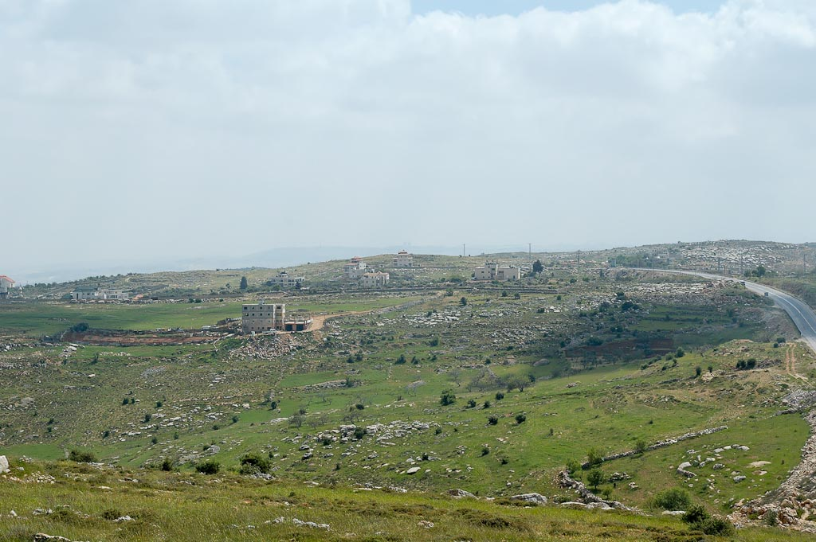
Khirbet el-Maqatir
(Ai?)
Khirbet el-Maqatir from north
Notes:
tb041106364

Slide 34
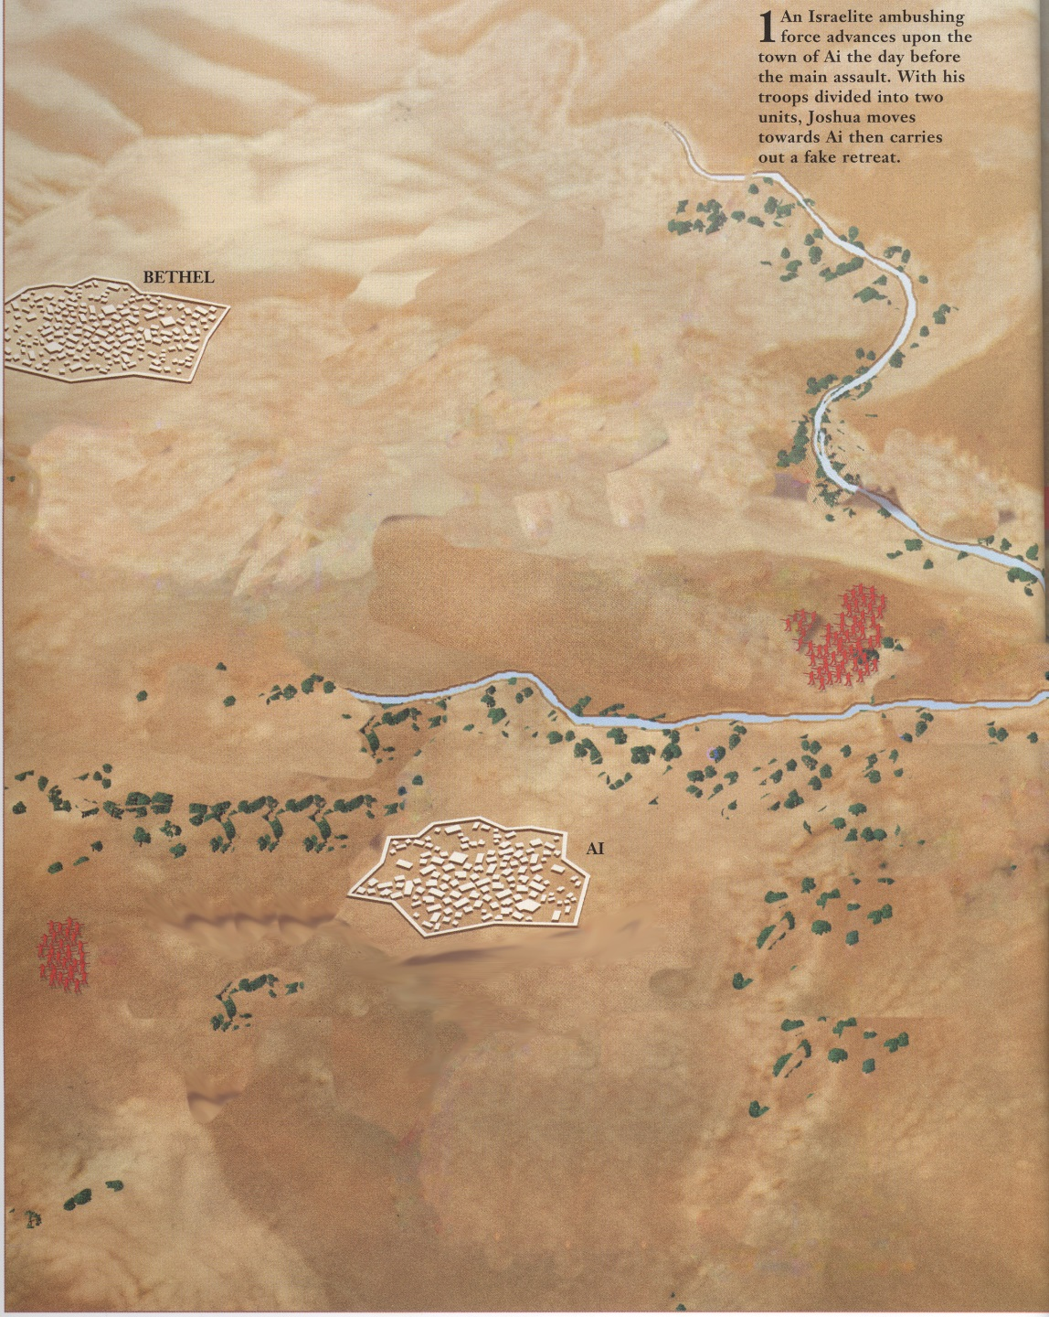
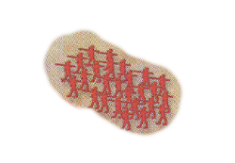
Joshua 8
1-5000 men Bethel/Ai
1-I and all the people who are with me will approach the city.
1-30,000 mighty men of valor and sent them out by night.

Slide 35

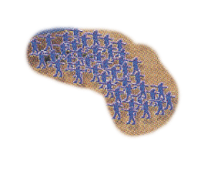
Joshua 8
1-5000 men Bethel/Ai
2-And when they come out against us just as before,
1- I and all the people who are with me will approach the city.
North Gate
1-30,000 mighty men of valor and sent them out by night.

Slide 36

Joshua 8
1-5000 men Bethel/Ai
2-And when they come out against us just as before,
North Gate
1-30,000 mighty men of valor and sent them out by night.
3- we shall flee before them.

Slide 37

Joshua 8
1-5000 men Bethel/Ai
4- And they will come out after us, until we have drawn them away from the city. For they will say, ‘They are fleeing from us, just as before.’ So we will flee before them.
North Gate
3- we shall flee before them.
1-30,000 mighty men of valor and sent them out by night.

Slide 38



Joshua 8
1-5000 men Bethel/Ai
5-Then you shall rise up from the ambush and seize the city, for the Lord your God will give it into your hand.
And as soon as you have taken the city, you shall set the city on fire.
4- And they will come out after us, until we have drawn them away from the city. For they will say, ‘They are fleeing from us, just as before.’ So we will flee before them.
North Gate
Not a man was left in Ai or Bethel who did not go out after Israel. They left the city open and pursued Israel.
1-30,000 mighty men of valor and sent them out by night.
3- we shall flee before them.

Slide 39


Joshua 8
1-5000 men Bethel/Ai
6-And when Joshua and all Israel saw that the ambush had captured the city, and that the smoke of the city went up, then they turned back and struck down the men of Ai.
7- And Israel struck them down, until there was left none that survived or escaped
North Gate
Not a man was left in Ai or Bethel who did not go out after Israel. They left the city open and pursued Israel.
1-30,000 mighty men of valor and sent them out by night.
3- we shall flee before them.

Slide 40
Reflected his mentor, Moses Exodus 24:13; 33:11
Loyal – Numbers 11
Courageous – Numbers 14:6-10
Emotional – Joshua 7:6
Intelligence/Wise military man – Joshua 8:3-29
Could be beguiled – Joshua 9:3-27
Prophetic – Joshua 6:26-27
Strong religious leader Judges 2:7
Obedient/Devoted to God Joshua 23-24
Good Example – Joshua 24:14-15
Focused – spied out Canaan Numbers 14
Endurance – Joshua 12
Speaking Ability – Joshua 24
Kept Oath – Joshua 9-10

Slide 41
A Ready Defense
In the words of Joseph Callaway (1968: 312), the
most recent excavator of et-Tell (1964–70):
“Ai is simply an embarrassment to every view of the conquest that takes the biblical and archaeological evidence seriously.” As a result, most scholars have concluded that the biblical account of the conquest of Ai in Joshua 7–8 is nonhistorical.

Slide 42
A Ready Defense
“This lack of any Late Bronze Canaanite city at the site [of et-Tell] or in the vicinity contradicts the narrative in Joshua 8 and shows that it was not based on historical reality despite its topographical and tactical plausibility” (Mazar 1990: 331, emphasis added).

Slide 43
Ai a Strategically Significant Site (Jos 7:2) - clear line-of-sight to Jerusalem
The topography (hills and valleys) must fit the Biblical description
a. Near Beth Aven (Jos 7:2) - is just 1 mi southeast of Beitin (Beth Aven)
b. Near and East of Bethel (Jos 7:2) - is 2 miles east of el-Bireh (Bethel).
c. Ambush Site West of Ai (Jos 8:9, 12) - the Wadi Sheban between Bethel & Ai
d. A Militarily Significant Hill North of Ai (Jos 8:11, 13) Jebel Abu Ammar, 1 mi north of Kh. el-Maqatir (Ai), is the highest hill in the region
e. A Shallow Valley North of Ai (Jos 8:13–14) The valley north of Ai must have been a shallow valley in order for the king of Ai to observe Joshua and his men. The Wadi el-Gayeh is just such a valley.
It must be smaller than Gibeon, but not to small to be insignificant. Late Bronze I fortress at Kh. el-Maqatir (Ai - less than 3 acres) smaller than 7 acres of Gibeon
It must be fortified with walls & a north gate just prior to Israelite invasion – Yes
It must be occupied or deserted at the times matching the Biblical chronology
Destroyed by Fire (Jos 8:28) - is abundant evidence that Late Bronze I fortress was destroyed by fire
A Ruin Forever (Jos 8:28) - Following the destruction of the Late Bronze I fortress it was abandoned & left exposed to the elements, later scavengers & the farmer’s plow.

Slide 45
What should be seen at Jericho?
Houses in wall (2:15) Rahab lived in the wall
Harvest Time (3:15) find grain??
Walls Fallen (6:20) wall fell down flat
Wall Make a Ramp (6:20) people went up into the city
City Burned (6:24) burned the city
Sign saying Joshua was here
Yes
Yes
Yes
Yes
Yes
No

Slide 46
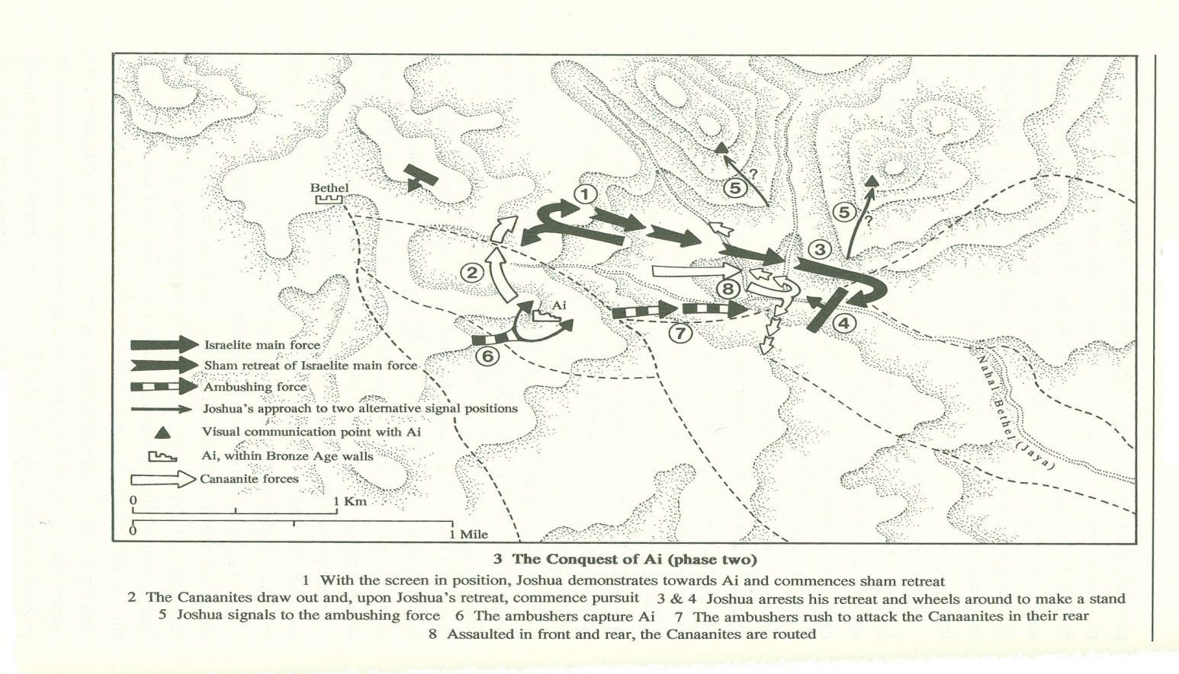
Second Battle of Ai
Take all the fighting men with you
ambush against the city, behind it. With 30,000 men
And when they come out against us just as before, we shall flee before them.
rise up from the ambush and seize the city
as soon as you have taken the city, you shall set the city on fire
Rear guard of 5000 at Bethel
Main Force – in sight of Ai
Flee as in 1st Battle
Ambush force
Turns & Fights
Ambush force hits from behind

