Slide 1
Gods Word
Song Service for Wednesday Night, February 18, 2015

Slide 2
How Shall Young Secure their Hearts All stanzas
Page 253
Praise For the Lord

Slide 3
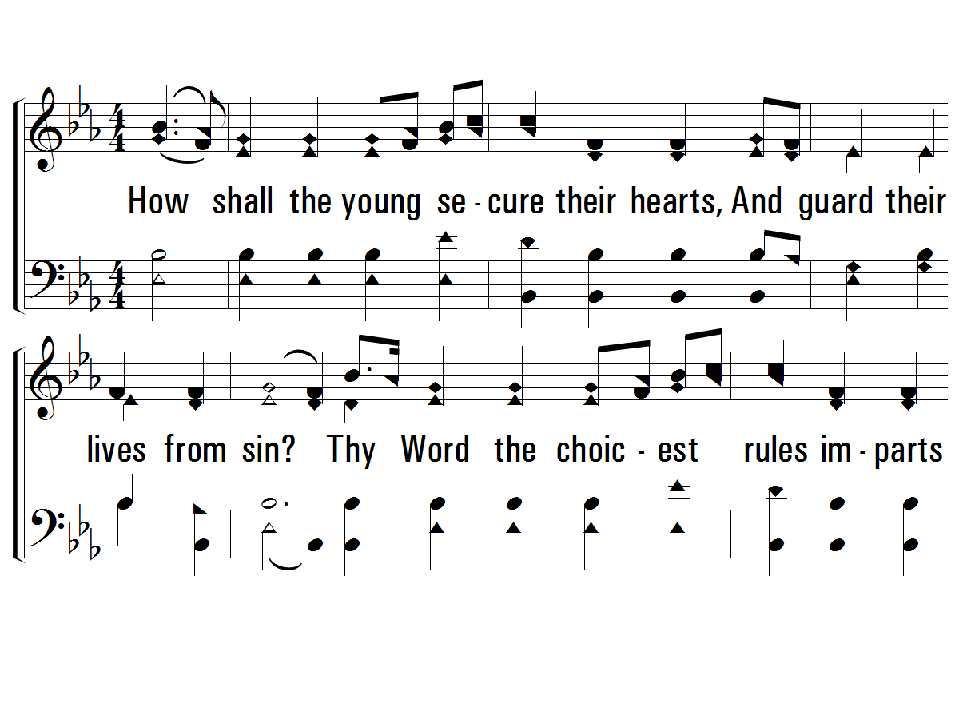
1 - How Shall the Young Secure Their Hearts?
253
1.
How shall the young secure their hearts,
And guard their lives from sin?
Thy Word the choicest rules imparts
To keep the conscience clean,
To keep the conscience clean.
Words by: Isaac Watts
Music by: Hasting’s & Bradbury’s Psalmista
© 2001 The Paperless Hymnal™

Slide 4
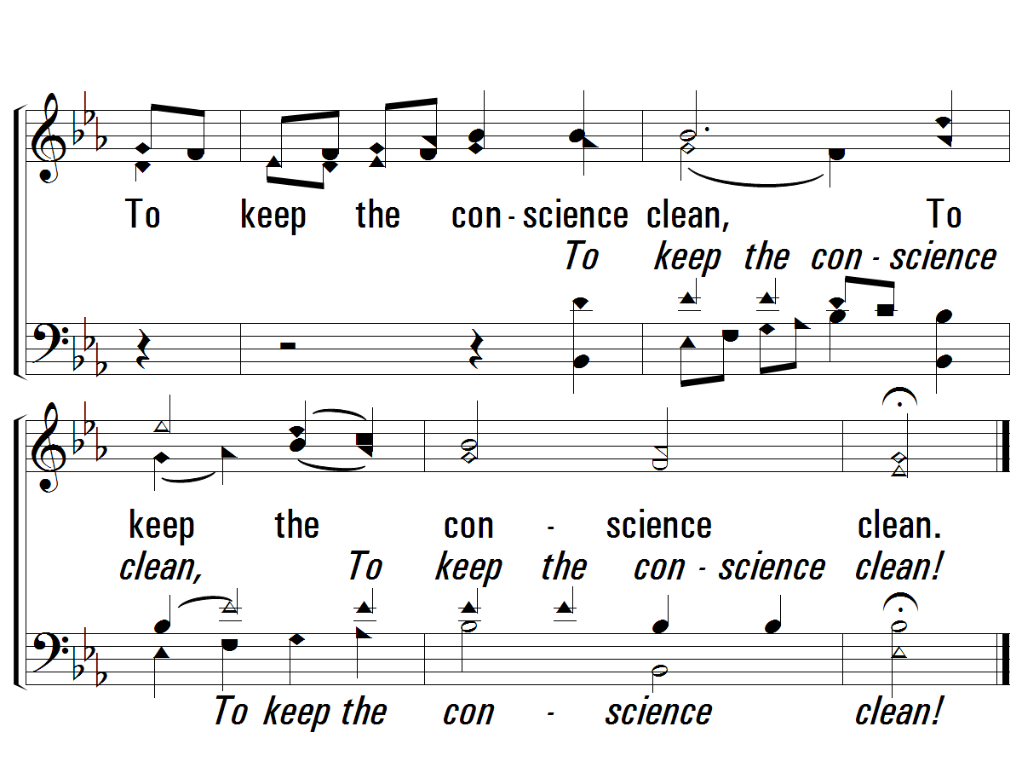
1 - How Shall the Young Secure Their Hearts?
253
© 2001 The Paperless Hymnal™

Slide 5
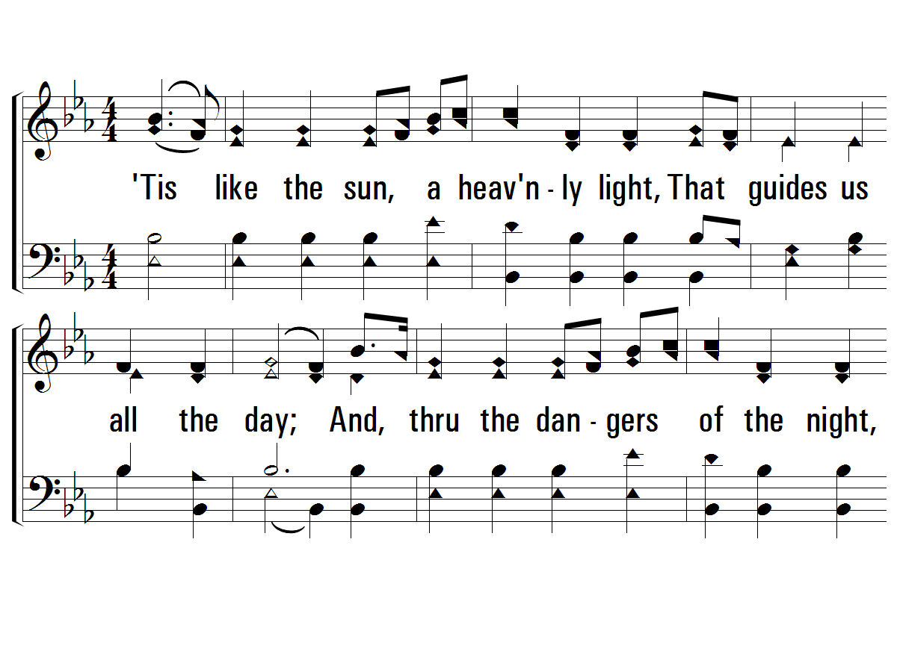
2 - How Shall the Young Secure Their Hearts?
253
2.
'Tis like the sun, a heavenly light,
That guides us all the day;
And, thru the dangers of the night,
A lamp to lead our way,
A lamp to lead our way.
Words by: Isaac Watts
Music by: Hasting’s & Bradbury’s Psalmista
© 2001 The Paperless Hymnal™

Slide 6
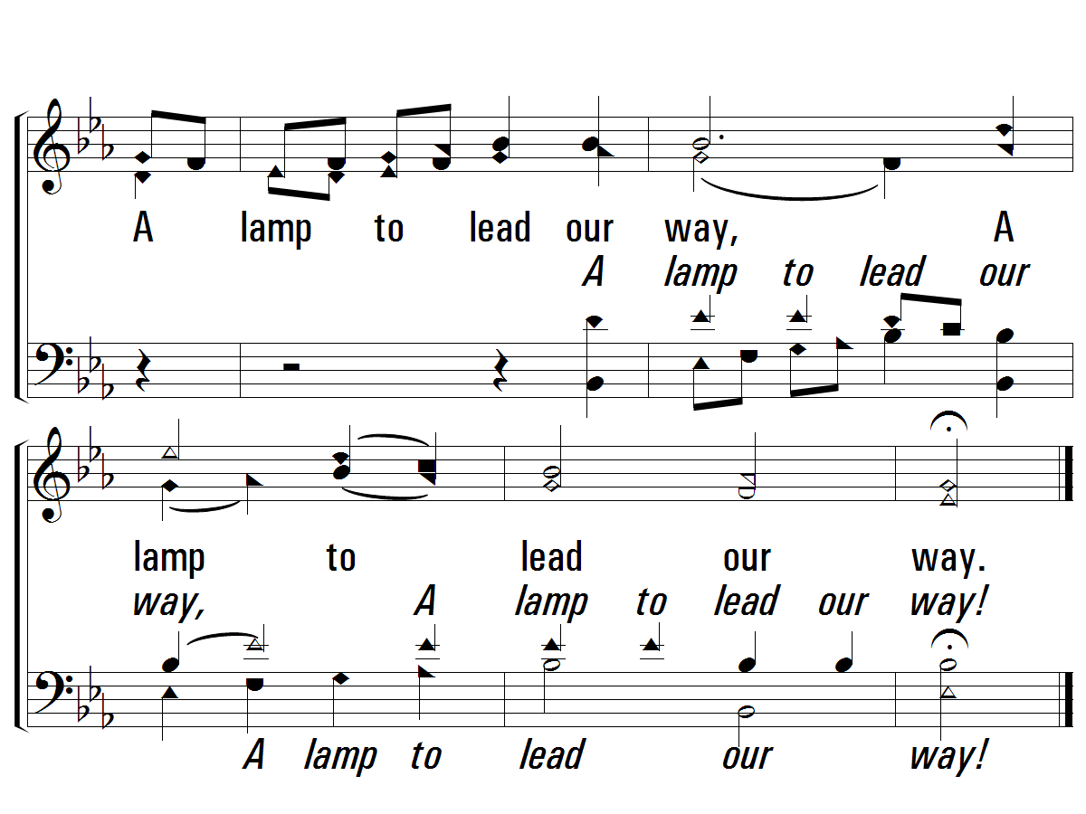
2 - How Shall the Young Secure Their Hearts?
253
© 2001 The Paperless Hymnal™

Slide 7
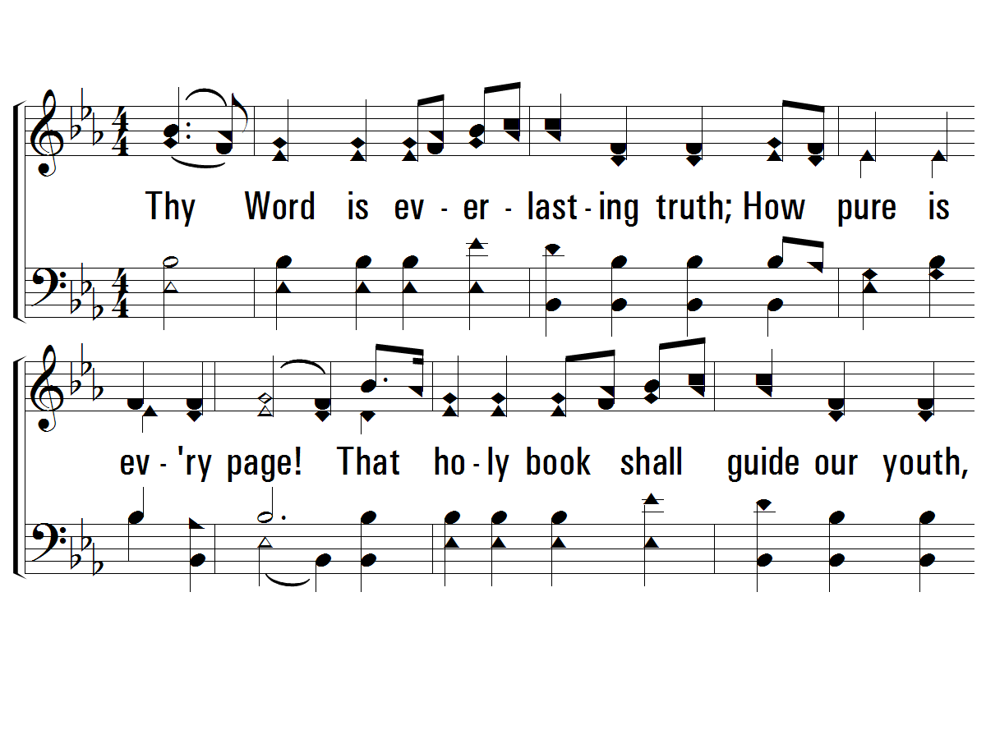
3 - How Shall the Young Secure Their Hearts?
253
3.
Thy Word is everlasting truth;
How pure is every page!
That holy book shall guide our youth,
And well support our age,
And well support our age.
Words by: Isaac Watts
Music by: Hasting’s & Bradbury’s Psalmista
© 2001 The Paperless Hymnal™

Slide 8
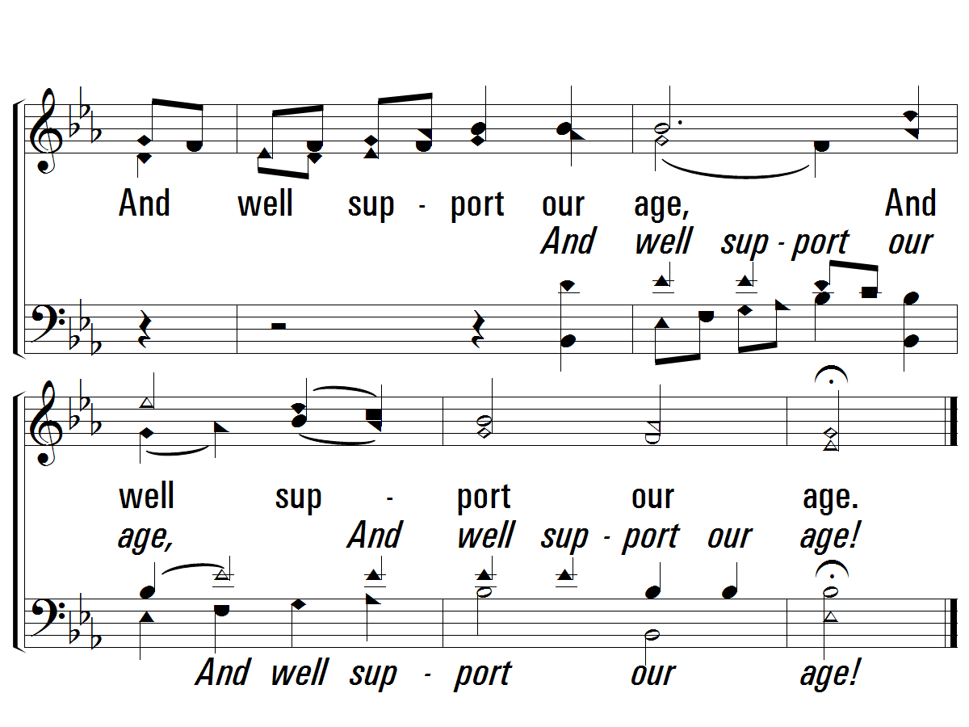
3 - How Shall the Young Secure Their Hearts?
253
END
© 2001 The Paperless Hymnal™

Slide 9
John 6:11-14, 47-55, 63

Slide 10
Hungry and Faint and Poor All stanzas
Page 258
Praise For the Lord

Slide 11
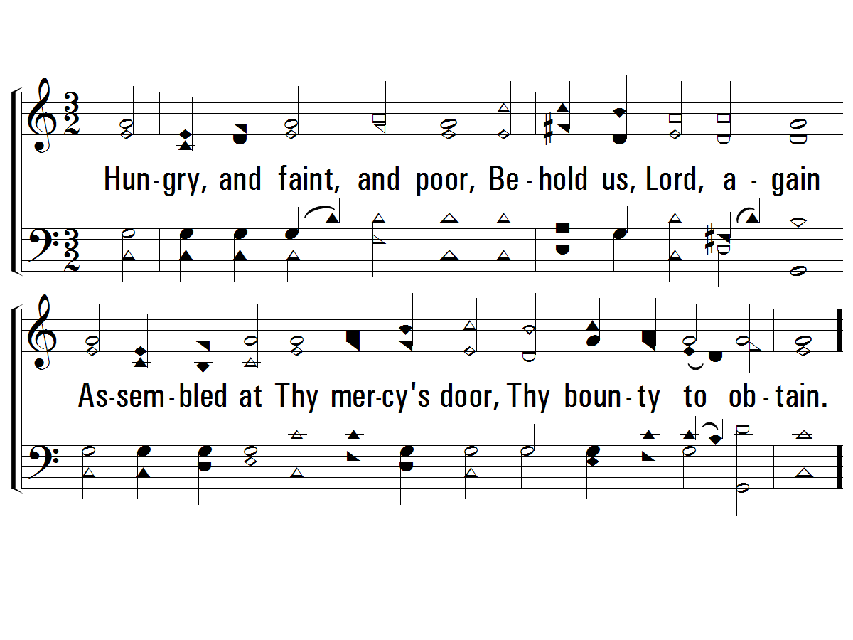
1 - Hungry, and Faint, and Poor
258
1.
Hungry, and faint, and poor,
Behold us, Lord, again
Assembled at Thy mercy's door,
Thy bounty to obtain.
Words: John Newton
Music: Lowell Mason
© 2006 The Paperless Hymnal™

Slide 12
2 - Hungry, and Faint, and Poor
258
2.
Thy word invites us nigh,
Or we would starve indeed;
For we no money have to buy,
Nor righteousness to plead.
Words: John Newton
Music: Lowell Mason
© 2006 The Paperless Hymnal™

Slide 13
3 - Hungry, and Faint, and Poor
258
3.
The food our spirits want,
Thy hand alone can give;
O hear the prayer of faith, and grant
That we may eat and live!
Words: John Newton
Music: Lowell Mason
© 2006 The Paperless Hymnal™

Slide 14
4 - Hungry, and Faint, and Poor
258
4.
Here, by the fount we stay,
Here eat this bread of Thine;
Then go rejoicing on our way,
Renewed with strength divine.
END
Words: John Newton
Music: Lowell Mason
© 2006 The Paperless Hymnal™

Slide 15
Break Thou the Bread of Life All stanzas
Page 282
Psalms, Hymns, Spiritual Songs

Slide 16
BreakThouTheBreadOfLife_st1_a
Vs 1
© 2014 Sumphonia Productions, LLC

Slide 17
BreakThouTheBreadOfLife_st1_b
Vs 1
© 2014 Sumphonia Productions, LLC

Slide 18
BreakThouTheBreadOfLife_st2_a
Vs 2
© 2014 Sumphonia Productions, LLC

Slide 19
BreakThouTheBreadOfLife_st2_b
Vs 2
© 2014 Sumphonia Productions, LLC

Slide 20
BreakThouTheBreadOfLife_st3_a
Vs 3
© 2014 Sumphonia Productions, LLC

Slide 21
BreakThouTheBreadOfLife_st3_b
Vs 3
© 2014 Sumphonia Productions, LLC
End

Slide 22
Psalm 19:7-11

Slide 23
The Law of the Lord All stanzas
Page 10
Psalms, Hymns, Spiritual Songs

Slide 24
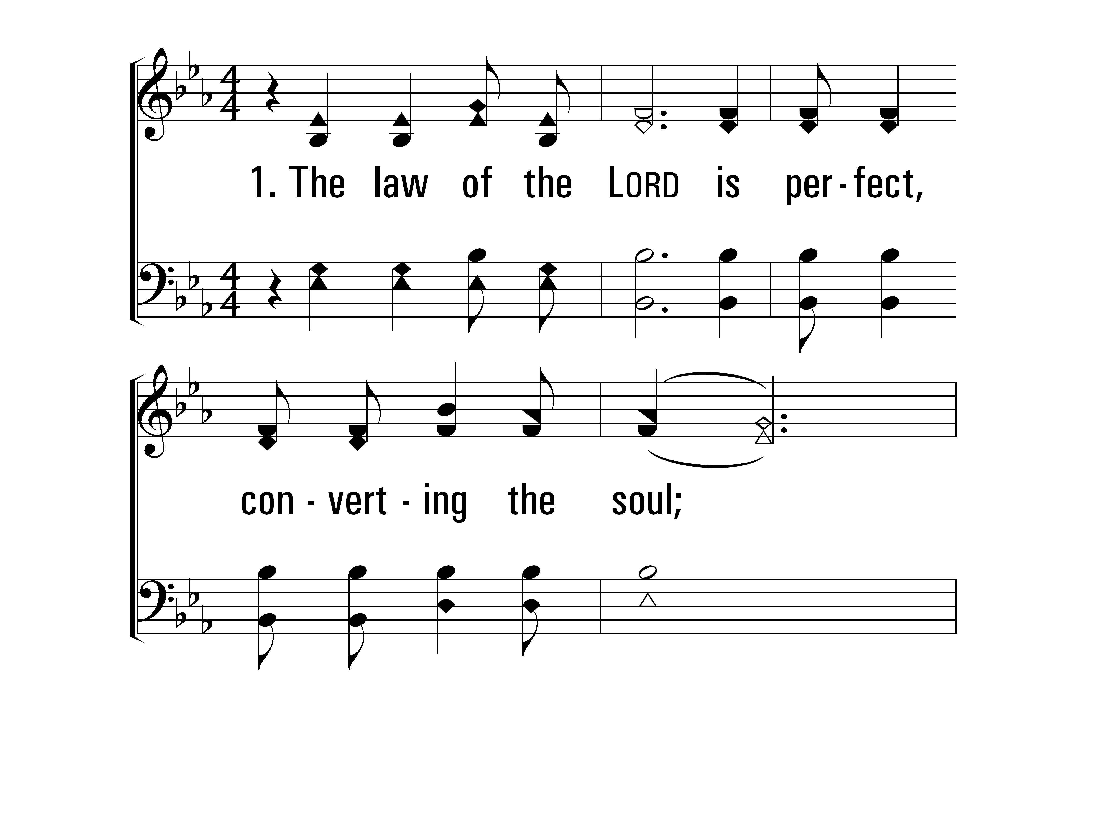
TheLawOfTheLord_st1_a
Vs 1
© 2014 Sumphonia Productions, LLC

Slide 25
TheLawOfTheLord_st1_b
Vs 1
© 2014 Sumphonia Productions, LLC

Slide 26
TheLawOfTheLord_cho_a
Chorus
© 2014 Sumphonia Productions, LLC

Slide 27
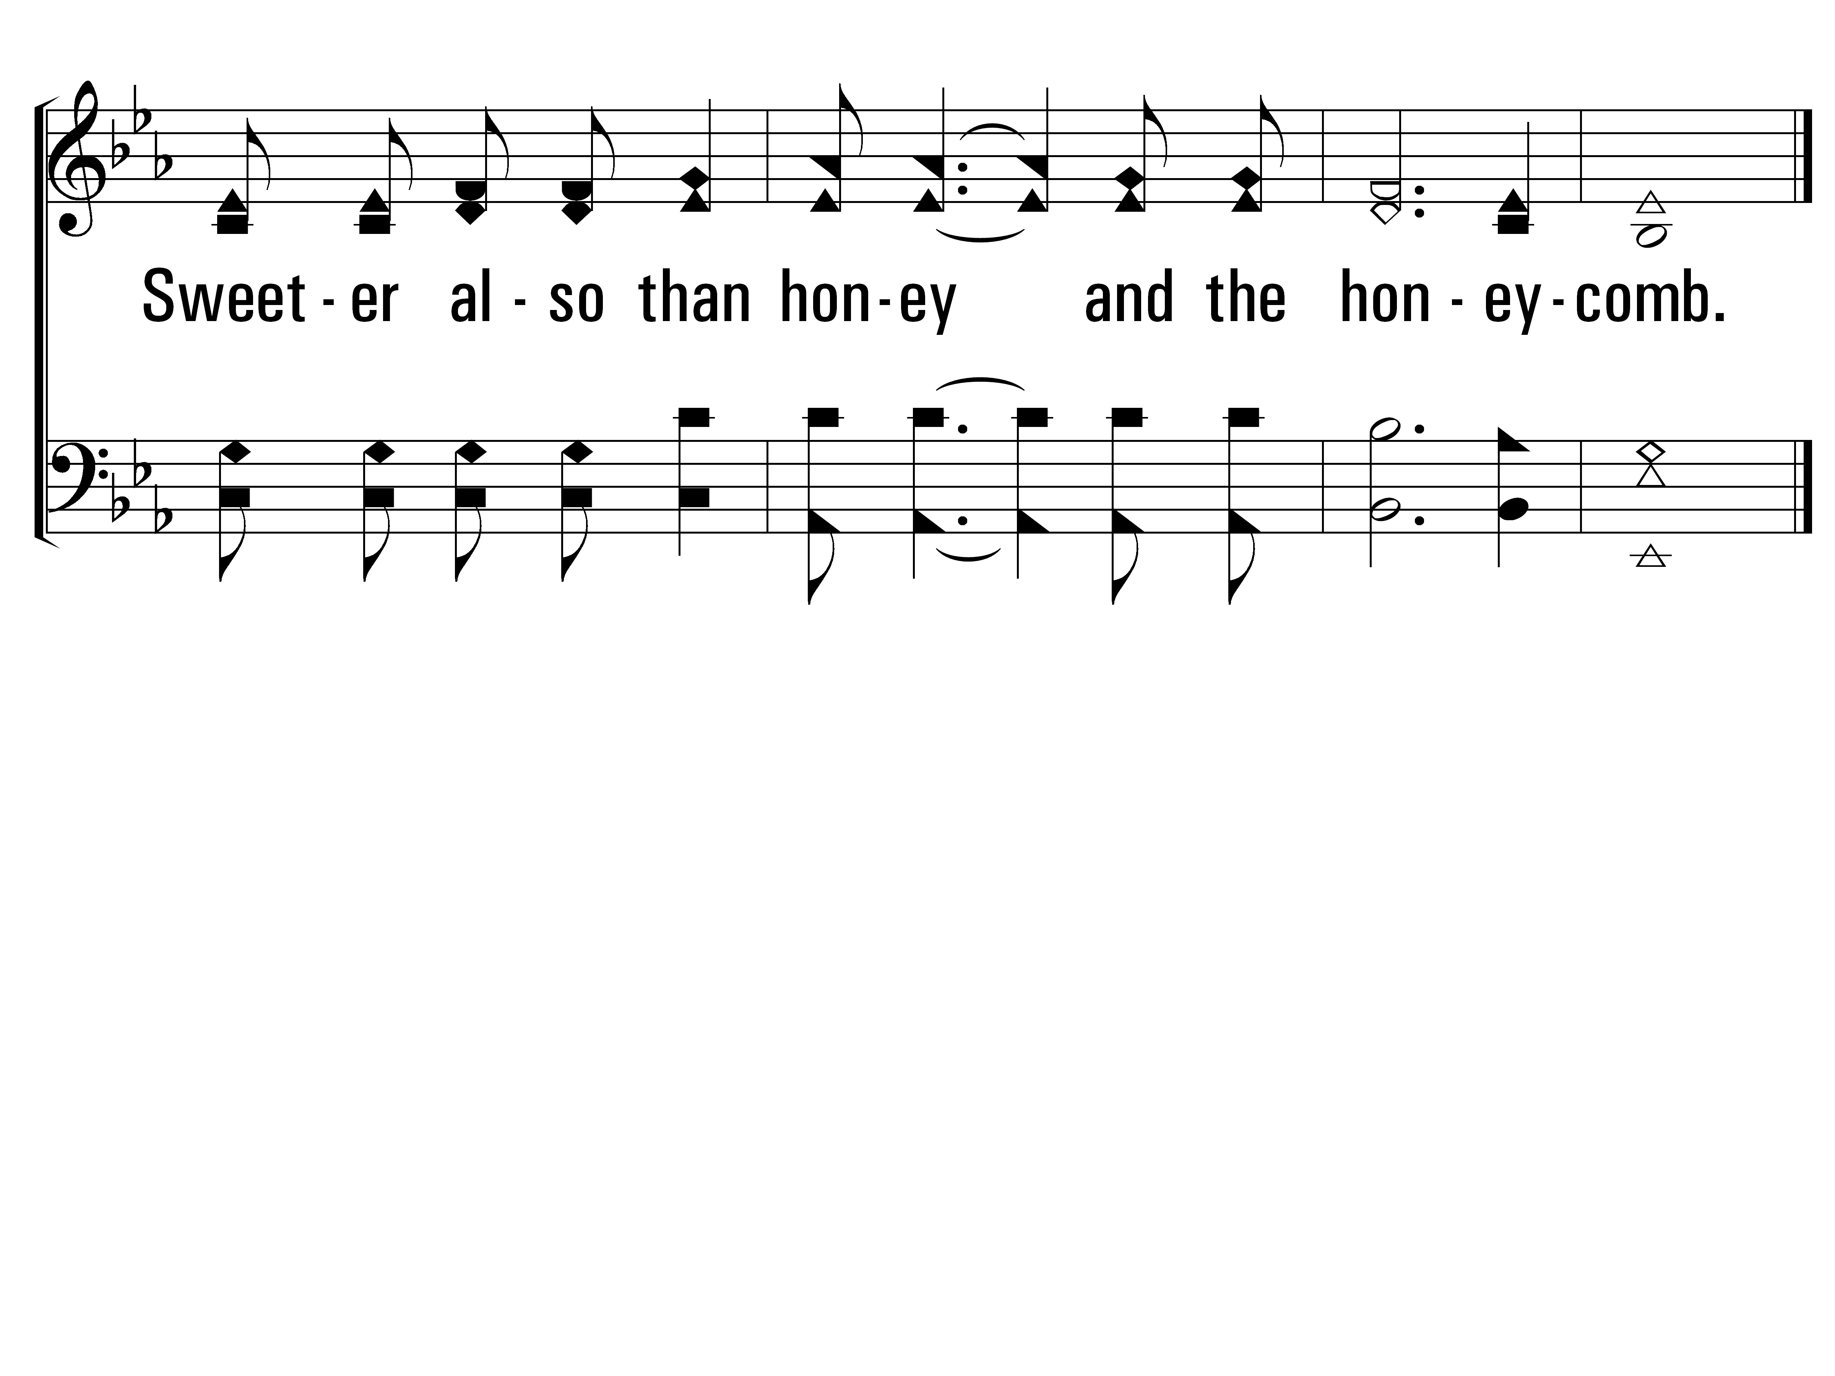
TheLawOfTheLord_cho_b
Chorus
© 2014 Sumphonia Productions, LLC

Slide 28
TheLawOfTheLord_st2_a
Vs 2
© 2014 Sumphonia Productions, LLC

Slide 29
TheLawOfTheLord_st2_b
Vs 2
© 2014 Sumphonia Productions, LLC

Slide 30
TheLawOfTheLord_cho_a
Chorus
© 2014 Sumphonia Productions, LLC

Slide 31
TheLawOfTheLord_cho_b
Chorus
© 2014 Sumphonia Productions, LLC

Slide 32
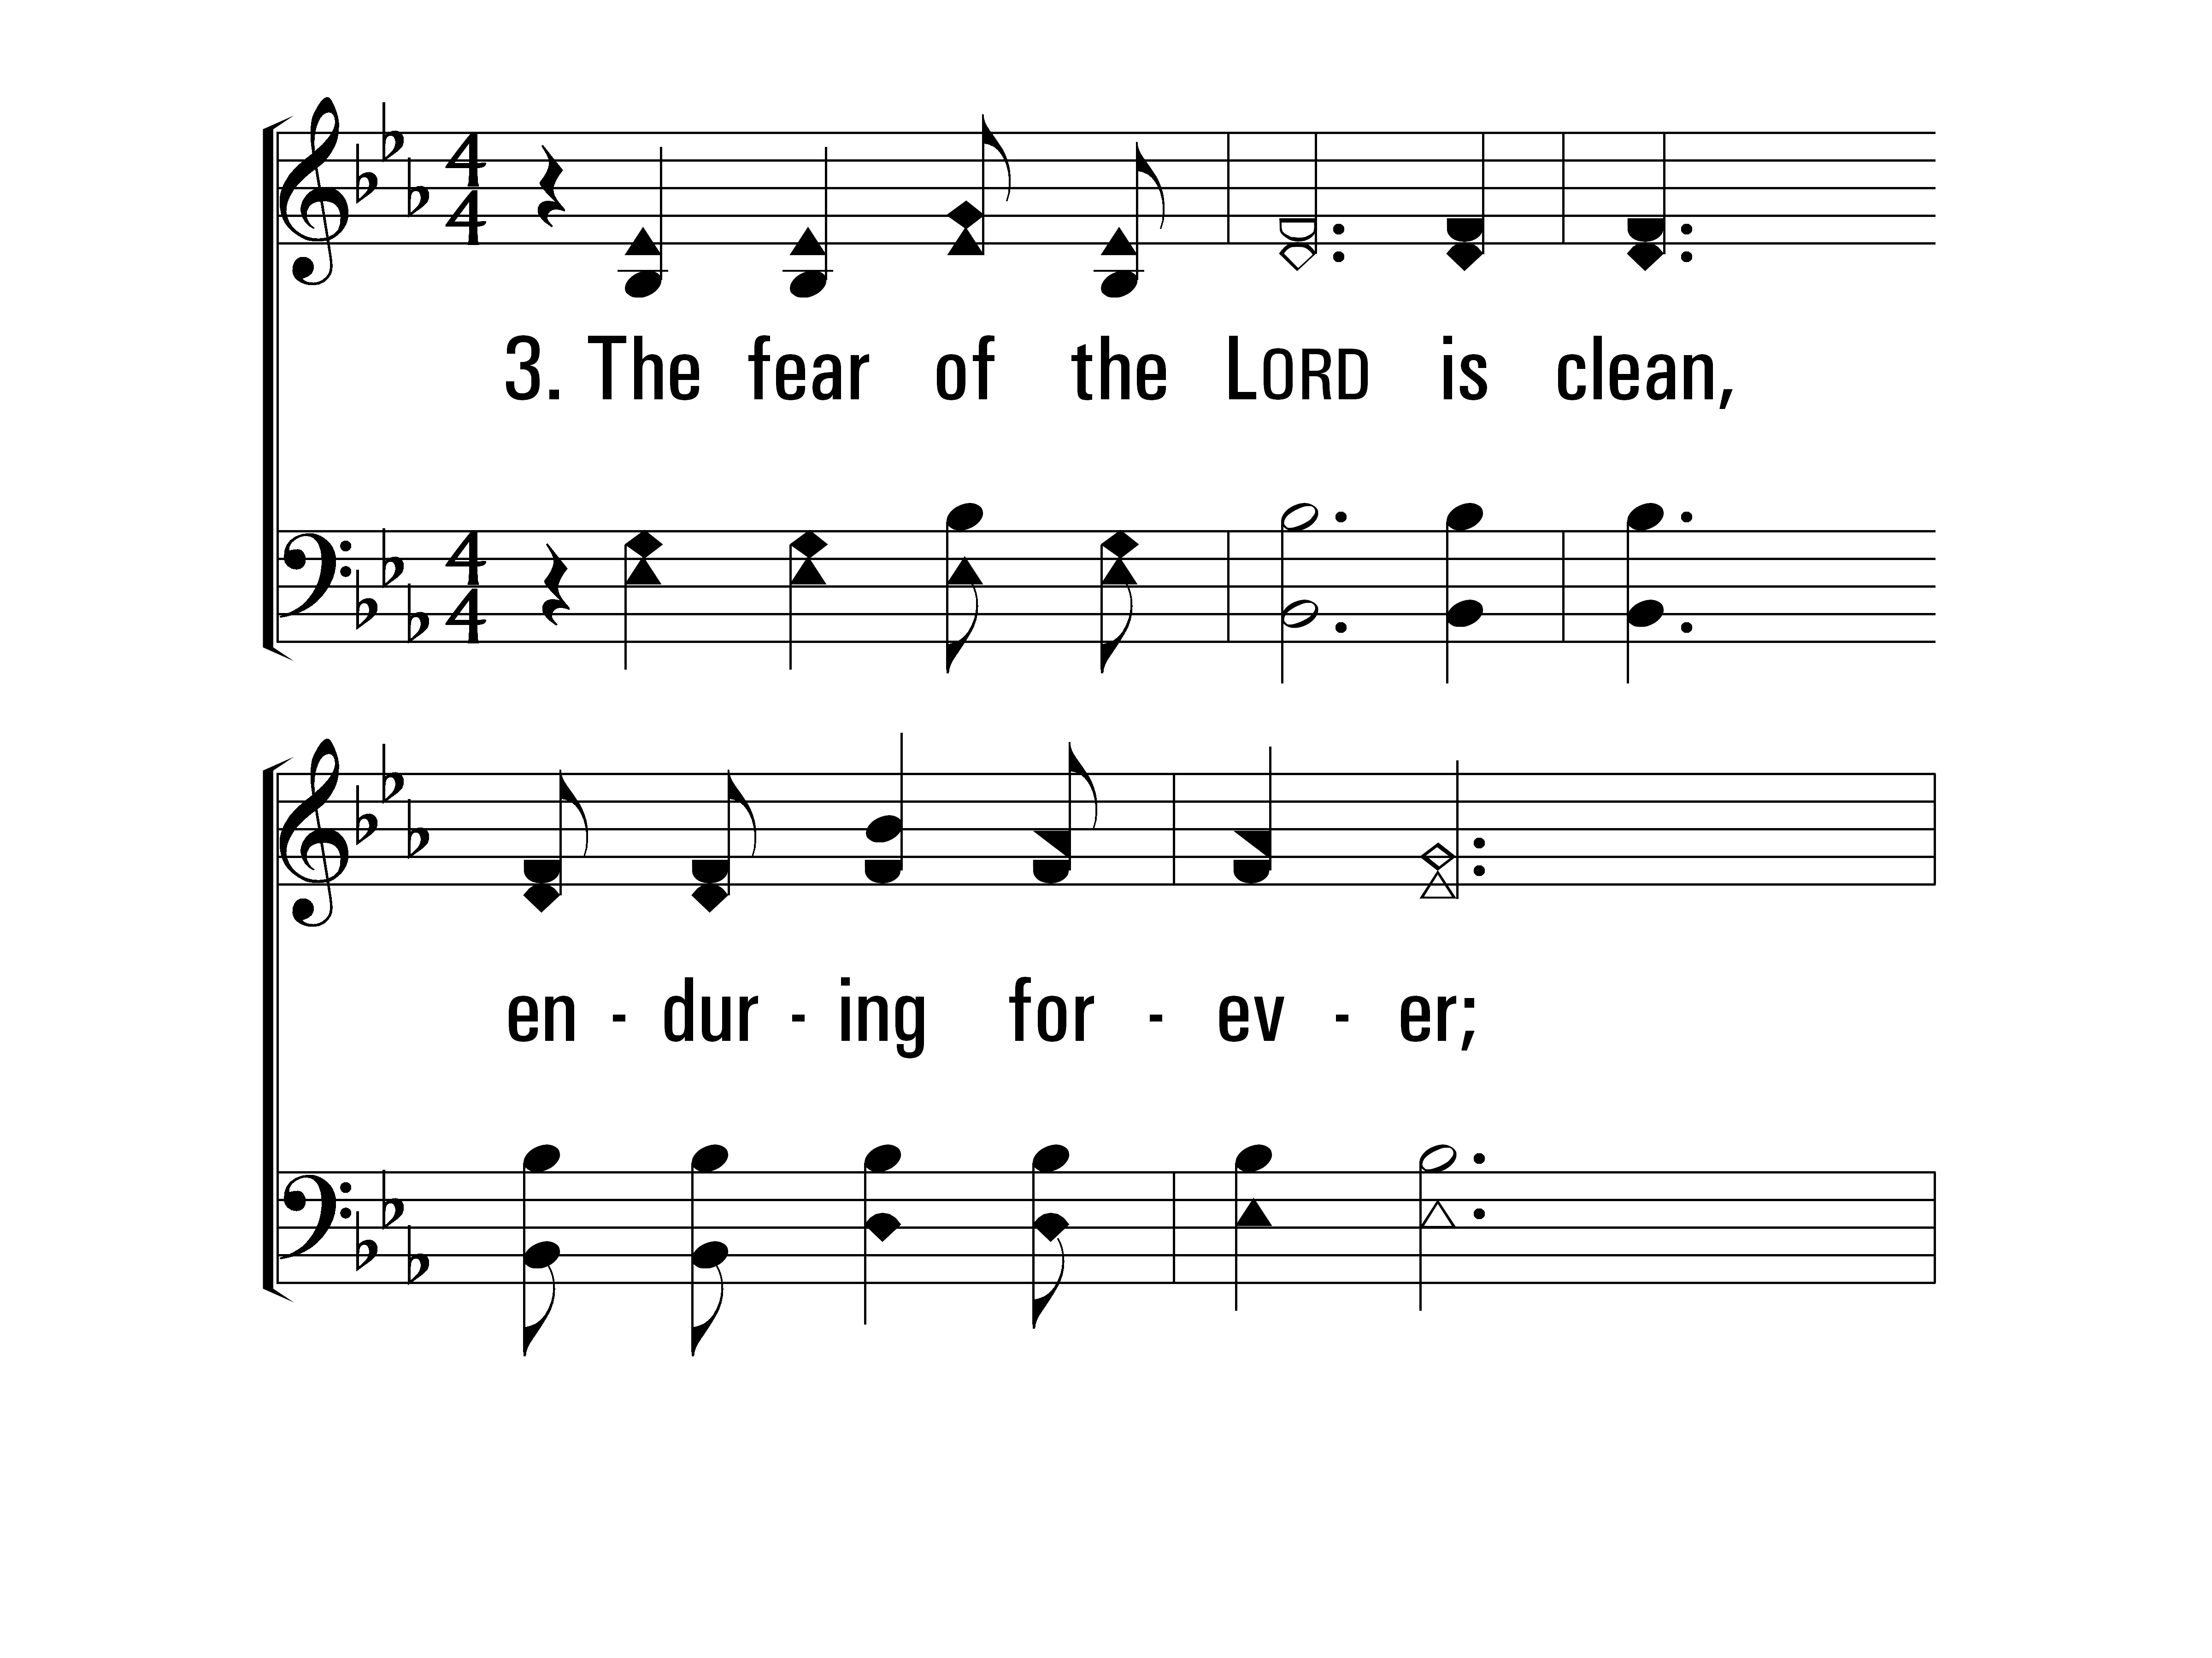
TheLawOfTheLord_st3_a
Vs 3
© 2014 Sumphonia Productions, LLC

Slide 33
TheLawOfTheLord_st3_b
Vs 3
© 2014 Sumphonia Productions, LLC

Slide 34
TheLawOfTheLord_cho_a
Chorus
© 2014 Sumphonia Productions, LLC

Slide 35
TheLawOfTheLord_cho_b
Chorus
© 2014 Sumphonia Productions, LLC
End

Slide 36
O How Love I Thy Law All Stanzas—Then Chorus
Page 477
Praise For the Lord

Slide 37
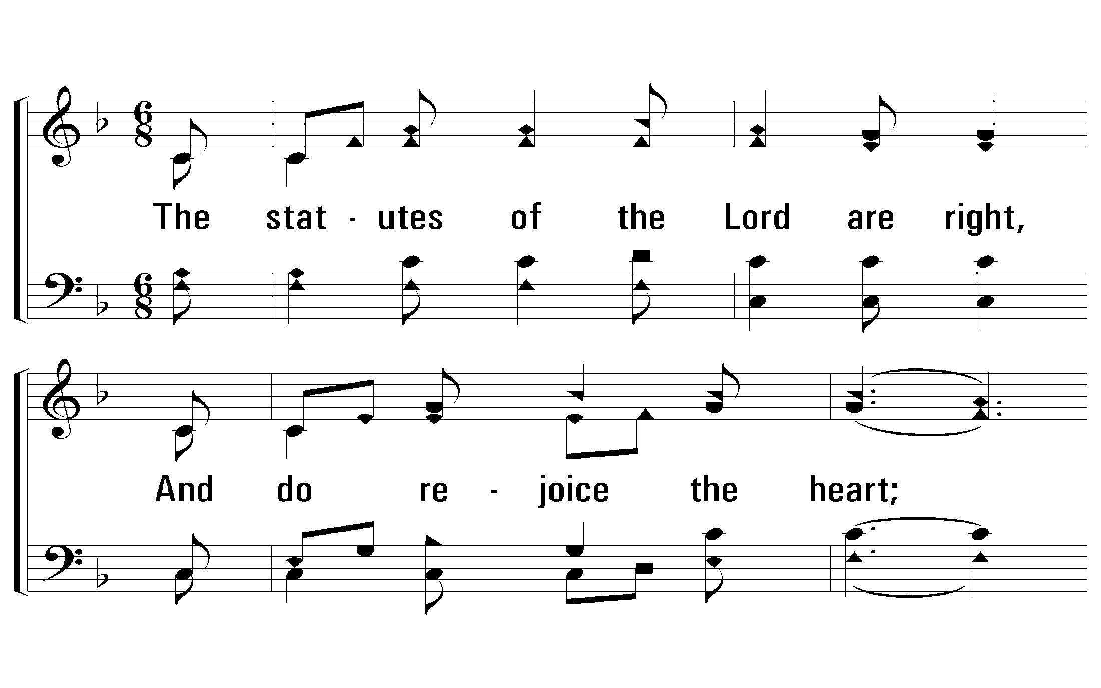
1 - O How Love I Thy Law
477
1.
The statutes of the Lord are right,
And do rejoice the heart;
The Lord's command is pure,
and doth Light to the eyes impart.
Words: From Psalms 19 & 119 / Arr.: James McGranahan
Music: James McGranahan
© 2010 The Paperless Hymnal®

Slide 38
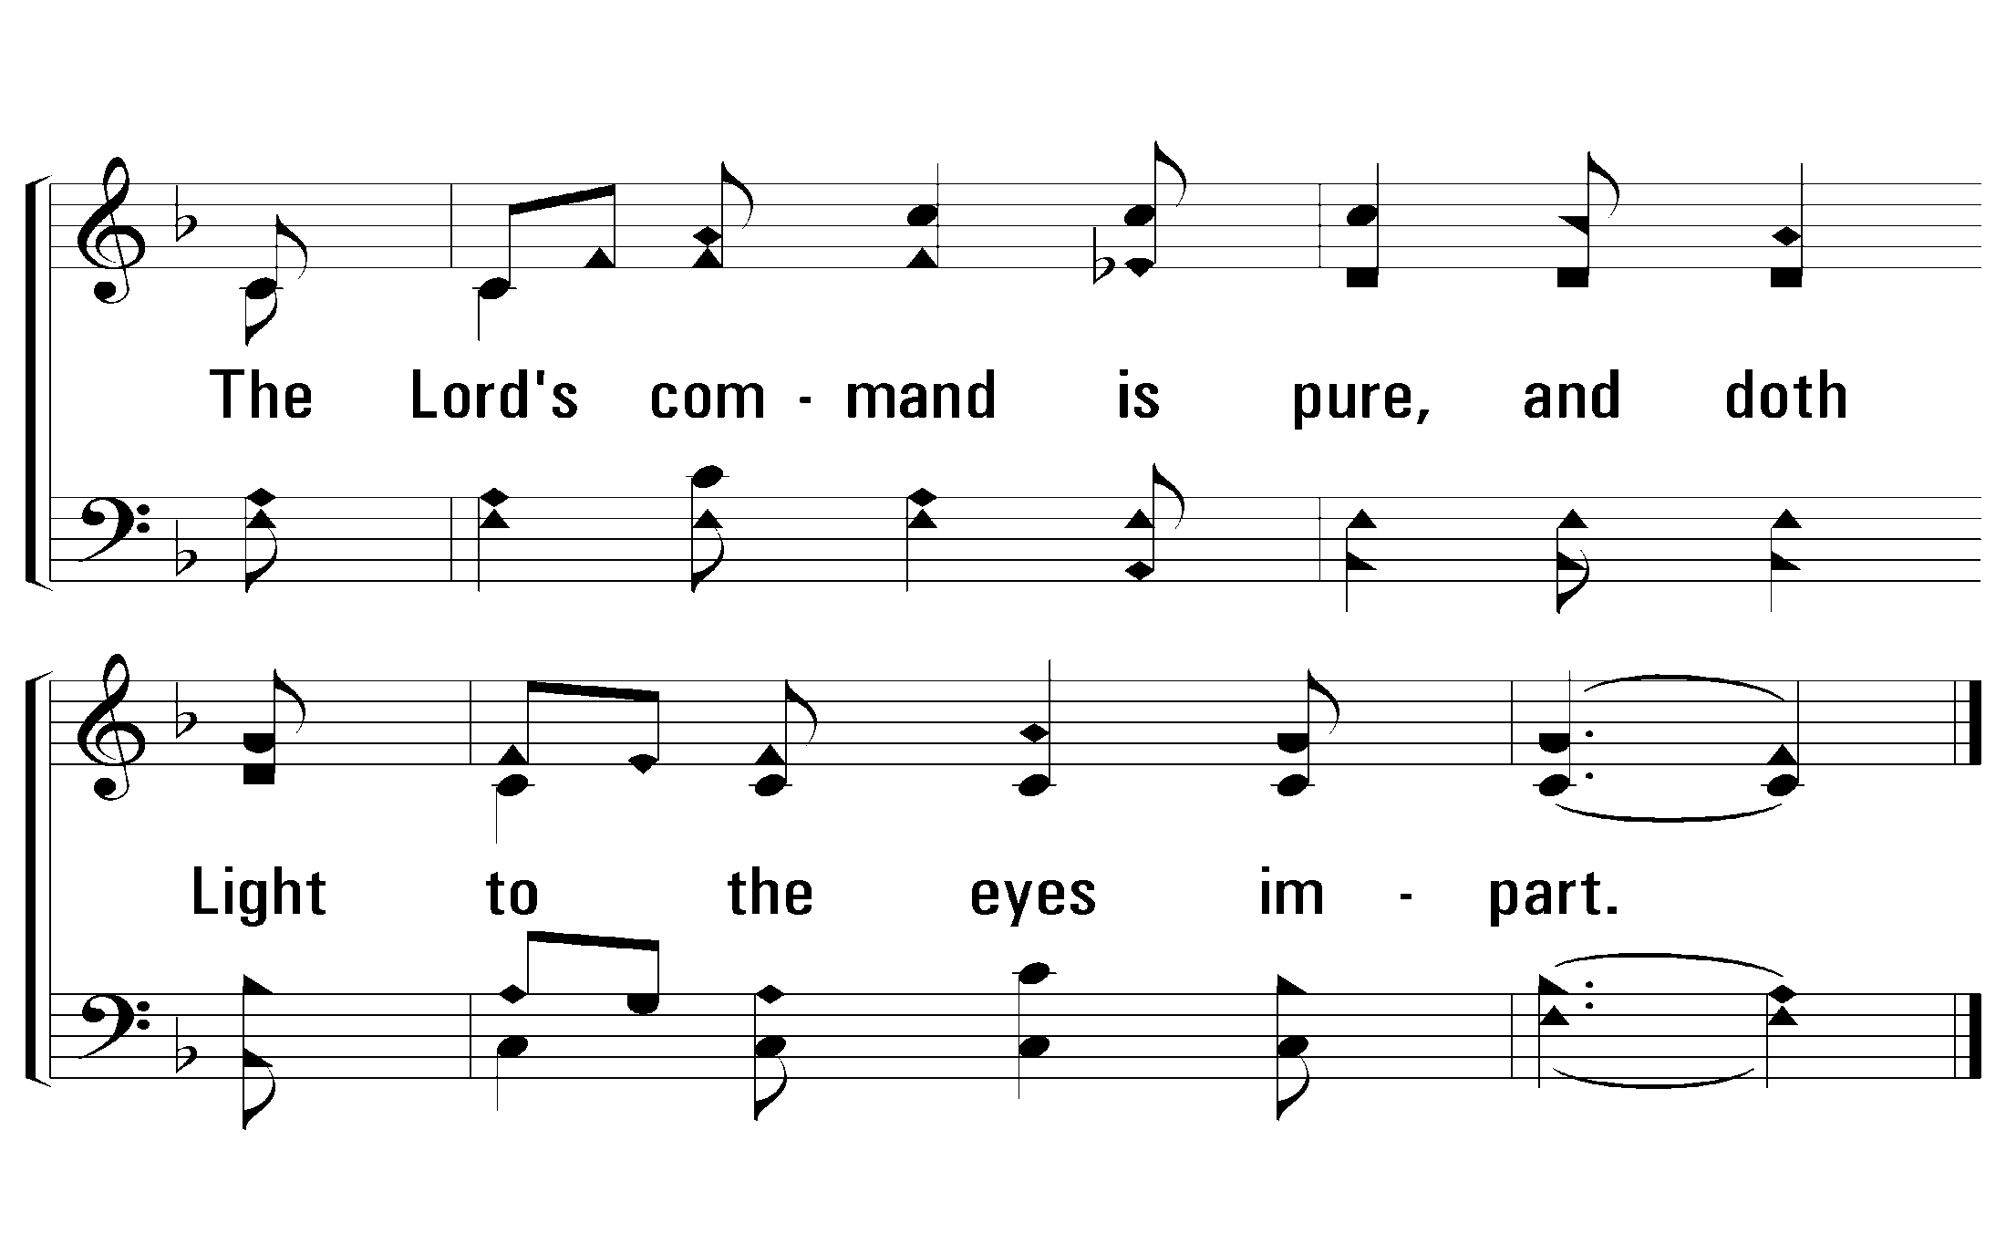
1 - O How Love I Thy Law
477
© 2010 The Paperless Hymnal®

Slide 39
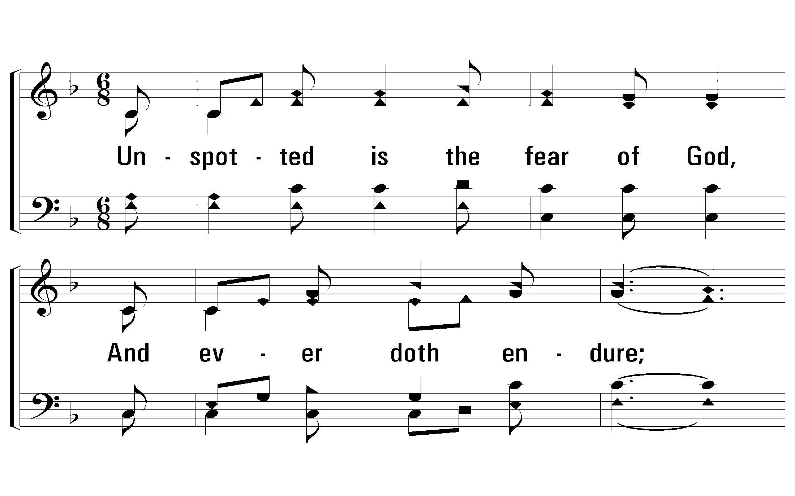
2 - O How Love I Thy Law
477
2.
Unspotted is the fear of God,
And ever doth endure;
The judgments of the Lord are truth,
And righteousness most pure.
Words: From Psalms 19 & 119 / Arr.: James McGranahan
Music: James McGranahan
© 2010 The Paperless Hymnal®

Slide 40
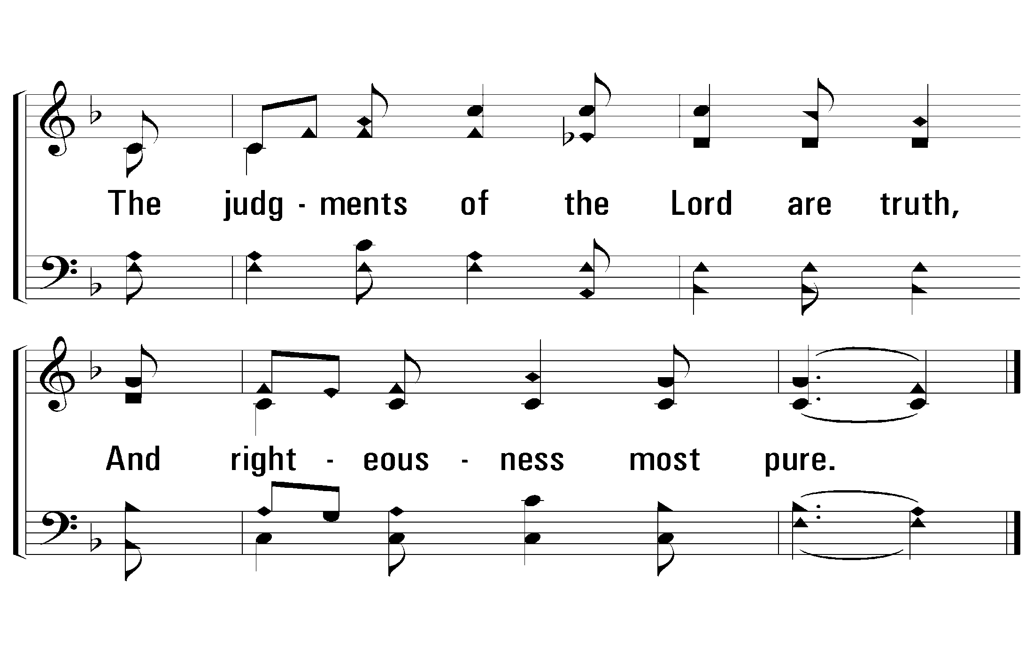
2 - O How Love I Thy Law
477
© 2010 The Paperless Hymnal®

Slide 41
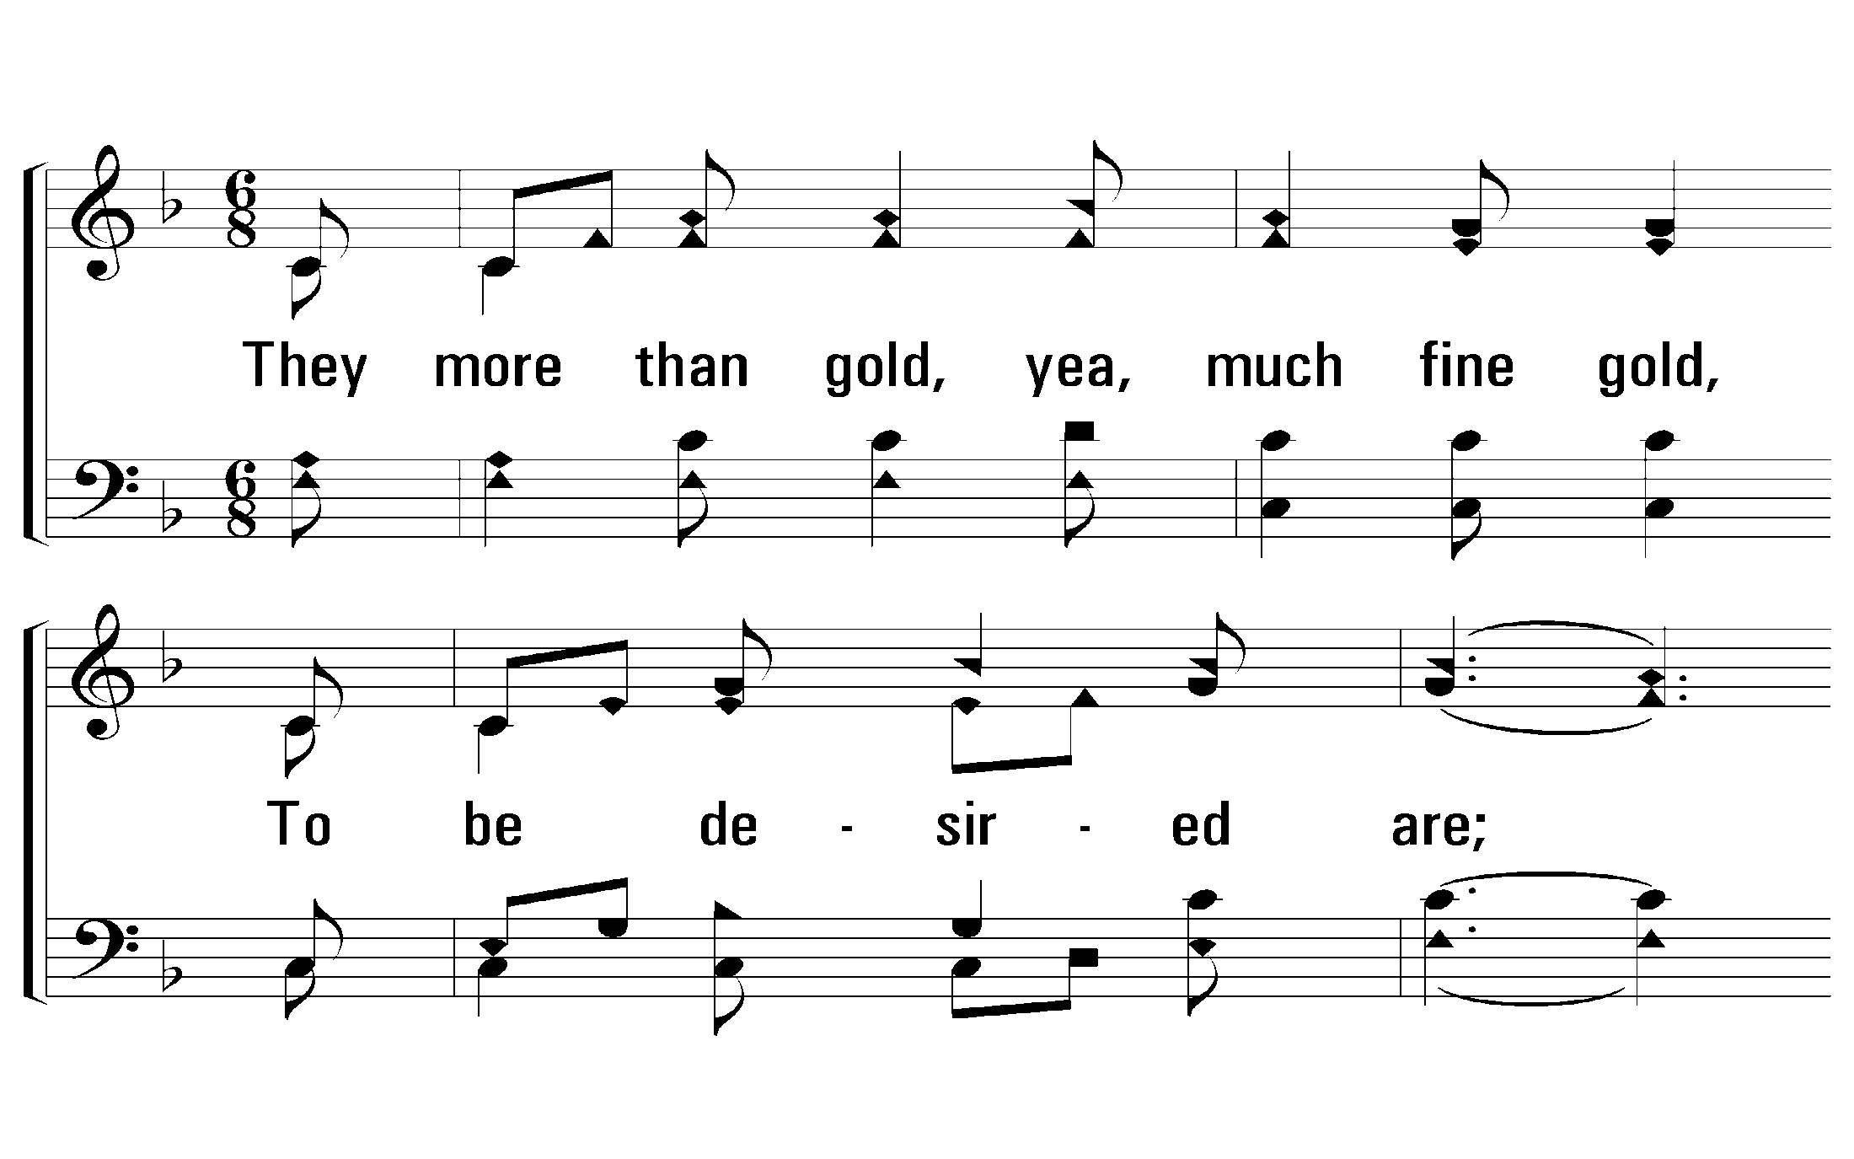
3 - O How Love I Thy Law
477
3.
They more than gold, yea, much fine gold,
To be desired are;
Than honey from the honeycomb
That droppeth – sweeter far.
Words: From Psalms 19 & 119 / Arr.: James McGranahan
Music: James McGranahan
© 2010 The Paperless Hymnal®

Slide 42
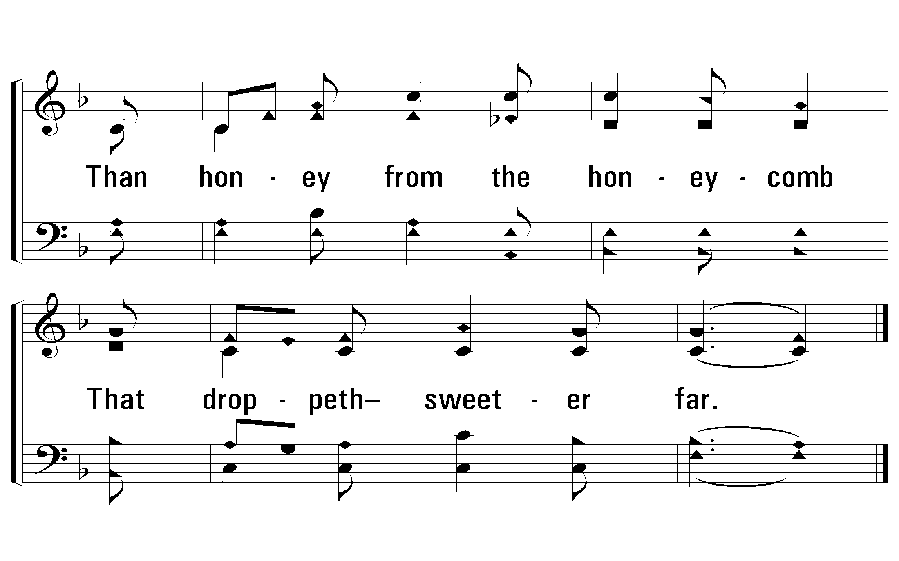
3 - O How Love I Thy Law
477
© 2010 The Paperless Hymnal®

Slide 43
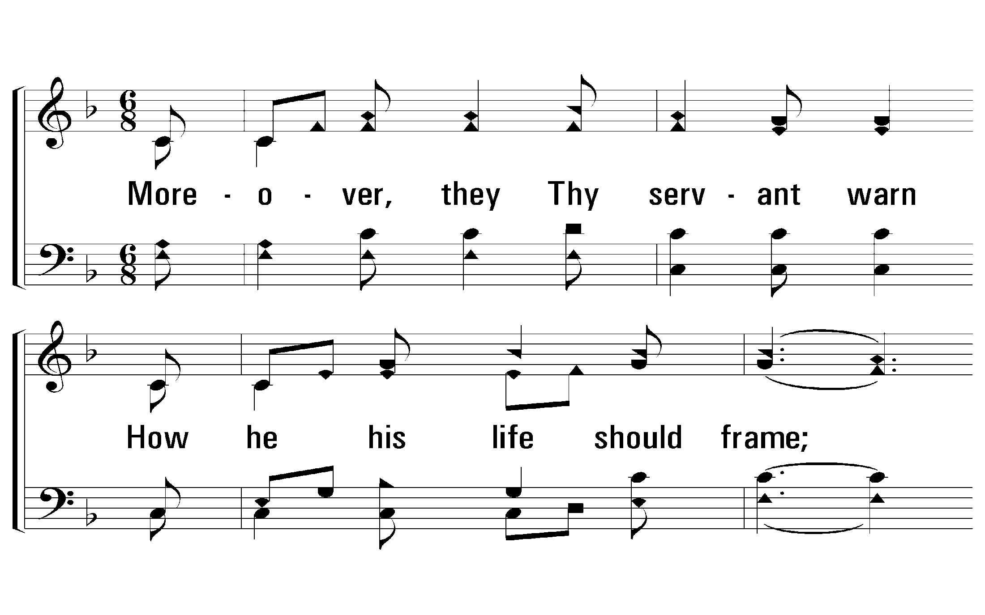
4 - O How Love I Thy Law
477
4.
Moreover, they Thy servant warn
How he his life should frame;
A great reward provided is
For them that keep the same.
Words: From Psalms 19 & 119 / Arr.: James McGranahan
Music: James McGranahan
© 2010 The Paperless Hymnal®

Slide 44
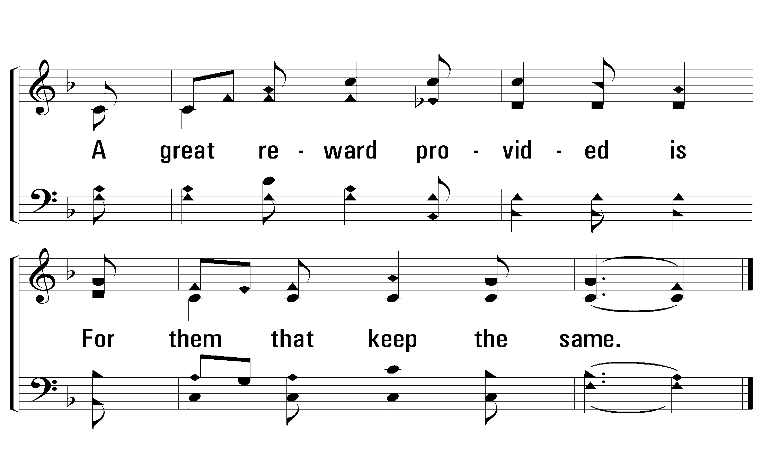
4 - O How Love I Thy Law
477
© 2010 The Paperless Hymnal®

Slide 45
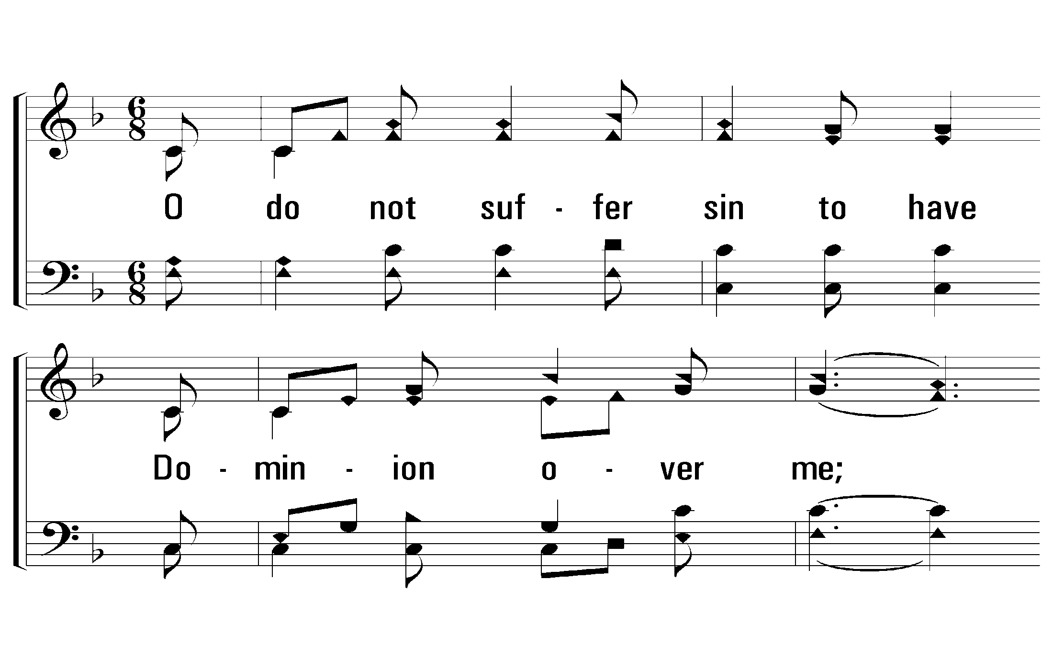
5 - O How Love I Thy Law
477
5.
O do not suffer sin to have
Dominion over me;
I shall be righteous, then, and from
The great transgression free.
Words: From Psalms 19 & 119 / Arr.: James McGranahan
Music: James McGranahan
© 2010 The Paperless Hymnal®

Slide 46
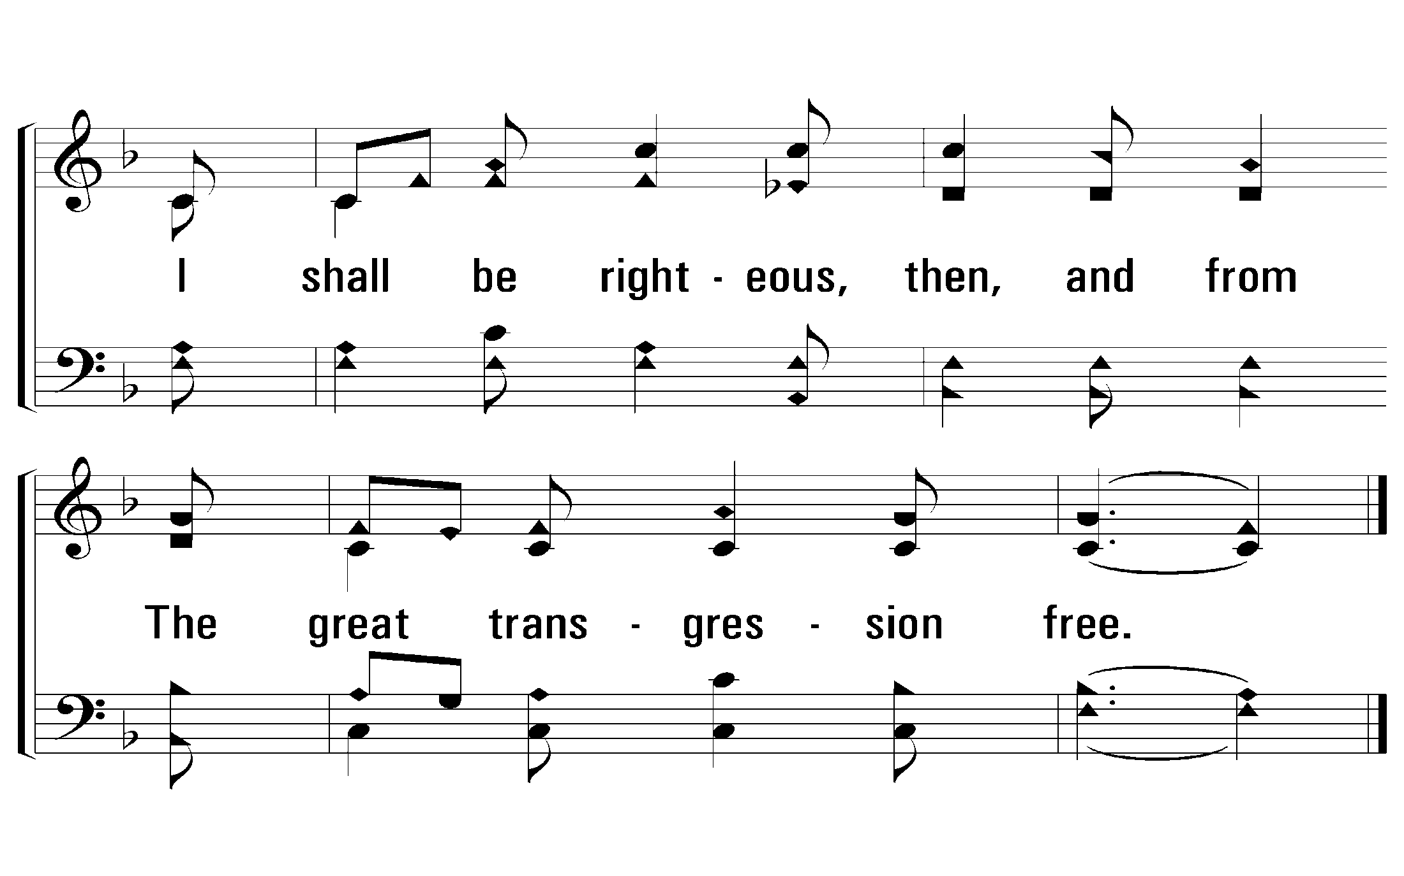
5 - O How Love I Thy Law
477
© 2010 The Paperless Hymnal®

Slide 47
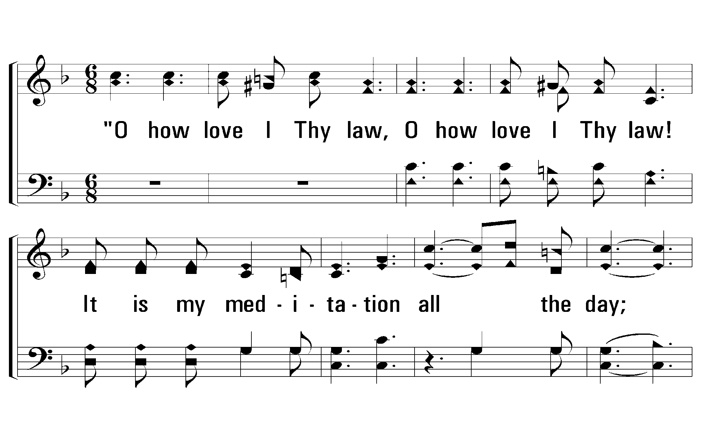
c - O How Love I Thy Law
477
“O how love I Thy law,
O how love I Thy law!
It is my meditation all the day;
O how love I Thy law,
O how love I Thy law;
It is my meditation all the day.”
© 2010 The Paperless Hymnal®

Slide 48
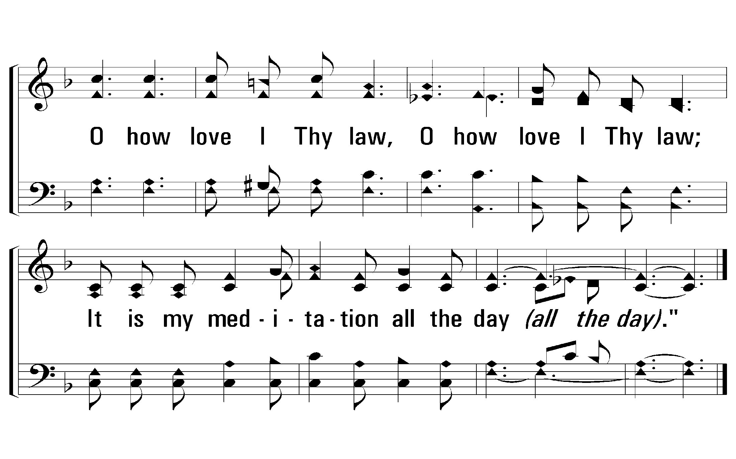
c - O How Love I Thy Law
477
END
© 2010 The Paperless Hymnal®

Slide 49
Psalm 119:97-105

Slide 50
Ancient Words All stanzas
Page 275
Psalms, Hymns, Spiritual Songs

Slide 51
AncientWords_st1_a
Vs 1
© 2014 Sumphonia Productions, LLC

Slide 52
AncientWords_st1_b
Vs 1
© 2014 Sumphonia Productions, LLC

Slide 53
AncientWords_st1_c
Vs 1
© 2014 Sumphonia Productions, LLC

Slide 54
AncientWords_st1_d
Vs 1
© 2014 Sumphonia Productions, LLC

Slide 55
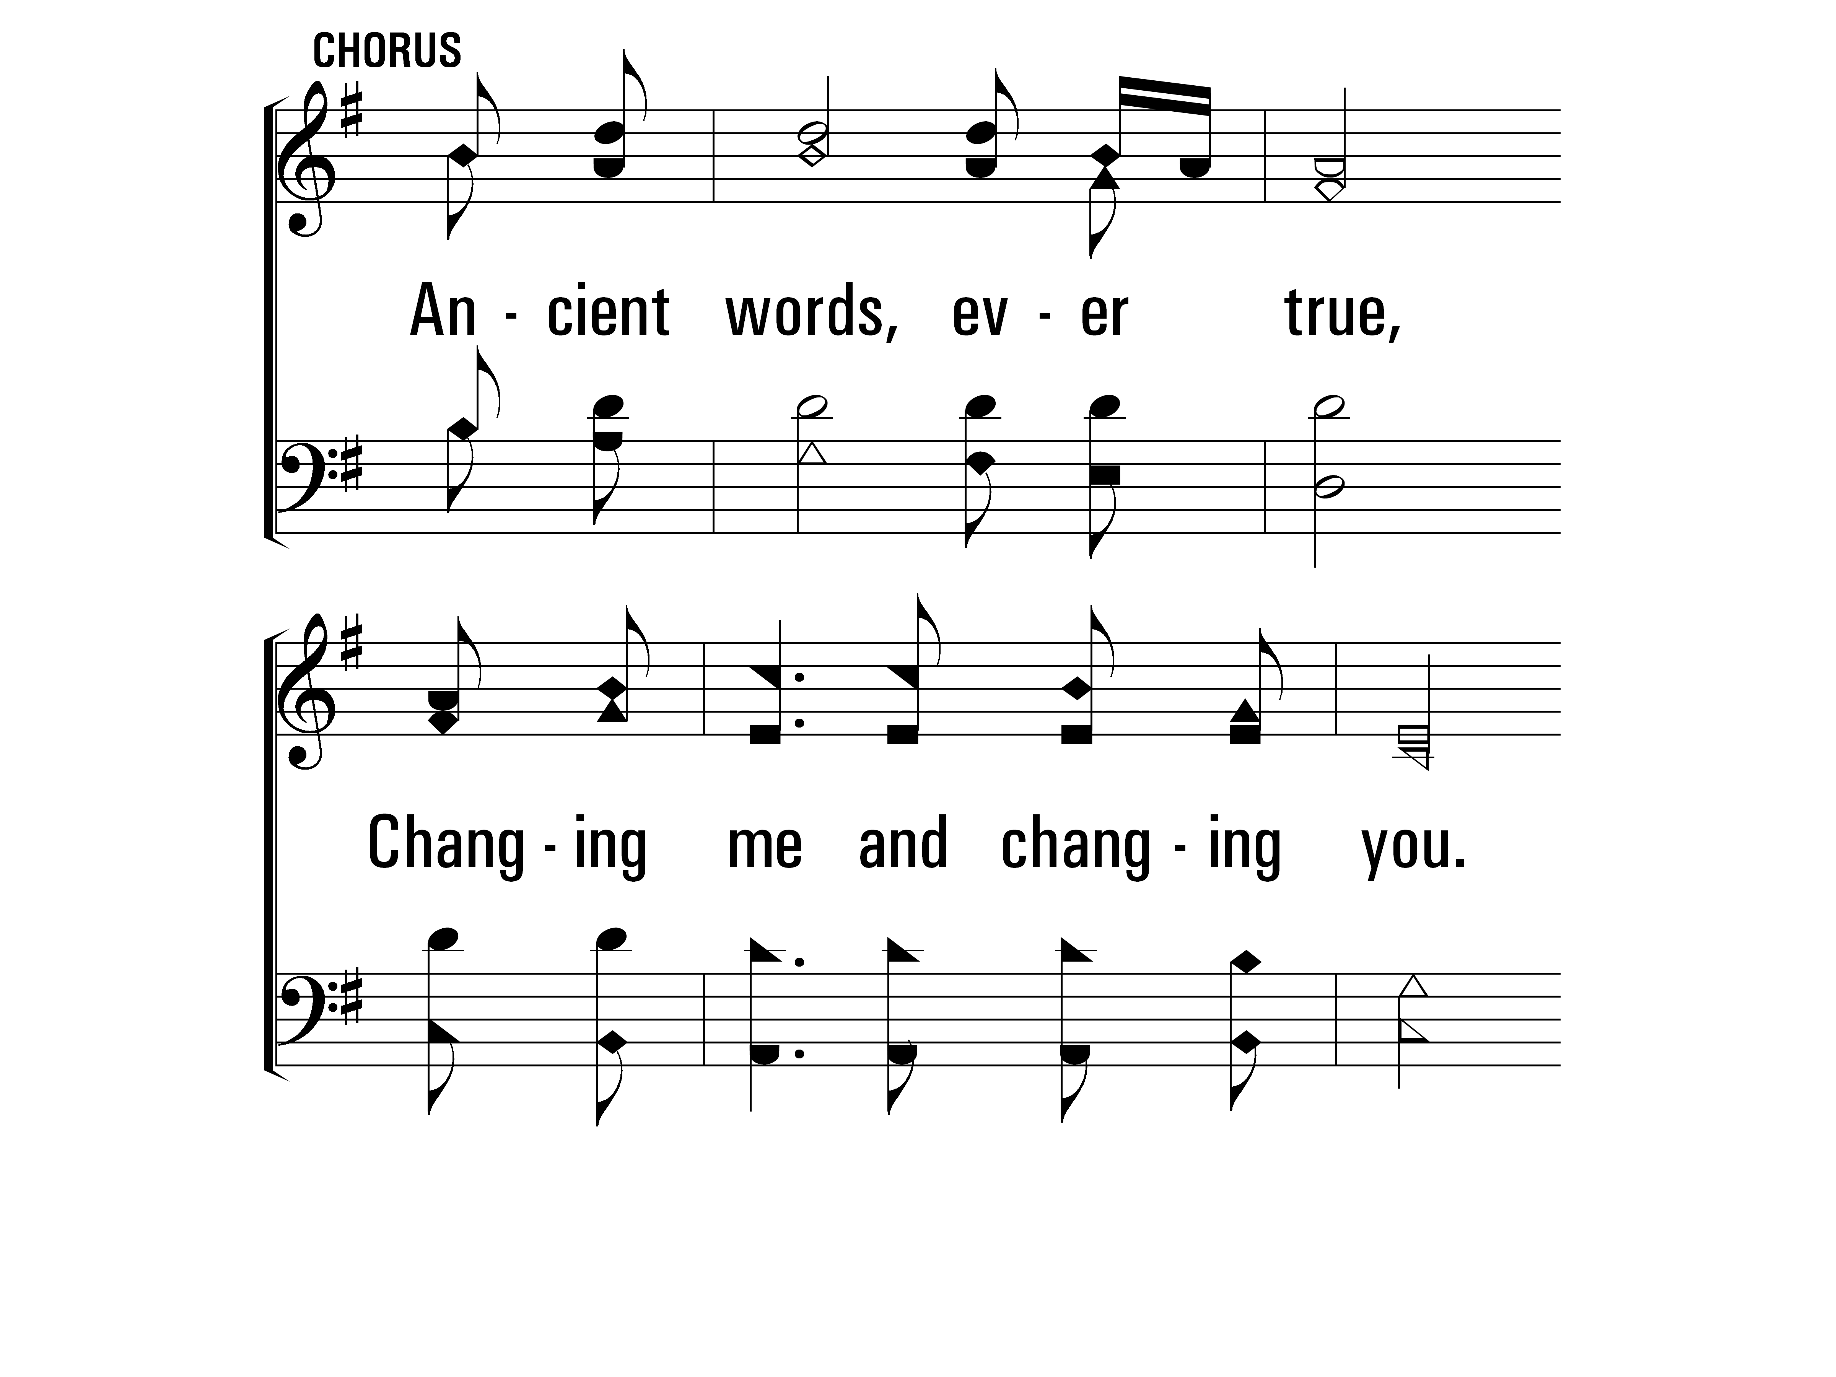
AncientWords_cho_a
Chorus
© 2014 Sumphonia Productions, LLC

Slide 56
AncientWords_cho_b
Chorus
© 2014 Sumphonia Productions, LLC

Slide 57
AncientWords_st2_a
Vs 2
© 2014 Sumphonia Productions, LLC

Slide 58
AncientWords_st2_b
Vs 2
© 2014 Sumphonia Productions, LLC

Slide 59
AncientWords_st2_c
Vs 2
© 2014 Sumphonia Productions, LLC

Slide 60
AncientWords_st2_d
Vs 2
© 2014 Sumphonia Productions, LLC

Slide 61
AncientWords_cho_a
Chorus
© 2014 Sumphonia Productions, LLC

Slide 62
AncientWords_cho_b
Chorus
© 2014 Sumphonia Productions, LLC
End

Slide 63
Thy Word is a Treasure All stanzas
Page 40
Psalms, Hymns, Spiritual Songs

Slide 64
ThyWordIsATreasure_st1_a
Vs 1
© 2014 Sumphonia Productions, LLC

Slide 65
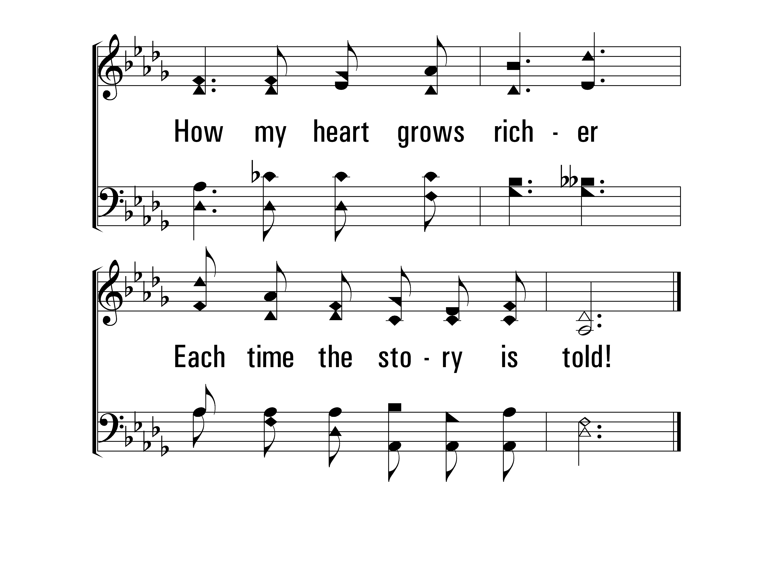
ThyWordIsATreasure_st1_b
Vs 1
© 2014 Sumphonia Productions, LLC

Slide 66
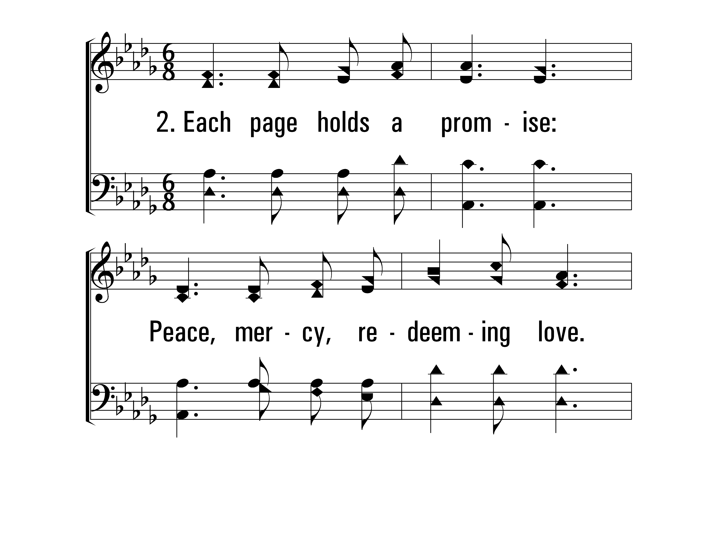
ThyWordIsATreasure_st2_a
Vs 2
© 2014 Sumphonia Productions, LLC

Slide 67
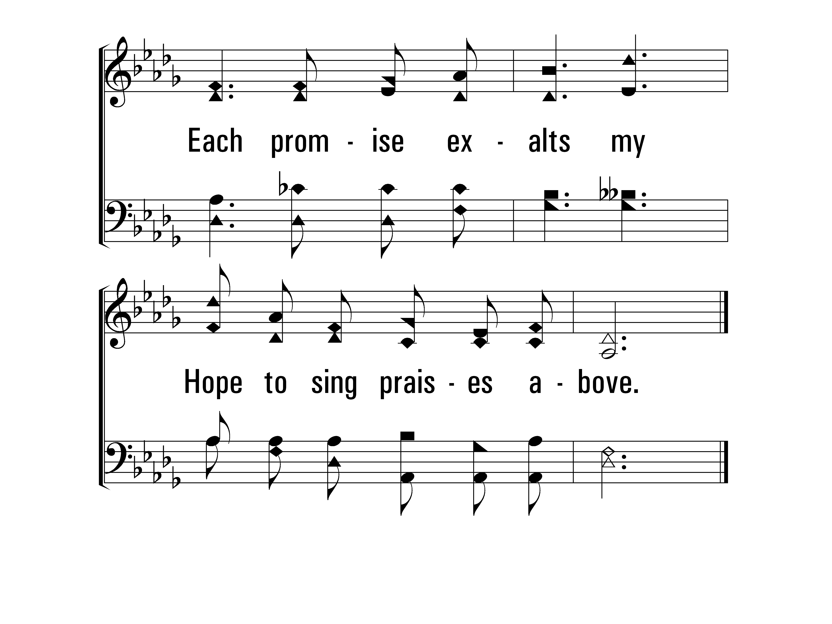
ThyWordIsATreasure_st2_b
Vs 2
© 2014 Sumphonia Productions, LLC

Slide 68
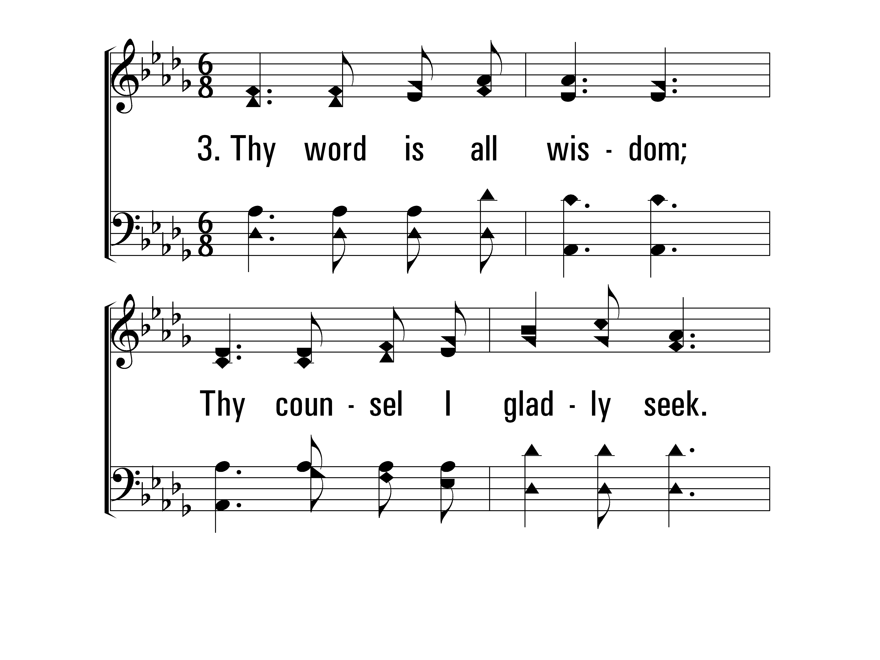
ThyWordIsATreasure_st3_a
Vs 3
© 2014 Sumphonia Productions, LLC

Slide 69
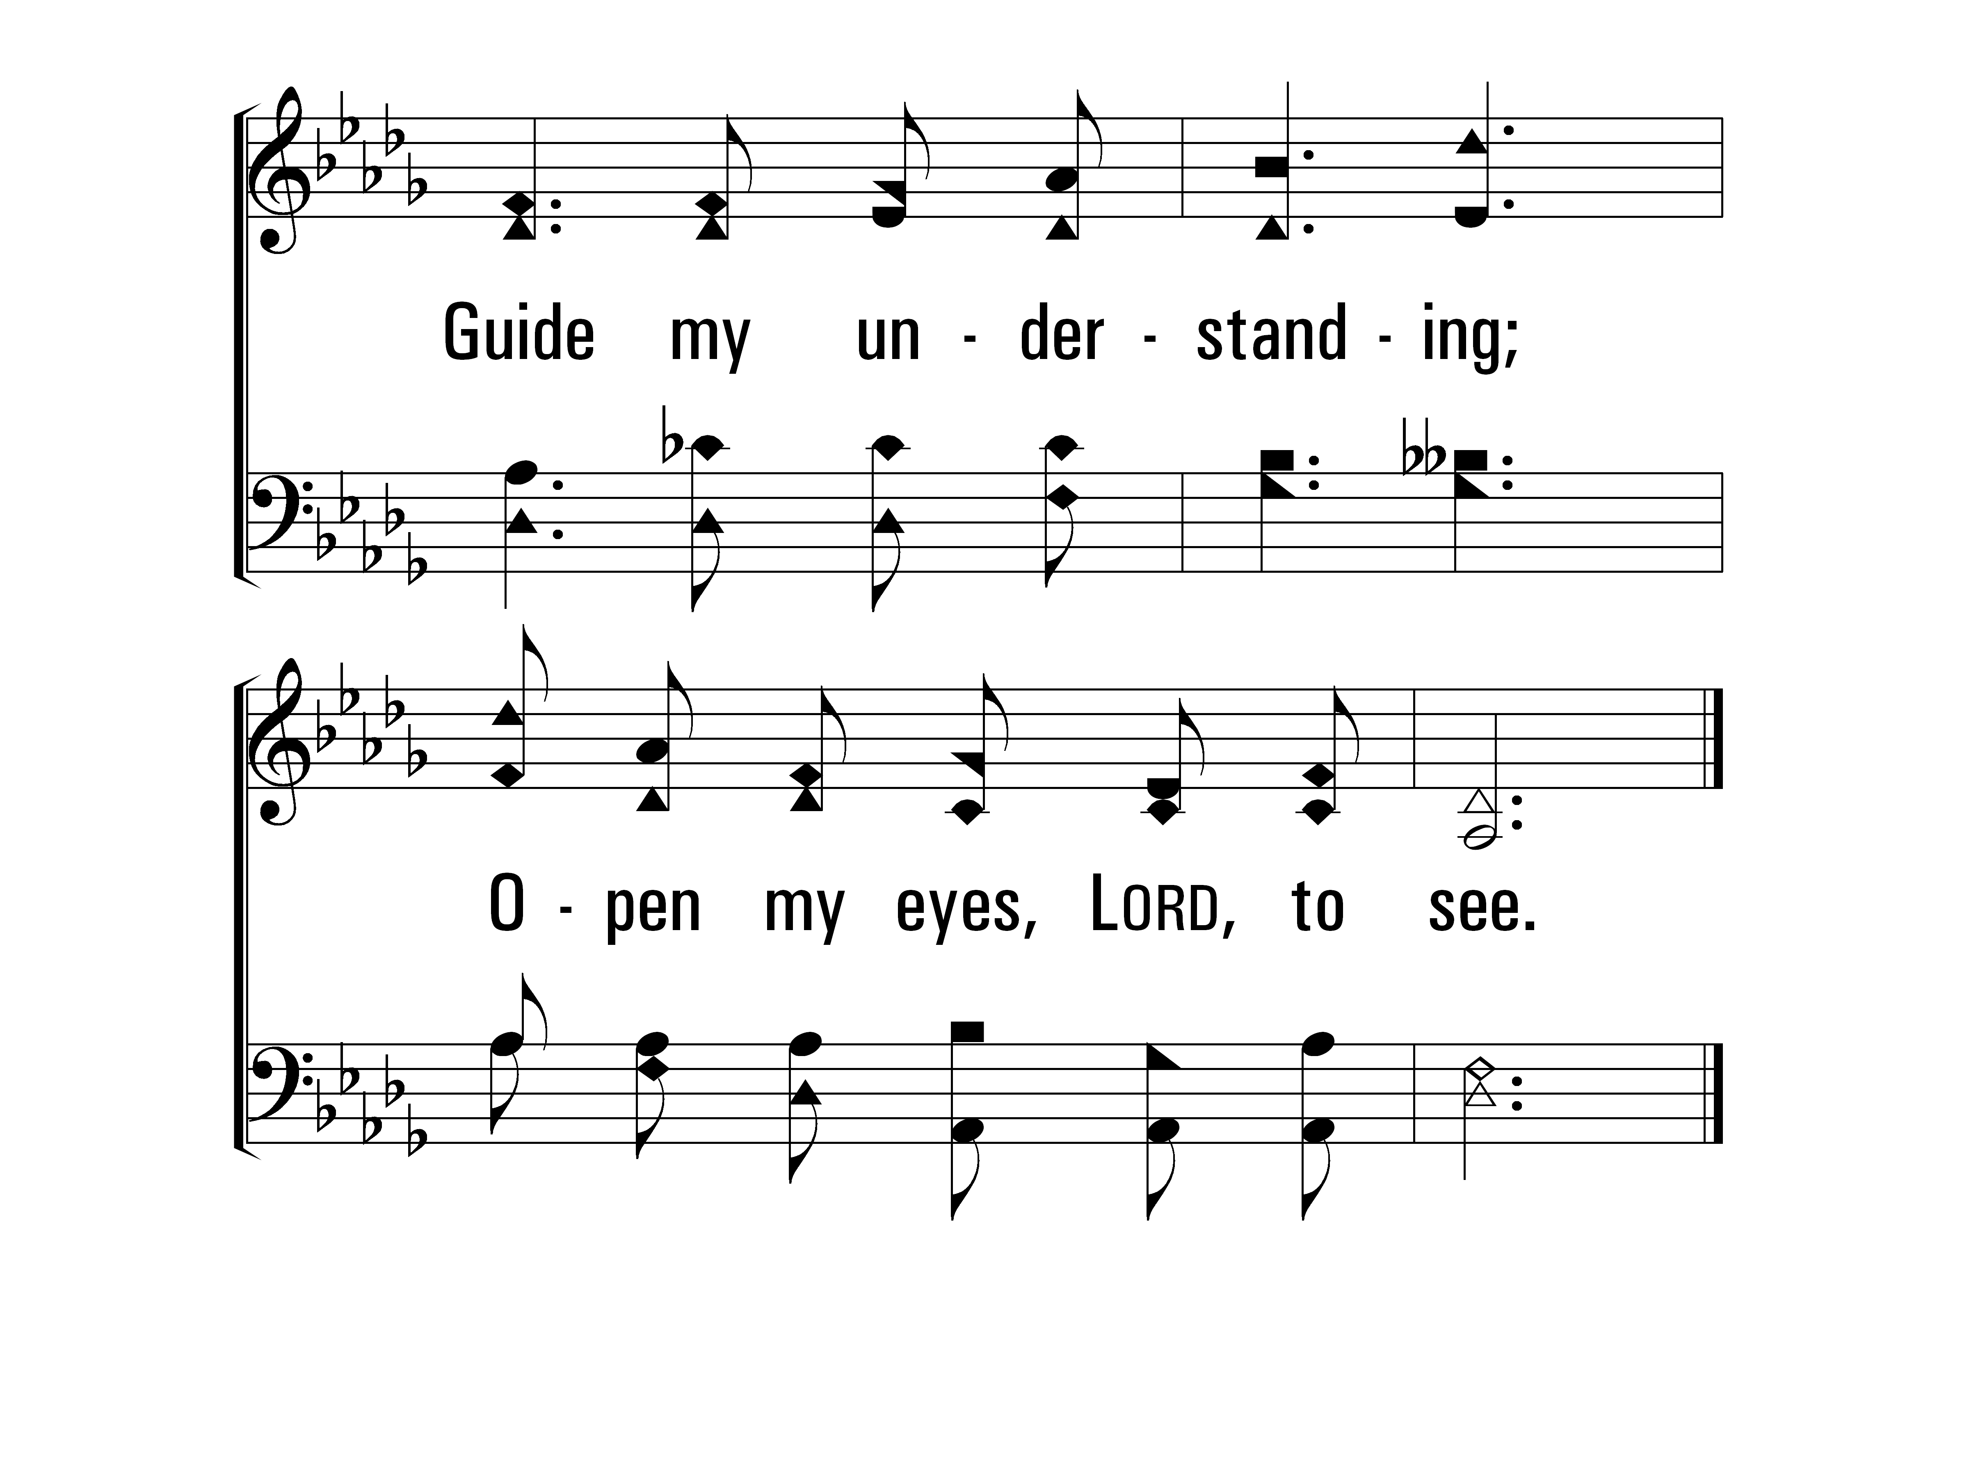
ThyWordIsATreasure_st3_b
Vs 3
© 2014 Sumphonia Productions, LLC

Slide 70
ThyWordIsATreasure_st4_a
Vs 4
© 2014 Sumphonia Productions, LLC

Slide 71
ThyWordIsATreasure_st4_b
Vs 4
© 2014 Sumphonia Productions, LLC

Slide 72
ThyWordIsATreasure_st5_a
Vs 5
© 2014 Sumphonia Productions, LLC

Slide 73
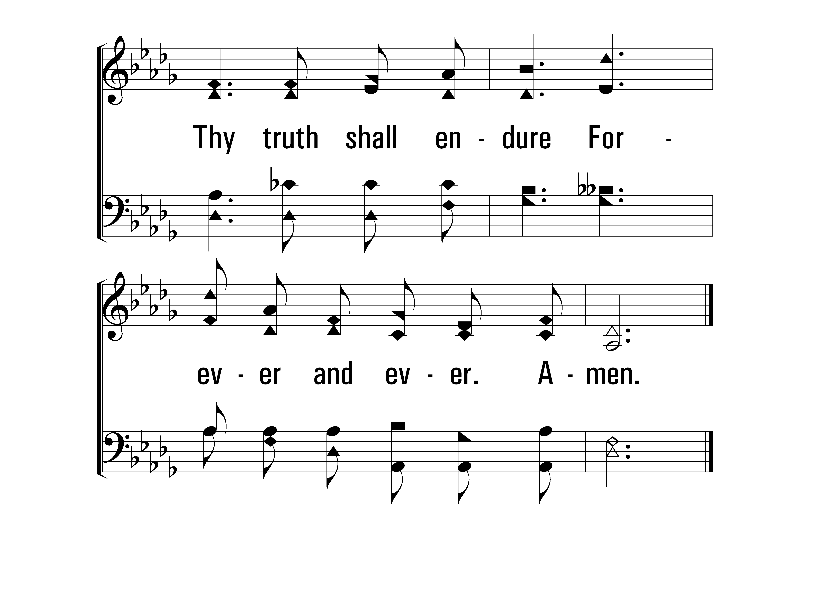
ThyWordIsATreasure_st5_b
Vs 5
© 2014 Sumphonia Productions, LLC
End

Slide 74
Give me the Bible,
Star of gladness gleaming,
To cheer the wandrer,
Lone and tempest tossed
No storm can hide
That radiance peaceful beaming,
Since Jesus came
To seek and save the lost.

Slide 75
Give Me the Bible First Stanza only –NO chorus
280
Psalms, Hymns, Spiritual Songs

Slide 76
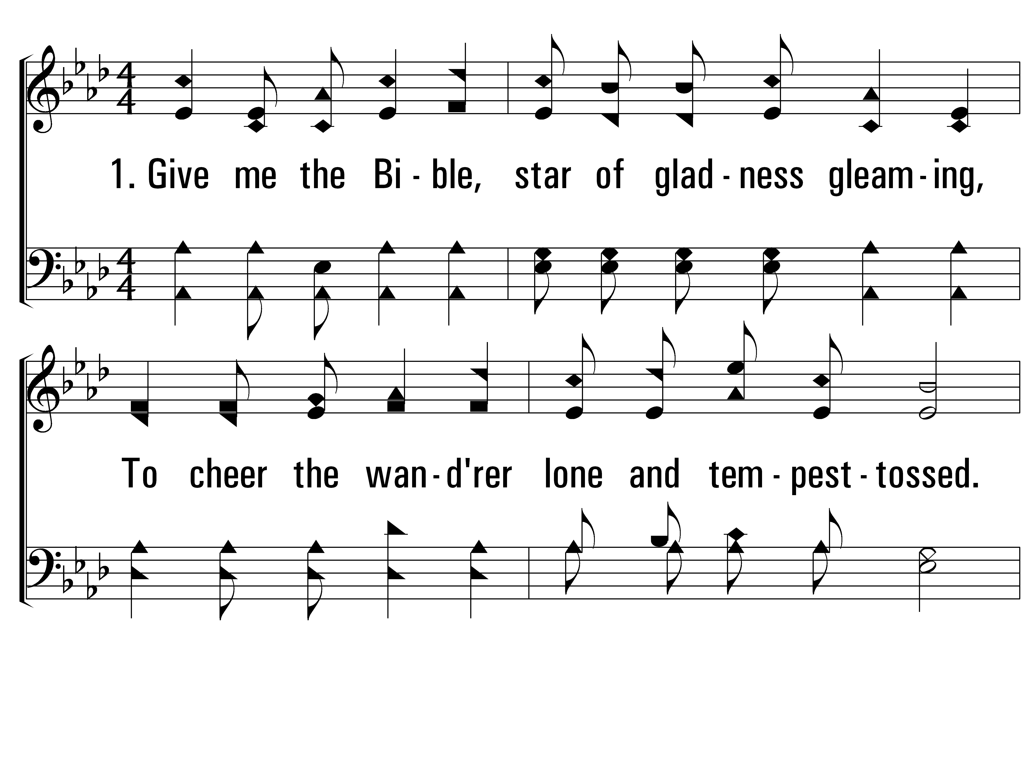
GiveMeTheBible_st1_a
Vs 1
© 2014 Sumphonia Productions, LLC

Slide 77
GiveMeTheBible_st1_b
Vs 1
© 2014 Sumphonia Productions, LLC

Slide 78
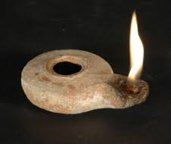
Give me the Bible,
When my heart is broken,
When sin and grief
Have filled my soul with fear.
Give me the precious words By Jesus spoken;
Hold up faith’s lamp
To show my savior near.

Slide 79
Give Me the Bible Second Stanza only –NO chorus
280
Psalms, Hymns, Spiritual Songs

Slide 80
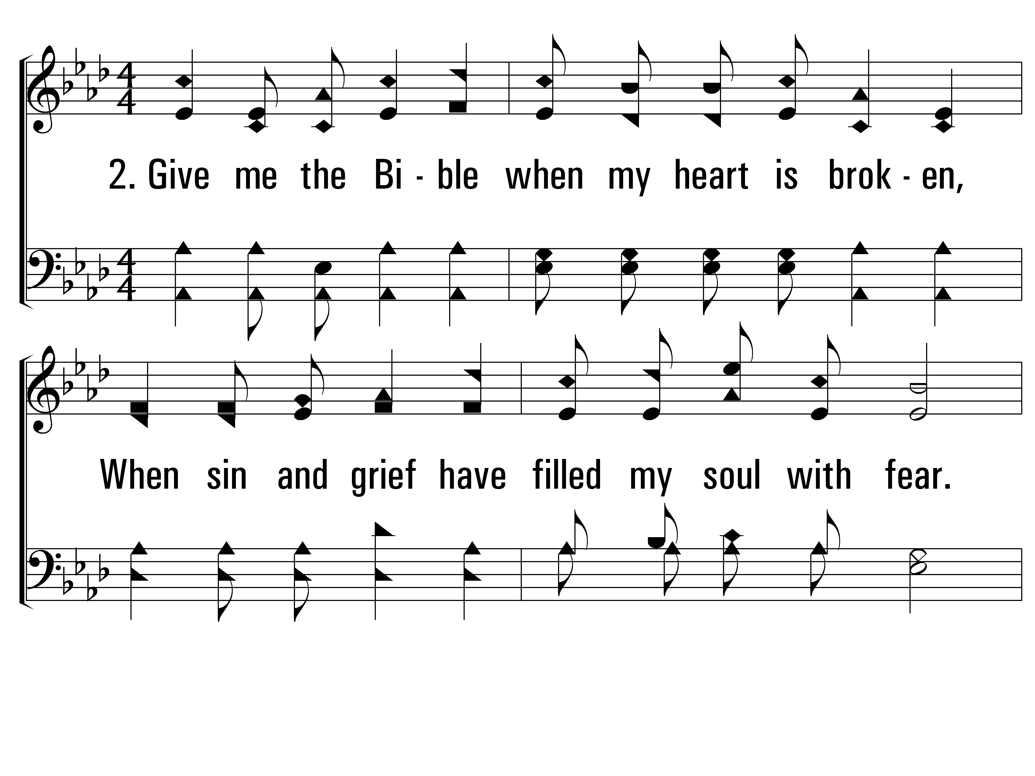
GiveMeTheBible_st2_a
Vs 2
© 2014 Sumphonia Productions, LLC

Slide 81
GiveMeTheBible_st2_b
Vs 2
© 2014 Sumphonia Productions, LLC

Slide 82
Give me the Bible,
All my steps enlighten, Teach me the danger
Of these realms below;
That lamp of safety
O’er the gloom shall brighten, That light alone the path of peace can show.

Slide 83
Give Me the Bible Third Stanza only –NO chorus
280
Psalms, Hymns, Spiritual Songs

Slide 84
GiveMeTheBible_st3_a
Vs 3
© 2014 Sumphonia Productions, LLC

Slide 85
GiveMeTheBible_st3_b
Vs 3
© 2014 Sumphonia Productions, LLC

Slide 86
Give me the Bible,
Lamp of life immortal,
Hold up that splendor
By the open grave;

Slide 87
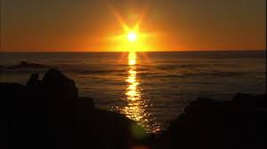
Show me the light
From Heaven’s shining portal.
Show me the glory
Gilding Jordan’s wave.

Slide 88
Give Me the Bible Fourth Stanza only –NO chorus
280
Psalms, Hymns, Spiritual Songs

Slide 89
GiveMeTheBible_st4_a
Vs 4
© 2014 Sumphonia Productions, LLC

Slide 90
GiveMeTheBible_st4_b
Vs 4
© 2014 Sumphonia Productions, LLC

Slide 91
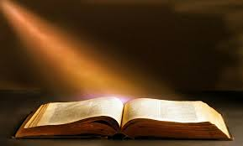
Give me the Bible, holy message shining; Thy light shall guide me in the narrow way; Precept and promise, law and love combining, Till night shall vanish in eternal day.
Priscilla J. Owens (1883)

Slide 92
Teach Me Thy Way All Stanzas
688
Psalms, Hymns, Spiritual Songs

Slide 93
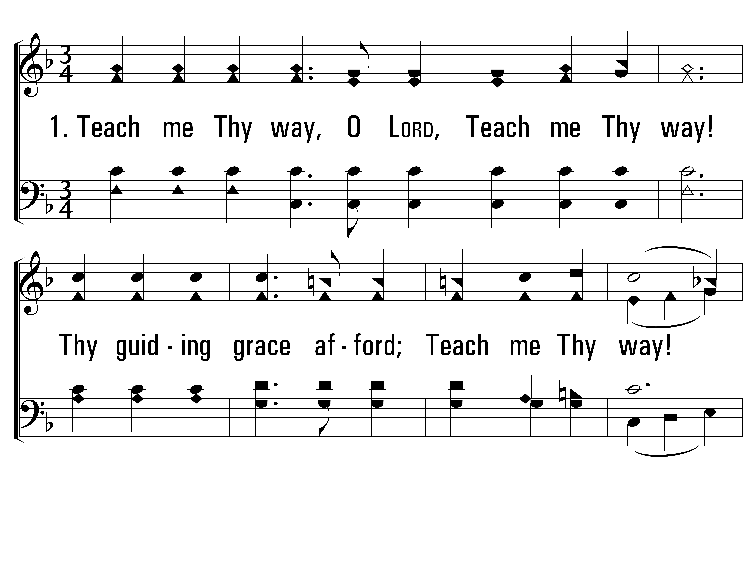
TeachMeThyWay_st1_a
Vs 1
© 2014 Sumphonia Productions, LLC

Slide 94
TeachMeThyWay_st1_b
Vs 1
© 2014 Sumphonia Productions, LLC

Slide 95
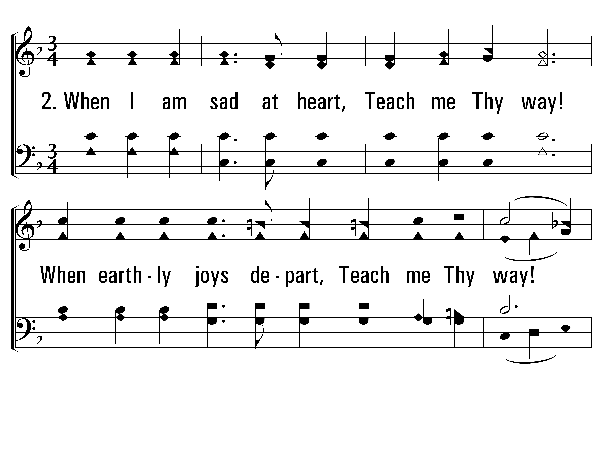
TeachMeThyWay_st2_a
Vs 2
© 2014 Sumphonia Productions, LLC

Slide 96
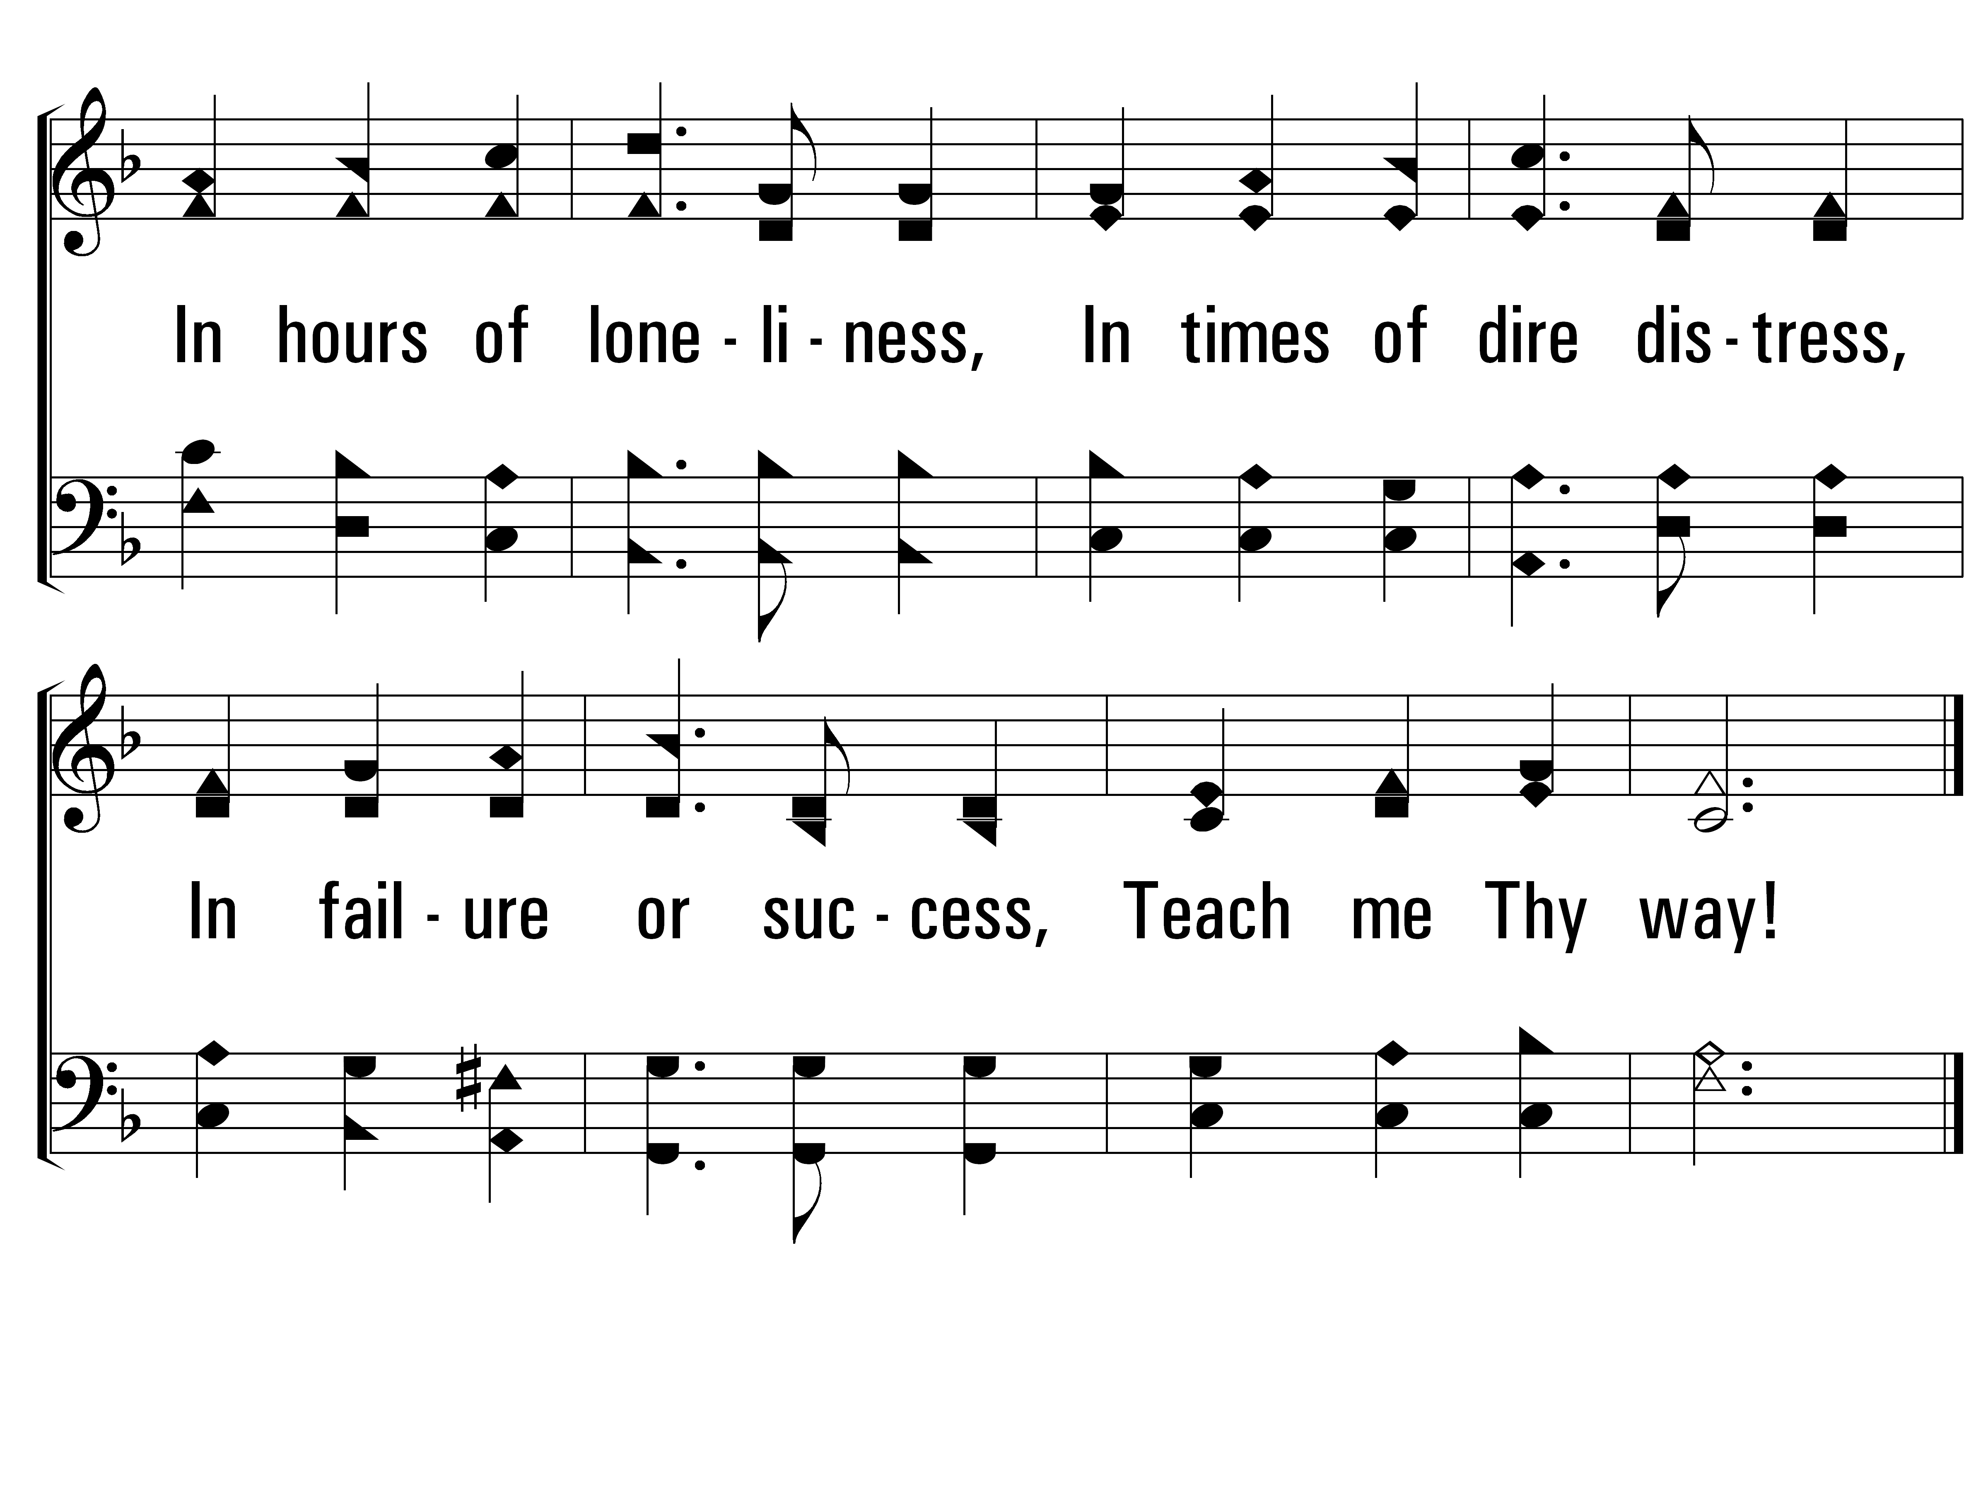
TeachMeThyWay_st2_b
Vs 2
© 2014 Sumphonia Productions, LLC

Slide 97
TeachMeThyWay_st3_a
Vs 3
© 2014 Sumphonia Productions, LLC

Slide 98
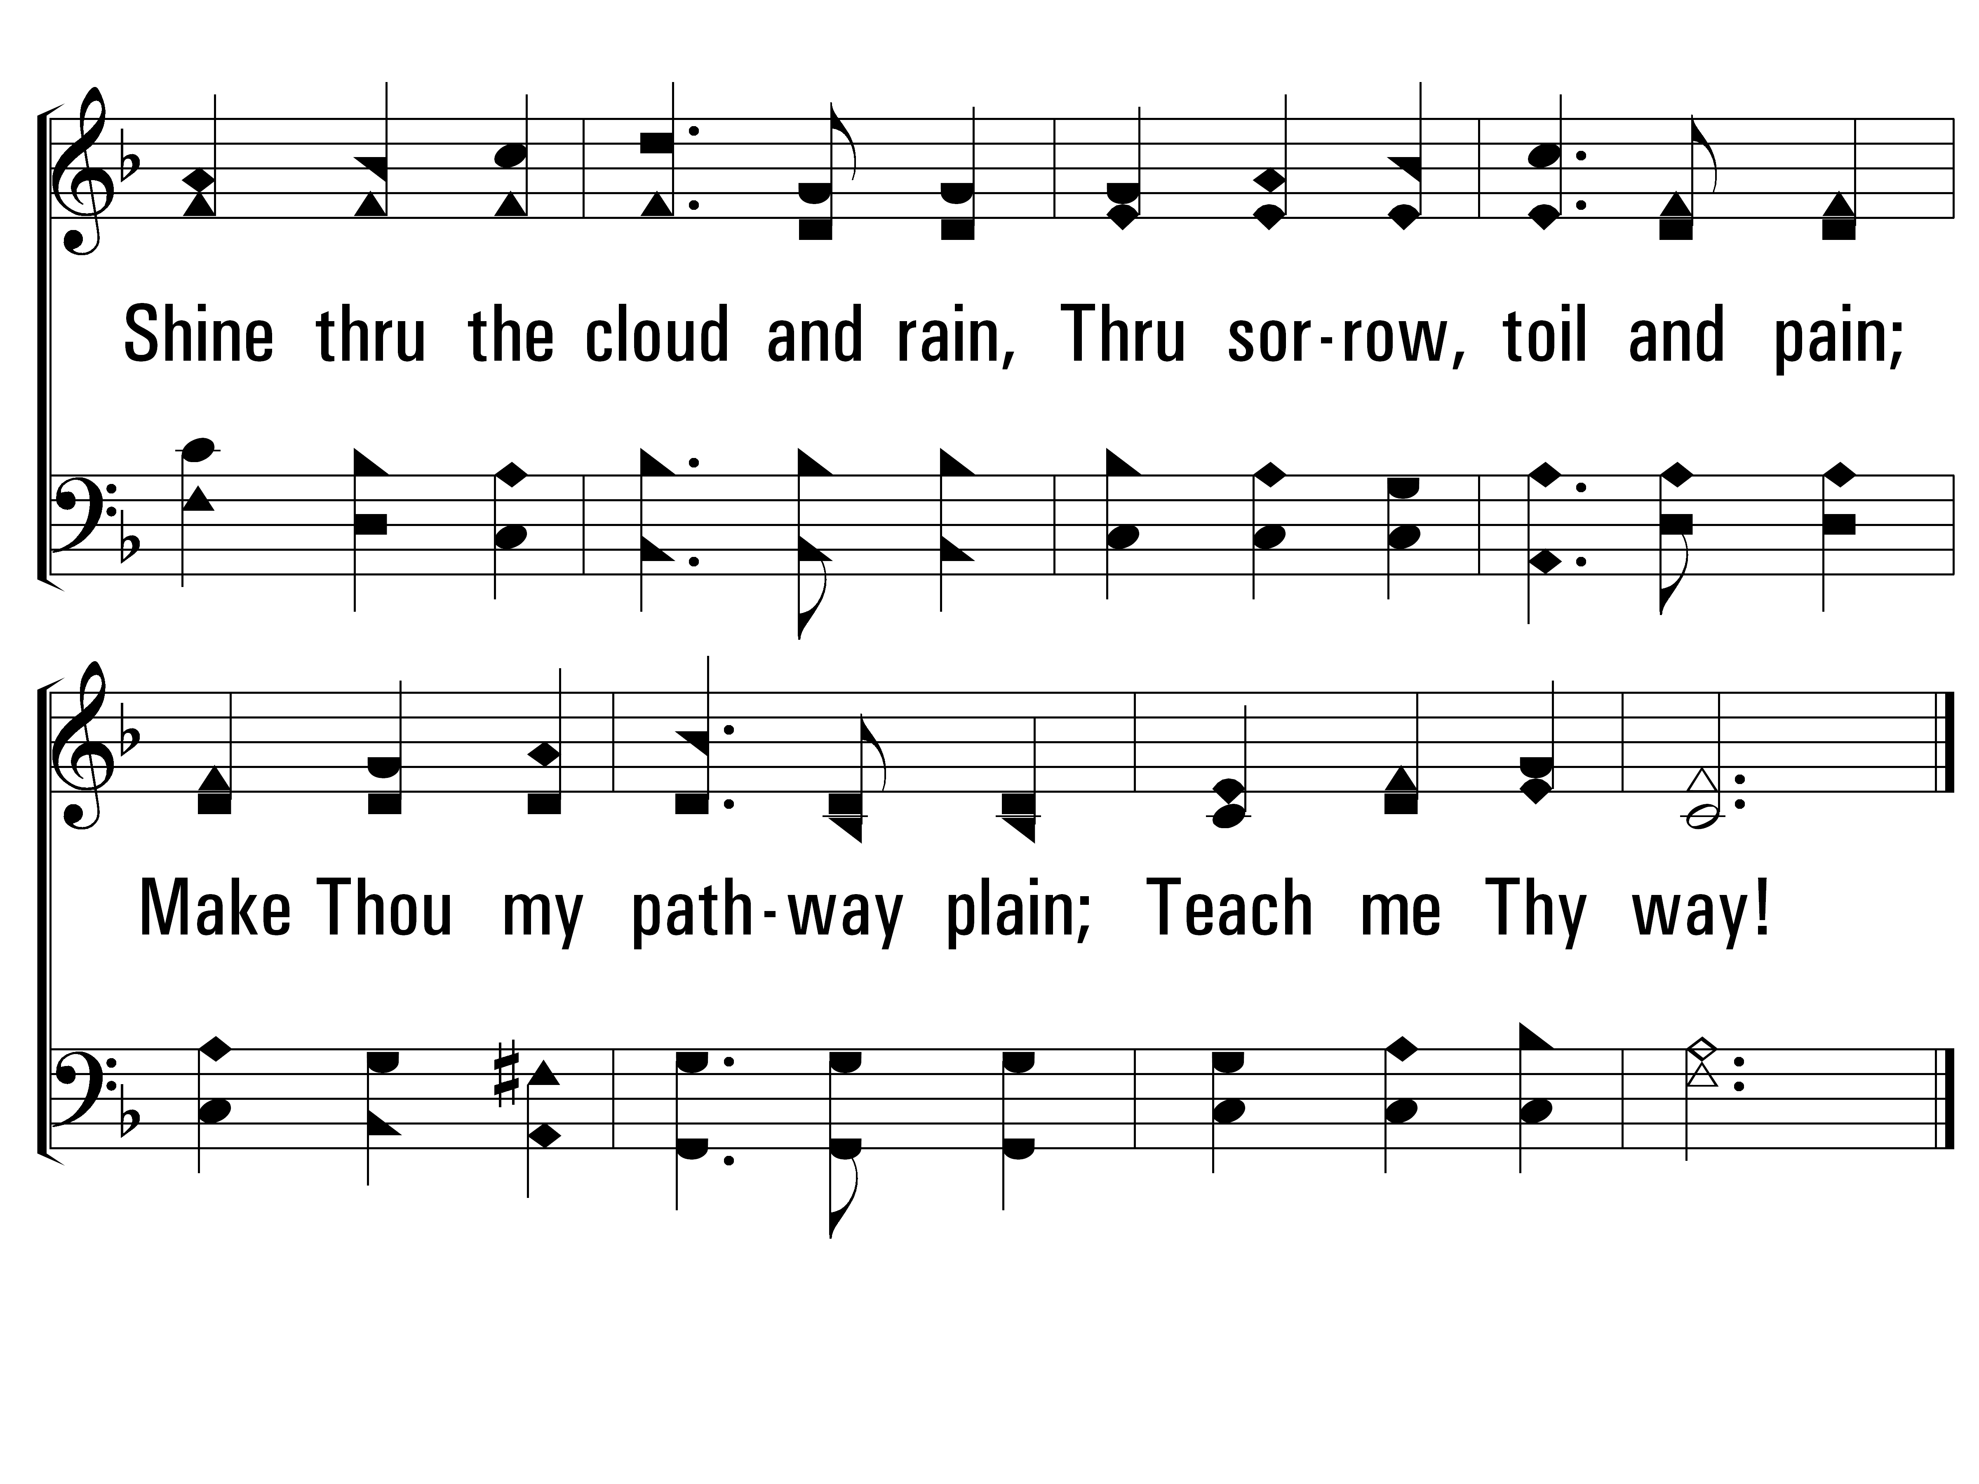
TeachMeThyWay_st3_b
Vs 3
© 2014 Sumphonia Productions, LLC

Slide 99
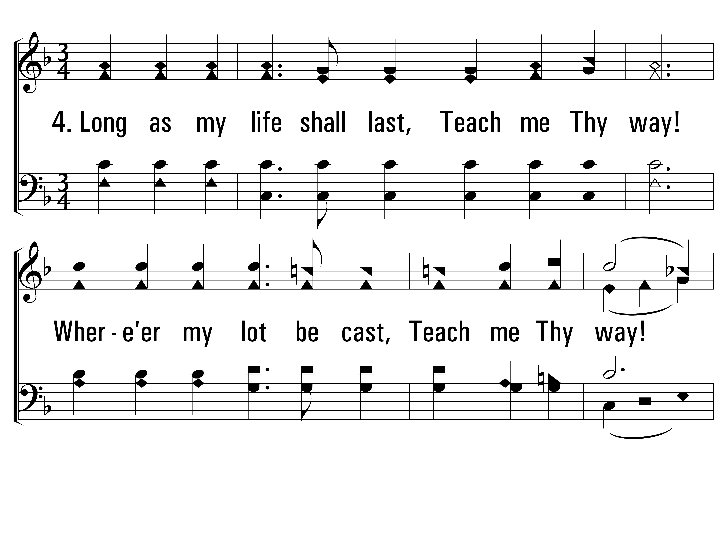
TeachMeThyWay_st4_a
Vs 4
© 2014 Sumphonia Productions, LLC

Slide 100
TeachMeThyWay_st4_b
Vs 4
© 2014 Sumphonia Productions, LLC
End

Slide 101
Lord, Speak to Me All Stanzas
632
Psalms, Hymns, Spiritual Songs

Slide 102
LordSpeakToMe_st1_a
Vs 1
© 2014 Sumphonia Productions, LLC

Slide 103
LordSpeakToMe_st1_b
Vs 1
© 2014 Sumphonia Productions, LLC

Slide 104
LordSpeakToMe_st2_a
Vs 2
© 2014 Sumphonia Productions, LLC

Slide 105
LordSpeakToMe_st2_b
Vs 2
© 2014 Sumphonia Productions, LLC

Slide 106
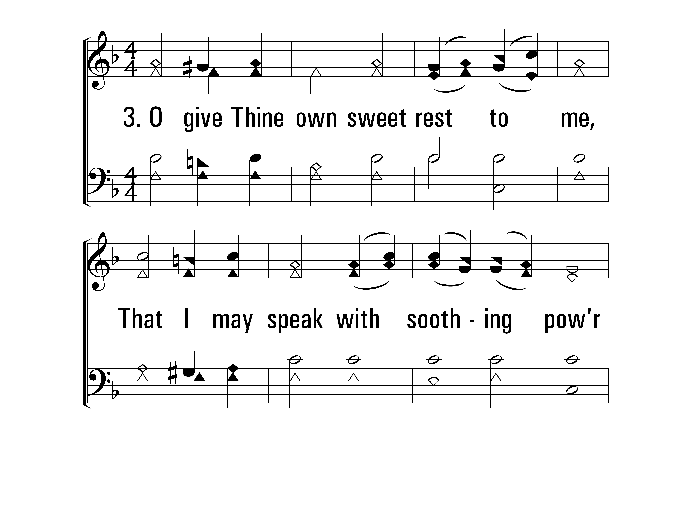
LordSpeakToMe_st3_a
Vs 3
© 2014 Sumphonia Productions, LLC

Slide 107
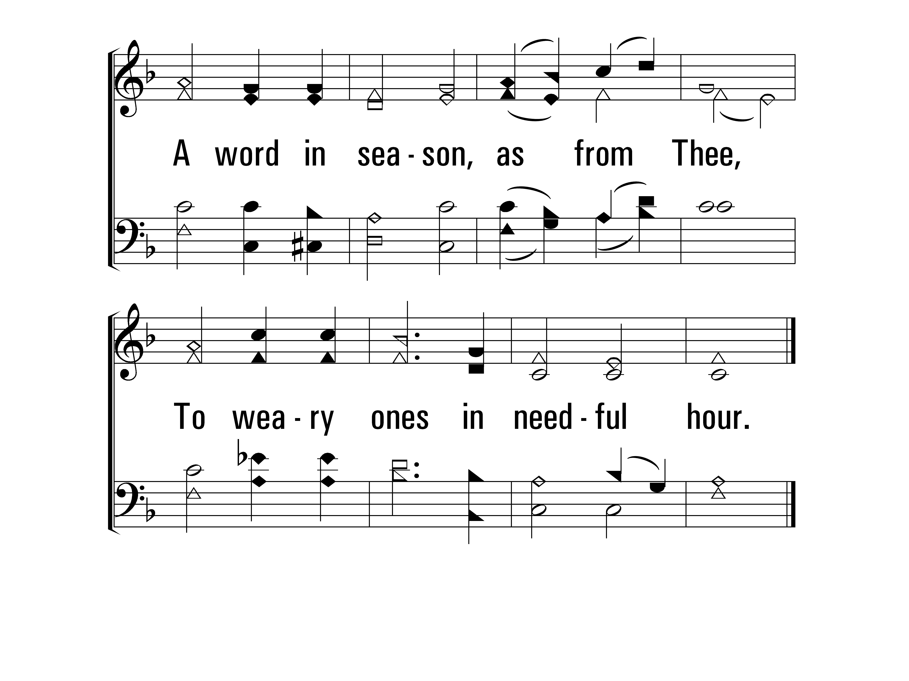
LordSpeakToMe_st3_b
Vs 3
© 2014 Sumphonia Productions, LLC

Slide 108
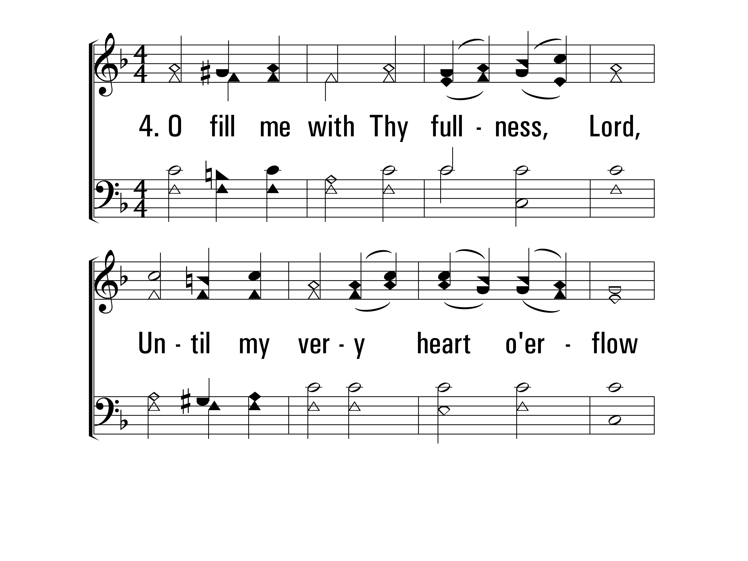
LordSpeakToMe_st4_a
Vs 4
© 2014 Sumphonia Productions, LLC

Slide 109
LordSpeakToMe_st4_b
Vs 4
© 2014 Sumphonia Productions, LLC
End

