Slide 1
1 & 2 Timothy
SEGMENT FIVE: April 12 – May

Slide 2
Schedule
Date | Text | Title
4/12 | - | Timothy
4/15 | 1 Tim. 1 | Sound Doctrine and Godliness
4/19 | 1 Tim. 2 | Gender Roles and Godliness
4/22 |  | GOSPEL MEETING: Robin Bauer
4/26 | 1 Tim. 3 | Church Leaders and Godliness
4/29 | 1 Tim. 4 | Exercise and Godliness
5/3 | 1 Tim. 5 | Benevolence and Godliness
Date | Text | Title
5/6 | 1 Tim. 6 | Worldliness and Godliness
5/10 | 2 Tim. 1 | Don’t Be Afraid or Ashamed
5/13 | 2 Tim. 2:1-13 | Images of Ministry
5/17 | 2 Tim. 2:14-26 | God’s Workers
5/20 | 2. Tim. 3 | Perilous Times
5/24 | 2. Tim. 4 | Final Charge and Instructions
5/27 |  | REVIEW

Slide 3
1. In how many of the 27 NT books is Timothy mentioned by name?
(A) 4 (B) 8 (C) 12 (D) 16
He’s in all but three of Paul’s letters,
plus Acts (and Hebrews)
Paul includes him as an addressee in six letters
(2 Corinthians, Philippians, Colossians, 1&2 Thessalonians, Philemon)

Slide 4
2. What was Timothy’s likely age when 1 Timothy was written?
(A) 20-30 (B) 30-40 (C) 40-50 (D) 50-60
1 Timothy 4:12
“Let no one despise your youth, but be an example to the believers in word, in conduct, in love, in spirit, in faith, in purity.”
1 Timothy one of the last of Paul’s letters, about 63 AD.

Slide 5
3. What was Timothy’s likely age when he first joined Paul in work?
(A) 20-30 (B) 30-40 (C) 40-50 (D) 50-60
Timothy joined Paul’s second missionary journey in about 50/51 AD (Acts 16:1-5).
This would likely put him in his early 20s and maybe even as young as 18.

Slide 6
Timothy’s Background (Acts 16:1-5)
What was Timothy’s hometown? ______________
What was his family situation? ________________
What was his reputation? ____________________
What did he do for the Jews’ sake? _________

Slide 7
Timothy’s Background (Acts 16:1-5)
Lystra
What was Timothy’s hometown? ______________

Slide 8
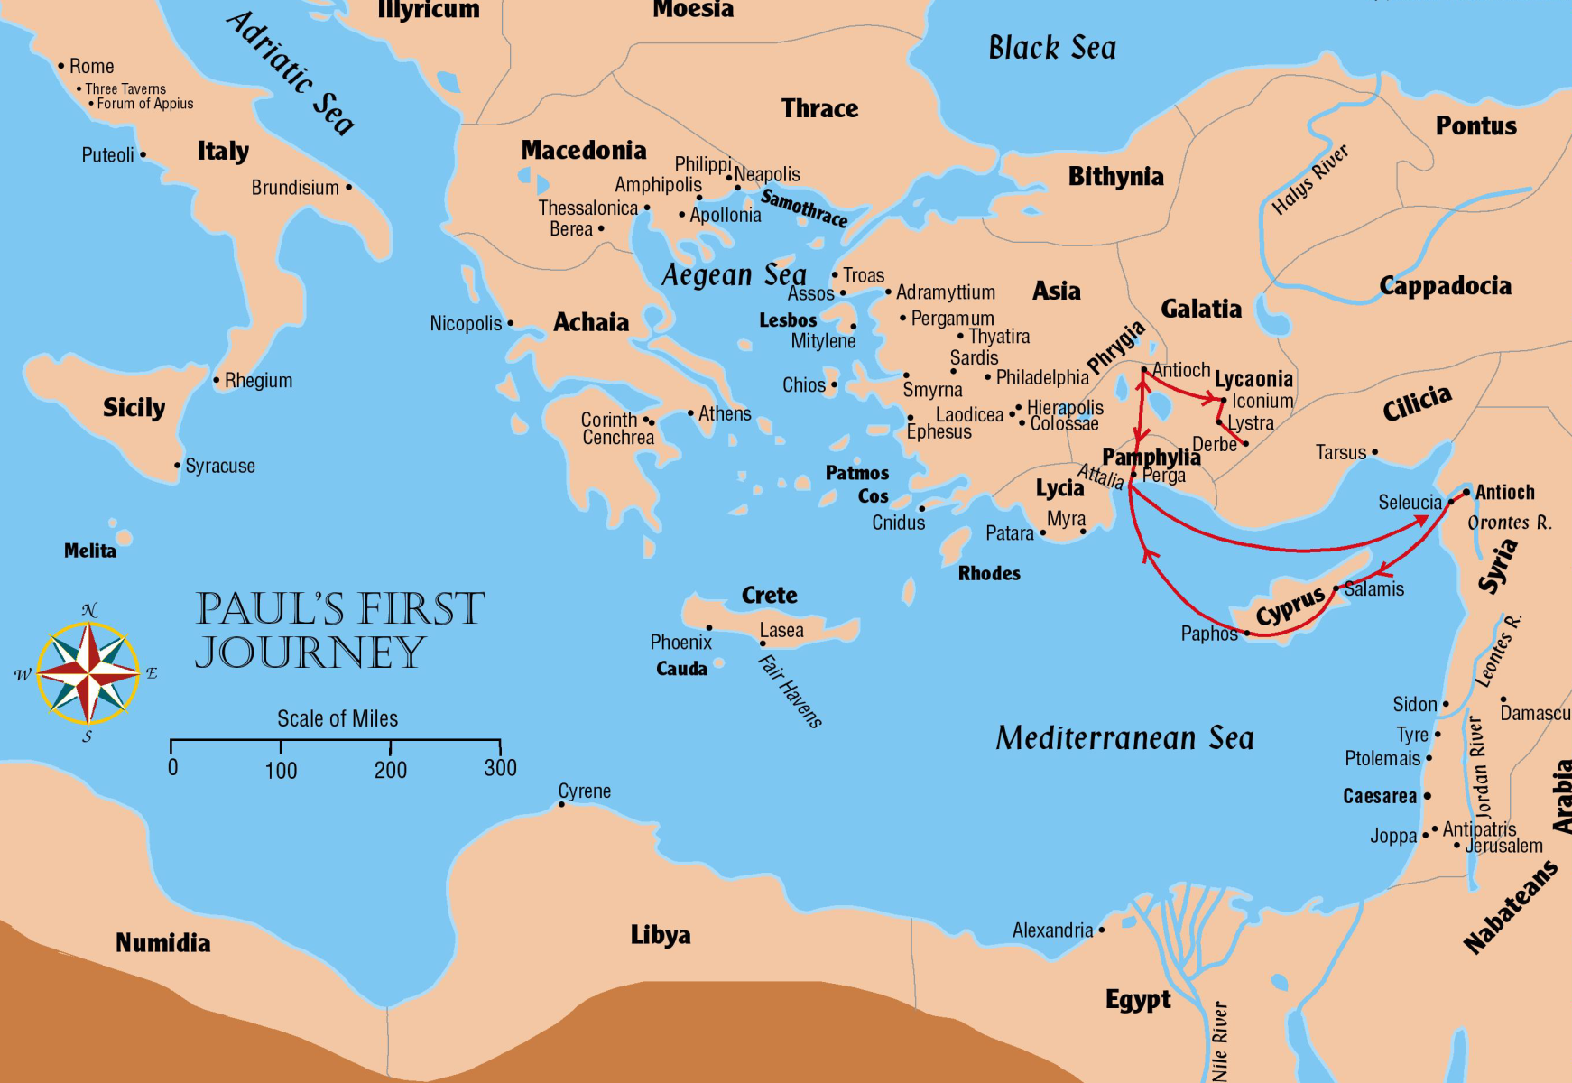
Iconium: “But the unbelieving Jews stirred up the Gentiles and poisoned their minds against the brethren … And when a violent attempt was made by both the Gentiles and Jews, with their rulers, to abuse and stone them, they became aware of it and fled to Lystra and Derbe …” (Acts 14:2,5-6)
45-48 AD

Slide 9
Lystra: “Then Jews from Antioch and Iconium came there; and having persuaded the multitudes, they stoned Paul and dragged him out of the city, supposing him to be dead. However, when the disciples gathered around him, he rose up and went into the city.” (Acts 14:19-20)
45-48 AD

Slide 10
“And when they had preached the gospel to that city and made many disciples, they returned to Lystra, Iconium, and Antioch, strengthening the souls of the disciples, exhorting them to continue in the faith, and saying, ‘We must through many tribulations enter the kingdom of God.”(Acts 14:21-22)
45-48 AD

Slide 11
“But you have carefully followed my doctrine, manner of life, purpose, faith, longsuffering, love, perseverance, persecutions, afflictions, which happened to me at Antioch, at Iconium, at Lystra – what persecutions I endured. And out of them all the Lord delivered me.” (2 Timothy 3:10-11)
45-48 AD

Slide 12
Timothy’s Background (Acts 16:1-5)
Lystra
What was Timothy’s hometown? ______________
What was his family situation? ________________
“…when I call to remembrance the genuine faith that is in you, which dwelt first in your grandmother Lois and your mother Eunice, and I am persuaded is in you also.” (2 Timothy 1:5)
“and that from childhood you have known the Holy Scriptures, which are able to make you wise for salvation through faith which is in Christ Jesus” (2 Timothy 3:15)
Mother a Jewish Christian
But Father a Greek

Slide 13
1. Teach them the Holy Scriptures 2. Live out a genuine faith
To make a difference in a child’s LIFE, no matter their background

Slide 14
Timothy’s Background (Acts 16:1-5)
Lystra
What was Timothy’s hometown? ______________
What was his family situation? ________________
What was his reputation? ____________________
What did he do for the Jews’ sake? _________
Mother a Jewish Christian
But Father a Greek
Well-spoken of by brethren
Circumcised

Slide 15
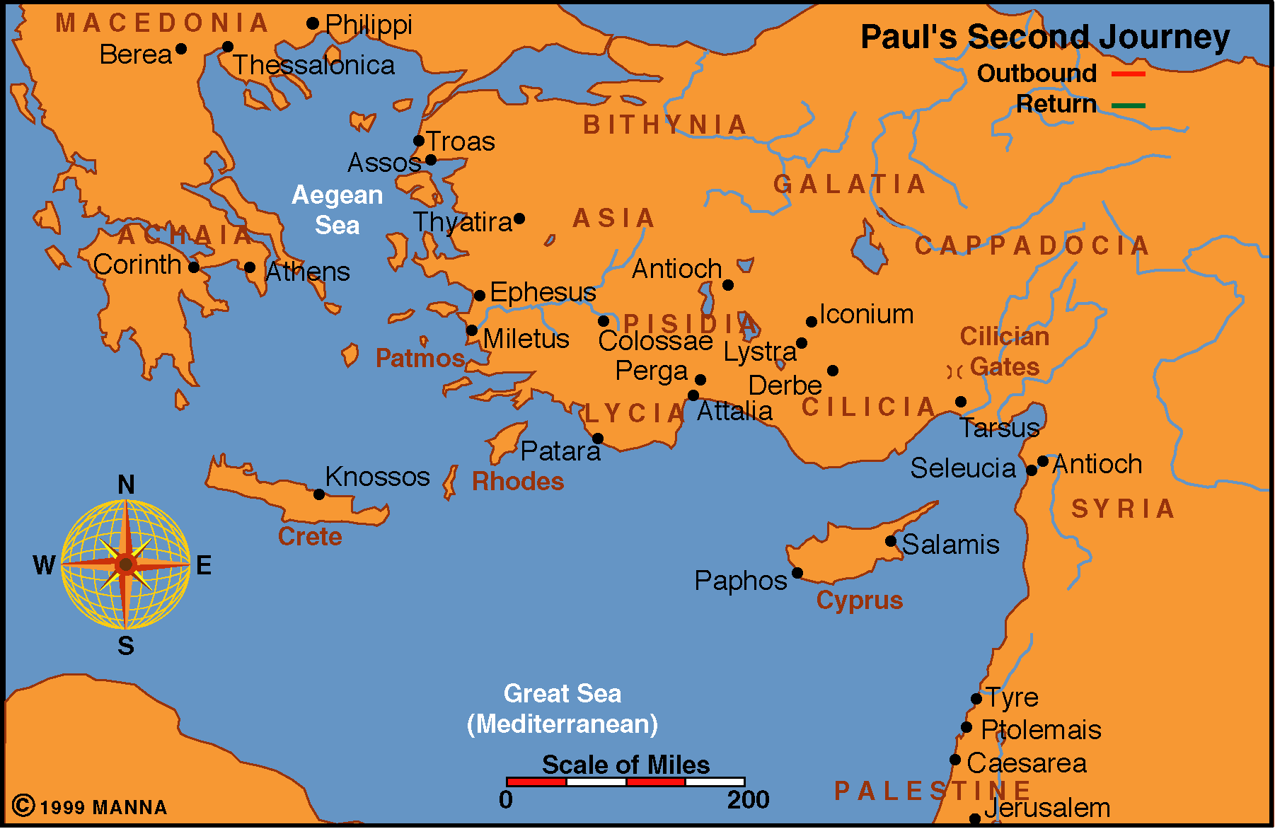
Acts 15:36-18:22
“Therefore, when we could no longer endure it, we though it good to be left in Athens alone, and sent Timothy … to establish you and encourage you…” (1 Thessalonians 3:1-2)

Slide 16
“I do not write these things to shame you, but as my beloved children I warn you … Therefore I urge you, imitate me. For this reason I have sent Timothy to you, who is my beloved and faithful son in the Lord, who will remind you of my ways in Christ, as I teach everywhere in every church.” (1 Corinthians 4:14-17)
“And if Timothy comes, see that he may be with you without fear; for he does the word of the Lord, as I also do. Therefore let no one despise him. But send him on his journey in peace…” (1 Corinthians 16:10-11)

Slide 17
1. Let no one despise your youth (1 Tim. 4:12) 2. Don’t despise your own youth. 3. Don’t despise your ability to do anything that God expects you to do.
EXPECTATIONS OF OURSELVES AND OTHERS

Slide 18
Godliness
1 Timothy 2:2,10; 3:16; 4:7-8; 6:3,5,6,11; 2 Timothy 3:5

Slide 19
¹⁴ These things I write to you, though I hope to come to you shortly; ¹⁵ but if I am delayed, I write so that you may know how you ought to conduct yourself in the house of God, which is the church of the living God, the pillar and ground of the truth. ¹⁶ And without controversy great is the mystery of godliness:
God was manifested in the flesh, Justified in the Spirit, Seen by angels, Preached among the Gentiles, Believed on in the world, Received up in glory.
(1 Timothy 3:14-16)

Slide 20
What is “godliness”?
Vine’s: Denotes that piety which, characterized by a Godward attitude, does that which is well-pleasing to Him
Mounce: A particular manner of life in which the believer is devoted to God
BDAG: Awesome respect accorded to God, devoutness, piety, godliness
Deep reverence for God that is demonstrated in devotion to Him

