Slide 1
Conversion
Last Lesson in Series

Slide 2
Conversion of 3,000 (Acts 2:36-42)
36 Therefore let all the house of Israel know assuredly that God has made this Jesus whom you crucified both Lord and Christ. 37 Now when they heard this they were pierced to the heart, and said to Peter and the rest of the apostles, “Brethren, what shall we do? 38 Peter said to them, “Repent and each of you be baptized in the name of Jesus Christ for the forgiveness of your sins; and you will receive the gift of the Holy Spirit.”
Change of mind
Change of will
Change of state

Slide 3
Evidences of Conversion Acts 2:42
“They were continually devoting themselves to the apostles’ teaching, and to fellowship, to the breaking of bread and to prayer” (NASV)
Authority?
Involvement?
Public Worship?
Private Devotions?

Slide 4
Question in this Lesson:
Is it possible for one who has been converted to be reconverted?

Slide 5
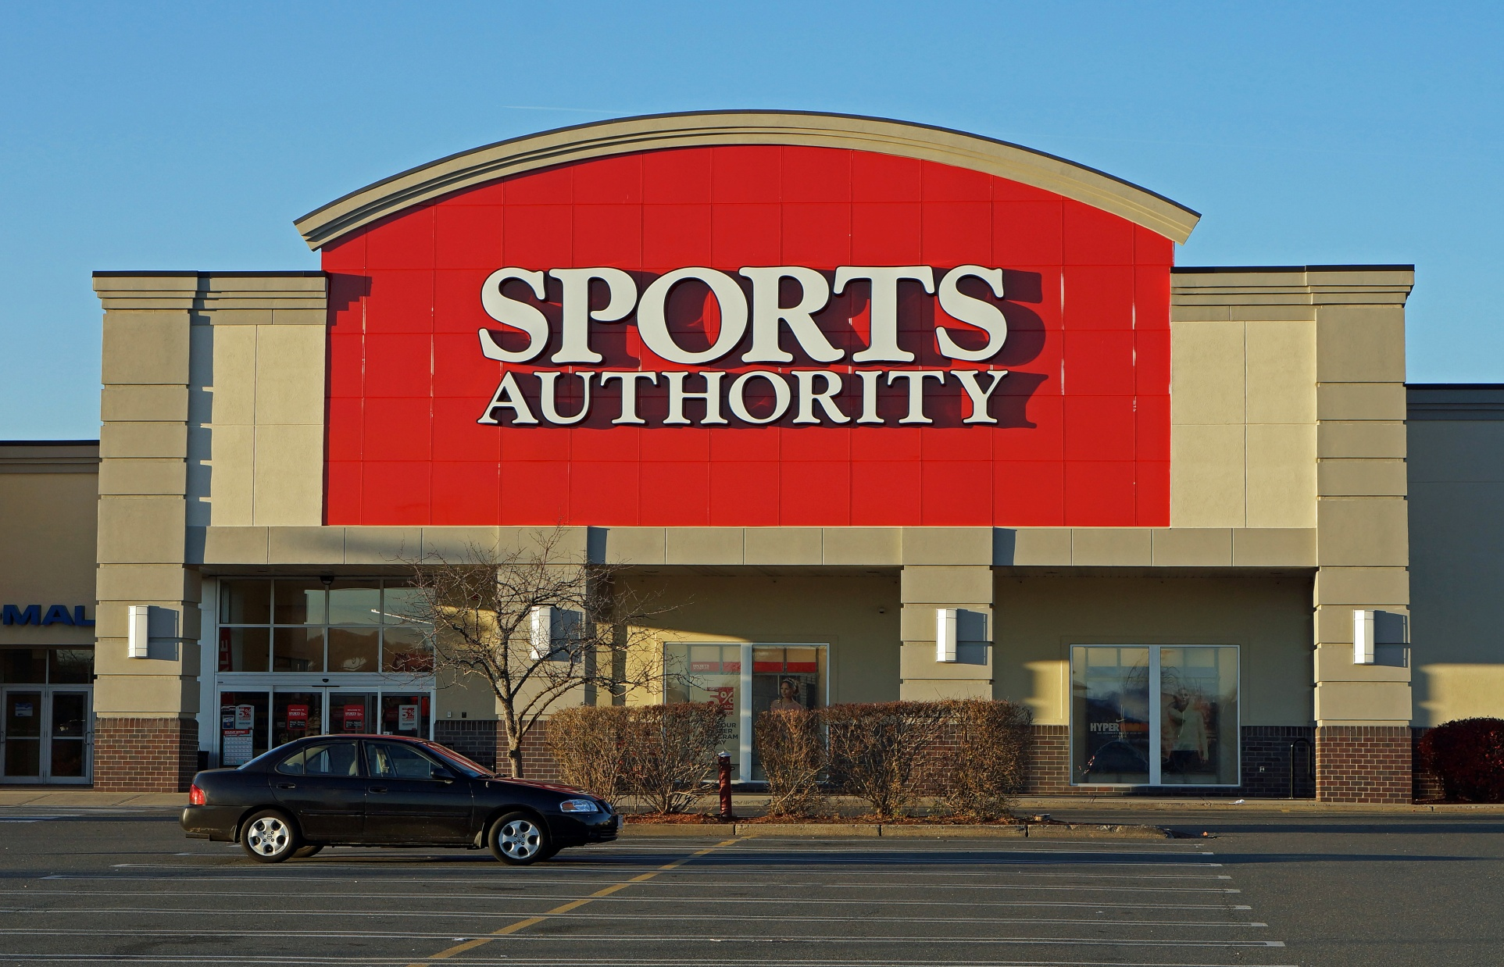
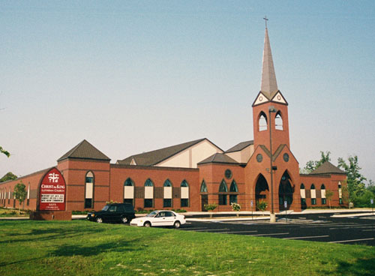
“Convert”
The Sporting Goods Store on Peachtree Pkwy was converted into a church building.
Could it be reconverted back into a Sporting Goods Store?
Notes:
Sporting Goods Store on Peachtree Pkwy.
o Took down signo
Moved out furnishingso
Added rooms on the sideo
Moved in seatingo
Added a steeple and a crosso
Different people began to come in and outo
It had been converted into a church building.

Slide 6
Warnings of Possible Regression of Hebrew Converts
Hebrews 2:1 (Pew Bible NT p. 169)
Hebrews 3:12 (p. 170)
Hebrews 4:1 (P. 170)
Hebrews 6:4-6 (p. 171)
Hebrews 10:32-39 (p. 174)

Slide 7
Evidences of Drifting Hebrews 2:1-2
Loss of Concern for study of and adherence to “the Apostles’ teaching”
Increasing involvement with the world & less with Christ & Christians
Loss of interest in attendance to public worship
Neglect of private devotions

Slide 8
What May have Contributed to their “Drifting Away?”
Could it have been a comparison of their Religion with the Jewish Religion they had left?

Slide 9
Some Differences
Jewish Worship
Christian Worship
Beautiful Temple
Robed High Priest
Levitical Priests
Animal Sacrifices
Instruments & Choirs
Millennia of History
Ordained by Moses
No Material Temples
Invisible High Priest
Common People
No animal sacrifices
No instruments, choirs
No long history
Taught by fishermen

Slide 10
Hebrew Writer’s Encouragement
“Now faith is the substance of things hoped for, the evidence of things not seen” (11:1)
Heavenly temple not made with hands.(9:11)
Perfect High Priest serving in Heaven (9:24)
“Most Holy Place” open to all (10:19-23)
One final, sufficient, perfect sacrifice. (9:14)
Worship with “fruit of lips.” (13:15)

Slide 11
Differences in Our Practices
No Instrumental Music
Believers Baptism by Immersion
No Christmas and Easter Celebration
No Gymnasium or Sports program
No Denominational Affiliation
Insistence on Scriptural Authority
This is the reason for all the other differences!

Slide 12
“We walk by faith; not by sight (2 Cor. 5:7)
“So then, faith comes by hearing and hearing by the word of God.” (Rom. 10:17)
Jesus asked, “Is it from Heaven or from Men?
“…learn in us not to think beyond what is written.”
“All scripture is given…that the man of God may be compete, thoroughly equipped for every good work.”
“Whoever transgresses and does not abide in the doctrine of Christ does not have God.”
We must abandon this concept if we are to be like those around us!

Slide 13
Churches Adding Instrumental Music
Do you suppose they were studying the scriptures and reached the conclusion that they should be using instruments?

Slide 14
“Scriptural citations backing the a cappella tradition include a passage in Ephesians but church history is a stronger influence.” (Tradition)
“But the larger Churches of Christ — they were actually very firm in embracing us.“
. "A cappella is like Latin, It is beautiful, it speaks to people at a certain level, but the problem is that a lot of people don't speak Latin. "What people in the Churches of Christ call instrumental music, other people just call music. It's English."
And in Music City, its appeal is undeniable… better connecting to Nashville and Brentwood….

Slide 15
Other Churches are Beginning to Use Women for Public Roles
Justified by saying prohibitions were to local situations.
Such reasoning was never thought of until churches around us began the practice.

Slide 16
When community practices begin to be our authority the church is being converted--
We become “Community Churches” Not “churches of Christ.”

