Slide 1
Fearless Through Faith: Abraham

Slide 2
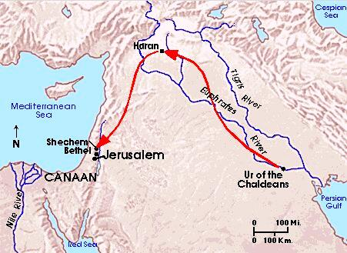

Slide 3
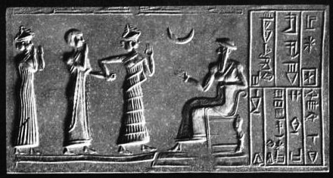
Moon-god Sin (~2100 BC)
“… the gods which your fathers
served beyond the River…”

Slide 5
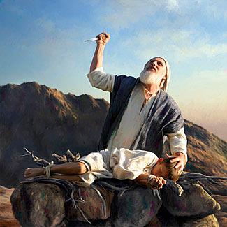

Slide 6
Hebrews 11
By faith Abraham
Obeyed when he was called
Went out, not knowing where he was going
Lived in tents, as an alien, as in a foreign land
Offered up Isaac
For
He was looking for the city which has foundations which God built

