Slide 1
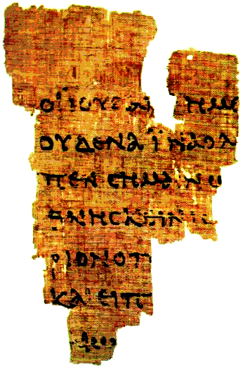
The Gospel of John
Lesson 5B
John Chapter 6

Slide 2
John Quiz
List the seven miracles in John, with chapters:
List the chapters in which these quotes are found:
a. ____ “Zeal for thy house has eaten me up.”
b. ____ “Go thy way, thy son lives.”
c. ____ “Can anything good come out of Nazareth?”
d. ____ “Except one be born of water and the Spirit, he cannot enter…”
e. ____ “Arise, take up thy bed and walk.”
f. ____ “I am the bread, which came down out of heaven.”
g. ____ “…Mine hour has not yet come.”
h. ____ “He must increase, but I must decrease.”
i. ____ “God is a spirit; … must worship in spirit and truth
j. ____ “I am the good shepherd.”
k. ____ “Behold the Lamb of God, that takes away the sin of the world”
Water to wine (2); Nobleman’s son (4); Lame man (5); Feeding 5,000 (6); Walking on Water (6); Man born blind (9); Lazarus raised (11)
2
4
1
3
5
6
2
3
4
10
1

Slide 3
Gospel of John - Schedule

Slide 4
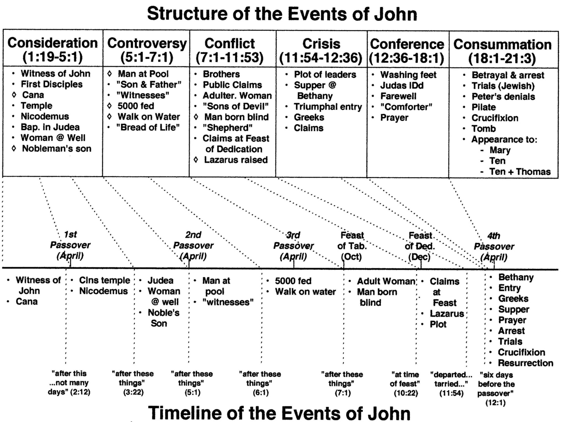
2:13
5:1?
6:4
7:2
10:22
13:1

Slide 5
Lesson 5 (part 2) Objectives (At the end of the class, the student should be able to...)
Name the two images of Christ portrayed within the text? (6:22-71)
List four comparisons between the old and the new law (bread)
Bread from Moses vs. Jesus is the Bread
Physical vs. Spiritual
Earthly Death vs. Eternal Life
Unfulfilling vs. Fulfilling
Flesh vs. Spiritual
Application in our lives – Determination to continually follow.

Slide 6
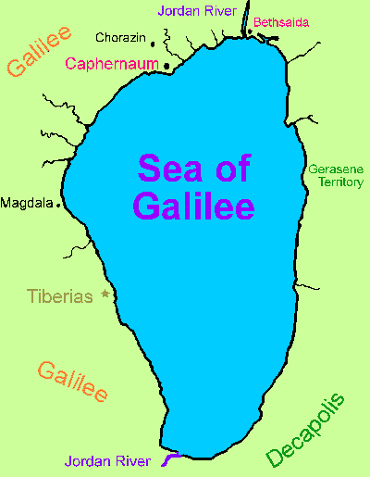
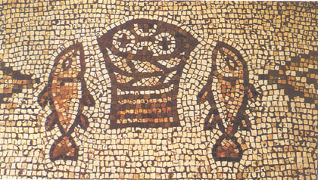
Feeding 5000 & “Bread of Life” Discourse

Slide 7
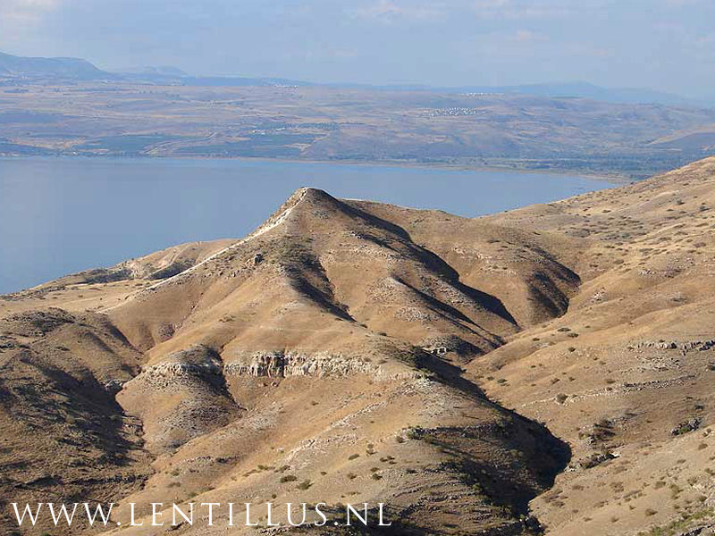

Slide 8
Organization of 6:22-70
²² On the following day, when the people who were standing on the other side of the sea saw that there was no other boat there, except that one which His disciples had entered, and that Jesus had not entered the boat with His disciples, but His disciples had gone away alone— ²³ however, other boats came from Tiberias, near the place where they ate bread after the Lord had given thanks— ²⁴ when the people therefore saw that Jesus was not there, nor His disciples, they also got into boats and came to Capernaum, seeking Jesus. ²⁵ And when they found Him on the other side of the sea, they said to Him, “Rabbi, when did You come here?”
²⁶ Jesus answered them and said, “Most assuredly, I say to you, you seek Me, not because you saw the signs, but because you ate of the loaves and were filled. ²⁷ Do not labor for the food which perishes, but for the food which endures to everlasting life, which the Son of Man will give you, because God the Father has set His seal on Him.”
²⁸ Then they said to Him, “What shall we do, that we may work the works of God?”
²⁹ Jesus answered and said to them, “This is the work of God, that you believe in Him whom He sent.”
³⁰ Therefore they said to Him, “What sign will You perform then, that we may see it and believe You? What work will You do? ³¹ Our fathers ate the manna in the desert; as it is written, ‘He gave them bread from heaven to eat.’”
³² Then Jesus said to them, “Most assuredly, I say to you, Moses did not give you the bread from heaven, but My Father gives you the true bread from heaven. ³³ For the bread of God is He who comes down from heaven and gives life to the world.”
³⁴ Then they said to Him, “Lord, give us this bread always.”
³⁵ And Jesus said to them, “I am the bread of life. He who comes to Me shall never hunger, and he who believes in Me shall never thirst. ³⁶ But I said to you that you have seen Me and yet do not believe. ³⁷ All that the Father gives Me will come to Me, and the one who comes to Me I will by no means cast out. ³⁸ For I have come down from heaven, not to do My own will, but the will of Him who sent Me. ³⁹ This is the will of the Father who sent Me, that of all He has given Me I should lose nothing, but should raise it up at the last day. ⁴⁰ And this is the will of Him who sent Me, that everyone who sees the Son and believes in Him may have everlasting life; and I will raise him up at the last day.”
⁴¹ The Jews then complained about Him, because He said, “I am the bread which came down from heaven.” ⁴² And they said, “Is not this Jesus, the son of Joseph, whose father and mother we know? How is it then that He says, ‘I have come down from heaven’?”
⁴³ Jesus therefore answered and said to them, “Do not murmur among yourselves. ⁴⁴ No one can come to Me unless the Father who sent Me draws him; and I will raise him up at the last day. ⁴⁵ It is written in the prophets, ‘And they shall all be taught by God.’ Therefore everyone who has heard and learned from the Father comes to Me. ⁴⁶ Not that anyone has seen the Father, except He who is from God; He has seen the Father. ⁴⁷ Most assuredly, I say to you, he who believes in Me has everlasting life. ⁴⁸ I am the bread of life. ⁴⁹ Your fathers ate the manna in the wilderness, and are dead. ⁵⁰ This is the bread which comes down from heaven, that one may eat of it and not die. ⁵¹ I am the living bread which came down from heaven. If anyone eats of this bread, he will live forever; and the bread that I shall give is My flesh, which I shall give for the life of the world.”
⁵² The Jews therefore quarreled among themselves, saying, “How can this Man give us His flesh to eat?”
⁵³ Then Jesus said to them, “Most assuredly, I say to you, unless you eat the flesh of the Son of Man and drink His blood, you have no life in you. ⁵⁴ Whoever eats My flesh and drinks My blood has eternal life, and I will raise him up at the last day. ⁵⁵ For My flesh is food indeed, and My blood is drink indeed. ⁵⁶ He who eats My flesh and drinks My blood abides in Me, and I in him. ⁵⁷ As the living Father sent Me, and I live because of the Father, so he who feeds on Me will live because of Me. ⁵⁸ This is the bread which came down from heaven—not as your fathers ate the manna, and are dead. He who eats this bread will live forever.”
⁵⁹ These things He said in the synagogue as He taught in Capernaum.
⁶⁰ Therefore many of His disciples, when they heard this, said, “This is a hard saying; who can understand it?”
⁶¹ When Jesus knew in Himself that His disciples complained about this, He said to them, “Does this offend you?⁶² What then if you should see the Son of Man ascend where He was before? ⁶³ It is the Spirit who gives life; the flesh profits nothing. The words that I speak to you are spirit, and they are life. ⁶⁴ But there are some of you who do not believe.” For Jesus knew from the beginning who they were who did not believe, and who would betray Him. ⁶⁵ And He said, “Therefore I have said to you that no one can come to Me unless it has been granted to him by My Father.”
⁶⁶ From that time many of His disciples went back and walked with Him no more. ⁶⁷ Then Jesus said to the twelve, “Do you also want to go away?”
⁶⁸ But Simon Peter answered Him, “Lord, to whom shall we go? You have the words of eternal life. ⁶⁹ Also we have come to believe and know that You are the Christ, the Son of the living God.”
⁷⁰ Jesus answered them, “Did I not choose you, the twelve, and one of you is a devil?” ⁷¹ He spoke of Judas Iscariot, the son of Simon, for it was he who would betray Him, being one of the twelve.
Multitudes (22-40)
Jews (41-59)
Disciples (60-71)

Slide 9
Believers & Unbelievers in John
“Jews”
Multitude
Crowd
Priests &
Levites
Pharisees
Disciples
People
Rulers

Slide 10
Questions asked of Jesus in 6:22-70
Multitudes (22-40)
(25) When did you come?
(28) What must we do…to work the works of God?
(30) What do you do for a sign? How about bread from heaven (like Moses)?
(34) Give us this bread always. (asking Jesus)
Jews (41-59)
(41-42) How could you “come from heaven?”
(52) How can He give us His flesh to eat?
Disciples (60-71)
(60) This is a hard saying, who can understand it?
(68) To whom shall we go?

Slide 11
Conversation with the Multitude
²² On the following day, when the people who were standing on the other side of the sea saw that there was no other boat there, except that one which His disciples had entered, and that Jesus had not entered the boat with His disciples, but His disciples had gone away alone— ²³ however, other boats came from Tiberias, near the place where they ate bread after the Lord had given thanks— ²⁴ when the people therefore saw that Jesus was not there, nor His disciples, they also got into boats and came to Capernaum, seeking Jesus. ²⁵ And when they found Him on the other side of the sea, they said to Him, “Rabbi, when did You come here?”
²⁶ Jesus answered them and said, “Most assuredly, I say to you, you seek Me, not because you saw the signs, but because you ate of the loaves and were filled. ²⁷ Do not labor for the food which perishes, but for the food which endures to everlasting life, which the Son of Man will give you, because God the Father has set His seal on Him.”
²⁸ Then they said to Him, “What shall we do, that we may work the works of God?”
²⁹ Jesus answered and said to them, “This is the work of God, that you believe in Him whom He sent.”
³⁰ Therefore they said to Him, “What sign will You perform then, that we may see it and believe You? What work will You do? ³¹ Our fathers ate the manna in the desert; as it is written, ‘He gave them bread from heaven to eat.’”
³² Then Jesus said to them, “Most assuredly, I say to you, Moses did not give you the bread from heaven, but My Father gives you the true bread from heaven. ³³ For the bread of God is He who comes down from heaven and gives life to the world.”
³⁴ Then they said to Him, “Lord, give us this bread always.”
³⁵ And Jesus said to them, “I am the bread of life. He who comes to Me shall never hunger, and he who believes in Me shall never thirst. ³⁶ But I said to you that you have seen Me and yet do not believe. ³⁷ All that the Father gives Me will come to Me, and the one who comes to Me I will by no means cast out. ³⁸ For I have come down from heaven, not to do My own will, but the will of Him who sent Me. ³⁹ This is the will of the Father who sent Me, that of all He has given Me I should lose nothing, but should raise it up at the last day. ⁴⁰ And this is the will of Him who sent Me, that everyone who sees the Son and believes in Him may have everlasting life; and I will raise him up at the last day.”

Slide 12
Multitudes’ Questions
(25) When did you come?
“…you seek me for the wrong reason.”
“work for the food which abides to eternal life.”
(28) What must we do…to work the works of God?
“the work of God is to believe.”
(30) What do you do for a sign? How about bread from heaven (like Moses)?
It wasn’t Moses.
The bread of God from heaven gives life.
(34) Give us this bread always. (asking Jesus)
I am the bread of life.
Look at me & believe, for eternal life (40).

Slide 13
Two Types of Food
The food that perishes:
Literally: food we eat
It does not satisfy for long (Jn 4:13)
Figuratively:
Human wisdom
Pleasure
Wealth
“Empire” Building

Slide 14
Perishable “Food”
Do not labor for such food (Jn 6:27)
Make no effort to supply needs?
Provide for your family (1 Tim 5:8)
If a man does not work, neither should he eat. (2 Thes 3:10-12)
Do not neglect the food that endures.
Don’t make the “Perishable” food your priority in life. (Matt 6:33)
Example of Martha (Luke 10:38-42)

Slide 15
Enduring Food
The Word of God (Jn 1:1)
How man should live (Matt 4:4)
David placed the words of the Lord above the perishable food. (Psalm 19:10)
Job said he treasured the words of His mouth more than his portion of food. (Job 23:12)

Slide 16
Enduring Food
Work for this food.
Our life’s work centered on Jesus.
Believe for everlasting life (vs 28-29)
Follow Him (vs 66-69)
Know Him
Obey Him
Self Evaluate: Is your “food” to do the will of the Father?

Slide 17
Conversation with the Jews
⁴¹ The Jews then complained about Him, because He said, “I am the bread which came down from heaven.” ⁴² And they said, “Is not this Jesus, the son of Joseph, whose father and mother we know? How is it then that He says, ‘I have come down from heaven’?”
⁴³ Jesus therefore answered and said to them, “Do not murmur among yourselves. ⁴⁴ No one can come to Me unless the Father who sent Me draws him; and I will raise him up at the last day. ⁴⁵ It is written in the prophets, ‘And they shall all be taught by God.’ Therefore everyone who has heard and learned from the Father comes to Me. ⁴⁶ Not that anyone has seen the Father, except He who is from God; He has seen the Father. ⁴⁷ Most assuredly, I say to you, he who believes in Me has everlasting life. ⁴⁸ I am the bread of life. ⁴⁹ Your fathers ate the manna in the wilderness, and are dead. ⁵⁰ This is the bread which comes down from heaven, that one may eat of it and not die. ⁵¹ I am the living bread which came down from heaven. If anyone eats of this bread, he will live forever; and the bread that I shall give is My flesh, which I shall give for the life of the world.”
⁵² The Jews therefore quarreled among themselves, saying, “How can this Man give us His flesh to eat?”
⁵³ Then Jesus said to them, “Most assuredly, I say to you, unless you eat the flesh of the Son of Man and drink His blood, you have no life in you. ⁵⁴ Whoever eats My flesh and drinks My blood has eternal life, and I will raise him up at the last day. ⁵⁵ For My flesh is food indeed, and My blood is drink indeed. ⁵⁶ He who eats My flesh and drinks My blood abides in Me, and I in him. ⁵⁷ As the living Father sent Me, and I live because of the Father, so he who feeds on Me will live because of Me. ⁵⁸ This is the bread which came down from heaven—not as your fathers ate the manna, and are dead. He who eats this bread will live forever.”
⁵⁹ These things He said in the synagogue as He taught in Capernaum.

Slide 18
Jews’ Questions
(41-42) How could you “come from heaven?”
“Father who sent Me”
“have seen the Father”
“I am the living bread which came down from heaven.”
“the bread…is My flesh…for the life of the world”
(52) How can he give us his flesh to eat?
“My flesh is food indeed, and My blood is drink indeed.”
“He who eats My flesh and drinks My blood abides in Me, and I in him.”
“the living Father sent Me…so he who feeds on Me will live because of Me.”
This bread came from heaven…eat it and live forever.

Slide 19
Conversation with the Disciples
⁶⁰ Therefore many of His disciples, when they heard this, said, “This is a hard saying; who can understand it?”
⁶¹ When Jesus knew in Himself that His disciples complained about this, He said to them, “Does this offend you? ⁶² What then if you should see the Son of Man ascend where He was before? ⁶³ It is the Spirit who gives life; the flesh profits nothing. The words that I speak to you are spirit, and they are life. ⁶⁴ But there are some of you who do not believe.” For Jesus knew from the beginning who they were who did not believe, and who would betray Him. ⁶⁵ And He said, “Therefore I have said to you that no one can come to Me unless it has been granted to him by My Father.”
⁶⁶ From that time many of His disciples went back and walked with Him no more. ⁶⁷ Then Jesus said to the twelve, “Do you also want to go away?”
⁶⁸ But Simon Peter answered Him, “Lord, to whom shall we go? You have the words of eternal life. ⁶⁹ Also we have come to believe and know that You are the Christ, the Son of the living God.”
⁷⁰ Jesus answered them, “Did I not choose you, the twelve, and one of you is a devil?” ⁷¹ He spoke of Judas Iscariot, the son of Simon, for it was he who would betray Him, being one of the twelve.

Slide 20
Disciples’ (and Jesus’) Questions
(60) This is a hard saying, who can understand it?
“Does this offend you?”
“The spirit gives life. The words I have spoken are spirit and life.”
(66) [Many went back.]
“Would you also go away?
(68) To whom shall we go?
“Did I not choose you, the twelve, and one of you is a devil?”

Slide 21
To Whom Shall We Go?
Where do people choose to go instead of the Lord?
Majority? (Matt 7:13-14)
The Experts of the World? (1 Cor 1:18-29)
Preachers?
Conscience? – Saul / Paul (Acts 26:9-11)
Feelings? (Prov 28:26)

Slide 22
To Whom Shall We Go?
Go to the “words of life”. (vs 68-69)
Words of Jesus
Words of the Apostles
The New Testament

Slide 23
Analysis of John 6:25-71
What does Jesus mean when he refers to the words “food that spoils”?
What was the reason for feeding the crowds with regards to the manna discussed in verses 30 onwards, and was that the intention for the feeding of the five thousand?
How does the above manna differ from the bread of life?
What evidence in the book of Hebrews can be used to support the message Jesus portrayed concerning the old and the new law? (Heb 7:12; 8:6, 13)
How can we apply the above to our efforts to teach others?
(6:27) Physical Food vs. Spiritual Food
Temporal Sustenance vs. Eternal Life
(6:30…) Jesus would teach them differently than what Moses had taught
A sign…so they would believe…disciples distributing bread, prepared them
Manna spoiled & eating it they would still perish / neither occur with bread of life
Change in Priesthood = Change in the Law
Christ’s Ministry, Covenant, Promises > old ministry, covenant, promises
first covenant = obsolete, growing old, ready to disappear
Bread from Moses vs. Jesus is the Bread / Physical vs. Spiritual
Earthly Death vs. Eternal Life / Unfulfilling vs. Fulfilling / Flesh vs. Spiritual

Slide 24
Learn about terms (John 6)
Food/Bread
Out of Heaven
Eternal Life
26-27 – Jesus: you seek me for the loaves; work for the food that endures to eternal life
31 – Multitude: our fathers ate manna [Jesus: and they died (vs 49,58)]
32-33 – Jesus: the true bread of God that comes from heaven gives life
35 – Jesus: I am the bread of life that satisfies
51 – I am the living bread that came down out of heaven: my flesh for the life of the world
56-58 – You must eat my flesh, drink my blood to live
(Remember 3:13 – Jesus: He that descended out of heaven: the Son of man)
31-33 – Multitude: manna was bread out of heaven; Jesus: bread of God… out of heaven
38 – Jesus: I am come down from heaven
41-42 – Jews: How does he say: “I am come down out of heaven”?
50-51, 58 – Jesus: I am the living bread which came down from heaven.
62 – Jesus: What if you see the son of man ascending where He was before?
27 – Jesus: work for food that endures to eternal life
33-35 – bread of life → never hunger or thirst
39-40 – raise up on last day; behold the Son & believe → have eternal life
44 – the Father draws; I will raise him up in the last day
47 – believes → have eternal life
51 – eat the living bread (Jesus) → live forever
53-58 – eat my flesh drink my blood → have eternal life (56 – “abides in me”)
63 – the Spirit gives life; the words I have spoken are spirit and are life
68 – Peter: You have the words of eternal life

Slide 25
Bread to Eat!
Earthly Bread (Manna)
Food that fills the body
Temporary
Eat it and hunger again
Physical
Bread of death
Will spoil
From Moses / Old Covenant
Not “from” heaven
Bread of Life
Food that fills the soul
Eternal – live forever
Eat of it and never hunger
Spiritual
Bread of life, living bread
Endures to everlasting life
From Jesus / More Excel.
True bread from heaven

