Slide 1
Chapter 12
Summer 2015

Slide 2
Review
_________________________________________________
_________________________________________________
_________________________________________________
_________________________________________________
_________________________________________________
_________________________________________________
_________________________________________________
_________________________________________________
_________________________________________________
_________________________________________________
_________________________________________________
Prologue, John’s witness; first disciples
P1
Water to wine miracle; first Temple cleansing
M1
Nicodemus; interaction with John’s disciples
Samaritan woman; healing nobleman’s son
M2
P2
Healing lame man at pool, “Witnesses” discourse
M3
P3
Feeding 5000; walking on water; “Bread of life”
M4,5
FT
Questioning of people in Jerusalem
Woman taken in adultery; “father is Abraham?”
Healing the man born blind
M6
FD
“Good Shepherd”
Raising Lazarus; council of the Pharisees
M7

Slide 3
The Miracles In John
Water to Wine (Chapter 2)
Jesus was called to action even when it wasn’t necessarily in His plan.
“What does this have to do with me? My hour has not yet come.”
Healing the Nobleman’s Son (Chapter 4)
Power Not Limited by Distance
Power in prayer even for those in far away places.
Healing the Lame Man at the Pool (Chapter 5)
We need help in Healing, We need Hope In Saving
Power that is Real (not tradition, not what man invented)
Feeding the 5,000 (Chapter 6)
Jesus desired to be alone with his disciples but, having compassion, served the multitudes.
Power to Multiply (my Offerings, My Talents, My Skills, My Blessings)
Walking on Water (Chapter 6)
Keep our hope focused on Jesus in the storms of life.
“To whom shall we go?”
Healing the Man Born Blind (Chapter 9)
Confess Jesus no matter the consequences.
“If this man were not from God, he could do nothing.”
Submission is Key – Must Obey
Raising of Lazarus (Chapter 11)
“Unbind him and let him go.”
Be free from sin and death.

Slide 4
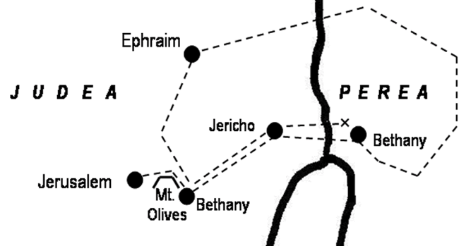
Geography of Final Weeks
Beyond Jordan (Jn 10:40)
To Bethany (Jn 11:18)
To Ephraim (Jn 11:54)
Back to Perea (Mk 10:1)
To Jericho (Lk 18:35)
Bethany (Jn 12:1)
To Jerusalem (Jn 12:12)
Dead Sea

Slide 5
John 11:1-16 Now a certain man was ill, Lazarus of Bethany, the village of Mary and her sister Martha. 2 It was Mary who anointed the Lord with ointment and wiped his feet with her hair, whose brother Lazarus was ill. 3 So the sisters sent to him, saying, “Lord, he whom you love is ill.” 4 But when Jesus heard it he said, “This illness does not lead to death. It is for the glory of God, so that the Son of God may be glorified through it.”
5 Now Jesus loved Martha and her sister and Lazarus. 6 So, when he heard that Lazarus[a] was ill, he stayed two days longer in the place where he was. 7 Then after this he said to the disciples, “Let us go to Judea again.” 8 The disciples said to him, “Rabbi, the Jews were just now seeking to stone you, and are you going there again?” 9 Jesus answered, “Are there not twelve hours in the day? If anyone walks in the day, he does not stumble, because he sees the light of this world. 10 But if anyone walks in the night, he stumbles, because the light is not in him.” 11 After saying these things, he said to them, “Our friend Lazarus has fallen asleep, but I go to awaken him.” 12 The disciples said to him, “Lord, if he has fallen asleep, he will recover.” 13 Now Jesus had spoken of his death, but they thought that he meant taking rest in sleep. 14 Then Jesus told them plainly, “Lazarus has died, 15 and for your sake I am glad that I was not there, so that you may believe. But let us go to him.” 16 So Thomas, called the Twin,[b] said to his fellow disciples, “Let us also go, that we may die with him.”
Notes:
Lazarus (Eleazar) = God is my Help
Only about 3-1/2 months remain in Jesus’ earthly ministry
While the other gospel writers do not include this miracle in their stories, the raising of Lazarus was one of His greatest, and aroused the most response from both His friends and His enemies.
John selected this miracle as the 7th in the series recorded in his book because it was really the climatic miracle of our Lord’s earthly ministry.
He had raised others from the dead, but Lazarus had been in the grave four days.
It was a miracle that could not be denied or avoided by the Jewish leaders.
If Jesus can do nothing about death, then whatever else He can do amounts to nothing.
1 Cor 15:19 – if in Christ we have hope in this life only, we are of all people most to be pitied.
1 Cor 15:26 – the last enemy to be destroyed is death.
A couple of repeated words are used in this test, which give us an idea of John’s theme
FAITH – used 8 times in this account
Glory of God
Light
Jesus seeks to strengthen the faith of three groups of people

Slide 6
John 11 – Faith, Glory of God, and Light
Strengthen the Disciples (11:1-16)
Believe no matter how discouraging circumstances might appear
If Jesus Loved Lazarus so much, why did He permit him to be sick?
Why did He Delay to go to the sisters?
Could He not have healed at a Distance?
Jesus’ Action seems to Contradict his Love.
Believe - Real Love is not a Pampering Love, but Perfecting Love.
Believe – Trust in the Will of God (His time had not yet come) 8-10
Believe - We must look to Glorify God in Every Circumstance
Psalms 50:15-call upon me in the day of trouble: I will deliver you and you shall glorify me.
Believe- The Result of God’s Glory is the Strengthening of Our Faith
Notes:
Message: while Jesus love them dearly, His feelings had to take a back seat to that which would give God the Glory. (2 Cor 1 = reason for suffering – So That god Would Get The Glory!!
Believe HIS WORD no matter how discouraging circumstances might appear
They knew Jesus could help, why didn’t he come.
When they saw their messenger return without Jesus following – imagine their disappoint
Have people ever let you down?
Have you ever prayed to God and didn’t get the answer you wanted?
That is what happened to Martha, Mary and Lazarus –
God has His own time table
Believe – Real Love is not Pampering, but Perfecting
We need to know His goal for us, His plan, His aim, and His desire for us
Love and Suffering are not incompatible (or rather – they are compatible).
Believe – we must look to Glorify God in every circumstance (11:39-40)
Jesus coming to Bethany was dangerous – but He came anyway – to Glorify God (courage)
Ask Him, Remind Him, but don’t tell Him what to do. God knows what to do
Our role is to Believe Him!
Believe – The Result of God’s Glory is the Strengthening of Our Faith
When we face disappointment, delay, death – our only encouragement is the Word of God
The situation seemed hopeless, but they must believe that Jesus is the Master of every situation.
Do we have the Courage of Thomas?

Slide 7
John 11:17-40
17 Now when Jesus came, he found that Lazarus had already been in the tomb four days. 18 Bethany was near Jerusalem, about two miles[c] off, 19 and many of the Jews had come to Martha and Mary to console them concerning their brother. 20 So when Martha heard that Jesus was coming, she went and met him, but Mary remained seated in the house. 21 Martha said to Jesus, “Lord, if you had been here, my brother would not have died. 22 But even now I know that whatever you ask from God, God will give you.” 23 Jesus said to her, “Your brother will rise again.” 24 Martha said to him, “I know that he will rise again in the resurrection on the last day.” 25 Jesus said to her, “I am the resurrection and the life. Whoever believes in me, though he die, yet shall he live, 26 and everyone who lives and believes in me shall never die. Do you believe this?” 27 She said to him, “Yes, Lord; I believe that you are the Christ, the Son of God, who is coming into the world.”
28 When she had said this, she went and called her sister Mary, saying in private, “The Teacher is here and is calling for you.” 29 And when she heard it, she rose quickly and went to him. 30 Now Jesus had not yet come into the village, but was still in the place where Martha had met him. 31 When the Jews who were with her in the house, consoling her, saw Mary rise quickly and go out, they followed her, supposing that she was going to the tomb to weep there. 32 Now when Mary came to where Jesus was and saw him, she fell at his feet, saying to him, “Lord, if you had been here, my brother would not have died.” 33 When Jesus saw her weeping, and the Jews who had come with her also weeping, he was deeply moved in his spirit and greatly troubled. 34 And he said, “Where have you laid him?” They said to him, “Lord, come and see.” 35 Jesus wept. 36 So the Jews said, “See how he loved him!” 37 But some of them said, “Could not he who opened the eyes of the blind man also have kept this man from dying?”
38 Then Jesus, deeply moved again, came to the tomb. It was a cave, and a stone lay against it. 39 Jesus said, “Take away the stone.” Martha, the sister of the dead man, said to him, “Lord, by this time there will be an odor, for he has been dead four days.” 40 Jesus said to her, “Did I not tell you that if you believed you would see the glory of God?”

Slide 8
“I AM” Statement of Jesus
I am the bread of life (John 6:35, 48, 51)
I am the light of the world (John 8:12; 9:5)
I am the door (John 10:7, 9)
I am the good shepherd (10:11, 14)
I am the resurrection and the life (John 11:25)
I am the way, the truth, and the life (14:6)
I am the true vine (15:1)
Before Abraham was, I am (John 8:58)
Notes:
“I AM the bread of life” (John 6:35)
Does this mean we will never have to physically eat or drink?
We no longer hunger for meaning; we have found it. Mann a must be sought every day, and trust
Jesus sustains our eternal destiny; we don’t have to continually seek it.
John 6:27, 4:14
“I AM the light of the world” (John 8:12)
We have a reliable pattern/model to follow (our prototype)
Jesus gives us the power to walk through the darkness in our lives.
We will follow Jesus to our eternal home, Heaven
John 1:4-5, 12:46; Ephesians 5:8-10
“I AM the door” (John 10:9)
Christ is the way to salvation
“Saved” - restoration and healing; being made whole
A place of safety & comfort (pasture)
John 5:24, Psalm 100:3-4
“I AM the good shepherd” (John 10:11,14)
Christ is willing to do all that is necessary to defend and save the flock.
The shepherd dies in the place of the sheep. Christ does likewise.
“Know” - a deep interest in our welfare. As He knows us, let us know Him.
Hebrews 13:20-21, 1 Peter 2:24-25, 1 John 5:20
“I AM the resurrection and the life” (John 11:25-26)
Jesus is the author or cause of eternal life; the very definition of life itself.
We will die physically on earth, but our spirit will never die.
Do you believe the trustworthy Jesus?
John 10:28, 1 Corinthians 1:30, Hebrews 9:27-28
“I AM the way, the truth, and the life” (John 14:6)
“Way” - the road; the only path that leads to eternal life
“Truth” - the source of truth; the very essence of truth; Jesus is the perfect representation of the truth of eternal things
No matter what someone does with their life, the only way to enter into eternal life is by accepting Jesus as your Savior.
John 6:68, 1 Peter 2:21
“I AM the true vine” (John 15:1,4-5)
Jesus is the real, genuine source of nourishment
We are totally dependent on God for our very existence; we thrive on His nourishment
We cannot do good apart from Him
Zechariah 3:8, Galatians 2:20, Acts 4:12

Slide 9
John 11 – Faith, Glory of God, and Light
Strengthen the Sisters – Mary and Martha (11:17-40)
Faith – “IF” you were here, our brother would not have died.
“ I AM the Resurrection and the Life” (11:25)
The Resurrection is Real
The Resurrection is Personal
The Resurrection is Present and not just Future (Ro 6:4; Gal 2:20; Phil 3:10)
“I believe You are the Lord, You are the Christ, Your are the Son of God” (27)
Mary is always found at the feet of Jesus
Sat at His Feet and Listened to His word (Lk 10.39), Fell at his Feet to express her sorrow (Jo 11.32), and She Came to His Feet to give Him Praise and Glory (Jo 12.3)
Jesus Wept (11:35) – For Sin, for Love
Faith – Relies on God’s Promises, it Releases His Strength
“Take away the stone”
Martha is challenged to believe. If she believed He could heal her brother, then believe He has power over death.
Notes:
Trials and Struggles are intended to purify us, and strengthen us.
But that depends on how we respond to the trial.
11:22 – Martha is quick to affirm her faith in Jesus
REAL: the old testament was not very clear about death and resurrection
Everything about Jesus and His ministry teaches us about the resurrection of the body
Death is Real, and so is the Resurrection.
Personal: in Christ, every doctrine is made personal. When you belong to Him, you have all that you ever need in life, death, time, and eternity.
JESUS WEPT
Roll Away the Stone
Martha’s trust is absolute, but it seems that she does not think Jesus’ power resides in Himself. She must think that he is a Holy man with a deep relationship with God, and that God would not deny His request. Jesus needed to take her faith further.
“I Am the Resurrection and the Life” – “Shall never die”: having a relationship with the Son of God is so all important that it is as if death did not exist at all.
When those who Trust, Obey, and have faith in Christ die, it is as if nothing unpleasant or distastful has happened at all
Phil 1:21 – to live is Christ and to die is gain
2 Cor 5:1 – if our earthly tent is destroyed we have a house not mad3 with hands – eternal
1 Cor 15 – O death where is your sting.

Slide 10
John 11:41-57
So they took away the stone. And Jesus lifted up his eyes and said, “Father, I thank you that you have heard me. 42 I knew that you always hear me, but I said this on account of the people standing around, that they may believe that you sent me.” 43 When he had said these things, he cried out with a loud voice, “Lazarus, come out.” 44 The man who had died came out, his hands and feet bound with linen strips, and his face wrapped with a cloth. Jesus said to them, “Unbind him, and let him go.”
45 Many of the Jews therefore, who had come with Mary and had seen what he did, believed in him, 46 but some of them went to the Pharisees and told them what Jesus had done. 47 So the chief priests and the Pharisees gathered the council and said, “What are we to do? For this man performs many signs. 48 If we let him go on like this, everyone will believe in him, and the Romans will come and take away both our place and our nation.” 49 But one of them, Caiaphas, who was high priest that year, said to them, “You know nothing at all. 50 Nor do you understand that it is better for you that one man should die for the people, not that the whole nation should perish.” 51 He did not say this of his own accord, but being high priest that year he prophesied that Jesus would die for the nation, 52 and not for the nation only, but also to gather into one the children of God who are scattered abroad. 53 So from that day on they made plans to put him to death.
54 Jesus therefore no longer walked openly among the Jews, but went from there to the region near the wilderness, to a town called Ephraim, and there he stayed with the disciples.
55 Now the Passover of the Jews was at hand, and many went up from the country to Jerusalem before the Passover to purify themselves. 56 They were looking for Jesus and saying to one another as they stood in the temple, “What do you think? That he will not come to the feast at all?” 57 Now the chief priests and the Pharisees had given orders that if anyone knew where he was, he should let them know, so that they might arrest him.

Slide 11
John 11 – Faith, Glory of God, and Light
Strengthen the Jews (11:41-57)
Lazarus was Dead (11:14)
Lazarus was Decayed (11:39)
Lazarus was Raised by the Power of God (11:42)
Lazarus was Bound (11:44)
Lazarus was Seated (12:2)
Lazarus Caused Faith (11:45; 12:9-11)
The Change in Lazarus caused by Jesus resulted in Faith!
Caiaphas Prophesied “One (Jesus) would die for the People” (vs 50)
Isaiah 53:8 – for the transgression of the people , He was stricken.
God is Always In Control (we are not) – Acts 2:23
Notes:
Now Jesus tried to strengthen the faith of the spectators.
The condition of Lazarus is the condition of us all. (Eph 2:1-10)
Caiaphas – an arrogant, ruthless man, with not sense of justice. It is expedient that one man die (no matter how innocent) than the rest of the nation be destroyed.
He does not have any deep emotional distress for the safety of the people, but rather a concern for his high office.
Two questions arise;
“How can I not believe in Him now?”
“How can we dispose of Him now?”
We ask the same questions today “He hurts my conscience so I wont listen to Him.”, “He makes me feel ashamed or guilty”

Slide 12
4 Themes in John 11
Jesus is God
“Son of God glorified” (4, & see 40)
“You are the Christ, the Son of God who is come into the World.” (27)
Images of the Christ
“Sees the light of the World” (9)
“I am the resurrection & life” (25)
Belief & Unbelief
“I am glad that I was not there, that you may believe” (15)
“He who believes will not die” (25)
“Believe… see the glory of God” (40)
“…That they may believe” (42)
Many believed, but some went away to the Pharisees
Mission of the Christ
For the glory of God (4)
12 hours in a day… walk (8)
…Jesus would die for the nation, & whole world (52)

Slide 13
Chapter 12
Summer 2015

Slide 14
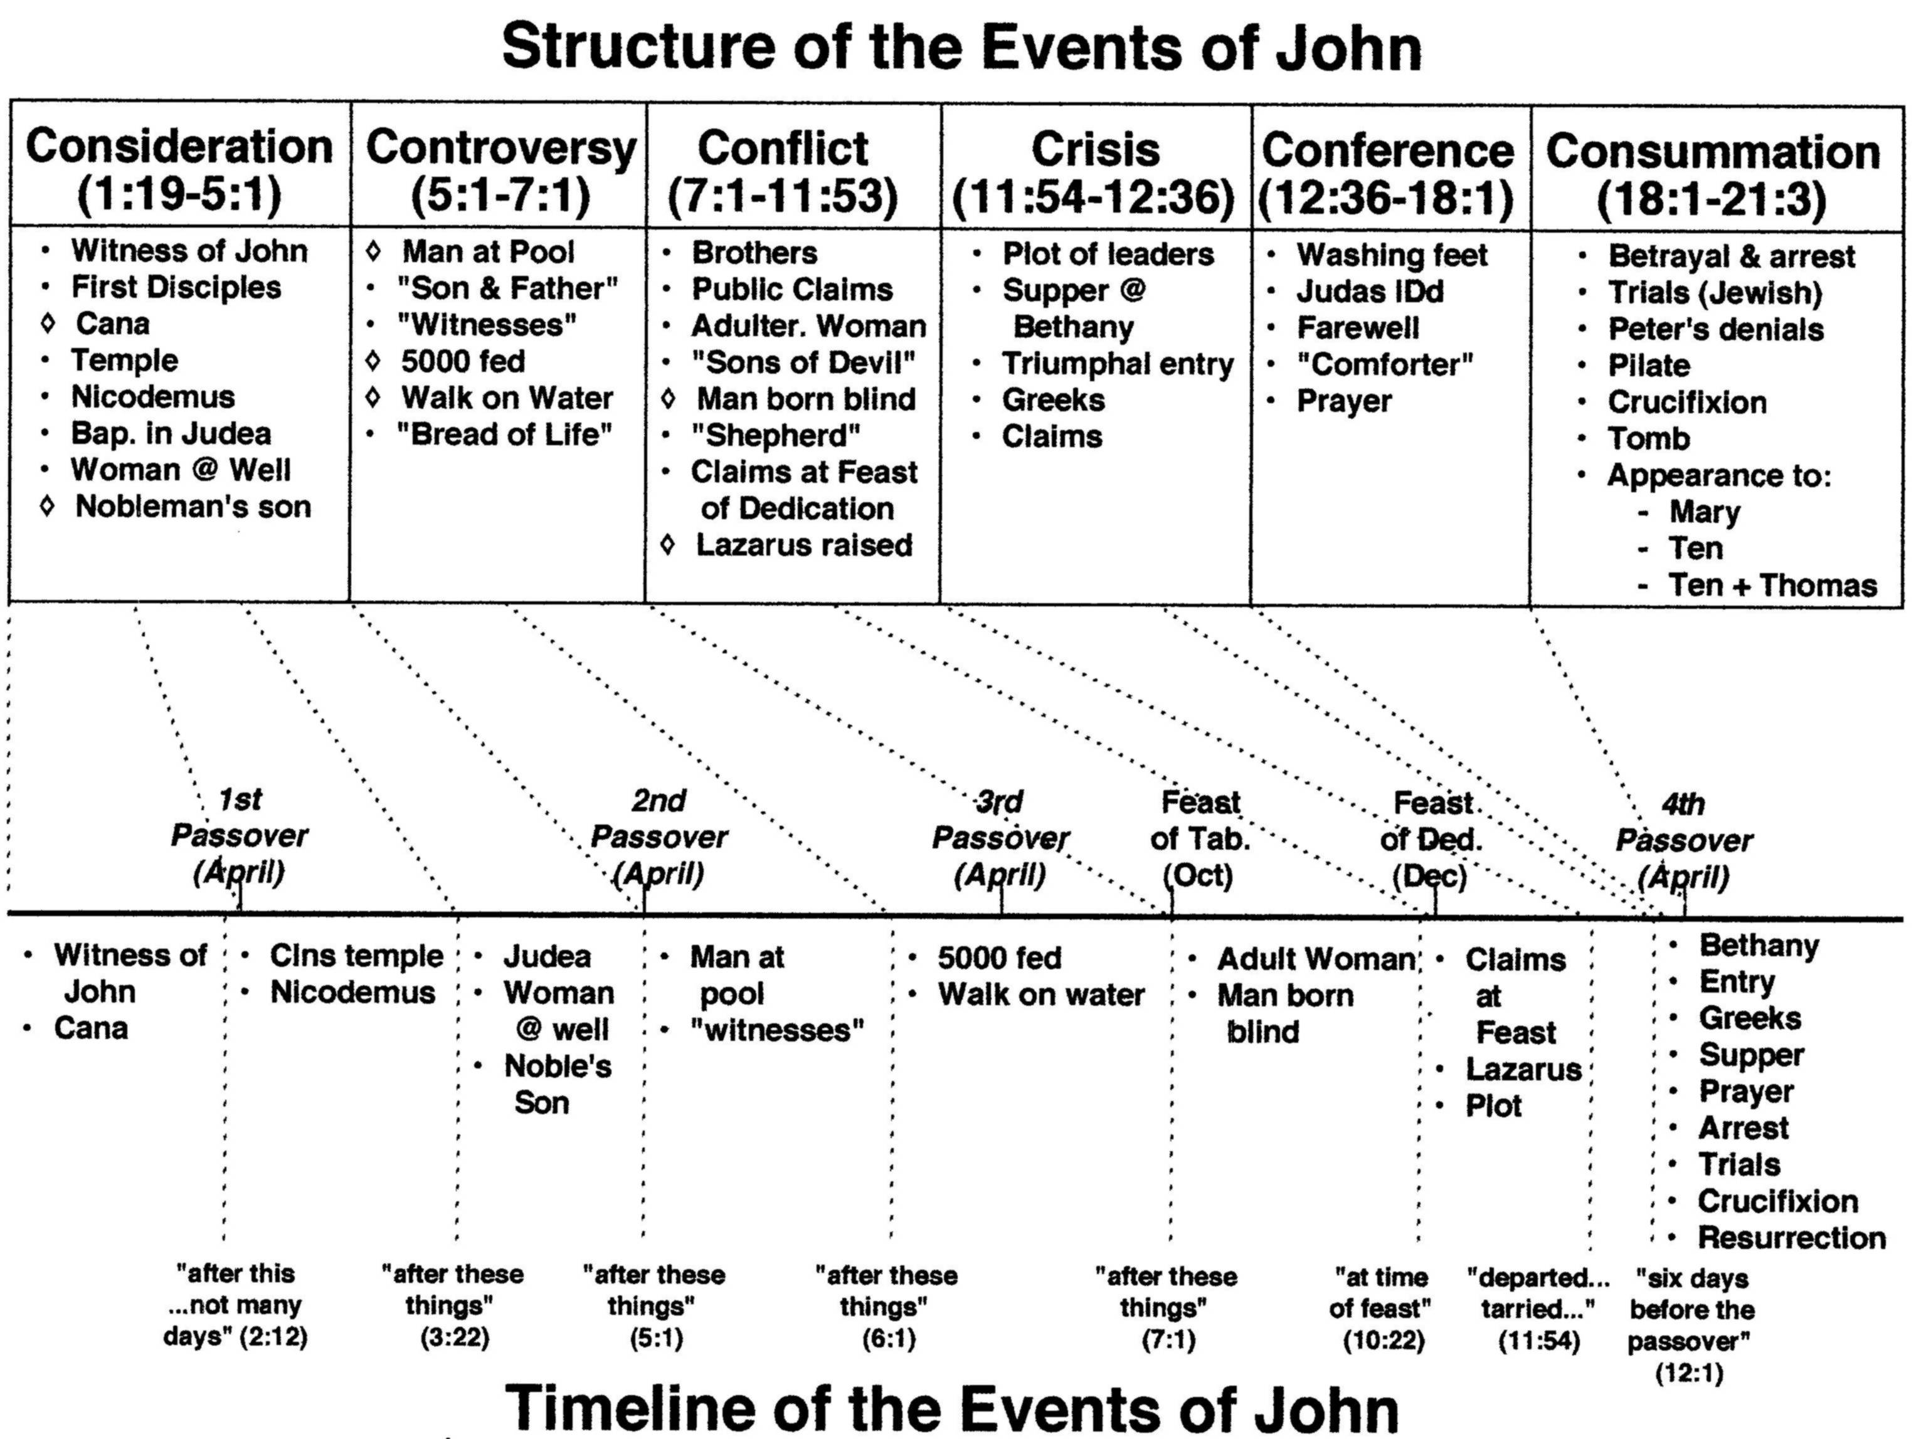
2:13
5:1?
6:4
7:2
10:22
13:1

Slide 15
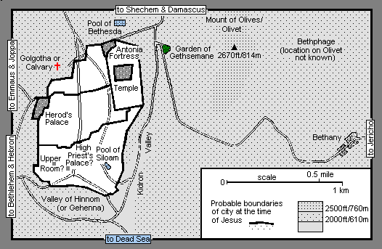
Jerusalem & Surroundings

Slide 16
John 12: 1-11
¹ Six days before the Passover, Jesus therefore came to Bethany, where Lazarus was, whom Jesus had raised from the dead. ² So they gave a dinner for him there. Martha served, and Lazarus was one of those reclining with him at table. ³ Mary therefore took a pound of expensive ointment made from pure nard, and anointed the feet of Jesus and wiped his feet with her hair. The house was filled with the fragrance of the perfume.
⁴ But Judas Iscariot, one of his disciples (he who was about to betray him), said, ⁵ “Why was this ointment not sold for three hundred denarii and given to the poor?” ⁶ He said this, not because he cared about the poor, but because he was a thief, and having charge of the moneybag he used to help himself to what was put into it. ⁷ Jesus said, “Leave her alone, so that she may keep it for the day of my burial. ⁸ For the poor you always have with you, but you do not always have me.”
⁹ When the large crowd of the Jews learned that Jesus was there, they came, not only on account of him but also to see Lazarus, whom he had raised from the dead. ¹⁰ So the chief priests made plans to put Lazarus to death as well, ¹¹ because on account of him many of the Jews were going away and believing in Jesus.

Slide 17
Dinner at Bethany
Jesus is in control of events and timetable.
Jn 11:54 – He no longer walked openly among the Jews.
Jn 11:56 – “What do you think? That he will not come to the feast at all?”
Jn 11:57 – Orders given that if anyone knew where Jesus was the chief priest and Pharisees were to be notified.
6 days before the Passover
Bethany approximately 2 miles from Jerusalem
There is risk involved with being in Bethany but Jesus is in control.
Are relationships important to Jesus?
Are relationships within the brotherhood important to us?

Slide 18
Dinner at Bethany
Contrast the belief/actions of Mary and Judas.
Why was Mary anointing the feet of Jesus?
What was the cost of the ointment?
Why was Judas following Jesus?
Didn’t Judas see Jesus raise Lazarus the same as Mary?
Didn’t Judas see many other signs? (vs 37)
Foreshadowing of burial and betrayal.
Jesus is working in all of our lives.
How are we responding?
Luke 17 – Healing of the 10 lepers. Only 1 returns to give praise.

Slide 19
John 12: 12-19
¹² The next day the large crowd that had come to the feast heard that Jesus was coming to Jerusalem. ¹³ So they took branches of palm trees and went out to meet him, crying out, “Hosanna! Blessed is he who comes in the name of the Lord, even the King of Israel!” ¹⁴ And Jesus found a young donkey and sat on it, just as it is written,
¹⁵ “Fear not, daughter of Zion; behold, your king is coming, sitting on a donkey's colt!”
¹⁶ His disciples did not understand these things at first, but when Jesus was glorified, then they remembered that these things had been written about him and had been done to him. ¹⁷ The crowd that had been with him when he called Lazarus out of the tomb and raised him from the dead continued to bear witness. ¹⁸ The reason why the crowd went to meet him was that they heard he had done this sign. ¹⁹ So the Pharisees said to one another, “You see that you are gaining nothing. Look, the world has gone after him.”

Slide 20
Triumphal Entry
Who made up the large crowd?
Witnesses of Lazarus’ raising.
Vs 17 – Those who heard when the crowds continued to bear witness of Lazarus’ raising.
Others?
Those who had witnessed the feeding the 5,000?
Those who saw the blind man healed?
Nobleman?
Servants at the wedding feast?
“Hosanna! Blessed is He who comes in the name of the Lord, even the King of Israel!”

Slide 21
Zechariah 9:9-11
⁹ Rejoice greatly, O daughter of Zion! Shout aloud, O daughter of Jerusalem! Behold, your king is coming to you; righteous and having salvation is he, humble and mounted on a donkey, on a colt, the foal of a donkey.
¹⁰ I will cut off the chariot from Ephraim and the war horse from Jerusalem; and the battle bow shall be cut off, and he shall speak peace to the nations; his rule shall be from sea to sea, and from the River to the ends of the earth.
¹¹ As for you also, because of the blood of my covenant with you, I will set your prisoners free from the waterless pit.

Slide 22
Jesus’ Mission of Salvation
Zechariah 9:9-11
Salvation not just for the Jews
For the entire world (sea to sea; ends of the earth)
“Blood of my covenant” = New covenant
“free from the waterless pit” = Living Water

Slide 23
Rev 7: 9-10
⁹ After this I looked, and behold, a great multitude that no one could number, from every nation, from all tribes and peoples and languages, standing before the throne and before the Lamb, clothed in white robes, with palm branches in their hands, ¹⁰ and crying out with a loud voice, “Salvation belongs to our God who sits on the throne, and to the Lamb!”

Slide 24
John 12: 20-26
²⁰ Now among those who went up to worship at the feast were some Greeks. ²¹ So these came to Philip, who was from Bethsaida in Galilee, and asked him, “Sir, we wish to see Jesus.” ²² Philip went and told Andrew; Andrew and Philip went and told Jesus.
²³ And Jesus answered them, “The hour has come for the Son of Man to be glorified. ²⁴ Truly, truly, I say to you, unless a grain of wheat falls into the earth and dies, it remains alone; but if it dies, it bears much fruit. ²⁵ Whoever loves his life loses it, and whoever hates his life in this world will keep it for eternal life. ²⁶ If anyone serves me, he must follow me; and where I am, there will my servant be also. If anyone serves me, the Father will honor him.”

Slide 25
Greeks seek Jesus
John 10:16-17
^{16 ”}And I have other sheep that are not of this fold. I must bring them also, and they will listen to my voice. So there will be one flock, one shepherd. ¹⁷ For this reason the Father loves me, because I lay down my life that I may take it up again.”
Jn 12:26 – “If anyone serves me the Father will honor him.”

Slide 26
“The hour has come….”
For the Son of Man to be Glorified. (23)
Grain of wheat symbolism? (24)
How will His death bear much fruit?
Suffer death through the unbelief of the Jews, and to be multiplied in the faith of many nations.

Slide 27
Living for self?
John 12:25 - ^{25 ”}Whoever loves his life loses it, and whoever hates his life in this world will keep it for eternal life.”
Temporal vs Eternal
Relationships that will last for eternity.
CS Lewis – “There is no safe investment. To love at all is to be vulnerable. Love anything, and your heart will certainly be wrung and possibly be broken. If you want to make sure of keeping it intact, you must give your heart to no one, not even to an animal. Wrap it carefully round with hobbies and little luxuries; avoid all entanglements; lock it up safe in the casket or coffin of your selfishness. But in that casket—safe, dark, motionless, airless—it will change. It will not be broken; it will become unbreakable, impenetrable, irredeemable…...”

Slide 28
John 12: 27-36
²⁷ “Now is my soul troubled. And what shall I say? ‘Father, save me from this hour’? But for this purpose I have come to this hour. ²⁸ Father, glorify your name.” Then a voice came from heaven: “I have glorified it, and I will glorify it again.” ²⁹ The crowd that stood there and heard it said that it had thundered. Others said, “An angel has spoken to him.”
³⁰ Jesus answered, “This voice has come for your sake, not mine. ³¹ Now is the judgment of this world; now will the ruler of this world be cast out. ³² And I, when I am lifted up from the earth, will draw all people to myself.” ³³ He said this to show by what kind of death he was going to die. ³⁴ So the crowd answered him, “We have heard from the Law that the Christ remains forever. How can you say that the Son of Man must be lifted up? Who is this Son of Man?”
³⁵ So Jesus said to them, “The light is among you for a little while longer. Walk while you have the light, lest darkness overtake you. The one who walks in the darkness does not know where he is going. ³⁶ While you have the light, believe in the light, that you may become sons of light.”

Slide 29
And What Shall I Say?
Father save me from this hour?
“But for this very purpose I have come to this hour.”
How often do we fail in our purpose/mission?
Are we hearing the voice of God or just thunder?
Vs 35 – We have a finite amount of time to respond. There is a period of light and then darkness.

Slide 30
John 12: 37-43
When Jesus had said these things, he departed and hid himself from them. ³⁷ Though he had done so many signs before them, they still did not believe in him, ³⁸ so that the word spoken by the prophet Isaiah might be fulfilled:
“Lord, who has believed what he heard from us, and to whom has the arm of the Lord been revealed?”
³⁹ Therefore they could not believe. For again Isaiah said,
⁴⁰ “He has blinded their eyes and hardened their heart, lest they see with their eyes, and understand with their heart, and turn, and I would heal them.”
⁴¹ Isaiah said these things because he saw his glory and spoke of him. ⁴² Nevertheless, many even of the authorities believed in him, but for fear of the Pharisees they did not confess it, so that they would not be put out of the synagogue; ⁴³ for they loved the glory that comes from man more than the glory that comes from God.

Slide 31
Fulfilling His Mission
To be glorified (23)
To die (24)
Cast out the ruler of this world. (31)
To be lifted up. (32)
Draw all people to himself. (32)
Produce belief in the Light. (36)
Produce belief through the signs (37)
Fulfill prophesy (38)
Save the world (47)

Slide 32
Belief and Unbelief
Vs 42 - ⁴² Nevertheless, many even of the authorities believed in him, but for fear of the Pharisees they did not confess it, so that they would not be put out of the synagogue;…”
Man born blind’s testimony resulted in being cast out.
His parents feared being put out of the synagogue.
Nicodemus came to Jesus by night.

Slide 33
John 12: 44-50
⁴⁴ And Jesus cried out and said, “Whoever believes in me, believes not in me but in him who sent me. ⁴⁵ And whoever sees me sees him who sent me. ⁴⁶ I have come into the world as light, so that whoever believes in me may not remain in darkness. ⁴⁷ If anyone hears my words and does not keep them, I do not judge him; for I did not come to judge the world but to save the world.
⁴⁸ The one who rejects me and does not receive my words has a judge; the word that I have spoken will judge him on the last day. ⁴⁹ For I have not spoken on my own authority, but the Father who sent me has himself given me a commandment—what to say and what to speak. ⁵⁰ And I know that his commandment is eternal life. What I say, therefore, I say as the Father has told me.”

Slide 34
Closing His Public Ministry
Summarizes his mission and message.
Contrasts again light and darkness.
Repeats mission is to save the world.
His words will judge the world because they are from the Father.
Does not say keeping the Father’s commandments leads to eternal life, but the commandment IS eternal life.
Result of the words and works of Jesus fulfilling his mission are the source of eternal life.
BELIEF!!

