Slide 1
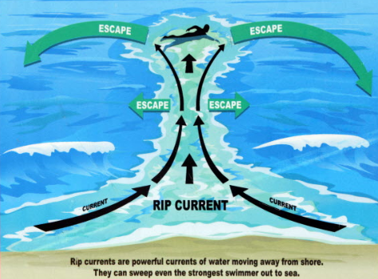
Watch Out For the Undertow”

Slide 2
Struggling with God
GENESIS 32:24-30

Slide 3
GENESIS 32:24-30 – JACOB WRESTLES WITH GOD
Genesis 32: 24-30 And Jacob was left alone. And a man wrestled with him until the breaking of the day. 25 When the man saw that he did not prevail against Jacob, he touched his hip socket, and Jacob’s hip was put out of joint as he wrestled with him. 26 Then he said, “Let me go, for the day has broken.” But Jacob said, “I will not let you go unless you bless me.” 27 And he said to him, “What is your name?” And he said, “Jacob.” 28 Then he said, “Your name shall no longer be called Jacob, but Israel, for you have striven with God and with men, and have prevailed.” 29 Then Jacob asked him, “Please tell me your name.” But he said, “Why is it that you ask my name?” And there he blessed him. 30 So Jacob called the name of the place Peniel, saying, “For I have seen God face to face, and yet my life has been delivered.”

Slide 4
GENESIS 32:9-12 – JACOB’S PRAYER
Genesis 32:9-12: And Jacob said, “O God of my father Abraham and God of my father Isaac, O LORD who said to me, ‘Return to your country and to your kindred, that I may do you good,’ 10 I am not worthy of the least of all the deeds of steadfast love and all the faithfulness that you have shown to your servant, for with only my staff I crossed this Jordan, and now I have become two camps. 11 Please deliver me from the hand of my brother, from the hand of Esau, for I fear him that he may come and attack me, the mothers with the children. 12 But you said, ‘I will surely do you good, and make your offspring as the sand of the sea, which cannot be numbered for multitude.’”

Slide 5
STRUGGLING WITH GOD
SOLITARY
“And Jacob was left alone” 32:24a

Slide 6
STRUGGLING WITH GOD
SOLITARY
PRIORITY
“And a man wrestled with him until the breaking of the day” 32:24b

Slide 7
STRUGGLING WITH GOD
SOLITARY
PRIORITY
LEVERAGE
“when the man saw that he did not prevail against Jacob, he touched his hop socket, and Jacob’s hip was put out of joint as he wrestled with him” 32:25

Slide 8
STRUGGLING WITH GOD
SOLITARY
PRIORITY
LEVERAGE
HOLD ON:
“I will not let you go unless you bless me” 32:26

Slide 10
STRUGGLING WITH GOD
SOLITARY
PRIORITY
LEVERAGE
HOLD ON
OUR IDENTITY CHANGES
“And he said to him ‘What is your name?’, the he said “Jacob” Your name shall no longer be called Jacob, but Israel, for you have striven with God and with men, and have prevailed” (32:27-28)
“Jacob” – one who grabs at the heel, Supplanter, Deceiver, Trickster
“Israel” – one who wrestles with God and prevails

Slide 11
STRUGGLING WITH GOD
SOLITARY
PRIORITY
LEVERAGE
HOLD ON
MY IDENTITY CHANGES
MY VIEW OF GOD CHANGES
“Please tell me your name”. But he said, “Why is it that you ask my name?” And there He blessed him. So Jacob called the name of the place Peniel, saying “For I have seen God face to face, and yet my life has been delivered” (29-30)

Slide 12
The promises of god
God has promised that His grace is sufficient for us. (II Corinthians 12:9).
God has promised us victory over death. (I Corinthians 15:3,4; I Corinthians 15:57).
God has promised that all things work together for good to those who love and serve Him faithfully (Romans 8:28).
God promised that if we search for Him we will find Him Deuteronomy 4:29
For all of God’s promises find their YES in Him (Jesus Christ) 2 Corinthians 1:20

Slide 13
STRUGGLING WITH GOD
SOLITARY
PRIORITY
LEVERAGE
HOLD ON
MY IDENTITY CHANGES
MY VIEW OF GOD CHANGES

