Slide 1
Chapter 20
Summer 2015

Slide 2
What Chapter in John?
__ a. Water to Wine miracle
__ b. Nicodemus comes by night
__ c. Man born blind miracle
__ d. Crucifixion & Burial
__ e. Feast of Dedication
__ f. Greeks to see Jesus
__ g. John & Jesus preaching
__ h. John’s witness & 1st disciples
__ i. Jesus’ prayer to the Father
__ j. Washing disciples feet
__ k. Nicodemus defends Jesus
__ h. Anointing by Mary
__ i. Lazarus Raised
__ j. Feeding 5000
__ k. Healing Nobleman’s son
__ l. Samaritan Woman
__ m. Jesus to prepare “abodes”
__ n. Resurrection (Galilee)
__ o. “Good Shepherd” sermon
__ p. Lame man healed at pool
__ q. “Witnesses” sermon
__ r. Father: Abraham or Devil?
__ s. Spirit to “guide to all Truth”
__ t. Betrayal Arrest & Trials
__ u. Great day of Feast of Tabern.
__ v. Resurrection (Jerusalem)
__ w. “Vine & Branches” sermon
__ x. Temple cleansing
__ y. Walking on water miracle
__ z. Caiaphas’ prophecy

Slide 3
What Chapter in John?
__ a. Water to Wine miracle
__ b. Nicodemus comes by night
__ c. Man born blind miracle
__ d. Crucifixion & Burial
__ e. Feast of Dedication
__ f. Greeks to see Jesus
__ g. John & Jesus preaching
__ h. John’s witness & 1st disciples
__ i. Jesus’ prayer to the Father
__ j. Washing disciples feet
__ k. Nicodemus defends Jesus
__ h. Anointing by Mary
__ i. Lazarus Raised
__ j. Feeding 5000
__ k. Healing Nobleman’s son
4
14
21
10
5
5
8
16
18
7
20
15
2
6
11
2
3
5
19
10
12
3
1
17
13
7
12
11
6
4
__ l. Samaritan Woman
__ m. Jesus to prepare “abodes”
__ n. Resurrection (Galilee)
__ o. “Good Shepherd” sermon
__ p. Lame man healed at pool
__ q. “Witnesses” sermon
__ r. Father: Abraham or Devil?
__ s. Spirit to “guide to all Truth”
__ t. Betrayal Arrest & Trials
__ u. Great day of Feast of Tabern.
__ v. Resurrection (Jerusalem)
__ w. “Vine & Branches” sermon
__ x. Temple cleansing
__ y. Walking on water miracle
__ z. Caiaphas’ prophecy

Slide 4
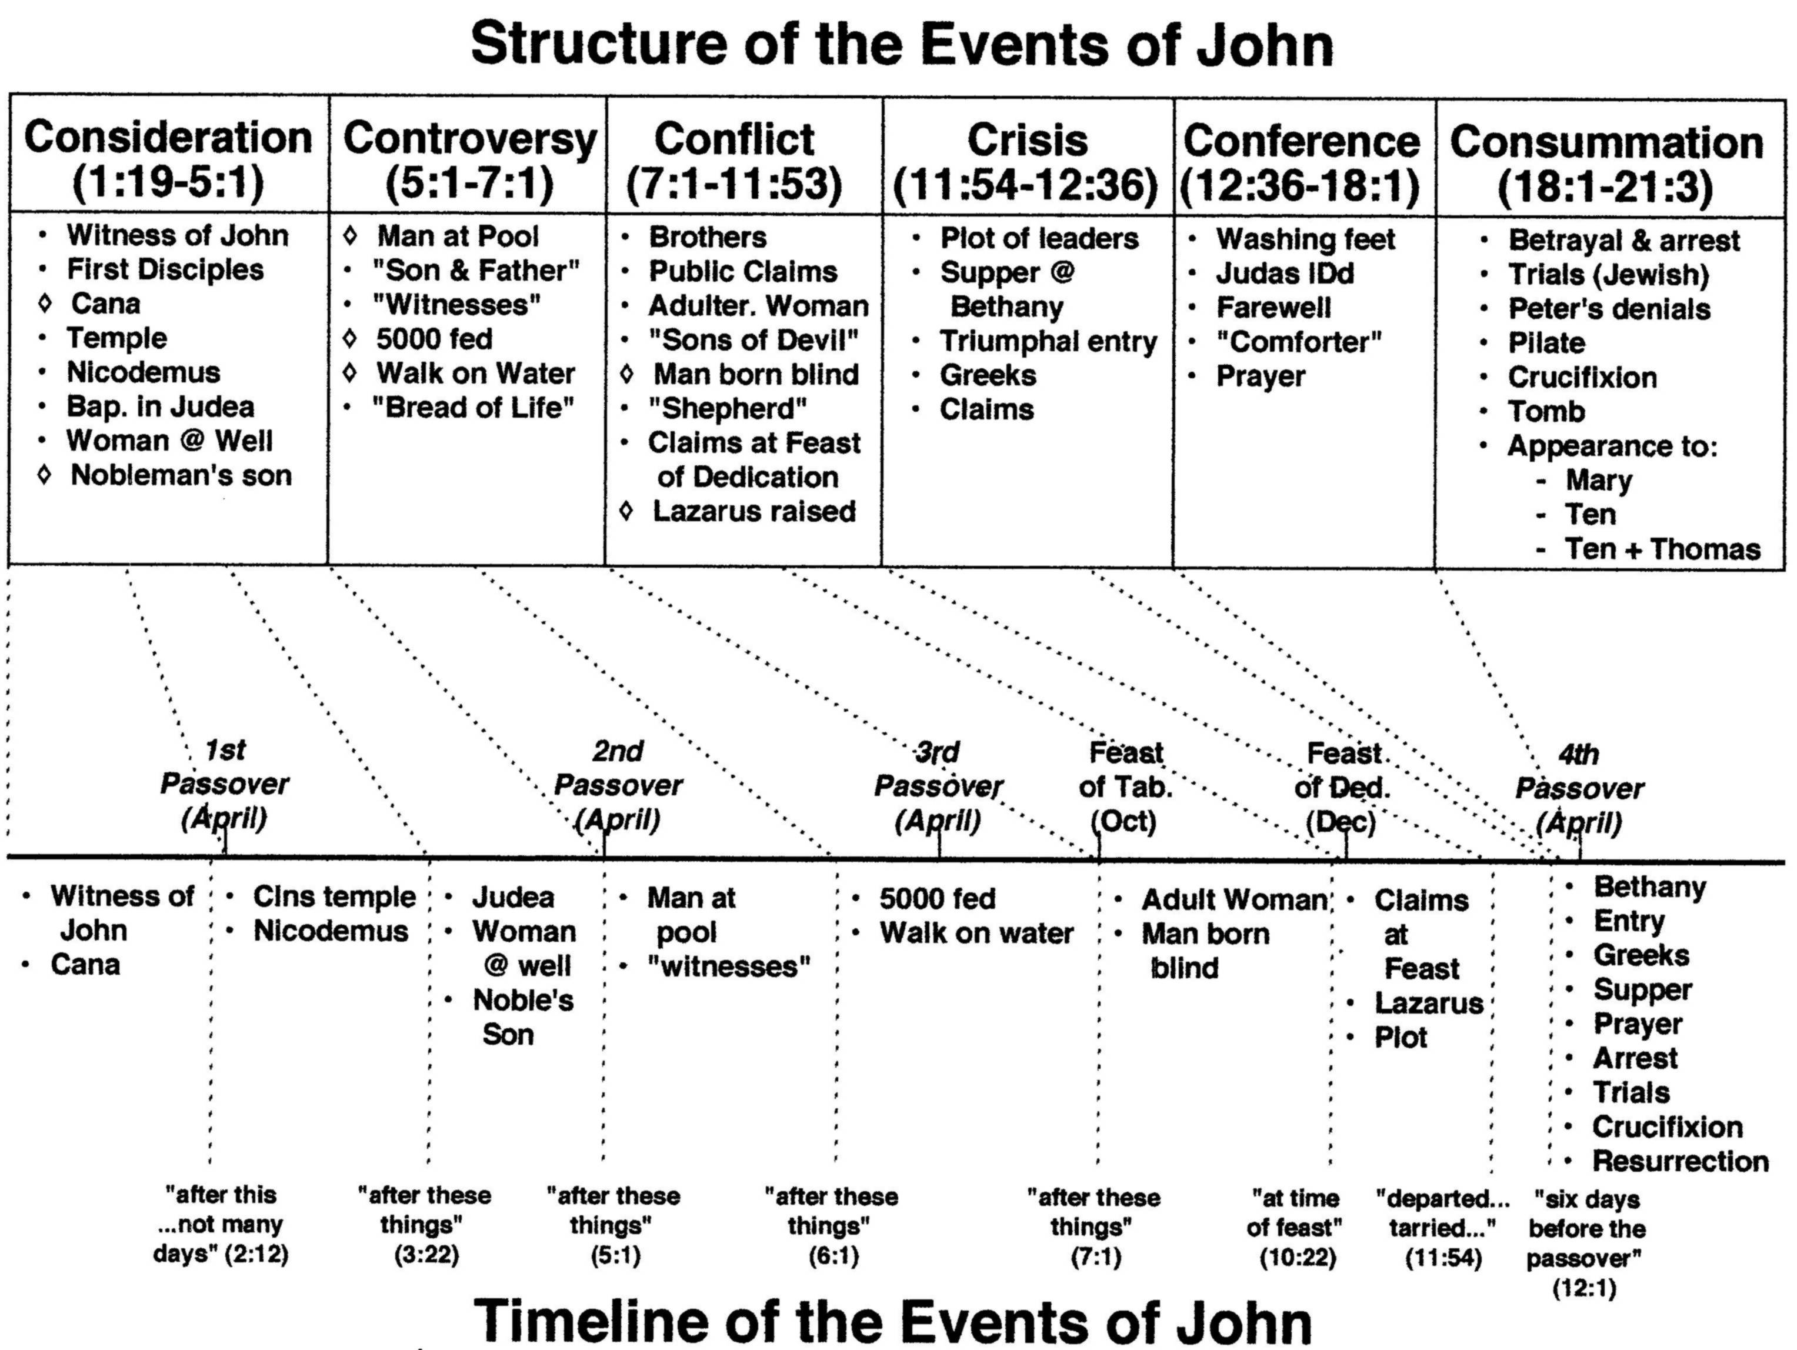
2:13
5:1?
6:4
7:2
10:22
13:1

Slide 5
Belief Events in John 20
Peter & John (3-10)
Sees empty tomb & grave-clothes
Mary (11-18)
Sees the empty tomb
Sees & hears two angels
Sees Jesus
Hears Jesus call her name
The Disciples (19-23)
Hear Mary’s testimony
Hear & see Jesus, including wounds
Thomas (24-29)
Hears testimony of the disciples
Hears & sees Jesus, including wounds
Future Disciples (30-31)
Do not see, but read John’s account

Slide 6
John 20:1-10 – The Empty Tomb
¹Now the first day of the week Mary Magdalene went to the tomb early, while it was still dark, and saw that the stone had been taken away from the tomb. ²Then she ran and came to Simon Peter, and to the other disciple, whom Jesus loved, and said to them, “They have taken away the Lord out of the tomb, and we do not know where they have laid Him.”
³Peter therefore went out, and the other disciple, and were going to the tomb. ⁴ So they both ran together, and the other disciple outran Peter and came to the tomb first. ⁵ And he, stooping down and looking in, saw the linen cloths lying there; yet he did not go in. ⁶ Then Simon Peter came, following him, and went into the tomb; and he saw the linen cloths lying there, ⁷ and the handkerchief that had been around His head, not lying with the linen cloths, but folded together in a place by itself. ⁸Then the other disciple, who came to the tomb first, went in also; and he saw and believed. ⁹For as yet they did not know the Scripture, that He must rise again from the dead. ¹⁰Then the disciples went away again to their own homes.

Slide 7
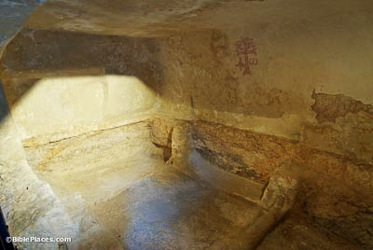
Tourist Site: The “Garden Tomb”

Slide 8
Mary at the Tomb (1-2)
Only Mary is mentioned in John.
Other Gospels mention other women there with Mary.
“…we do not know where they have laid him.” – evidence that others were with her.
Mary may be the focus as she is the one who spoke to the “other disciple, the one who Jesus loved.”

Slide 9
Mary at the Tomb (1-2)
Concluded the body was stolen.
Ran to Peter and John to report the missing body of Jesus.
Does not specify who “they” might be that have taken the Lord out of the tomb.

Slide 10
Disciple Whom Jesus Loved
13:23 – One of his disciples, whom Jesus loved (Asked Jesus who would betray him.)
18:15 – Simon Peter followed Jesus, and so did another disciple. (When Jesus was on trial.)
19:26 – When Jesus saw his mother and the disciple whom he loved standing nearby… (While on the cross, Jesus put Mary into his care.)
20:2 – So she ran and went to Simon Peter and the other disciple, the one whom Jesus loved..
20:3-4 – Peter went out with the other disciple… the other disciple outran Peter and reached the tomb first.
20:8 – Then the other disciple….also went in, and he saw and believed.
21:7 – That disciple whom Jesus loved therefore said to Peter, “It is the Lord! (Coming back from fishing.)
21:20 – Peter turned and saw the disciple whom Jesus loved following them…

Slide 11
Peter and John at the Tomb
“The other disciple” arrives first but did not immediately enter.
Peter enters the tomb on arrival.
John records specific details of the linen cloths and face cloth.
“The other disciple” enters the tomb, and he saw and believed.
(9) ;for as yet they did not understand the Scripture, that he must rise from the dead.
Went back to their homes.
THE TOMB IS EMPTY!!

Slide 12
John 20:11-18 – Mary Sees the Risen Lord
¹¹But Mary stood outside by the tomb weeping, and as she wept she stooped down and looked into the tomb. ¹²And she saw two angels in white sitting, one at the head and the other at the feet, where the body of Jesus had lain. ¹³Then they said to her, “Woman, why are you weeping?” She said to them, “Because they have taken away my Lord, and I do not know where they have laid Him.”
¹⁴Now when she had said this, she turned around and saw Jesus standing there, and did not know that it was Jesus. ¹⁵Jesus said to her, “Woman, why are you weeping? Whom are you seeking?” She, supposing Him to be the gardener, said to Him, “Sir, if You have carried Him away, tell me where You have laid Him, and I will take Him away.” ¹⁶Jesus said to her, “Mary!” She turned and said to Him, “Rabboni!” (which is to say, Teacher). ¹⁷Jesus said to her, “Do not cling to Me, for I have not yet ascended to My Father; but go to My brethren and say to them, ‘I am ascending to My Father and your Father, and to My God and your God.’” ¹⁸Mary Magdalene came and told the disciples that she had seen the Lord, and that He had spoken these things to her.

Slide 13
Mary Sees Jesus
Mary returns to the tomb and is weeping.
Sees 2 angels in white sitting in the tomb.
They ask why she is weeping.
“They have taken away my Lord, and I do not know where they have laid him.”

Slide 14
Mary Sees Jesus
She turn and sees Jesus but does not recognize him.
Jesus asks – “Woman, why are you weeping? Whom are you seeking?”
“Sir, if you have carried him away, tell me where you have laid him, and I will take him away.”
“Mary.”
“Rabboni!”
“Do not cling to me….. Go to my brothers and say to them, ‘I am ascending to my Father and your Father, to my God and your God.’”
“I have seen the Lord”

Slide 15
John 20:19-30 – Thomas
¹⁹Then, the same day at evening, being the first day of the week, when the doors were shut where the disciples were assembled, for fear of the Jews, Jesus came and stood in the midst, and said to them, “Peace be with you.” ²⁰When He had said this, He showed them His hands and His side. Then the disciples were glad when they saw the Lord.
²¹So Jesus said to them again, “Peace to you! As the Father has sent Me, I also send you.” ²²And when He had said this, He breathed on them, and said to them, “Receive the Holy Spirit. ²³If you forgive the sins of any, they are forgiven them; if you retain the sins of any, they are retained.”
²⁴Now Thomas, called the Twin, one of the twelve, was not with them when Jesus came. ²⁵The other disciples therefore said to him, “We have seen the Lord.”
So he said to them, “Unless I see in His hands the print of the nails, and put my finger into the print of the nails, and put my hand into His side, I will not believe.”
²⁶And after eight days His disciples were again inside, and Thomas with them. Jesus came, the doors being shut, and stood in the midst, and said, “Peace to you!”
²⁷Then He said to Thomas, “Reach your finger here, and look at My hands; and reach your hand here, and put it into My side. Do not be unbelieving, but believing.”
²⁸And Thomas answered and said to Him, “My Lord and my God!”
²⁹Jesus said to him, “Thomas, because you have seen Me, you have believed. Blessed are those who have not seen and yet have believed.”
³⁰And truly Jesus did many other signs in the presence of His disciples, which are not written in this book; ³¹ but these are written that you may believe that Jesus is the Christ, the Son of God, and that believing you may have life in His name.

Slide 16
Jesus Appears to the Disciples
Evening on the resurrection day.
The doors are locked for fear of the Jews.
“Peace be with you.”
Shows them his hands and his side.
The disciples were glad when they saw the Lord. (See John 16:20-22)
“As the Father has sent me, even so I am sending you.” (See John 17:18)
…he breathed on them and said to them, “Receive the Holy Spirit…” (See John 7:38-39)

Slide 17
Jesus Appears to Thomas
Disciples - “We have seen the Lord.”
Thomas - “Unless I see in his hands the mark of the nails, and place my finger in the mark of the nails, and place my hand into his side, I will never believe.”
Eight days later, again behind locked doors.
“Peace be with you.”
“Put your finger here, and see my hands; and put out your hand, and place it in my side. Do not disbelieve, but believe.”
“My Lord and my God!” (See John 8:28)
“Have you believed because you have seen me? Blessed are those who have not seen and yet have believed.” (See John 17:20)

Slide 18
Purpose
Memory verse!
And truly Jesus did many other signs in the presence of His disciples, which are not written in this book; ³¹but these are written that you may believe that Jesus is the Christ, the Son of God, and that believing you may have life in His name.
John 20:30-31
Dual Purpose for writing:
That unbelievers might come to believe in Jesus and have eternal life.
That the faith of believers will be strengthened.

Slide 19
Belief Events in John 20
believe
Peter & John: See empty tomb & grave-clothes
Mary
Sees empty tomb (doesn’t believe)
Sees & hears angels (doesn’t believe)
Sees Jesus (doesn’t recognize him)
Hears Jesus call her name
The Disciples
Hear Mary’s testimony (don’t believe)
Hear & see Jesus, including wounds
Thomas
Hears testimony of the disciples (doesn’t believe)
Hears & sees Jesus, including wounds
Future Disciples: Do not see, but read John’s account
believes
believe
believes
believe

Slide 20
Belief Theme in John
Verb believe is used about 100 times.
Adjective believing is used twice.
Noun for faith is not used.
7 miracles recorded to produce belief. Plus many other “signs”.
“Many believed” – 2:11, 22; 4:39, 41, 53; 7:31; 8:30; 10:42; 11:45; 12:11, 42; 20:8
“They did not believe” – 7:5; 9:18; 12:37; 20:25
Disciples “believed” – 1:50; 2:11, 22; 6:69; 16:30; 20:8, 29
Infers belief is a repeated action.

Slide 21
Belief Theme in John
1:7 – He came as a witness, to bear witness about the light, that all might believe through him.
1:12 – But all who did receive him, who believed in his name, he gave the right to become children of God,
Salvation is only to those that believe – 3:15, 16, 18, 36; 5:24; 6:40, 47; 8:24; 11:26; 20:31
Cannot separate believing in Jesus from believing in God – 10:38; 12:42; 14:1, 10; 16:27

Slide 22
Belief Theme in John
“Believe that”:
I am (8:24, 13:9)
The Father is in me and I in him (10:38, 14:10)
You (Jesus) are the Christ, the Son of God (11:27, 20:31)
You (the Father) sent Me (11:42, 17:21)
You (Jesus) came forth from God (16:30)

Slide 23
Belief Theme in John
“Believe because”:
I saw you under the fig tree (1:50)
Signs that Jesus did (2:11, 23; 4:48; 6:30; 7:31; 11:45; 12:11; 14:11)
Words Jesus said (2:22; 4:41; 8:30; 13:19; 14:29; 16:30)
Word of the woman at the well (4:39)
Moses…wrote about me (5:46)
“I tell the truth” (8:46)
John’s testimony (19:35, 20:31)
Saw the tomb (20:8)
The evidence for believing is overwhelming!

