Slide 1
Study of Daniel
Fall 2015

Slide 2
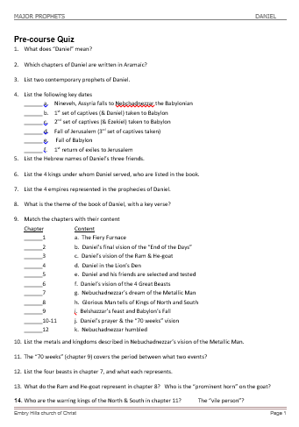
Take Pre-course Quiz on Daniel

Slide 3
A. Daniel’s Personal Information
Daniel: “God is my Judge”
Life spanned Babylonian & Medo-Persian Empires
Book spans 70 years of Daniel’s life (606-536 BC)
Daniel’s work was primarily in Babylon
Contemporary Prophets: Jeremiah and Ezekiel
Jeremiah remained in Jerusalem
Ezekiel prophesied in Babylon
Daniel’s Class: “King’s descendant” and “Noble”

Slide 4
1445-1405 BC
Wilderness
Wanderings
931-722 BC
Divided
Kingdom
605-538 BC
Babylonian
Captivity
444 BC - ~4 BC
The Silent Years
(Intertestamental)
30-90 AD
The Church
NT Era
2166-1859 BC
Patriarchs
1300-1050 BC
Judges
Slavery in Egypt
1859-1445 BC
Conquest
of Canaan
1405-1300 BC
United
Kingdom
1050-931 BC
Life of
Christ
4 BC – 30 AD
United
Kingdom
1050-931 BC
Judah
Alone
722-605 BC
Return
From Exile
538-444 BC
722 BC
586 BC
Temple/City Destroyed
Northern Kingdom:
ISRAEL
597 BC
Ezekiel
605 BC
Daniel
Saul
David
Solomon
Southern Kingdom:
JUDAH
931 BC
Based on Graphics from Marc Hinds & David Maxson
Notes:
With animation

Slide 5
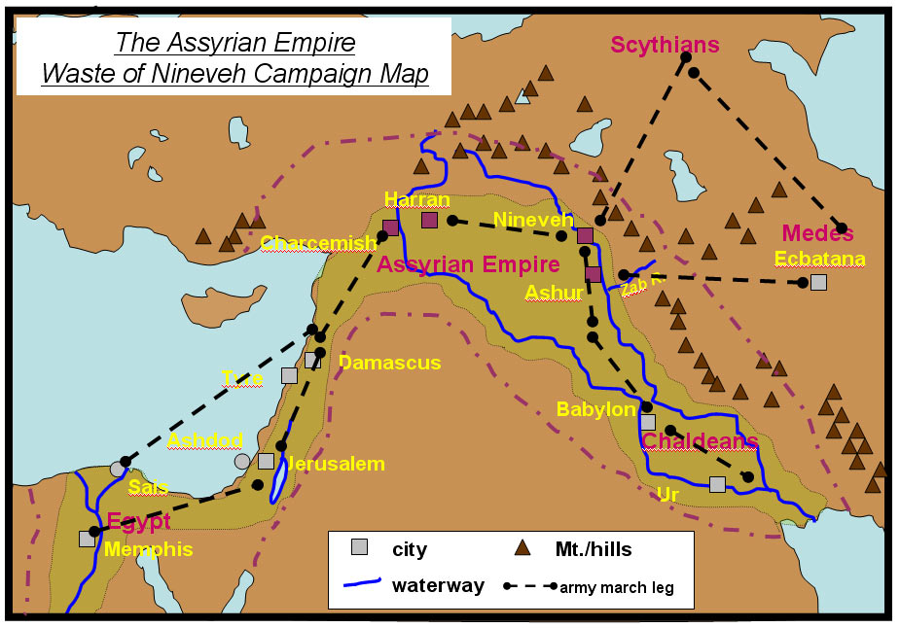
Assyria, Babylon, Egypt

Slide 7
C. Theme of Daniel
And He changes the times and the seasons; He removes kings and raises up kings; He gives wisdom to the wise And knowledge to those who have understanding. (Dan 2:21)
In order that the living may know That the Most High rules in the kingdom of men, Gives it to whomever He will, And sets over it the lowest of men.’ (Dan 4:17)
And you have lifted yourself up against the Lord of heaven. They have brought the vessels of His house before you, and you and your lords, your wives and your concubines, have drunk wine from them. And you have praised the gods of silver and gold, bronze and iron, wood and stone, which do not see or hear or know; and the God who holds your breath in His hand and owns all your ways, you have not glorified. (Dan 5:23)

Slide 8
C. Precursor Prophecies
Leviticus 26
Deuteronomy 28
Isaiah 44:23 – 45:1
II Kings 20:16 Isaiah 39:7
Jeremiah 25
Jeremiah 29
(see Matt 24:15)
Desolation, scattering
Foreign King (far away)
‘Cyrus’ to allow a return
Babylon to take sons away
Babylon punished in 70 yrs
People to return in 70 yrs
“… spoken of by Daniel…”

Slide 9
D. Characters from Daniel
Four Hebrew Men in Babylon
Ch 1-2,4-12
Daniel^{H}
“God is my Judge”
Belteshazzar^{B}
“May Balak protect”
Ch 1,3
Shadrach^{B}
“Command of Aku”
Hananiah^{H}
“The Lord is gracious”
Ch 1,3
Meshach^{B}
“Who is what Aku is”
Mishael^{H}
“Who is what God is”
Ch 1,3
Abenego^{B}
“Servant of Nebo”
Azariah^{H}
“The Lord has helped”
Two Kings of Babylon
Ch 1-4
Nebuchadnezzar
“Nebo, protect the crown”
Ch 5,7,8
Belshazzar
“Bel protect the king”
Two Kings of Medo-Persian
Ch 1,6,10
Cyrus the Persian
“Throne”
Ch 5-6,9,11
Darius the Mede – governor of Babylon
“Preserver”

Slide 10
Chapter Content
Chapter Content
____ 1 a. Daniel’s friends in the Fiery Furnace
____ 2 b. Daniel’s final vision of the “End of the Days”
____ 3 c. Daniel’s vision of the Ram & He-goat
____ 4 d. Daniel in the Lion’s Den
____ 5 e. Daniel and his friends are selected and tested
____ 6 f. Daniel’s vision of the 4 Great Beasts
____ 7 g. Nebuchadnezzar’s dream of the Metallic Man
____ 8 h. Glorious Man tells of Kings of North and South
____ 9 i. Belshazzar’s feast and Babylon’s Fall
____ 10-11 j. Daniel’s prayer & the “70 weeks” vision
____ 12 k. Nebuchadnezzar humbled
e
g
a
k
i
d
f
c
j
h
b

Slide 11
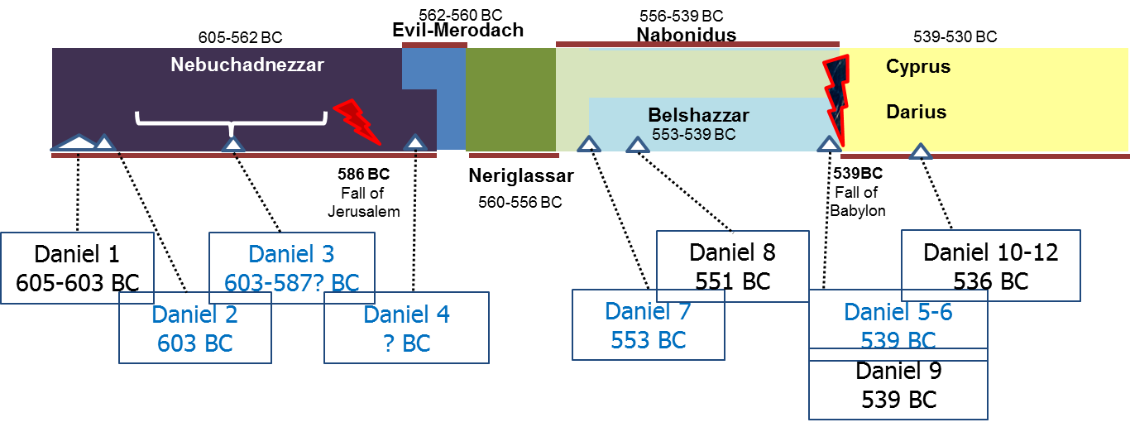
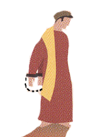
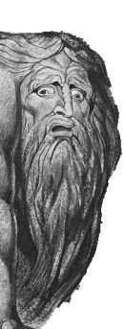
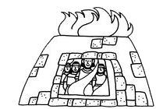
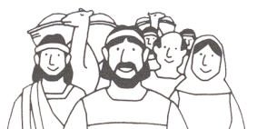
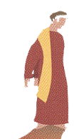
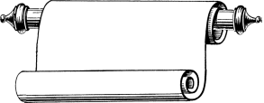
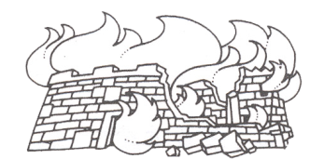
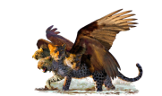
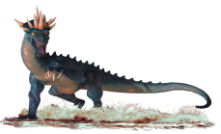
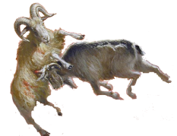
620 BC
605
600
590
580
570
560
550
540
530
520
627-605 BC
605-562 BC
(co 555?)562-560 BC
556-539 BC
Cyrus
Nabopolassar
Nebuchadnezzar
Evil-Merodach
Nabonidus
539-
530 BC
Cambyses
Born
About
620 BC
Darius
The
Mede
530-
522 BC
Taken
Into
Captivity
Chapter 1
Chapter 2
Interprets
Nebuchadnezzar’s
Dream
Chapter 9
Return from Exile
538 BC
Prays for Return
Interprets
Nebuchadnezzar’s
Dream
Chapter 3
Chapter
10-12
Fiery
Furnace
Chapter 4
Chapter 5
Interprets
Writing on
The Wall
Israel’s
Future
MENE, MENE,
TEKEL, UPHASSIN
Chapter 6
Lion’s
Den
4 Creatures
Chapter 7
586 BC
Jerusalem
Temple
Destroyed
Chapter 8
2nd Captives
Including Ezekiel
597 BC
Neriglassar
Belshazzar
Ram &
Goat
560-556 BC
553-539 BC

Slide 12
Chapter Content
Chapter Content of Daniel
1 Daniel and his friends are selected and tested
2 Nebuchadnezzar’s dream of the Metallic Man
Daniel’s friends in the Fiery Furnace
Nebuchadnezzar humbled
5 Belshazzar’s feast and Babylon’s Fall
6 Daniel in the Lion’s Den
7 Daniel’s vision of the 4 Great Beasts
8 Daniel’s vision of the Ram & He-goat
9 Daniel’s prayer & the “70 weeks” vision
10-11 Glorious Man tells of Kings of North and South
12 Daniel’s final vision of the “End of the Days”

Slide 13
Outline of Daniel
Chapter | Description | Language
1
2
3
4
5
6
7
8
9
10
11
12
Daniel & Friends tested in captivity
Hebrew
Daniel & Nebuchadnezzar’s
dream of 4 kingdoms
Aramaic
Faith tested in fire
Aramaic
4 Empires Rise & Fall
God Humbles Proud
Nebuchadnezzar is shown
God rules in the nations
Aramaic
Belshazzar’s feast & Babylon’s fall
Aramaic
God Rescues Faithful
Daniel’s faith in a Lion’s Den
Aramaic
Daniel’s vision of 4 beasts
Aramaic
Daniel’s vision of the ram & he-goat
Hebrew
Daniel’s prayer for return
Hebrew
Intro to Daniel’s last visions
Hebrew
Daniel’s vision Between Testaments
Hebrew
Daniel’s vision of the End Days
Hebrew
Notes:
Animated

