Slide 1
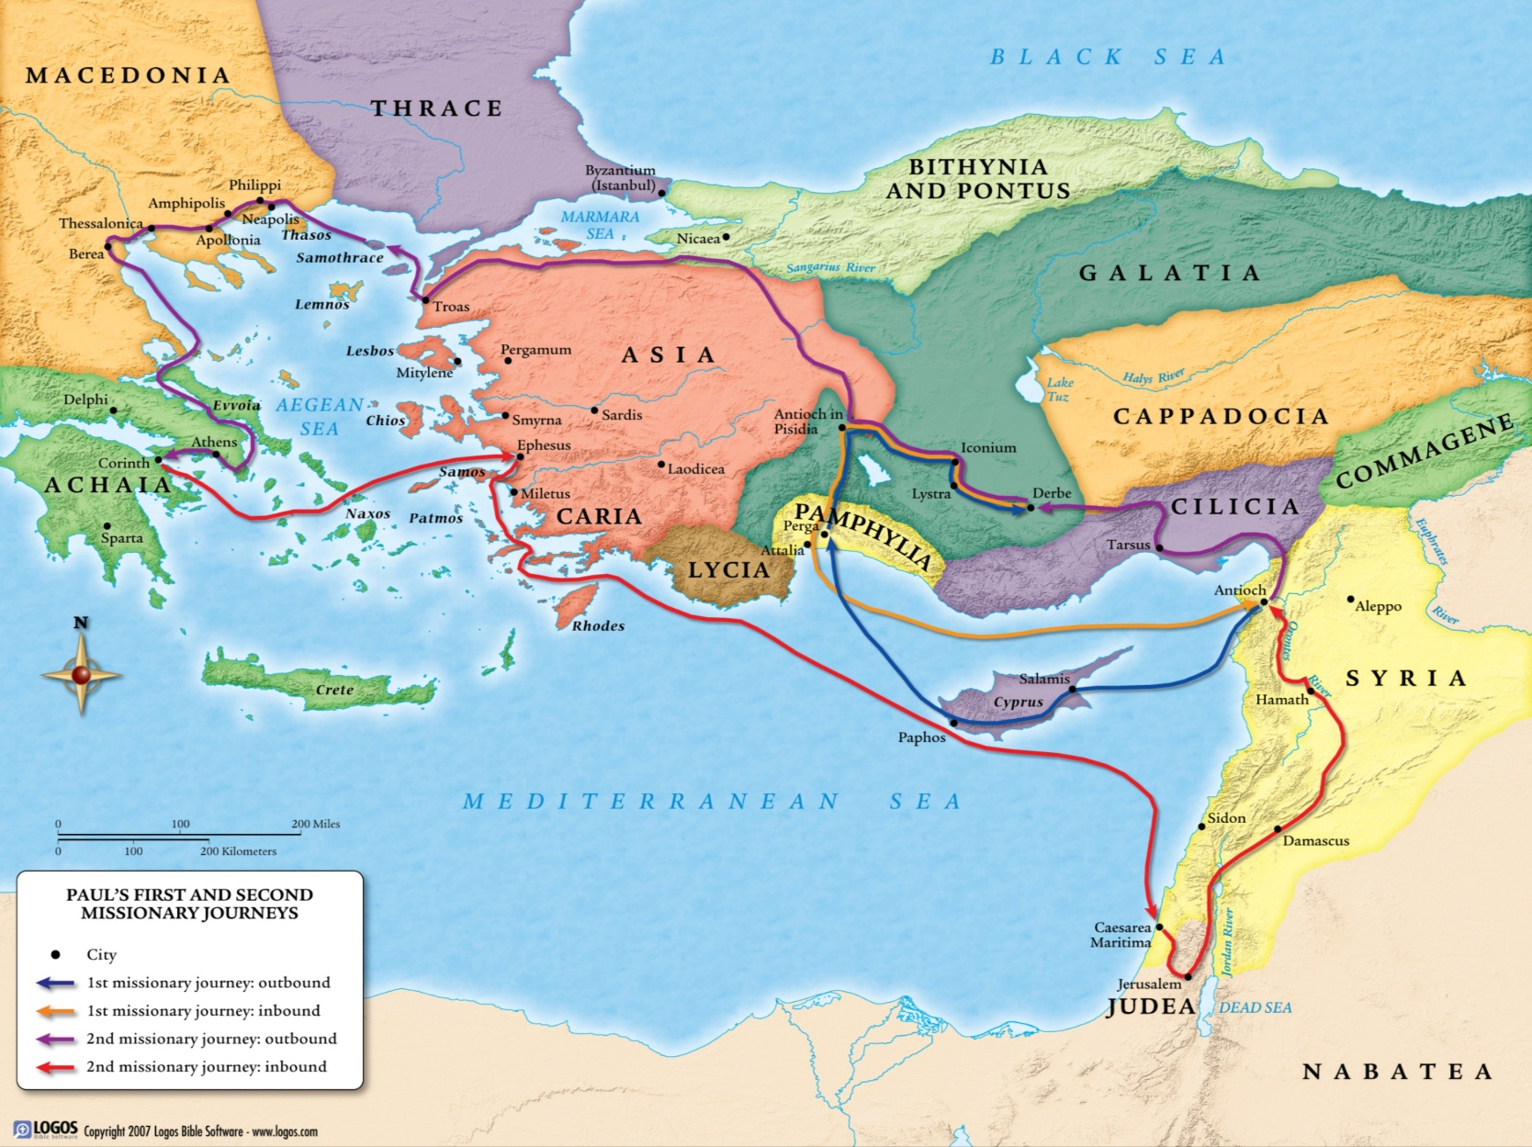

Slide 2
Knowing Your
Brothers and Sisters

Slide 3
The Christians in Rome
Prisca and Aquila fellow workers in Christ
risked their necks for my life
Epaenetus beloved, first convert to Christ in Asia
Mary who has worked hard for you
Andronicus & Junia my kinsmen and fellow prisoners
known to Apostles, in Christ before me
Ampliatus my beloved in the Lord
Urbanus our fellow worker in Christ
Stachys my beloved
Apelles who is approved in Christ
Herodion my kinsman
Tryphaena/Tryphosa workers in the Lord
Persis beloved, who has worked hard in the Lord
Rufus chosen in the Lord
Rufus’ mother a mother to me as well

Slide 4
The Christians in Rome
Prisca and Aquila fellow workers in Christ
risked their necks for my life
Epaenetus beloved, first convert to Christ in Asia
Mary who has worked hard for you
Andronicus & Junia my kinsmen and fellow prisoners
known to Apostles, in Christ before me
Ampliatus my beloved in the Lord
Urbanus our fellow worker in Christ
Stachys my beloved
Apelles who is approved in Christ
Herodion my kinsman
Tryphaena/Tryphosa workers in the Lord
Persis beloved, who has worked hard in the Lord
Rufus chosen in the Lord
Rufus’ mother a mother to me as well

Slide 5
II Corinthians 3:2-3
² You yourselves are our letter of recommendation, written on our hearts, to be known and read by all. ³ And you show that you are a letter from Christ delivered by us, written not with ink but with the Spirit of the living God, not on tablets of stone but on tablets of human hearts.

Slide 6
Why is this knowledge needed?
To see we are not struggling alone
To build deeper relationships
To glorify God through one voice

Slide 7
Romans 15:5-7
⁵ May the God of endurance and encouragement grant you to live in such harmony with one another, in accord with Christ Jesus, ⁶ that together you may with one voice glorify the God and Father of our Lord Jesus Christ. ⁷ Therefore welcome one another as Christ has welcomed you, for the glory of God.

Slide 8
Romans 14:4
⁴ Who are you to pass judgment on the servant of another? It is before his own master that he stands or falls. And he will be upheld, for the Lord is able to make him stand.
Romans 14:10-12
¹⁰ Why do you pass judgment on your brother? Or you, why do you despise your brother? For we will all stand before the judgment seat of God; ¹¹ for it is written,
“As I live, says the Lord, every knee shall bow to me, and every tongue shall confess to God.” ¹² So then each of us will give an account of himself to God.

Slide 9
Romans 14:4
⁴ Who are you to pass judgment on the servant of another? It is before his own master that he stands or falls. And he will be upheld, for the Lord is able to make him stand.
Romans 14:10-12
¹⁰ Why do you pass judgment on your brother? Or you, why do you despise your brother? For we will all stand before the judgment seat of God; ¹¹ for it is written,
“As I live, says the Lord, every knee shall bow to me, and every tongue shall confess to God.” ¹² So then each of us will give an account of himself to God.

Slide 10
Romans 14:6-9
⁶ The one who observes the day, observes it in honor of the Lord. The one who eats, eats in honor of the Lord, since he gives thanks to God, while the one who abstains, abstains in honor of the Lord and gives thanks to God. ⁷ For none of us lives to himself, and none of us dies to himself. ⁸ For if we live, we live to the Lord, and if we die, we die to the Lord. So then, whether we live or whether we die, we are the Lord's.

Slide 11
Romans 14:18-19
¹⁸ Whoever thus serves Christ is acceptable to God and approved by men. ¹⁹ So then let us pursue what makes for peace and for mutual upbuilding.

Slide 12
What can each of us do?
Acknowledge improvement is needed
Meet and know one another’s story
Find someone new at the building
Commit to the group meetings
Give thanks to God

Slide 14
Godly Courage

Slide 15
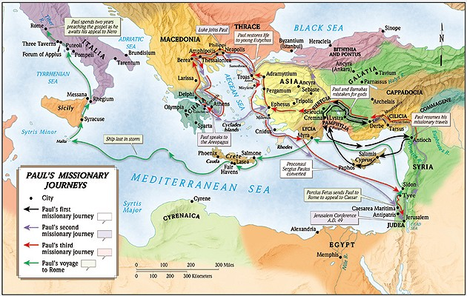

Slide 16
Courage Demanded
for God gave us a spirit not of fear but of power and love and self-control. II Timothy 1:7

Slide 17
Courage Demanded
So we are always of good courage. We know that while we are at home in the body we are away from the Lord, ⁷ for we walk by faith, not by sight. ⁸ Yes, we are of good courage . . .
II Corinthians 5:6-8a

Slide 18
Courage Demanded
And you are her children, if you do good and do not fear anything that is frightening (ESV) I Peter 3:6
you have become her children if you do what is right without being frightened by any fear. (NASB)

Slide 19
Courage Demanded
²⁶ “So have no fear of them, for nothing is covered that will not be revealed, or hidden that will not be known . . . ²⁸ And do not fear those who kill the body but cannot kill the soul . . . ³¹ Fear not, therefore; you are of more value than many sparrows. ³² So everyone who acknowledges me before men, I also will acknowledge before my Father who is in heaven, ³³ but whoever denies me before men, I also will deny before my Father who is in heaven. Matt. 10:26, 28, 31-33

Slide 20
Romans 8:31, 35-39
³¹ What then shall we say to these things? If God is for us, who can be against us? . . . ³⁵ Who shall separate us from the love of Christ? Shall tribulation, or distress, or persecution, or famine, or nakedness, or danger, or sword? ³⁶ As it is written,
“For your sake we are being killed all the day long; we are regarded as sheep to be slaughtered.” ³⁷ No, in all these things we are more than conquerors through him who loved us. ³⁸ For I am sure that neither death nor life, nor angels nor rulers, nor things present nor things to come, nor powers, ³⁹ nor height nor depth, nor anything else in all creation, will be able to separate us from the love of God in Christ Jesus our Lord.

Slide 21
What we fear:
Social/Cultural Changes
Economic Problems

Slide 22
Matthew 6:25
²⁵ “Therefore I tell you, do not be anxious about your life, what you will eat or what you will drink, nor about your body, what you will put on. Is not life more than food, and the body more than clothing?

Slide 23
Hebrews 10:34-39
joyfully accepted the plundering of your property, since you knew that you yourselves had a better possession and an abiding one.
do not throw away your confidence, which has a great reward. ³⁶ For you have need of endurance, so that when you have done the will of God you may receive what is promised. ³⁷ For, “Yet a little while, and the coming one will come and will not delay; ³⁸ but my righteous one shall live by faith, and if he shrinks back, my soul has no pleasure in him.” ³⁹ But we are not of those who shrink back and are destroyed, but of those who have faith and preserve their souls.

Slide 24
Hebrews 13:5-6
⁶ So we can confidently say,
“The Lord is my helper; I will not fear;
what can man do to me?”
Keep your life free from love of money, and be content with what you have, for he has said, “I will never leave you nor forsake you.”

Slide 25
What we fear:
Social/Cultural Changes
Economic Problems
Death

Slide 26
Philippians 1:20-24
²⁰ as it is my eager expectation and hope that I will not be at all ashamed, but that with full courage now as always Christ will be honored in my body, whether by life or by death. ²¹ For to me to live is Christ, and to die is gain.
²² If I am to live in the flesh, that means fruitful labor for me. Yet which I shall choose I cannot tell.
²³ I am hard pressed between the two. My desire is to depart and be with Christ, for that is far better. ²⁴ But to remain in the flesh is more necessary on your account.

Slide 27
II Timothy 4:6-8
the time of my departure has come. ⁷ I have fought the good fight, I have finished the race, I have kept the faith. ⁸ Henceforth there is laid up for me the crown of righteousness, which the Lord, the righteous judge, will award to me on that Day, and not only to me but also to all who have loved his appearing.

Slide 28
Hebrews 2:14-15
¹⁴ Since therefore the children share in flesh and blood, he himself likewise partook of the same things, that through death he might destroy the one who has the power of death, that is, the devil, ¹⁵ and deliver all those who through fear of death were subject to lifelong slavery.

Slide 29
I Corinthians 15:51-58
⁵¹ Behold! I tell you a mystery. We shall not all sleep, but we shall all be changed, ⁵² in a moment, in the twinkling of an eye, at the last trumpet. For the trumpet will sound, and the dead will be raised imperishable, and we shall be changed. ⁵³ For this perishable body must put on the imperishable, and this mortal body must put on immortality. ⁵⁴ When the perishable puts on the imperishable, and the mortal puts on immortality, then shall come to pass the saying that is written:

Slide 30
I Corinthians 15:51-58
“Death is swallowed up in victory.” ⁵⁵ “O death, where is your victory? O death, where is your sting?”
⁵⁶ The sting of death is sin, and the power of sin is the law.
⁵⁷ But thanks be to God, who gives us the victory through our Lord Jesus Christ.
⁵⁸ Therefore, my beloved brothers, be steadfast, immovable, always abounding in the work of the Lord, knowing that in the Lord your labor is not in vain.

Slide 31
Romans 8:35-39
³⁵ Who shall separate us from the love of Christ? Shall tribulation, or distress, or persecution, or famine, or nakedness, or danger, or sword?
³⁶ As it is written,
“For your sake we are being killed all the day long; we are regarded as sheep to be slaughtered.” ³⁷ No, in all these things we are more than conquerors through him who loved us. ³⁸ For I am sure that neither death nor life, nor angels nor rulers, nor things present nor things to come, nor powers, ³⁹ nor height nor depth, nor anything else in all creation, will be able to separate us from the love of God in Christ Jesus our Lord.

