Slide 2
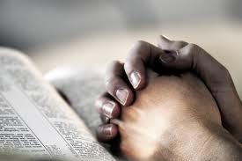
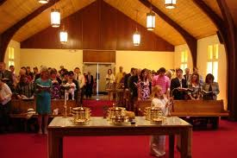
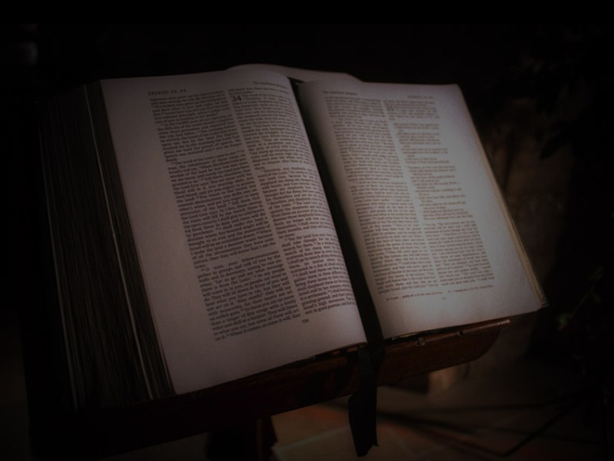
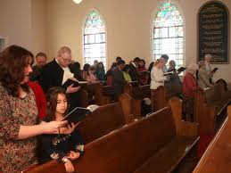
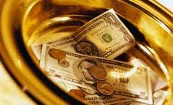
Putting More into and Getting More out of Worship

Slide 3
Putting More into and Getting More out of Worship
Lord’s Supper and Preaching

Slide 4
Worship – Key Verse John 4:23-24
²³ But the hour is coming, and is now here, when the true worshipers will worship the Father in spirit and truth, for the Father is seeking such people to worship him. ²⁴ God is spirit, and those who worship him must worship in spirit and truth.”

Slide 5
Who is pleasing to God? Romans 8:5-10
⁵ For those who live according to the flesh set their minds on the things of the flesh, but those who live according to the Spirit set their minds on the things of the Spirit. ⁶ For to set the mind on the flesh is death, but to set the mind on the Spirit is life and peace. ⁷ For the mind that is set on the flesh is hostile to God, for it does not submit to God's law; indeed, it cannot. ⁸ Those who are in the flesh cannot please God. ⁹ You, however, are not in the flesh but in the Spirit, if in fact the Spirit of God dwells in you. Anyone who does not have the Spirit of Christ does not belong to him. ¹⁰ But if Christ is in you, although the body is dead because of sin, the Spirit is life because of righteousness.

Slide 6
Before we sing hymns, psalms and spiritual songs:
Ephesians 5:18b
but be filled with the Spirit
Colossians 3:16
¹⁶ Let the word of Christ dwell in you richly

Slide 7
Three Facts About Worship – Lord’s Supper
Lord’s Supper must be focused on Christ
the Lord Jesus on the night when he was betrayed took bread, ²⁴ and when he had given thanks, he broke it, and said, “This is my body which is for you. Do this in remembrance of me.” ²⁵ In the same way also he took the cup, after supper, saying, “This cup is the new covenant in my blood. Do this, as often as you drink it, in remembrance of me.” – I Cor. 11:23-26

Slide 8
Three Facts About Worship – Lord’s Supper
Lord’s Supper must be focused on Christ
Lord’s Supper involves the whole church (all members)
I Corinthians 11:18, 20, 33
¹⁸ For, in the first place, when you come together as a church
²⁰ When you come together
³³ So then, my brothers, when you come together to eat

Slide 9
Three Facts About Worship – Lord’s Supper
Lord’s Supper must be focused on Christ
Lord’s Supper involves the whole church (all members)
Lord’s Supper must be kept in spirit and in truth
²¹ You cannot drink the cup of the Lord and the cup of demons. You cannot partake of the table of the Lord and the table of demons. – 10:21
²⁷ Whoever, therefore, eats the bread or drinks the cup of the Lord in an unworthy manner will be guilty concerning the body and blood of the Lord. – 11:27
²⁹ For anyone who eats and drinks without discerning the body eats and drinks judgment on himself. – 11:29

Slide 10
Three Facts About Worship – Lord’s Supper
Lord’s Supper must be focused on Christ
Lord’s Supper involves the whole church (all members)
Lord’s Supper must be kept in spirit and in truth
In truth – guided by God
In spirit – with emotions

Slide 11
Knowledge of Christ Knowledge of His Life Grasp of the purpose of the Supper A clear view of Christ’s majesty humility love
Edification
Stir emotions and
resolution of mind:
Sorrow
Gratitude
Awe
Joy
Lord’s
Supper
Reflection
And
Remembrance

Slide 12
Awe

Slide 13
Awe
(wow!)
Unbeliever
Awe
God is
Great
Believer

Slide 14
Public Preaching and Reading
Acts 20:7
Colossians 4:16 Letter to be read in more than one church
I Timothy 4:13 Evangelist devoted to public reading of Scripture, teaching
I Cor. 4:19, 26 Words to instruct others, has a lesson

Slide 15
I Thessalonians 2:13
that when you received the word of God, which you heard from us, you accepted it not as the word of men but as what it really is, the word of God, which is at work in you believers

Slide 16
I Corinthians 2:10-14
¹⁰ these things God has revealed to us through the Spirit. For the Spirit searches everything, even the depths of God. ¹¹ For who knows a person's thoughts except the spirit of that person, which is in him? So also no one comprehends the thoughts of God except the Spirit of God. ¹² Now we have received not the spirit of the world, but the Spirit who is from God, that we might understand the things freely given us by God. ¹³ And we impart this in words not taught by human wisdom but taught by the Spirit, interpreting spiritual truths to those who are spiritual. ¹⁴ The natural person does not accept the things of the Spirit of God, for they are folly to him, and he is not able to understand them because they are spiritually discerned

Slide 17
Worship in Song – Practical Considerations

Slide 18
Worship in Spirit
Ephesians 5:18b-21 but be filled with the Spirit, ¹⁹ addressing one another in psalms and hymns and spiritual songs, singing and making melody to the Lord with your heart, ²⁰ giving thanks always and for everything to God the Father in the name of our Lord Jesus Christ, ²¹ submitting to one another out of reverence for Christ
Colossians 3:16-17 ¹⁶ Let the word of Christ dwell in you richly, teaching and admonishing one another in all wisdom, singing psalms and hymns and spiritual songs, with thankfulness in your hearts to God. ¹⁷ And whatever you do, in word or deed, do everything in the name of the Lord Jesus, giving thanks to God the Father through him.

Slide 19
Two Questions to Consider
Why do we use the scriptures (the New Testament) as our guide?
¹³ And we also thank God constantly for this, that when you received the word of God, which you heard from us, you accepted it not as the word of men but as what it really is, the word of God, which is at work in you believers. ¹⁴ For you, brothers, became imitators of the churches of God in Christ Jesus that are in Judea. For you suffered the same things from your own countrymen as they did from the Jews, – I Thessalonians 2:13-14

Slide 20
Two Questions to Consider
Why do we use the scriptures (the New Testament) as our guide?
How do these scriptures guide us?

Slide 21
Putting More in and Getting More out of Worship

Slide 22
Goals of these sermons (that we will each . . .)
Worship God with a more sincere heart
Gain more from worship
Be true worshippers
And that above all else
God will be honored more in our worship

Slide 23
Three Facts About Worship in Song
Our worship in song must be focused on God
Ephesians 5:18b-21 but be filled with the Spirit, ¹⁹ addressing one another in psalms and hymns and spiritual songs, singing and making melody to the Lord with your heart, ²⁰ giving thanks always and for everything to God the Father in the name of our Lord Jesus Christ, ²¹ submitting to one another out of reverence for Christ
Colossians 3:16-17 ¹⁶ Let the word of Christ dwell in you richly, teaching and admonishing one another in all wisdom, singing psalms and hymns and spiritual songs, with thankfulness in your hearts to God. ¹⁷ And whatever you do, in word or deed, do everything in the name of the Lord Jesus, giving thanks to God the Father through him.

Slide 24
Questions to Consider
Why did you come here this morning?
Are you excited to be here? Why or why not?
What’s been on your mind before you got here this morning?
What do you hope to gain from this morning’s worship? (question focuses on us)
What do you hope to accomplish this morning? (focus turned to God and/or others)
Do you feel privileged to be here?

Slide 25
Four Points from the Teaching of Jesus
We need to understand the urgency of our situation
‘Master, I knew you to be a hard man, reaping where you did not sow, and gathering where you scattered no seed, ²⁵ so I was afraid, and I went and hid your talent in the ground. Here you have what is yours.’ - Matt. 25:24-25

Slide 26
Four Points from the Teaching of Jesus
We need to understand the urgency of our situation
We need to have an honest view of what we are able to do
Everyone to whom much was given, of him much will be required, and from him to whom they entrusted much, they will demand the more. - Luke 12:48

Slide 27
Four Points from the Teaching of Jesus
We need to understand the urgency of our situation
We need to have an honest view of what we are able to do
We need to overcome the distractions of this world
²² As for what was sown among thorns, this is the one who hears the word, but the cares of the world and the deceitfulness of riches choke the word, and it proves unfruitful. – Matthew 13:22

Slide 28
Four Points from the Teaching of Jesus
We need to understand the urgency of our situation
We need to have an honest view of what we are able to do
We need to overcome the distractions of this world
We need to have the right priorities

Slide 29
Two Examples from the Life of Jesus
The Healed Demoniac – Mark 5:1-20
² And when Jesus had stepped out of the boat, immediately there met him out of the tombs a man with an unclean spirit. ³ He lived among the tombs. And no one could bind him anymore, not even with a chain, ⁴ for he had often been bound with shackles and chains, but he wrenched the chains apart, and he broke the shackles in pieces. No one had the strength to subdue him. ⁵ Night and day among the tombs and on the mountains he was always crying out and cutting himself with stones. – Mark 5:2-5

Slide 30
Two Examples from the Life of Jesus
The Healed Demoniac – Mark 5:1-20
“Go home to your friends and tell them how much the Lord has done for you, and how he has had mercy on you.” ²⁰ And he went away and began to proclaim in the Decapolis how much Jesus had done for him, and everyone marveled. – Mark 5:19-20

Slide 31
Two Examples from the Life of Jesus
The Healed Demoniac – Mark 5:1-20
Mary – John 12:2-8, Mark 14:3-9
“Leave her alone. Why do you trouble her? She has done a beautiful thing to me. ⁷ For you always have the poor with you, and whenever you want, you can do good for them. But you will not always have me. ⁸ She has done what she could; she has anointed my body beforehand for burial. ⁹ And truly, I say to you, wherever the gospel is proclaimed in the whole world, what she has done will be told in memory of her.” – Mark 14:6-9

Slide 32
Practical Applications
Work on your personal relationship with God
Take advantage of teaching opportunities
Serve through hospitality
Address the needs of others
Give more

Slide 33
Universal Nature of Guilt
Romans 3:19, 23
¹⁹ Now we know that whatever the law says, it says to those who are under the law, that every mouth may be stopped, and all the world may become guilty before God. ²³ for all have sinned and fall short of the glory of God
I John 1:8-10
⁸ If we say that we have no sin, we deceive ourselves, and the truth is not in us. ⁹ If we confess our sins, He is faithful and just to forgive us our sins and to cleanse us from all unrighteousness. ¹⁰ If we say that we have not sinned, we make Him a liar, and His word is not in us
James 2:10
¹⁰ For whoever shall keep the whole law, and yet stumble in one point, he is guilty of all.

Slide 34
God’s Solution for Guilt: Romans 3:22-26
²² the righteousness of God through faith in Jesus Christ for all who believe. For there is no distinction: ²³ for all have sinned and fall short of the glory of God, ²⁴ and are justified by his grace as a gift, through the redemption that is in Christ Jesus, ²⁵ whom God put forward as a propitiation by his blood, to be received by faith. This was to show God's righteousness, because in his divine forbearance he had passed over former sins. ²⁶ It was to show his righteousness at the present time, so that he might be just and the justifier of the one who has faith in Jesus.

Slide 35
Story of Ten Brothers
Genesis 37

Slide 36
Jacob’s Family
Leah Reuben Zilpah Gad
Simeon (Leah’s servant) Asher Levi
Judah
Issachar
Zebulon
Rachel Joseph Bilhah Dan
Benjamin (Rachel’s servant) Naptali

Slide 37
Story of Ten Brothers
Genesis 37
Joseph is sold by his brothers
Jacob convinced of his death
Genesis 42

Slide 38
Story of Ten Brothers
Genesis 37
Joseph is sold by his brothers
Jacob convinced of his death
Genesis 42
Ten travel to Egypt for grain
Simeon left
Jacob refuses to send Benjamin
Genesis 43
Brothers return with Benjamin
Simeon released
Genesis 44
Benjamin appears to be guilty
Judah’s plea

Slide 39
Genesis 44:16
“What shall we say to my lord? What shall we speak? Or how can we clear ourselves? God has found out the guilt of your servants; behold, we are my lord's servants, both we and he also in whose hand the cup has been found.”

Slide 40
Guilt and the Ten Brothers
Did not deny their guilt
Did they allow guilt to define them?
Not by giving up and remaining jealous, self-seeking, cruel men – why not?

Slide 41
Jacob’s Family
Leah Reuben (4) Zilpah Gad (7)
Simeon (5+1) (Leah’s servant) Asher (4) Levi (3)
Judah (3+2)
Issachar (4)
Zebulon (3)
Rachel Joseph Bilhah Dan (1)
Benjamin (Rachel’s servant) Naptali (4)

Slide 42
Guilt and the Ten Brothers
Did not deny their guilt
Did they allow guilt to define them?
Not by giving up and remaining jealous, self-seeking, cruel men – why not?
Yet perhaps in a sense while still trying to serve God
Who then is to be our example of using guilt as motivation to be remade (but with peace)?

Slide 43
Example of Paul
I Timothy 1:15
“Christ Jesus came into the world to save sinners, of whom I am the foremost” Yet
¹² I thank him who has given me strength, Christ Jesus our Lord, because he judged me faithful, appointing me to his service, ¹³ though formerly I was a blasphemer, persecutor, and insolent opponent. But I received mercy because I had acted ignorantly in unbelief, ¹⁴ and the grace of our Lord overflowed for me with the faith and love that are in Christ Jesus.

Slide 44
Example of Paul
I Timothy 1:15
Romans 7:24 – 8:1
Philippians 3:13-14
But one thing I do: forgetting what lies behind and straining forward to what lies ahead, ¹⁴ I press on toward the goal for the prize of the upward call of God in Christ Jesus.

Slide 45
#345 – 3rd verse
“My sin – O, the bliss of this glorious thought, my sin – not in part but the whole, is nailed to His cross and I bear it no more, Praise the Lord, praise the Lord, O, my soul.”

Slide 46
Ephesians 4 - 5
Putting Off Putting On
Lying Truth
Anger
Stealing Labor – honest work Corrupt talk Speech that builds up
Bitterness, wrath, malice Kindness, forgiveness
Sexual immorality
Filthiness, crude jokes Thanksgiving
Foolishness Understand the Lord’s will
Drunkenness Spirit, singing to the Lord

Slide 47
Lying – Ephesians 4:25
²⁵Therefore, having put away falsehood, let each one of you speak the truth with his neighbor, for we are members one of another.

Slide 48
Stealing – Ephesians 4:28
²⁸Let the thief no longer steal, but rather let him labor, doing honest work with his own hands, so that he may have something to share with anyone in need.

Slide 49
Corrupt Speech – Ephesians 4:29, 5:4
²⁹ Let no corrupting talk come out of your mouths, but only such as is good for building up, as fits the occasion, that it may give grace to those who hear.
⁴Let there be no filthiness nor foolish talk nor crude joking, which are out of place, but instead let there be thanksgiving

Slide 50
Ephesians 4:20-21
²⁰But that is not the way you learned Christ!— ²¹assuming that you have heard about him and were taught in him, as the truth is in Jesus,

Slide 51
Ephesians 4:31-32
³¹ Let all bitterness and wrath and anger and clamor and slander be put away from you, along with all malice. ³² Be kind to one another, tenderhearted, forgiving one another, as God in Christ forgave you.

Slide 52
Ephesians 5:3
³But sexual immorality and all impurity or covetousness must not even be named among you, as is proper among saints.

Slide 53
Putting on a New Self

Slide 54
I John 5:18-19
¹⁸ We know that whoever is born of God does not sin; but he who has been born of God keeps himself, and the wicked one does not touch him. ¹⁹ We know that we are of God, and the whole world lies under the sway of the wicked one.
Christians

