Slide 1
Study of Daniel
Lesson 11 – Chapter 10 & 11
Fall 2015

Slide 2

1445-1405 BC
Wilderness
Wanderings
931-722 BC
Divided
Kingdom
605-538 BC
Babylonian
Captivity
444 BC - ~4 BC
The Silent Years
(Intertestamental)
30-90 AD
The Church
NT Era
2166-1859 BC
Patriarchs
1300-1050 BC
Judges
Slavery in Egypt
1859-1445 BC
Conquest
of Canaan
1405-1300 BC
United
Kingdom
1050-931 BC
Life of
Christ
4 BC – 30 AD
United
Kingdom
1050-931 BC
Judah
Alone
722-605 BC
Return
From Exile
538-444 BC
597 BC
2nd Captives
Ezekiel
605 BC
1st Captives
Daniel
586 BC
Fall of
Jerusalem
539BC
Fall of
Babylon
538 BC
1st Return from Exile
562-560 BC
556-539 BC
Evil-Merodach
Nabonidus
Nebuchadnezzar
Neriglassar
Belshazzar
Cyrus the Great
Darius the Mede
605-562 BC
560-556 BC
553-539 BC
539-530 BC
Daniel 1
605-603 BC
Daniel 2
603 BC
Daniel 3
603-587? BC
Daniel 4
? BC
Daniel 5-6
539 BC
Daniel 7
553 BC
Daniel 8
551 BC
Daniel 9
539 BC
Daniel 10-12
536 BC
Based on Graphics from Marc Hinds & David Maxson
Notes:
With animation

Slide 3

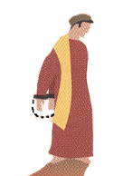
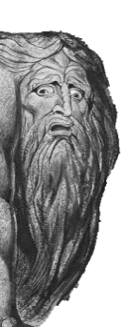
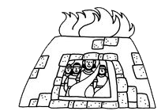
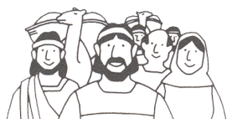






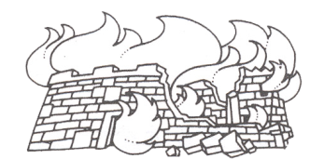
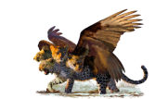
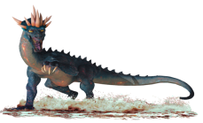

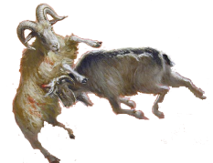

620 BC
605
600
590
580
570
560
550
540
530
520
627-605 BC
605-562 BC
(co 555?)562-560 BC
556-539 BC
Cyrus
Nabopolassar
Nebuchadnezzar
Evil-Merodach
Nabonidus
539-
530 BC
Cambyses
Born
About
620 BC
Darius
The
Mede
530-
522 BC
Taken
Into
Captivity
Chapter 1
Captive
But obey
Food Laws
Chapter 2
Interprets
Nebuchadnezzar’s
Dream
Chapter 9
Return from Exile
538 BC
Prays for Return
Interprets
Nebuchadnezzar’s
Dream
Chapter 3
Chapter
10-12
God Controls Rise & Fall of Kingdoms
Fiery
Furnace
Chapter 4
Chapter 5
Pray to God not Objects
Interprets
Writing on
The Wall
Israel’s
Future
God Humbles Powerful Dynasty building Kings
God Humbles Vain Spoiled Bad Kings
MENE, MENE,
TEKEL, UPHASSIN
Chapter 6
Lion’s
Den
4 Creatures
Pray to God not Kings
Chapter 7
586 BC
Jerusalem
Temple
Destroyed
Chapter 8
2nd Captives
Including Ezekiel
597 BC
Neriglassar
Belshazzar
Ram &
Goat
560-556 BC
553-539 BC

Slide 4
Cycle of Visions
1
2
3
4
5
6
7
8
9
10
11
12
Mighty
Metallic
Man
Four
Beasts
Seventy
Weeks
1
Gold⁴
1
Lion⁴
2
Silver
2
Bear⁵
Ram³
(Intro)
3 more Kings²
3
Bronze
3
Leopard⁶
He-Goat⁸
Kings of N&S⁶
Fierce King²³
Vile Person²¹
4
Iron/clay
4
(ugly)⁷
[evil] King³⁶
Stone³⁴
Son of Man¹³
Messiah²⁵
time of
trouble¹, time of the end⁴

Slide 5


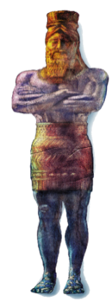


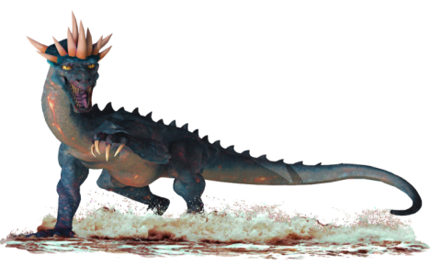
70 Weeks
Daniel
Daniel 2:44-45(NKJV)
⁴⁴And in the days of these kings the God of heaven will set up a kingdom which shall never be destroyed; and the kingdom shall not be left to other people; it shall break in pieces and consume all these kingdoms, and it shall stand forever.
Chapter 9
Chapter 2
Chapter 7
Daniel 9:25(NKJV)
²⁵ “Know therefore and understand,
That from the going forth of the command
To restore and build Jerusalem
Until Messiah the Prince,
There shall be seven weeks and sixty-two weeks;
The street shall be built again, and the wall,
Even in troublesome times.
Daniel 7:27(NKJV)
²⁷ Then the kingdom and dominion,
And the greatness of the
kingdoms under the whole heaven,
Shall be given to the people, the saints
of the Most High.
His kingdom is an everlasting kingdom,
And all dominions shall serve and
obey Him.’
400+ Years of Silence

Slide 6
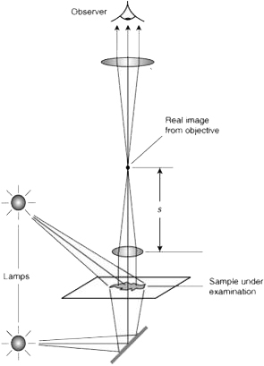
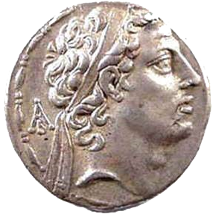
Daniel 8
Ram = Media and Persia.
Male goat = Greece.
Large horn =first king Alexander the Great
broken horn and the 4
four kingdoms shall arise out of that nation
Daniel
“Look, I am making known to you what shall happen in the latter time of the indignation
Daniel 8:13(NKJV)
¹³Then I heard a holy one speaking; and another holy one said to that certain one who was speaking, “How long will the vision be, concerning the daily sacrifices and the transgression of desolation, the giving of both the sanctuary and the host to be trampled underfoot?”
A king shall arise
Having fierce features
Who understands
sinister schemes.
Antiochus IV Epiphanes
Visions

Slide 7
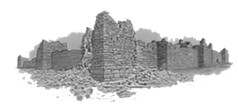
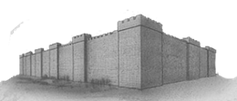

Daniel 9:22(NKJV)
²²And he informed me, and talked with me, and said, “O Daniel, I have now come forth to give you skill to understand.
Daniel
Daniel 9:24(NKJV)
²⁴ “Seventy weeks (sevens) are determined
For your people and for your holy city,
To finish the transgression,
To make an end of sins,
To make reconciliation for iniquity,
To bring in everlasting righteousness,
To seal up vision and prophecy,
And to anoint the Most Holy.
Visions
70 Weeks
Chapter 9

Slide 8
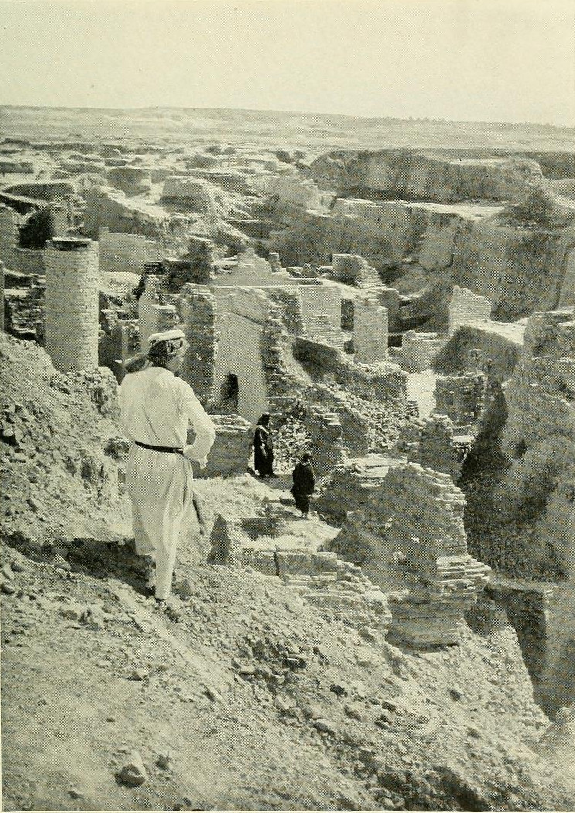
RETURN OF THE
PEOPLE
Proclamation of Cyrus – Ezra 1
Return to Land Ezra - 2:1
TEMPLE ALTAR
Jeshua the priest and Zerubbabel - Ezra 3:2
TEMPLE
Haggai , Zechariah Zerubbabel & Darius the Persian- Ezra 5-6
LAW
Ezra Sent - Ezra 7
WALLS
Nehemiah Sent - Nehemiah
KING
Daniel 2, 7, 9-12

Slide 9

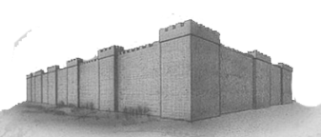
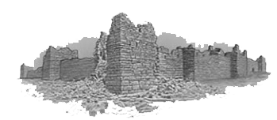
Laying Out the 70 Weeks (70 “7’s”)
²⁴ “Seventy weeks (sevens) are determined
For your people and for your holy city,
To finish the transgression,
²⁷ But in the middle of the week
He shall bring an end to sacrifice
& offering
²⁵ Command to
Restore &
Build Jerusalem
Zerubbabel
Ezra
Nehemiah
²⁵ Until Messiah the Prince
Between the Testaments
7
Weeks
95 yrs
440 yrs
74 yrs
62 Weeks
1
Week
539 BC
444 BC
4 BC
70 AD
²⁷ And on the wing of abominations shall be one who makes desolate
²⁵ Even in troublesome times

Slide 10
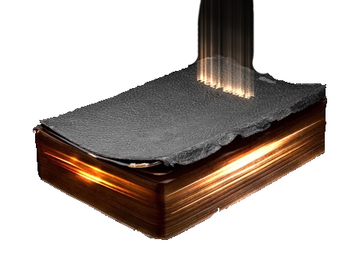
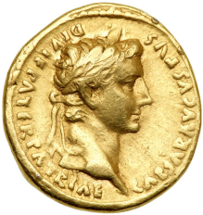
Daniel 10:14(NKJV)
¹⁴Now I have come to make you understand what will happen to your people in the latter days, for the vision refers to many days yet to come.”
Daniel
539 BC
530-522 522 522-486 486-465
336-323
323
274 – 271
~246 death
246-241
240
240-187
217
204
198
197-190 BC
187
178
175-164
~175
168
167
166-37
37-4AD
31 BC
14 AD
Book of Daniel a Survival Guide for
Between the
Testaments
Visions
Emperor
Augustus
4th Kingdom
Jesus about 18 yrs old

Slide 11
Outline of Chapter 10 & 11
Chapter 10
1–3 Setting of the Vision
4–9 Vision of Heavenly Messenger
10-13 Daniel’s Recovery
14-17 What Message is about & Further Effect on Daniel
18–21 Strengthened by Heavenly Messenger
Chapter 11
1–4 Four Persian Kings & Alexander the Great to Come
5–20 Conflict of Greek Kings of North & South
21-35 Antiochus Epiphanes
36-45 Willful King/Roman Empire

Slide 12
Setting of the Vision
536 BC
Daniel 10:1-3 (NKJV)
¹In the third year of Cyrus king of Persia a message was revealed to Daniel, whose name was called Belteshazzar.
The message was true, but the appointed time was long; and
he understood the message, and had understanding of the vision.
²In those days I, Daniel, was mourning three full weeks.
³I ate no pleasant food, no meat or wine came into my mouth,
nor did I anoint myself at all, till three whole weeks were fulfilled.
,

Slide 13
Vision of Heavenly Messenger
(Passover)
Daniel 10:4-6(NKJV)
⁴Now on the twenty-fourth day of the first month, as I was by the side of the great river, that is, the Tigris,
⁵I lifted my eyes and looked, and behold, a certain man clothed in linen, whose waist was girded with gold of Uphaz!
⁶His body was like beryl, his face like the appearance of lightning, his eyes like torches of fire, his arms and feet like burnished bronze in color, and the sound of his words like the voice of a multitude.

Slide 14
Vision of Heavenly Messenger
(Passover)
Daniel 10:4-6(NKJV)
⁴Now on the twenty-fourth day of the first month, as I was by the side of the great river, that is, the Tigris,
⁵I lifted my eyes and looked, and behold, a certain man clothed in linen, whose waist was girded with gold of Uphaz!
⁶His body was like beryl, his face like the appearance of lightning, his eyes like torches of fire, his arms and feet like burnished bronze in color, and the sound of his words like the voice of a multitude.
Revelation 1:13-15(NKJV)
¹³and in the midst of the seven lampstands One like the Son of Man,
clothed with a garment down to the feet and girded about the chest with a golden band.
¹⁴His head and hair were white like wool, as white as snow, and His eyes like a flame of fire;
¹⁵His feet were like fine brass, as if refined in a furnace, and His voice as the sound of many waters;

Slide 15
Vision of Heavenly Messenger
Daniel 10:7-9(NKJV)
⁷And I, Daniel, alone saw the vision,
for the men who were with me did not see the vision;
but a great terror fell upon them,
so that they fled to hide themselves.
⁸Therefore I was left alone when I saw this great vision,
and no strength remained in me;
for my vigor was turned to frailty in me,
and I retained no strength.
⁹Yet I heard the sound of his words; and while I heard the sound of his words I was in a deep sleep on my face, with my face to the ground.

Slide 16
Daniel’s Recovery
Daniel 10:10-13(NKJV)
¹⁰Suddenly, a hand touched me,
which made me tremble on my knees and on the palms of my hands.
¹¹And he said to me,
“O Daniel, man greatly beloved,
understand the words that I speak to you,
and stand upright, for I have now been sent to you.”
While he was speaking this word to me, I stood trembling.
¹³But the prince of the kingdom of Persia withstood me twenty-one days;
and behold, Michael, one of the chief princes,
came to help me, for I had been left alone there with the kings of Persia.

Slide 17
What Message is about
& Further Effect on Daniel
Daniel 10:14-17(NKJV)
¹⁴Now I have come to make you understand what will happen to your people in the latter days, for the vision refers to many days yet to come.”
¹⁵When he had spoken such words to me,
I turned my face toward the ground and became speechless.
¹⁶And suddenly, one having the likeness of the sons of men touched my lips;
then I opened my mouth and spoke, saying to him who stood before me, “My lord, because of the vision my sorrows have overwhelmed me,
and I have retained no strength.
¹⁷For how can this servant of my lord talk with you, my lord?
As for me, no strength remains in me now, nor is any breath left in me.”

Slide 18
Strengthened by Heavenly Messenger
Daniel 10:18-21& 11:1(NKJV)
¹⁸Then again, the one having the likeness of a man touched me and strengthened me.
¹⁹And he said, “O man greatly beloved, fear not!
Peace be to you; be strong, yes, be strong!”
So when he spoke to me I was strengthened, and said,
“Let my lord speak, for you have strengthened me.”
Daniel 10:19(ESV)
¹⁹And he said, “O man greatly loved, fear not,
peace be with you; be strong and of good courage.”
And as he spoke to me, I was strengthened and said,
“Let my lord speak, for you have strengthened me.”

Slide 19
Strengthened by Heavenly Messenger
Daniel 10:18-21& 11:1(NKJV)
¹⁸Then again, the one having the likeness of a man touched me and strengthened me.
¹⁹And he said, “O man greatly beloved, fear not!
Peace be to you; be strong, yes, be strong!”
So when he spoke to me I was strengthened, and said,
“Let my lord speak, for you have strengthened me.”
²⁰Then he said, “Do you know why I have come to you?
And now I must return to fight with the prince of Persia;
and when I have gone forth, indeed the prince of Greece will come.
²¹But I will tell you what is noted in the Scripture of Truth. (No one upholds me against these, except Michael your prince. ¹“Also in the first year of Darius the Mede, I, even I, stood up to confirm and strengthen him.)

Slide 20
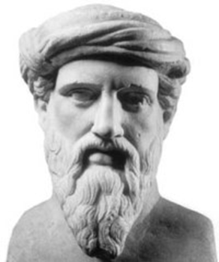
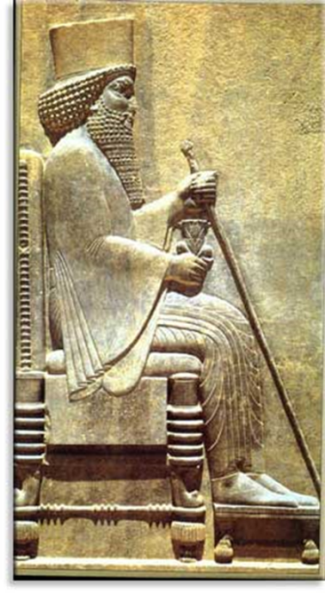
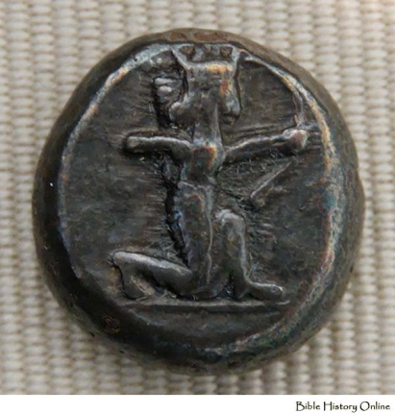
Four Persian Kings
& Alexander the Great to Come
Cambyses II
Vs 2
three more kings shall arise in Persia, and a fourth… shall stir up all against the kingdom of Greece
530-522 BC Cambyses II (conquers Egypt)
522 Bardiya (Smerdis) Imposter/Ursurper
522-486 Darius I
(490 invasion of Greece)
486-465 Xerxes I (Ahasuerus)
– 480 invasion of Greece/Esther
480/479 BC Persians defeated at Thermopylae & Salamis
Silver shekel by King Darius I,
showing King of Persia firing his bow
Xerxes I

Slide 21
Bible Events & Persians
Persian Ruler | Dates | Scripture | Fill In Bible Event
 | 740-690 BC | Isaiah 44:28, 45:1
Cyrus | 539-530 BC | 2 Chr 36:22-23
 |  | Daniel 1:21
 |  | Daniel 10:1
Cambyses II | 530-522 BC |  | 526 BC Conquers Egypt
Darius I | 522-486 BC |  | 500 BC Height of Persian Power 490 BC Persians defeat at Marathon
 |  | Ezra 4:4-5
 |  | Ezra 4:24-6:12
 |  | Haggai 1:1
 |  | Zechariah 1:1
Xerxes I (Ahasuerus) | 486-465 BC |  | 480/479 BC Persians defeated at Thermopylae & Salamis
 |  | Ezra 4:6
 |  | Esther
Artaxerxes I | 464-423 BC |  | Greek Golden Age 461-431 BC Prophecy of Malachi 433 BC Peloponnesian Wars Start 431 BC
 |  | Nehemiah 2:1-8
Darius II | 423-404 BC |  | Peloponnesian Wars Ends 404 BC
Cyrus –rebuild Jerusalem/Temple
Cyrus –declares Israel can go back
Daniel in Babylon till 1st year of Cyrus
Daniel has vision in 3rd year of Cyrus
discouraged the people of Judah
work on house of God in Jerusalem stopped
work on house of God in Jerusalem
Visions from the Lord
inhabitants of Judah and Jerusalem accused
Esther made Queen/saves people
Let me go and rebuild walls

Slide 22
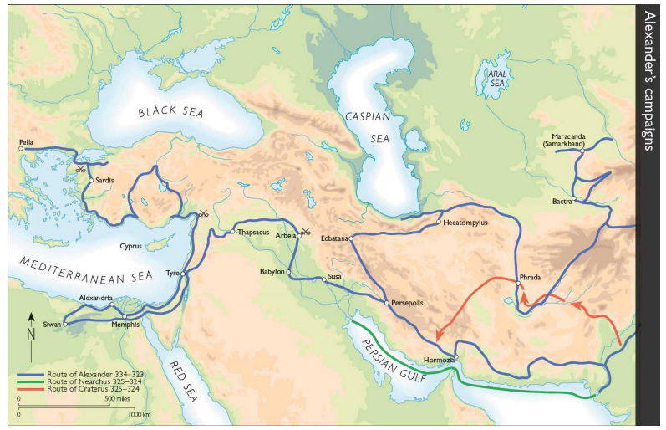
11:3
Then a mighty king shall arise, who shall rule with great dominion and do as he wills. – Alexander the Great 336-323 BC

Slide 23
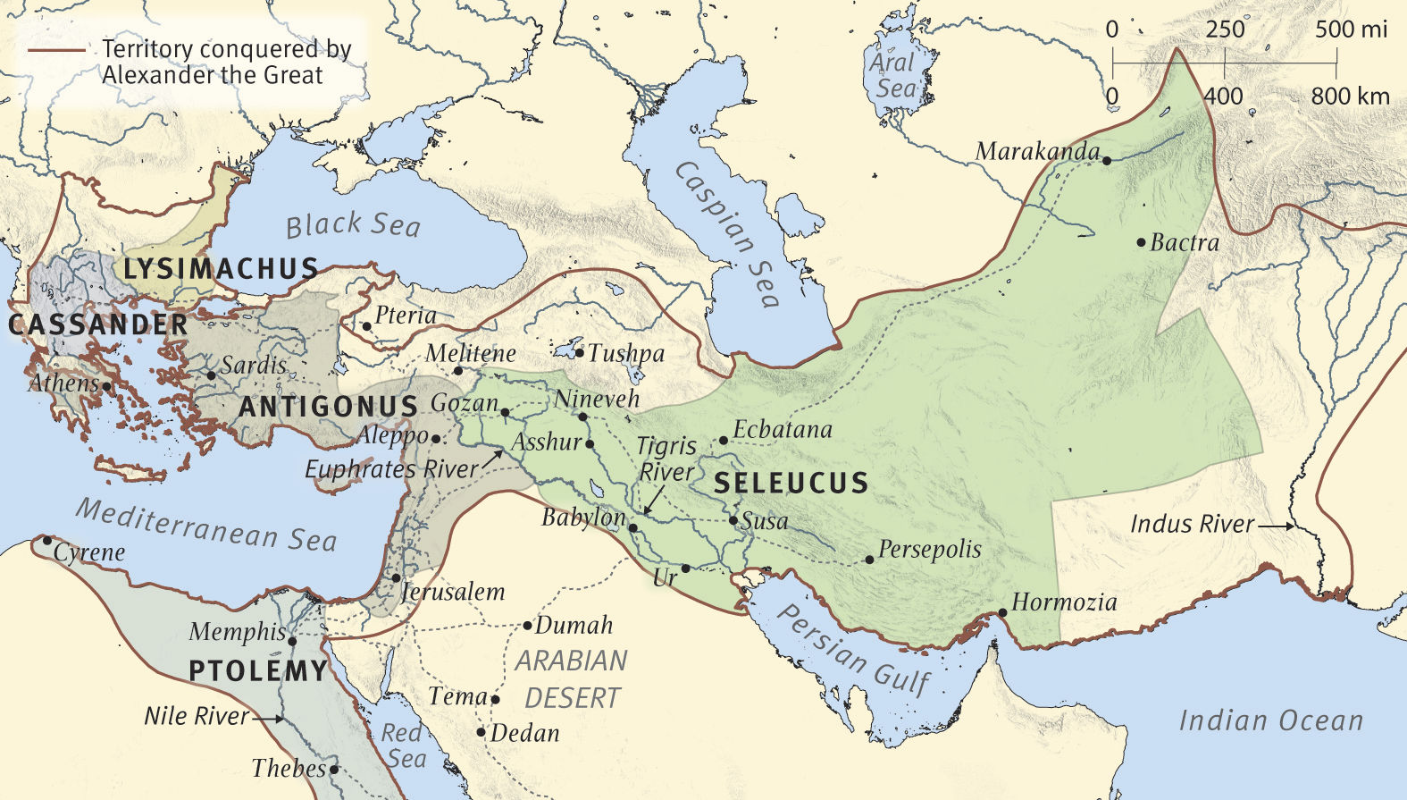
Vs 4 as soon as he has arisen, his kingdom shall be broken and divided toward the four winds of heaven
– kingdom divided 4 ways
1) Lysimachus 3) Seleucus I
2) Cassander son of Antipater 4) Ptolemy I

Slide 24
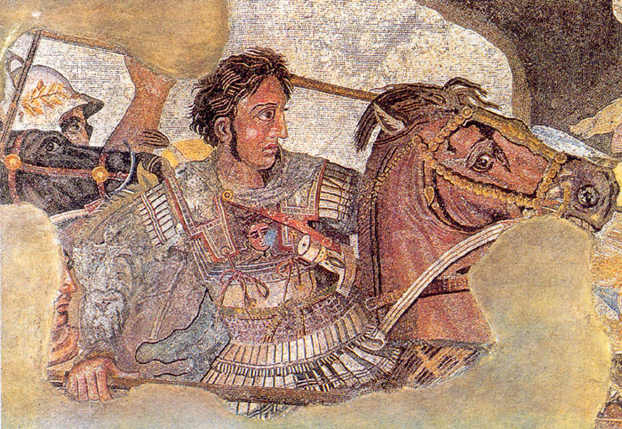
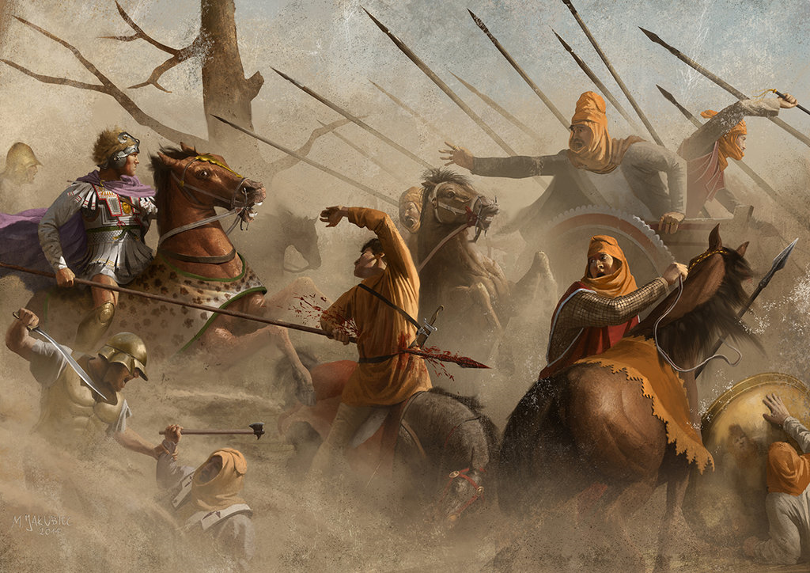
Vs 4 but not to his posterity
– Alexander’s wife & son born posthumously
son & wife murdered – 323 BC
315 BC Maath
315 BC Zadok
290BC Naggai

Slide 25
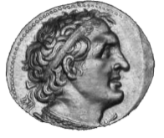
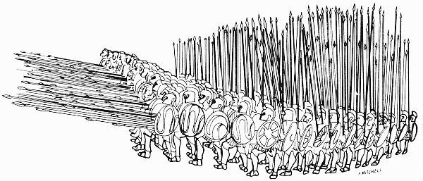
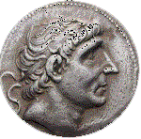
Vs 5 Then the king of the south shall be strong,
but one of his princes shall be stronger than he
and shall rule
Ptolemy I of Egypt
& Seleucus I of Syria prince stronger –
1st Syrian War
a major victory for the Ptolemies via
Ptolemy II (285-246 BC)
vs
Antiochus Soter I (280-261 BC)
First Syrian War (274 – 271 BC)
Second Syrian War (260 – 253 BC)
Third Syrian War (246 – 241 BC)
Fourth Syrian War (219 – 217 BC)
Fifth Syrian War (202 – 195 BC)
Sixth Syrian War (170 – 168 BC)
Seleucids would become stronger by end
265 BC Esli
270 BC Achim

Slide 26

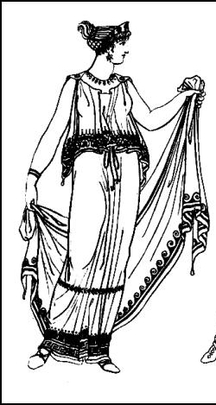
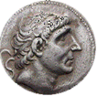
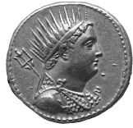
X
X
Ptolemy II
(285-246 BC)
Marries Berenice
Daughter of Ptolemy II
Ptolemy III
(246-221 BC)
Antiochus II Theos
(261-246 BC)
(246 BC)
Vs 6
After some years they shall make an alliance, and the daughter of the king of the south shall come to the king of the north to make an agreement. But she shall not retain the strength of her arm, and he and his arm shall not endure
Berenice Daughter of Ptolemy II marries
Antiochus II
but his former wife (Laodice)poisons both–
Starts 3rd Syrian War (246-241 BC)

Slide 27

(Seleucus II son of Laodice who had poisoned Ptolemy II & Berenice & their son)
Ptolemy III
(246-221 BC)
Selucus II
(246-226 BC)
Vs 7-8
He shall come against the army and enter the fortress of the king of the north, and he shall deal with them and shall prevail. He shall also carry off to Egypt their gods with their metal images and their precious vessels of silver and gold, and for some years he shall refrain from attacking the king of the north.
– Ptolemy III (Berenice’s brother) defeats Seleucus II victoriously to captured Antioch and marched all the way to Bactria and also defeated the Seleucid navy in the Aegean, recapturing the former conquests of his father in Asia Minor
Ptolemy III went on to recapture the treasures that had been looted from Egypt in the days of Cambyses
(246 – 241 BC 3rd Syrian War)
Notes:
Ptolemy III Euergetes organized a campaign to avenge the murder of his sister. He captured Antioch and marched all the way to Bactria and also defeated the Seleucid navy in the Aegean, recapturing the former conquests of his father in Asia Minor.

Slide 28
(Seleucus II son of Laodice who had poisoned Ptolemy II & Berenice & their son)
Ptolemy III
(246-221 BC)
Selucus II
(246-226 BC)
Vs 9
Then the latter shall come into the realm of the king of the south but shall return to his own land.
– Seleucus II counter attacks but is defeated
240BC
240 BC Nahum
Notes:
Ptolemy III Euergetes organized a campaign to avenge the murder of his sister. He captured Antioch and marched all the way to Bactria and also defeated the Seleucid navy in the Aegean, recapturing the former conquests of his father in Asia Minor.

Slide 29
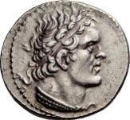
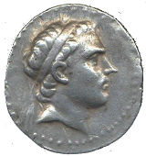
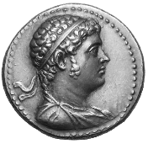
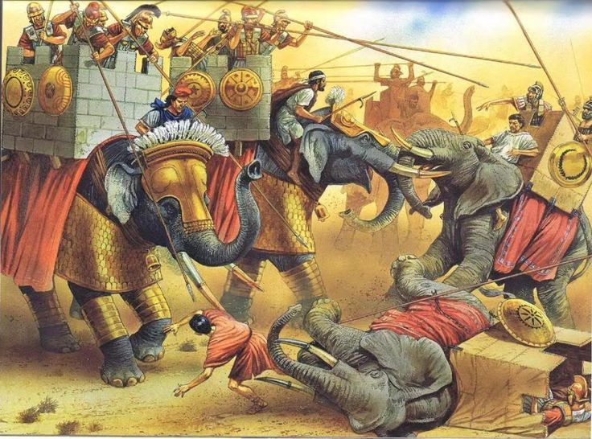
Ptolemy IV
(221-203 BC)
Antiochus III
(223-187 BC)
Ptolemy V
(203-181 BC)
Vs 10
His sons shall wage war and assemble a multitude of great forces, which shall keep coming and overflow and pass through, and again shall carry the war as far as his fortress.
4th Syrian Wars – 219-217 BC
5th Syrian Wars – 202-195 BC
Antiochus’ III early campaigns against the Ptolemaic Kingdom were unsuccessful, but later years Antiochus gained several military victories
240-187 BC
First Syrian War (274 – 271 BC)
Second Syrian War (260 – 253 BC)
Third Syrian War (246 – 241 BC)
Fourth Syrian War (219 – 217 BC)
Fifth Syrian War (202 – 195 BC)
Sixth Syrian War (170 – 168 BC)
Notes:
Ptolemy III Euergetes organized a campaign to avenge the murder of his sister. He captured Antioch and marched all the way to Bactria and also defeated the Seleucid navy in the Aegean, recapturing the former conquests of his father in Asia Minor.

Slide 30
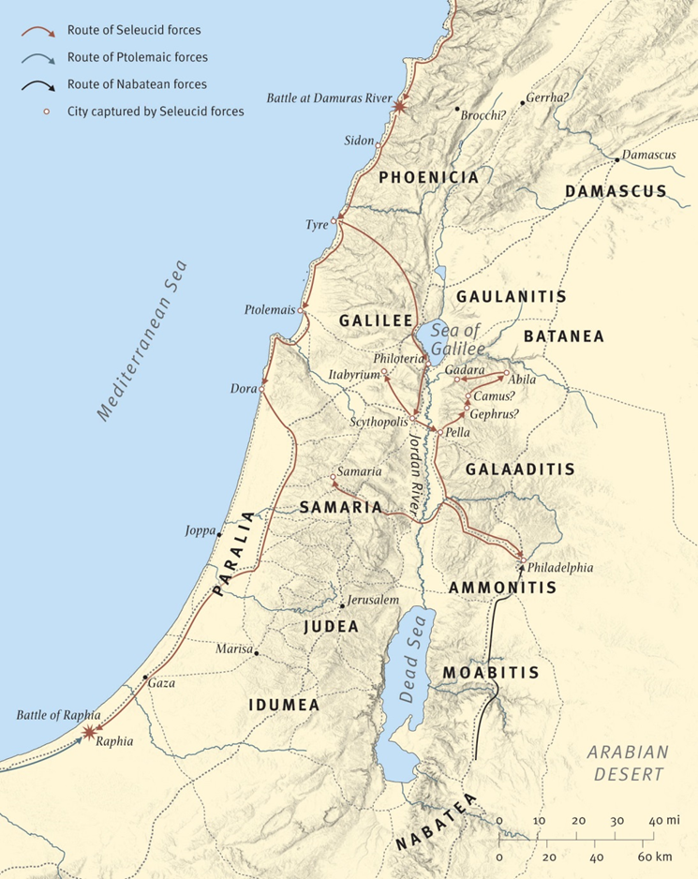
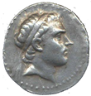
Dan 11 | Year | Event
11 | 217 | Then the king of the south, moved with rage, shall come out and fight with the king of the north. (Battle of Raphia)– Ptolemy IV defeats Antiochus III – 4th Syrian War
215 BC Amos
225 BC Eluid
According to Polybius,
Battle of Raphia – 217 BC
Ptolemy IV had 70,000 infantry, 5,000 cavalry, and 73 war elephants
Antiochus III had 62,000 infantry, 6,000 cavalry, and 102 elephants

Slide 31
Ptolemy IV
(221-203 BC)
Antiochus III
(223-187 BC)
Vs 13
For the king of the north shall again raise a multitude, greater than the first.
And after some years he shall come on with a great army and abundant supplies.
Antiochus III now succeeds with Macedonian help
204BC
Vs 14
the violent among your own people shall lift themselves up in order to fulfill the vision, but they shall fail –
Some Jews allay themselves with Antiochus III
Notes:
Ptolemy III Euergetes organized a campaign to avenge the murder of his sister. He captured Antioch and marched all the way to Bactria and also defeated the Seleucid navy in the Aegean, recapturing the former conquests of his father in Asia Minor.

Slide 32
Ptolemy V
(203-181 BC)
Antiochus III
(223-187 BC)
198BC
Cleopatra I
Vs 15 Then the king of the north shall come and throw up siege works and take a well-fortified city. – Antiochus III takes Sidon
Vs 16 He shall stand in the Glorious Land with destruction in his power. & Palestine
Vs 17 He shall give him the daughter of women to destroy the kingdom, but it shall not stand or be to his advantage – Antiochus III gives daughter to Ptolemy V but she sides with husband -
Notes:
Ptolemy III Euergetes organized a campaign to avenge the murder of his sister. He captured Antioch and marched all the way to Bactria and also defeated the Seleucid navy in the Aegean, recapturing the former conquests of his father in Asia Minor.

Slide 33
Ptolemy V
(203-181 BC)
Antiochus III
(223-187 BC)
198BC
Cleopatra I
Vs 15 Then the king of the north shall come and throw up siege works and take a well-fortified city. – Antiochus III takes Sidon
Vs 16 He shall stand in the Glorious Land with destruction in his power. & Palestine
Vs 17 He shall give him the daughter of women to destroy the kingdom, but it shall not stand or be to his advantage – Antiochus III gives daughter to Ptolemy V but she sides with husband -
Notes:
Ptolemy III Euergetes organized a campaign to avenge the murder of his sister. He captured Antioch and marched all the way to Bactria and also defeated the Seleucid navy in the Aegean, recapturing the former conquests of his father in Asia Minor.

Slide 34
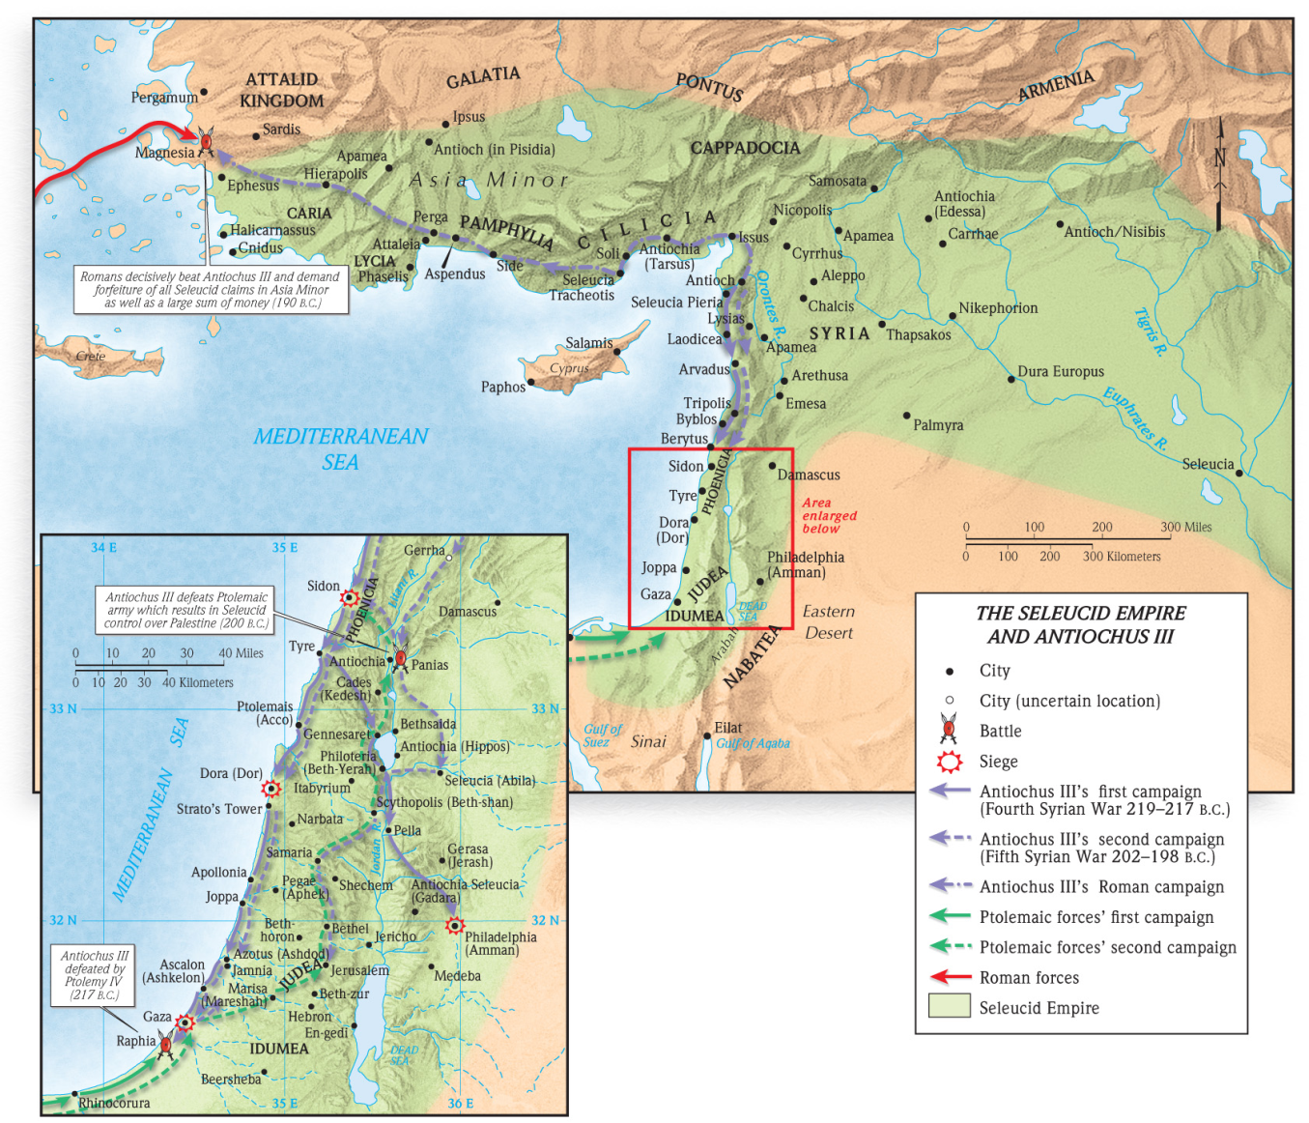
Antiochus III
(223-187 BC)
197-190 BC
Vs 18
he shall turn his face to the coastlands and shall capture many of them, but a commander shall put an end to his insolence –
Antiochus III takes Asia Minor, Thrace, Greece-defeated by Romans at Thermopylae in 191 & Lucius Scipio defeats him at Magnesium in 190

Slide 35
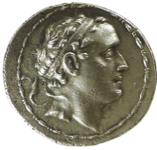
Antiochus III
(223-187 BC)
Vs 19
but he shall stumble and fall, and shall not be found
– Antiochus III assassinated by his own people
187 BC
Seleucus IV
(187-175 BC)
Vs 20
Then shall arise in his place one who shall send an exactor of tribute for the glory of the kingdom. But within a few days he shall be broken, neither in anger nor in battle – Seleucus IV sends Heliodorus to tax Jews & seize temple treasure to pay the Romans instead he is poisoned
Notes:
Ptolemy III Euergetes organized a campaign to avenge the murder of his sister. He captured Antioch and marched all the way to Bactria and also defeated the Seleucid navy in the Aegean, recapturing the former conquests of his father in Asia Minor.

Slide 36
190 BC Mattathiah
180 BC Eleazar

Slide 37
165BC Joseph
140 BC Janna
135 BC Matthan
115BC Melchi
90 BC Levi
90 BC Jacob
70 BC Matthat
45 BC Heli
45 BC Joseph
20 BC Mary
4 BC Jesus
Dates estimated

Slide 38
