Slide 1
Lessons from the Book of Second Joshua
March 4, 2012

Slide 2
#1
#3
#4
Creation & Fall
Exodus & Conquest
Kings & Prophets
Life of Jesus
#5
The Patriarchs
The
Judges
Exile & Return
Early Church
#2
Law
History
Gospels
Acts
Wisdom
Letters
Prophets
Rev

Slide 3
Law
History
Wisdom
Old Testament – 39
New Testament – 27
Total – 66
Major Prophets
Minor Prophets
Gospels
Acts
Letters
Rev

Slide 4
Joshua Continues Moses’ Leadership
“On that day the Lord exalted Joshua in the sight of all Israel; and they feared him, as they had feared Moses, all the days of his life.” (Josh 4:14)
“As the Lord had commanded Moses his servant, so Moses commanded Joshua, and so Joshua did. He left nothing undone of all that the Lord had commanded Moses.” (Josh 11:15)

Slide 5
Moses → Joshua → Success!
II Joshua
Obedience & Trust
Peace & Plenty
Joshua
“Strong and Courageous”
Land Conquered & Settled
Commitment to Faithfulness
Moses
Deliverance from Egypt
Law Given
Rebellions Overcome
New Generation, ready to conquer

Slide 6
Law
Genesis
Exodus
Leviticus
Numbers
Deuteronomy
II Joshua
Joshua
Judges
Ruth
I Samuel
II Samuel
I Kings
II Kings
I Chronicles
II Chronicles
Ezra
Nehemiah
Esther
History

Slide 7
Deuteronomy 7:12-15
¹² “Then it shall come to pass, because you listen to these judgments, and keep and do them, that the Lord your God will keep with you the covenant and the mercy which He swore to your fathers. ¹³ And He will love you and bless you and multiply you; He will also bless the fruit of your womb and the fruit of your land, your grain and your new wine and your oil, the increase of your cattle and the offspring of your flock, in the land of which He swore to your fathers to give you. ¹⁴ You shall be blessed above all peoples; there shall not be a male or female barren among you or among your livestock. ¹⁵ And the Lord will take away from you all sickness, and will afflict you with none of the terrible diseases of Egypt which you have known, but will lay them on all those who hate you.

Slide 8
Deuteronomy 28:7-10
⁷ “The Lord will cause your enemies who rise against you to be defeated before your face; they shall come out against you one way and flee before you seven ways.
⁸ “The Lord will command the blessing on you in your storehouses and in all to which you set your hand, and He will bless you in the land which the Lord your God is giving you.
⁹ “The Lord will establish you as a holy people to Himself, just as He has sworn to you, if you keep the commandments of the Lord your God and walk in His ways. ¹⁰ Then all peoples of the earth shall see that you are called by the name of the Lord, and they shall be afraid of you.

Slide 9
Lessons from Second Joshua
The people were blessed because they were:
Unified & guided by God, not men.
No central human leader (Jg 1:1)
Led by faith-filled people, when required (1:2)
No competition (Num 11:25-29)
Every Generation “Knew God” (Jg 3:9)

Slide 10
Knowing God – Deuteronomy 4
7 – Near
15 – Spiritual
24 – Jealous
31 – Merciful (to those who turn)
35 – Exclusive
36-37 – Mighty & Powerful
39 – Transcendent
God was their King!

Slide 11
Lessons from Second Joshua
The people were blessed because they were:
Unified & guided by God, not men.
Carefully obedient to the written Word.

Slide 12
Deuteronomy 5:32-33
Therefore you shall be careful to do as the Lord your God has commanded you; you shall not turn aside to the right hand or to the left. You shall walk in all the ways which the Lord your God has commanded you, that you may live and that it may be well with you, and that you may prolong your days in the land which you shall possess.

Slide 13
Joshua 8:34-35
Afterward, Joshua read all the words of the law—the blessings and the curses—just as it is written in the Book of the Law. ³⁵ There was not a word of all that Moses had commanded that Joshua did not read to the whole assembly of Israel, including the women and children, and the foreigners who lived among them.

Slide 14
Joshua 23:6
Therefore be very courageous to keep and to do all that is written in the Book of the Law of Moses, lest you turn aside from it to the right hand or to the left.

Slide 15
Lessons from Second Joshua
The people were blessed because they were:
Unified & guided by God, not men.
Carefully obedient to the written Word.
Not following own judgment (Deut 12:8)
Not adding or taking away (Deut 12:28, 32)
Willing to challenge one another (Josh 22:10)

Slide 16
Lessons from Second Joshua
The people were blessed because they were:
Unified & guided by God, not men.
Carefully obedient to the written Word.
Intensely separated from false religions.

Slide 17
Exodus 34:10-16
Take heed to yourself, lest you make a covenant with the inhabitants of the land where you are going, lest it be a snare in your midst. ¹³ But you shall destroy their altars, break their sacred pillars, and cut down their wooden images ¹⁴ (for you shall worship no other god, for the Lord, whose name is Jealous, is a jealous God), ¹⁵ lest you make a covenant with the inhabitants of the land, and they play the harlot with their gods and make sacrifice to their gods, and one of them invites you and you eat of his sacrifice, ¹⁶ and you take of his daughters for your sons, and his daughters play the harlot with their gods and make your sons play the harlot with their gods.

Slide 18
Deuteronomy 7:2-5
And when the Lord your God delivers them over to you, you shall conquer them and utterly destroy them. You shall make no covenant with them nor show mercy to them. ³ Nor shall you make marriages with them. You shall not give your daughter to their son, nor take their daughter for your son. ⁴ For they will turn your sons away from following Me, to serve other gods; so the anger of the Lord will be aroused against you and destroy you suddenly. ⁵ But thus you shall deal with them: you shall destroy their altars, and break down their sacred pillars, and cut down their wooden images, and burn their carved images with fire.

Slide 19
Joshua 23:11-13
Therefore take careful heed to yourselves, that you love the Lord your God. ¹² Or else, if indeed you do go back, and cling to the remnant of these nations—these that remain among you—and make marriages with them, and go in to them and they to you, ¹³ know for certain that the Lord your God will no longer drive out these nations from before you. But they shall be snares and traps to you, and scourges on your sides and thorns in your eyes, until you perish from this good land which the Lord your God has given you.

Slide 20
Is this Racism?

Slide 21
Exodus 22:20-21
²⁰ “He who sacrifices to any god, except to the Lord only, he shall be utterly destroyed.
²¹ “You shall neither mistreat a stranger nor oppress him, for you were strangers in the land of Egypt.

Slide 22
Lessons from Second Joshua
The people were blessed because they were:
Unified & guided by God, not men.
Carefully obedient to the written Word.
Intensely separated from false religions.
Purged all traces of false worship (Josh 11:14-15)
Relationships based on common faith (Jg 3:6-7)
Purified even their own families (Dt 13:6-11)

Slide 23
Lessons from Second Joshua
The people were blessed because they were:
Unified & guided by God, not men.
Carefully obedient to the written Word.
Intensely separated from false religions.
Trusting in God’s care.

Slide 24
Deuteronomy 3:21-22
And I commanded Joshua at that time, saying, ‘Your eyes have seen all that the Lord your God has done to these two kings; so will the Lord do to all the kingdoms through which you pass. ²² You must not fear them, for the Lord your God Himself fights for you.’

Slide 25
Joshua 23:10
But you shall hold fast to the Lord your God, as you have done to this day. ⁹ For the Lord has driven out from before you great and strong nations; but as for you, no one has been able to stand against you to this day. ¹⁰ One man of you shall chase a thousand, for the Lord your God is He who fights for you, as He promised you.

Slide 26
Lessons from Second Joshua
The people were blessed because they were:
Unified & guided by God, not men.
Carefully obedient to the written Word.
Intensely separated from false religions.
Trusting in God’s care.
Not afraid to face enemies (Josh 23:10)
Not dependent on worldly measures (Josh 11:21)
Not dependent on worldly weapons (Josh 5:13)
Strengthened by repeated victories (Dt 3:21)

Slide 27
There is no Second Joshua.

Slide 28
Hebrews 4
then He would not afterward have spoken of another day. ⁹ There remains therefore a rest for the people of God. ¹⁰ For he who has entered His rest has himself also ceased from his works as God did from His.
⁸ For if Joshua had given them rest,

Slide 29
The Real Second Joshua – Hebrews 4
¹¹ Let us therefore be diligent to enter that rest, lest anyone fall according to the same example of disobedience. ¹² For the word of God is living and powerful, and sharper than any two-edged sword, piercing even to the division of soul and spirit, and of joints and marrow, and is a discerner of the thoughts and intents of the heart. ¹³ And there is no creature hidden from His sight, but all things are naked and open to the eyes of Him to whom we must give account.

Slide 30
The Real Second Joshua – Hebrews 4
¹⁴ Seeing then that we have a great High Priest who has passed through the heavens, Jesus the Son of God, let us hold fast our confession. ¹⁵ For we do not have a High Priest who cannot sympathize with our weaknesses, but was in all points tempted as we are, yet without sin. ¹⁶ Let us therefore come boldly to the throne of grace, that we may obtain mercy and find grace to help in time of need.

Slide 32
Key Points
Unified by their faith in God
No central organization
led by faith-filled people, as needed
“No King…everyone did that which was right in God’s eyes.”
Intensely separated from the World
Purged enemies & idolatry out (even from own families)
Formed no alliances, except with faithful people
Their purity & obedience were examples to the World around
Carefully obedient to God’s Laws
Remembered the consequences of obedience & disobedience
Every generation knew the Lord (Jg 2:10)
The word filled their lives (Levites, family study)
They worshiped as God instructed
Trusted in God’s care (Jg 2:7)
Content with the blessing in the land.
Not afraid to face enemies of God.
Did not depend on Worldly measures of strength
Were strengthened by their repeated victories

Slide 33
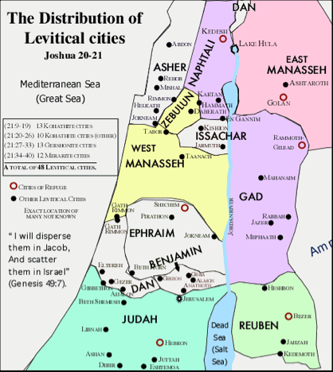
Cities of Refuge & Cities for Levites

Slide 34
“Strangers” in the Land

Slide 35
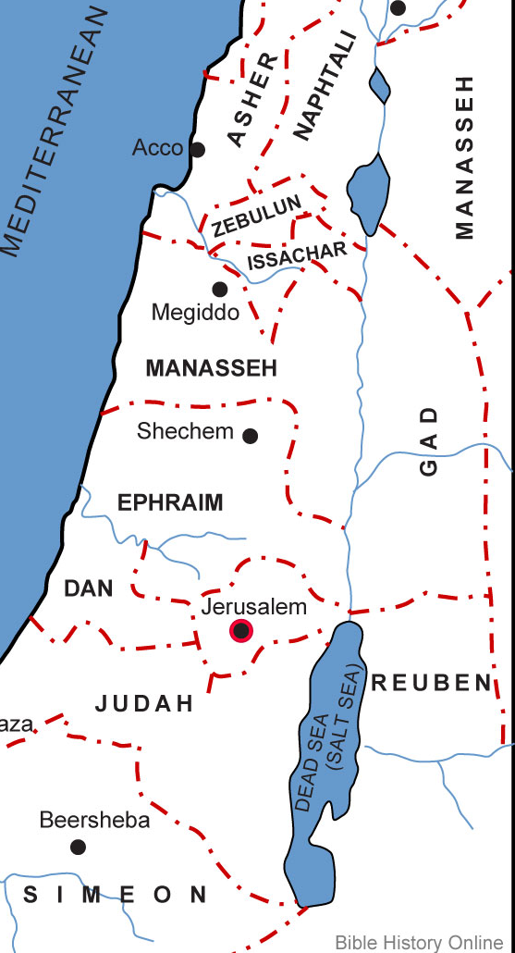
The Promised Land
Fully Captured & Divided
Idolatrous Inhabitants Destroyed

Slide 36
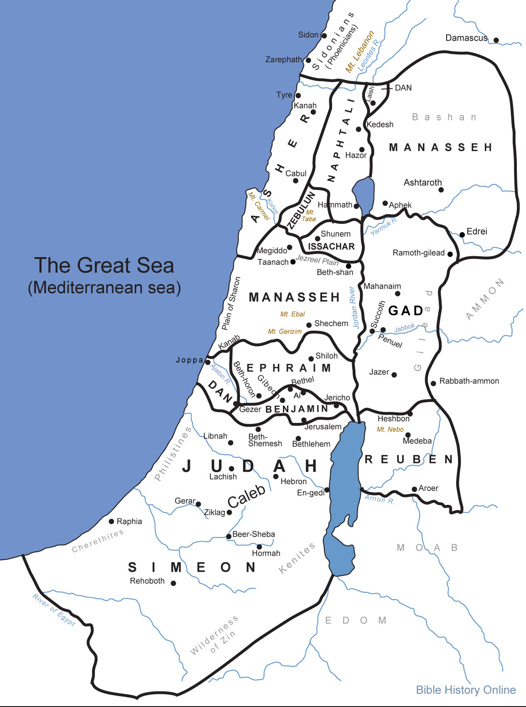
(Nothing has failed of the promises…)

