Slide 1
Paul at Mars Hill
Embry Hills – May 18, 2013

Slide 2
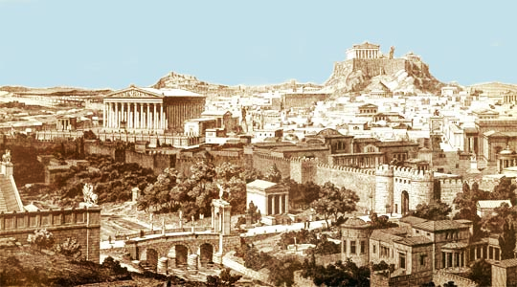

Slide 3
Epicureans & Stoics
Epicureans
Stoics
Gratifying desires is the highest good
No ‘good’ or ‘evil’
Agnostic: gods irrelevant & distant
Man as ‘matter only’ (No soul, no resurrection)
Mocked popular mythology
Virtue is the highest good
[Human] reason determined good & evil
Pantheistic: gods in nature
Man ‘reabsorbed’ at death
Temples, etc. = Art

Slide 4
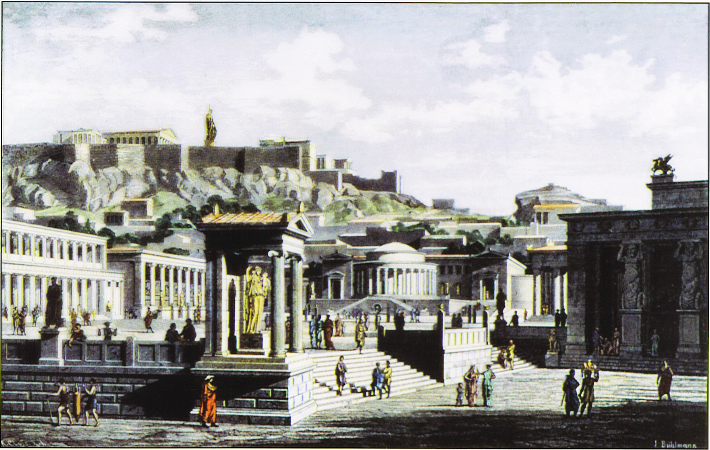

Slide 5
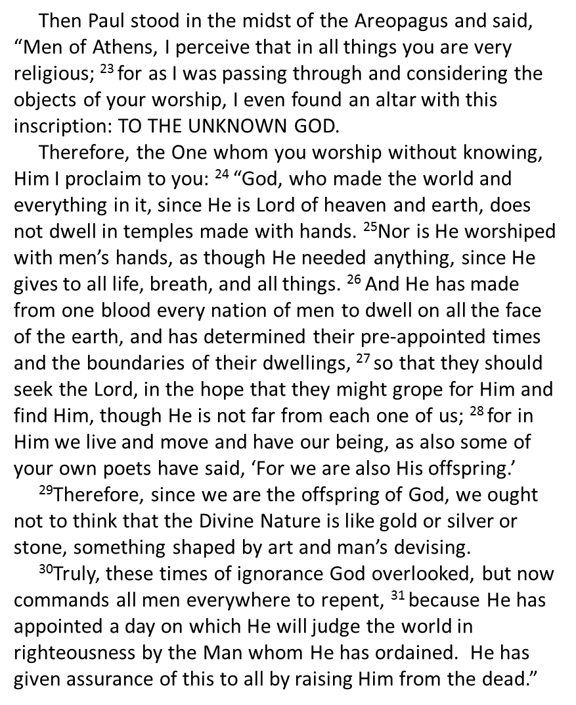
About God
Created Everything
(not other way around)

Slide 6
About God
Created Everything (not other way around)
Powerful & Active

Slide 7
About God
Created Everything (not other way around)
Powerful & Active
Personal & Near

Slide 8
About God
Created Everything (not other way around)
Powerful & Active
Personal & Near
Merciful & Just

Slide 9
About Mankind
One blood: same needs

Slide 10
About Mankind
One blood: same needs
Designed to seek God
Nevertheless He did not leave Himself without witness, in that He did good, gave us rain from heaven and fruitful seasons, filling our hearts with food and gladness. (Acts 14:17)

Slide 11
About Mankind
One blood: same needs
Designed to seek God
Mistaken about God
Men, why are you doing these things? We also are men with the same nature as you, and preach to you that you should turn from these useless things to the living God.. (Acts 14:17)

Slide 12
About Mankind
One blood: same needs
Designed to seek God
Mistaken about God
Able to change (repent)

Slide 13
About Evangelism
God-centered

Slide 14
About Evangelism
God-centered
Scripture-centered

Slide 15
Paul’s Old Testament References
Thus says God the Lord, Who created the heavens and stretched them out, Who spread forth the earth and that which comes from it, Who gives breath to the people on it, And spirit to those who walk on it… (Isaiah 42:5)
You alone are the Lord; You have made heaven, The heaven of heavens, with all their host, The earth and everything on it, The seas and all that is in them, And You preserve them all. (Neh 9:6)
But will God indeed dwell on the earth? Behold, heaven and the heaven of heavens cannot contain You. How much less this temple which I have built! (I Kings 8:27; Acts 7:48)
Have we not all one Father? Has not one God created us? (Mal 2:10)
When the Most High divided their inheritance to the nations, When He separated the sons of Adam, He set the boundaries of the peoples… (Dt 32:8)
“Am I a God near at hand,” says the Lord, “And not a God afar off?” (Jer 23:23)
And you have praised the gods of silver and gold, bronze and iron, wood and stone, which do not see or hear or know; and the God who holds your breath in His hand and owns all your ways, you have not glorified. (Dan 5:23b)
He shall judge the world in righteousness, And He shall administer judgment for the peoples in uprightness. (Ps 9:8)

Slide 16
About Evangelism
God-centered
Scripture-centered
Judgment-centered

Slide 17
About Evangelism
God-centered
Scripture-centered
Judgment-centered
Resurrection-centered

Slide 18
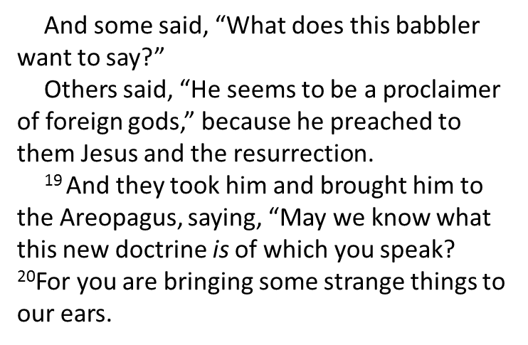
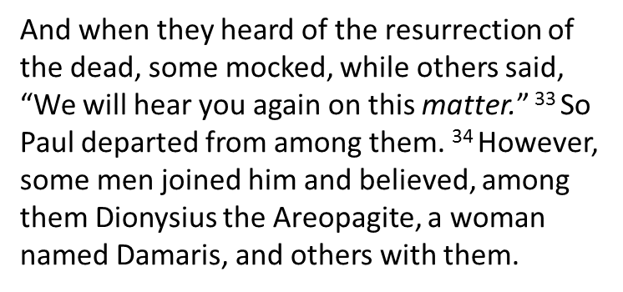
About Evangelism
God-centered
Scripture-centered
Judgment-centered
Resurrection-centered
Not Popular

Slide 20
ΑΓΝΩΣΤΩ ΘΕΩ
To the Unknown God
AGNOSTO THEO

Slide 21
