Slide 1
“I Am Divine Project”
Sierra Leone Trip, February 2012

Slide 4
Sierra Leone
Former British colony
Rich in natural resources
Major Ethnic Groups: Mende & Temne
Language: English (official), Mende, Temne, Krio (most used)
Religion: %60 Muslim, %10 Christian (est.)
Median Age: 19.1 years
Life Expectancy: 56.55 years
PPP = $800 (#218)

Slide 12
Small Group & Individual Studies

Slide 13
Small Group & Individual Studies

Slide 14
Small Group & Individual Studies

Slide 15
Small Group & Individual Studies

Slide 16
Small Group & Individual Studies

Slide 17
Teaching in Churches

Slide 18
Teaching in Churches

Slide 19
Teaching in Churches

Slide 20
Teaching in Churches

Slide 21
Teaching in Schools

Slide 22
Teaching in Schools

Slide 23
Teaching in Schools

Slide 24
Teaching on Radio

Slide 25
Teaching on Radio

Slide 26
Gondoma Barracks

Slide 27
Youth Studies

Slide 28
Thomas MacCauley

Slide 29
Mohammed Conteh

Slide 30
Frank

Slide 31
Mohammed Massaquoi (left) & Abraham Charles (right)

Slide 32
Victor Mbawah

Slide 33
Alhaji (L), James Paul (M), Kaikus (R)

Slide 34
Abdullah, Ansu, Abraham

Slide 35
Victor & Augustine

Slide 36
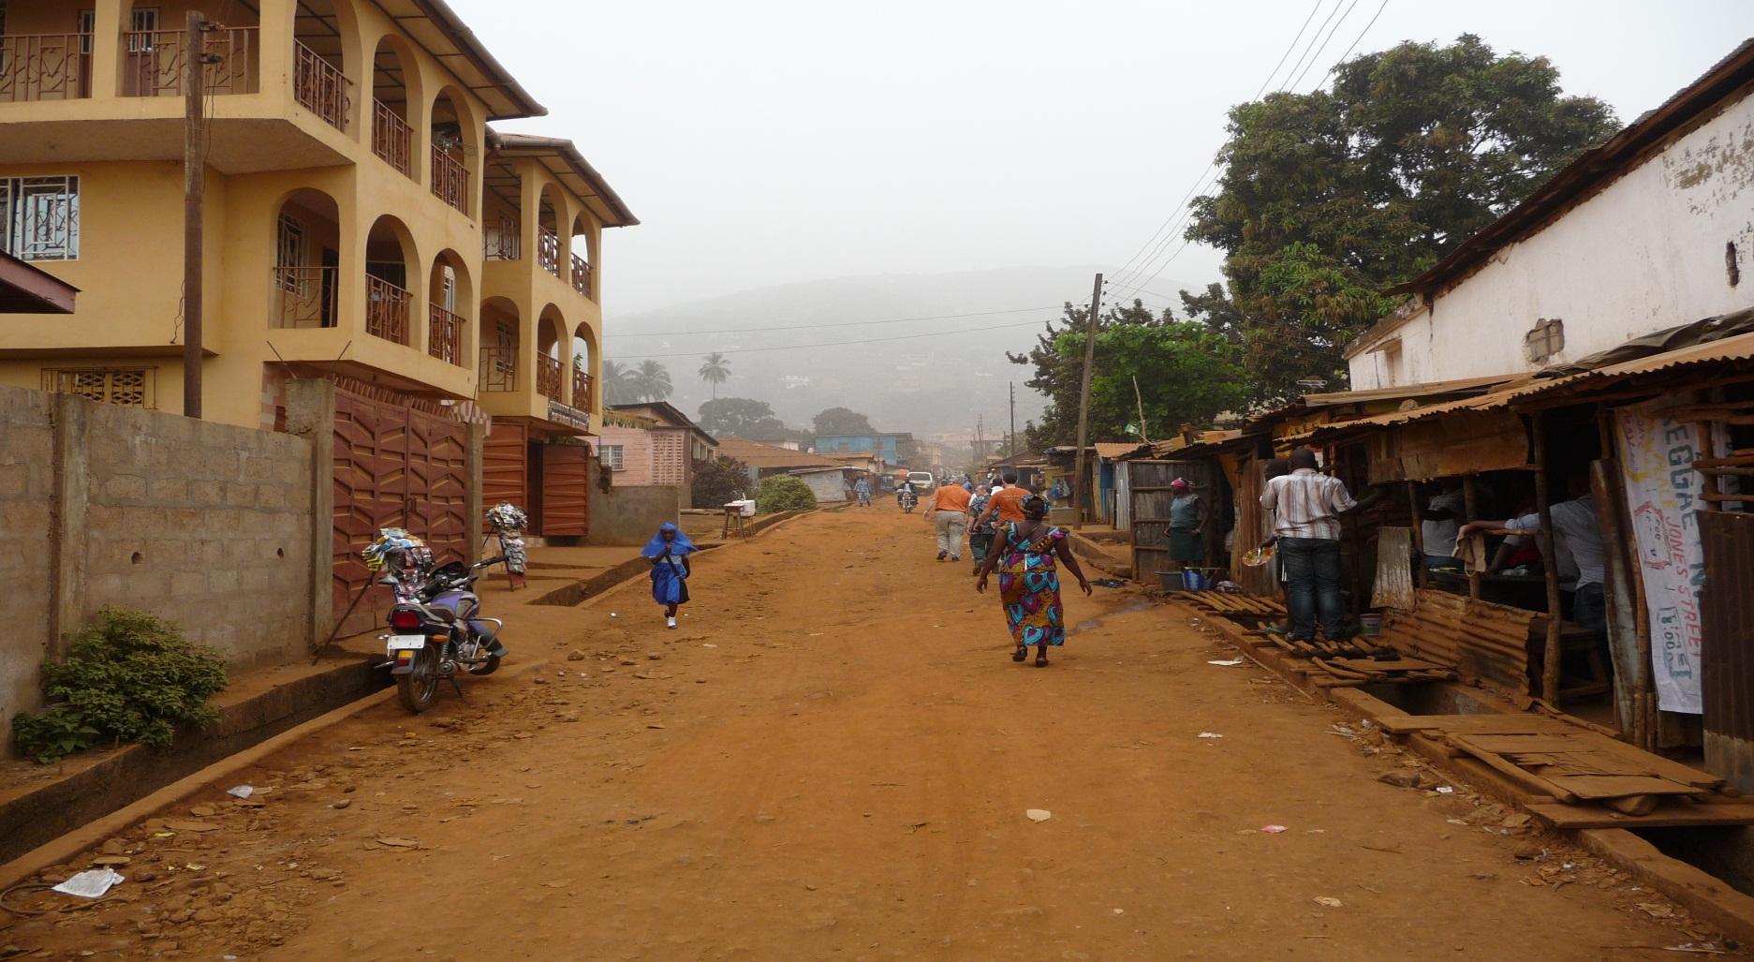
Hard Things
Poverty & Inequality

Slide 37
Hard Things
Poverty & Inequality
“Miracle-Workers”
Lack of Leadership/Experience

Slide 38
Lessons Learned
Real Faith: “As for me, I will ask the Lord…”
Evangelism: “I want you to have eternal life!”
What “church” Is All About
Thanksgiving: “How are you?” …
Determination & Optimism
Community Atmosphere
Desire for God

Slide 39
Lessons Learned

Slide 40
Lessons Learned
“preach the good news to every creature”

