Slide 1
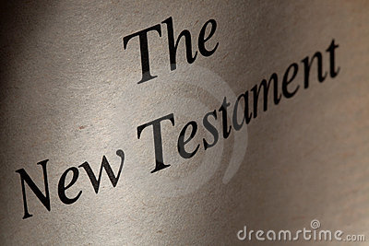

1
New Testament Survey
Summer, 2012
Embry Hills church of Christ

Slide 2
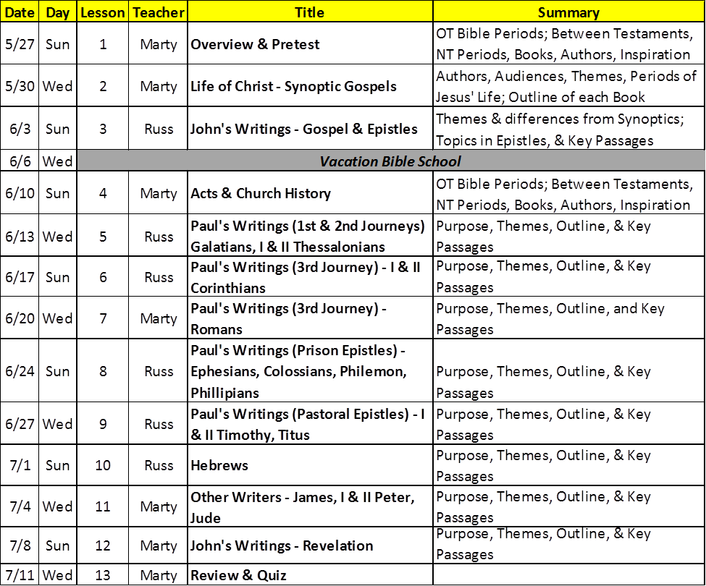
New Testament Course Schedule

Slide 3
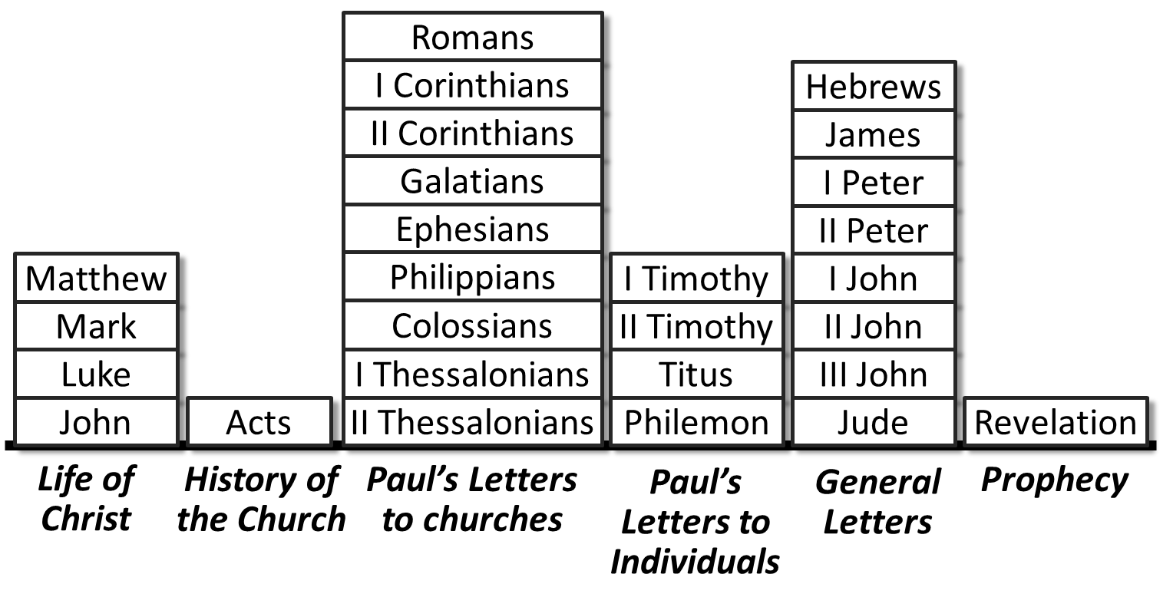
Course Goals
Build our knowledge of & interest in the historical and doctrinal context, the author, readers, purposes, content, character, and organization of each book of the New Testament, in order to:
  Motivate study
  Increase our ability to interpret the Word
  Increase our confidence & skills to teach others

Slide 4
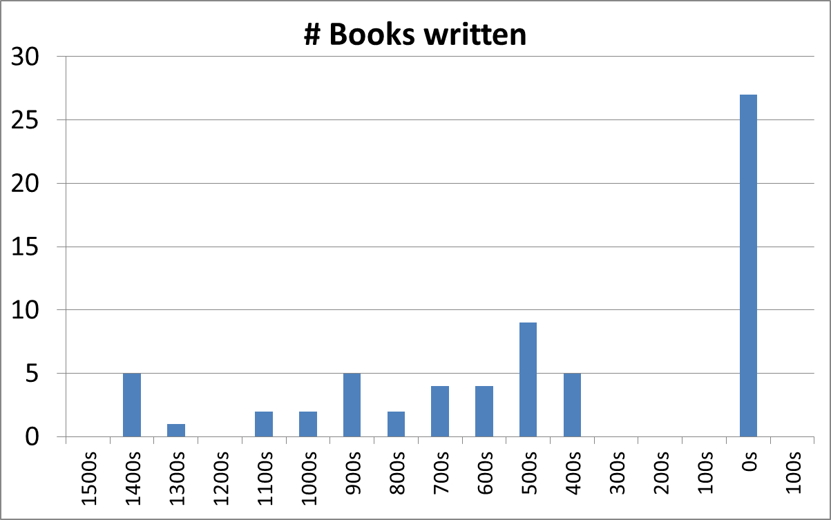
Distribution of Time of Writing of Bible Books
New Testament
Moses
History & Prophets
Poetry & Wisdom

Slide 5
Old Testament Preparation
Adam & Eve - Genesis 3:15 – “enmity between seeds”
Abraham - Genesis 12:3; 22:18 – “all families of the earth blessed”
David - II Sam 7:13; Ps 2, 110 – “establish the throne of David forever”
Prophets
  Is 42:1-7; 49:5-7 “Covenant to the peoples, light to Gentiles”
  Jer 31:31-34 “New covenant with Israel & Judah…”
  Ezek 34:11-24 “One shepherd, my servant David, over them”
  Dan 2:44 “In the days of those kings…”
  Mal 3:1; 4:4-6 “Messenger to prepare the way;” “send Elijah”
And beginning at Moses and all the Prophets, He expounded to them in all the Scriptures the things concerning Himself. (Lk 24:27)

Slide 6
Psalm 74
1 Why have you rejected us forever, O God?
Why does your anger smolder against the sheep of your pasture?
2 Remember the people you purchased of old,
the tribe of your inheritance, whom you redeemed—
Mount Zion, where you dwelt.
3 Turn your steps toward these everlasting ruins,
all this destruction the enemy has brought on the sanctuary.
4 Your foes roared in the place where you met with us;
they set up their standards as signs.
5 They behaved like men wielding axes
to cut through a thicket of trees.
6 They smashed all the carved paneling
with their axes and hatchets.
7 They burned your sanctuary to the ground;
they defiled the dwelling place of your Name.
8 They said in their hearts, "We will crush them completely!"
They burned every place where God was worshiped in the land.
9 We are given no miraculous signs;
no prophets are left, and none of us knows how long this will be.

Slide 7
Psalm 89
3 You said, "I have made a covenant with my chosen one, I have sworn to David my servant,
4 'I will establish your line forever and make your throne firm through all generations.' "
38 But you have rejected, you have spurned,
you have been very angry with your anointed one.
39 You have renounced the covenant with your servant and have defiled his crown in the dust.
40 You have broken through all his walls and reduced his strongholds to ruins.
41 All who pass by have plundered him; he has become the scorn of his neighbors.
42 You have exalted the right hand of his foes; you have made all his enemies rejoice.
43 You have turned back the edge of his sword and have not supported him in battle.
44 You have put an end to his splendor and cast his throne to the ground.
45 You have cut short the days of his youth; you have covered him with a mantle of shame.
46 How long, O LORD ? Will you hide yourself forever? How long will your wrath burn like fire?
47 Remember how fleeting is my life. For what futility you have created all men!
48 What man can live and not see death, or save himself from the power of the grave?
49 O Lord, where is your former great love, which in your faithfulness you swore to David?
50 Remember, Lord, how your servant has been mocked, how I bear in my heart the taunts of all the nations,
51 the taunts with which your enemies have mocked, O LORD, with which they have mocked every step of your anointed one.

Slide 8
Significance of Jewish History to the NT
Persian Period (466-333BC) – Return to the land, focus on Law, Scribes, Synagogues
Greek Period (333-323 BC) – Common language, philosophic thinking, high-priest rule
Egyptian Period (232-204 BC) – Septuagint translation of the Old Testament
Syrian Period (204-165 BC) – Palestine divided
Maccabean Period (165 – 63BC) – National pride, e.g. Feast of Dedication
Roman Period (63 BC →) – Herod’s temple, roads, travel, ‘civilization’

Slide 9
New Testament Revelation
“These things I have spoken to you while being present with you. ²⁶ But the Helper, the Holy Spirit, whom the Father will send in My name, He will teach you all things, and bring to your remembrance all things that I said to you. (John 14:25-26)
“I still have many things to say to you, but you cannot bear them now. ¹³ However, when He, the Spirit of truth, has come, He will guide you into all truth; for He will not speak on His own authority, but whatever He hears He will speak; and He will tell you things to come. ¹⁴ He will glorify Me, for He will take of what is Mine and declare it to you.
(John 16:12-14)

Slide 10
New Testament Authors
Matthew - 1
Mark - 1
Luke - 2
John - 5
Paul - 13
? – (Hebrews)
James - 1
Peter - 2
Jude - 1

Slide 11
New Testament Book Order
Gospel Accounts
History
Paul’s Letters
to churches
Paul’s Letters
to individuals
?
Other Letters (General)
Prophecy
Matthew, Mark, Luke, John
Acts
Romans, I & II Corinthians, Galatians, Ephesians, Philippians, Colossians,
I & II Thessalonians
I & II Timothy, Titus, Philemon
Hebrews
James, I & II Peter, I-III John, Jude
Revelation

Slide 12
The New Testament Books
Romans
I Corinthians
Hebrews
II Corinthians
James
Galatians
I Peter
Ephesians
II Peter
Matthew
Philippians
I Timothy
I John
Mark
Colossians
II Timothy
II John
Luke
I Thessalonians
Titus
III John
John
Acts
II Thessalonians
Philemon
Jude
Revelation
Life of Christ
History of the Church
Paul’s Letters to churches
Paul’s Letters to Individuals
General Letters
Prophecy

Slide 13
Kinds of Books
Historical/narrative
Doctrinal letters
Personal letters
Prophecy
Matthew, Mark, Luke, John, Acts
Romans, I & II Corinthians, Galatians, Ephesians, Philippians, Colossians, I & II Thessalonians, Hebrews, James, I & II Peter, I John, Jude
I & II Timothy, Titus, Philemon, II & III John
Revelation

Slide 14
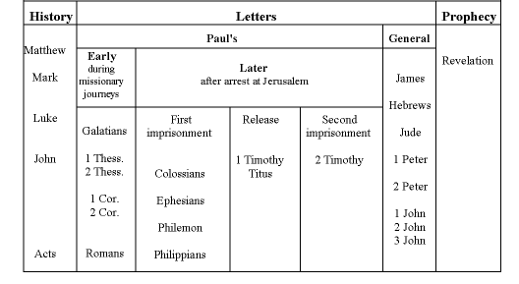
New Testament Books

Slide 15
New Testament Chronology*
Inception
Expansion
Destruction of Jerusalem
Paul’s 2nd Imprisonment
Council in Jerusalem
Paul’s 1st Imprisonment
Saul’s Conversion
Paul’s 2nd Journey
Birth of Jesus
Baptism of Jesus
Paul’s 1st Journey
Paul’s 3rd Journey
Crucifixion
Consolidation
- 4
26
29
36
45
49
52
55
60
68
70
85
95
Matthew, Luke
Acts
General Epistles
Rev
Mark
Paul’s Epistles
John
Jas
Eph
I Pet
I-III Jno
Gal
Phil
II Pet
Rev
Col
Heb
I & II Thes
Phle
Jude
I & II Cor
I Tim
Rom
Titus
II Tim
Matthew
Luke
John
*Merrill C. Tenney, New Testament Survey, Eerdmans, 1954, p128.
Mark
Acts

Slide 16
2
New Testament Survey
Summer, 2012
Embry Hills church of Christ

Slide 17
Warm up Quiz
27
How many books are there in the NT?
What does “testament” mean?
How many different authors wrote the NT?
Over how many years were the NT books written?
List the “personal letters”.
List the historical/narrative books.
List several ways in which the world was prepared for the Messiah in the “period between the Testaments”.
Agreement
8 or 9
50
I & II Timothy,
Titus, Philemon, II & III John
Matthew, Mark, Luke, John, Acts
Return, temple, law-emphasis, language, Septuagint, roads, travel

Slide 18
New Testament Chronology*
Inception
Expansion
Destruction of Jerusalem
Paul’s 2nd Imprisonment
Council in Jerusalem
Paul’s 1st Imprisonment
Saul’s Conversion
Paul’s 2nd Journey
Birth of Jesus
Baptism of Jesus
Paul’s 1st Journey
Paul’s 3rd Journey
Crucifixion
Consolidation
- 4
26
29
36
45
49
52
55
60
68
70
85
95
Matthew, Luke
Acts
General Epistles
Rev
Mark
Paul’s Epistles
John
Jas
Eph
I Pet
I-III Jno
Gal
Phil
II Pet
Rev
Col
Heb
I & II Thes
Phle
Jude
I & II Cor
I Tim
Rom
Titus
II Tim
Matthew
Luke
John
*Merrill C. Tenney, New Testament Survey, Eerdmans, 1954, p128.
Mark
Acts

Slide 19
Survey of the New Testament
Lesson 2 – Life of Christ – Synoptic Gospels
Matthew, Mark, Luke
Romans
I Corinthians
Hebrews
II Corinthians
James
Galatians
I Peter
Ephesians
II Peter
Matthew
Philippians
I Timothy
I John
Mark
Colossians
II Timothy
II John
Luke
I Thessalonians
Titus
III John
John
Acts
II Thessalonians
Philemon
Jude
Revelation
Life of Christ
History of the Church
Paul’s Letters to churches
Paul’s Letters to Individuals
General Letters
Prophecy

Slide 20
Periods of Jesus’ Life
Birth & Child-hood
John 2
John 5?
John 6
John 7
John 10
30
Yrs
old
P
P
P
T
D
Beginnings & Early Judean
Galilean
(1st Tour)
Galilean
(2nd, 3rd Tours)
Later Galilean
Later
Judean
Lk 3:23
John 12
P
Perean
Last Week
Trials & Crucifixion
Resur-rection

Slide 21
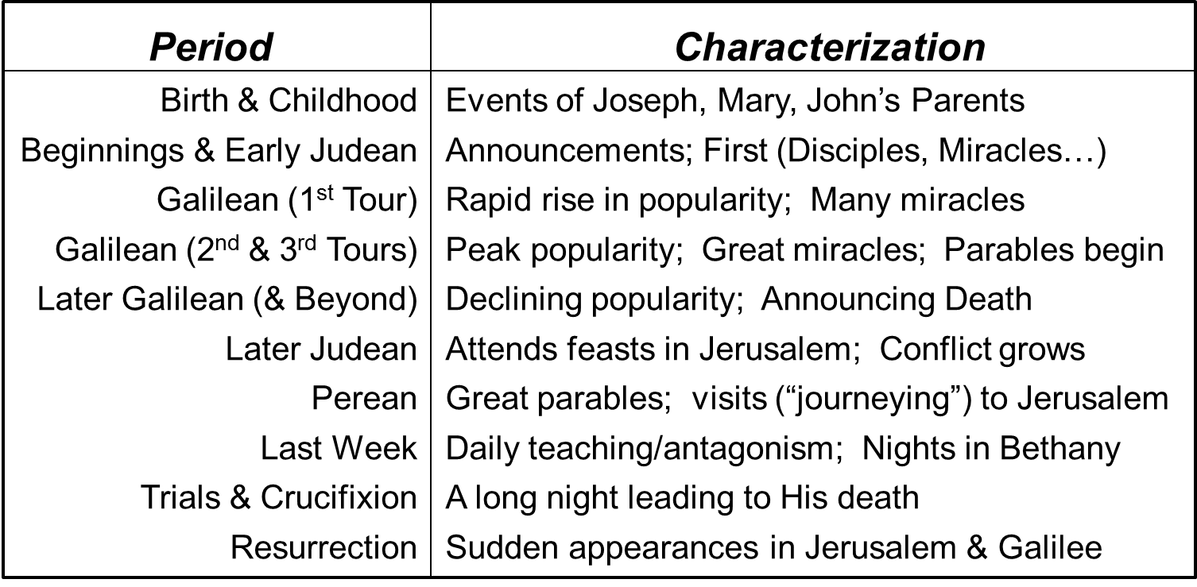
Timeline of Jesus Ministry
P
P
P
T
D
P
Beginnings &
Early Judean
Galilean
(1st Tour)
Galilean
(2nd & 3rd Tours)
Later
Galilean
Later
Judean
Perean
Last
Week
Trials &
Crucifixion
Resurrection

Slide 22
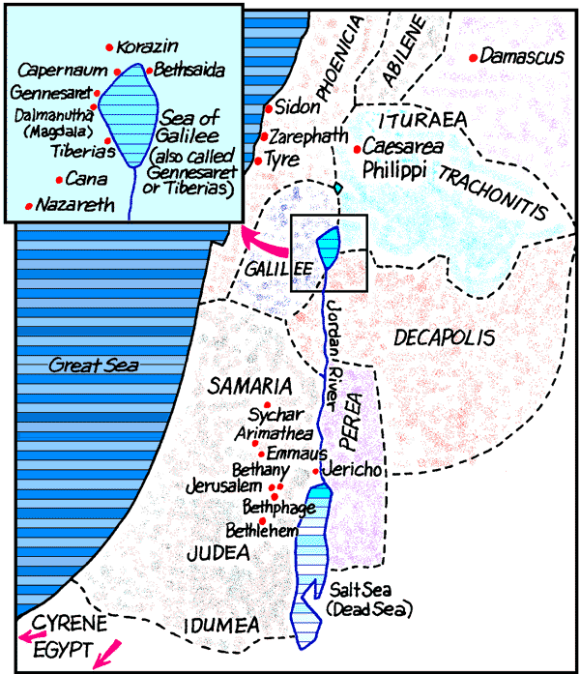
Geography of Palestine in Jesus’ Time
Birth & Childhood
Beginnings & Early Judean
Galilean (1st & 2nd)
Galilean (3rd Tour)
Later Galilean & Beyond
Later Judean
Perean
Last Week
Trials & Crucifixion
Resurrection Appearances

Slide 23
Example Events from Each Period
Period
Example Events
Birth & Childhood
Beginnings & Early Judean
Galilean (1st Tour)
Galilean (2nd & 3rd Tours)
Later Galilean (& Beyond)
Later Judean
Perean
Last Week
Trials & Crucifixion
Resurrection
John’s Birth, Jesus’ Birth, Shepherds, Wise Men
Flight to Egypt, Visit to Temple at 12
Baptism, Temptations, 1st disciples, 1st miracle, Move to Capernaum, 1st temple cleansing
Nobleman’s Son, Rejection at Nazareth, Lame Man at Pool, Widow of Nain, Sermon on Mount (?)
Kingdom parables, Stilling storm, Demons by sea Jairus’ daughter, Woman touches hem, 5000 fed
Syrophoenician Woman, ‘4000,’ Demand for sign, Peter’s confession, Transfiguration, 10 Lepers
Feast of Tabernacles, Man born blind, Feast of Dedication, 70 sent, Mary & Martha
Parables of lost things, Raising Lazarus, MDR, Rich young ruler, Blind man - Jericho, Zacchaeus
Anointing by Mary, Triumphal entry, 2nd Temple cleansing, Woes, Questions, Last Supper, Garden
Arrest, Trials, Denials, Crucifixion, Burial, Guard
Morning of Resurrection, Road to Emmaus, Upper room (x 2), Appears in Galilee, Great Commission

Slide 24
Record of the Major Periods
Period
Birth & Childhood
Beginnings & Early Judean
Galilean (1st Tour)
Galilean (2nd & 3rd Tours)
Later Galilean (& Beyond)
Later Judean
Perean
Last Week
Trials & Crucifixion
Resurrection
Matthew Mark Luke John
1-2 1-2
3-4 1 3-4 1-4
4-9,11-12 1-3 4-7 4-5
12-13,9-10,14 3-6 8-9 6
15-18 7-9 9-10
7-10
19-20 10-18 11
21-26 10-14 18-22 12-17
26-27 14-15 22-23 18-19
28 16 24 20-21

Slide 25
Three Galilean Tours
(Early Galilean Period)
First Tour
Matt 4:17… 23
Mark 1:14,15… 39
Luke 4:14…44
Second Tour
Matt 9:35 (?)
Luke 8:1-3
Third Tour
Matt 11:1
Mark 6:6b
Luke 9:1
Follows Call of the Fisherman
Parables Begin (cf Lk 8:4ff to Matt 13:3 & see vs 34,35)
Follows the empowerment and sending out of the 12 Apostles
(Matt 10)

Slide 26
Galilean (1st Tour) Introductory Events
Events
Samaritan Woman
Nobleman’s Son
Rejection at Nazareth
Calling Fisherman
Busy Day at Capernaum
Miraculous Catch
Healing Leper
Healing Paralytic (from roof)
Call of Matthew
Man at Pool (Jerusalem)
Matthew Mark Luke John
4:1-32
4:46-54
4:16-30
4:18-22 1:16-21
8:14-17 1:21-34 4:31-41
    5:1-11
8:2-4 1:40-45 5:12-16
9:1-8 2:1-12 5:17-26
9:9-13 2:13-17 5:27-32
5:1-47
“Galilean Preaching Tour”
4:15
4:17
1:14
S o M
S o M
4:23
1:39
4:44
S o M

Slide 27
Matthew
Character
  Presents Jesus as the Messiah, King of the Jews.
  Contains 5 collections of Jesus' teachings.
  Key Words: “Kingdom,” “Fulfill”
Author: Matthew
  a Jew, tax collector
  known as Levi, called to be an apostle.
  hosted a feast for Jesus (Lk 5:27-32; Mt 9:9-13).
Audience: Jews, familiar with OT prophecy
  Jewish customs mentioned, but not explained.
  Often mentions the Law of Moses.
  Opens with genealogy to Abraham, through David.
  Birth narrative contains 5 fulfilled prophecies

Slide 28
Transition Verses in Matthew
7:28 When Jesus had finished these words, the crowds were amazed at His teaching.
11:1 Now it came to pass, when Jesus finished commanding His twelve disciples, that He departed from there to teach and to preach in their cities
13:53 Now it came to pass, when Jesus had finished these parables, that He departed from there.
19:1 Now it came to pass, when Jesus had finished these sayings, that He departed from Galilee and came to the region of Judea beyond the Jordan.
26:1 Now it came to pass, when Jesus had finished all these sayings, that He said to His disciples, ² “You know that after two days is the Passover, and the Son of Man will be delivered up to be crucified.”

Slide 29
Matthew Section Descriptions
___1:1-4:11 Coming of the Messiah – lineage, prophecies, preparatory events
___4:12- 7:29 Inaugural address – Sermon on the Mount
___8:1-11:1 Power revealed – introductory miracles
___11:2-13:53 Teaching in cities & preaching in parables
___13:54-19:2 Purpose revealed; Preparing for the Cross
___19:3-26:2 Challenges & conflicts leading to the cross
___26:3-28:10 Crucifixion & resurrection events
___28:11-20 Conclusion – challenge to Action
c
f
h
d
e
g
b
a
Notes:
“finished” verses:
7:28 – And so it was, when Jesus had ended these sayings
11:1 – Now it came to pass, when Jesus finished commanding His twelve disciples…
13:53 – Now it came to pass, when Jesus had finished these parables, that He departed from there
19:1 – Now it came to pass, when Jesus had finished these sayings, that He departed from Galilee and came to the region of Judea beyond the Jordan.
26:1 – Now it came to pass, when Jesus had finished all these sayings, that He said to His disciples, ² “You know that after two days is the Passover, and the Son of Man will be delivered up to be crucified.”

Slide 30
Verses to Remember in Matthew
13
___ “Again, the kingdom of heaven is like treasure hidden in a field…”
___ “Blessed are the pure in heart: for they shall see God.”
___ “Woe to you, scribes and Pharisees, hypocrites!”
___ “A voice was heard in Ramah, weeping and great mourning, Rachel weeping for her children…
___ “Simon Peter answered and said, Thou art the Christ, the Son of the living God.”
___ “Whoever divorces his wife, except for sexual immorality, and marries another, commits adultery
___ “Do not think that I came to destroy the Law or the Prophets. I did not come to destroy but to fulfill. “
___ “Go therefore and make disciples of all the nations, baptizing them in the name of the Father and of the Son and of the Holy Spirit”
___ “…You have heard that it was said to those of old, ‘You shall not murder’…”
5
23
2
16
19
5
28
5

Slide 31
Mark
Character:
  Fast-Paced, compact, action-oriented, visual, emotional
  Factual style: Sometimes in present tense
  Omits birth & genealogy of Jesus, starts w/ baptism & ministry.
  Teaching passages are condensed, compared to other gospels
  Key words “immediately,” “authority”
Author: Mark
  Traveled with his cousin Barnabus and with Paul.
  Peter and Paul favorably mentioned him. (e.g. I Pet 5:13)
  Known as Mark (Latin) and John (Hebrew).
Audience: probably for Romans.
  Often explained Jewish words, customs, and places.
  Uses Roman time and translates some words into Latin.

Slide 32
Mark Section Descriptions
f
___1:1-1:13 Preparation: John, Baptism, Temptations
___1:14-5:43 Opening ministry in Galilee
___6:1-8:26 Full Ministry: Nazareth, Desert, Tyre & Sidon, Decapolis
___8:27-10:31 Closing Ministry: Preparing disciples; Challenges in Caesarea, Judea, Perea
___10:32-13:37 Last journey to Jerusalem
___14:1-15:47 Crucifixion Events
___16:1-20 Resurrection & Postscript
d
a
g
b
e
c

Slide 33
Verses to Remember in Mark
____ “Go into all the world and preach the gospel to every creature…”
____ “Now a certain young man followed Him, having a linen cloth thrown around his naked body.”
____ “As He went out of Jericho with His disciples and a great multitude, blind Bartimaeus, the son of Timaeus, sat by the road begging.”
16
14
10

Slide 34
Luke
Character:
  Compiled from eyewitnesses (see 1:2).
  Written "in order“ (Lk 1:1-4, Acts 1:1-2).
  References to history (1:5, 2:1-2, 3:1-2)
  Jewish customs & places often explained.
  Special attention to women (Mary, Elizabeth, … 8:1-3; 23:49)
  Lengthy parables: Good Samaritan, Prodigal Son, Rich Man & Lazarus, Rich Fool…
Author: Luke, Greek doctor (Col 4:14)
  Friend of the Apostle Paul
  Educated Historian
  Medical details (4:38, 5:12, 6:6, 9:39-42, 18:25, 22:44)
Audience: Written to Theophilus, “one who loves God”

Slide 35
Luke Section Descriptions
____ 1:1-4 Introduction
____ 1:5-2:52 Preparation: Announcements, Birth of John, Birth & Childhood of Jesus
____ 3:1-4:15 Jesus’ introduction: John, Baptism, Genealogy, Temptation
____ 4:16-9:50 Beginning ministry: announcement of purpose, power, apostles
____ 9:51-18:30 Work: challenges, the 70, Kingdom teaching , preparing the disciples
____ 18:31-23:56 Crucifixion: from entry into Jerusalem to Burial
____ 24:1-53 Resurrection, appearances, commission, & ascension
g
f
d
b
a
e
c

Slide 36
Verses to Remember in Luke
15
___ “… for this my son was dead and is alive again; he was lost and is found…”
___ “Father, I have sinned against heaven and in your sight, and am no longer worthy to be called your son.”
___ “Then the angel said to her, “Do not be afraid, Mary, for you have found favor with God.”
___ “Two men went up to the temple to pray, one a Pharisee and the other a tax collector. “
___ “ ‘The Spirit of the Lord is upon Me, because He has anointed Me to preach the gospel to the poor…’”
___ “O foolish ones, and slow of heart to believe in all that the prophets have spoken!”
___ “But he, wanting to justify himself, said to Jesus, “And who is my neighbor?”
15
1
18
4
24
10

Slide 37
3
New Testament Survey
Summer, 2012
Embry Hills church of Christ

Slide 38
Warm up Quiz
27
How many books are there in the NT?
What does “testament” mean?
How many different authors wrote the NT?
Over how many years were the NT books written?
List the “personal letters”.
List the historical/narrative books.
List several ways in which the world was prepared for the Messiah in the “period between the Testaments”.
Agreement
8 or 9
50
I & II Timothy,
Titus, Philemon, II & III John
Matthew, Mark, Luke, John, Acts
Return, temple, law-emphasis, language, Septuagint, roads, travel

Slide 39
New Testament Course Schedule

Slide 40
Course Goals
Build our knowledge of and interest in the historical and doctrinal context, the author, readers, purposes, content, character, and organization of each book of the New Testament, in order to:
  Motivate study
  Increase our ability to interpret the Word
  Increase our confidence and skills to teach others

Slide 41
Survey of the New Testament
Lesson 3 – John’s Writings
Gospel of John & Epistles of John
Romans
I Corinthians
Hebrews
II Corinthians
James
Galatians
I Peter
Ephesians
II Peter
Matthew
Philippians
I Timothy
I John
Mark
Colossians
II Timothy
II John
Luke
I Thessalonians
Titus
III John
John
Acts
II Thessalonians
Philemon
Jude
Revelation
Life of Christ
History of the Church
Paul’s Letters to churches
Paul’s Letters to Individuals
General Letters
Prophecy

Slide 42
John the Apostle
Family
Son of Zebedee (Mk 1:19,20)
Son of Salome (Mt 27:56 = Mk 16:1)
Brother of James (Mk 1:20)
Nephew of Mary (cf. Mt 27:56; Mk 15:40; Jno 19:25)
Relationships
Business Partner of Peter & Andrew (Lk 5:7-10)
Disciple of John the Baptist (Jno 1:40)
In the “inner circle” of Apostles (5:37; 9:2; 13:23; 14:33)
The “disciple whom Jesus loved” (Jno 21:20)
Known by the high priest, Annas (Jno 18:15,16)
Given Responsibility for the Care of Mary, Jesus’ mother (Jno 19:26,27)
Early Character
With James, Given the name “Sons of Thunder” (Mk 3:17)
Forbid the unknown exorcist (Lk 9:49)
Called for fire on the Samaritans (Lk 9:54)
Ambition for position (Mk 10:35; Mt 20:20)
Later History
With Peter in Jerusalem incidents (Acts 3 & 4)
“Pillar” of the church in Jerusalem (Gal 2:9)
Wrote the Revelation from Patmos (Rev 1:9)

Slide 43
The Apostle John in his Gospel
1:14 – “we beheld His glory”
19:35 – “seen and borne witness”
21:24 – “this is the disciple that bears witness...”
1:35 – (?) one of the two first disciples in Judea
18:15 – (?) Present at the Jewish trials
13:23 – Next to Jesus at Last Supper, asked…
19:26 – Entrusted with Jesus’ mother
20:2 – Mary told him of the missing body
21:7 – Fishing in Galilee, recognized Jesus
21:20-23 – walking behind Jesus & Peter

Slide 44
John’s Purpose
And truly Jesus did many other signs in the presence of His disciples, which are not written in this book; ³¹but these are written that you may believe that Jesus is the Christ, the Son of God, and that believing you may have life in His name.
John 20:30-31
This is the disciple who testifies of these things, and wrote these things; and we know that his testimony is true. And there are also many other things that Jesus did, which if they were written one by one, I suppose that even the world itself could not contain the books that would be written.
John 21:24,25

Slide 45
John’s Purpose
And he who has seen has testified, and his testimony is true; and he knows that he is telling the truth, so that you may believe…
John 19:35
Therefore, when He had risen from the dead, His disciples remembered that He had said this to them; and they believed the Scripture and the word which Jesus had said.
John 2:22

Slide 46
Uniqueness of John’s Gospel
Does not include: Birth, Baptism, Temptations, Last Supper, Gethsemane, Ascension, Exorcism, parables…
Does include:
  Simultaneous ministry with John the Baptist
  Details of Judean/Jerusalem ministries
  Additional events (e.g. Nicodemus, Thomas)
  Additional miracles…
  Additional discourses (often associated with miracles)
  Teaching about the role of the Apostles
  Information on duration (feasts) of ministry

Slide 47
Miracles in John
Water to Wine (2:1-11)
Healing Nobleman’s Son (4:46-54)
Healing Lame Man at Pool (John 5:1-13)
Feeding 5,000 (John 6:1-14)
Walking on Water (John 6:16-21)
Healing Man Born Blind (John 9:1-12)
Raising of Lazarus (John 11:1-46)

Slide 48
Themes in John’s Gospel
Jesus is God — the logos of God in the flesh, Son of God, Oneness with God
Images of the Christ (“I am”) — Light, Life, Bread, Water, Shepherd, Lamb, King, Word
Belief and Unbelief —
a) Evidence for believers
b) Explaining why some do not believe
Mission of the Christ —
a) His purpose was a sacrificial death
b) He controlled events
c) He only did the will of the Father

Slide 49
The “C” Periods (M. Tenney)
Prologue 1:1-18
Consideration 1:19 – 5:1
Controversy 5:1 – 7:1
Conflict 7:1 – 11:53
Crisis 11:54 – 12:36
Conference 12:36 – 18:1
Consummation 18:1 – 20:31
Epilogue 21:1-25

Slide 50
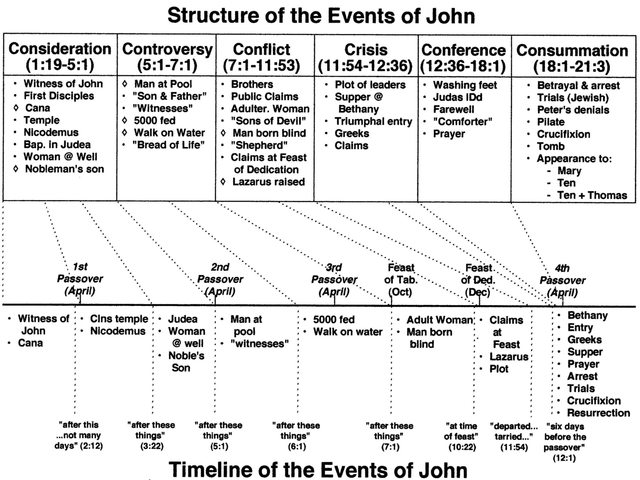
Tenney’s divisions of John
Only miracles in common with all other gospels
2:13
5:1?
6:4
7:2
10:22
13:1

Slide 51
I John
Author: John
  Based on style & similarity (e.g. Jn 1:1 to I Jn 1:1, and Jn 20:31 to I Jn 5:13).
Themes/Unique Features:
  Typical John style
  Recurring threads (e.g. love of man, love of God, keeping commandments)
  “we know” used 13 times
Purpose:
  to counter false teaching about Jesus and to emphasize the certainty of their faith and salvation (life) – I John 5:13
  To encourage them not to sin – I John 2:1
  That the readers’ (or John’s) joy would be complete – I John 1:4
Audience: Christians in the late First Century.

Slide 52
I John Section Descriptions
c
___ 1:1-4 Historical manifestation of the ‘Life’
___ 1:5-2:29 Walking in the Light: conduct, relationships, separation from World
___ 3:1-4:21 Abiding in Love: as children of God; shown in loving brethren
___ 5:1-13 Belief exercised: keeping commandments, believing witnesses
___ 5:14-21 Conclusion: praying and avoiding sin
b
e
d
a

Slide 53
Verses to Remember in I John
2
___ “Do not love the world or the things in the world. If anyone loves the world, the love of the Father is not in him.”
___ “We know that we are of God, and the whole world lies under the sway of the wicked one.”
___ “By this we know love, because He laid down His life for us. And we also ought to lay down our lives for the brethren.”
___ “If we walk in the light as He is in the light, we have fellowship with one another, and the blood of Jesus Christ His Son cleanses us from all sin.”
5
3
1

Slide 54
II John
Author: John
  Similar style vs. 6-7
Unique Features:
  Written to an unknown individual woman
Purpose:
  Encourage opposition to false teaching – vs. 7-10
Audience: the “elect lady”
Date: late First Century.

Slide 55
Key Verse - II John 9
“Whoever transgresses and does not abide in the doctrine of Christ does not have God. He who abides in the doctrine of Christ has both the Father and the Son.”

Slide 56
III John
Author: John
  Similar style to II John
Unique Features:
  Comments regarding Diotrephes
Purpose:
  Provide instructions regarding support of faithful brethren
Audience: Gaius, a leader of a church
Date: late First Century

Slide 57
Key Verse - III John 4
“I have no greater joy than to hear that my children walk in truth.”

Slide 58
4
New Testament Survey
Summer, 2012
Embry Hills church of Christ

Slide 59
Warm up Quiz – Lesson 4
How many books are in the NT?
Account of Jesus’ life for Jewish readers:
Account of Jesus’ life that begins at His birth:
Account of Jesus’ life with unique, detailed parables:
Account of Jesus’ life that is action oriented:
Miracle recorded in all four accounts:
Purpose of John’s gospel:
II John was written to:
A repeated topic in I John:
List the book & chapter where these quotes can be found:
  _____“Whoever transgresses and does not abide in the doctrine of Christ does not have God…”
  _____“Jesus did many other signs in the presence of His disciples, which are not written in this book…”
  _____“…But whoever drinks of the water that I shall give him will never thirst…”
  _____“… for this my son was dead and is alive again; he was lost and is found…”
  _____“Go into all the world and preach the gospel to every creature…”
  _____“Go therefore and make disciples of all the nations, baptizing them in the name of the Father and of the Son and of the Holy Spirit”
  _____“Again, the kingdom of heaven is like treasure hidden in a field…”
  _____“We know that we are of God, and the whole world lies under the sway of the wicked one.”
  _____“Then the angel said to her, “Do not be afraid, Mary, for you have found favor with God.”
  _____“Woe to you, scribes and Pharisees, hypocrites!”

Slide 60
Warm up Quiz
How many books are there in the NT?
Account of Jesus’ life for Jewish readers.
Account of Jesus’ life that starts at His birth.
Account of Jesus’ life with unique, detailed parables.
Account of Jesus’ life that is action oriented:
Miracle in all four accounts:
The purpose of John’s gospel:
II John written to:
A repeated topic in I John:
List the book & chapter where these quotes can be found:
  _____“Whoever transgresses and does not abide in the doctrine of Christ does not have God…”
  _____“Jesus did many other signs in the presence of His disciples, which are not written in this book…”
  _____“…But whoever drinks of the water that I shall give him will never thirst…”
  _____“… for this my son was dead and is alive again; he was lost and is found…”
  _____“Go into all the world and preach the gospel to every creature…”
  _____“Go therefore and make disciples of all the nations, baptizing them in the name of the Father and of the Son and of the Holy Spirit”
  _____“Again, the kingdom of heaven is like treasure hidden in a field…”
  _____“We know that we are of God, and the whole world lies under the sway of the wicked one.”
  _____“Then the angel said to her, “Do not be afraid, Mary, for you have found favor with God.”
  _____“Woe to you, scribes and Pharisees, hypocrites!”
27
Matthew
Matthew, Luke
Luke
Mark
Feeding 5,000
“that you might believe…”
“The Elect Lady”
Love, Knowing, Commands
II John 9
John 20
John 4
Luke 15
Mark 16
Matt 28
Matt 13
I John 4
Luke 1
Matt 23

Slide 61
New Testament Chronology*
Inception
Expansion
Destruction of Jerusalem
Paul’s 2nd Imprisonment
Council in Jerusalem
Paul’s 1st Imprisonment
Saul’s Conversion
Paul’s 2nd Journey
Birth of Jesus
Baptism of Jesus
Paul’s 1st Journey
Paul’s 3rd Journey
Crucifixion
Consolidation
- 4
26
29
36
45
49
52
55
60
68
70
85
95
Matthew, Luke
Acts
General Epistles
Rev
Mark
Paul’s Epistles
John
Jas
Eph
I Pet
I-III Jno
Gal
Phil
II Pet
Rev
Col
Heb
I & II Thes
Phle
Jude
I & II Cor
I Tim
Rom
Titus
II Tim
Matthew
Luke
John
*Merrill C. Tenney, New Testament Survey, Eerdmans, 1954, p128.
Mark
Acts

Slide 62
Survey of the New Testament
Lesson 4 – Early Church History
Acts
Romans
I Corinthians
Hebrews
II Corinthians
James
Galatians
I Peter
Ephesians
II Peter
Matthew
Philippians
I Timothy
I John
Mark
Colossians
II Timothy
II John
Luke
I Thessalonians
Titus
III John
John
Acts
II Thessalonians
Philemon
Jude
Revelation
Life of Christ
History of the Church
Paul’s Letters to churches
Paul’s Letters to Individuals
General Letters
Prophecy

Slide 63
Acts Section Descriptions
___1:1-11 Intro; Last words of Jesus; Ascension
___1:12-8:3 Origin & early years of church - Jerusalem
___8:4-11:18 Transition of the church: Scattering; Samaritans & Gentiles Converted
___11:19-14:28 Expansion: Antioch to Galatia (1st Journey)
___15:1-35 Conference in Jerusalem
___15:36-18:22 Expansion to Greece (2nd Journey)
___18:23-21:16 Establishing the churches (3rd Journey)
___21:17-28:31 Paul’s imprisonment, defenses; Rome
d
a
b
e
f
h
c
g

Slide 64
Outline of Acts*
I. Introduction (1:1-11)
II. Origin of the Church: Jerusalem (1:12-8:3)
III. Period of Transition: Samaria (8:4-11:18)
IV. Expansion to the Gentiles (11:19-21:16)
  - Church in Antioch (11:19-30)
  - More Persecution in Jerusalem (12)
  - Extension from Antioch to Galatia (13:1-15:35)
  Extension to Greece – 2nd Journey (15:36-18:22)
  3rd Journey
V. Paul’s Imprisonment & Defense (21:17-28:31)
(Caesarea & Rome)
Ascension & Coming of Holy Spirit
Stephen’s Death & Persecution
Gentile (Cornelius) Conversion
Famine in Judea
1st Journey
‘Conference’
Paul’s Arrest
*From Tenney, New Testament Survey

Slide 65
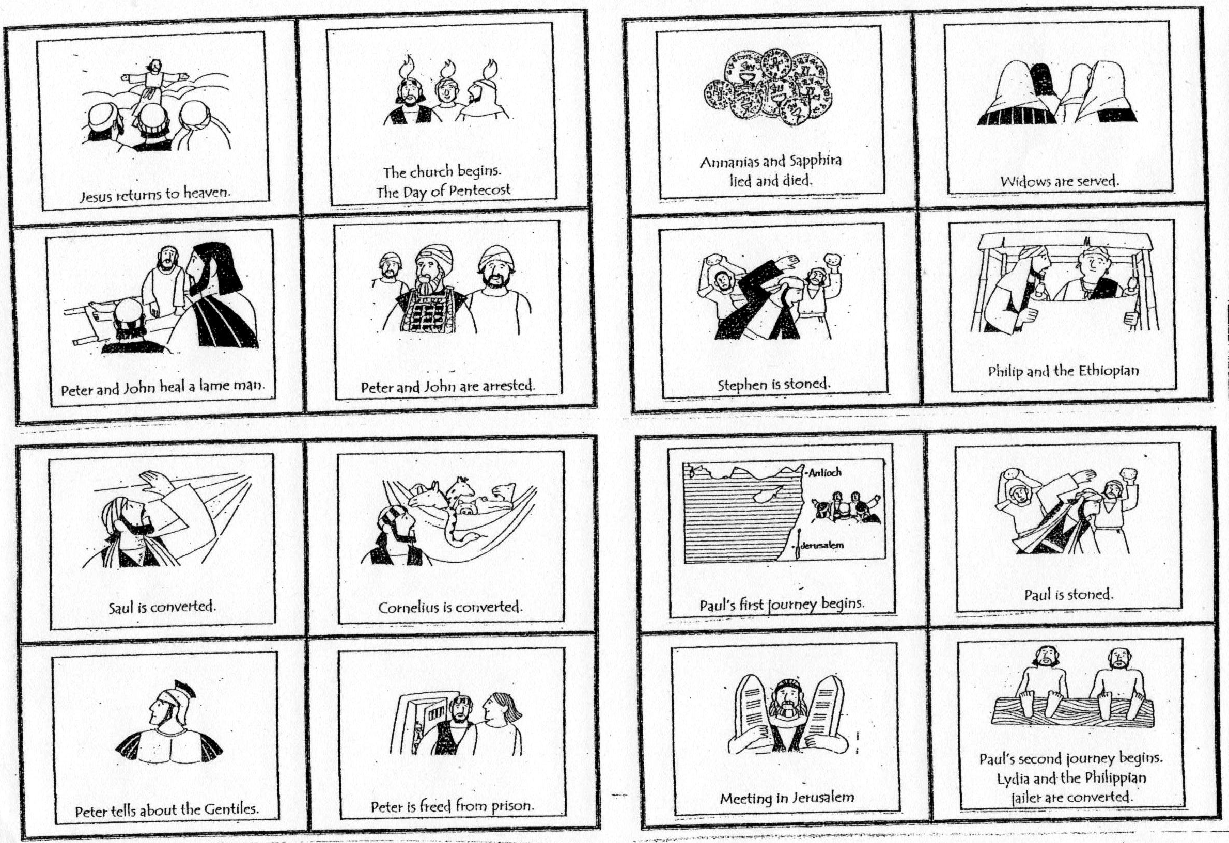
Chapters in Acts Flash Cards

Slide 66
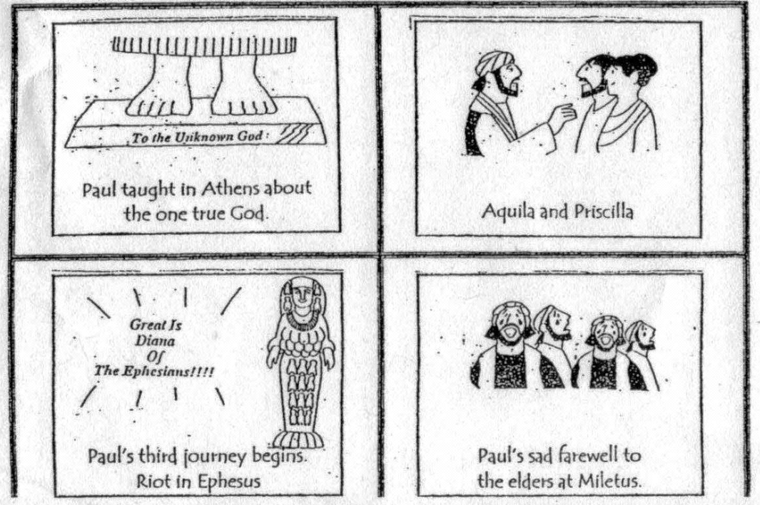
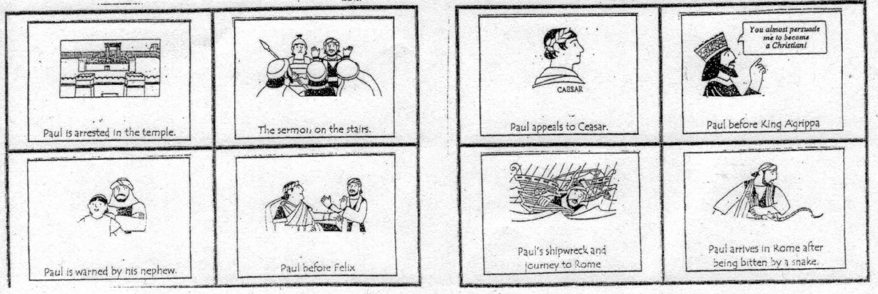
Chapters in Acts Flash Cards

Slide 67
Chapters in Acts
Ascension
Pentecost
Peter heals lame man
Peter & John imprisoned
Ananias & Sapphira lie
Grecian widows
Stephen preaches & stoned
Gospel to Samaria; Ethiopian
Saul converted
Cornelius converted
Peter tells Cornelius story
James killed; Peter imprisoned & released
1st Journey begins: Cyprus, Antioch of Pisidia
1st Journey ends: Iconium, Lystra, Derbe …to Antioch
Conference in Jerusalem
2nd Journey – Philippi
2nd: Thessalonica → Athens
2nd ends: Corinth → Antioch; 3rd Journey begins (18:23)
3rd: Paul at Ephesus
3rd: Paul & Ephesian elders
Paul at Jerusalem; arrested
Paul’s defense in Jerusalem
Plot to kill Paul; to Caesarea
Paul before Felix
Paul before Festus; Appeals to Caesar
Paul before Agrippa
Journey to Rome; Shipwreck
Paul through Malta to Rome

Slide 68
Verses to Remember in Acts
17
____ “…These times of ignorance God overlooked, but now commands all men everywhere to repent”
____ “It is not desirable that we should leave the word of God and serve tables.”
____ “But we believe that through the grace of the Lord Jesus Christ we shall be saved in the same manner as they.”
____ “Then Peter said to them, ‘Repent, and let every one of you be baptized in the name of Jesus Christ for the remission of sins’”
____ “See, here is water. What hinders me from being baptized?”
____ “Can anyone forbid water, that these should not be baptized who have received the Holy Spirit just as we?”
____ “And now why are you waiting? Arise and be baptized, and wash away your sins, calling on the name of the Lord.’
____ “Now on the first day of the week, when the disciples came together to break bread, Paul, ready to depart the next day, spoke to them…”
____ “Why have you conceived this thing in your heart? You have not lied to men but to God.”
____ “Then he knelt down and cried out with a loud voice, ‘Lord, do not charge them with this sin.’”
____ “And the disciples were first called Christians in Antioch.”
6
15
2
8
24
22
20
5
7
11

Slide 69
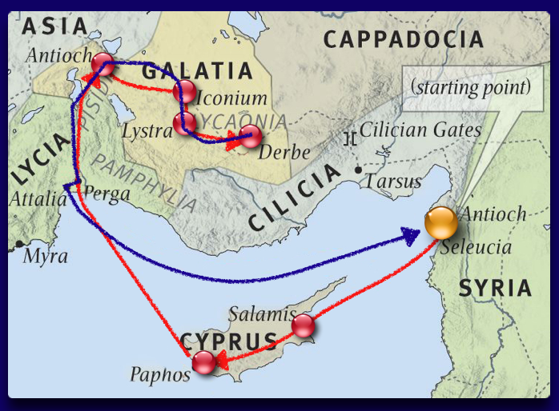
Paul’s 1st Journey

Slide 70
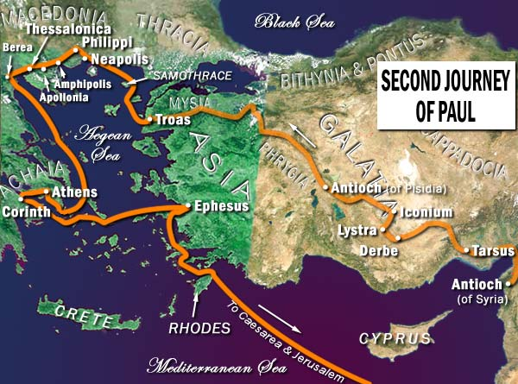

Slide 71
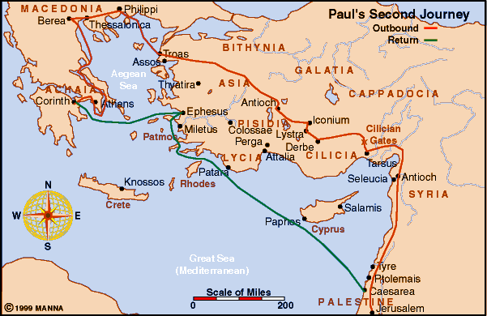
Paul’s 2nd Journey
I & II Thessalonians Written

Slide 72
Second Journey Records
Acts
I Thessalonians
17:1-10 – Now when they had passed through Amphipolis and Apollonia, they came to Thessalonica, where there was a synagogue of the Jews. ² Then Paul, as his custom was, went in to them, and for three Sabbaths reasoned with them from the Scriptures…
¹⁰ Then the brethren immediately sent Paul and Silas away by night to Berea… ¹³ But when the Jews from Thessalonica learned that the word of God was preached by Paul at Berea, they came there also and stirred up the crowds. ¹⁴ Then immediately the brethren sent Paul away, to go to the sea; but both Silas and Timothy remained there. ¹⁵ So those who conducted Paul brought him to Athens; and receiving a command for Silas and Timothy to come to him with all speed, they departed.
18:5 - When Silas and Timothy had come from Macedonia, Paul was compelled by the Spirit, and testified to the Jews that Jesus is the Christ
1:1 - Paul, Silvanus, and Timothy, to the church of the Thessalonians in God the Father and the Lord Jesus Christ:
3:1-6 Therefore, when we could no longer endure it, we thought it good to be left in Athens alone, ² and sent Timothy, our brother and minister of God, and our fellow laborer in the gospel of Christ, to establish you and encourage you concerning your faith, ³ that no one should be shaken by these afflictions; for you yourselves know that we are appointed to this. ⁴ For, in fact, we told you before when we were with you that we would suffer tribulation, just as it happened, and you know. ⁵ For this reason, when I could no longer endure it, I sent to know your faith, lest by some means the tempter had tempted you, and our labor might be in vain.
⁶ But now that Timothy has come to us from you, and brought us good news of your faith and love, and that you always have good remembrance of us, greatly desiring to see us, as we also to see you—

Slide 73
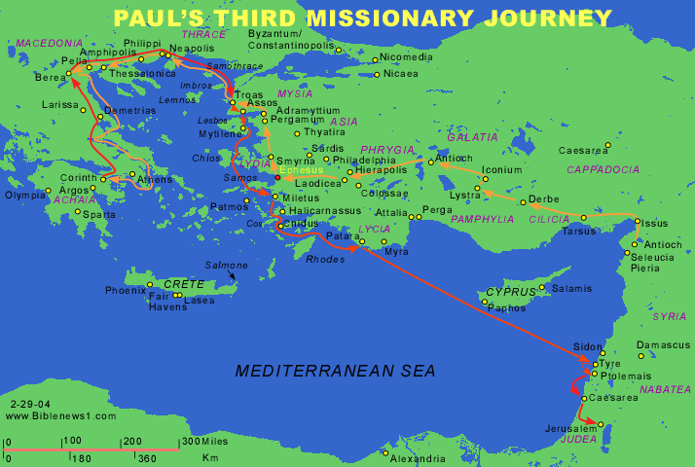
Paul’s 3rd Journey
II Corinthians written
I Corinthians written
Romans written

Slide 74
Third Journey Records
Acts
I Corinthians
19:9-12 – [In Ephesus] And this continued for two years, so that all who dwelt in Asia heard the word of the Lord Jesus, both Jews and Greeks. ¹¹Now God worked unusual miracles by the hands of Paul…
19:29-31 – And when they heard this, they were full of wrath and cried out, saying, "Great is Diana of the Ephesians!” ²⁹So the whole city was filled with confusion, and rushed into the theater with one accord, having seized Gaius and Aristarchus, Macedonians, Paul's travel companions. ³⁰And when Paul wanted to go in to the people, the disciples would not allow him. ³¹Then some of the officials of Asia, who were his friends, sent to him pleading that he would not venture into the theatre.
20:1,2 – [In Ephesus] After the uproar had ceased, Paul called the disciples to him, embraced them, and departed to go to Macedonia. ²Now when he had gone over that region and encouraged them with many words, he came to Greece…
16:5-9 Now I will come to you when I pass through Macedonia (for I am passing through Macedonia). ⁶ But it may be that I will remain, or even spend the winter with you, that you may send me on my journey, wherever I go… ⁸ But I will tarry in Ephesus until Pentecost. ⁹ For a great and effective door has opened to me, and there are many adversaries.
15:32 – If, in the manner of men, "I have fought with beasts at Ephesus, what advantage is it to me? If the dead do not rise, "Let us eat and drink, for tomorrow we die."
II Cor 1:8-10 – For we do not want you to be ignorant, brethren, of our trouble which came to us in Asia: that we were burdened beyond measure, above strength, so that we despaired even of life. ⁹ Yes, we had the sentence of death in ourselves, that we should not trust in ourselves but in God who raises the dead, ¹⁰ who delivered us from so great a death, and does deliver us…

Slide 75
Third Journey Records
Acts
II Corinthians
20:1-3 – After the uproar had ceased, Paul called the disciples to himself, embraced them, and departed to go to Macedonia. ² Now when he had gone over that region and encouraged them with many words, he came to Greece ³ and stayed three months. And when the Jews plotted against him as he was about to sail to Syria, he decided to return through Macedonia.
20:31 – [Back at Ephesus] Therefore watch, and remember that for three years I did not cease to warn everyone night and day with tears.
1:15-17 – And in this confidence I intended to come to you before, that you might have a second benefit— ¹⁶ to pass by way of you to Macedonia, to come again from Macedonia to you, and be helped by you on my way to Judea. ¹⁷ Therefore, when I was planning this, did I do it lightly? Or the things I plan, do I plan according to the flesh, that with me there should be Yes, Yes, and No, No?
8:1-7 – Moreover, brethren, we make known to you the grace of God bestowed on the churches of Macedonia: ² that in a great trial of affliction the abundance of their joy and their deep poverty abounded in the riches of their liberality…
12:14 – Now for the third time I am ready to come to you. And I will not be burdensome to you; for I do not seek yours, but you. For the children ought not to lay up for the parents, but the parents for the children.

Slide 76
Third Journey Records
Acts
Romans
19:21-22 – [In Ephesus] When these things were accomplished, Paul purposed in the Spirit, when he had passed through Macedonia and Achaia, to go to Jerusalem, saying, "After I have been there, I must also see Rome.“ ²²So he sent into Macedonia two of those who ministered to him, Timothy and Erastus, but he himself stayed in Asia for a time.
20:1-2 – After the uproar had ceased, Paul called the disciples to him, embraced them, and departed to go to Macedonia. ²Now when he had gone over that region and encouraged them with many words, he came to Greece ³and stayed three months. And when the Jews plotted against him as he was about to sail to Syria, he decided to return through Macedonia.
1:13,15 – Now I do not want you to be unaware, brethren, that I often planned to come to you (but was hindered until now), that I might have some fruit among you also, just as among the other Gentiles… ¹⁵So, as much as is in me, I am ready to preach the gospel to you who are in Rome also.
15:22 – For this reason I also have been much hindered from coming to you. ²³But now no longer having a place in these parts, and having a great desire these many years to come to you, ²⁴whenever I journey to Spain, I shall come to you. For I hope to see you on my journey, and to be helped on my way there by you, if first I may enjoy your company for a while. ²⁵But now I am going to Jerusalem to minister to the saints. ²⁶For it pleased those from Macedonia and Achaia to make a certain contribution for the poor among the saints who are in Jerusalem. …²⁸Therefore, when I have performed this and have sealed to them this fruit, I shall go by way of you to Spain.

Slide 77
Third Journey Records
I Corinthians
Romans
1:14 – I thank God that I baptized none of you except Crispus and Gaius…
16:23 – Gaius, my host and the host of the whole church, greets you. Erastus, the treasurer of the city, greets you, and Quartus, a brother.

Slide 78
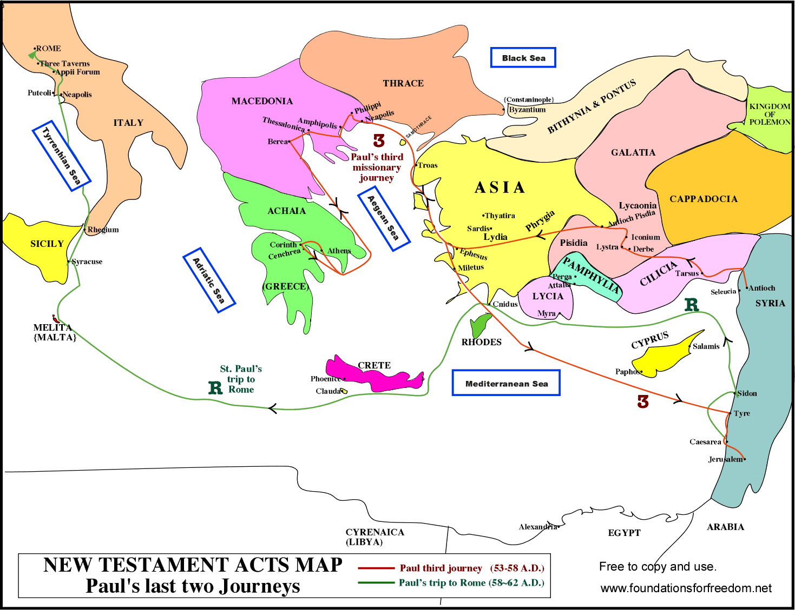

Slide 79
Timeline of “Acts of the Apostles”
Ascension, Pentecost
Council in Jerusalem
Paul’s 1st Imprisonment
Saul’s Conversion
Paul’s 2nd Journey
Paul’s 1st Journey
Paul’s 3rd Journey
29
36
45
49
52
53
57
60
Peter
Paul
Paul’s 1st Roman Imprisonment
(22-28)
Jerusalem (1-7)
Judea & Samaria (8-12)
Paul’s 3rd Journey (18:23-21)
Paul’s 1st Journey (13-14)
Paul’s 2nd Journey (16-18:22)
Council (15)
James
I&II Cor
Eph
Gal
Romans
Phil
Col
I&II Thess
Philem

Slide 80
Themes in the Sermons in Acts
Miracles & Signs of Jesus, with witnesses, show His Deity
Jesus’ rejection by Jews, led to crucifixion (& their guiltiness)
Resurrection of Jesus, with witnesses, show His reigning office
Prophecies of the Christ (Messiah) are fulfilled in Jesus
  Suffering Messiah (the Jewish rejection foreknown by God)
  Resurrection
  Coronation (Throne of David)
Christ’s is currently reigning in Heaven.
There is a coming Judgment of all men.
God controls events, including the cross & spread of the gospel.
Man is guilty before God.
Forgiveness is granted by response to the Gospel
  A requirement to repent
  Baptism is the point of forgiveness
Truth is Exclusive.
The Gospel is universal: for all men.

Slide 81
Themes in Acts Sermons
chapter 2 3 7 10
Miracles 22 16 38
Rejection by Jews 23,36 4:11 51,52 39
Resurrection 24 15 (56) 40
Prophecies… 24 37 43
  Suffering Messiah 27 18 52
  Resurrection 24,31 (24) (56)
  Coronation 33,34 4:11 (56)
Reign in Heaven 36 21 (56) 42
Judgment 20,40 21 42
God’s Control 17-on 15,18… -all- 36,38,40,42
Human Guilt 36,40 26 51-53
Forgiveness 38,40 19 (60?) 36, 43
  Repentance 38 19 11:18
  Baptism 38 47
Exclusivity 40 4:12 6 “must do”
Universality 39 25,26 34,35

Slide 82
Sample Acts Sermons (chap 4, 5)
⁸Then Peter, filled with the Holy Spirit, said to them, “Rulers of the people and elders of Israel: ⁹If we this day are judged for a good deed done to the helpless man, by what means he has been made well, ¹⁰let it be know to you all, and to all the people of Israel, that by the name of Jesus Christ of Nazareth, whom you crucified, whom God raised from the dead, by Him this man stands here before you whole. ¹¹This is the ‘stone which was rejected by you builders, which has become the chief cornerstone.’ ¹²Nor is there salvation in any other, for there is no other name under heaven given among men by which we must be saved.” (Acts 4:8-12)
²⁹Then Peter and the other apostles answered and said: “We ought to obey God rather than men. ³⁰The God of our fathers raised up Jesus whom you murdered by hanging on a tree. ³¹Him God has exalted to His right hand to be Prince and Savior, to give repentance to Israel and forgiveness of sins. ³²And we are His witnesses to these things, and so also is the Holy Spirit whom God has given to those who obey Him.” (Acts 5:29-32)

Slide 83
Messages not Found in Acts
An appeal of worldly comfort or success
A mission of universal benevolence
A call for social justice or legislated morality
A call to reform corrupt governments
An acceptance (or tolerance) of all religions
Predictions of a future earthly kingdom
Emphasis on destruction of Jerusalem

Slide 84
A Brief “Life of Paul”
Year Event Reference Letters
36 Conversion Acts 9
40 *First Jerusalem Visit (w/ Barnabas) Acts 9:26-30
41-43 In Tarsus Acts 9:30
44-45 In Antioch with Barnabas Acts 11:25, 26
45 *Second Jerusalem Visit (w/ Gifts) Acts 11:27
46-47 First Journey (w/ Barnabas) Acts 13,14
48-49 In Antioch Acts 14:26-28
50 *Third Jerusalem Visit (Conference) Acts 15 Galatians?
50-53 Second Journey (w/ Silas & Timothy) Acts 15-18 I, II Thess
53 *Fourth Jerusalem Visit (the Church) Acts 18:22
(To Antioch)
54-58 Third Journey Acts 18:23-21:14 I, II Corinthians Romans
58 *Fifth Jerusalem Visit (Imprisoned) Acts 21:15-23:30
58-60 Imprisoned in Caesarea Acts 23-26
60-61 Taken to Rome Acts 27,28 Col., Philemon,
61-63 Early Imprisonment in Rome Acts 28:16-31 Eph., Philippians
63-67 ?? Release, Journey to Spain, etc.?? I Tim, Titus
67-68 Later Imprisonment in Rome, Death II Timothy

Slide 85
Backup and scratch-work slides

Slide 86
New Testament Chronology*
Inception
Expansion
Destruction of Jerusalem
Paul’s 2nd Imprisonment
Council in Jerusalem
Paul’s 1st Imprisonment
Saul’s Conversion
Paul’s 2nd Journey
Birth of Jesus
Baptism of Jesus
Paul’s 1st Journey
Paul’s 3rd Journey
Crucifixion
Consolidation
- 4
26
29
36
45
49
52
55
60
68
70
85
95
Matthew, Luke
Acts
General Epistles
Rev
Mark
Paul’s Epistles
John
Jas
Eph
I Pet
I-III Jno
Gal
Phil
II Pet
Rev
Col
Heb
I & II Thes
Phle
Jude
I & II Cor
I Tim
Rom
Titus
II Tim
Matthew
Luke
John
*Merrill C. Tenney, New Testament Survey, Eerdmans, 1954, p128.
Mark
Acts

Slide 87
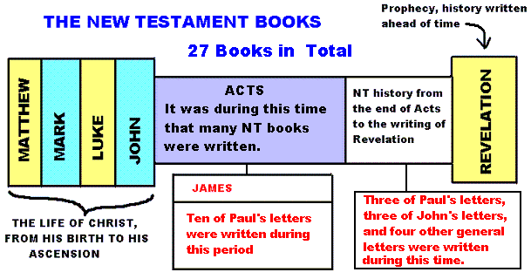
Time line of the New Testament

Slide 88
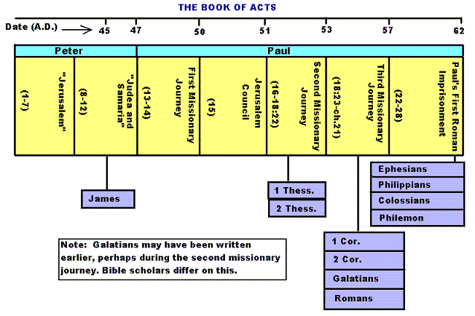
Timeline of the New Testament - 1

Slide 89
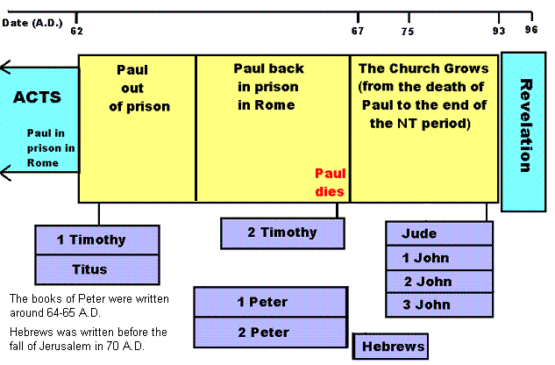
Timeline of the New Testament - 2

Slide 90
Colossians, Philemon, & Ephesians
Colossians Philemon Ephesians
With Timothy 1:1 1
With Epaphras 1:7; 4:12 23
With Mark & Aristarchus 4:10 24
With Luke & Demas 4:14 24
Onesimus Sent 4:9 10,11
Tychicus Sent 4:7,8 6:21,22
Greetings To Archippus 4:17 2

Slide 91
Dates of writing
Book | Author |  | Date Written
Genesis | Moses |  | ? - 1445 B.C.
Exodus | Moses |  | 1445 - 1405 B.C.
Leviticus | Moses |  | 1405 B.C.
Numbers | Moses |  | 1444 - 1405 B.C.
Deuteronomy | Moses |  | 1405 B.C.
Joshua | Joshua |  | 1404-1390 B.C.
Judges | Samuel |  | 1374-1129 B.C.
Ruth | Samuel |  | 1150? B.C.
First Samuel | Samuel |  | 1043-1011 B.C.
Second Samuel | Ezra? |  | 1011-1004 B.C.
First Kings | Jeremiah? |  | 971-852 B.C.
Second Kings | Jeremiah? |  | 852-587 B.C.
First Chronicles | Ezra? |  | 450 - 425 B.C.
Second Chronicles | Ezra? |  | 450 - 425 B.C.
Ezra | Ezra |  | 538-520 B.C.
Nehemiah | Nehemiah |  | 445 - 425 B.C.
Esther | Mordecai? |  | 465 B.C.
Job | Job? |  | 950?
Psalms | David |  | 1000? B.C.
 | Sons of Korah - Psalms 42, 44-49, 84-85, 87; Asaph - Psalms 50, 73-83; Heman - Psalm 88; Ethan - Psalm 89; Hezekiah - Psalms 120-123, 128-130, 132, 134-136; Solomon - Psalms 72, 127.
Proverbs | Solomon wrote 1-29 Agur - 30; Lemuel - 31 | 950 - 700 B.C.
Ecclesiastes | Solomon | 935 B.C.
Song of Solomon | Solomon | 965 B.C.
Isaiah | Isaiah | 740 - 680 B.C.
Jeremiah | Jeremiah | 627 - 585 B.C.
Lamentations | Jeremiah | 586 B.C.
Ezekiel | Ezekiel | 593-560 B.C.
Daniel | Daniel | 605-536 B.C.
Hosea | Hosea | 710 B.C.
Joel | Joel | 835 B.C.
Amos | Amos | 755 B.C.
Obadiah | Obadiah | 840 or 586 B.C.
Jonah | Jonah | 760 B.C.
Micah | Micah | 700 B.C.
Nahum | Nahum | 663 - 612 B.C.
Habakkuk | Habakkuk | 607 B.C.
Zephaniah | Zephaniah | 625 B.C.
Haggai | Haggai | 520 B.C.
Zechariah | Zechariah | 520 - 518 B.C.
Malachi | Malachi | 450 - 600 B.C.
Book | Author | Date Written (A.D)
Matthew | Matthew | 60's
Mark | John Mark | late 50's - early 60's
Luke | Luke | 60
John | John | late 80's - early 90's
Acts | Luke | 61
Romans | Paul | 55
1 Corinthians | Paul | 54
2 Corinthians | Paul | 55
Galatians | Paul | 49
Ephesians | Paul | 60
Philippians | Paul | 61
Colossians | Paul | 60
1 Thessalonians | Paul | 50 - 51
2 Thessalonians | Paul | 50 - 51
1 Timothy | Paul | 62
2 Timothy | Paul | 63
Titus | Paul | 62
Philemon | Paul | 60
Hebrews | ?Paul, Apollos, Barnabas | 60's
James | James, brother of Jesus | 40's or 50's
1 Peter | Peter | 63
2 Peter | Peter | 63 - 64
1 John | John | late 80's - early 90's
2 John | John | late 80's - early 90's
3 John | John | late 80's - early 90's
Jude | Jude, brother of Jesus | 60's or 70's
Revelation | John | late 80's - early 90's

Slide 92
Geography of Palestine in Jesus’ Time
Birth & Childhood
Beginnings & Early Judean
Galilean (1st & 2nd)
Galilean (3rd Tour)
Later Galilean & Beyond
Later Judean
Perean
Last Week
Trials & Crucifixion
Resurrection & Appearances

Slide 93
Characterizing the Periods
Period
Birth & Childhood
Beginnings & Early Judean
Galilean (1st Tour)
Galilean (2nd & 3rd Tours)
Later Galilean (& Beyond)
Later Judean
Perean
Last Week
Trials & Crucifixion
Resurrection
Characterization
Events of Joseph, Mary, John’s Parents
Announcements; First (Disciples, Miracles…)
Rapid rise in popularity; Many miracles
Peak popularity; Great miracles; Parables begin
Declining popularity; Announcing Death
Attends feasts in Jerusalem; Conflict grows
Great parables; visits (“journeying”) to Jerusalem
Daily teaching/antagonism; Nights in Bethany
A long night leading to His death
Sudden appearances in Jerusalem & Galilee

Slide 94
Male
Female
How many years have you been a Christian?
0-2 yrs
2-5 yrs
5-10 yrs
> 10 yrs
Grew up in a
church of Christ
Did not grow up in a church of Christ
Answer Choices:
During First Journey
During Second Journey
During Third Journey
During First Imprisonment
After First Imprisonment
Answer Choices:
Narrative / History
Doctrinal Letter
Personal Letter
Prophecy

