Slide 1
The Calm Before The Cross: Keeping Our Cool
Notes:
In 1939 during the beginning of the Second World War, the British government wanted to create a motivational poster to raise morale in the aftermath of a major attack. So a poster was designed and over 2.5 million copies were printed. Yet – they never went into public display. In 2000, the poster was rediscovered by a used book seller named Stuart Manley and since then the design has become an international sensation…In fact, you’ve probably seen it many time…. It simply says:
Keep Calm & Carry On.
Today, this message has been placed on websites, t-shirts, coffee mugs, and of course posters – and if you don’t like the original wording, that’s okay! It’s been modified in every way imaginable…Keep Calm and Drink Coffee, Keep Calm and Pray On, Keep Calm and Eat Chocolate, you can even have a picture of Darth Vader saying Keep Calm and Join the Darkside. If you can think of it – you can get it.
However, despite the ABUNDANCE of these posters and catch phrases – actually KEEPING our COOL in the face of daily pressures and occasionally extreme pressure is still a challenge.
So today I want us to study HOW JESUS DID THIS SO WELL by looking at Matthew 26:36-56 on the night of His betrayal. During His time in the Garden,there are 3 back-to-back events that would cause most of us to snap – yet each time Jesus is able to keep calm and respond with Gentleness. I read this passage and just ask myself “HOW DID HE DO THAT!”
I lose my cool so quickly sometime over the most insignificant stuff – but Here is JESUS keeping CALM when everything around Him is chaotic! This is an outstanding passage for us to study because His gentle spirit during this crisis sat an unforgettable example for the apostles that night – and it is still an unforgettable example for us, in how to respond under pressure.

Slide 2
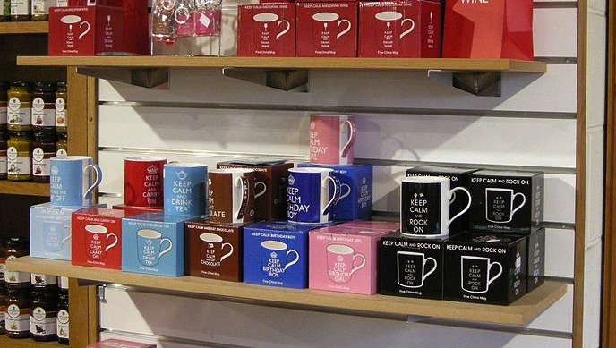

Slide 3
3 Gentle Responses
When Disappointed By Those Closest To Us
Vs 40-41
When Betrayed Into The Hands of Sinners
Vs 45-50
When Others React Rashly
Vs 51-56
Notes:
Disappointment: We get dissappointed by plenty of things we can easily get over. Poor customer service, The Weatherman was wrong, etc… but when it is someone close to us – it hurts. How many marriages have ended because of unmet expectations and disappointment? How many friendships have ended because someone felt “let down.” How many good works have come to a screeching halt – bc partners were disappointed.
*Make Allowances For Weakness & Imperfection in Good Willed People.
Side-Note: IF Jesus needs his friends praying for him – how much MORE do we need our friends praying for us and to be praying for our friends! Let’s remember to pray for each other – not just in our opening or closing prayers – but to pray for each other in an on-going manner.
*Father I want to pray for every member of this local church and for every person here tonight. Lord you know each one has Big Decisions they are wrestling with, each one has family Matters that need their attention. Each one has hopes that are growing in their hearts. So, Father we bring these all to you tonight. We ask for your help in making Godly choices, we ask for your Aid in bringing Love and Harmony into our homes, we ask for you to guard and protect our hearts. We ask Father for you to open the door to our hopes when they will bring us closer to You.
Father – we ask for your forgiveness – we have days when the spirit is willing – but we give in to the Weaknesses of the Flesh. Dear God please take away this sin and deal Gently with us. Dear God strengthen our bonds with each other so that we will deal Gently with one another like Jesus dealt with the Apostles. In the Name of Your Son we pray – Amen.
BETRAYED… Thankfully most of us don’t deal with betrayal on a regular basis – but I would guess no adult here has completely escaped this hurtful experience.
- *Remember The Power of an Hour! 1 Hour of self control can change everything. I know that sounds contrite – but it is true. One hour to say NO to going to a party. One hour to say NO to alchol or drugs. One hour to say NO to lust and fornication. 1 Hour to not get in the car with a drunk. 1 Hour to think carefully about a career, a job move, a big step. It can make all the difference. **How much more an hour in prayer**
OTHERS ARE RASH: Jesus reminds them how He used to sit and teach in the temple. Jesus causes them to think about why they have come with such a blood thirst, with such an army. As they realize that it isn’t necessary, they can search their own hearts. Its amazing: to the very end, He is asking Great Questions.

Slide 4
Exercising Self Control
Mentally Prepare to Face Grief & Distress
Work With Others To Reach The Goal
Pay Attention To What’s At Stake
Surrender Yourself To God’s Will
Take Bad Options Off The Table
Notes:
Looking at the Success of Jesus and the Failure of the Apostles – there are 5 Great Take Away’s from this Chapter that can help us respond appropriately….
- Jesus told apostles about what was to come. Jesus was certainly not surprised to come to this day. *To be prepared sounds crazy – you can never be fully prepared – but you can be aware that we will face hardships.
Jesus teaches that we are to Count the Cost of following Him.
WORK TOGETHER: One of the things that bothers me about this passage…why didn’t the apostles help each other stay awake!
Take Bad Options Off the Table (Most of us consider chopping up our enemies with a sword – off the table of options.) But what we can learn from Peter is that in his heart – given the right set of circumstances – this was an option on the table. Jesus had far more power than a sword could provide – but because He was governed by doing God’s will and desired to fulfill the scriptures – calling the angels was off the table.
*We need to decide what is OFF the table. It simply isn’t an option. No matter what… I’m not going to turn to sin to try and solve my problems.

Slide 5
Keeping Our Cool
Notes:
When it comes to keeping our cool – Peter wants to shine a spot light at the end of Jesus life on earth because the example that the Lord sat during this time is matchless.

