Slide 1
Comfort One Another

Slide 2
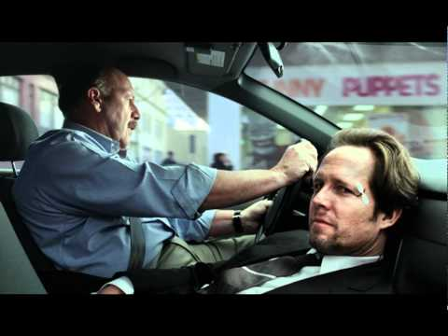
MAYHEM IS OUT THERE

Slide 3
LIFE COMES AT YOU FAST

Slide 4
Christians experience suffering
The Fall
The flesh
The devil

Slide 5
Christians sometimes respond in unhealthy ways
Two basic responses:
Escape
Embrace
Common places used for escape:
Substance abuse (drugs, alcohol, etc.)
Work (long, inappropriate hours at job)
Pleasure (food, sex, etc.)
Entertainment (gaming, TV, Internet, golf, etc.)

Slide 7
The Spirit was given to provide comfort
He is called the Comforter
John 14:15-17, 26; 15:26; 16:7
Jesus tells them he is going away (13:33, 36; 14:2-4, 12, 19, 28; 16:5-7, 16, 28)
Parakletos
“summoned, called to one’s side, esp. called to one’s aid.” (Strong’s)
“a helper, succourer, aider, assitant.” (Strong’s)
“Helper,” “Advocate,” Counselor,” and “Comforter”

Slide 8
The Spirit was given to provide comfort
Ways he provides comfort:
Presence (John 14:16-17; Acts 9:31; 2 Cor 13:14; 1 Peter 4:14)
Guidance (John 14:26-27)
Intercession (1 John 2:1; Romans 8:26-27)

Slide 9
Which provides more comfort?
Holy spirit
Means of escape
Presence
(that we cannot see)
Guidance
(that we cannot hear)
Intercession
(that we cannot understand)
Substances
Work
Pleasure
Entertainment

Slide 10
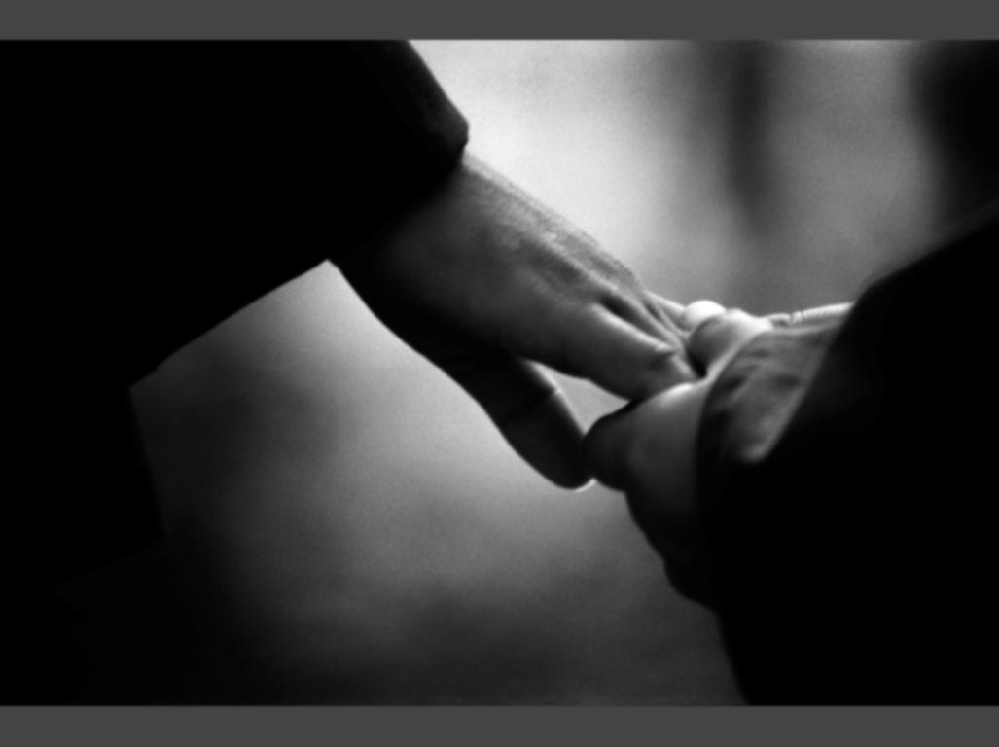
we comfort one another…
through experiences
through Scripture
with our presence

Slide 11
Blessed be the God and Father of our Lord Jesus Christ, the Father of mercies and God of all comfort, who comforts us in all our affliction, so that we may be able to comfort those who are in any affliction, with the comfort with which we ourselves are comforted by God. For as we share abundantly in Christ’s sufferings, so through Christ we share abundantly in comfort too. If we are afflicted, it is for your comfort and salvation; and if we are comforted, it is for your comfort, which you experience when you patiently endure the same sufferings that we suffer. Our hope for you is unshaken, for we know that as you share in our sufferings, you will also share in our comfort.
2 Corinthians 1:3-7

Slide 12
But we do not want you to be uninformed, brothers, about those who are asleep, that you may not grieve as others do who have no hope. For since we believe that Jesus died and rose again, even so, through Jesus, God will bring with him those who have fallen asleep. For the Lord himself will descend from heaven with a cry of command, with the voice of an archangel, and with the sound of the trumpet of God. And the dead in Christ will rise first. Then we who are alive, who are left, will be caught up together with them in the clouds to meet the Lord in the air, and so we will always be with the Lord. Therefore encourage one another with these words.
1 Thessalonians 4:13-18

Slide 13
Rejoice with those who rejoice, weep with those who weep.
Romans 12:15
If one member suffers, all suffer together; if one member is honored, all rejoice together.
1 Corinthians 12:26

Slide 14
Who could you turn to if you were met by a life-altering crisis right now?

Slide 15
If you’ve suffered, are you willing to be used by God to bring comfort to a brother or sister?

Slide 16
Are you willing to take a risk and open yourself up to others who want to help you find comfort?

Slide 17
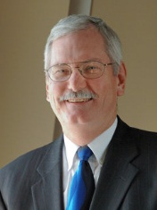
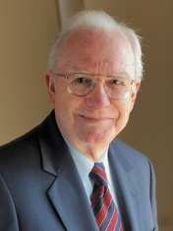

Slide 18
