Slide 1
Men Not of this World
Embry Hills - February, 2016
Notes:
Lesson based on Scripture (not experimental evidence). Will make no sense to those who do not believe that God has spoken. (That’s what ‘Not of this World’ means.)
Not popular views – not acceptable in some situations, perhaps soon will be illegal…
We have no intent to change our society by political action, nor even by pragmatic arguments, but only by ‘conversion’ of those who are willing
We believe that we must be subject to the government, except where our conscience is violated.

Slide 2
The Creation of Male & Female
Then God said, “Let Us make man in Our image, according to Our likeness; let them have dominion over the fish of the sea, over the birds of the air, and over the cattle, over all the earth and over every creeping thing that creeps on the earth.” ²⁷ So God created man in His own image; in the image of God He created him; male and female He created them. (Gen 1:26-27)
God Created
In His Own Image
Male & Female
Notes:
All three raise unanswered questions:
Why did God Create Man
If we are in His Image, what has happened in the World?
What is the purpose of the two types of humans? How do they relate to each other?

Slide 3
Tasks for Man (from Genesis)
Be fruitful & multiply (1:28) – as animals (1:22)
Fill the earth and subdue it (1:28)
Have dominion over [rule] … every living thing (1:28)
Till [work] the ground (2:5)
Tend and keep the Garden (2:15)
Accept restrictions (2:16-17)
Become “one-flesh” with a woman (2:23)
Notes:
This is significant and challenging work…. Even before the curses that are yet to come.
Note, too that these were all given to Adam when he was alone (with no helper)
It requires abilities…

Slide 4
Useful Male Characteristics
Strength
Knowledge & Skills
Initiative, Goal Setting, and Planning
Courage
Self-control
Notes:
Physical strength, endurance, perhaps to match some animals, and work with the earth
The ability to observe, collect (learn) and synthesize information, and Physical and mental skills beyond knowledge, developed by practice and invention
The ability to envision a future (not yet seen) state, develop a plan, get started, see it through…
The courage to try, when failure is possible or even likely. To try again without discouragement…
As woman was created, there are implied differences, then in their roles. They are physically different (and likely different in other ways as well). What are some of the implications of different roles

Slide 5
Implied Role Differences
Adam created first (2:7, and see I Tim 2:13)
Moral guidelines given to Adam (2:16); later transmitted to Eve (3:2).
Eve presented as a suitable helper (Gen 2:20)
Adam called first (3:9) and questioned (3:11)

Slide 6
Problems after the Fall
Strained Relationship with Woman (Gen 3:16b)
Impending Death (Gen 3:19; I Cor 15:22)
Cursed Earth:
Thorns, thistles (Gen 3:17)
Toil required to eat (Gen 3:17,19)
Survival Now a Challenge
Physical difficulty & death
Sin in the World

Slide 7
Corruption After the Fall
Cain (Gen 4:1-15)
Jealousy, Anger, Temper, Violence, Deceit
Cain (Gen 4:16)
Built a city – named it after his son
Lamech (Gen 4:19; 23-24)
Multiple wives
Revenge Killing (Protection? Precedent? Warning?) → Warfare
The World of the Flood
Continual Wickedness in Action & Thought (Gen 6:1-2; 5)
Babel (Gen 11:4)
Ambition and Pride
Other OT Males: Men of Sodom, Jacob & Esau, Simeon & Levi, Joseph’s brothers, Samson, Saul, Ahab…

Slide 8
Implied (Godly) Male Roles
Heads of Households (Patriarchs)
Teachers of Truth – “For I have known him, in order that he may command his children and his household after him, that they keep the way of the Lord, to do righteousness and justice, that the Lord may bring to Abraham what He has spoken to him.” (Gen 18:19)
Moral Leaders – “For I, the Lord your God, am a jealous God, visiting the iniquity of the fathers upon the children to the third and fourth generations of those who hate Me…” (Deut 5:9)
Civil & Religious Leaders (e.g. Moses’ law, Kings)
Warriors & Military Leaders (Judges & Kings)
Notes:
God’s guidance implied that men should take these roles, but how has man responded to that responsibility?
What do we see in the male culture of today?

Slide 9
Worldly Male Character
The ‘Natural Man’ (I Cor 2:14; James 3:14-16)
Evolution Model: Stronger Live Longer
Live for Self: Survival & Fulfilled Desires
Follow Natural Inclinations
Propagated by Society
A “Rights-Oriented” Culture
Self-Centered Motivations
Enforced Equality/Denial of Differences
Reaction in Women:
Sexually Manipulative (Lust-driven Male)
Competitive, Aggressive (Retiring Male)
Notes:
I Cor 2:14 - But the natural man does not receive the things of the Spirit of God, for they are foolishness to him…
James 3: 14-16 - But if you have bitter envy and self-seeking in your hearts, do not boast and lie against the truth. ¹⁵ This wisdom does not descend from above, but is earthly, sensual, demonic. ¹⁶ For where envy and self-seeking exist, confusion and every evil thing are there.

Slide 10
Modern Male Behavior
Dominating
Strong & Scheming → to Conquer and Control
Fearless & Fearsome → to Prevent Domination
Seductive & Dominating → to Fulfil Lusts
Submissive
Harmless & Retiring
Pacifist & Tolerant
Driven by Feelings/Emotions, Without Conviction
Notes:
Example of the 3 commercials: WWF, Marie Osmond, Woman Karate
The problem we have is we ‘breathe this air’. It’s taught in our schools. It’s modeled in all forms of entertainment (Woman Jedi Warrior), politics, and media – usually as assumptions not assertions.
But what is God’s plan related to the interaction of the sexes?

Slide 11
The “Great Mystery”
“For this reason a man shall leave his father and mother and be joined to his wife, and the two shall become one flesh.” ³² This is a great mystery, but I speak concerning Christ and the church. (Eph 5:31-32)
…How that by revelation He made known to me the mystery (as I have briefly written already, ⁴ by which, when you read, you may understand my knowledge in the mystery of Christ), ⁵ which in other ages was not made known to the sons of men, as it has now been revealed by the Spirit to His holy apostles and prophets. (Eph 3:3-5)

Slide 12
Male Roles in Marriage
²³ For the husband is head of the wife, as also Christ is head of the church; and He is the Savior of the body. ²⁴ Therefore, just as the church is subject to Christ, so let the wives be to their own husbands in everything.
²⁵ Husbands, love your wives, just as Christ also loved the church and gave Himself for her, ²⁶ that He might sanctify and cleanse her with the washing of water by the word, ²⁷ that He might present her to Himself a glorious church, not having spot or wrinkle or any such thing, but that she should be holy and without blemish. ²⁸ So husbands ought to love their own wives as their own bodies; he who loves his wife loves himself. ²⁹ For no one ever hated his own flesh, but nourishes and cherishes it, just as the Lord does the church. ³⁰ For we are members of His body, of His flesh and of His bones. ³¹ “For this reason a man shall leave his father and mother and be joined to his wife, and the two shall become one flesh.” ³² This is a great mystery, but I speak concerning Christ and the church. ³³ Nevertheless let each one of you in particular so love his own wife as himself, and let the wife see that she respects her husband. (Eph 5:23-33)

Slide 13
Husbands: Heads like Christ (Eph 5:22-33)
23 Head (see Col 2:19 – Causes to Grow)
23 Saves
Loves (as Christ did the Church)
25 Gives Himself for (Sacrificial)
Sanctifies, Cleanses
Presents Glorious, Without Imperfection, Holy
Loves as Own Body
Nourishes (Feeds, Causes Growth)
29 Cherishes (Cares for, Sensitive to Needs)
United with (in Action & Purpose)
33 Loves as Himself

Slide 14
Headship is Difficult
Protect/provide—courage, strength, skill, perseverance, sacrifice
Spiritual Vision—knowledge, faith & hope in trial
Solve Problems—initiator, reconciler, 1st to confess, 1st to forgive
Decide—making and sticking to, and taking blame for unpleasant decisions based on immutable values (but not knowing the future)
Nurture—for growth, & admonishing for improvement (Eph 6:4)
Motivate—encourages others to action, not discouraged or deterred by opposition or difficulty
Discipline Self—spiritual, physical, emotional, financial…
Humbly Sacrifice—all actions/decisions not for self-benefit
Men: What is your plan for your family?

Slide 15
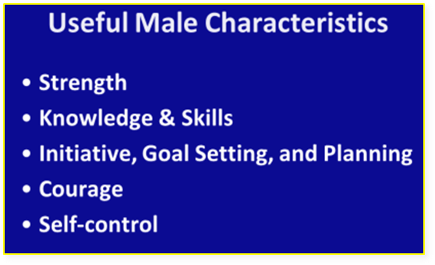
Male Character Commanded
Generally:
Holy hands, prayer (I Tim 2:8)
Sober/self controlled (Tit 2:2,6)
Example of Integrity (Titus 2:7)
Without anger or argument (I Tim 2:8)
Example, Respectable (Tit 2:7)
Sound speech (Tit 2:8)
At Home:
Sacrificial love to wife: purifying, honoring... (Eph 5:25-33)
Dwelling with wives according to knowledge (I Pet 3:7)
Not bitter or harsh to wife: controlled emotions (Col 3:19)
Giving honor to wives as weaker vessel (I Pet 3:7)
Rule [Manage] household well, with gravity (I Tim 3:4,5)
Not provoking children or discouraging them (Col 3:21)
Nurturing, chastening, admonishing children (Eph 6:4)
Notes:
These passages indicate the roles of men are to be: teachers and overseers in the church, fathers, worship leaders, role models and mentors… But the key teaching is the character required, not the enforcement (by edict) of the position.
In the History of mankind (usually at war), the men were the leaders, warriors, and protectors. The fully male characteristics equipped [some] men for that duty. What is the purpose of that today? How can we put that to use?

Slide 16
Are We at War?
For I delight in the law of God according to the inward man. ²³ But I see another law in my members, warring against the law of my mind, and bringing me into captivity to the law of sin which is in my members. (Rom 7:22-23)
Finally, my brethren, be strong in the Lord and in the power of His might. ¹¹ Put on the whole armor of God, that you may be able to stand against the wiles of the devil. ¹² For we do not wrestle against flesh and blood, but against principalities, against powers, against the rulers of the darkness of this age, against spiritual hosts of wickedness in the heavenly places. ¹³ Therefore take up the whole armor of God, that you may be able to withstand in the evil day, and having done all, to stand. (Eph 6:10-13)

Slide 17
Timothy, a Courageous Warrior
This charge I commit to you, son Timothy, according to the prophecies previously made concerning you, that by them you may wage the good warfare, ¹⁹ having faith and a good conscience… (I Tim 1:18)
Fight the good fight of faith, lay hold on eternal life, to which you were also called… (I Tim 6:12)
You therefore must endure hardship as a good soldier of Jesus Christ. ⁴ No one engaged in warfare entangles himself with the affairs of this life, that he may please him who enlisted him as a soldier. (II Tim 2:3-4)

Slide 18
¹³ Be on the alert, stand firm in the faith, act like men, be strong. ¹⁴ Let all that you do be done in love.
I Cor 16:13-14

Slide 20
Other Applications
…Having a good conscience, that when they defame you as evildoers, those who revile your good conduct in Christ may be ashamed. ¹⁷ For it is better, if it is the will of God, to suffer for doing good than for doing evil.
¹⁸ For Christ also suffered once for sins, the just for the unjust, that He might bring us to God… (I Pet 3:16-18)

Slide 21
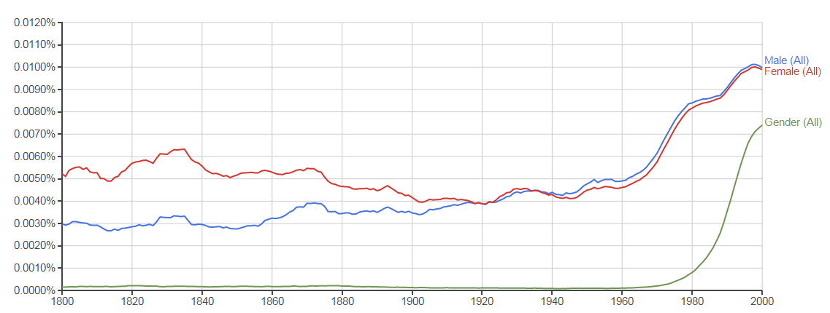
Word Usage

