Slide 1
Jerusalem was a Dangerous Place for Jesus
John 5:16
John 7:1
John 7:32
John 8:59
John 10:31
John 10:39-40

Slide 2
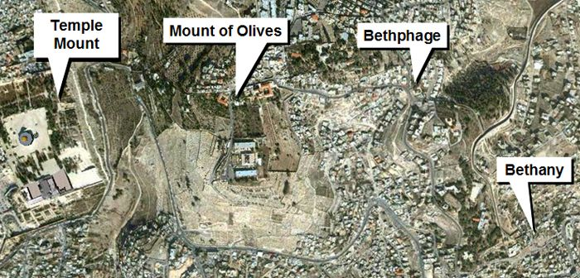
John 11:1
Now a certain man was sick, Lazarus of Bethany, the town of Mary and her sister Martha.
Less than 2 Miles
Read John 11:2-15

Slide 3
Qualities of Jesus
Humanity/Divinity of Jesus
His special love for Mary, Martha, Lazarus
His concern for “the glory of God.”
His confidence that He would be safe.
His inscrutable purposes.

Slide 4
God moves in a mysterious way His wonders to perform; He plants His footsteps in the sea And rides upon the storm.
Deep in unfathomable mines Of never failing skill He treasures up His bright designs And works His sovereign will.
Ye fearful saints, fresh courage take; The clouds you so much dread Are big with mercy and shall break In blessings on your head.
Judge not the Lord by feeble sense, But trust Him for His grace; Behind a frowning providence He hides a smiling face.
His purposes will ripen fast, Unfolding every hour; The bud may have a bitter taste,
But sweet will be the flower.
Blind unbelief is sure to err And scan His work in vain; God is His own interpreter, And He will make it plain.

Slide 5
Qualities of Jesus
Humanity/Divinity of Jesus
His special love for Mary, Martha, Lazarus
His concern for “the glory of God.”
His confidence that He would be safe.
His inscrutable purposes.
His supernatural knowledge of events miles away.
His “big picture” view of death.

Slide 6
Other Characters in the Story
John 11:16
John 11:17-27
John 11:28-32
Thomas – Submitting
Martha – Believing
Mary – Loving
Lazarus –
Serving

Slide 7
Back to Jesus
John 11:33-40

Slide 8
More Qualities of Jesus
Emotional—Humanity evident
- “Groaned in the spirit”
- “Was troubled”
- “Jesus wept.”
Weeping with those who wept.
“Became agitated.”
“Shook,” “Shuddered”

Slide 9
Does Jesus care when I’ve said “goodbye” To the dearest on earth to me, And my sad heart aches till it nearly breaks— Is it aught to Him? Does He see?
Oh, yes, He cares, I know He cares, His heart is touched with my grief; When the days are weary, the long nights dreary, I know my Savior cares.

Slide 10
More Qualities of Jesus
Emotional—Humanity evident
- “Groaned in the spirit”
- “Was troubled”
- “Jesus wept.”
Weeping with those who wept.
Patient with Martha’s wavering faith

Slide 11
“I am the resurrection and the life. He who believes in Me, though he may die, he shall live. ²⁶ And whoever lives and believes in Me shall never die.” (John 11:25-26)
In John 11:41-44 He proved it!

Slide 12
Response
Faith of His disciples was increased (vs. 15)
Probable explanation for feast of John 12:1-3).
Unbelievers were converted (John 11:45)
Other unbelievers were hardened (11:46-53)
They even plotted to kill Lazarus (John 12:10).
Proved what Abraham said in Luke 16:27-31

Slide 13
Lessons for Us
We can imitate some qualities of Jesus
- His loving nature
- His concern for “the glory of God.”
- His courage when seeking God’s glory.
- His awareness that death is not permanent.
- Weeping with those that weep.
- His patience with those whose faith wavers
We can be like Thomas, Martha, Mary, Lazarus
We can learn that confirmed unbelievers will not be converted by miracles.

Slide 14
Do not marvel at this; for the hour is coming in which all who are in the graves will hear His voice ²⁹ and come forth—those who have done good, to the resurrection of life, and those who have done evil, to the resurrection of condemnation.
(John 5:28-29)

Slide 15
When Jesus stood at Lazarus’ tomb
And none believed He had the power
Despite their grief and their disbelief,
He commanded, “Take away the stone.”
When Jesus lay in Joseph’s tomb
And none believed He had the power,
True Love spoke forth in a Father’s voice,
And the angel took away the stone.
When I shall lie within my tomb
And none believe He has the power,
The Lord Himself shall descend from heaven
With a shout to take away the stone.

