Slide 1
The Kings of Judah
An evening series for February

Slide 2
1 Kings
2 Kings
2 Samuel
1 Samuel
931 BC
722 BC
Northern Kingdom:
ISRAEL
20 Kings in the North and South
586 BC
Saul
David
Solomon
40 yr
40 yr
40 yr
Southern Kingdom:
JUDAH
1 Chronicles
2 Chronicles

Slide 3
Rehoboam | 17 yr
Abijah | 3 yr
Asa | 41 yr
Jehoshaphat | 25 yr
Jehoram | 8 yr
Ahaziah | 1 yr
Athaliah | 7 yr
Joash | 40 yr
Amaziah | 29 yr
Uzziah | 52 yr
Jotham | 16 yr
Ahaz | 16 yr
Hezekiah | 29 yr
Manasseh | 55 yr
Amon | 2 yr
Josiah | 31 yr
Jehoahaz | 3 mo
Jehoiakim | 11 yr
Jehoiachin | 3 mo
Zedekiah | 11 yr

Slide 4
Rehoboam | 17 yr
Abijah | 3 yr
Asa | 41 yr
Jehoshaphat | 25 yr
Jehoram | 8 yr
Ahaziah | 1 yr
Athaliah | 7 yr
Joash | 40 yr
Amaziah | 29 yr
Uzziah | 52 yr
Jotham | 16 yr
Ahaz | 16 yr
Hezekiah | 29 yr
Manasseh | 55 yr
Amon | 2 yr
Josiah | 31 yr
Jehoahaz | 3 mo
Jehoiakim | 11 yr
Jehoiachin | 3 mo
Zedekiah | 11 yr

Slide 5
Rehoboam | 17 yr
Abijah | 3 yr
Asa | 41 yr
Jehoshaphat | 25 yr
Jehoram | 8 yr
Ahaziah | 1 yr
Athaliah | 7 yr
Joash | 40 yr
Amaziah | 29 yr
Uzziah | 52 yr
Jotham | 16 yr
Ahaz | 16 yr
Hezekiah | 29 yr
Manasseh | 55 yr
Amon | 2 yr
Josiah | 31 yr
Jehoahaz | 3 mo
Jehoiakim | 11 yr
Jehoiachin | 3 mo
Zedekiah | 11 yr

Slide 6
Series Schedule
A.M. | David: Priorities
P.M. | Jehoshaphat: Associations
Feb 13 | Hezekiah: Devotion
Feb 20 | Manasseh: Grace
Feb 27 | Josiah: Word

Slide 7
Manasseh
Grace: The Foundation of Restoration

Slide 8
Sin and rebellion!
And he did what was evil in the sight of the LORD, according to the abominations of the nations whom the LORD drove out before Israel. 33:2
For he rebuilt the high places that his father Hezekiah had broken down… 33:3
…and he erected altars to the Baals, and made Asherahs, and worshiped all the host of heaven and served them. 33:3

Slide 9
Sin and rebellion!
And he built altars in the house of the LORD, of which the LORD had said, “In Jerusalem shall my name be forever.” 33:4
And he burned his sons as an offering in the Valley of the Son of Hinnom… 33:6
…and used fortune-telling and omens and sorcery, and dealt with mediums and with wizards. He did much evil in the sight of the LORD, provoking him to anger. 33:6

Slide 10
Sin and rebellion!
And the carved image of the idol that he had made he set in the house of God, of which God said to David and to Solomon his son, “In this house, and in Jerusalem, which I have chosen out of all the tribes of Israel, I will put my name forever...” 33:7
But you are a chosen race, a royal priesthood, a holy nation, a people for his own possession, that you may proclaim the excellencies of him who called you out of darkness into his marvelous light. 1 Peter 2:9

Slide 11
…you yourselves like living stones are being built up as a spiritual house, to be a holy priesthood, to offer spiritual sacrifices acceptable to God through Jesus Christ.
1 Peter 2:5

Slide 12
First two expressions of grace!
The LORD spoke to Manasseh and to his people… 33:10
Therefore the LORD brought upon them the commanders of the army of the king of Assyria… 33:11

Slide 13
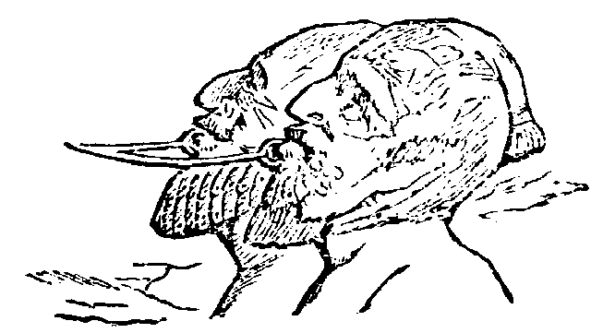
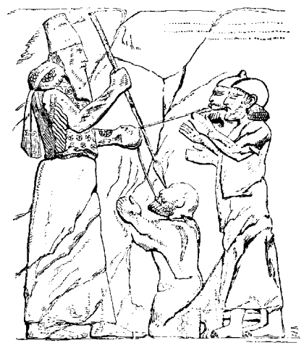

Slide 14
Humility and prayer!
And when he was in distress, he entreated the favor of the LORD his God and humbled himself greatly before the God of his fathers. 33:12
Then Manasseh knew that the LORD was God. 33:13

Slide 15
…if my people who are called by my name humble themselves, and pray and seek my face and turn from their wicked ways… 2 Chronicles 7:14

Slide 16
Greatest expression of grace!
The LORD spoke to Manasseh and to his people… 33:10
Therefore the LORD brought upon them the commanders of the army of the king of Assyria… 33:11
God was moved by his entreaty and heard his plea and brought him again to Jerusalem into his kingdom. 33:13

