Slide 1


Slide 2
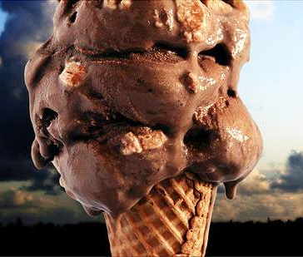
ADDICTIONS
Come in many forms…

Slide 3

ADDICTIONS
Come in many forms…

Slide 4

ADDICTIONS
Come in many forms…

Slide 5
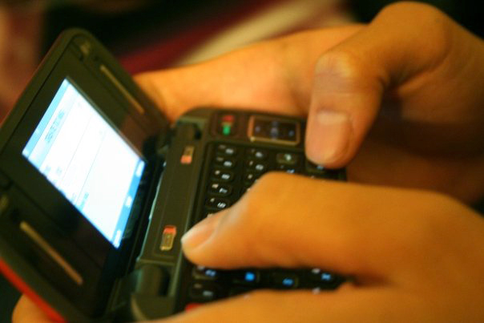
ADDICTIONS
Come in many forms…

Slide 6

ADDICTIONS
Come in many forms…

Slide 7

ADDICTIONS
Come in many forms…

Slide 8

ADDICTIONS
Come in many forms…

Slide 9

ADDICTIONS
Come in many forms…

Slide 10

Definition of Addiction
Compulsive need for and use of a habit-forming substance (as heroin, nicotine, or alcohol) characterized by tolerance and by well-defined physiological symptoms upon withdrawal.

Slide 11
Definition of Addiction
Broadly: persistent compulsive use of a substance known by the user to be harmful.

Slide 12
Consequences of Addiction
Job performance
Relationships
Health
Spiritual life

Slide 13
“All things are lawful for me,” but not all things are helpful.” All things are lawful for me,” but I will not be enslaved by anything.
1 Corinthians 6:12

Slide 14

Behold, I stand at the door and knock.
Rev 3:20

Slide 15
Opening the Door
How to overcome the sin that enslaves

Slide 16
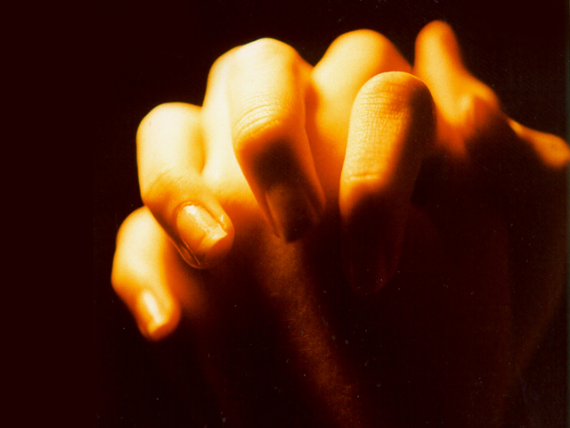
1. Confess it to God
If we confess our sins, he is faithful and just to forgive us our sins and to cleanse us from all unrighteousness. 1 John 1:9

Slide 17
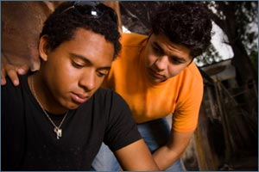
2. Ask someone to pray
Therefore, confess your sins to one another and pray for one another, that you may be healed. The prayer of a righteous person has great power as it is working. James 5:16

Slide 18

3. Remove temptation
With the temptation he will also provide a way of escape, that you may be able to endure it. Therefore, my beloved, flee… 1 Corinthians 10:13-14

Slide 19
4. Fill the void
And do not get drunk with wine, for that is debauchery, but be filled with the Spirit… Ephesians 5:18

Slide 20
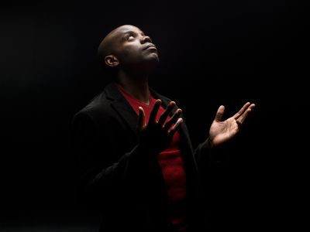
5. Pray for strength
…praying at all times in the Spirit, with all prayer and supplication. Ephesians 6:18

Slide 21

6. Make a vow
I have been crucified with Christ…
Galatians 2:20

Slide 22

7. Stick with good people
So flee youthful passions and pursue righteousness… with those who call on the Lord from a pure heart. 2 Tim 2:22

