Slide 1
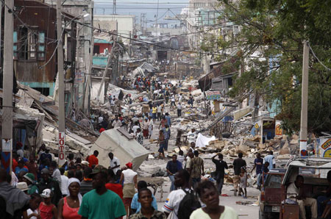

Slide 2
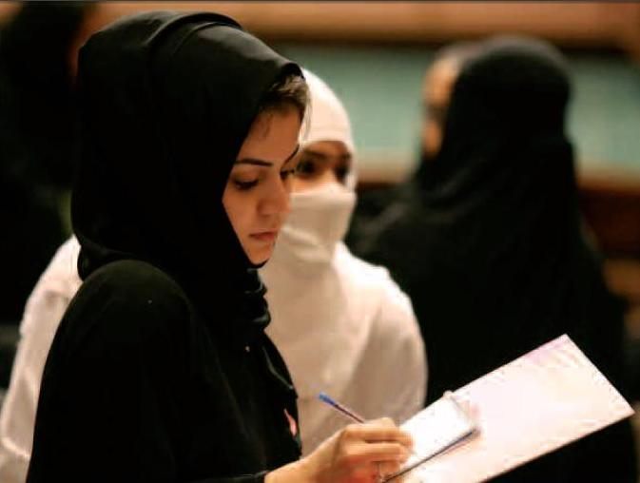

Slide 3
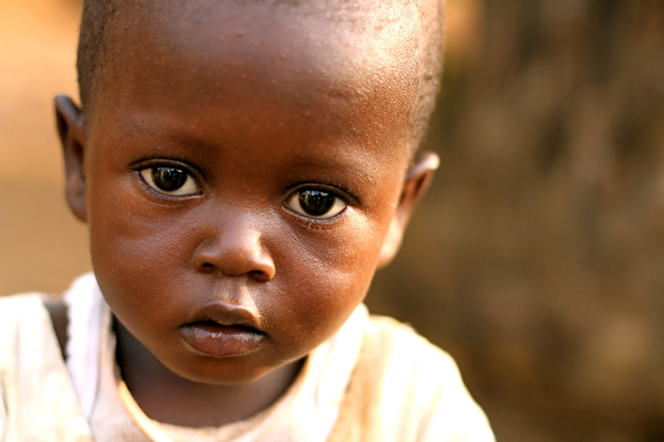

Slide 4
Show me
How can I survive in this evil world?

Slide 5
Finding the Answers
Man’s Answers
Self
World

Slide 6
World

Slide 7
World
Greed

Slide 8
World
Greed
Injustice

Slide 9
World
Greed
Injustice
Violence

Slide 10
World
Greed
Injustice
Violence
Strife

Slide 11
Finding the answers
Man’s Answers
God’s Answers
Self
World
Idols
Faith (2:4)

Slide 12
Surviving by Humble Faith (Hebrews 10:35-39)
But the righteous will live by his faith.
Jesus’ Sacrifice
Faith of Righteous

Slide 13
Finding the answers
Man’s Answers
God’s Answers
Self
World
Idols
Faith (2:4)
Knowledge (2:14)

Slide 14
Light of God’s Glory (2 Corinthians 4:3-6)
For the earth will be filled with the knowledge of the glory of the LORD, as the waters cover the sea.
Jesus’ Message
Knowledge of God

Slide 15
Finding the answers
Man’s Answers
God’s Answers
Self
World
Idols
Faith (2:4)
Knowledge (2:14)
Reverence (2:20)

Slide 16
Seeing the Awesome God (Ephesians 2:19-22)
The LORD is in His holy temple. Let all the earth be silent before Him.
Jesus’ People
Temple of God

Slide 17
Habakkuk’s strength
Yet I will exult in the LORD, I will rejoice in the God of my salvation. The Lord GOD is my strength, and He has made my feet like hinds' feet, and makes me walk on my high places. ~Habakkuk 3:18-19

