Slide 1
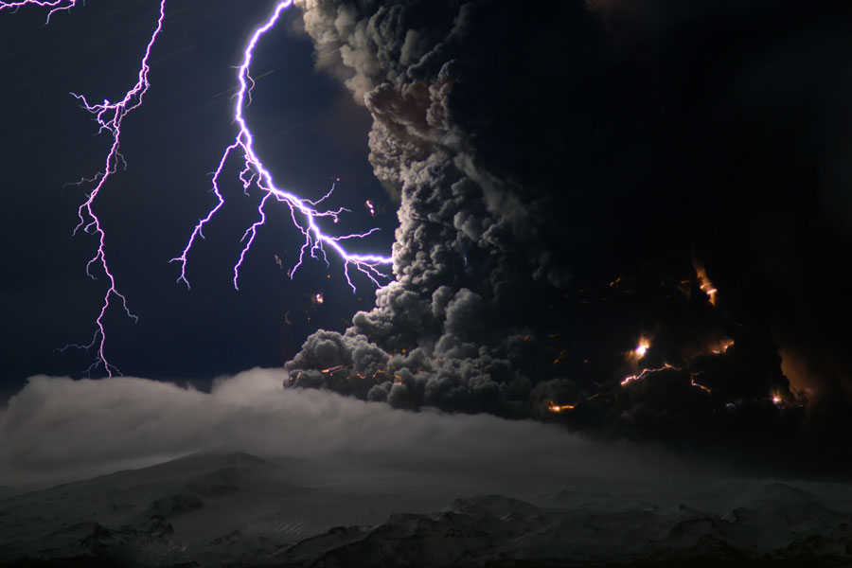

Slide 2
The Tabernacle
Drawing near to a holy God…

Slide 3
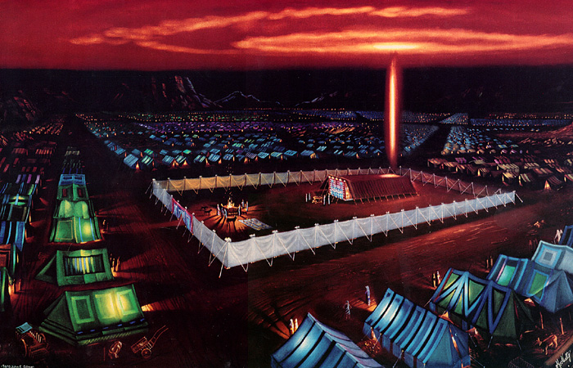

Slide 5
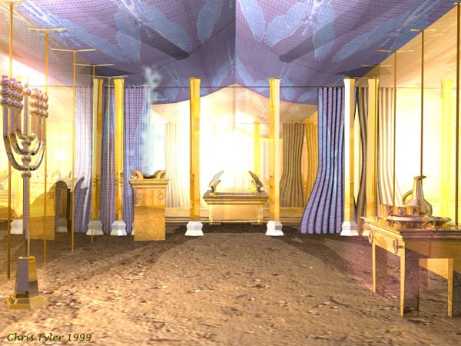

Slide 6
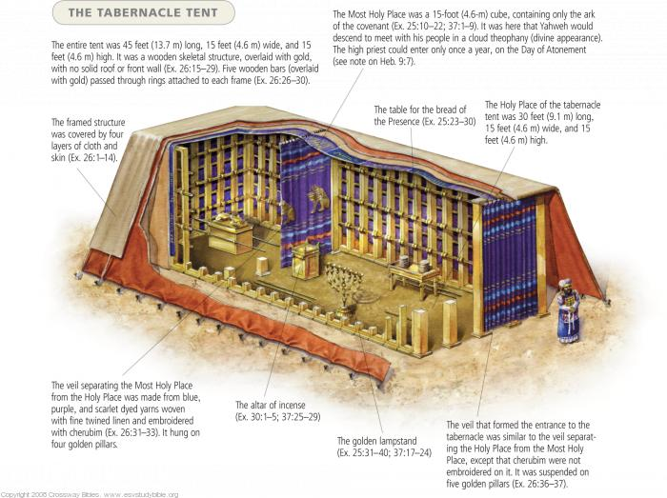

Slide 7
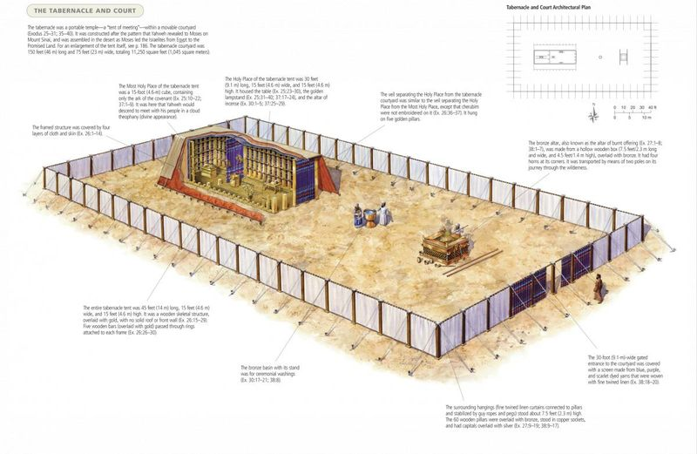

Slide 8
The Pattern
Exactly as I show you concerning the pattern of the tabernacle, and of all its furniture, so you shall make it. Ex 25:9
And see that you make them after the pattern for them, which is being shown you on the mountain. Ex 25:40
The you shall erect the tabernacle according to the plan for it that you were shown on the mountain. Ex 26:30

Slide 9
The Pattern
“Our fathers had the tent of witness in the wilderness, just as he who spoke to Moses directed him to make it, according to the pattern he had seen. Acts 7:44
They serve as a copy and shadow of the heavenly things. For when Moses was about to erect the tent, he was instructed by God, saying, “See that you make everything according to the pattern that was shown you on the mountain.” Heb 8:5

Slide 10
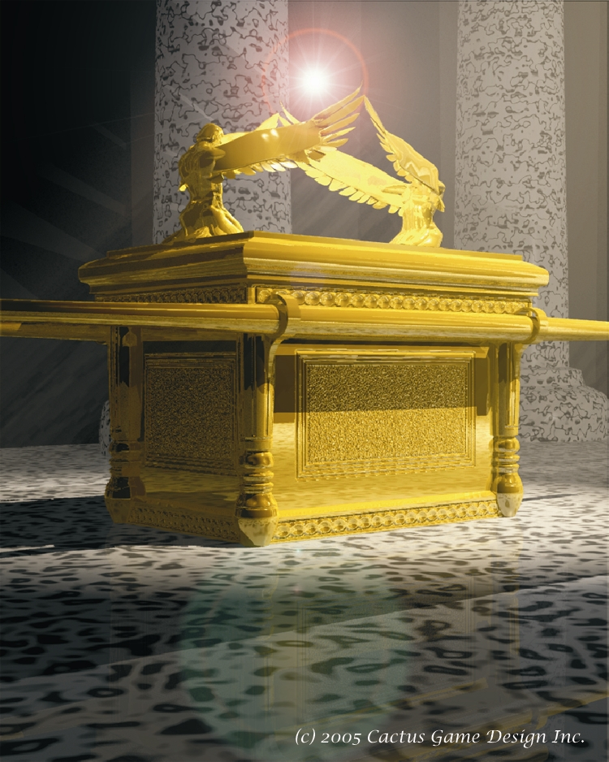

Slide 11
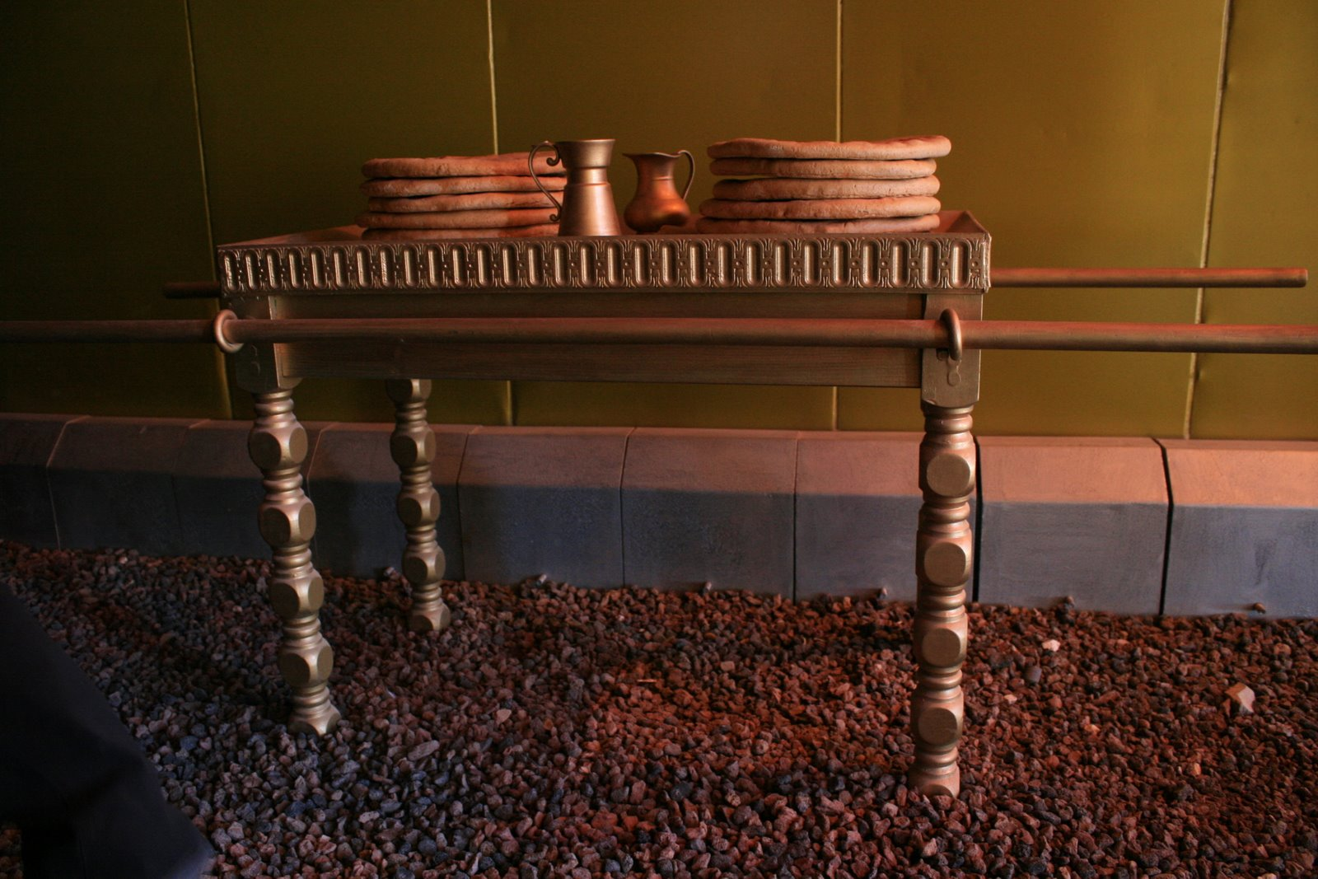

Slide 12
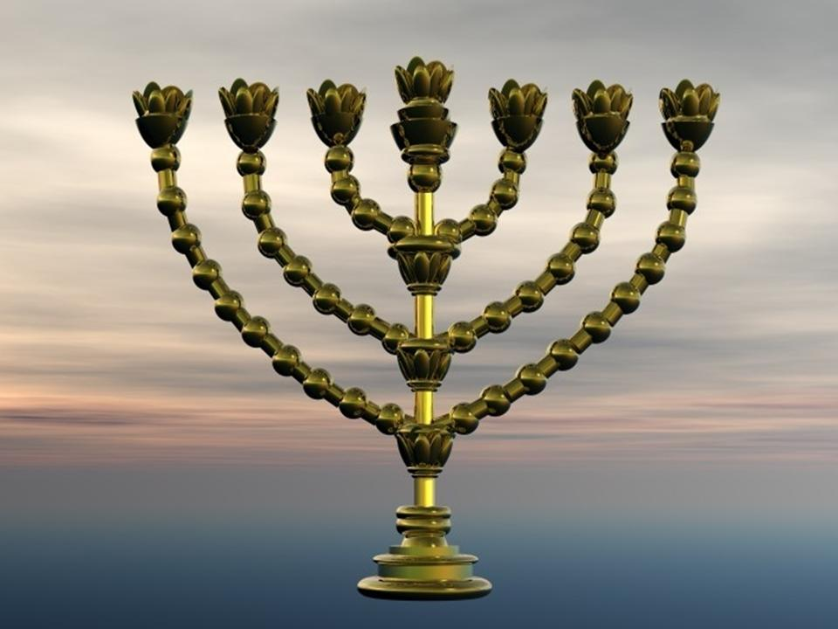

Slide 13
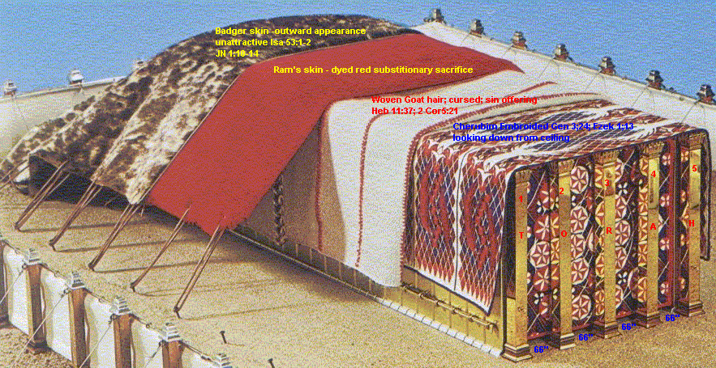

Slide 14
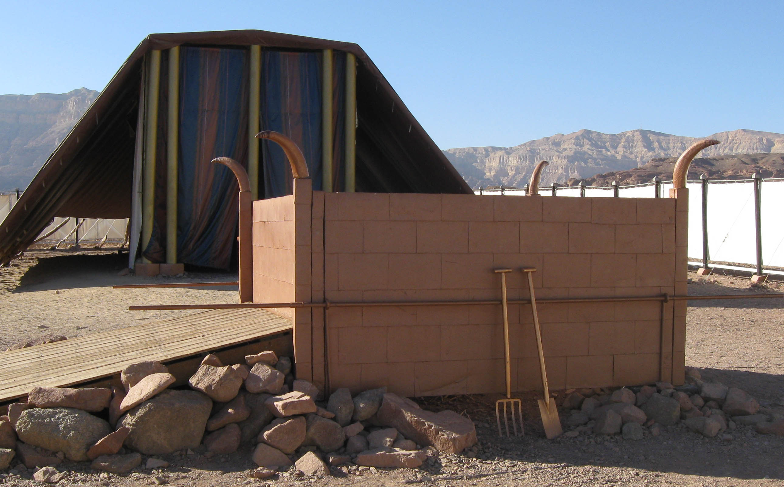

Slide 15
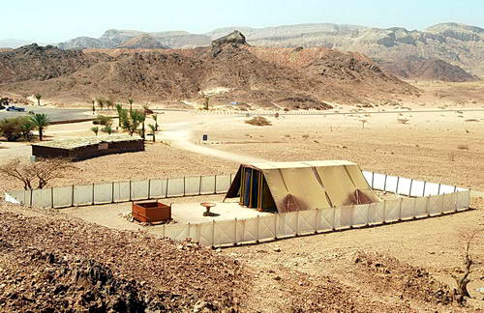

Slide 16
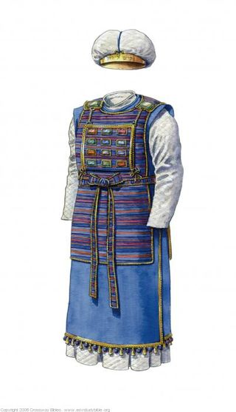

Slide 17
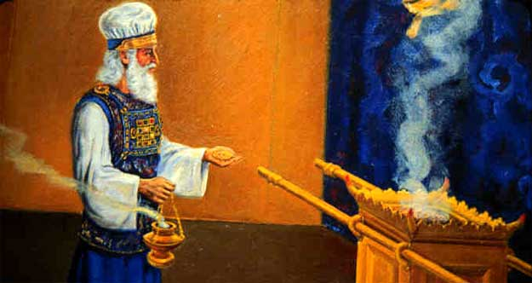

Slide 18
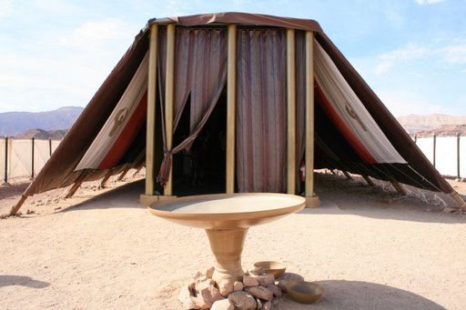

Slide 19
The Pattern
The directions: Exodus 25-31
The construction: Exodus 35-40
Language almost identical to directions
“as the LORD had commanded Moses” (39:1, 5, 7, 21, 26, 29, 31, 32, 42, 43; 40:19, 21, 23, 25, 27, 29, 32)

Slide 20
Nadab & Abihu
Leviticus 8
Washed, special clothing (v 5-9)
Anointed with special oil (v 10-13)
Sin offering (v 14-17)
Burnt offering (v 18-21)
Ordination offering (v 22-29)
Sit at entrance of tent of meeting for 7 days (v 30-36)

Slide 21
Leviticus 9
Sin offering
“As the Lord commanded Moses”
Leviticus 10
Altar of incense
“which he had not commanded them.”
Fire came down from the LORD
Fire came down from the LORD

Slide 22
Lev 10:3
“Among those who are near me I will be sanctified, and before all the people I will be glorified.”
Lev 16:2
“Tell Aaron your brother not to come at any time into the Holy Place inside the veil, before the mercy seat that is on the ark, so that he may not die.”

Slide 23
Holiness of God
Tabernacle
Furniture
Garments
Sacrifices

Slide 24
Long ago, at many times and in many ways, God spoke to our fathers by the prophets, but in these last days he has spoken to us by his Son, whom he appointed the heir of all things, through whom also he created the world.

Slide 25
He is the radiance of the glory of God and the exact imprint of his nature, and he upholds the universe by the word of his power. After making purification for sins, he sat down at the right hand of the Majesty on high… Heb 1:1-2

Slide 26
Since then we have a great high priest who has passed through the heavens, Jesus, the Son of God, let us hold fast our confession. For we do not have a high priest who is unable to sympathize with our weaknesses, but one who in every respect has been tempted as we are, yet without sin.

Slide 27
Let us then with confidence draw near to the throne of grace, that we may receive mercy and find grace to help in time of need.
Hebrews 4:14-16

Slide 28
These preparations having thus been made, the priests go regularly into the first section, performing their ritual duties, but into the second only the high priest goes, and he but once a year, and not without taking blood, which he offers for himself and for the unintentional sins of the people.

Slide 29
By this the Holy Spirit indicates that the way into the holy places is not yet opened as long as the first section is still standing.
Hebrews 9:6-8

Slide 30
According to this arrangement, gifts and sacrifices are offered that cannot perfect the conscience of the worshiper, but deal only with food and drink and various washings, regulations for the body imposed until the time of reformation. Heb 9:9-10

Slide 31
Therefore, brothers, since we have confidence to enter the holy places by the blood of Jesus, by the new and living way that he opened for us through the curtain, that is, through his flesh, and since we have a great priest over the house of God,

Slide 32
let us draw near with a true heart in full assurance of faith, with our hearts sprinkled clean from an evil conscience and our bodies washed with pure water.
Hebrews 10:19-22

Slide 33
QUESTION
Obedience was necessary under the old covenant of works, is it still necessary under the new covenant of grace?

Slide 34
Therefore let us be grateful for receiving a kingdom that cannot be shaken, and thus let us offer to God acceptable worship, with reverence and awe, for our God is a consuming fire.
Hebrews 12:29-29

Slide 35
Therefore let us be grateful for receiving a kingdom that cannot be shaken, and thus let us offer to God acceptable worship, with reverence and awe, for our God is a consuming fire.
Hebrews 12:29-29

