Slide 1
The Rich Young Ruler
A window to our own heart

Slide 2
Lesson #1
Entrance into the kingdom involves more than outward obedience

Slide 3
A lot to commend:
Eager – he ran up
Humble – knelt before him
Respectful – “Good Teacher”
Good question – “What must I do…?”
Lived moral life – “all these I have kept…”
Good family – “…from my youth.”
Jesus loved him!

Slide 4
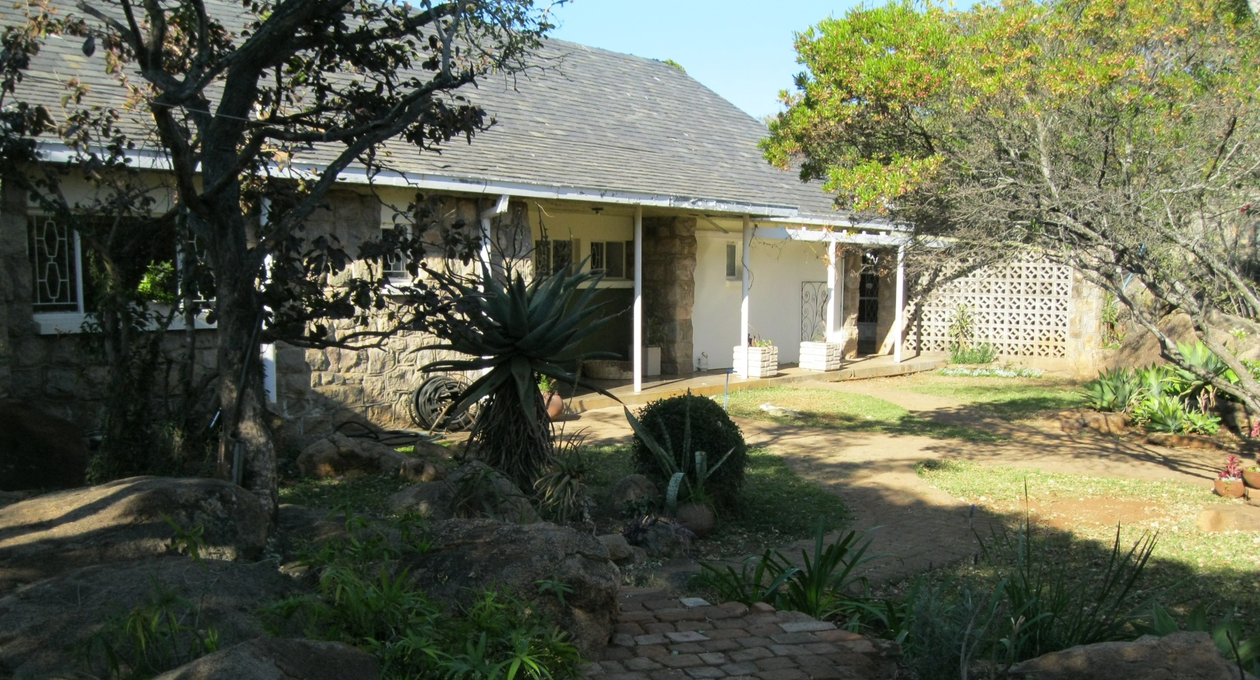

Slide 5
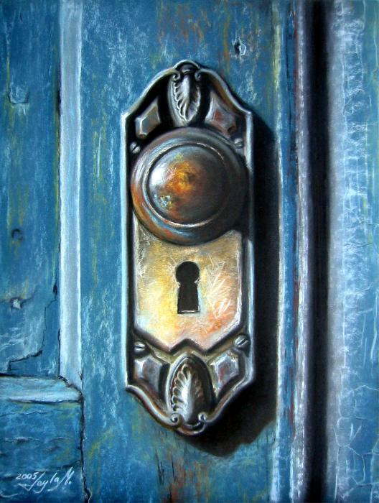
Behold, I stand at the door and knock.
Revelation 3:20

Slide 6
Lesson #2
In the kingdom of God we receive more than we give up

Slide 7
Do the math
What we give up
What we Receive
House
Brothers
Sisters
Mother
Father
Children
Lands
100 x Houses
100 x Brothers
100 x Sisters
100 x Mothers
100 x Children
100 x Lands
Persecutions…
ETERNAL LIFE!

Slide 8
Guess how much it is worth?
Nothing!

Slide 9
Lesson #3
In the kingdom of God many who are first will be last, and the last first

Slide 10
And they were bringing children to him that he might touch them, and the disciples rebuked them.
Mark 10:13

Slide 11
Why would someone walk 12 miles on crutches to attend a gospel meeting?

Slide 12
“I have come to be filled.”

Slide 13
“Let the children come to me; do not hinder them, for to such belongs the kingdom of God. Truly, I say to you, whoever does not receive the kingdom of God like a child shall not enter it.”
Mark 10:14-15

