Slide 1
Pictures of God’s People In The World
“Youth Not Of This World”
Embry Hills April 2016

Slide 2
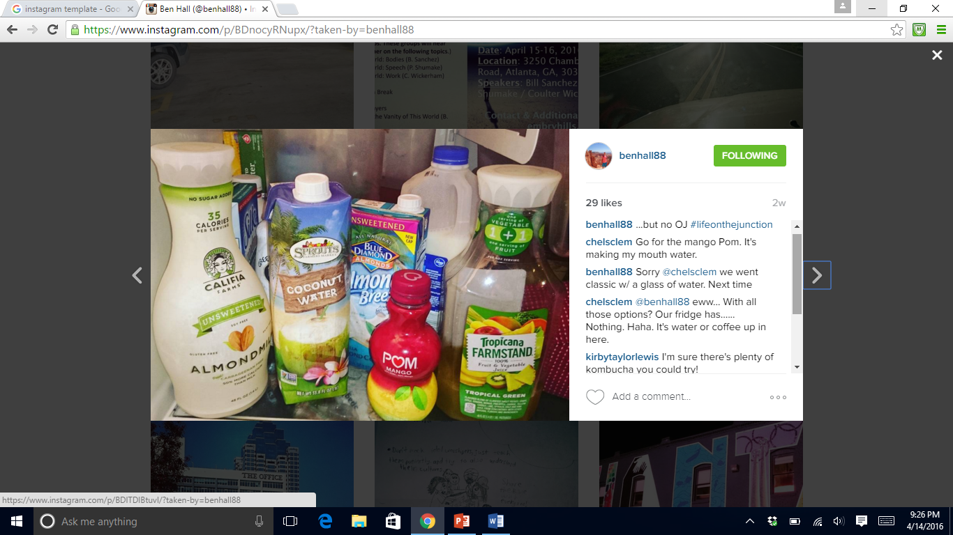

Slide 3
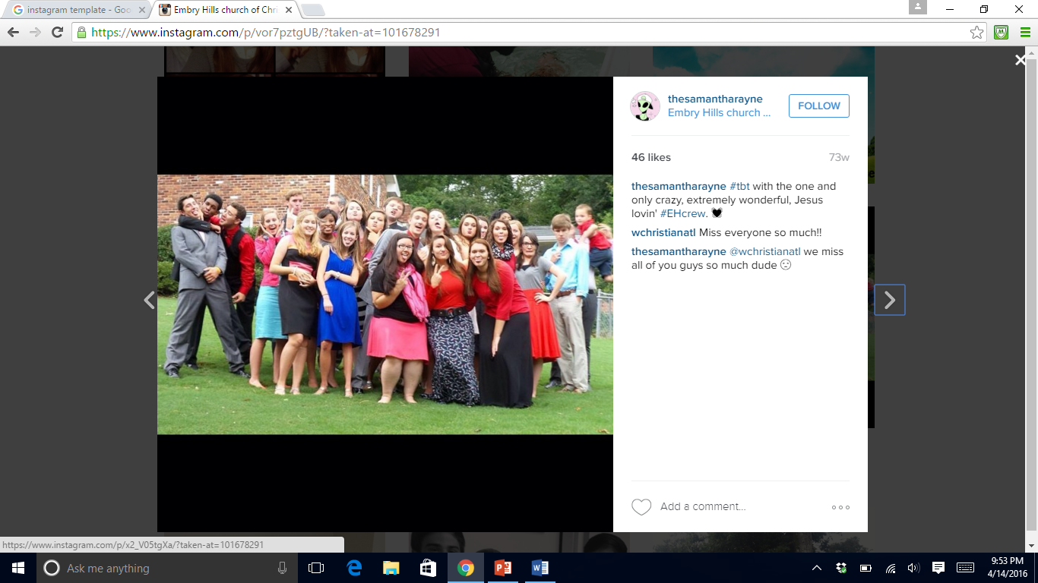

Slide 4
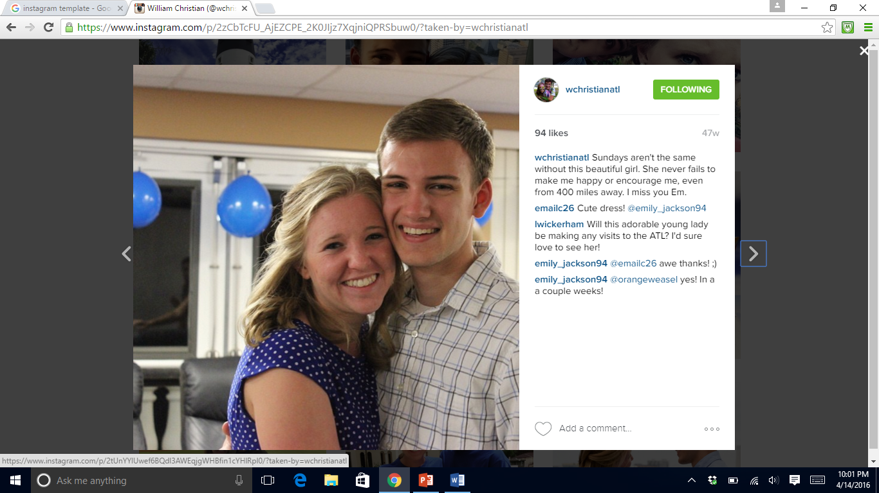

Slide 5
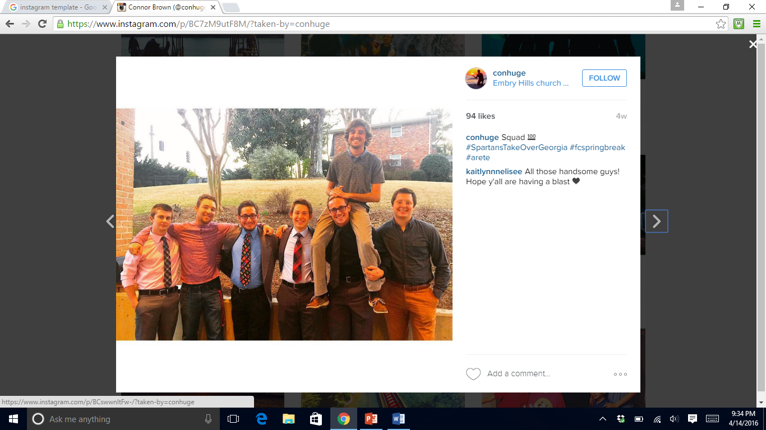

Slide 6
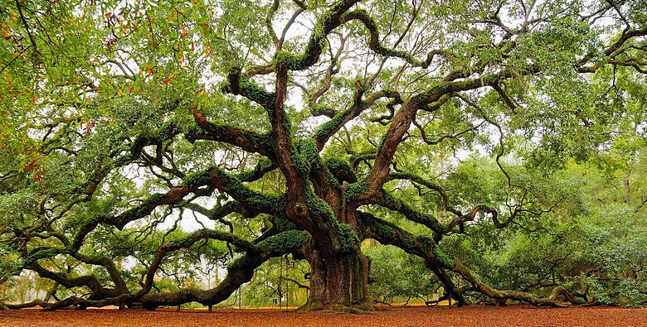

Slide 7
Pictures of God’s People In The World
The prophets show us how God sees His people/church.
The Messiah would create a New Restored Israel.
Nine of The 12 include this concept. Consider Micah:
1-2 Jehovah Gathers The Remnant Like Sheep
3-5 Jehovah Restores The Remnant’s Royalty
6-7 Jehovah Forgives The Remnant People
It first occurs in [Micah 2:12-13] & then again… in 4:1-8 & 7:8-12. The New Jerusalem of Praise!

Slide 8
Pictures of God’s People In The World
Micah 4 Pictures of Restored Israel:
4:1 A New Temple… Raised Above All The Mtns
4:2 A New Nation… Made Up Of All Races
A Zion That Is Unshakable [Heb 12:18-29]
4:3 A Peaceful & Productive People
4:4-5 A People That Are Not Afraid cf. Mt 10:28
4:6-8 A Promise Available For EVERY Person!

Slide 9
Pictures of God’s People In The World
The World is a busy & dark place. Are we too busy? Too busy to be God’s Picture of Joyful Praise?
This goes for the athlete, the artist, & the academic.
A typical overachieving high-school junior may rise at dawn, arrive at school early for debate club, spend his study-hall time cramming for a calculus mid-term, eat lunch in the library while prepping for the PSAT he’ll take on Saturday, & end the school day researching an extra-credit project in physics. After dinner he’ll revise his paper about Heart of Darkness for honors English (with a break for the latest Walking Dead episode), wind down by beating up women in Grand Theft Auto V, & finally crash at midnight. His life is heavy: heavy academics, heavy entertainment, heavy expectations.
-J. Cheaney “Child’s Play” World Magazine

Slide 10
Pictures of God’s People In The World
Finally in Micah 7 the laments turn to praise!
The picture of God’s people we need most:
God’s People are full of Joy & Praise!
What Joy is there in a world that is so dark?
The Character of Jehovah [Mic 7:18-20]
Don’t neglect the hymns of salvation! James 5:13

Slide 12
namehere
namehere
4 minutes ago
namehere
namehere
4 minutes ago
namehere
message goes here
namehere
message goes here
namehere
4 minutes ago

Slide 13
namehere
namehere
4 minutes ago
message goes here. This should be two-three and possibly include a # that is relevant.
namehere
namehere
namehere
message goes here. This should be a sentence or two and possibly include a # that is relevant.
namehere
message goes here. This should be a sentence or two and possibly include a # that is relevant.

Slide 14
namehere
namehere
4 minutes ago
message goes here. This should be two-three and possibly include a # that is relevant.
namehere
namehere
namehere
message goes here. This should be a sentence or two and possibly include a # that is relevant.
namehere
message goes here. This should be a sentence or two and possibly include a # that is relevant.

Slide 15
namehere
namehere
4 minutes ago
message goes here. This should be two-three and possibly include a # that is relevant.
namehere
namehere
namehere
message goes here. This should be a sentence or two and possibly include a # that is relevant.
namehere
message goes here. This should be a sentence or two and possibly include a # that is relevant.

Slide 16
namehere
namehere
121
121
121
Month Year
Month Year

Slide 17
NAMEHERE
namehere
Real Name Here
Information about your character/person
websiteforcharacter/person.com
101 likes
namehere
type comment here
continue typing message here…
view all comments

Slide 18
namehere
namehere
namehere
101 likes
namehere
namehere
101 likes
101 likes
namehere
type comment here
namehere
type comment here
namehere
type comment here
continue typing message here…
continue typing message here…
continue typing message here…
view all comments
view all comments
view all comments

