Slide 1
Stand Firm and Be Stirred Up – I and II Peter, Jude
Pre-Class Questions
What do you know about Peter from the four gospel accounts of Christ’s life?
What do you know about Peter from the Book of Acts?

Slide 2
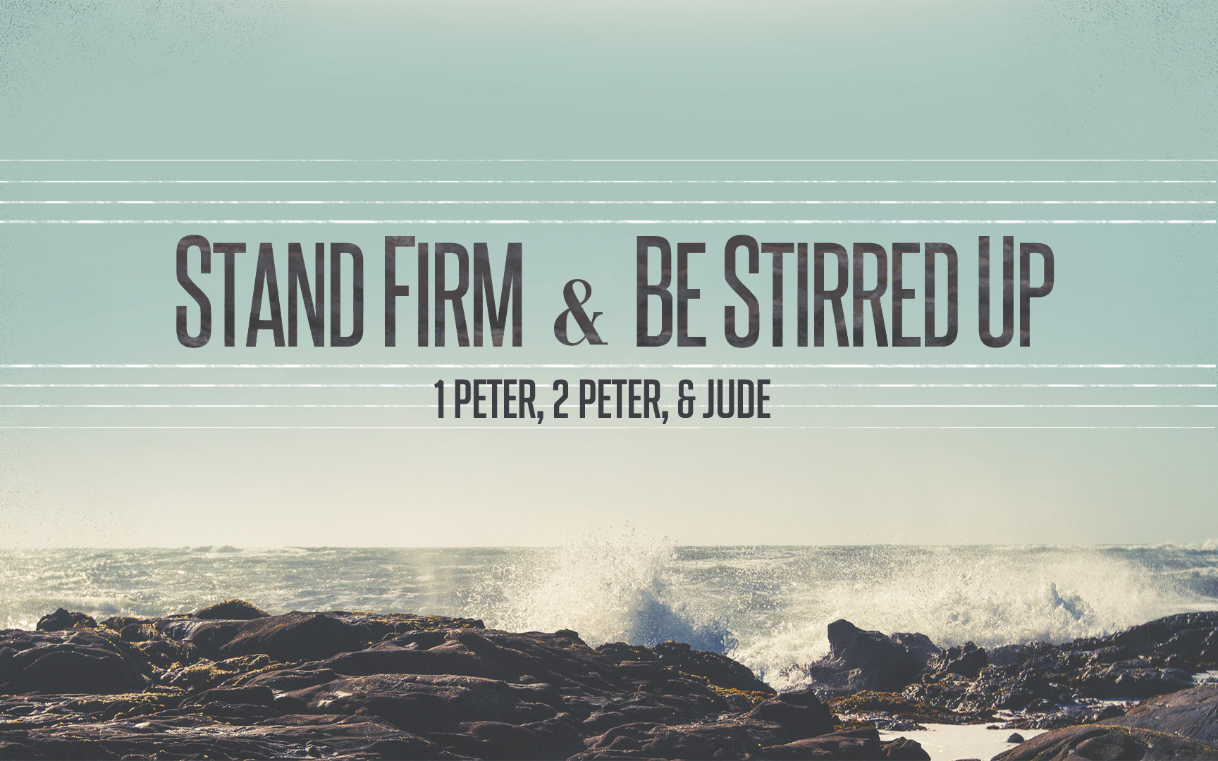
Stand Firm & Be Stirred Up

Slide 3
Class Lesson Schedule
Lesson | Title/Material | Teacher | Day | Date
1 | Introduction to I Peter | Russ | Sunday | May 29, 2016
2 | Stand Firm in Salvation (I Peter 1:1-12) | Russ | Wednesday | June 1, 2016
3 | Stand Firm in Hope & Holiness (I Peter 1:13-2:10) | Phillip | Sunday | June 5, 2016
 | VBS – Special Class |  | Wednesday | June 8, 2016
4 | Stand Firm in Community and Family (I Peter 2:11-3:12) | Phillip | Sunday | June 12, 2016
5 | Stand Firm in Zeal during Suffering (I Peter 3:13-4:19) | Phillip | Wednesday | June 15, 2016
6 | Stand Firm with the Chief Shepherd (I Peter 5:1-13) | Phillip | Sunday | June 19, 2016
7 | Introduction to II Peter | Russ | Wednesday | June 22, 2016
8 | Stirring Up our Spiritual Growth (II Peter 1:1-21) | Phillip | Sunday | June 26, 2016
9 | Stirring Up Pure Doctrine and Pure Living (II Peter 2:1-22) | Phillip | Wednesday | June 29, 2016
10 | Contending for the Faith (Jude) | Phillip | Sunday | July 3, 2016
11 | Stirring Up our Insight (II Peter 3:1-18) | Phillip | Wednesday | July 6, 2016
12 | Grounded & Growing in Difficult Times | Phillip | Sunday | July 10, 2016
13 | Review | Phillip | Wednesday | July 13, 2016

Slide 4
Stand Firm and Be Stirred Up – I and II Peter, Jude
By the end of the study each of us will:
Develop a reputation for good works among those who are most critical of our faith
Promote greater “Harmony” in our home by learning our part well
Build a deeper relationship with the shepherds
Deepen our appreciation for the suffering of Christ and what it means to share in that suffering
Invest in the things that last the longest

Slide 5
Familiarity with Christ
I Peter 1:23
“since you have been born again . . .”
John 3:3, 5
“Most assuredly, I say to you, unless one is born again, he cannot see the kingdom of God.”

Slide 6
Familiarity with Christ
I Peter 2:7
“ The stone which the builders rejected has become the chief cornerstone,”
Matthew 21:42
“The stone which the builders rejected has become the chief cornerstone.”

Slide 7
Familiarity with Christ
I Peter 3:9
9 not returning evil for evil or reviling for reviling, but on the contrary blessing
Luke 6:27-28
27 “But I say to you who hear: Love your enemies, do good to those who hate you, 28 bless those who curse you

Slide 8
Familiarity with Christ
I Peter 3:21
21 Baptism, which corresponds to this, now saves you,
Mark 16:16
16 He who believes and is baptized will be saved;

Slide 9
Familiarity with Christ
I Peter 4:14
14 If you are reproached for the name of Christ, blessed are you,
Matthew 5:11
11 “Blessed are you when they revile and persecute you, and say all kinds of evil against you falsely for My sake.

Slide 10
Familiarity with Christ
I Peter 5:4
4 and when the Chief Shepherd appears
John 10:11
11 “I am the good shepherd. The good shepherd gives His life for the sheep.

Slide 11
I Peter references to
Events in the Life of Jesus
Foreordained, Manifested 1:20
Blood, Lamb 1:19
Silence before accusers 2:23
Crucified (Tree) 2:24
Stripes 2:24
Resurrection 3:21
Ascension 3:22

Slide 12
Key Events During Peter’s Life
Time With Jesus
Made an Apostle
Jairus’ daughter raised
Walks on water (until his faith fails)
Blessed by Jesus upon confession - Resisted idea of Jesus dying
Witnesses transfiguration - Proposes to build three “tents”
At Passover meal – Lord’s Supper
In the Garden of Gethsemane
Denying knowing Jesus during trials
Crucifixion / Resurrection / Ascension
Ran to the empty tomb
“Do you love me?”
Prediction of Peter’s death

Slide 13
Key Events During Peter’s Life
Establishment of the church
Preaching on the day of Pentecost
Arrested with John and addressed Sanhedrin boldly
Action against Ananias and Sapphira
Peter’s fame
Many sick hoped that just Peter’s shadow would fall on them
Imprisoned again - “We ought to obey God rather than men”
Preached to the Gentiles for the first time
Argues for their inclusion at the “Jerusalem Council”
Visits Antioch
Does not eat with them (playing the hypocrite)

Slide 14
Peter’s View of Scriptures
I Peter 1:10-11
10 Of this salvation the prophets have inquired and searched carefully, who prophesied of the grace that would come to you, 11 searching what, or what manner of time, the Spirit of Christ who was in them was indicating when He testified beforehand the sufferings of Christ and the glories that would follow.

Slide 15
Peter’s View of Scriptures
II Peter 1:21
²⁰ knowing this first of all, that no prophecy of Scripture comes from someone's own interpretation. ²¹ For no prophecy was ever produced by the will of man, but men spoke from God as they were carried along by the Holy Spirit.

Slide 16
Peter’s View of Scriptures
I Peter 1:12
12 To them it was revealed that, not to themselves, but to us they were ministering the things which now have been reported to you through those who have preached the gospel to you by the Holy Spirit sent from heaven

Slide 17
Peter’s View of Scriptures
II Peter 3:15-16
Paul, according to the wisdom given to him, has written to you, 16 as also in all his epistles, speaking in them of these things, in which are some things hard to understand, which untaught and unstable people twist to their own destruction, as they do also the rest of the Scriptures.

Slide 18
Introduction to First Peter
Author
“Peter, an apostle of Jesus Christ”
Addressees
“Pilgrims of the Dispersion in Pontus, Galatia, Cappadocia, Asia, and Bithynia”
Evidence that some were Jews: 1 Peter 1:1, 2:12
Evidence that some were Gentiles: 1 Peter 1:14, 18; 2:10; 4:3
They were Christians whose citizenship is in Heaven who lived in five districts of the Roman Empire (a region known as Asia Minor)
Notes:
Evidence that some were Jews: 1 Peter 1:1, 2:12
Evidence that some were Gentiles: 1 Peter 1:14, 18; 2:10; 4:3
Pilgrims of the Dispersion is used metaphorically to refer to Christians here, not to the Jews scattered abroad by the Assyrian and Babylonian empires.

Slide 19
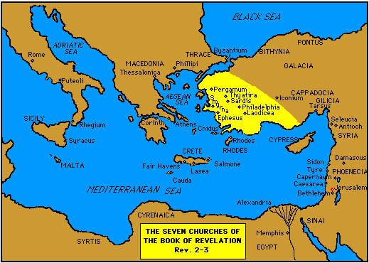

Slide 20
Introduction to First Peter
Author
“Peter, an apostle of Jesus Christ”
Addressees
“Pilgrims of the Dispersion in Pontus, Galatia, Cappadocia, Asia, and Bithynia”
Evidence that some were Jews: 1 Peter 1:1, 2:12
Evidence that some were Gentiles: 1 Peter 1:14, 18; 2:10; 4:3
They were Christians whose citizenship is in Heaven who lived in five districts of the Roman Empire (a region known as Asia Minor)
Place of Writing: Babylon (literal or figurative?)
Mark was with Peter, and Silvanus may have been the messenger.
Notes:
Evidence that some were Jews: 1 Peter 1:1, 2:12
Evidence that some were Gentiles: 1 Peter 1:14, 18; 2:10; 4:3
Pilgrims of the Dispersion is used metaphorically to refer to Christians here, not to the Jews scattered abroad by the Assyrian and Babylonian empires.

Slide 21
Nature of Persecution in First Peter
Specific Persecutions
Thought (called) strange (4:4)
Spoken of as evil (4:4)
Spoken against (3:16)
Good manner of life reviled (3:16)
Accused of evil deeds (2:12)
Reproached in connection with the name of Christ (4:14)
Punished for being a Christian (4:16)
Possible Reasons
“Not afraid” – independence from worldly influence (3:13,14)
“Free” from the world / sin – independence from worldly thought (2:16)
Offensive doctrines
As we study First Peter, make a list of some of the doctrines that non-Christians may have considered offensive.

Slide 22
Theme of First Peter
Enduring trials and suffering through the hope of glory (Stand Firm)
Suffer (pascho) – used 16 times
Pain or grief inflicted by those around them as a result of doing right or living godly (not by illness or one’s own misconduct).
Glory (doxa) – used 15 times
Honor resulting from a good opinion
Glorification of believers – “The state of blessedness into which believers are to enter hereafter”
Glorify God – To praise, extol, magnify, celebrate
Glory of God – His magnificence and splendor
“Of the nature and acts of God in self-manifestation – what He essentially is and does, as exhibited in the way he reveals Himself, and particularly in the person of Christ”

Slide 23
Peter’s Experience in Relationship to the Theme of First Peter
Did he witness Jesus suffering?
Did he suffer himself as a Christian?
Did he experience persecution?
Did he ever fail during trials?
Did he persevere despite great pressure?
Did he witness Jesus being glorified?
Notes:
1 PET 2:19-24; 3:18; 4:1, 13; 5:1
Acts 4:13-18, 23 – 31; Acts 5:17 – 26, 40 – 44
MT 17:1-5; 2 PET 1:16-18

Slide 24
Paul to
Rome
Beginning
of
Nero’s
persecution
Jewish
War
begins
Jerusalem
destroyed
58
60
62
64
66
68
70
1 Peter
?
Peter
killed
(tradition)
Paul
killed
(tradition)
2 Pet.
?
Romans
written;
Peter not
in Rome
Mark
in
Rome
Col. 4:10
Great
fire in
Rome
Mark
called to
Rome
2 Tim. 4:11

Slide 26
I Peter
Selected Events in the Life of Peter
Apostle Mark 3:16
Jairus’ Daughter Mark 5:22
Transfiguration Matt. 17:1
Gethsemane Matt. 26:37
Walking on the Sea Matt. 14:29
Denial Luke 22:57
Witness Luke 24:34
Questioned John 21:15

Slide 27
Class Lesson Schedule
 | Title | Content | Teacher | Date
1 | Introduction & Overview | Introduction, plus Godliness | Russ | Sun, 7/19
2 | Selflessness & Sacrifice | Selflessness, Humility , Meekness | Russ | Wed, 7/22
3 | Forbearing & Forgiving | Forbearance & Forgiveness | Dave | Sun, 7/26
4 | Contentment & Kindness | Contentment & Kindness | Russ | Wed, 7/29
5 | Husbands & Headship | Husbands: Sacrificial leadership | Dave | Sun, 8/2
6 | Wives & Submission | Wives: Submission & Responsibility | Dave | Wed, 8/5
7 | Personal Relationships | Personal Relationship (Romance) | Russ | Sun, 8/9
8 | Case Studies 1 | Self-centeredness; Separate lives | Russ | Wed, 8/12
9 | Case Studies 2 | Annoyances & Unmet Expectations | Dave | Sun, 8/16
10 | Case Studies 3 | Spiritual Leadership & Priorities | Dave | Wed, 8/19
11 | Case Studies 4 | Maintaining Roles | Russ | Sun, 8/23
12 | Case Studies 5 | Unfaithfulness & Forgiveness | Russ | Wed, 8/26
13 | Case Studies 6 | Tragedy, Crisis, Discouragement | Russ | Sun, 8/30

Slide 28
Major Point Outline of I Peter
Introduction (1:1,2)
The Great Salvation (1:3-12)
The Products of Salvation (1:13-2:10)
The Duties of the Christian (2:11-3:12)
Suffering as a Christian (3:13-4:19)
Exhortation to Shepherds (5:1-5)
Exhortations to Soldiers (5:6-11)
Conclusions (5:12,13)

Slide 29
Introduction 1:1,2
The Great Salvation 1:3-12
The Nature of the Salvation 1:3-9
The Revelation of the Salvation 1:10-12
The Products of Salvation 1:13-2:10
Holiness 1:13-16
Reverence 1:17-21
Love 1:22-25
Growth 2:1-3
Sacrifices 2:4-8
Testimony 2:9,10
The Duties of the Christian 2:11-3:12
Before Gentiles (Introd.) 2:11,12
To the State 2:13-17
To Masters 2:18-25
To Family: Husbands, Wives, Brethren 3:1-12
Suffering as a Christian 3:13-4:19
Suffering for Righteousness 3:13-17
Christ, an Example of Suffering 3:18-22
Purpose of Suffering 4:1-6
Responsibilities to One Another 4:7-11
Consolation of Suffering 4:12-19
Exhortation to Shepherds 5:1-5
Exhortations to Soldiers 5:6-11
Conclusions 5:12,13
Outline of First Peter

Slide 30
Introduction 1:1,2
The Great Salvation 1:3-12
The Nature of the Salvation 1:3-9
The Revelation of the Salvation 1:10-12
The Products of Salvation 1:13-2:10
Holiness 1:13-16
Reverence 1:17-21
Love 1:22-25
Growth 2:1-3
Sacrifices 2:4-8
Testimony 2:9,10
The Duties of the Christian 2:11-3:12
Before Gentiles (Introduction) 2:11,12
To the State 2:13-17
To Masters 2:18-25
To Family: Husbands, Wives, Brethren 3:1-12
Suffering as a Christian 3:13-4:19
Suffering for Righteousness 3:13-17
Christ, an Example of Suffering 3:18-22
Purpose of Suffering 4:1-6
Responsibilities to One Another 4:7-11
Consolation of Suffering 4:12-19
Exhortation to Shepherds 5:1-5
Exhortations to Soldiers 5:6-11
Conclusions 5:12,13
Outline of First Peter

Slide 31
Stand Firm & Be Stirred Up

