Slide 1
Lesson 3
Othniel, Ehud & Shamgar

Slide 2
Objectives – Lesson 1 Introduction and Overview
Place the 12 major Old Testament periods in order.
Define both concepts behind the term: “Judge” .
Explain why the sum of intervals of the “Oppressions” and “Judging” is more than the total time elapsed in the period of the Judges.
List the three major sections of the book.
Label a map of Palestine with the locations of the major tribes and enemies.
List the four elements of the “Disobedience Cycle” in the period of the Judges.

Slide 3
Objectives – Lesson 2 Conditions in Israel (1:1-3:6)
Define “Gilgal” and “Bochim,” and explain the significance of these terms/places.
List the tribe that did best at conquest.
List the tribe that did worst at conquest.
Describe the geographical order of ch. 1
List 3 areas of Israelites’ disobedience

Slide 4
Objectives – Lesson 3 Conditions in Israel (1:1-3:6)
• List and find the tribes of Othniel & Ehud.
• Define “Othniel,” and list his well-known
relative.
• Describe the method of Ehud’s
assassination of Eglon.
• List Shamgar’s interesting weapon &
explain why strange weapons were needed).
• List the enemies of Othniel, Ehud, and
Shamgar and locate on a map.

Slide 5
12 OT Periods
# | Major OT Period | Heroes of Faith Hebrew 11
1 | Beginnings | Abel, Enoch
2 | Flood | Noah
3 | Patriarchs | Abraham & Sarah Isaac, Jacob, Joseph
4 | Slaves in Egypt | Moses
5 | Wilderness Wanderings | Moses, people crossed the Red Sea,
6 | Conquest | they marched 7 times around Jericho, Rahab
7 | Judges | Gideon, Barak, Samson, Jephthah, and Samuel
8 | United Kingdom | Samuel, David
9 | Divided Kingdom | The prophets
10 | Judah Alone | The prophets
11 | Babylonian Captivity | The prophets
12 | Return from Exile | The prophets

Slide 6
1-Beginnings Gen 1-5
2-Flood Gen 6-11
1445-1405 BC
5-Wilderness
Wanderings
931-722 BC
9-Divided
Kingdom
605-538 BC
11-Babylonian
Captivity
444 BC - ~4 BC
The Silent Years
(Intertestamental)
30-90 AD
The Church
NT Era
2166-1859 BC
3-Patriarchs
1380-1050 BC
7-Judges
4-Slavery in Egypt
1859-1445 BC
6-Conquest
of Canaan
1405-1380 BC
8-United
Kingdom
1050-931 BC
10-Judah
Alone
722-605 BC
12-Return
From Exile
538-444 BC
Life of
Christ
4 BC – 30 AD
1400 BC
1300 BC
1200 BC
1100 BC
East of Jordan:
Ammonites
& Philistines
Jephthah
Jair
Eli
Samuel
West of Jordan:
Elon
Midianites
Tola
Abdon
Saul
David
Solomon
Gideon
Canaanites
Moab
Deborah
Ehud
Philistines
Shamgar?
Samson
Judah : South
Othniel
Philistines
Mesopotamian
Ibzan
Egypt:
Battle of Kadesh
Egypt-Hittites
Merneptah
Sea People
Vs Ramses III
Based on Graphics from Marc Hinds & Zondervan Pictorial Encyclopedia of the Bible
Notes:
Judges describes cycles of apostasy, oppression, and deliverance in the southern region (3:7–31), the central region (6:1–10:5), the eastern region (10:6–12:15), and the western region (13:1–16:31).

Slide 7
I. Conditions in Israel (1:1-3:6)
II. The Judges (3:7-16:31)
III. Cultural Decline (17:1-21:25)
Outline of judges

Slide 8
I. Conditions in Israel (1:1-3:6)
- Unoccupied Areas (1:1-2:5)
- Religious/Political Cycles (2:6-3:6)
II. The Judges (3:7-16:31)
- Othniel* (3:7-11)
- Ehud* (3:12-30)
- Shamgar* (3:31)
- Deborah* and Barak (4:1-5:31)
- Gideon* (6:1-8:35)
- Abimelech, Tola, Jair (9:1-10:5)
- Jephthah* (10:6-12:7)
- Ibzan, Elon, Abdon (12:8-15)
- Samson* (13:1-16:31)
III. Cultural Decline (17:1-21:25)
- Micah and the Danites (17:1-18:31)
- Crime and Civil War (19:1-21:25)
Outline of judges

Slide 9
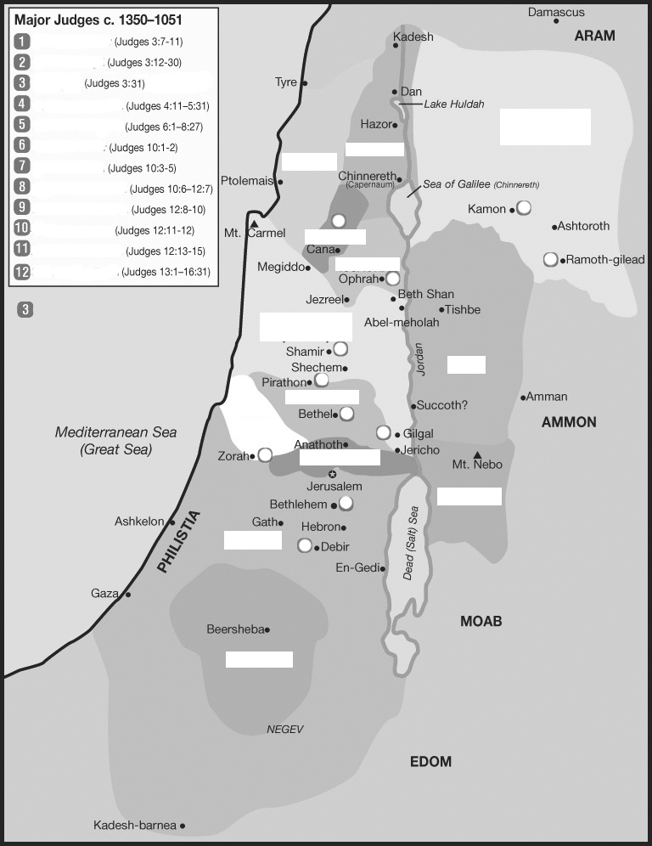
Placing the judges & tribes
Othniel
Ehud
Shamgar
Manasseh
East
Asher
Naphtali
Zebulun
Issachar
West of
Jordan
Manasseh
West
East of
Jordan
Gad
Ephraim
3
????
Dan
2
Benjamin
Reuben
Judah
1
Judah
South
Simeon

Slide 10
Israel in the Promised Land – The Ideal
Unified & guided by God, not men.
No central governmental organization
Led, locally, by faith-filled people, as needed
No competition for power/leadership (see Num 11:25-29)
“No King…everyone did that which was right in God’s eyes.”
Intensely separated from the non-believing world
Purged idolatry and immorality (even from own families)
Formed no alliances, covenants, intermarriages, except with faithful people
Their purity & obedience were examples to the nations around
Carefully obedient to the written Word
Every generation knew the Lord (Jg 2:10)
Remembered (carried out) the consequences of obedience & disobedience
The Word filled their lives (Levites, family study – Dt 6)
They worshiped as God instructed
Trusted in God’s care (Jg 2:7)
Content with the blessing in the land.
Not afraid to face enemies of God.
Did not depend on worldly measures of strength
Were strengthened by their repeated victories

Slide 11
Sins of Israelites
Did not know Jehovah or His works (2:10)
Served Baals and Ashtoreths (2:11-13)
Did not drive out the Canaanites (1:28)
Did not obey Jehovah, as their fathers (2:17b)
Gave & took daughters & sons in marriage (3:5) (made covenants, 2:2)
Judges 3:7 (ESV) ⁷ And the people of Israel did what was evil in the sight of the LORD. (4?)
They forgot the LORD their God (1)
and served the Baals and the Asheroth. (2)

Slide 12
Judges 3:8
Judges 3:8 (ESV) ⁸ Therefore the anger of the LORD was kindled against Israel, and he sold them into the hand of Cushan-rishathaim king of Mesopotamia. And the people of Israel served Cushan-rishathaim eight years.
Judges 3:8 (NIV) ⁸ The anger of the LORD burned against Israel so that he sold them into the hands of Cushan-Rishathaim king of Aram Naharaim, to whom the Israelites were subject for eight years.

Slide 13
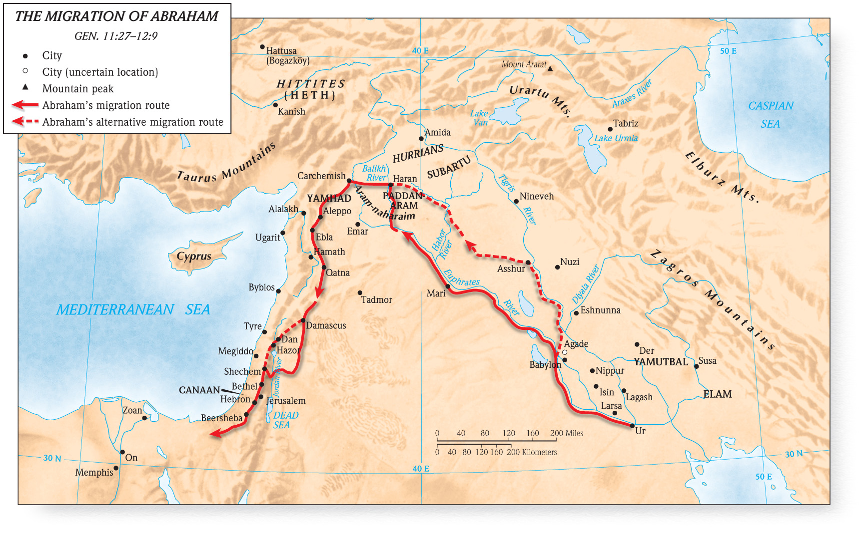
Judges 3:8 oppressor
ARAM-NAHARAIM - Country name meaning, “Aram of the two rivers.” It refers to the land between the Tigris and Euphrates River.
Nahor, Abraham’s brother, lived there; and Rebekah, Isaac’s wife, came from there. Balaam, the prophet Balak hired to curse Israel as they entered Moab from the wilderness, came from Aram-Naharaim. So did Cushan-Rishathaim, who oppressed Israel before Othniel delivered them. The Ammonites bought military help from Aram-Naharaim to fight David.
CUSHAN-RISHATHAIM (cyoo’ sshan- rihssh uh thay’ ihm) Personal name meaning, “dark one of double evil.” King of Aram Naharaim
Holman Bible Dictionary.

Slide 14
Othniel – Name/tribe/home
OTHNIEL (ahth’ nih ehl)
Name meaning, “God is powerful.”
First of Israel’s judges or deliverers.
Othniel received Caleb’s daughter Achsah as his wife as a reward for his capture of Kiriath-sepher (Debir)
(Josh. 15:15-19; Judg. 1:11-15). Holman Bible Dictionary.

Slide 15
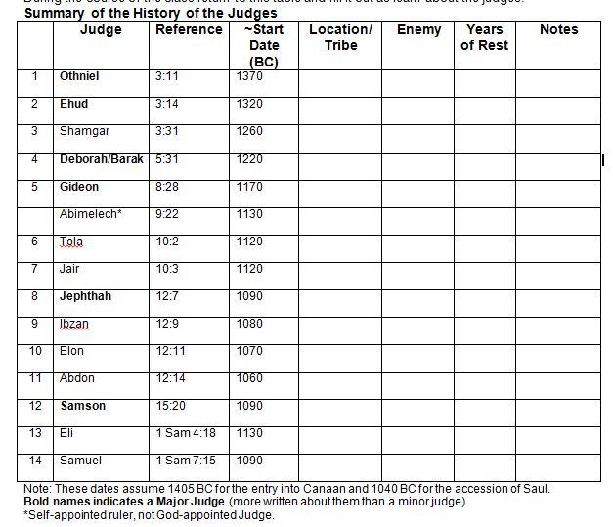
Judah/
Debir
Cushan-rishathaim
40
Related
to Caleb

Slide 16
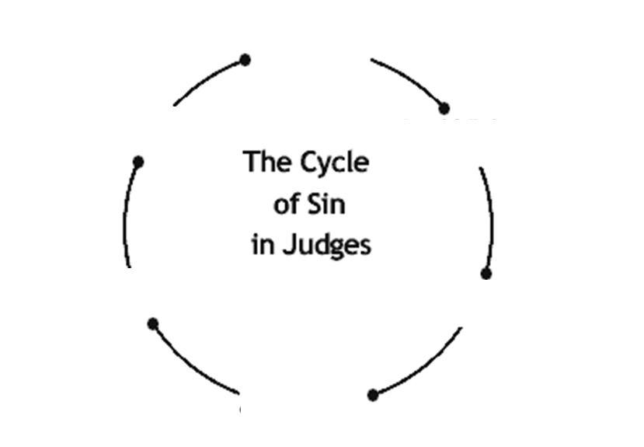
Judge Cycle
1-SIN
Apostasy
Rebellion
Judge
passes
2-SERVITUDE
Oppression
Punishment
REST
3-SUPPLICATION
Cry out to Lord
4-SALVATION
Deliverance

Slide 17
Sins
Did not know Jehovah or His works (2:10)
Served Baals and Ashtoreths (2:11-13)
Did not drive out the Canaanites (1:28)
Did not obey Jehovah, as their fathers (2:17b)
Gave & took daughters & sons in marriage (3:5) (made covenants, 2:2)
Judges 3:12-14 (ESV) ¹² And the people of Israel again did what was evil in the sight of the LORD, (4)
and the LORD strengthened Eglon the king of Moab against Israel,
because they had done what was evil in the sight of the LORD. (4)

Slide 18
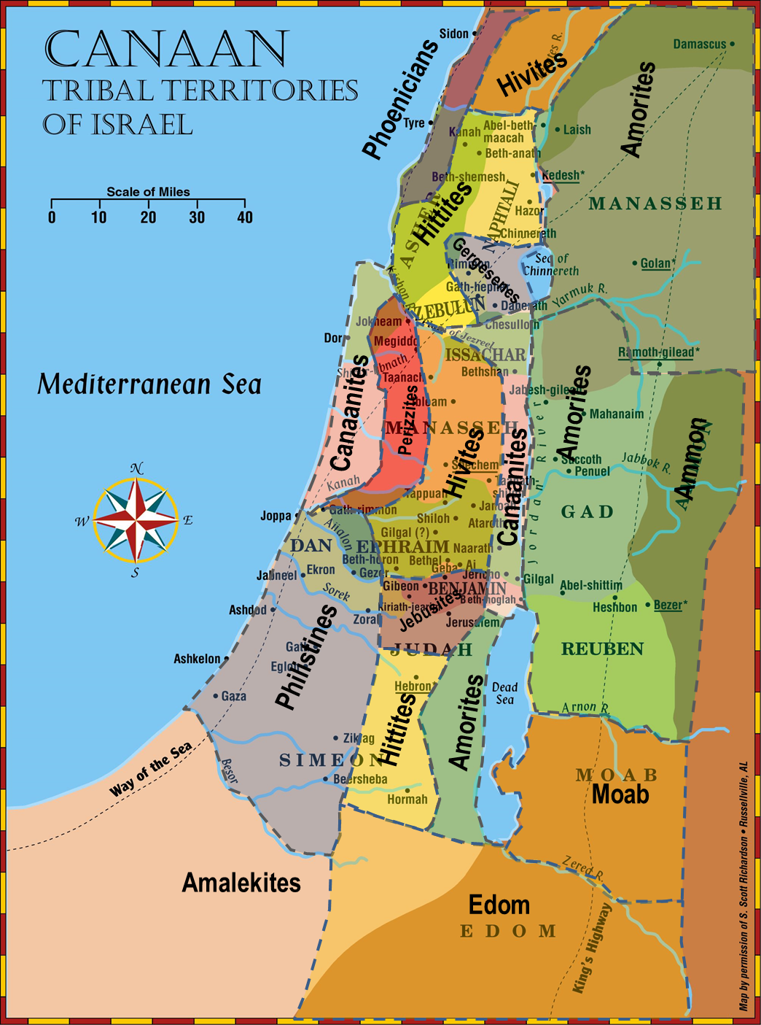
opressors
Judges 3:12-14 (ESV) ¹² And the people of Israel again did what was evil in the sight of the LORD, and the LORD strengthened Eglon the king of Moab against Israel, because they had done what was evil in the sight of the LORD.
¹³ He gathered to himself the Ammonites and the Amalekites, and went and defeated Israel. And they took possession of the city of palms. ¹⁴ And the people of Israel served Eglon the king of Moab eighteen years.

Slide 19
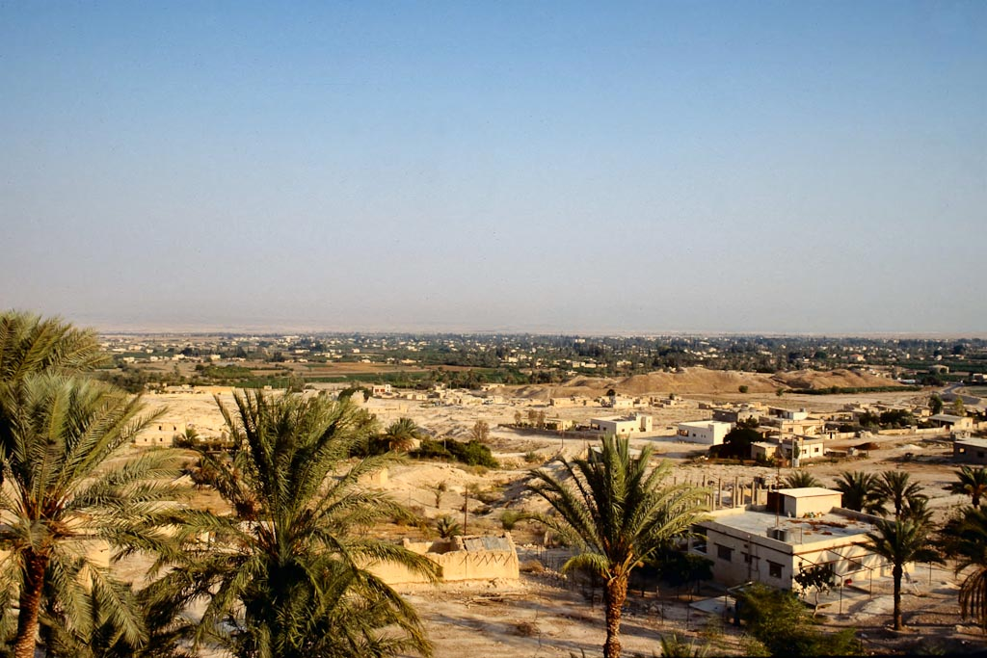
Deuteronomy 34:1-3 (ESV) ¹ Then Moses went up from the plains of Moab to Mount Nebo, to the top of Pisgah, which is opposite Jericho. And the LORD showed him all the land, Gilead as far as Dan, ² all Naphtali, the land of Ephraim and Manasseh, all the land of Judah as far as the western sea, ³ the Negeb, and the Plain, that is, the Valley of Jericho the city of palm trees, as far as Zoar.
Jericho, Tell es-Sultan from northwest
Notes:
tbs44359009

Slide 20
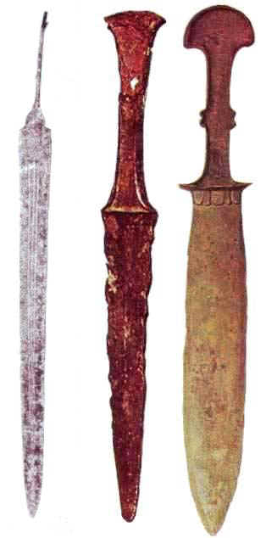
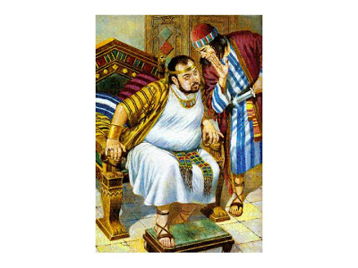
Judge ehud
Judges 3:15-16 (ESV) ¹⁵ Then the people of Israel cried out to the LORD, and the LORD raised up for them a deliverer,
Ehud, the son of Gera, the Benjaminite, a left-handed man. The people of Israel sent tribute by him to Eglon the king of Moab.
¹⁶ And Ehud made for himself a sword with two edges, a cubit in length, and he bound it on his right thigh under his clothes.
Right Side
Left Handed
1 cubit = 18 inches – 1.5 ft

Slide 21
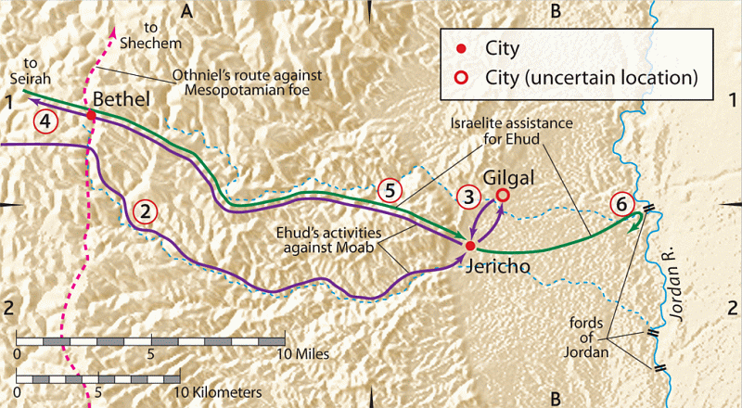
Judges 3:18-19 (ESV) ¹⁸ And when Ehud had finished presenting the tribute, he sent away the people who carried the tribute. ¹⁹ But he himself turned back at the idols near Gilgal …
and said, “I have a secret message for you, O king.” And he commanded, “Silence.” And all his attendants went out from his presence.

Slide 22
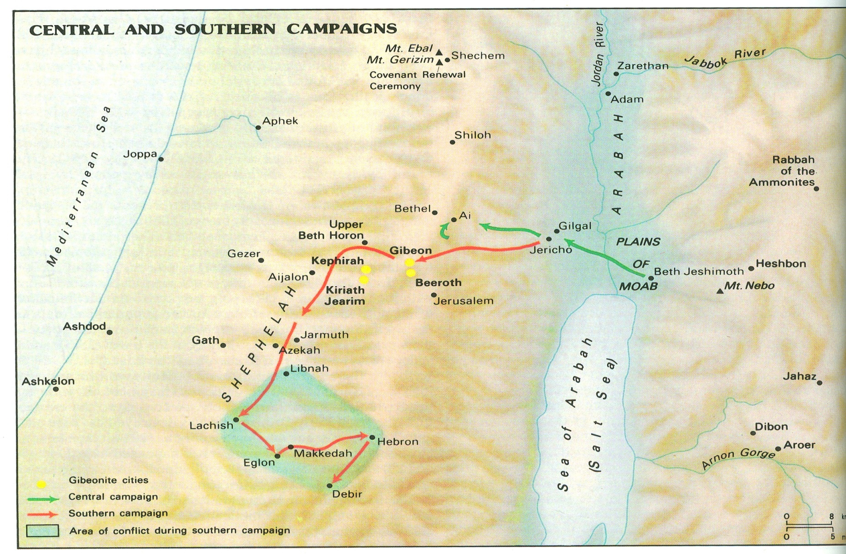
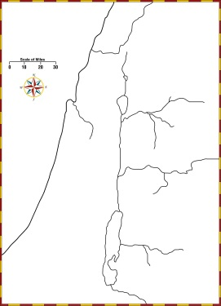

Slide 23
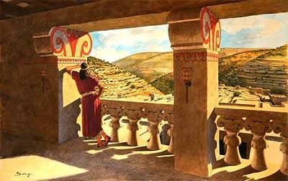
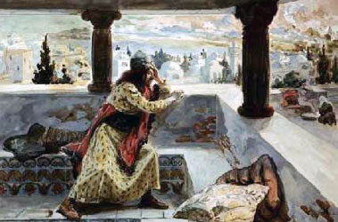
Ehud kills eglon
Judges 3:19-25 (ESV) ¹⁹ But he himself turned back at the idols near Gilgal
and said, “I have a secret message for you, O king.” And he commanded, “Silence.” And all his attendants went out from his presence. ²⁰ And Ehud came to him as he was sitting alone in his cool roof chamber. And Ehud said, “I have a message from God for you.” And he arose from his seat.
²¹ And Ehud reached with his left hand, took the sword from his right thigh, and thrust it into his belly. ²² And the hilt also went in after the blade, and the fat closed over the blade, for he did not pull the sword out of his belly; and the dung came out. ²³ Then Ehud went out into the porch and closed the doors of the roof chamber behind him and locked them.

Slide 24
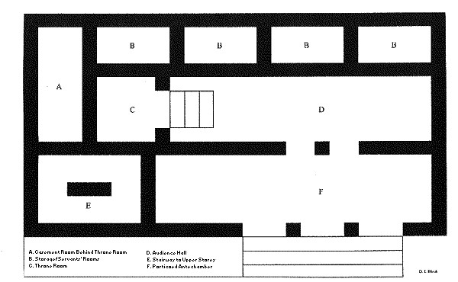
Eglon’s palace
Judges 3:24-25 (ESV) ²⁴ When he had gone, the servants came, and when they saw that the doors of the roof chamber were locked, they thought, “Surely he is relieving himself in the closet of the cool chamber.” ²⁵ And they waited till they were embarrassed. But when he still did not open the doors of the roof chamber, they took the key and opened them, and there lay their lord dead on the floor.

Slide 25
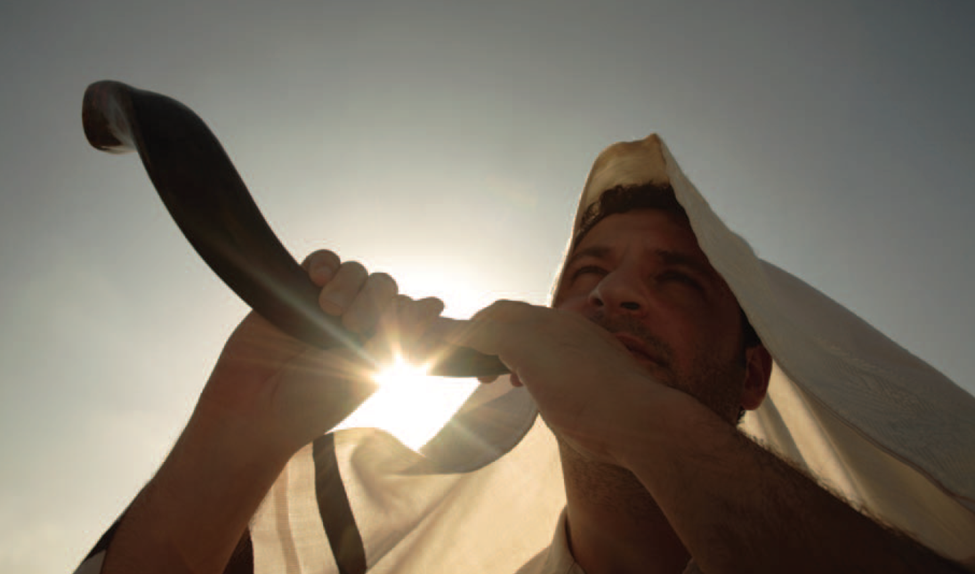
Ehud’s call
Judges 3:27 (ESV) ²⁷ When he arrived, he sounded the trumpet in the hill country of Ephraim. Then the people of Israel went down with him from the hill country, and he was their leader.

Slide 26
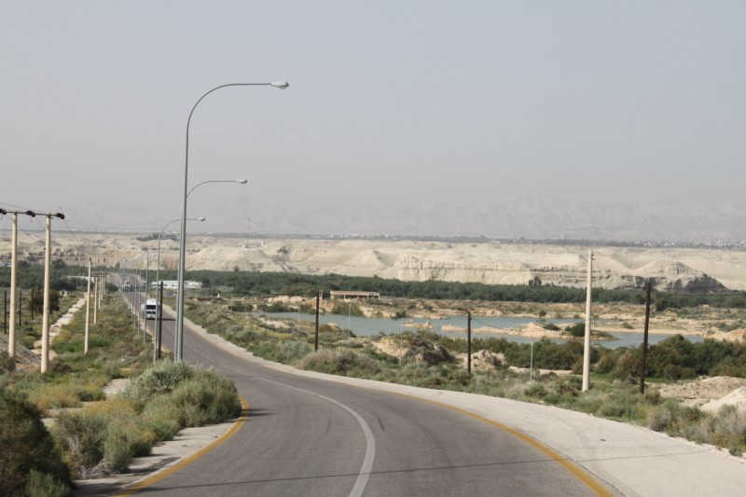
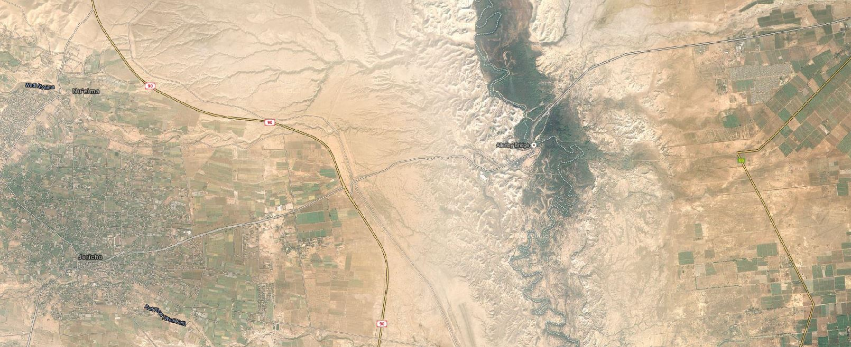
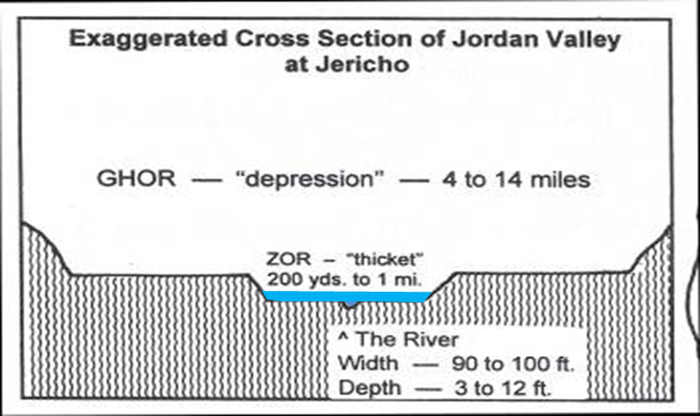
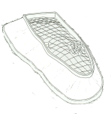
Judges 3:28-30 (ESV) ²⁸ And he said to them, “Follow after me, for the LORD has given your enemies the Moabites into your hand.” So they went down after him and seized the fords of the Jordan against the Moabites and did not allow anyone to pass over. ²⁹ And they killed at that time about 10,000 of the Moabites, all strong, able-bodied men; not a man escaped. ³⁰ So Moab was subdued that day under the hand of Israel. And the land had rest for eighty years.
Moab
Allenby Bridge
Jericho

Slide 27
Judah/
Debir
Cushan-rishathaim
40
Related
to Caleb
Benjamin
Eglon/Moab++
80
Left handed
Notes:
Judges 3:26 (ESV) ²⁶ Ehud escaped while they delayed, and he passed beyond the idols and escaped to Seirah.

Slide 28
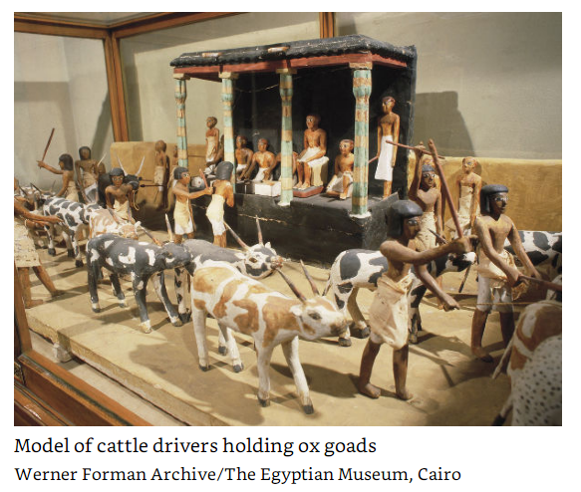
OX-Goad/Ox Prod
SHAMGAR (Shăm´ gär)
Hurrian name meaning “Shimig (the god) has given.”
A mysterious warrior who slew 600 Philistines with an oxgoad, a long metal-tipped pole (Judg. 3:31). His name is Hurrian, but whether that was his lineage is uncertain.
In the song of Deborah (Judg. 5), Shamgar (the “son of Anath”) is praised for clearing the highways of robbers, making travel once again possible.
Holman Illustrated Bible Dictionary.

Slide 29
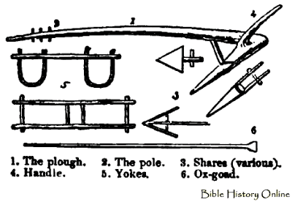
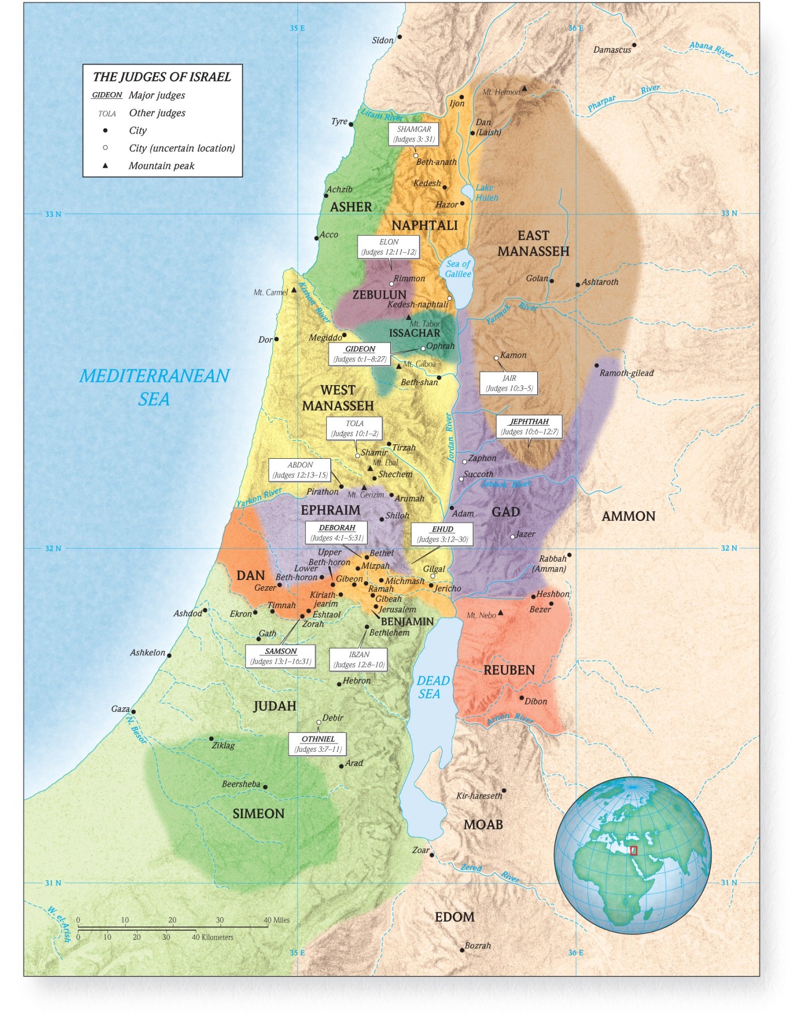
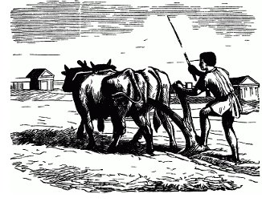
shamgar
Judges 3:31 (ESV) ³¹ After him was Shamgar the son of Anath, who killed 600 of the Philistines with an oxgoad, and he also saved Israel.

Slide 30
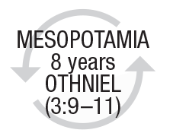
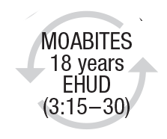
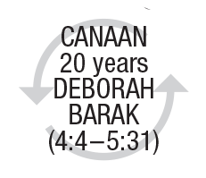
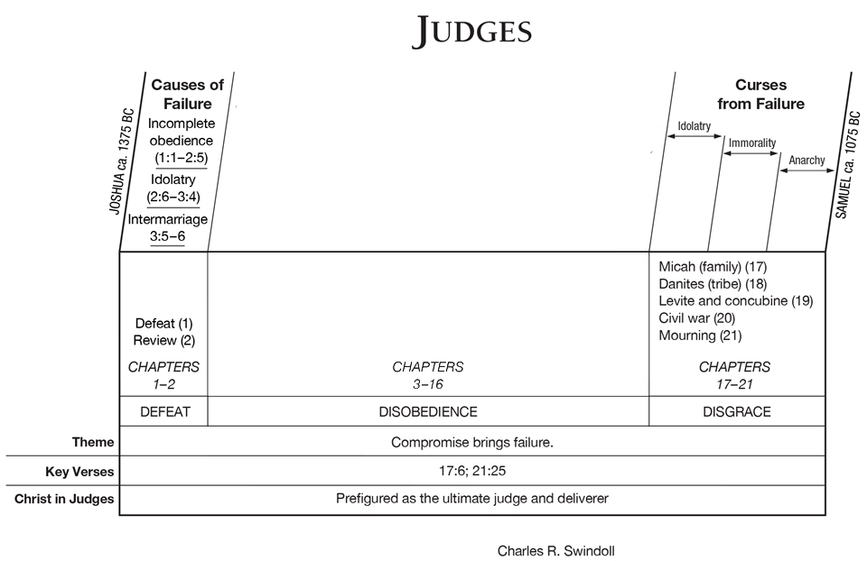
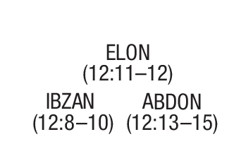
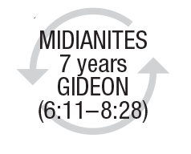
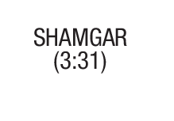
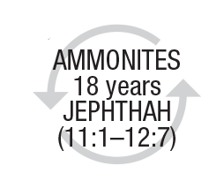
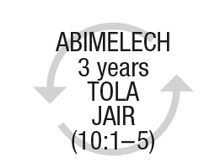
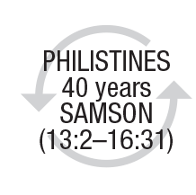
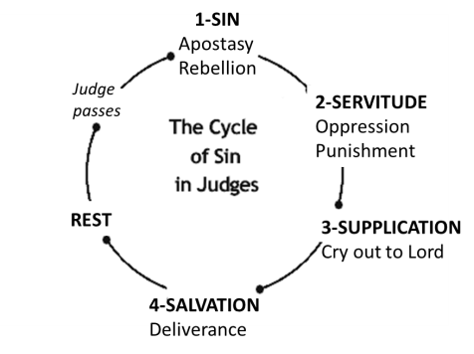
DISOBEDIENCE & DELIVERANCE
modified

Slide 31
Major/Minor Difference is length

Slide 32
The Cycle
⁷ So the people served the Lord all the days of Joshua, and all the days of the elders who outlived Joshua, who had seen all the great works of the Lord which He had done for Israel. ⁸ Now Joshua the son of Nun, the servant of the Lord, died when he was one hundred and ten years old.⁹ And they buried him within the border of his inheritance at Timnath Heres, in the mountains of Ephraim, on the north side of Mount Gaash.¹⁰ When all that generation had been gathered to their fathers, another generation arose after them who did not know the Lord nor the work which He had done for Israel.
¹¹ Then the children of Israel did evil in the sight of the Lord, and served the Baals; ¹² and they forsook the Lord God of their fathers, who had brought them out of the land of Egypt; and they followed other gods from among the gods of the people who were all around them, and they bowed down to them; and they provoked the Lord to anger. ¹³ They forsook the Lord and served Baal and the Ashtoreths. ¹⁴ And the anger of the Lord was hot against Israel. So He delivered them into the hands of plunderers who despoiled them; and He sold them into the hands of their enemies all around, so that they could no longer stand before their enemies. ¹⁵ Wherever they went out, the hand of the Lord was against them for calamity, as the Lord had said, and as the Lord had sworn to them. And they were greatly distressed.
¹⁶ Nevertheless, the Lord raised up judges who delivered them out of the hand of those who plundered them. ¹⁷ Yet they would not listen to their judges, but they played the harlot with other gods, and bowed down to them. They turned quickly from the way in which their fathers walked, in obeying the commandments of the Lord; they did not do so. ¹⁸ And when the Lord raised up judges for them, the Lord was with the judge and delivered them out of the hand of their enemies all the days of the judge; for the Lord was moved to pity by their groaning because of those who oppressed them and harassed them. ¹⁹ And it came to pass, when the judge was dead, that they reverted and behaved more corruptly than their fathers, by following other gods, to serve them and bow down to them. They did not cease from their own doings nor from their stubborn way.
Judges 2:7-19

Slide 33
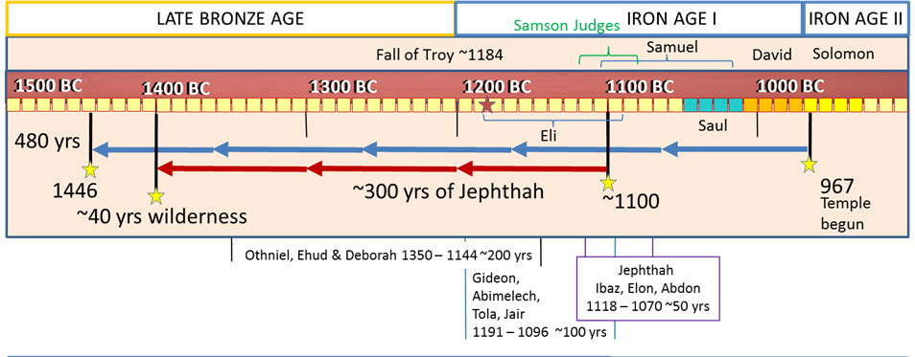
Changing Times

