Slide 1

Lesson 11
Micah and the Danites

Slide 2
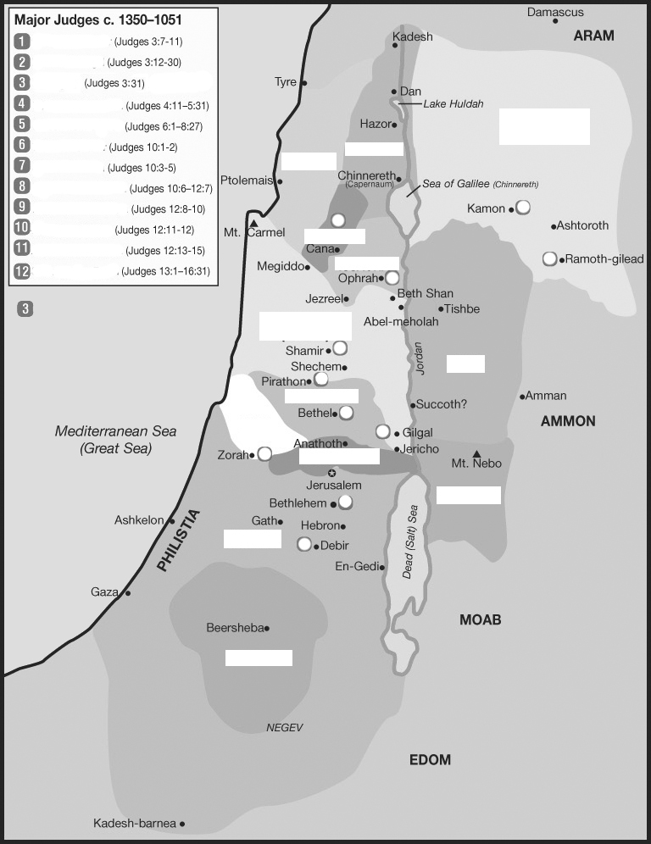
Placing the judges & tribes
Othniel
Ehud
Shamgar
Deborah/Barack
3
Manasseh
East
Gideon
Tola
Asher
Naphtali
Jair
Jephthah
4
Ibzan
10
7
Elon
Zebulun
Abdon
Issachar
8
Samson
5
West of
Jordan
Manasseh
West
East of
Jordan
6
11
Gad
Ephraim
Dan
4
2
12
Benjamin
9
Reuben
Judah
1
Judah
South
Simeon

Slide 3
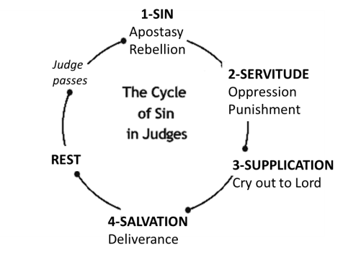
I. Conditions in Israel (1:1-3:6)
II. The Judges (3:7-16:31)
III. Cultural Decline (17:1-21:25)
Outline of judges
Notes:
Cycle of Sin…
Sin, Servitude, Supplication, Salvation, Rest…
So starting in chapter 13… what are the present conditions in Israel?

Slide 4
I. Conditions in Israel (1:1-3:6)
  - Unoccupied Areas (1:1-2:5)
  - Religious/Political Cycles (2:6-3:6)
II. The Judges (3:7-16:31)
  - Othniel* (3:7-11)
  - Ehud* (3:12-30)
  - Shamgar* (3:31)
  - Deborah* and Barak (4:1-5:31)
  - Gideon* (6:1-8:35)
  - Abimelech, Tola, Jair (9:1-10:5)
  - Jephthah* (10:6-12:7)
  - Ibzan, Elon, Abdon (12:8-15)
  - Samson* (13:1-16:31)
III. Cultural Decline (17:1-21:25)
  - Micah and the Danites (17:1-18:31)
  - Crime and Civil War (19:1-21:25)
Outline of judges

Slide 5
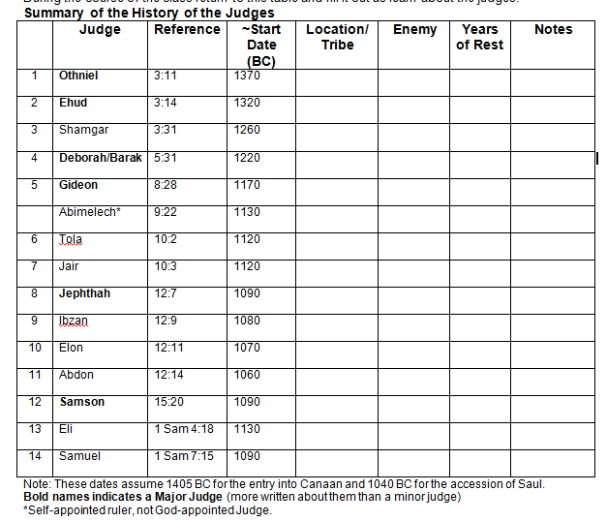
Judah/
Debir
Cushan-rishathaim
40
Related
to Caleb
Benjamin
Eglon/Moab++
80
Left handed
Philistines
Kills 600 Philistines with Ox Prod
Bethel-Ephraim /Kedesh-Naphtali
Jabin of Hazor
& Sisera
40
900 iron chariots
Death by woman
Oprah/Manasseh
Midainites, Amalekites, East
40
From 32000 to 300 men, signs
Shechem
/Manasseh
Civil war
Parable of the trees
Ephraim
Issachar
23
Gilead/Manasseh
22
30 sons, donkeys, cities
Gilead/Manasseh
Philistines &
Ammonites
Judged
6 yrs
Rash/Tragic vow
Bethlehem/Judah
Judged 7yrs
30 sons +
30 daughters
Aijalon/Zebulun
Judged 10yrs
Pirathon/Ephraim
Judged 8yrs
40 sons + 30 grandsons w/donkeys
Zorah/Dan
Philistines
Judged
20 yrs
Strength/Nazirite/ women
Notes:
Judges 3:26 (ESV)
²⁶ Ehud escaped while they delayed, and he passed beyond the idols and escaped to Seirah.

Slide 6
Objectives – Lesson 11
Micah & the Danites (Judges 17, 18)
Be able to put the events in the story in chronological order.
Explain, by means of the story, how every character or group exhibited sinful attitudes & actions.
Explain how the city of Dan ended up so far to the North of their assigned territory.

Slide 7

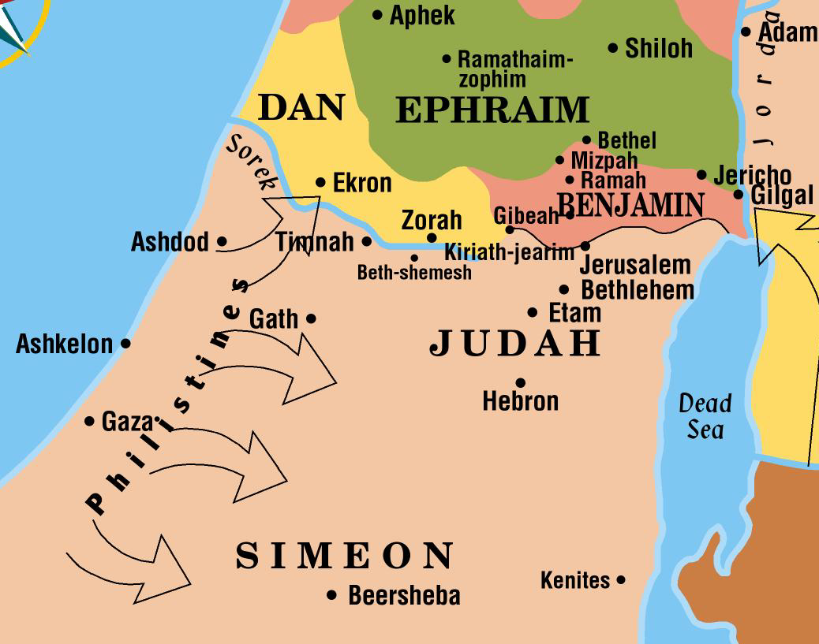
The Latter Judges
IRON AGE I
IRON AGE II
Samson Judges
Micmash
Saul kills priest at Nob
Samuel
Amalekites
967 BC
Temple begun
Mt Gilboa
1200 BC
1150 BC
1100 BC
1050 BC
1000 BC
950 BC
Saul
David &
Goliath
Solomon
Eli
End of Judges
Samuel the Last
David
Absalom rebels
Rehoboam
born
Samuel called
~age 10
Aphek
Ebenezer
~1092
Tamar raped
Sinful Census
Mizpah
~1070
Bathsheba
Jabesh Gilead
~1050
Samson met his downfall in the valley of Sorek
  They learned the secret of his strength through Delilah
  They put out his eyes and forced him to be a slave
  While mocking him in the house of their god Dagon in Gaza, he bowed himself on the pillars of the temple
    He killed more in his death than he had in the rest of his life

Slide 8
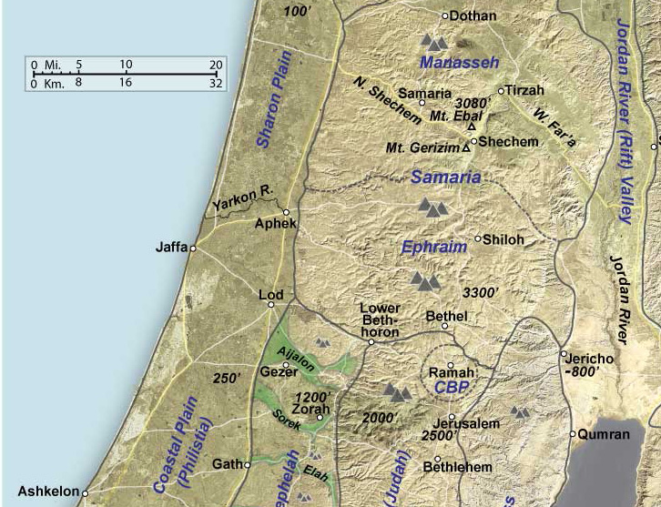
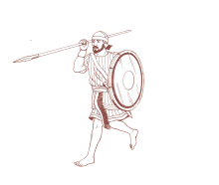
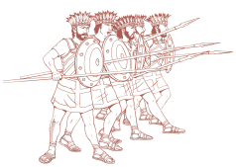




1 Samuel 4:10-11(ESV)
¹⁰So the Philistines fought, and Israel was defeated, and they fled, every man to his home. And there was a very great slaughter, for there fell of Israel thirty thousand foot soldiers.
¹¹And the ark of God was captured, and the two sons of Eli, Hophni and Phinehas, died.
Ebenezer
Jeremiah 7:12 (ESV)
¹²Go now to my place that was in Shiloh, where I made my name dwell at first, and see what I did to it because of the evil of my people Israel.

Slide 9
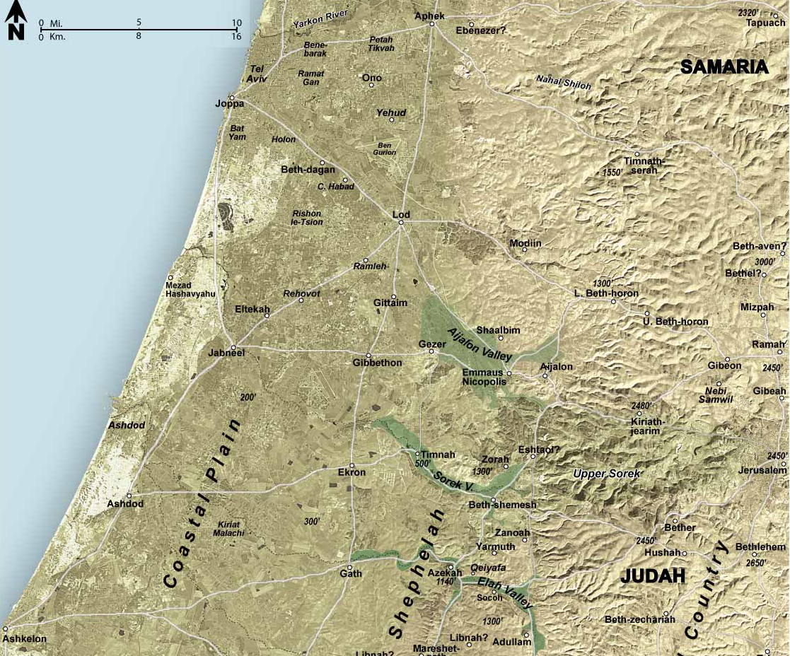

1 Samuel 5:1(ESV)
¹When the Philistines captured the ark of God, they brought it from Ebenezer to Ashdod.

Slide 10

1 Samuel 6:19-21(ESV)
¹⁹And he struck some of the men of Beth-shemesh, because they looked upon the ark of the Lord. He struck seventy men of them, and the people mourned because the Lord had struck the people with a great blow. ²⁰Then the men of
Beth-shemesh said,
“Who is able to stand before the Lord, this holy God?
And to whom shall he go up away from us?”
²¹So they sent
messengers to the inhabitants of Kiriath-jearim,
saying,
“The Philistines have
returned the ark of
the Lord. Come down
and take it up to you.”

Slide 11
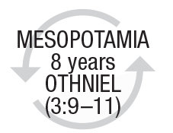
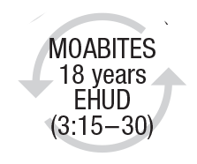
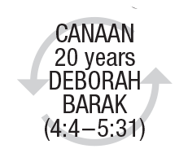
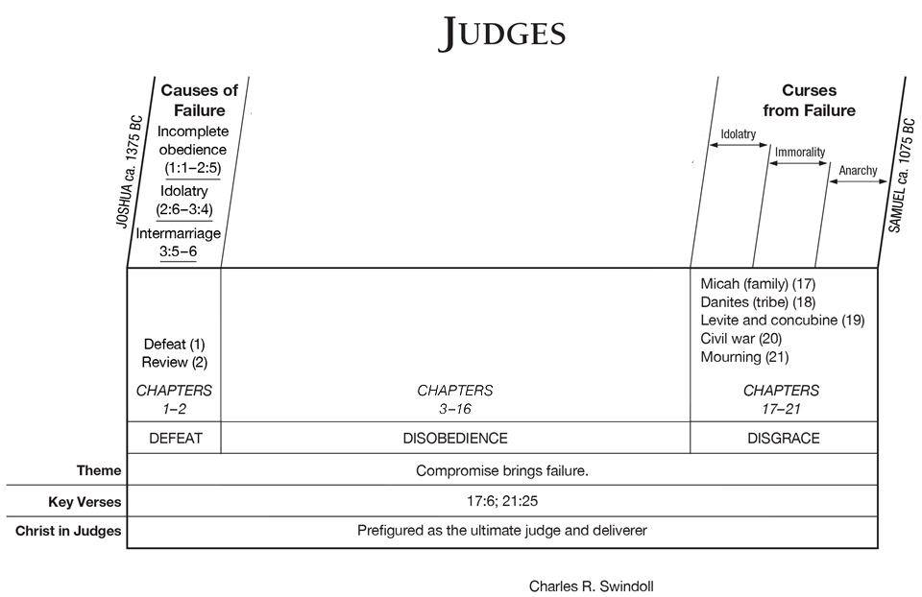
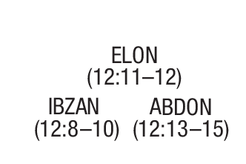
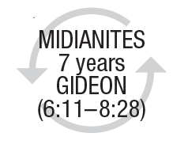
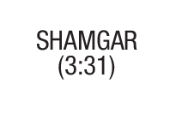
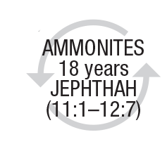
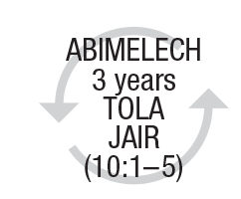
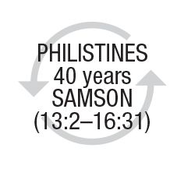

DISOBEDIENCE & DELIVERANCE
modified

Slide 12
Transition to New Section
The Judges (3:7-16:31)
After opening each cycle with “The Israelites did evil in the sight of the Lord,” the focus has consistently been on how God answers the increasing Canaanization by sending foreign powers to punish them, then raising a deliverer in response to the people’s cries of pain and providing victory for Israel through the deliverer.
Cultural Decline (17:1-21:25)
In the following chapters the narrator will offer the reader a series of glimpses at how ordinary Israelites fared in the dark days of the “judges” (governors). The effect will be to confirm the picture of a pervasively and increasingly Canaanized society
Judges 17:6(ESV) Micah & Danites
⁶In those days there was no king in Israel.
Everyone did what was right in his own
eyes.
Judges 21:25(ESV) Crime @ Gibeah
²⁵In those days there was no king in Israel.
Everyone did what was right in his own
eyes.

Slide 13
Transition to New Section
The Judges (3:7-16:31)
After opening each cycle with “The Israelites did evil in the sight of the Lord,” the focus has consistently been on how God answers the increasing Canaanization by sending foreign powers to punish them, then raising a deliverer in response to the people’s cries of pain and providing victory for Israel through the deliverer.
Cultural Decline (17:1-21:25)
In the following chapters the narrator will offer the reader a series of glimpses at how ordinary Israelites fared in the dark days of the “judges” (governors). The effect will be to confirm the picture of a pervasively and increasingly Canaanized society
1 Samuel 8:7(ESV)
⁷And the Lord said to Samuel, “Obey the voice of the people in all that they say to you, for they have not rejected you, but they have rejected me from being king over them.
Judges 17:6(ESV) Micah & Danites
⁶In those days there was no king in Israel.
Everyone did what was right in his own
eyes.
Judges 21:25(ESV) Crime @ Gibeah
²⁵In those days there was no king in Israel.
Everyone did what was right in his own
eyes.

Slide 14
Both tribes, Dan and Benjamin, were assigned territory in Israel’s heartland, between Judah and Ephraim
Both tribes found themselves in dire straights
  tribe of Dan had been unable to occupy the territory allotted
  tribe of Benjamin incurred the hostility of the rest of the nation
Both accounts the crisis precipitated by a nameless Levite.
In both accounts the Levite had a Bethlehem-Judah connection
  first Levite came from Bethlehem-Judah (17:7–8)
  second traveled to Bethlehem-Judah (19:1–2).
Both Levites had connections with Mount Ephraim.
  first Levite ended at household of Micah at Mt Ephraim (17:1)
  second actually lived in this region (19:1).
Both accounts involved priestly characters inquiring of God concerning the outcome of a proposed plan (18:5–6; 20:27–28).
Both accounts reference Shiloh. Judges 18:31 notes Danites continued to use Micah’s idols as long as the tabernacle was at Shiloh; in 21:19–24 describes an event that took place at Shiloh.
both accounts military contingents consisting of six hundred men played a critical role (18:11, 16–25, 25; 20:47; 21:7, 12, 14, 16–17, 23).
Both accounts are punctuated by variations of the refrain “In those days Israel had no king” (17:6; 18:1; 19:1; 21:25).
Notes:
1. Both tribes, Dan and Benjam, were assigned territory in Israel’s heartland, between Judah and Ephraim, the tribes that would later lead the Southern and Northern Kingdoms respectively. By selecting episodes that concern these tribes the narrator cleverly emphasizes that the degenerating tendency in Israel was not simply a problem in the fringe territories. It had infected the very heart of the nation.
2. Both tribes found themselves in dire straights, though for different reasons. As announced in the prologue to the book (1:34–36), the tribe of Dan had been unable to occupy the territory allotted to it by Joshua and was forced to search for a homeland elsewhere. The tribe of Benjamin incurred the hostility of the rest of the nation and came frighteningly close to disappearing as a victim of Israel’s “holy war.”
3. In both accounts the crisis was precipitated by the actions of a nameless Levite.
4. In both accounts the Levite had a Bethlehem-Judah connection. The first Levite came from Bethlehem-Judah (17:7–8); the second traveled to Bethlehem-Judah (19:1–2).
5. Both Levites had connections with Mount Ephraim. The first Levite ended up in the household of Micah, who lived on Mount Ephraim (17:1); the second actually lived in this region (19:1).
6. Both accounts involved priestly characters inquiring of God concerning the outcome of a proposed plan of action (18:5–6; 20:27–28).
7. Both accounts conclude with a reference to Shiloh. Judges 18:31 notes that the Danites continued to use Micah’s idols as long as the tabernacle was at Shiloh; in 21:19–24 the narrator describes an event that took place at Shiloh.
8. In both accounts military contingents consisting of six hundred men played a critical role (18:11, 16–25, 25; 20:47; 21:7, 12, 14, 16–17, 23).
9. Both accounts are punctuated by variations of the refrain “In those days Israel had no king” (17:6; 18:1; 19:1; 21:25). In the first the formula is inserted at critical junctures in the narrative and functions as an episode marker; in the second the formula frames the entire narrative, appearing at the beginning and the end. Twice, once in each section, the formula is augmented with, “Everyone did as he saw fit” (17:6; 21:25).
Block, D. I. (1999). Judges, Ruth (Vol. 6, pp. 473475). Nashville: Broadman & Holman Publishers.
Block, D. I. (1999). Judges, Ruth (Vol. 6, pp. 473–475). Nashville: Broadman & Holman Publishers.

Slide 15



1-Beginnings Gen 1-5
2-Flood Gen 6-11
1445-1405 BC
5-Wilderness
Wanderings
931-722 BC
9-Divided
Kingdom
605-538 BC
11-Babylonian
Captivity
444 BC - ~4 BC
The Silent Years
(Intertestamental)
30-90 AD
The Church
NT Era
2166-1859 BC
3-Patriarchs
1380-1050 BC
7-Judges
4-Slavery in Egypt
1859-1445 BC
6-Conquest
of Canaan
1405-1380 BC
8-United
Kingdom
1050-931 BC
10-Judah
Alone
722-605 BC
12-Return
From Exile
538-444 BC
Life of
Christ
4 BC – 30 AD
1400 BC
1300 BC
1200 BC
1100 BC
East of Jordan:
Ammonites
& Philistines
Jephthah
Jair
Eli
Samuel
West of Jordan:
Danites
take
Laish
Elon
Gibeah
Incident
Tola
Abdon
Saul
David
Solomon
Midianites
Canaanites
Gideon
Moab
Deborah
Ehud
Philistines
Samson
Judah : South
Othniel
Philistines
Shamgar?
Mesopotamian
Ruth?
Ibzan
Egypt:
Battle of Kadesh
Egypt-Hittites
Merneptah
Sea People
Vs Ramses III
Travels of
Wen-Amon
Based on Graphics from Marc Hinds & Zondervan Pictorial Encyclopedia of the Bible
Notes:
Judges describes cycles of apostasy, oppression, and deliverance in the southern region (3:7–31), the central region (6:1–10:5), the eastern region (10:6–12:15), and the western region (13:1–16:31).

Slide 16
Why the Earlier Dates
Danites take Territory in the North
Judges 17-18 & Joshua 19:47
Joshua 19:47(ESV) Dan conquest given in Joshua
⁴⁷When the territory of the people of Dan was lost to them, the people of Dan went up and fought against Leshem, and after capturing it and striking it with the sword they took possession of it and settled in it, calling Leshem, Dan, after the name of Dan their ancestor.
Joshua 6:25(ESV) Rahab still alive when Joshua written
²⁵But Rahab the prostitute and her father’s household and all who belonged to her, Joshua saved alive. And she has lived in Israel to this day, because she hid the messengers whom Joshua sent to spy out Jericho.

Slide 17
Why the Earlier Dates
Gibeah’s crime and the Civil War
Judges 19-21/Phineas, son of Eleazar
Numbers 25:6-8(ESV) Baal Worship at Peor
⁶And behold, one of the people of Israel came and brought a Midianite woman to his family, in the sight of Moses and in the sight of the whole congregation of the people of Israel, while they were weeping in the entrance of the tent of meeting. ⁷When Phinehas the son of Eleazar, son of Aaron the priest, saw it, he rose and left the congregation and took a spear in his hand ⁸and went after the man of Israel into the chamber and pierced both of them, the man of Israel and the woman through her belly. Thus the plague on the people of Israel was stopped.
Joshua 22:10-13(ESV) The Eastern Tribes’ Altar of Witness
¹⁰And when they came to the region of the Jordan that is in the land of Canaan, the people of Reuben and the people of Gad and the half-tribe of Manasseh built there an altar by the Jordan, an altar of imposing size.
¹¹And the people of Israel heard it said, “Behold, the people of Reuben and the people of Gad and the half-tribe of Manasseh have built the altar at the frontier of the land of Canaan, in the region about the Jordan, on the side that belongs to the people of Israel.”
¹²And when the people of Israel heard of it, the whole assembly of the people of Israel gathered at Shiloh to make war against them.
¹³Then the people of Israel sent to the people of Reuben and the people of Gad and the half-tribe of Manasseh, in the land of Gilead, Phinehas the son of Eleazar the priest,

Slide 18
Micah
Micah’s mother
levite
danites
1,100 pieces of silver taken
uttered curse
confesses
“Blessed be my son by the Lord.”
“I dedicate the silver to the Lord from my hand for my son,

Slide 19
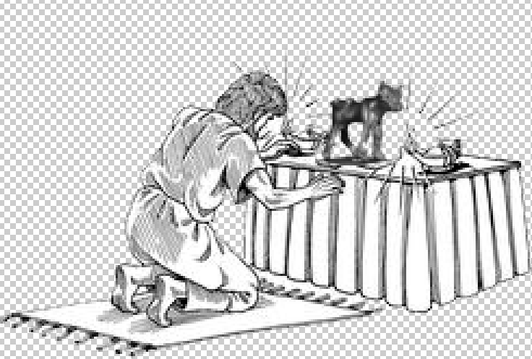
Micah
Micah’s mother
levite
danites
1,100 pieces of silver taken
uttered curse
confesses
“Blessed be my son by the Lord.”
“I dedicate the silver to the Lord from my hand for my son,
to make a carved image and a metal image.
Micah had a shrine, and he made an ephod & household gods, & ordained one of his sons, who became his priest.
his mother took 200 pieces of silver to silversmith, who made a carved image and a metal image. And it was in the house of Micah.

Slide 20
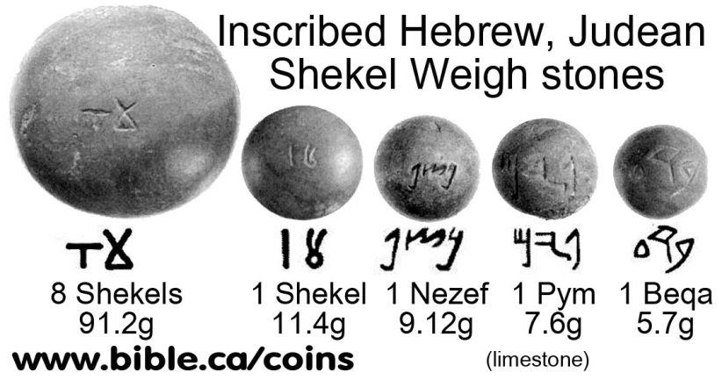
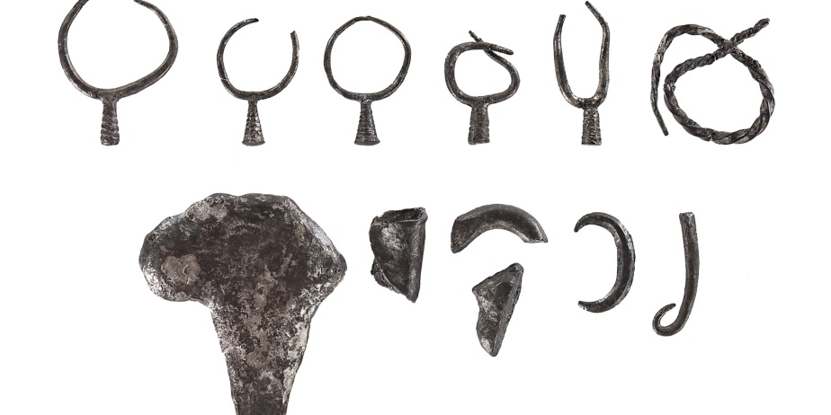
Micah
Micah’s mother
levite
danites
1,100 pieces of silver taken
uttered curse
confesses
“Blessed be my son by the Lord.”
“I dedicate the silver to the Lord from my hand for my son,
0.4 oz
to make a carved image and a metal image.
earrings
his mother took 200 pieces of silver to silversmith, who made a carved image and a metal image. And it was in the house of Micah.
pieces of silver
1100 = 440 oz about 27.5 lbs
200 = 80 oz about 5 lbs

Slide 21
Micah
Micah’s mother
levite
danites
1,100 pieces of silver taken
uttered curse
confesses
“Blessed be my son by the Lord.”
“I dedicate the silver to the Lord from my hand for my son,
to make a carved image and a metal image.
Micah had a shrine, and he made an ephod & household gods, & ordained one of his sons, who became his priest.
his mother took 200 pieces of silver to silversmith, who made a carved image and a metal image. And it was in the house of Micah.

Slide 22
Micah
Micah’s mother
levite
danites
be a father and a priest, and I will give you ten pieces of silver a year and a suit of clothes and your living.
Young Levite looking to find a place
And the Levite went in.
the Levite was content to dwell with the man, and the young man became to him like one of his sons.
And Micah ordained the Levite, and the young man became his priest, and was in the house of Micah.
Then Micah said, “Now I know that the Lord will prosper me, because I have a Levite as priest.”

Slide 23
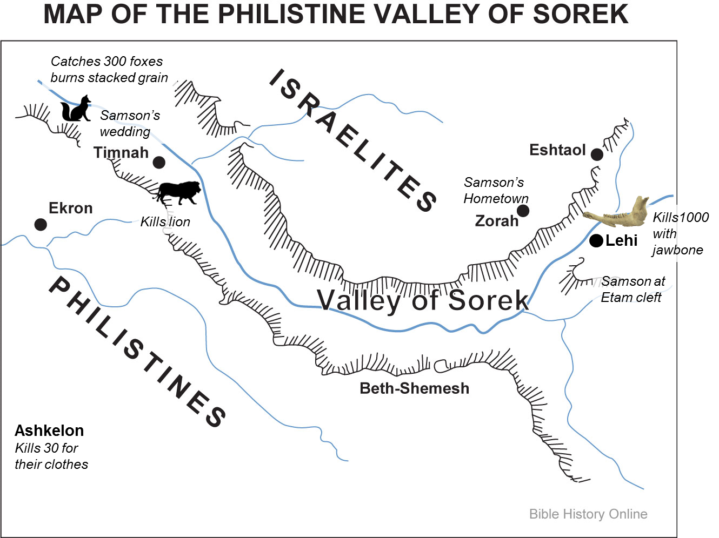
Micah
Micah’s mother
levite
danites
So the people of Dan sent five able men from the whole number of their tribe, from Zorah and from Eshtaol, to spy out the land and to explore it.

Slide 24
Micah
Micah’s mother
levite
danites
So the people of Dan sent five able men from the whole number of their tribe, from Zorah and from Eshtaol, to spy out the land and to explore it.
And the priest said to them, “Go in peace. The journey on which you go is under the eye of the Lord.”
And they said to him, “Inquire of God, please, that we may know whether the journey on which we are setting out will succeed.”
came to Laish and saw the people who were there, how they lived in security, after the manner of the Sidonians, quiet and unsuspecting…
no dealings with no one

Slide 25
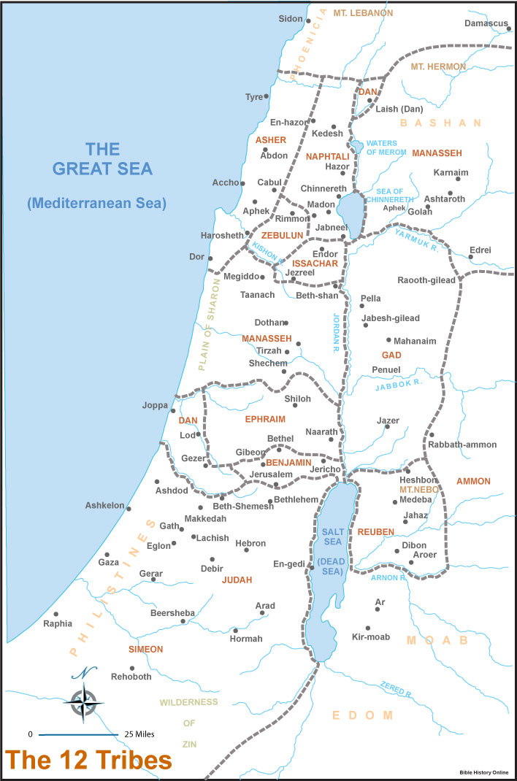

House
Of Micah
Eshtaol
Zorah
Kiriath-jearim

Slide 26
Micah
Micah’s mother
levite
danites
So 600 men of the tribe of Dan, armed with weapons of war, set out from Zorah and Eshtaol,
And the five men who had gone to scout out the land into Micah’s house and took the carved image, the ephod, the household gods, and the metal image while the priest stood by the entrance of the gate with the 600 men armed with weapons of war.
priest’s heart was glad. He took the ephod and the household gods and the carved image and went along with the people.
Is it better for you to be priest to the house of one man, or to be priest to a tribe and clan in Israel

Slide 27
Micah
Micah’s mother
levite
danites
the men who were in the houses near Micah’s house were called out, and they overtook the people of Dan.
“What is the matter with you, that you come with such a company?”
“Do not let your voice be heard among us, lest angry fellows fall upon you, and you lose your life with the lives of your household.”
“You take my gods that I made and the priest, and go away, and what have I left? How then do you ask me, ‘What is the matter with you?’”
the people of Dan took what Micah had made, and the priest who belonged to him, and they came to Laish, to a people quiet & unsuspecting, & struck them with the edge of the sword & burned the city with fire.
And when Micah saw that they were too strong for him, he turned and went back to his home.
Jonathan the son of Gershom, son of Moses, and his sons were priests to the tribe of the Danites until the day of the captivity of the land.
So they set up Micah’s carved image that he made, as long as the house of God was at Shiloh.

Slide 28
2
4
5
House
Of Micah
1
6
3
Eshtaol
7
Zorah
Kiriath-jearim
8
9

Slide 29
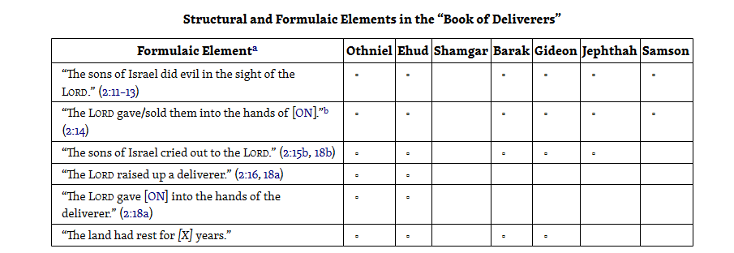
Major Judges

