Slide 1
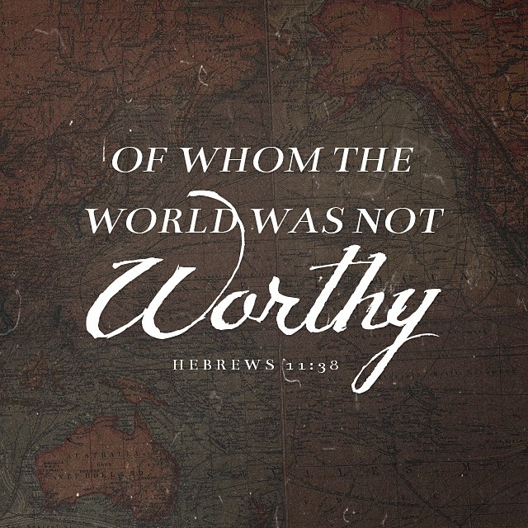

Slide 2
Foundation of Their Faith…
The foundation of faith is the continued faithfulness of God. (10:23)
Faith isn’t blindly following after a nonexistent thing, it’s believing in the unseen. (11:1)
Our faith commends or condemns us. (11:2)
It is impossible to peace God without it. (11:6)

Slide 3
Church at San Miguel
As you come to him, a living stone rejected by men but in the sight of God chosen and precious, you yourselves like living stones are being built up as a spiritual house, to be a holy priesthood, to offer spiritual sacrifices acceptable to God through Jesus Christ.

Slide 4
Brigham Eubanks
And he who had received the five talents came forward, bringing five talents more, saying, ‘Master, you delivered to me five talents; here I have made five talents more. His master said to him, ‘Well done, good and faithful servant. You have been faithful over a little; I will set you over much.
(Matthew 26:20-21)

Slide 5
Arturo Rojas
Have nothing to do with foolish, ignorant controversies; you know that they breed quarrels. And the Lord's servant must not be quarrelsome but kind to everyone, able to teach, patiently enduring evil, correcting his opponents with gentleness. God may perhaps grant them repentance leading to a knowledge of the truth.
(2nd Timothy 2:23-25)

Slide 6
Rogelio
By faith Rogelio, being warned by God(‘s Word) concerning events as yet unseen, in reverent fear preached for the saving of his household. By this he condemned the world and became an heir of the righteousness that comes by faith.

Slide 7
Concepcion
By faith Concepcion… choose rather to be mistreated with the people of God than to enjoy the fleeting pleasures of sin. He considered the reproach of Christ greater wealth than the treasures of this world, for he was looking to the reward.
Notes:
Moses 24.26

Slide 8
The World Isn’t Worthy of them Because…
They acknowledge that they are strangers and foreigners. (v.13)
They don’t just acknowledge but they speak. (v.14)
They keep their eyes on the land they’re going to. (v.15)
They desire a better world. (v.16)

