Slide 2
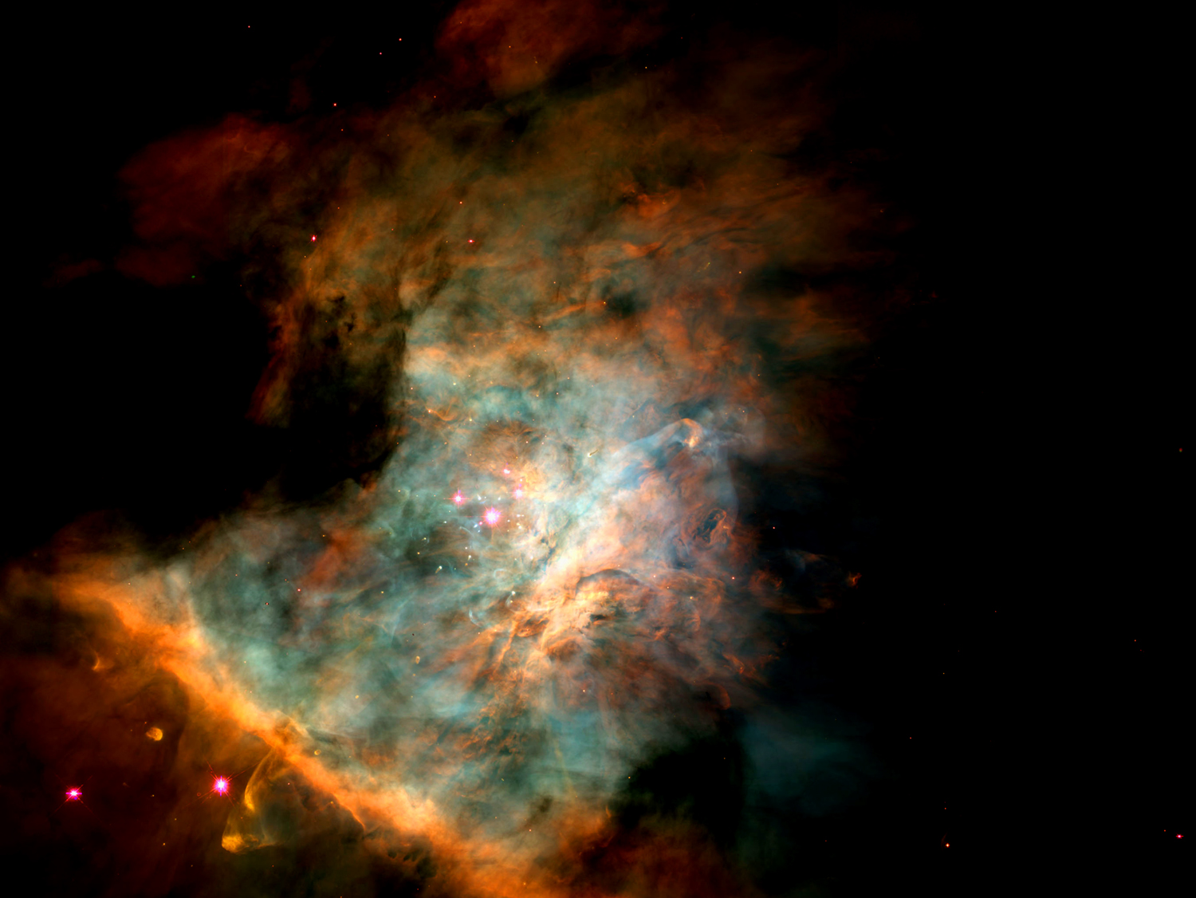

Slide 3
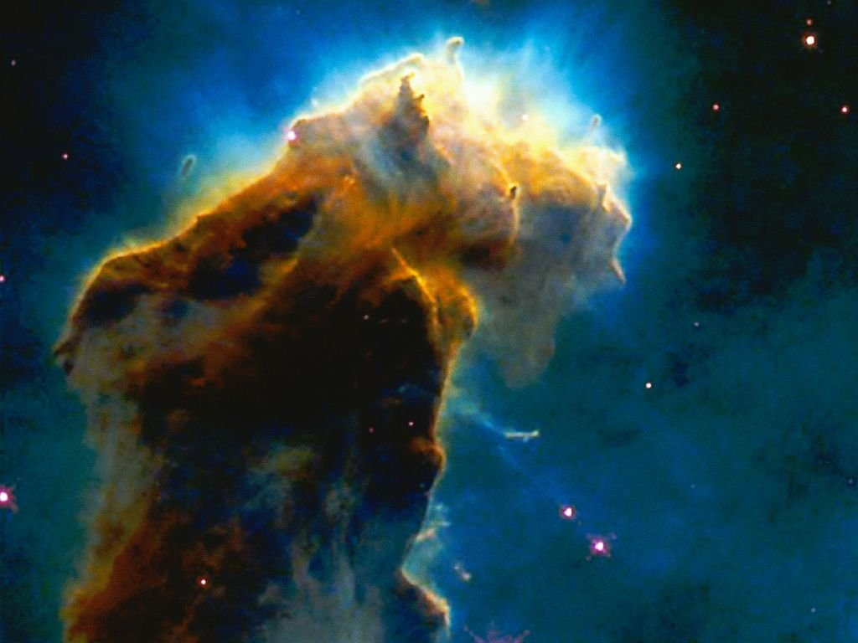
“In the beginning God
created the heavens and the earth” (Genesis 1:1)
Notes:
The Bible begins with this simple but profound declaration of faith – in the beginning there was only God, nothing else. Everything else that comes to be comes as the result of the activity of God.
The first name for God that is found in the Bible in Genesis 1:1 is Elohim.
What does this name mean? In the context of Genesis 1:1, it is a declaration that God (Elohim) alone is eternal.
In a humanistic system, the universe becomes god-like, creating life out of lifeless matter through some mindless random system.
By declaring that Elohim alone is eternal and is the Creator of all that exists, scripture gives dignity and meaning to our life and existence.
We can know that life has meaning and purpose. If we are to discover that purpose, we must know the one who alone is eternal, our Creator.
Further, it lays open the possibility that we can have eternal life. Mankind has always sought to find the secret to life after death, to eternal life.
But it’s no secret! Eternal life can only be found in a relationship to God, to Elohim, who is eternal.

Slide 4
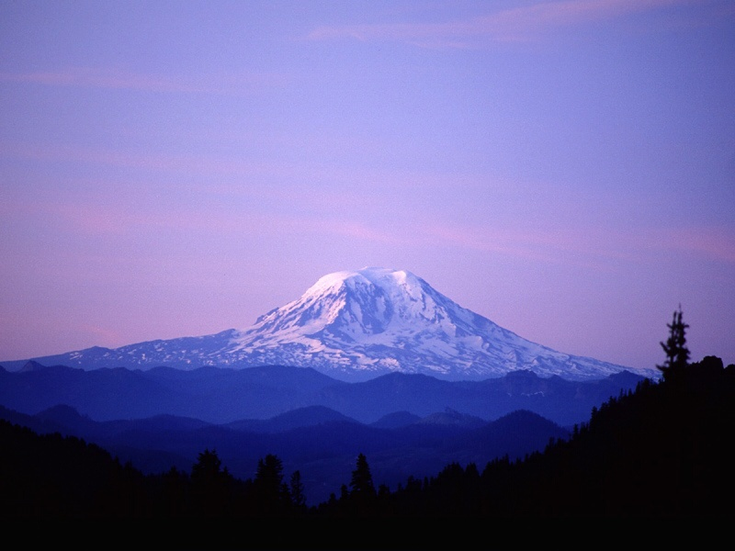
“Oh LORD (Jehovah) our Lord (Adonai) How majestic is your name in all the earth” Psalms 8:9
Notes:
While these names do imply or demand a responsibility on the part of man to conform to the Being in whose image we are made, the Adonai makes a definite claim for man’s obedience and service for He is Lord and Master. We studied the meaning of El Shaddai last time because it is easier call Him El Shaddai (that He is all you need) than it is to call Him Adonai (your Master). Yet you will never know His sufficiency apart from knowing Him as your Lord and Master.

Slide 5
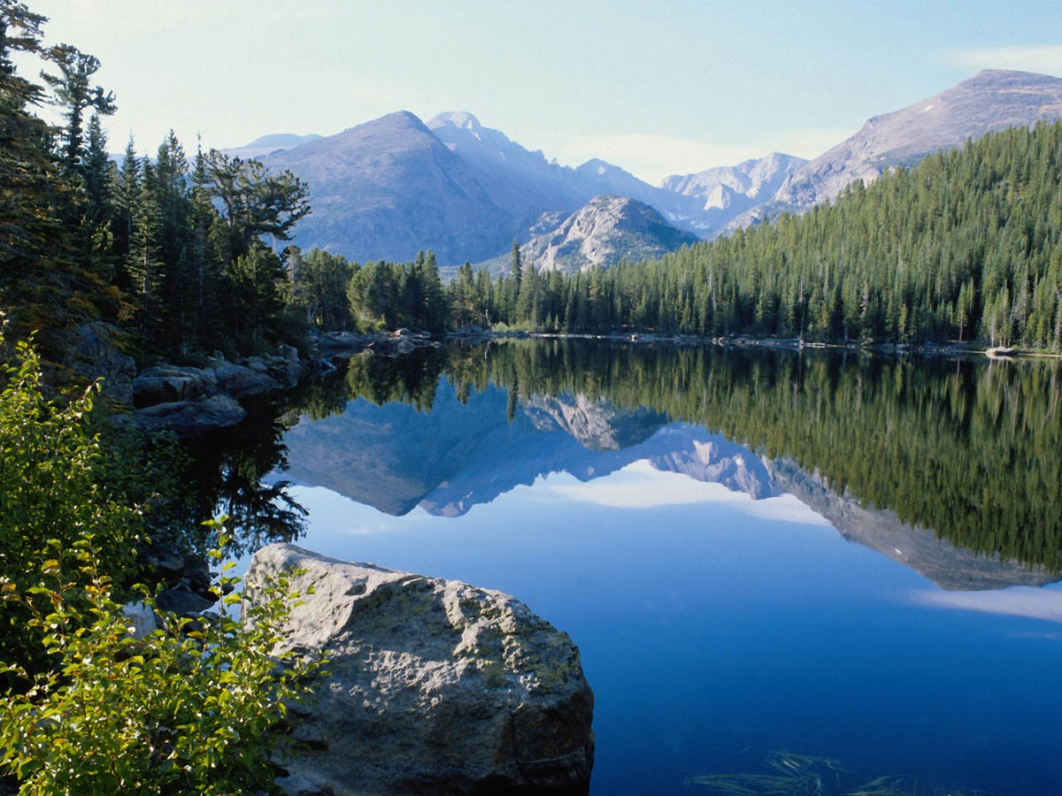
God Almighty

Slide 6
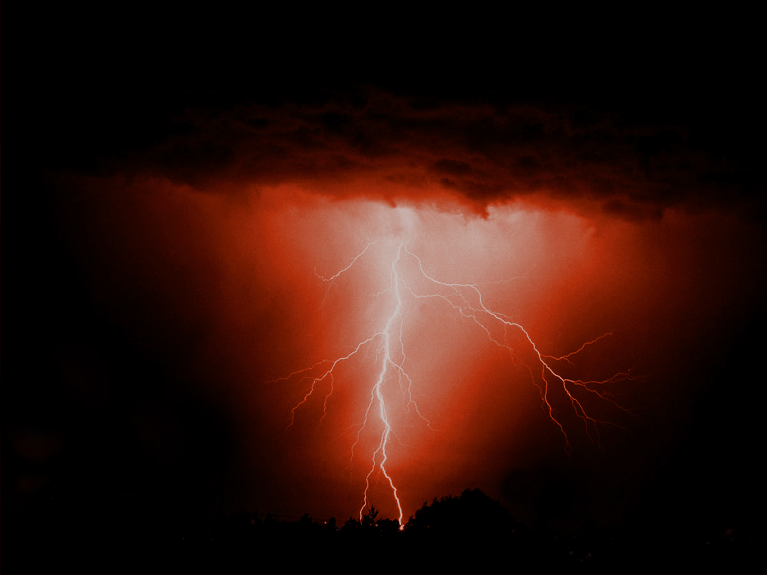
The God Who Sees Me
Notes:
EL ROI: Yes, He is El Roi, the God who sees. The omnipresent God is there, and His eyes are not shut. He isn’t asleep, unaware of all the circumstances. He sees.
Read Genesis 16. The first, and only, time we meet El Roi is in a desperate situation. We find Him telling Hagar to go back and deal with a bad situation. Hagar fled from Sarai into the wilderness. She is mistreated, she is abused, she is scared. Yet the LORD comes to her and comforts her and promises to take care of her.

Slide 7
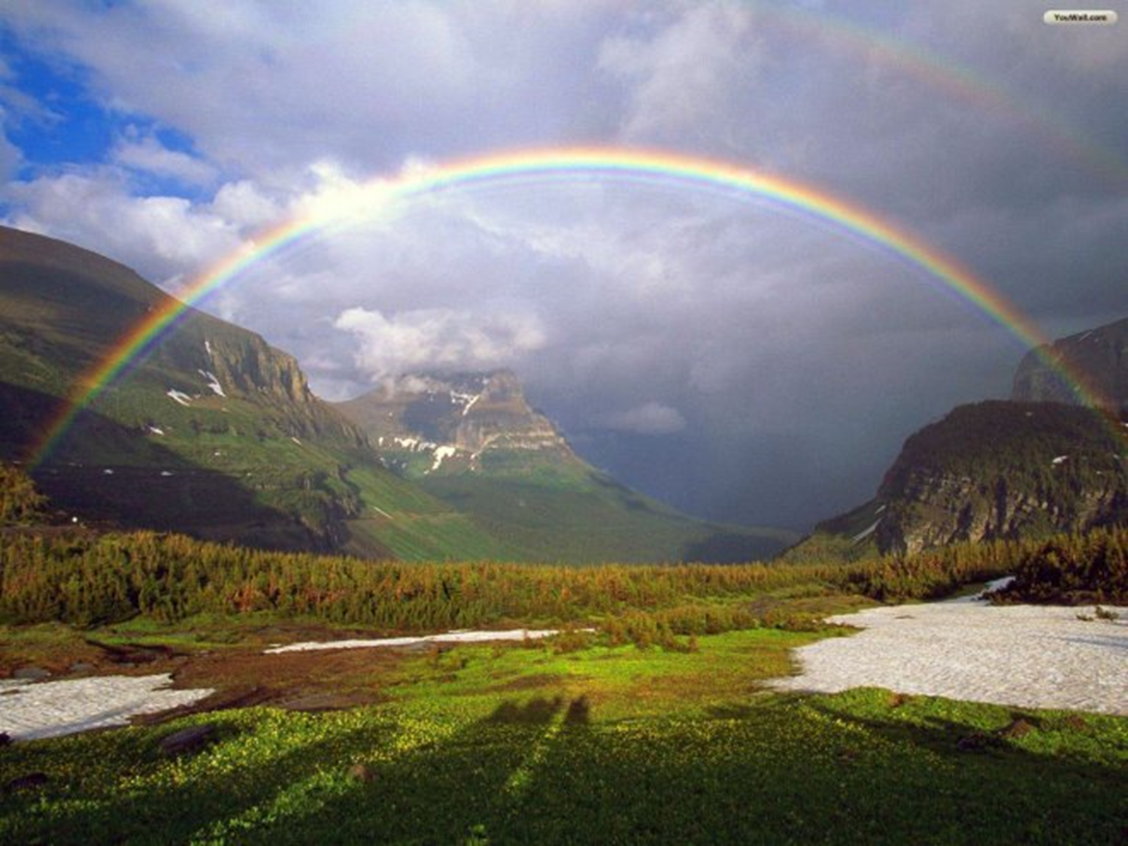
In Whom We Hope
The God Who Makes and Keeps Promises

Slide 8
And Abraham called the name of that place “The LORD will provide, as it is said to this day; on the Mount of the LORD it shall be provided. (Gen 22:14)

Slide 9
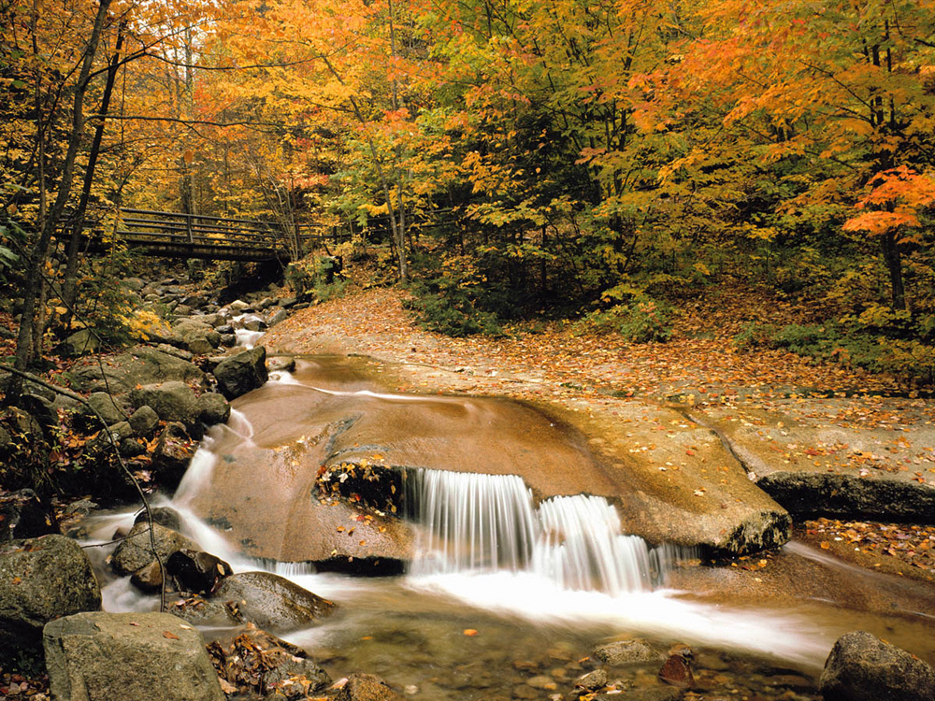
Jehovah-rophe (rapha) – The God who Heals. He can take our bitter experiences and make them sweet
Notes:
The name JEHOVAH-rophe means Jehovah heals. This is the second compound name of Jehovah (the first was Jehovah-jireh).
It seems there is a progressive revelation of Jehovah meeting every need as it arises in the experience of His redeemed people – saving, sustaining, strengthening, sanctifying, and so on.
Of course we should not be surprised, for the Apostle Paul tells us that the things that happened to Israel were for a reason – for our learning, they are examples for us today (1 Cor. 10:6; 10:11).
The name “Jehovah-rophe” occurs in Exodus 15. The children of Israel, after 400 years in Egypt, many of those years as slaves, working in the brick pits to make monuments to Pharaoh, were on their way to the Promise Land.
They watched the plagues descend from the LORD on Egypt, until finally the death of the first born of Egypt causes Pharaoh to let the Hebrews go. But soon after, Pharaoh changes his mind and he pursues the Israelites to the borders of the Red Sea.
The Children of Israel watch in amazement as the LORD parts the sea and they pass over on dry ground and to safety as the LORD then destroys the Egyptian army as the waters roll back to their place.
Israel began to sing praises to the LORD for His deliverance. This song of triumph (Exodus 15) is a glorious song of worship and trust.
I will sing to the LORD, for He is highly exalted; The horse and its rider He has hurled into the sea The LORD is my strength and song; And He has become my salvation;
This is my God, and I will praise Him; My father’s God, and I will extol Him.
The LORD is a warrior; The LORD is His name (vv. 2-3)

Slide 10
The Dayspring from on High
Psalms 27:1 The LORD is my light, and my salvation

Slide 11
The Bright Morning Star

Slide 12
LORD of Hosts

Slide 13
LORD of Hosts
Host – Armies, Heavenly Bodies
Not Sabbath but Sabaoth
LORD Who is Able
LORD Almighty
El Shaddai – God Almighty

Slide 14
Strong Tower
When We Fail or Feel Powerless
When We Are Weak
When Our Resources are Inadequate
When There is No Other Help
When We Feel Small and Enemies Strong

Slide 15
Our Defender
Our Deliverer
Our Protector
Our Redeemer

Slide 16
When You Feel Oppressed
(1 Samuel 1 - Hannah)
Elkanah, Penninah and Hannah
Rival, Provoke, Grieve, Irritate, Troubled, Anxiety, Vexation, Worthless
1 Samuel 1:6-7 - And her rival used to provoke her grievously to irritate her, because the Lord had closed her womb. (7) So it went on year by year. As often as she went up to the house of the Lord, she used to provoke her. Therefore Hannah wept and would not eat.

Slide 17
1 Samuel 1:10-11 - She was deeply distressed and prayed to the Lord and wept bitterly. And she vowed a vow and said, “O Lord of hosts (Jehovah-Sabaoth), if you will indeed look on the affliction of your servant and remember me and not forget your servant, but will give to your servant a son, then I will give him to the Lord all the days of his life, and no razor shall touch his head.”

Slide 18
1 Samuel 1:18-20 - And she said, “Let your servant find favor in your eyes.” Then the woman went her way and ate, and her face was no longer sad. They rose early in the morning and worshiped before the Lord; then they went back to their house at Ramah. And Elkanah knew Hannah his wife, and the Lord remembered her. And in due time Hannah conceived and bore a son, and she called his name Samuel, for she said, “I have asked for him from the Lord.”

Slide 19
When You Feel Oppressed
When You Feel Overwhelmed
(1 Samuel 17:45 – David and Goliath)
Vs 24 – They all ran away from him in great fear
Vs 26 – Who is this that defies the armies of the Living God

Slide 20
Vs 45-47 - Then David said to the Philistine, “You come to me with a sword and with a spear and with a javelin, but I come to you in the name of the LORD of hosts, the God of the armies of Israel, whom you have defied. This day the LORD will deliver you into my hand, and I will strike you down and cut off your head.

Slide 21
7 Principles When You Are Overwhelmed
We Will Face Giants (Fear, Doubt, Trials)
Measure Them Against Jehovah-Sabaoth
Don’t Try to Fight Them With Man’s Solutions
Don’t Run Away From Your Problems
Affirm Your Confidence In Jehovah-Sabaoth
Remember Who You Are
Remember Who Jehovah-Sabaoth Is

Slide 22
When You Feel Oppressed
When You Feel Overwhelmed
When You Are Outnumbered
(2 Kings 6:16-17 - Elisha, His Servant and the King of Syria)
Vs 15-17 - When the servant of the man of God rose early in the morning and went out, behold, an army with horses and chariots was all around the city. And the servant said, “Alas, my master! What shall we do?” (16) He said, “Do not be afraid, for those who are with us are more than those who are with them.” (17) Then Elisha prayed and said, “O Lord, please open his eyes that he may see.” So the Lord opened the eyes of the young man, and he saw, and behold, the mountain was full of horses and chariots of fire all around Elisha.
Romans 8:31 - What then shall we say to these things? If God is for us, who can be against us?

Slide 23
When Your Courage Waivers
When You Are Under Peer Pressure
When Friends Harass You
When You Are Weak and Full of Doubt
When a Loved One Hurts
Hebrews 4:16 Let us then with confidence draw near to the throne of grace, that we may receive mercy and find grace to help in time of need.

Slide 24
When You Feel Oppressed
When You Feel Overwhelmed
When You Are Outnumbered
When You Feel Helpless
(Haggai 1:4-11 – Rebuild My Temple!)

Slide 25
Haggai 1:5-6 - Now, therefore, thus says the Lord of hosts: Consider your ways. You have sown much, and harvested little. You eat, but you never have enough; you drink, but you never have your fill. You clothe yourselves, but no one is warm. And he who earns wages does so to put them into a bag with holes.
Vs 7-11 - “Thus says the Lord of hosts: Consider your ways. (8) Go up to the hills and bring wood and build the house, that I may take pleasure in it and that I may be glorified, says the Lord. (9) You looked for much, and behold, it came to little. And when you brought it home, I blew it away. Why? declares the Lord of hosts. Because of my house that lies in ruins, while each of you busies himself with his own house. (10) Therefore the heavens above you have withheld the dew, and the earth has withheld its produce. (12) And I have called for a drought on the land and the hills, on the grain, the new wine, the oil, on what the ground brings forth, on man and beast, and on all their labors.”

Slide 26
When You Feel Oppressed
When You Feel Overwhelmed
When You Are Outnumbered
When You Feel Helpless
(Haggai 1:4-11 – Rebuild My Temple!)
We Need to Put Jehovah-Sabaoth First In Our Lives
Jehovah-Sabaoth Will Not Take Second Place In Our Lives!!

