Slide 1
Haggai, Zechariah, Malachi
Lesson 1: Class Introduction

Slide 2
Haggai, Zechariah, Malachi
Class Goals (by the end of our study each of us will . . .)
Have an increased appreciation for the sovereignty and power of God
Have an increased faith in Jesus as the prophesied Messiah
Worship in a more sincere and sacrificial manner

Slide 3
Timeline #1
70 yrs
70 yrs
609 B.C. 597 586 | 539 538 537 522 520 516 B.C.
g
e
f
c
b
a
d
Book of Haggai, start rebuilding temple again
Darius the great restores order and becomes emperor
First year in Judah; altar rebuilt, ceremonies restored, temple foundation laid
Temple finished
Cyrus the Persian conquers Babylon
Cyrus’ edict for Jews to return
Three sieges of Judah by Babylonians; Captivity

Slide 4
Timeline #2
Cambyses | Darius I | Xerxes I | Artaxerxes I
530 B.C.
522
486
465
445
424 B.C.
479
458
c
f
a
516
b
d
Esther becomes queen
Ezra returns
Haggai and Zechariah preach and prophecy
Temple completed
Malachi preaches and prophecies
Nehemiah returns
460
e
432

Slide 5
Haggai
Zechariah
malachi
Match the following with the associated book
m
_____ “Will man rob God?”
_____ Zerubbabel chosen as a signet
_____ Eight messianic prophecies
_____ “Is it a time for you yourselves to dwell in your paneled
houses, while this house lies in ruins?”
_____ Priests specifically condemned
_____ First to command the temple be rebuilt
_____ Eight night visions
_____ Encourages the people to rebuild the temple
_____ John the Baptist foretold
h
z
h
m
h
z
z
m

Slide 6
FILL IN THE STRUCTURE OF THE EIGHT NIGHT VISIONS
Structure of Eight Night Visions
First
Second
Third
Fourth
Fifth
Sixth
Seventh
Eighth
a/c
e
God patrolling the earth
The cleaning of the land
God patrolling the earth
The two anointed leaders of post-exilic Judah
The threat of the nations against Judah
d
b
a/c

Slide 7
ANSWER THE FOLLOWING QUESTIONS
Which OT book gives a good historical background to the writings of Haggai, Zechariah, and Malachi?
Which OT book gives an account of the rebuilding of Jerusalem’s walls less than a hundred years after the completion of the temple?
Besides Haggai, Zechariah, Malachi, and the answer to #1 and #2, what is the only other OT book to detail events in the post-exilic period (post Babylonian captivity)?
Ezra
Nehemiah
Esther

Slide 8
Ezra
A historical background to haggai, Zechariah, and malachi
Notes:
Why Ezra?
Written by Ezra the scribe during the last third of the 5th century B.C. Somewhere between 430 and 424 B.C.
Records two time periods:
1-6 provide a record of Israel’s return from Captivity during the 23 year period between 538-516 B.C. During this period Zerubbabel was governor. Jeshua was high priest, and Haggai and Zechariah were prophets.
7-10 skip a period of 57 years and pick up with the commission given by Artaxerxes to Ezra in 458 B.C., Ezra’s journey to Jerusalem, and his doings there between 458 and 457. And that was the time of Malachi.
Ezra is historical background for everything we’re going to be covering in this class
Shows us how God, after 70 years of exile, fulfilled his promise by:
Delivering his people from Babylon
The rebuilding of the temple in Jerusalem
The restoration of the temple worship according to the law
And then preserving those restored people from fresh lapses into sins like idolatry and intermarriage
Hopefully as we’re going over these three prophets everything will make more sense since we will have seen the broad picture

Slide 9
Chapter 1
What proclamation is given by Cyrus, king of Persia?
² “Thus says Cyrus king of Persia: The LORD, the God of heaven, has given me all the kingdoms of the earth, and he has charged me to build him a house at Jerusalem, which is in Judah. ³ Whoever is among you of all his people, may his God be with him, and let him go up to Jerusalem, which is in Judah, and rebuild the house of the LORD, the God of Israel — he is the God who is in Jerusalem. ⁴ And let each survivor, in whatever place he sojourns, be assisted by the men of his place with silver and gold, with goods and
with beasts, besides freewill offerings for the house of God that is in Jerusalem.”
Ezra 1:2-4 (ESV)

Slide 10
The Cyrus cylinder
Among other things, describes how Cyrus returned captive peoples and their gods to their native lands.
Notes:
This picture is from it’s display in the Metropolitan Museum of Art in NYC, but I think it’s permanent home is in the British Museum, which I could be wrong about.
What Cyrus did here was really unbelievable. This is his first year of authority over the Chaldean kingdom (which at that time included Israel), and this great ruler of Persia not only grants Israel permission to return to Palestine, but aids them very substantially in doing so. There was no precedent for this. This was very unique, and I think shows us in part the role that God played in Israel’s return. This didn’t just happen on a whim, this was God at work.
Jeremiah prophesied it. Isaiah prophesied it, and he even gave Cyrus’ name as the one who would who would accomplish this rebuilding of Jerusalem and the temple (Is 44:28 – 45:7)

Slide 11
Chapter 2
What do many of the exiles do in response to the proclamation of Cyrus?
¹ …They returned to Jerusalem and Judah, each to his own town. ² They came with Zerubbabel, Jeshua, Nehemiah, Seraiah, Reelaiah, Mordecai, Bilshan, Mispar, Bigvai, Rehum, and Baanah.
Ezra 2:1b-2 (ESV)
⁶⁴ The whole assembly together was 42,360, ⁶⁵ besides their male and female servants, of whom there were 7,337, and they had 200 male and female singers. ⁶⁶ Their horses were 736, their mules were 245, ⁶⁷ their camels were 435, and their donkeys were 6,720.
Ezra 2:64-67 (ESV)
Notes:
7 distinct groups:
Leaders
Men of Israel
Prists
Levites
Temple servants
Sons of Solomon’s servants
Those of uncertain genealogy
Like a lot of other genealogies we find in the Bible, this list establishes continuity for God’s chosen people. The list probably meant a lot more to the immediate readers than it does to us now.

Slide 12
Chapter 3
What did the Israelites accomplish?
² Then arose Jeshua the son of Jozadak, with his fellow priests, and Zerubbabel the son of Shealtiel with his kinsmen, and they built the altar of the God of Israel, to offer burnt offerings on it, as it is written in the Law of Moses the man of God.
Ezra 3:2 (ESV)
¹⁰ And when the builders laid the foundation of the temple of the LORD, the priests in their vestments came forward with trumpets, and the Levites, the sons of Asaph, with cymbals, to praise the LORD, according to the directions of David king of Israel.
Ezra 3:10 (ESV)
Notes:
It’s interesting at the end of this chapter when it says that a lot of the men were weeping at the sight of this new temple. There must have been so many emotions among the people… some were overjoyed, but some of the men who had seen the first temple, and now saw the relative insignificance and poverty of this new foundation….it must have been a little sad.
Maybe they thought about what lead up to where they were at that point, or maybe it was just that pathetic compared to the old.
The good news though is that the glory of this second temple far surpassed that of Solomon’s because Christ himself appeared in this one.

Slide 13
Persian rulers from 559-358 B.C.
539 – 530 Cyrus
530 – 522 Cambyses
522 – 486 Darius I (Hystaspes)
486 – 465 Xerxes I (Ahashuerus)
465 – 424 Artaxerxes (Longimanus)
424 – 423 Xerxes II
423 – 404 Darius II (Nothus)
404 – 358 Artaxerxes (Mnemon)

Slide 14
Chapter 5
Who prophecies to the people to begin rebuilding again?
¹ Now the prophets, Haggai and Zechariah the son of Iddo, prophesied to the Jews who were in Judah and Jerusalem, in the name of the God of Israel who was over them. ² Then Zerubbabel the son of Shealtiel and Jeshua the son of Jozadak arose and began to rebuild the house of God that is in Jerusalem, and the prophets of God were with them, supporting them.
Ezra 5:1-2 (ESV)

Slide 15
haggai
Author: Haggai, literally ‘festival’
or ‘joyous one’
Date: ~520 B.C.
Theme: Build the Temple

Slide 16
Zechariah
Author: Zechariah, means ‘God
remembers’
Date: ~520-516 B.C.
Theme: Turn back to the LORD

Slide 17
Chapter 5
Who prophecies to the people to begin rebuilding again?
¹ Now the prophets, Haggai and Zechariah the son of Iddo, prophesied to the Jews who were in Judah and Jerusalem, in the name of the God of Israel who was over them. ² Then Zerubbabel the son of Shealtiel and Jeshua the son of Jozadak arose and began to rebuild the house of God that is in Jerusalem, and the prophets of God were with them, supporting them.
Ezra 5:1-2 (ESV)
Notes:
One more thing about chapter 5. Verse 6 to the end is a letter written by Tattenai the governor of the province Beyond the River, aka someone who had an interest in what the Jews were doing. So this letter is nothing like the letter from Rehum to Artaxerxes in chapter 4. His was prejudiced and derogatory, but this one is fair. He states what he knows, then in verse 17 he asks for the king to check the archives and make sure the Jews were telling the truth, that Cyrus had made a decree.
And this was a big deal because Medo-Persian law said that if the king made a decree, it couldn’t be changed. Daniel made reference to this in Daniel 6:15 when he said “It is a law of the Medes and Persians that no interdict nor statute which the king establisheth may be changed.” So with this letter from Tattenai, if the king found that the decree was made, then the Jews would be left alone.
Which brings us to chapter 6.

Slide 18
Chapter 6
What decree is given by Darius the king? Is the decree carried out?
⁶ “Now therefore, Tattenai, governor of the province Beyond the River, Shethar-bozenai, and your associates the governors who are in the province Beyond the River, keep away. ⁷ Let the work on this house of God alone. Let the governor of the Jews and the elders of the Jews rebuild this house of God on its site.
Ezra 6:6-7 (ESV)
¹³ Then, according to the word sent by Darius the king, Tattenai, the governor of the province Beyond the River, Shethar-bozenai, and their associates did with all diligence what Darius the king had ordered. ¹⁴ And the elders of the Jews built and prospered through the prophesying of Haggai the prophet and Zechariah the son of Iddo. They finished their building by decree of the God of Israel and by decree of Cyrus and Darius and Artaxerxes king of Persia; ¹⁵ and this house was finished on the third day of the month of Adar, in the sixth year of the
reign of Darius the king.
Ezra 6:13-15 (ESV)

Slide 19
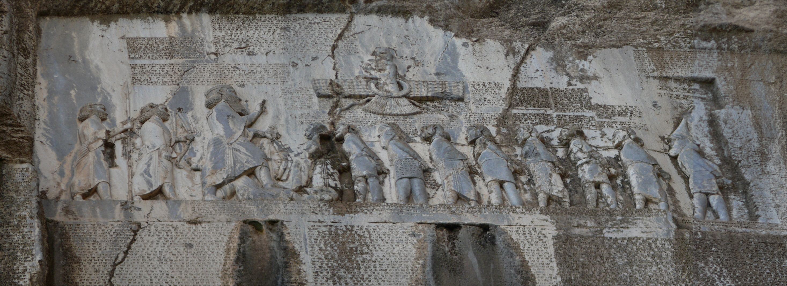
The behistun inscription
Notes:
Something I thought you might find interesting.
In chapter 6 verse 2 who’s starts with “And in Ecbatana”?
Does anyone have Achmetha?
This inscription is in Ecbatana on the side of a mountain, which is now Iran. And they call the place Ecbatana now because this inscription tells us that that’s the Persian name for Achmetha. There are three different languages on this, Persian, Elomite, and Babylonian, and it’s written in Cuneiform (wedge shaped marks on clay tablets). Which makes this inscription sort of like a Rosetta Stone….if you know one of the languages, you can understand all of them.

Slide 20
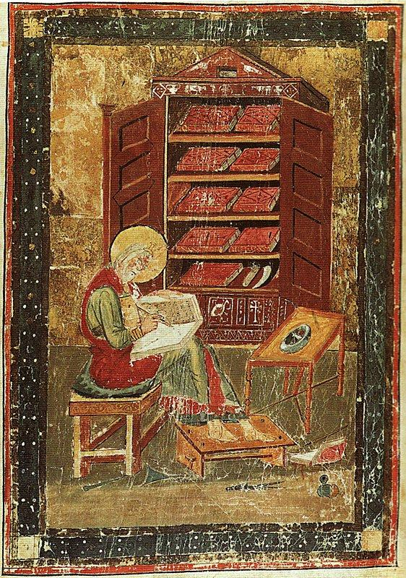
Chapter 7
Who is sent to “teach [God’s] statutes and rules in Israel”?
¹ Now after this, in the reign of Artaxerxes king of Persia, Ezra the son of Seraiah… ⁶ this Ezra went up from Babylonia. He was a scribe skilled in the Law of Moses that the LORD, the God of Israel, had given, and the king granted him all that he asked, for the hand of the LORD his God was on him.
Ezra 7:1a, 6 (ESV)
Notes:
The illustration is from the early 8th century from the Codex Amiatinus, which is the earliest surviving manuscript of the nearly complete Bible in the Latin Vulgate version. This was an illustration in that manuscript of “Ezra the scribe”.

Slide 21
malachi
Author: Malachi, means ‘my
messenger’
Date: ~460-432 B.C.
Theme: You have robbed God

Slide 22
Chapter 7
Who is sent to “teach [God’s] statutes and rules in Israel”?
¹ Now after this, in the reign of Artaxerxes king of Persia, Ezra the son of Seraiah… ⁶ this Ezra went up from Babylonia. He was a scribe skilled in the Law of Moses that the LORD, the God of Israel, had given, and the king granted him all that he asked, for the hand of the LORD his God was on him.
Ezra 7:1a, 6 (ESV)

Slide 23
Chapter 8
Which tribe does Ezra send for and teach?
¹⁵ I gathered them to the river that runs to Ahava, and there we camped three days. As I reviewed the people and the priests, I found there none of the sons of Levi. ¹⁶ Then I sent for Eliezer, Ariel, Shemaiah, Elnathan, Jarib, Elnathan, Nathan, Zechariah, and Meshullam, leading men, and for Joirib and Elnathan, who were men of insight, ¹⁷ and sent them to Iddo, the leading man at the place Casiphia, telling them what to say to Iddo and his brothers and the temple servants at the place Casiphia, namely, to send us ministers for the house of our God. ¹⁸ And
By the good hand of our God on us, they brought us a man of discretion, of the sons of Mahli the son of Levi, son of Israel, namely Sherebiah with his sons and kinsmen, 18; ¹⁹ also Hashabiah, and with him Jeshaiah of the sons of Merari, with his kinsmen and their sons, 20; ²⁰ besides 220 of the temple servants, whom David and his officials had set apart to attend the Levites. These were all mentioned by name.
Ezra 8:15-20 (ESV)
Notes:
I won’t read all of this but you see that Ezra is making sure he gets Levites.
And you can make a good guess as to why he was having trouble getting them. If you read Malachi you’ll see a very scathing review of the job the priests were doing. It was criminal, so bad in fact that God curses them. The priesthood had been severely corrupted. Who were the only people who were supposed to be priests? Levites.
Well then why do we read in Ezra 2, the genealogy chapter, that 4289 priests returned with Zerubbabel, but only 341 Levites? About 1 out of every 12 priests was an actual Levite. So that may be why Ezra had a bit of trouble rounding them up.

Slide 24
Chapter 9
What does Ezra specifically pray about?
¹ After these things had been done, the officials approached me and said, “The people of Israel and the priests and the Levites have not separated themselves from the peoples of the lands with their abominations, from the Canaanites, the Hittites, the Perizzites, the Jebusites, the Ammonites, the Moabites, the Egyptians, and the Amorites. ² For they have taken some of their daughters to be wives for themselves and for their sons, so that the holy race has mixed itself with the peoples of the lands. And in this faithlessness the hand of the officials and chief men has
been foremost.” 3 As soon as I heard this, I tore my garment and my cloak and pulled hair from my head and beard and sat appalled. 4 Then all who trembled at the words of the God of Israel, because of the faithlessness of the returned exiles, gathered around me while I sat appalled until the evening sacrifice. 5 And at the evening sacrifice I rose from my fasting, with my garment and my cloak torn, and fell upon my knees and spread out my hands to the LORD my God, 6 saying:…
Ezra 9:1-5 (ESV)

Slide 25
Chapter 10
What do the people do in response to Ezra’s prayer?
¹ While Ezra prayed and made confession, weeping and casting himself down before the house of God, a very great assembly of men, women, and children, gathered to him out of Israel, for the people wept bitterly. ² And Shecaniah the son of Jehiel, of the sons of Elam, addressed Ezra: “We have broken faith with our God and have married foreign women from the peoples of the land, but even now there is hope for Israel in spite of this. ³ Therefore let us make a covenant with our God to put away all these wives and their children, according to the counsel of my lord and of
Those who tremble at the commandment of our God, and let it be done according to the Law. ⁴ Arise, for it is your task, and we are with you; be strong and do it.” ⁵ Then Ezra arose and made the leading priests and Levites and all Israel take an oath that they would do as had been said. So they took the oath.
Ezra 10:1-5 (ESV)
Notes:
(Present 9 and 10 together)
The oath that the Israelites took here, is brutal. It’s easy to look at this and be like “well that’s what God told them to do in the first place, so good….that’s what they need to be doing”. But consider this practically. This means families would be torn apart. Many of these intermarriages were probably very happy, productive marriages.
I can’t imagine taking an oath like this. But this is exactly the sort of thing we all need to do to remove things from our lives that God doesn’t approve of. It’s radical, and there will be grief and sorrow. You may need to change jobs, or live somewhere different, or sever relationships, or stop using the internet, but there will be a lot of joy in heaven when God sees you putting Him first.

Slide 26
Chapter 4
What decree is made by king Artaxerxes?
¹⁷ The king sent an answer: “To Rehum the commander and Shimshai the scribe and the rest of their associates who live in Samaria and in the rest of the province Beyond the River, greeting. And now ¹⁸ the letter that you sent to us has been plainly read before me. ¹⁹ And I made a decree, and search has been made, and it has been found that this city from of old has risen against kings, and that rebellion and sedition have been made in it. ²⁰ And mighty kings have been over Jerusalem, who ruled over the whole province
Beyond the River, to whom tribute, custom and toll were paid. ²¹ Therefore make a decree that these men be made to cease, and that this city be not rebuilt, until a decree is made by me. ²² And take care not to be slack in this matter. Why should damage grow to the hurt of the king?”
Ezra 4:17-22 (ESV)
Notes:
This chapter is very confusing.
Depending on who you talk to, this Artaxerxes in verse 7 is either Artaxerxes from 465 – 424 B.C., 60-70 years after Cyrus, or it’s actually Cambyses…Cyrus’ son, which keeps us in the same time period.
I honestly don’t know which it is…but I lean towards this being the Artaxerxes from 60-70 years later. Verse 12 talks about the walls being rebuilt and the surrounding commanders are worried about what will happen if the city is completely rebuilt and that would seem a more appropriate letter in the time of Nehemiah, not now when they’ve built a foundation that several men are weeping over.
Of course if this is true, if it is Artaxerxes and not Cambyses, then this is a very strange writing style because 6-23 is basically a very long aside, and then he returns to the present in verse 24.
So I’m going to say that this decree by Artaxerxes was not to stop building the temple, it was to stop building Jerusalem. This is what Nehemiah was dealing with in the middle of the 400’s B.C.
What this chapter does in the very beginning is starts telling of the opposition against the Jews rebuilding the temple, then he kind of tangents off and tells of the opposition that continued all the way until Artaxerxes. Then in verse 24 it returns back to the time we were in….the work on the temple stopped until the second year of Darius, which was 520.

