Slide 2
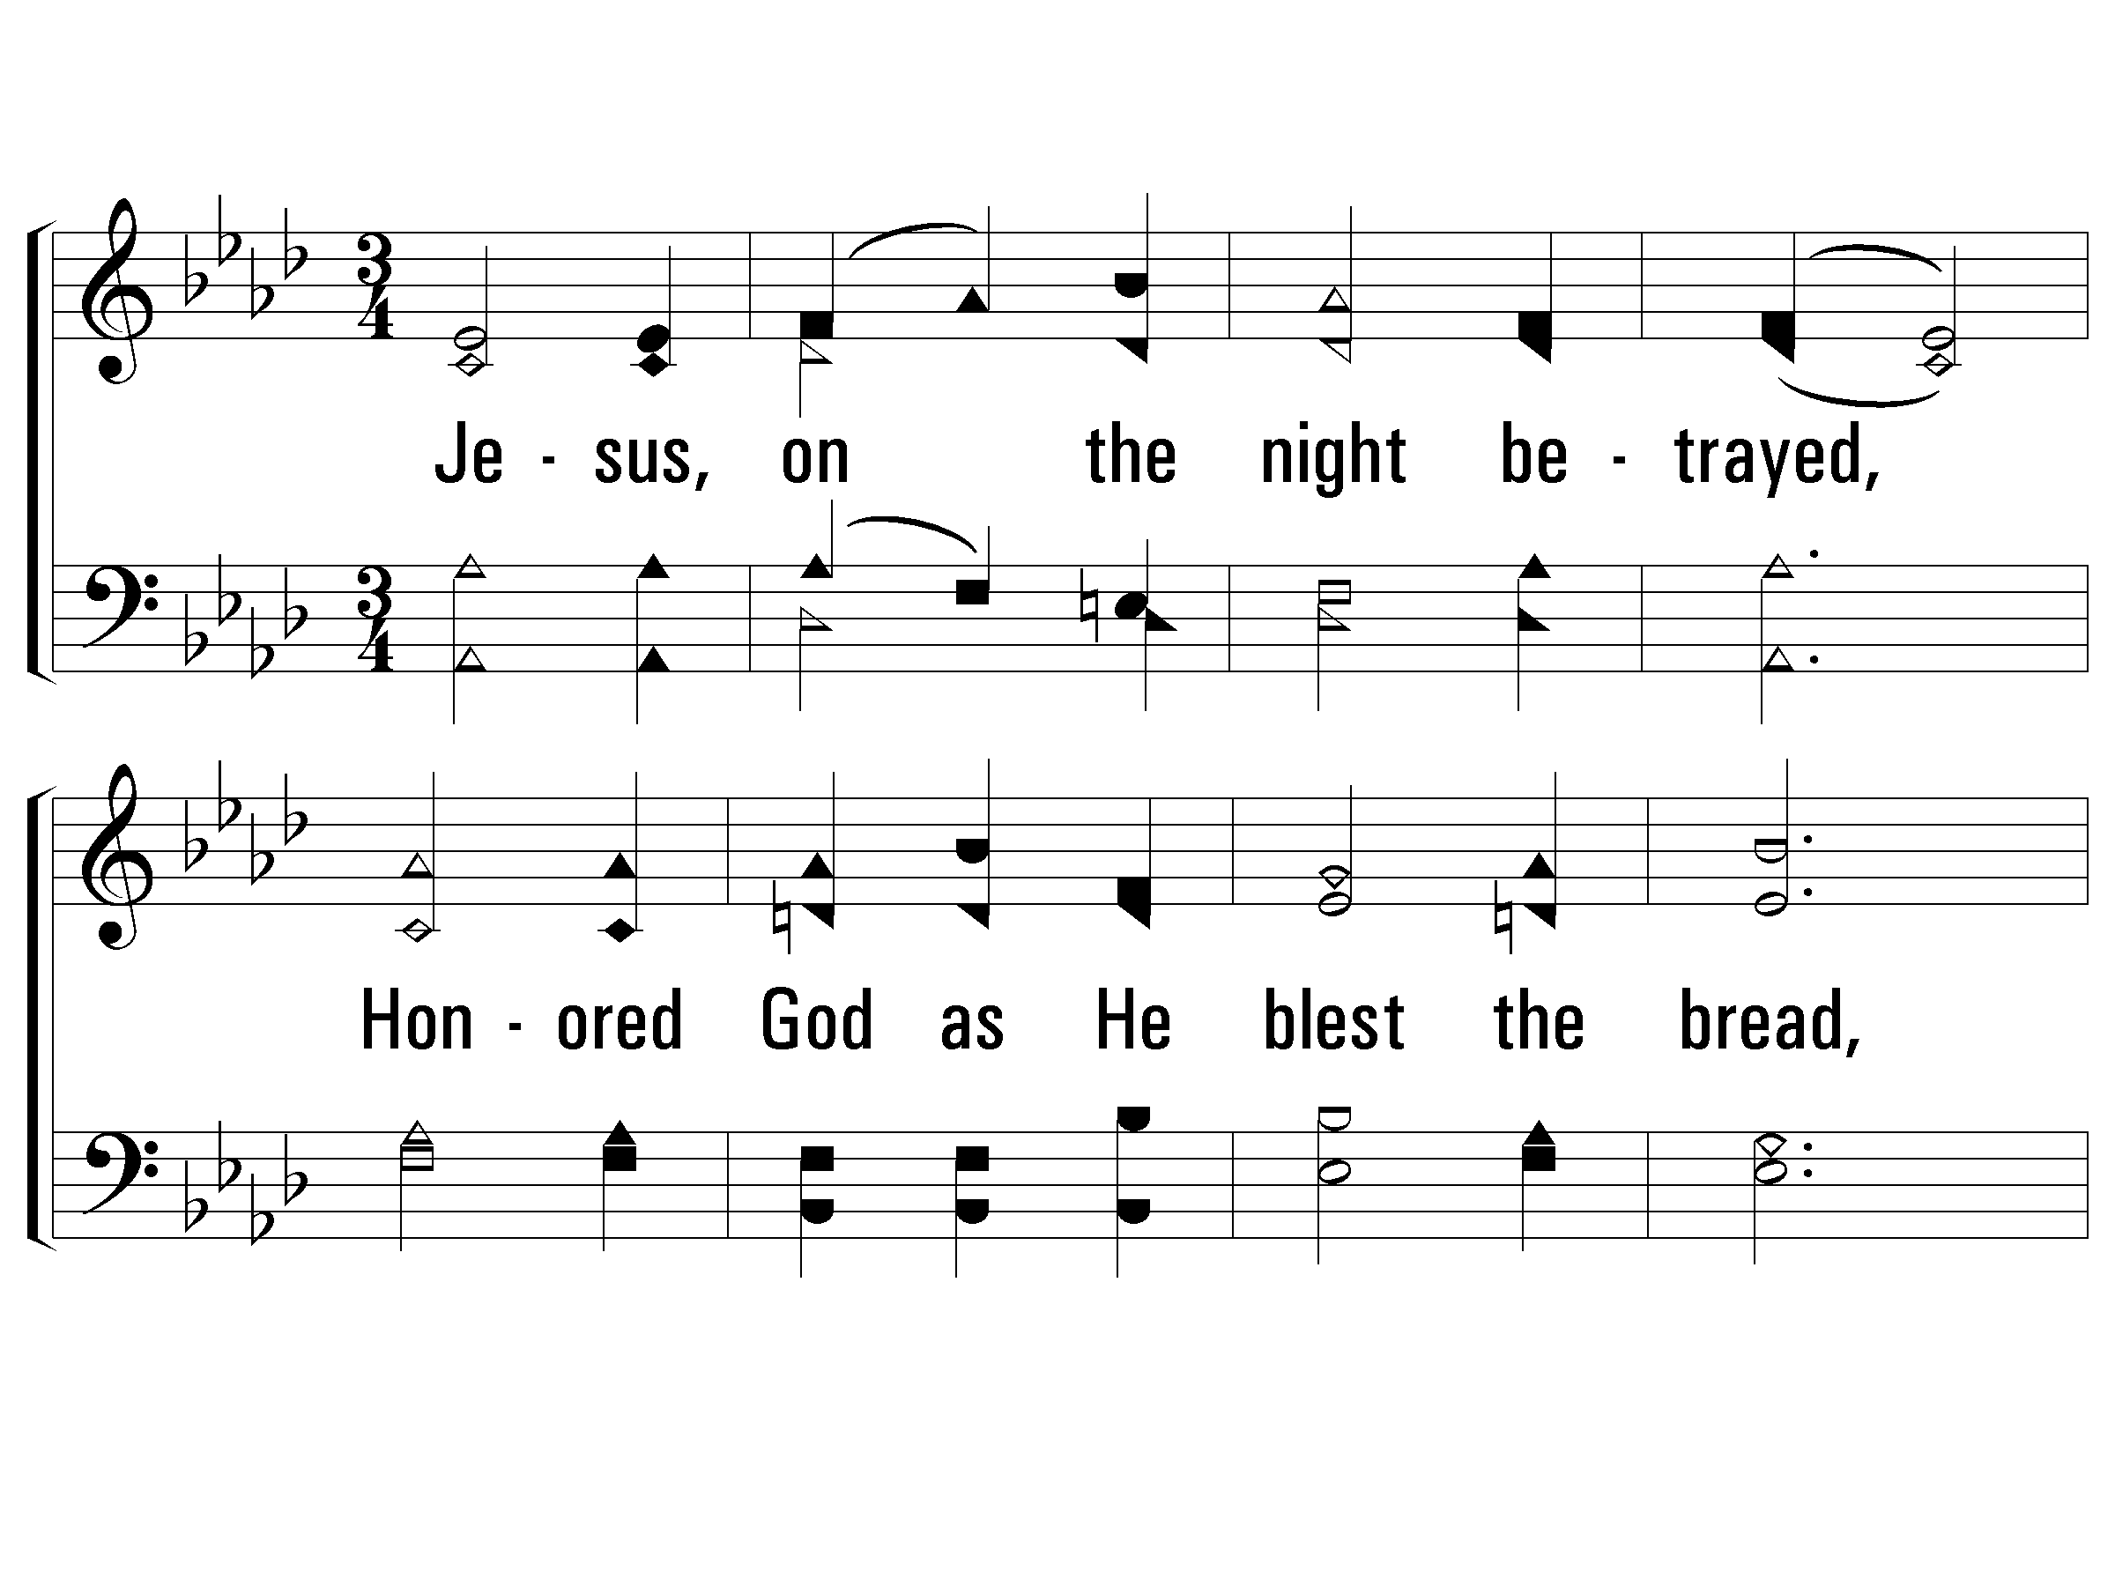
1 - Thus Remember Me
688
1.
Jesus, on the night betrayed,
Honored God as He blest the bread,
And to His disciples said:
"Thus remember Me."
Words & Music: Lloyd O. Sanderson
Copyright © 1971 by L. O. Sanderson, Leon B. Sanderson, owner.
All rights reserved. Used by permission.
© 2006 The Paperless Hymnal®

Slide 3
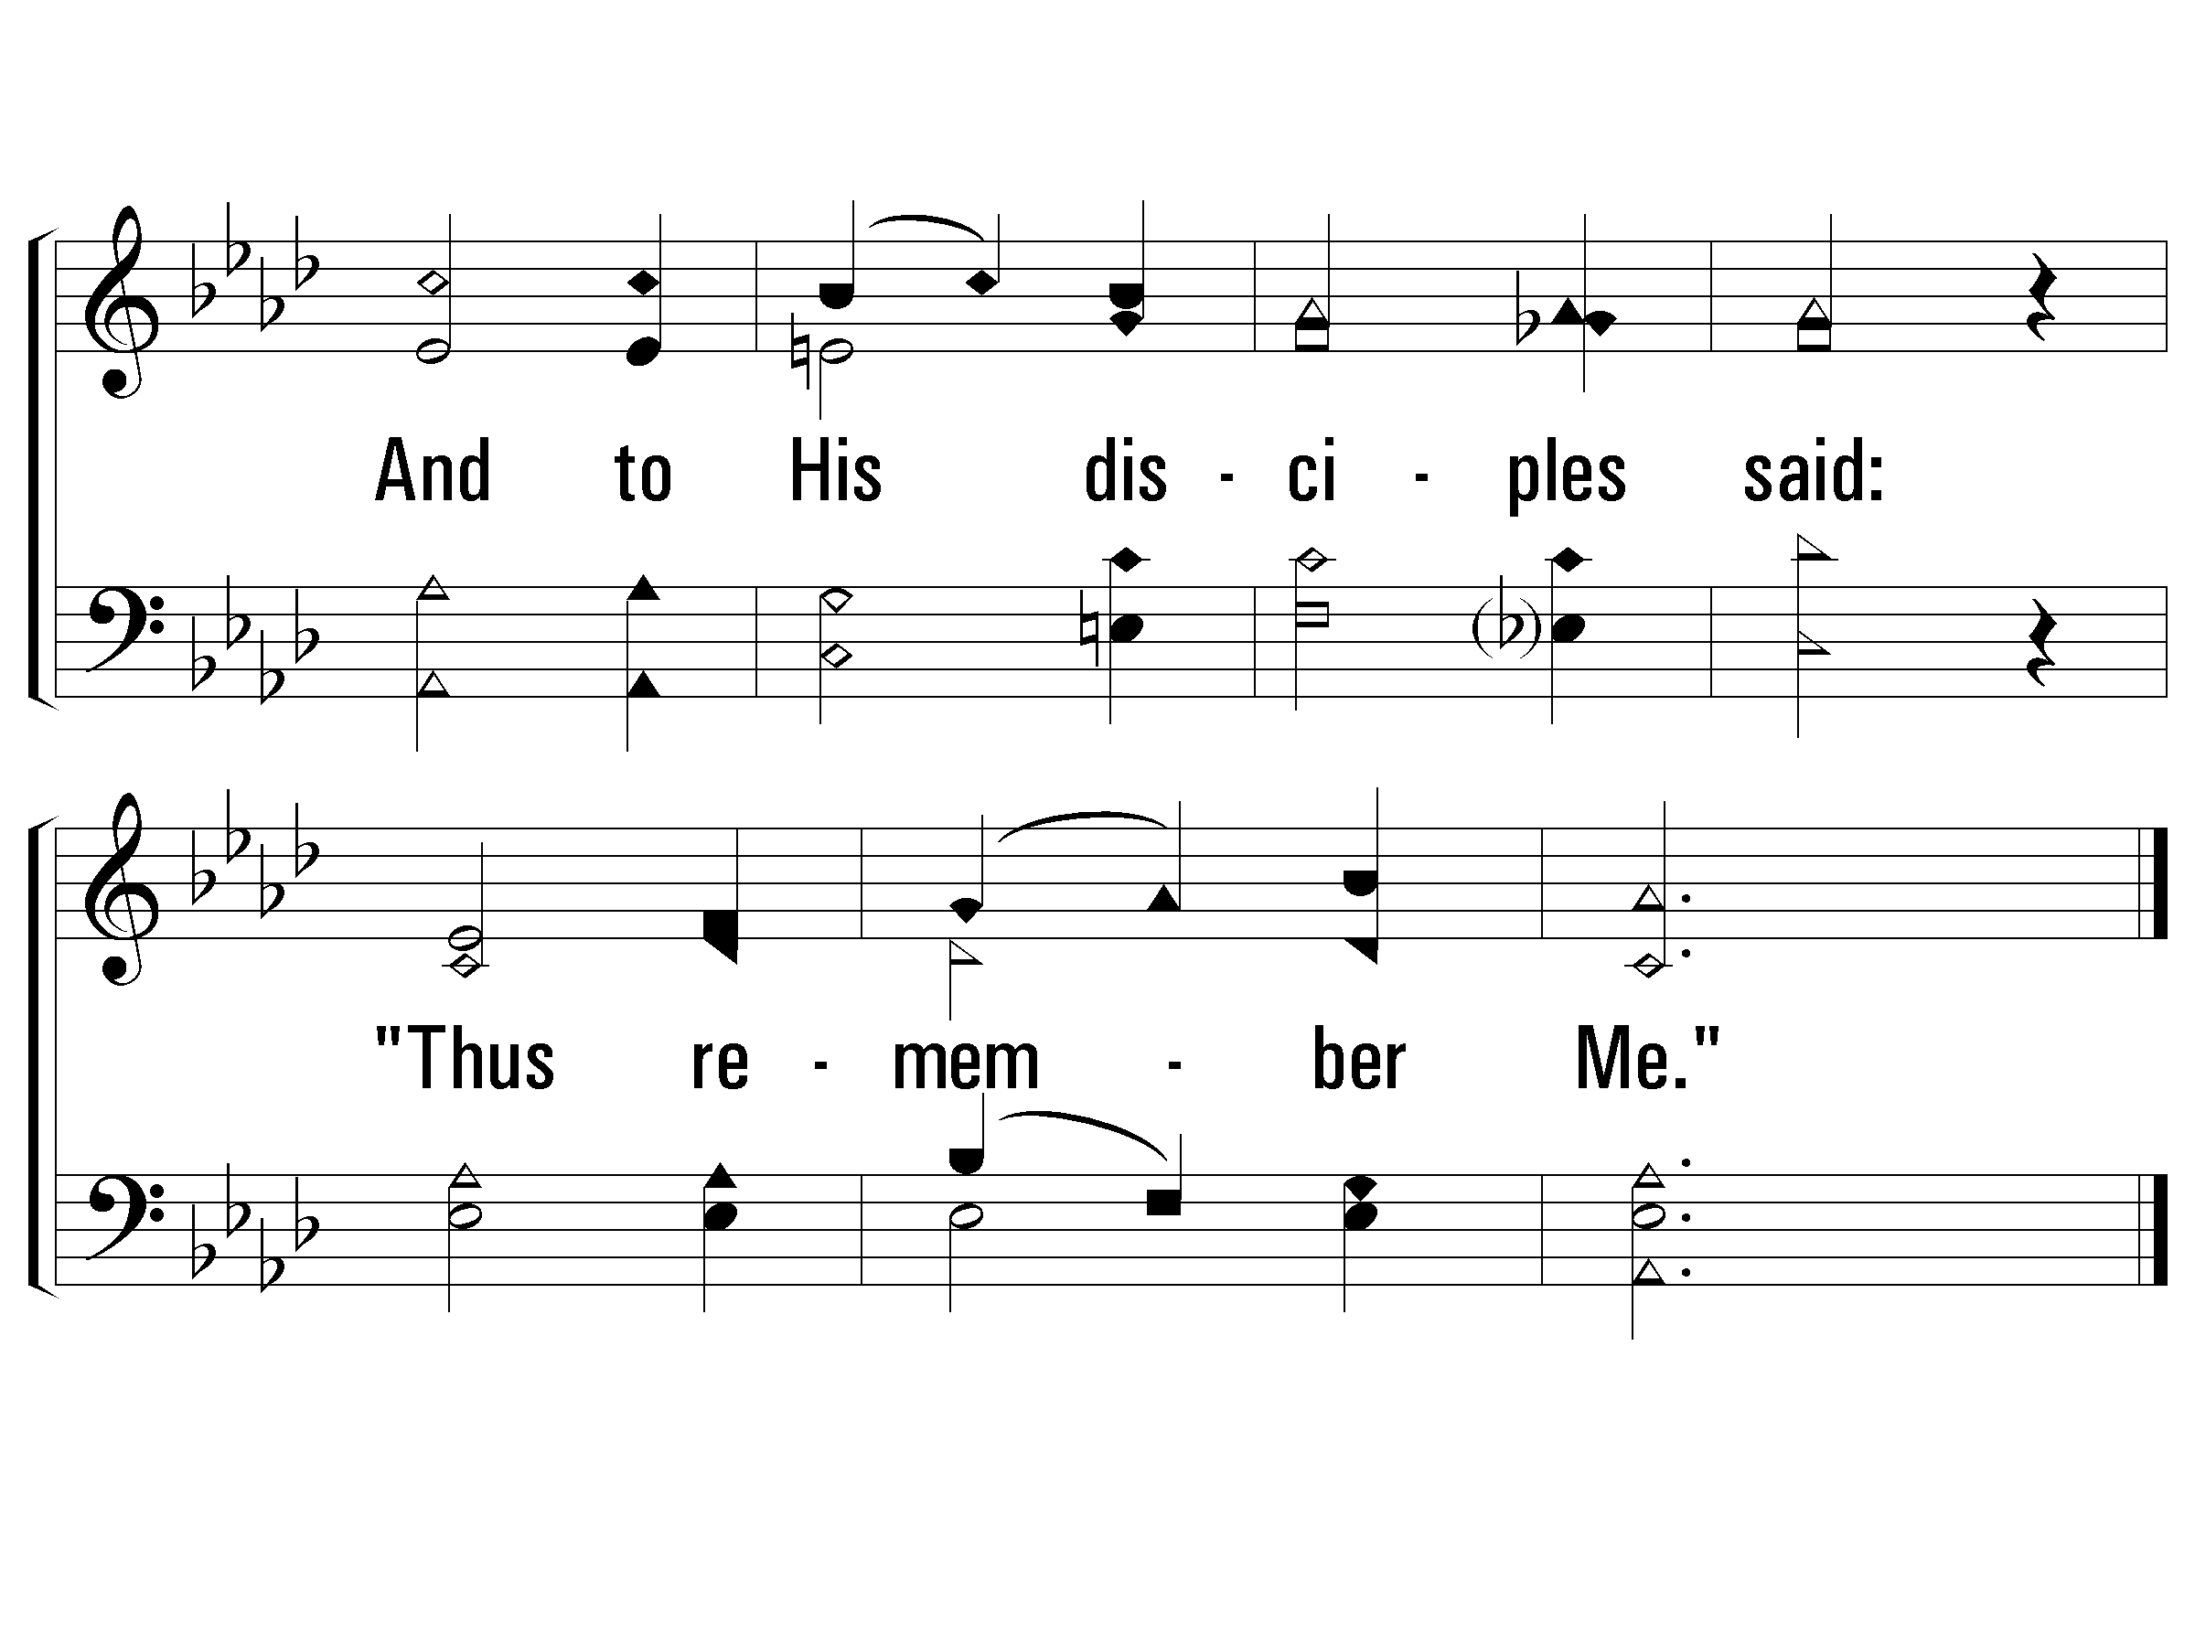
1 - Thus Remember Me
688
© 2006 The Paperless Hymnal®

Slide 4
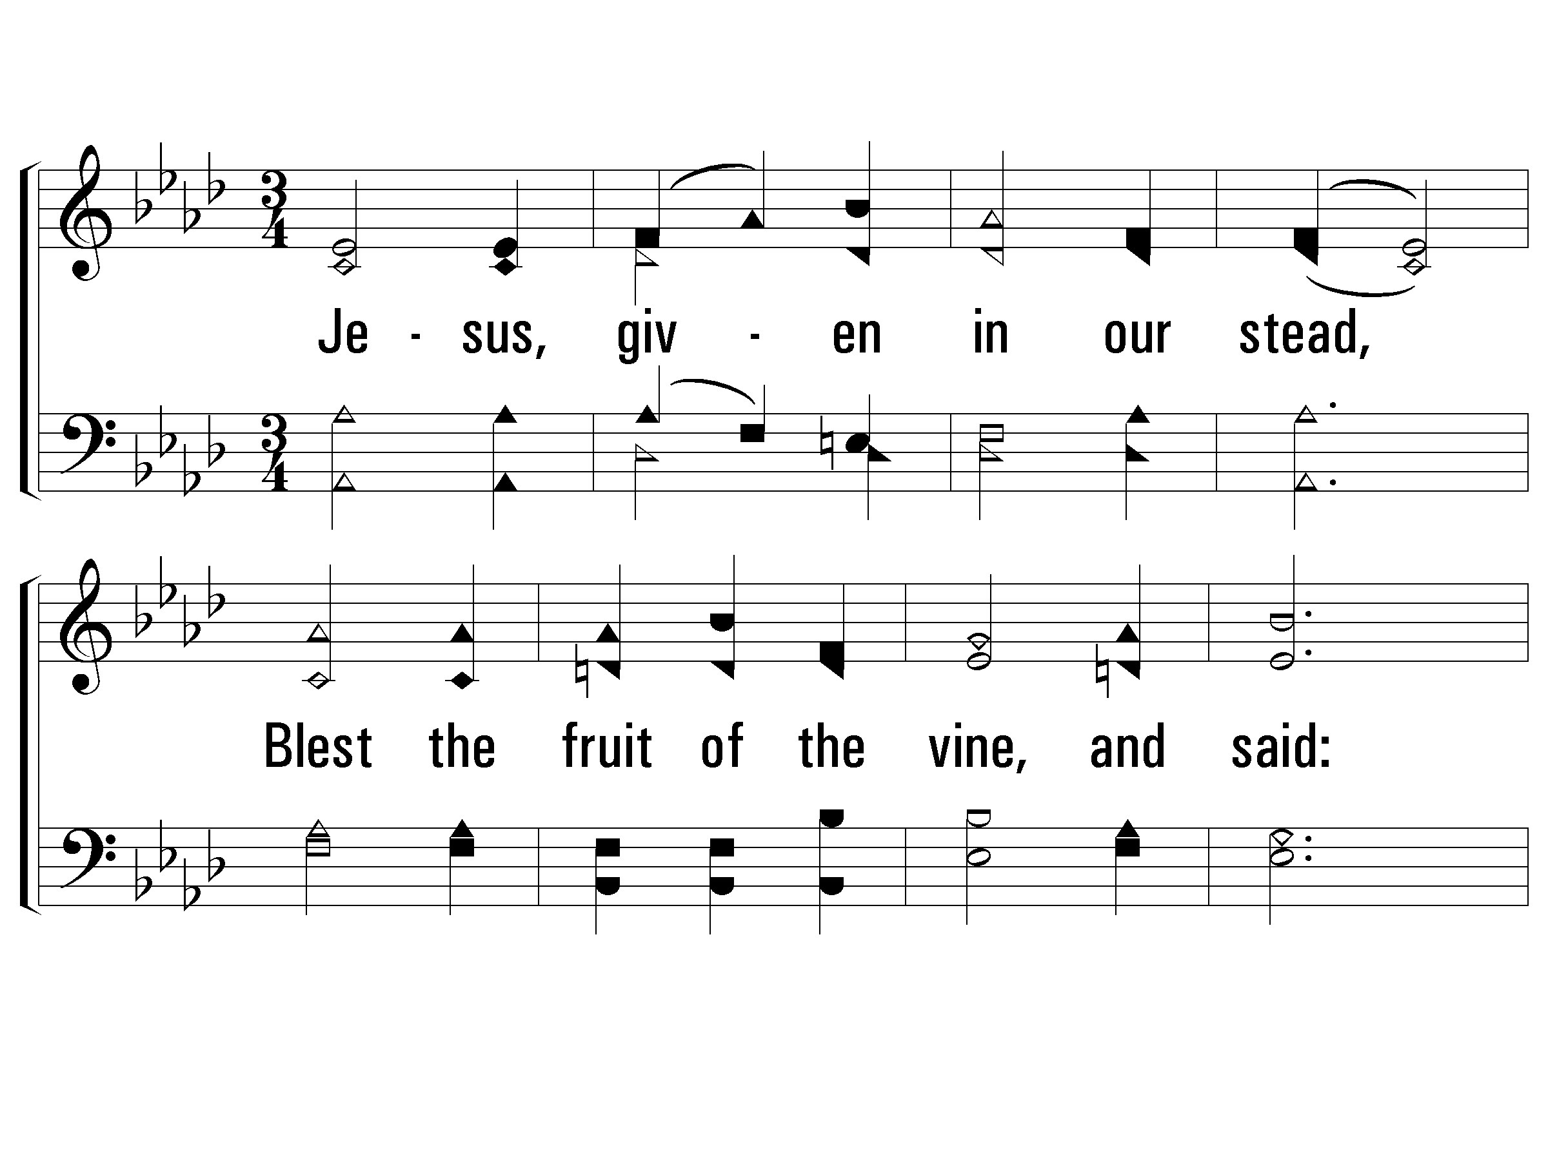
2 - Thus Remember Me
688
2.
Jesus, given in our stead,
Blest the fruit of the vine, and said:
"This, My blood, for you is shed;
So, remember me."
Words & Music: Lloyd O. Sanderson
Copyright © 1971 by L. O. Sanderson, Leon B. Sanderson, owner.
All rights reserved. Used by permission.
© 2006 The Paperless Hymnal®

Slide 5
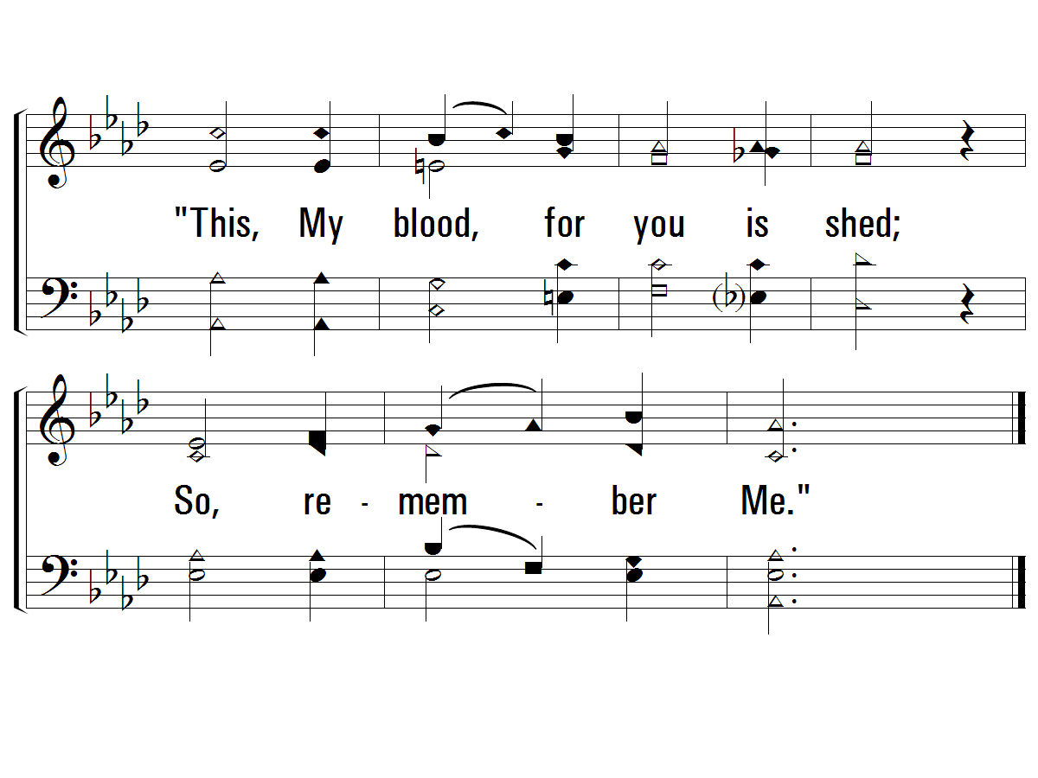
2 - Thus Remember Me
688
End
© 2006 The Paperless Hymnal®

Slide 7
Lord’s Supper

Slide 8
Ephesians 5:2
² And walk in love, as Christ also has loved us and given Himself for us, an offering and a sacrifice to God for a sweet-smelling aroma.
Notes:
1/29/17
7/30/17

Slide 10
Colossians 1:19-22
¹⁹ For it pleased the Father that in Him all the fullness should dwell, ²⁰ and by Him to reconcile all things to Himself, by Him, whether things on earth or things in heaven, having made peace through the blood of His cross.
²¹ And you, who once were alienated and enemies in your mind by wicked works, yet now He has reconciled ²² in the body of His flesh through death, to present you holy, and blameless, and above reproach in His sight

Slide 11
John 12:32
³² And I, if I am lifted up from the earth, will draw all peoples to Myself.”
³³ This He said, signifying by what death He would die.

Slide 13
HowDeepTheFathersLove_st2_a
Vs 2
© 2014 Sumphonia Productions, LLC

Slide 14
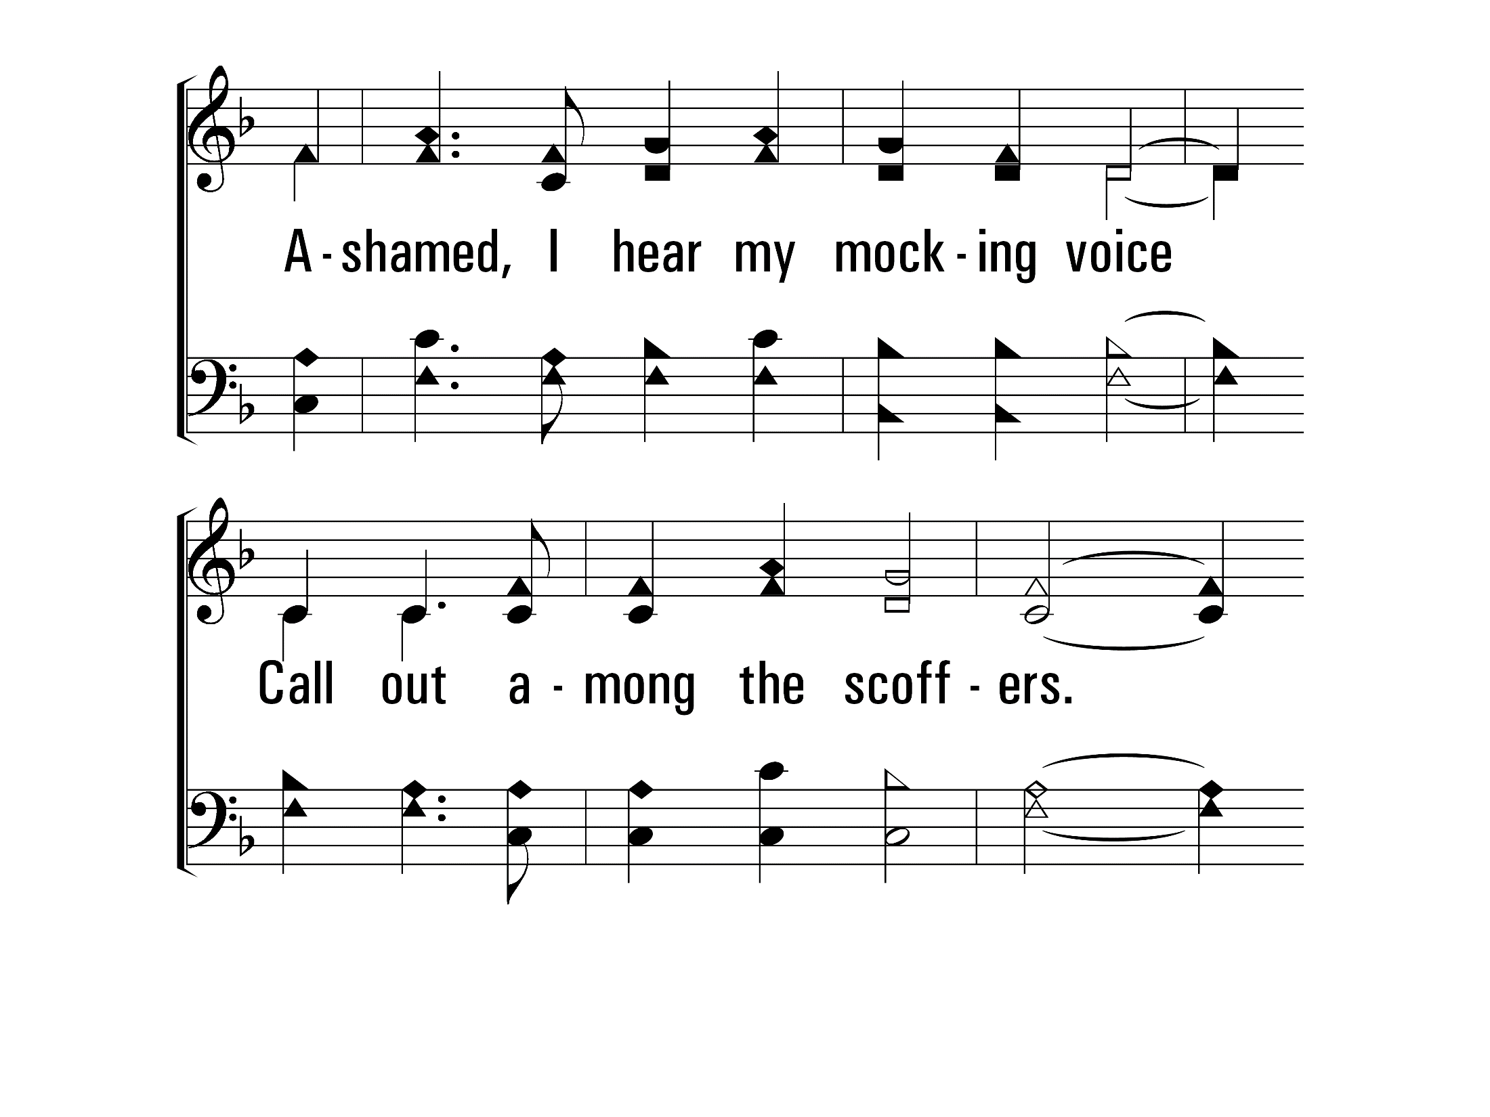
HowDeepTheFathersLove_st2_b
Vs 2
© 2014 Sumphonia Productions, LLC

Slide 15
HowDeepTheFathersLove_st2_c
Vs 2
© 2014 Sumphonia Productions, LLC

Slide 16
HowDeepTheFathersLove_st2_d
End
Vs 2
© 2014 Sumphonia Productions, LLC

Slide 18
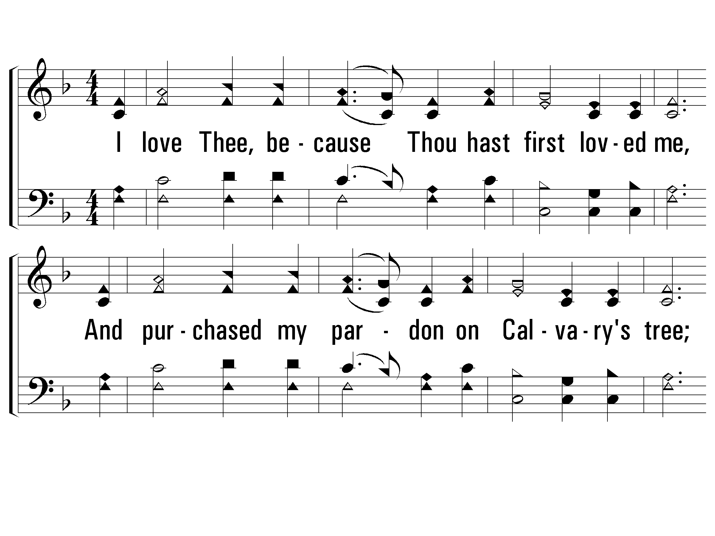
2 - My Jesus, I Love Thee
440
2.
I love Thee, because Thou hast first loved me,
And purchased my pardon on Calvary's tree;
I love Thee for wearing the thorns on Thy brow;
If ever I loved Thee, my Jesus, 'tis now.
Words by: Primitive Methodist Magazine / Attr.: William R. Featherston
Music by: Adoniram J. Gordon
© 2001 The Paperless Hymnal™

Slide 19
2 - My Jesus, I Love Thee
440
End
© 2001 The Paperless Hymnal™

