Slide 1
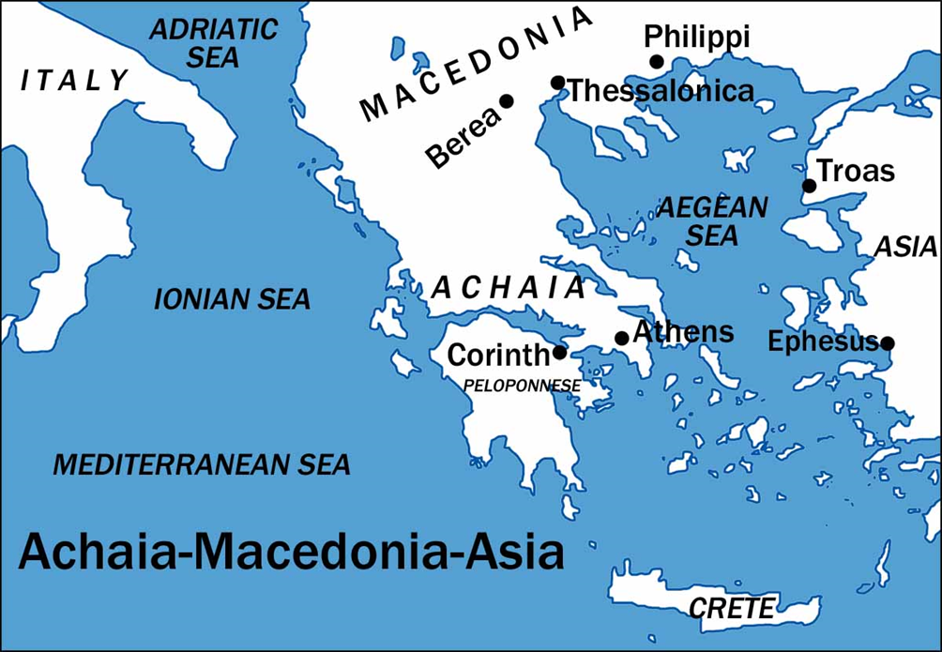
I Corinthians
Auditorium
Segment 4 – 2017

Slide 2
Approach for today’s study:
Introduce the City of Corinth
Paul’s Relationship with them
Reasons for writing / content overview
Chapter 1 :1-17

Slide 3
 | Title | Day | Date
1 | Introduction | Sunday | Feb 25, 2017
2 | The Wisdom of God | Wednesday | March 1, 2017
3 | Spiritual vs. Carnal | Sunday | March 5, 2017
4 | Puffed Up | Wednesday | March 8, 2017
5 | Lawsuits and Former Lives | Sunday | March 12, 2017
6 | Questions of Marriage | Wednesday | March 15, 2017
7 | Regard for Others | Sunday | March 19, 2017
 | Meeting | Wednesday | March 22, 2017

Slide 4
1. City of Corinth
Notes:
The old Corinth was burned in 146 B.C. by the Roman proconsul, L. Mummius. Because it was a city devoted to the gods. In 46 B.C., Julius Caesar rebuilt the city, populated it with a colony of veterans and freedmen, and
named it Julia Corinthus. It soon became a very important commercial center. About 50 miles to the east was the city of Athens. The city's close proximity to the city of Athens probably added the problem of intellectualism.

Slide 5
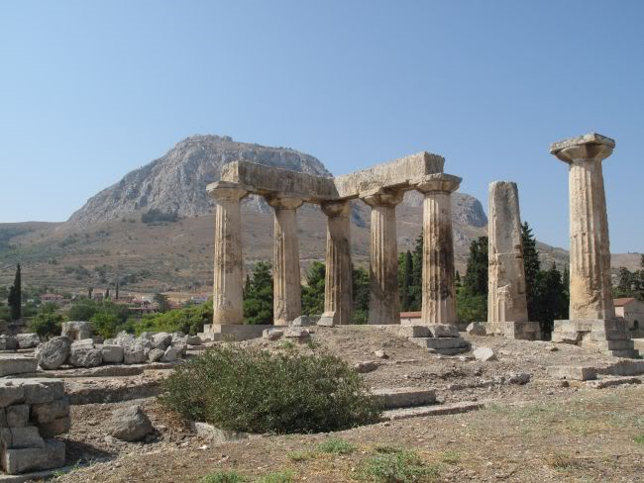
Temple of Aphrodite
Notes:
it was a place for all sorts of vice. An example of its immorality was found in the temple of Venus (Aphrodite),which hosted 1000 priestesses dedicated to prostitution in the name of religion.

Slide 6
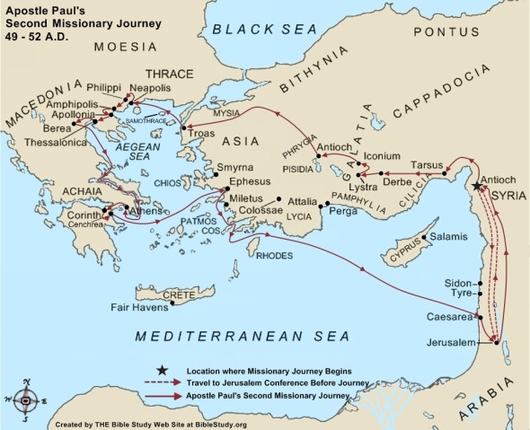
2. Paul’s Relationship with them
Acts 18:1 After these things Paul departed from Athens and went to Corinth. 2 And he found a certain Jew named Aquila, born in Pontus, who had recently come from Italy with his wife Priscilla (because Claudius had commanded all the Jews to depart from Rome); and he came to them

Slide 7
2. Paul’s Relationship with them
Acts 18:1-18
Abiding with Aquila and Priscilla, fellow tentmakers; reasoning in the synagogue every Sabbath (Ac 18:1-6).
9Now the Lord spoke to Paul in the night by a vision, “Do not be afraid, but speak, and do not keep silent; 10 for I am with you, and no one will attack you to hurt you; for I have many people in this city.”
2) In the house of Justus, abiding there and teaching for a year and six months (Ac 18:7-11)
3) An incident before Gallio, proconsul of Achaia (Ac 18:12-18)
12 When Gallio was proconsul of Achaia, the Jews with one accord rose up against Paul and brought him to the judgment seat, 13 saying, “This fellow persuades men to worship God contrary to the law.”
Notes:
8Then Crispus, the ruler of the synagogue, believed on the Lord with all his household. And many of the Corinthians, hearing, believed and were baptized.

Slide 8
2. Paul’s Relationship with them
Took with him Aquila and Priscilla when he sailed for Syria Acts 18:18
Paul looked at them has his children 1Cor 4:14-15
14 I do not write these things to shame you, but as my beloved children I warn you. 15 For though you might have ten thousand instructors in Christ, yet you do not have many fathers; for in Christ Jesus I have begotten you through the gospel.
Notes:
8Then Crispus, the ruler of the synagogue, believed on the Lord with all his household. And many of the Corinthians, hearing, believed and were baptized.

Slide 9
Approach for today’s study:
Introduce the City of Corinth
Paul’s Relationship with them
Reasons for writing / content overview
Chapter 1 :1-17

Slide 10
3 Reasons for writing / content overview
The bad news concerning the problems at Corinth had reached Paul in Ephesus…
Two sources:
1) the household of Chloe (1:11)
2) a letter sent to him (7:1), (possibly by the hands of Stephanas, Fortunatus, and Achaicus 16:17)

Slide 11
3 Reasons for writing / content overview
I. PROBLEMS REPORTED BY THE HOUSE OF CHLOE (1:10-6:20)
A. FACTIONS IN THE CHURCH (1:1-4:21)
B. SEXUAL IMMORALITY (5:1-13)
C. LAWSUITS AMONG BRETHREN (6:1-11)
D. MORAL DEFILEMENTS (6:12-20)

Slide 12
3 Reasons for writing / content overview
II. PROBLEMS MENTIONED IN THE LETTER FROM CORINTH (7:1-16:9)
A. MARRIAGE & CELIBACY (7:1-40)
B. EATING MEATS SACRIFICED TO IDOLS (8:1-11:1)
C. WOMEN PRAYING AND PROPHESYING (11:2-16)
D. THE LORD'S SUPPER (11:17-34)
E. SPIRITUAL GIFTS (12:1-14:40)
F. RESURRECTION FROM THE DEAD (15:1-58)
G. COLLECTION FOR THE SAINTS (16:1-4)

Slide 13
Why Study this Letter?
Why should we listen to Paul?

Slide 14
How Did the Apostles Intend for churches to use teachings/ letters?
Phil 4:9 – The things which you learned and received and heard and saw in me, these do, and the God of peace will be with you.
I Thes 2:13,14 -- For this reason we also thank God without ceasing, because when you received the word of God which you heard from us, you welcomed it not as the word of men, but as it is in truth, the word of God, which also effectively works in you who believe. ¹⁴For you, brethren, became imitators of the churches of God which are in Judea in Christ Jesus. For you also suffered the same things from your own countrymen, just as they did from the Judeans,
II Thes 2:15 – Therefore, brethren, stand fast and hold the traditions which you were taught, whether by word or our epistle.
I Tim 3:14,15 – These things I write to you, though I hope to come to you shortly; ¹⁵but if I am delayed, I write so that you may know how you ought to conduct yourself in the house of God, which is the church of the living God, the pillar and ground of the truth.

Slide 15
Was/is Compliance Necessary?
I Cor 4:16,17a – ¹⁶Therefore I urge you, imitate me. ¹⁷For this reason I have sent Timothy to you, who is my beloved and faithful son in the Lord, who will remind you of my ways in Christ, as I teach everywhere in every church.
Tit 1:5 – For this reason I left you in Crete, that you should set in order the things that are lacking, and appoint elders in every city as I commanded you…
I Cor 11:33,34 – ³³Therefore, my brethren, when you come together to eat, wait for one another. ³⁴But if anyone is hungry, let him eat at home, lest you come together for judgment. And the rest I will set in order when I come.
1 Corinthians 1:10 “Now I plead with you, brethren, by the name of our Lord Jesus Christ, that you all speak the same thing, and that there be no divisions among you, but that you be perfectly joined together in the same mind and in the same judgment.”

Slide 16
Applicable for us today?
Questions about inspiration
Problems of addictive behavior (sexual, drugs, alcohol, tobacco ) chap 6
Living with an unbelieving spouse (chap 7)
Need to make sacrifices to encourage others (Chap 10)
Lack of heartfelt worship (Chap 14)
Need for self-control (Chap 9)
A woman’s spiritual role (Chap 11, and 14)
Faith in resurrection

Slide 17
Approach for today’s study:
Introduce the City of Corinth
Paul’s Relationship with them
Reasons for writing / content overview
Chapter 1 :1-17

Slide 18
1 Corinthians 1:1 Paul, called to be an apostle of Jesus Christ through the will of God, and Sosthenes our brother,2 To the church of God which is at Corinth, to those who are sanctified in Christ Jesus, called to be saints, with all who in every place call on the name of Jesus Christ our Lord, both theirs and ours:3 Grace to you and peace from God our Father and the Lord Jesus Christ.4 I thank my God always concerning you for the grace of God which was given to you by Christ Jesus, 5 that you were enriched in everything by Him in all utterance and all knowledge, 6 even as the testimony of Christ was confirmed in you, 7 so that you come short in no gift, eagerly waiting for the revelation of our Lord Jesus Christ, 8 who will also confirm you to the end, that you may be blameless in the day of our Lord Jesus Christ. 9 God is faithful, by whom you were called into the fellowship of His Son, Jesus Christ our Lord.10 Now I plead with you, brethren, by the name of our Lord Jesus Christ, that you all speak the same thing, and that there be no divisions among you, but that you be perfectly joined together in the same mind and in the same judgment.

Slide 19
How does Paul describe the church at Corinth (vs. 2)?
2. How had the Corinthians been enriched in Christ?
3. What did he beseech them to do?
2 To the church of God which is at Corinth, to those who are sanctified in Christ Jesus, called to be saints, with all who in every place call on the name of Jesus Christ our Lord, both theirs and ours:
5 that you were enriched in everything by Him in all utterance and all knowledge, 6 even as the testimony of Christ was confirmed in you:
10 Now I plead with you, brethren, by the name of our Lord Jesus Christ, that you all speak the same thing, and that there be no divisions among you, but that you be perfectly joined together in the same mind and in the same judgment.

Slide 20
Chapter 1 – No Reasons for Divisions
They Were Enriched By God
Called Out To Be Holy
Utterance and Knowledge
Waited On Christ’s Return
Could Count On God’s Faithfulness

Slide 21
1 Corinthians 1: 11 For it has been declared to me concerning you, my brethren, by those of Chloe’s household, that there are contentions among you. 12 Now I say this, that each of you says, “I am of Paul,” or “I am of Apollos,” or “I am of Cephas,” or “I am of Christ.” 13 Is Christ divided? Was Paul crucified for you? Or were you baptized in the name of Paul?14 I thank God that I baptized none of you except Crispus and Gaius, 15 lest anyone should say that I had baptized in my own name. 16 Yes, I also baptized the household of Stephanas. Besides, I do not know whether I baptized any other. 17 For Christ did not send me to baptize, but to preach the gospel, not with wisdom of words, lest the cross of Christ should be made of no effect.

Slide 22
4. How does he describe the contentions that existed among them?
5. Whom had Paul baptized?
Why was he glad that he had not baptized others?
What was Paul's mission?
…that there are contentions among you. 12 Now I say this, that each of you says, “I am of Paul,” or “I am of Apollos,” or “I am of Cephas,” or “I am of Christ.”
14 I thank God that I baptized none of you except Crispus and Gaius,
16 Yes, I also baptized the household of Stephanas.
17 For Christ did not send me to baptize, but to preach the gospel, not with wisdom of words, lest the cross of Christ should be made of no effect.

Slide 23
Chapter 1 – No Reasons for Divisions
They Were Enriched By God
Called Out To Be Holy
Utterance and Knowledge
Waited On Christ’s Return
Could Count On God’s Faithfulness
They Suffered From “Preacher-itis”
Only Christ Died For Our Sins
Only Baptized Into Christ

Slide 24
In their own words…
John Wesley: “Would to God that all party names, and unscriptural phrases and forms which have divided the Christian world, were forgot and that the very name [Methodist] might never be mentioned more, but be buried in eternal oblivion.”
Martin Luther: “I ask that men make no reference to my name, and call themselves not Lutherans, but Christians. What is Luther? My doctrine, I am sure, is not
mine, nor have I been crucified for any one. St. Paul, in 1 Cor. 3, would not
allow Christians to call themselves Pauline or Petrine, but Christian. How then
should I, poor, foul carcass that I am, come to have men give to the children of
Christ a name derived from my worthless name? No, no, my dear friends; let
us abolish all party names, and call ourselves Christians after Him Whose
doctrine we have.”

Slide 26
I Corinthians
Auditorium
Segment 4 – 2017

Slide 27
 | Title | Day | Date
1 | Introduction | Sunday | Feb 25, 2017
2 | The Wisdom of God | Wednesday | March 1, 2017
3 | Spiritual vs. Carnal | Sunday | March 5, 2017
4 | Puffed Up | Wednesday | March 8, 2017
5 | Lawsuits and Former Lives | Sunday | March 12, 2017
6 | Questions of Marriage | Wednesday | March 15, 2017
7 | Regard for Others | Sunday | March 19, 2017
 | Meeting | Wednesday | March 22, 2017

Slide 28
Chapters of 1 Corinthians
Chapter 1 –
Chapter 2 –
Chapter 3 –
Chapter 4 –
Chapter 5 –
Chapter 6 –
Chapter 7 –
Chapter 8 –
No Reason for Divisions
Paul’s Message: The Wisdom of God
Corinthians’ Carnal Minds
Servant Evangelists
Sin in the Church
Lawsuits and Liberties (or Immorality)
Liberties: Marriage
Liberties: Meat Offered to Idols
Notes:
From the book we can learn much about the problems that existed;
The church was on the verge of a division caused by inordinate allegiance to men.
Incest existed among the members
Brethren were going to law with one another
They were confused about marriage
Problem of eating meats sacrificed to idols
Abusing the Lord’s Supper
Women were acting out of place
Spiritual gifts were being misused
Some were even denying the resurrection
Someone was undermining Paul’s apostleship.
PURPOSE: Paul wrote to help the church overcome their pressing problems.
Here is a group of people that had come out of a very sinful lifestyle (6:9-11) and there would be the temptation to lapse into old vices.
They lived in a very corrupt city and surrounded by evil influences.

Slide 29
Chapters of 1 Corinthians
Chapter 9 –
Chapter 10 –
Chapter 11 –
Chapter 12 –
Chapter 13 –
Chapter 14 –
Chapter 15 –
Chapter 16 –
Paul’s Liberties
Israel’s “Liberties” Lesson
Head Covering; Lord’s Supper
Spiritual Gifts: Members of One Body
Spiritual Gifts: Love is Better
Spiritual Gifts: Strive for Edification
Summary of the Gospel
Collection for the Saints
Notes:
From the book we can learn much about the problems that existed;
The church was on the verge of a division caused by inordinate allegiance to men.
Incest existed among the members
Brethren were going to law with one another
They were confused about marriage
Problem of eating meats sacrificed to idols
Abusing the Lord’s Supper
Women were acting out of place
Spiritual gifts were being misused
Some were even denying the resurrection
Someone was undermining Paul’s apostleship.
PURPOSE: Paul wrote to help the church overcome their pressing problems.
Here is a group of people that had come out of a very sinful lifestyle (6:9-11) and there would be the temptation to lapse into old vices.
They lived in a very corrupt city and surrounded by evil influences.

Slide 30
Chapter Two
1 Corinthians 2: I knew nothing among you except Christ crucified. We speak the wisdom of God. Through the Spirit we know what God has revealed.
Chapter 2 – The Wisdom of God
Paul’s Manner Of Preaching
Paul Proclaimed Only Christ and Him Crucified (1-3)
In Weakness, Fear, and Trembling (3)
Demonstrated Of The Spirit And Of Power (4-5)
Faith Should Rest In Power Of God Not In Men (5)
True Wisdom Of God (6-16)
The Hidden Nature Of God’s Wisdom (6-9)
The Spirit’s Revelation Of God’s Wisdom (10-13)
The “Natural Man” VS. Spiritual Man (14-16)
Natural - Not Guided By Revelation
Spiritual - Guided By God’s Revelation

Slide 31
Chapter 3
1 Corinthians 3: You are still infants. One follows Paul, another Apollos. We are co-workers with God. Christ is the foundation. You are God's temple.
Chapter 3 – Carnal Minds
LET NO MAN GLORY IN MEN (3:1-23)
Division - Proof of Their Immaturity (1-4)
Carnal (1) Babes, Not spiritual, Made of Flesh
Carnal (2) They were Anti-Spiritual. Dominated by the Flesh
Ministers Are Servants – Not Masters (5-9)
The Lord Gave to them
The Test of Every Preachers Work (10-15)
How do they Build on the Foundation of Christ?
Does Their Work Last?
Therefore Let No Man Glory in Men (16-23)
All things are yours (21)

Slide 32
Chapter 4
1 Corinthians 4: Think of us as stewards of the mysteries of God. You are kings already (8)? We are fools for Christ. I admonish you as my dear children.
Chapter 4 – Servant Evangelists
Proper Estimation and Work of a Preacher (1-5)
Count Ministers for what they are
Ministers (under-oarsman) and Steward (servant and manager)
Judgment of Men Matters Little
Judgment of God is all that Matter
Do Not Compare or Judge Ministers (4:6-13)
God Causes the Differences Between Men (7)
You are Showing Superiority (8)
True Ministers are put Last (9-10)
True Ministers Serve – No Matter What (11-13)
The Faithfulness / Purpose of Ministers (14-21)
Minister Does Not Shame – but Admonishes (14)
Minister Shows a fatherly spirit (15)
Minister Sets an Unmatched Example (16)
Ministers Provides Growth for the church (17)
Minister Wants to be with God’s People – to help them get better (18)

Slide 33
Chapter 5
1 Corinthians 5: You boast about the sexual immorality among you. You should deliver that man to Satan. But I am not judging those outside the church.
Chapter 5– Sin in the Church
Sexual Immorality & Church Discipline
Mourn the Sin (5:1-2)
But they were puffed up!
Judge the Sin (5:3-5) –
Deliver him to Satan
Purge the Sin (5:6-13)–
To Save the Sinner (5b)
To Save the Church (6-8)

Slide 34
Major Points in Chapter 6
1 Corinthians 6: Do you take one another to court? Why not rather be wronged? Your body is not for sexual immorality, it is a temple of the Spirit.
Chapter 6 – Lawsuits & Liberties
It is a sin to defraud your brother
How dare you take your brother to a heathen court. It is an utter shame!
As a Christian, you are Washed, Sanctified, and Justified – Act Like It!!
You are different from the Unrighteous World in which you live.
Your conduct should reflect who you are
How you use your body matters – Always Glorify God!

Slide 35
Church Discipline
Consider the Church (5:1-13)
Mourn the Sin (5:1-2)
Judge the Sin (5:3-5)
Purge the Sin (5:6-13)
Consider the Lost (6:1-8)
Presenting a Poor Example to the Lost
Failed to Live Up to Their Position in Christ
Christians Suing Brethren had Already Lost
Consider the Lord (6:9-20)
Consider the Father (6:12-14)
Consider the Son (15-18)
Consider the Holy Spirit (19-20)

Slide 36
Now Concerning …
Marriage (7:1)
Divorce (7:10)
Virgins (7:25)
Food Offered to Idols (8:1)
Spiritual Gifts (12:1)
The Collection for Jerusalem (16:1)
Apollos (16:12)

Slide 37
Chapter 7
1 Corinthians 7: It is good to stay unmarried, but better to marry than to burn with lust. Each should live as God has called. I want you to be free.
Chapter 7 – Liberties: Marriage
Marriage is Good (1-9)
Avoid Immorality (1-2) Marry or exercise self-control (7-9)
Maintain Affection (3-4)
A Time for Abstinence (prayer/fasting) (5-6)
Instructions on Divorce (10-24)
Do Not Depart – Leave or Divorce your Spouse
Not “Under-Bondage” – To Reconcile, To Marriage Duties, to Save Them (NOT Free to Re-Marry)
Remain in the Condition You were Called (Social Status)
Keep the Commandments of God (19)
Instructions to the Single (25-40)
“Present Distress” – Remain Single if you Can
Widows – Ok to Marry “in the Lord”, but might be happier single

Slide 38
Chapter 8
1 Corinthians 8: About food offered to idols: An idol is nothing. There is only one God. But if food makes my brother stumble I will never eat meat.
Chapter 8– Liberties: Meats offered to Idols
Knowledge, Love and Eating Meat Offered to Idols (8:1-6)
Knowledge Puffs Up BUT Love Edifies (1)
Applying Love Toward Those Whose Consciences are Weak (7-13)
Not Everyone has Correct Knowledge / Strong Consciences (7)
Our “Liberty” (Right) Must Not Cause Others to Stumble (8-9)
We Can Abuse our Knowledge and Liberty – Leading to Sin (10-12) – both the strong and the weak.
Be Willing to Give Up Your Liberty for Your Brothers Sake (13)
“I will never eat meat again if it causes my brother to stumble”
Notes:
The problem is primarily attitudinal. They think Christian conduct is predicated on knowledge and that knowledge gives them ..rights/freedom to act as they will in the matter. Paul has another view: The content of their knowledge is only partially correct, but more importantly, knowledge is not the ground of Christian behaviour, love is.' (Fee p. 363)
They may have settled this issue in their own minds and their argument appears to have run something like, 'Since idols are nonentities, and since food is a matter of indifference to God, it matters not not only what we eat but where we eat it as well. So how can Paul forbid their going to the temples?' (Fee p. 362)
Paul says “Wait a minute!” KNOWLEDGE PUFFS UP – Knowledge makes arrogant
Paul will make it clear that a man with knowledge may be loveless and/or puffed up...We will learn that nothing in the disciple's life is to be judged merely by knowledge.' (McGuiggan p. 121)
Since love does not rejoice in unrighteousness (13:6) but rejoices with the truth.
Paul points out that one can hold the correct view, and yet be completely wrong in their motives. (13:2 'And if I have...all knowledge but do not have love, I am nothing.)
'one who determines to act solely in accordance with what is theoretically allowable has not yet learned the Christian way of life.' (p. 89)
We need to examine such subjects as smoking, social drinking, gambling, questionable apparel-movies, music, in light of the principle that Paul lays down here.

Slide 39
Chapter 9
1 Corinthians 9: You are the seal of my apostleship. Do we not have the right to material support? But I made myself a servant to all for the gospel.
Chapter 9 – Paul’s Liberties
Paul’s Liberty as an Apostle (1-14)
Paul Affirms He is An Apostle (1-2)
Eyewitness of the Lord, His Work among the Corinthians
Liberties available to Paul
Eat and Drink, a Wife, and Support as a Preacher (4-5)
Illustrations of Soldier, Farmer, and a Shepherd (7)
Paul Restricted His Liberty (15-27)
Concerning Support (15-18)–“Woe if I do not preach gospel”
Service toward Others (19-23) – To Save Others (22)
The Possibility of Apostasy (24-27) – Lest I be disqualified

Slide 40
Chapter 10
1 Corinthians 10: Do not desire evil as our fathers did. God will make you able to endure temptation. Flee from idolatry. Do all to the glory of God.
Chapter 10 – Israel’s Liberties
Israel’s Example
God was not pleased (5)
Serves as an Example to Us;
We might not desire evil (6)
We must not indulge in Sexual Immorality (8)
We must not put Christ to the test (9)
We must not grumble (10)
Faithfulness of God when we are Tempted
If you think you Stand – Be Careful, You may fall (12)
God will always provide an escape so you might endure (13)
Do All Things to Glorify God (32)
Look to Build Up, Look to the Good of our Neighbor (23-24)
Try to Please Everyone in what you do – that they might be saved

Slide 41
Chapter 11
1 Corinthians 11: The head of a woman is her husband. I hear that some go hungry when you meet! With the bread and cup you proclaim the Lord's death.
Chapter 11 – Head Covering / Lord’s Supper
The Covering (1-16)
Hair, Custom, Miraculous Gifts, Divine Command.
Headship
The Lord’s Supper (17-34)
All worship is not acceptable to God
The Corinthians even had divisions when they came together
Treated the Lord’s Supper as a common meal
How to Take the Lord’s Supper
Look Back (23-26a) – Remember His Death
Remember THAT, WHY, and HOW He Died
Look Ahead (26b) Until He Comes
Look Within (27-28; 31-32) – Worthy Manner
Look Around (33-34) – Wait!

Slide 42
Chapter 12 - Review
1 Corinthians 12: Now there are various spiritual gifts, but one Spirit. If the whole body were an eye, how would it hear? You are the body of Christ.
Chapter 12 – Gifts: Members of One Body
All Spiritual Gifts, Though Diverse, Come From the Same Spirit and Are to be Used for the Benefit of All (1-11)
All Members (and Spiritual Gifts) Are Important. (12-27)
Paul Compares the Church to a Body with Many Different, but Essential Members.
Not Everyone Had the Same Gifts or Function (28-31)
Desire the Greater Gifts (Apostleship, Prophecy, Teaching) the Gifts that Instruct People in the Word of God.
“Gifts” Do Not Make One a Better Christian, But Love Will.

Slide 43
Chapter 13
1 Corinthians 13: Without love I am nothing. Love is patient, does not boast, love endures all things. Tongues will cease, but faith, hope and love remain.
Chapter 13 – Gifts: Love is Better
LOVE IS
Long Suffering
Kind
Rejoicing in Truth
Bears all things
Believes all things
Hopes all things
Endures all things
Love Never Fails
LOVE IS NOT
Envious
Boastful
Arrogant
Rude
Selfish
Easily Provoked
Thinks no Evil
Hates Sin
Miraculous Gifts will Cease When the New Testament Comes Together
So now Faith, Hope, and Love abide, these three, but the greatest of these is love (13:13)

Slide 44
Chap 14 – Proper Use of Spiritual Gifts
1 Corinthians 14: Tongues edifies the speaker, prophecy edifies the church. Each of you brings a hymn, a lesson or a tongue. Let all be done in order.
Chapter 14 – Gifts: Strive for Edification
Edification (14:1-5, 26b)
Edify – To build-up, Body-Building Exercises
We are all part of the same body, so we need to be busy building each other up!
We Must Share The Word Of God!
Understanding (14:6-25)
“Understanding” – used eight times in this section!
Illustrations: Music, Bugle Call, and Conversation
What We Share, Must Be Understood To Do Any Good!
Order (14:26-40)
Let all things be done unto edifying (26)
Let all things be done decently and in order (40)
When We Share, Do It In A Manner That Is Orderly

Slide 45
Chapter 15
1 Corinthians 15: Christ was raised from the dead. If not then your faith is futile. But he is the first-fruits. At the trumpet we will all be changed.
Chapter 15 – Summary of the Gospel
The Resurrection Of Jesus is The Basis Of Our Faith.
He Died (3), was Buried (4), Was Seen (5-7)
The Corinthians Were Taught This and they Believe This! (11)
Why Do We Believe That Jesus Was Raised From The Dead?
If Not – Then we Are to be Most Pitied (19)
What Is The Sequence Of Events At The end Of Time?
What Body will we have? (35-49)
How are we Raised? (50-58)
Since death ends nothing for the Christian, since Jesus conquered death – what we do in this life for God means Everything!
“Be Steadfast, Immoveable, Abound in the work of the Lord!
Notes:
Paul lays the foundation for their belief in the resurrection of Christ.
Paul then answers those who denied the general resurrection by showing that to accept the one demanded belief in the other.
To deny the resurrection of Christ would mean that faith and hope are in vain.
Then Paul proceeds to explain that when Christ returned, the resurrection would occur, and that He would deliver the kingdom to His Father, and even that would mark the “END”
Then finally Paul answers the objections raised by those who denied the possibility of the bodily resurrection.
“How are the dead raised up? – since the body begins to decay after death, how is it possible to be raised?
“With what body do they come?” – If one thinks only of a physical body, resurrection seems inconceivable.

Slide 46
Chapter 16
1 Corinthians 16: Put aside an offering for the saints. I will come to you. The churches of Asia greet you. The grace of our Lord Jesus be with you.
Chapter 16 – Collection for the Saints
15:58 – “…know your labor is not in vain”
What better chance to be “steadfast, immovable, and abounding in the Lord’s work” – than to help their brethren in Judea.
Concerning the Collection for the Saints
“Upon the First Day of the Week” (2)
“Lay something aside” – store up, deposit
As he may Prosper – as one is able
So – No Collections When I Come
Watch, Stand, Act Like Men, Strength (13)
But, Don’t Forget to be Loving… (14)
Quarrels and Factions (chaps 1-3)
Attitude toward Paul (Chap 4 & 9)
Lawsuits (chap 6)
Husband – Wife Relationships (chap 7)
How they treat each other (meat) – chap 8)
How you view your “rights: - chap 9
How you serve each other (with your gifts) – chaps 12-14)
Notes:
'Now concerning'-(7:1; 8:1; 12:1; 16:12). Indicating this was subject matter in which they wished for Paul to give additional instruction concerning.
The leadership in the Jerusalem Church and the other Apostles had requested that Paul 'remember the poor'. (Galatians 2:10)
'The more probable and permanent cause was the persecution and social ostracism suffered by Christians in Jerusalem...In a city of which the prosperity depended in large measure upon Jewish rites and ceremonies, converts to Christianity would have peculiar difficulty in securing employment and obtaining financial support..
Paul speaks of this collection in terms that are full of theological content: "fellowship" (2 Cor. 8:4; 9:13); "service" (2 Cor. 8:4; 9:1,12,13); "grace" (2 Cor. 8:4,6,7); "blessing" (2 Cor. 9:5); "divine service" (2 Cor. 9:12). All of this together suggests that the "collection" was not some mere matter of money, but was for Paul an active response to the grace of God
FOR THE SAINTS - While individual members could assist non-Christians (Galatians 6:10; James 1:27), resources pooled at the congregational level were only used for relieving the needs of other Christians. (Acts 2:44-45; 4:32-37; 11:29-30; 1 Timothy 5:16; 9-10)
Unfortunately, some have ridiculed the above truth. Churches of Christ who refuse to relieve the needs of non-Christians out of the treasury are viewed as uncaring, unsympathetic, and just looking for a scripture to hide behind so they don't have to spend their money.
Every religious body, must limit who it will help (for no religious body has unlimited resources) Why not use God's standard-i.e. from the collected funds, only Christians are to be helped?

